Slide 1
THE MOLE RATIO AND STOICHIOMETRY

Slide 2
Stoichiometry
Calculating the amounts of reactants and/or products that are involved in a reaction
How much do I have, need, or make?

Slide 3
STEPS
Know ions
Write formulas, cross over if needed
Predict products if needed
Balance
Find pathways and conversion factors
Dimensional analysis
Units!

Slide 4
Stoichiometry
We need a balanced equation before we can do stoichiometry.
The coefficients in the balanced equation gives insight into how much of each thing we need or make

Slide 5
Balanced Equation Coefficients
2H₂ + O₂ → 2H₂O
Can be thought of as how many molecules are needed
- 2 hydrogen molecules
- 1 oxygen molecule
- 2 water molecules

Slide 6
Balanced Equation Coefficients
2H₂ + O₂ → 2H₂O
Can ALSO be thought of as
how many MOLES of molecules
- 2 moles hydrogen molecules
- 1 moles oxygen molecule
- 2 moles water molecules

Slide 7

Mole Ratios
The “KEY” to stoichiometry!
If I have 3 moles of this, how many moles of that do I have?
If I have 2 moles of this, how many moles of that can I make?
Stoichiometry
Mole Ratios

Slide 8



Mole Ratios
2H₂ + O₂ → 2H₂O
$$\frac{2 moles H2}{1 mole O2}$$
$$\frac{2 moles H2}{2 moles H2O}$$
Stoichiometry
$$\frac{1 mole O2}{2 moles H2O}$$
Don’t reduce
your mole ratios!
Leave them!
Mole Ratios

Slide 9






Mole Ratios
You can flip all mole ratios
$$\frac{2 moles H2}{1 mole O2}$$
$$\frac{2 moles H2}{2 moles H2O}$$
$$\frac{1 mole O2}{2 moles H2O}$$
$$\frac{1 mole O2}{2 moles H2}$$
$$\frac{2 moles H2O}{2 moles H2}$$
$$\frac{2 moles H2O}{1 mole O2}$$

Slide 10






Mole Ratios
Write all the mole ratios
2C₂H₂ + 5O₂ → 2H₂O + 4CO₂
$$\frac{2 mole C2H2}{5 moles O2}$$
$$\frac{2 mole C2H2}{2 moles H2O}$$
$$\frac{2 mole C2H2}{4 moles CO2}$$
$$\frac{5 moles O2}{2 moles H2O}$$
$$\frac{5 moles O2}{4 moles CO2}$$
$$\frac{2 moles H2O}{4 moles CO2}$$

Slide 11
You either need to…
Write the formulas into your Dimensional Analysis Line Method set up
OR
Use “A” and “B” in your Dimensional Analysis Line Method Set Up
A = known
B = unknown

Slide 12
Mole Ratios
2C₂H₂ + 5O₂ → 2H₂O + 4CO₂
Can be used as conversion factors!
How many moles of carbon dioxide can be made from 19.46 moles of oxygen gas?
19.46 moles O₂
4 moles CO₂
= 15.57
moles CO₂
5 moles O₂

Slide 13
Mole Ratios
2C₂H₂ + 5O₂ → 2H₂O + 4CO₂
Can be used as conversion factors!
If you made 13.42 moles of water, how many moles of oxygen gas did you start with?
13.42 moles H₂O
5 moles O₂
= 33.55
moles O₂
2 moles H₂O

Slide 14
What if you don’t want your answer in moles?
What if you weren’t given moles?

Slide 15


THE MOLE HIGHWAY
All roads lead to the mole!

Slide 16
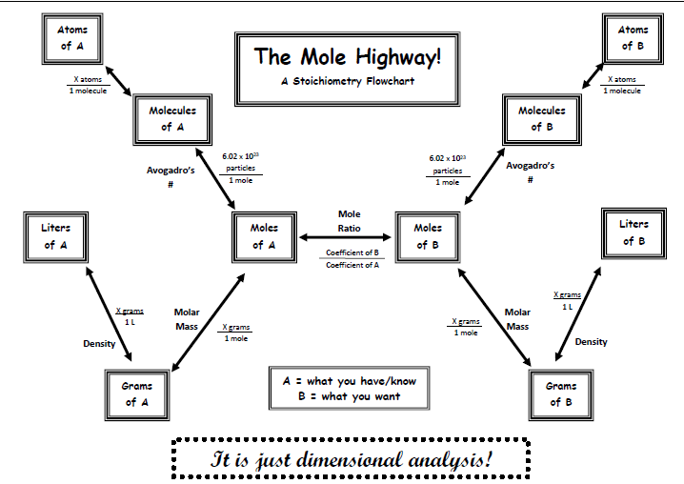

Slide 17
YouTube link to Presentation
https://youtu.be/qz2uDkBnXtw

