Slide 1
B I N G-B I N G-T O E
 |  | FREE Space

Slide 2
B I N G-B I N G-T O E – GAME RULES
Right side of room – X
Left side of room – O
2 players from each team go head to head (standing by opposite team)
Team may not help
First team to hold up board with correct answer gets to play a square.
Teams lose points for trying to distract the other team or help their team with answers.
Each BING-TOE = 1 point

Slide 3
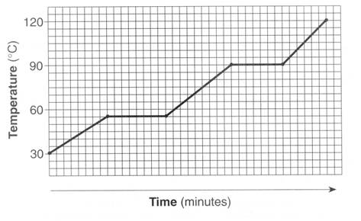
#1 – what is the freezing point?
120
90
60
30

Slide 4
60 degrees C

Slide 5
#2 – Which takes longer – melting or boiling of water. WHY?

Slide 6
Boiling Lvap > Lfus

Slide 7
#3 – What is the opposite of vaporizing?

Slide 8
Condensing

Slide 9
#4 – Which areas of a heating curve undergo an increase in kinetic energy? Use our numbering system (1, 2, 3, 4, 5)

Slide 10
1, 3, 5

Slide 11
#5 – What are the units for latent heat?

Slide 12
J/g

Slide 13
#6 – If water vapor condenses on the outside of a soda can is energy absorbed or released? Is it endo or exothermic?

Slide 14
Released Exothermic

Slide 15
#7 – The quantity of heat required to change the temperature of 1 g of a substance by 1°C is defined as what?

Slide 16
Specific Heat

Slide 17
#8 – How many kJ is 85300 J?

Slide 18
85.3 kJ

Slide 19
#9 – What section of the heating curve has atoms moving the most? Use our numbering system, 1, 2, 3, 4, 5

Slide 20
5

Slide 21
#10 – If a reaction is endothermic do you feel hot or cold?

Slide 22
cold

Slide 23
#11 – If a reaction is exothermic is Q positive or negative? Is ΔT positive or negative?

Slide 24
Q = - ΔT = -

Slide 25
#12 – Calculate the energy transferred when 4.6g of ice is melted.

Slide 26
1532 J

Slide 27
#13 – Calculate the energy transferred when 36.8 grams of water forms an ice cube in a freezer.

Slide 28
-12254.4 J

Slide 29
#14 – What is the energy during a phase change being used for?

Slide 30
Spreading molecules out

Slide 31
#15 – A metal spoon is used to stir a cup of hot chocolate. What is the sign (+ or -) of the Q_{spoon}?

Slide 32
Q = +

Slide 33
#16 – Which part of the heating curve for water requires the most amount of energy to speed up the molecules?

Slide 34
3

Slide 35
#17 – How much energy is required to heat 25 grams of ice from -10°C into water at 0°C?

Slide 36
8848 J

Slide 37
#18 – Compare a piece of brass with a specific heat of 0.85 J/g°C and water with a specific heat of 4.184 J/g°C. Which of these substances heats more quickly? Why?

Slide 38
Brass C is smaller

Slide 39
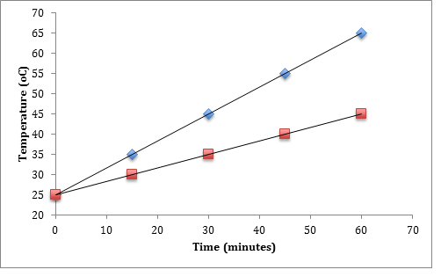
#19 – Which of the two substance (blue or red marks) would cool the fastest?

Slide 40
blue

Slide 41
#20 – How much energy does it take to raise 50 grams of ice at 0 °C to 100 °C and then boil.

Slide 42
149550 J

Slide 43
#21 – What “law” is important for calorimeter calculations?

Slide 44
Conservation of Energy

Slide 45
#22 – Which way does heat flow? Hot → cold OR cold→Hot

Slide 46
Hot to Cold

Slide 47
#23 – Why does a bathtub full of water heat faster than a swimming pool full of water?

Slide 48
Bathtub has smaller mass

Slide 49
#24 – How much energy in joules does 30.0 g of sulfur lose when it lowers from 120 °C to 114 °C. The specific heat of sulfur is 0.71 J/g°C

Slide 50
-127.8 J

Slide 51
#25 – A piece of iron is heated until it absorbs 250 J of energy. It is dropped into a cup of cold water. What is the Q_{iron}, and Q_{water} once the metal is in the water?

Slide 52
Qiron = -250 J Qwater = +250 J

Slide 53
#26 – The amount of energy needed to heat 40.00 g of iron from 40.0ºC to 100.0ºC is 100 J. The specific heat capacity is what?

Slide 54
0.0417 J/gC

Slide 55
#27 – The specific heat capacity of aluminum is 0.89 J/gºC. Calculate mass of the aluminum block if 8900 J were needed to heat the aluminum from 75.0ºC to 145.0ºC

Slide 56
142.9 g

Slide 57
#28 – an unknown metal has a mass of 280g, absorbs 3000kJ of energy and goes from 10 °C to 95 °C. What is the specific heat?

Slide 58
126.05 J/gC (or 0.12605 kJ/gC)

Slide 59
#29 – How much energy is required to boil 10 grams of mercury if the latent heat of vaporization is 294 J/g

Slide 60
2940 J

Slide 61
#30 – mercury is a neurotoxin that when inhaled can be highly dangerous. Calculate the amount of energy required to change 14g of liquid mercury into a gas at 357 °C. The latent heat of fusion is 11 J/g and the latent heat of vaporization is 294 J/g

Slide 62
4116 J

Slide 63
#31 – a substance has a melting point of 27°C and a vaporization point of 168°C. Draw the heating curve.

Slide 64
First flat segment should be at 27C, and second flat segment should be at 168C

Slide 65
#32 – How much energy is released when cooling 10g steam from 150°C to ice at -15°C?

Slide 66
-31158 J

Slide 67
#33 – A 2.7 gram piece of metal is heated to 98.7 C. It is added to a beaker containing 150mL of water at 23.5 C. The final temperature of the water and the metal is 25.2 C. What is the specific heat of the metal? Remember…energy absorbed is opposite energy released…and this is just like the brass lab!

Slide 68
5.37 J/gC

