Slide 1
Heating Curve Calculation Notes No KCQ required YouTube Link to Presentation: https://youtu.be/AjGaZUKRlDU

Slide 2
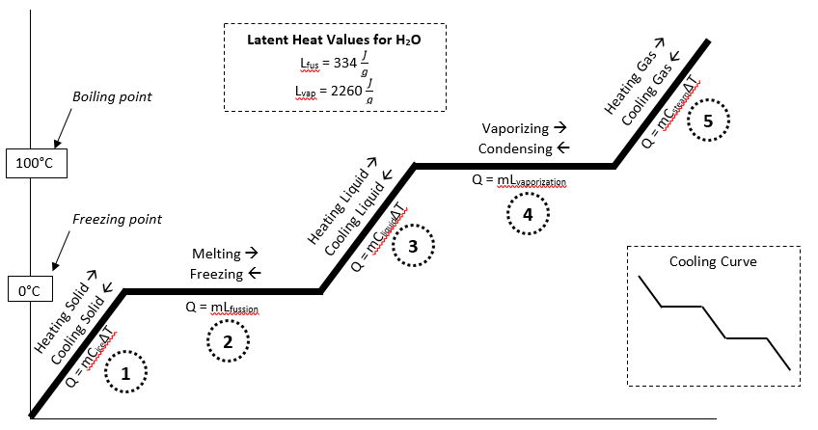
Calculate ONE line segment at a time!!!
Calculate everything separately and then add up your answers. You could have up to five Q values to add up!

Slide 3
Careful with ∆T Values!
Use ONLY the temperature change on the ONE LINE you are working with at a time! You will see this on our practice problems in a minute…

Slide 4
Practice Problems
Glue the questions in your notebook
Show your work the way I do!
Annotate the practice problems with comments, tips, warnings, explanations, etc! These are NOTES not just practice problems!

Slide 5
Practice Problems
What is the energy needed to melt 326 grams of ice and heat it to 100°C?
Determine the energy required to convert 21.1 grams of ice at -6°C to steam at 100°C
What is the heat transfer involved when you convert 51 grams of water 0°C to ice at -20.3°C?
What is the energy absorbed when you melt 75 grams of ice at -5°C to water at 90°C?

Slide 6
108884 J
245152 J

