Slide 1
KCQ - Heating and Cooling Curves
I can use heating and cooling curves to help calculate the energy changes during phase changes

Slide 2
What do they show us?
Heating or cooling → the sloped parts of graph
Phase changes → the flat parts of graph
TEMP
TIME

Slide 3
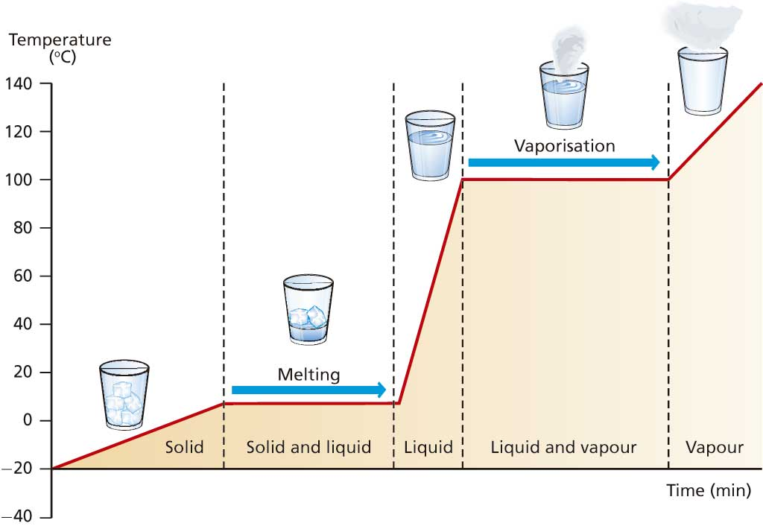

Slide 4
Heating Curve
Vaporizing
Liquid → Gas
Melting
Solid → Liquid
Heating a gas
Heating a liquid
Heating a solid

Slide 5
Cooling Curve
Condensing
Gas → Liquid
Cooling a gas
Freezing
Liquid → Solid
Cooling a liquid
Cooling a solid

Slide 6
Why are some areas sloped and some flat?
Heating | Phase Changes
Issue: SPEED | Issue: POSITION
All the energy is going towards SPEEDING UP the molecules | All the energy is going towards SPREADING OUT the molecules
Results in a temperature change | Results in NO temperature change
(Cooling would just be the opposite of these things!)

Slide 7
Why are some areas sloped and some flat?
Heating | Phase Changes
Issue: SPEED | Issue: POSITION
All the energy is going towards SPEEDING UP the molecules | All the energy is going towards SPREADING OUT the molecules
Results in a temperature change | Results in NO temperature change
(Cooling would just be the opposite of these things!)

Slide 8
How is our math changed by NO ∆T?
HEATING/COOLING
PHASE CHANGES
Q = mC∆T
C = J/g°C → Has a temperature component.
So…. Cant use it for phase changes
∆T = 0 BUT Q = 0
Get rid of ∆T, and replace C with something else
Q = mL
L = “Latent Heat” → J/g The energy required to phase change one gram of substance

Slide 9
Specific Heat and Latent Heat Labels
HEATING/COOLING
PHASE CHANGES
C_{solid}
C_{liquid}
C_{gas}
Always positive values
L_{fusion}
L_{vaporization}
Positive if endothermic process (melting/vaporizing)
Negative if exothermic process (condensing/freezing)

Slide 10
Values to Memorize for Water
Heating/Cooling |  | Phase Changes
C_{ice} | 2.09 J/g°C | L_{fus} | 334 J/g
C_{liq} | 4.18 J/g°C | L_{vap} | 2260 J/g
C_{steam} | 1.87 J/g°C | L is (+) if heating up and (–) if cooling down!

Slide 11
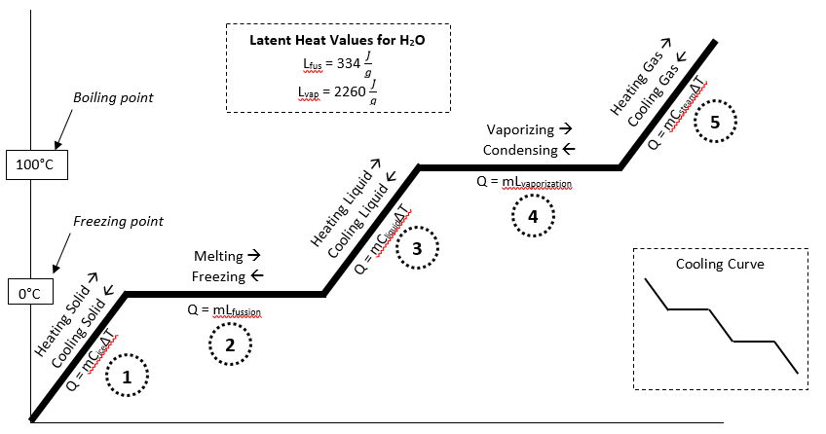
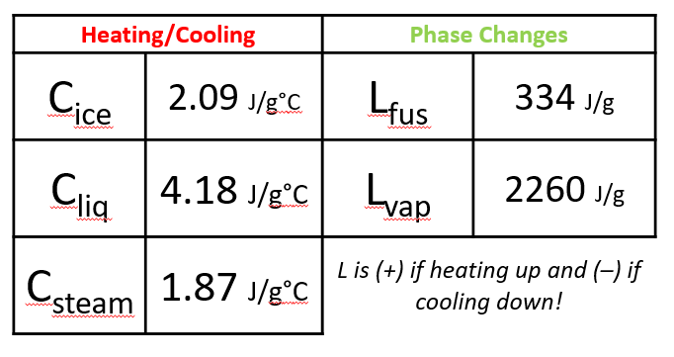
Completely Labeled Heating Curve
*These numbers are specific for H₂O. A different chemical would have different melting/boiling temperatures, different C and L values. I would give those numbers to you. You should know the numbers for H₂O

Slide 12
YouTube Link to Presentation
https://youtu.be/5ElksSZfU_M

