Slide 1
CLASS COPY YOU MUST RETURN BEFORE LEAVING! Share with a partner

Slide 2
Instructions
Put the following Target at the top of your notes: I can describe the differences between Thermochemistry and Kinetics, and can explain the basics of Kinetics.
Take notes in your notebook
Add color annotations to your notes
Add KCQ boxes at the bottom of your notes
When the notes are finished go show the sub and they will stamp your work as completed.
Get the “Webquest” from the sub and work on that for the rest of the period.

Slide 3
Thermo vs. Kinetics
Thermo
Is all about the Energy (heat)
Question we ask ourselves: is a reaction GOING to happen? Do I have enough energy for this reaction to happen?
YES NO
Kinetics
Is all about the Speed
Question we ask ourselves: How FAST is the reaction going to happen?
FAST SLOW

Slide 4
SLOW DOESN’T MEAN THE REACTION DOESN’T HAPPEN! SOME REACTIONS ARE JUST REALLY REALLY SLOW!
Does the reaction happen?
YES (Thermo) NO
FAST (Kinetics) SLOW

Slide 5
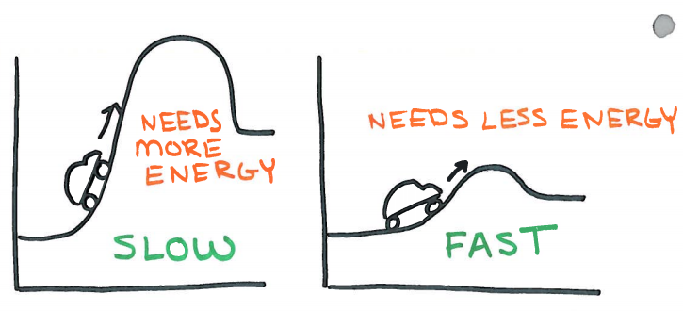
The energy of a reaction (thermo) can be related to the speed of the reaction (kinetics)
Think about a car trying to drive up a big hill versus a small hill. It needs a lot more energy to get up the big hill and it will take a long time. It needs a little bit of energy to get up the small hill so it will take less time.

Slide 6
The speed of a reaction is called the “rate.”
Think about the way we talk about speed when driving a car – we say “miles per hour” right? If we put that as an equation it would look like this: Miles Hour
But to calculate it you have to do some subtractions of where you started and when you started so it turns into this which is an equation for a “rate” or a speed as we usually call it in real life: ∆Distance ∆time

Slide 7
When we want the “rate” of the reaction we have a very similar equation: ∆Concentration
∆time
Instead of seeing how many miles we drove over a period of time, we are trying to see how many molecules were made, or how many molecules were used up over a period of time!
Concentration is a way to measure how “strong” a solution is, how many molecules do you have inside a certain volume of liquid.

Slide 8
Products will have a positive rates because you are making them! If you make more of them your ∆Concentration part will end up positive when you do (Final Concentration – Initial Concentration)
Big # - Small # = positive rate
Reactants will have negative rates because you are using them up! If you use them up your ∆Concentration part will end up positive when you do (Final Concentration – Initial Concentration)
Small # - Big # = negative rate

Slide 9
To calculate concentration in chemistry we usually use something called “molarity.”
Molarity = # of moles of a substance
# of Liters of liquid it is in
We usually abbreviate it like this: M = mol L

Slide 10
Example: What is the Molarity of a solution that is made by mixing together 5 moles of liquid in 2 Liters of water?
Molarity = 5 mol = 2.5 M 2 L
So we would say that the concentration is “2.5 molar”

Slide 11
Sometimes they will give you grams and you need to find moles first! Or they will give you mL and you have to convert to Liters! Tricky! You will need dimensional analysis and metric conversions! Example: What is the Molarity of a solution that is made by mixing together 75.5 grams of NaOH into 600mL of water?
75.5 g NaOH 1 mole = 1.89 moles 600mL = 0.6 L 40 g
1.89 moles = 3.15 M of NaOH 0.6 L

Slide 12
Example: What is the rate of reaction if you start with a 3.5 M solution and after 25 seconds you have a 4.2 M solution? Your reaction made more molecules, the concentration went up which means these are products!
Rate = ∆Concentration = (4.2M – 3.5M) = 0.028 M ∆time 25 sec sec
This means that every second that passes, you make 0.028 M more of your product molecules. Because you are making more you have a positive rate!

Slide 13
Example: What is the rate of reaction if you start with a 6.3 M solution and after 65 seconds you have a 2.7 M solution? Your reaction used up the molecules so the concentration went down, which means these are reactants!
Rate = ∆Concentration = (2.7M – 6.3M) = -0.055 M ∆time 65 sec sec
This means that every second that passes, you use up 0.055 M of your reactant molecules. Because you are using it up you end up with a negative rate!

Slide 14
Sometimes they will give you data charts to use. It is also common to see people using square brackets to represent concentration: [H₂] means “concentration of H₂” Example: What is the rate of reaction between time 30 seconds and 15 seconds for H₂?
Rate = ∆Concentration = (6.5M – 4.2M) = 0.153 M ∆time (30sec-15sec) sec
Time | [O₂] | [H₂]
0 | 0.5 | 0.3
15 | 1.6 | 4.2
30 | 4.2 | 6.5
45 | 7.3 | 9.8

Slide 15
SUMMARY
Where | Units | Equation | Issue
Car | Miles Hour | Δ Distance Δ Time | SPEED
Thermo | Joules | mCΔT mL | ENERGY
Kinetics | Molarity M Second sec | Concentration Time | SPEED
Using up reactants = decrease in # molecules = NEGATIVE rate
Making more products = increase in # molecules = POSTIVE rate

Slide 16
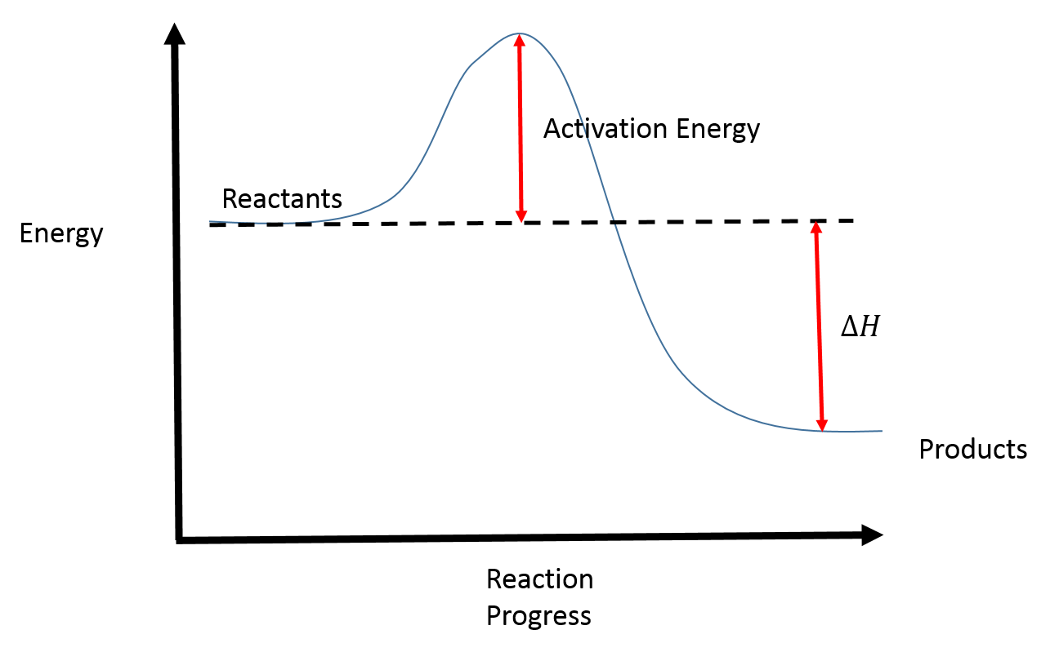
Reactions need energy to happen. If the reaction doesn’t have enough energy then it can’t finish the reaction. The molecules need to hit each other hard enough, and hit in the right directions in order for the reaction to happen. The amount of energy required for the reaction to happen is the “Activation Energy.” We can see the activation energy by looking at “Reaction Diagrams.” Once they reach the top of the activation energy “bump” they have enough energy for the reaction to finish making products.

Slide 17
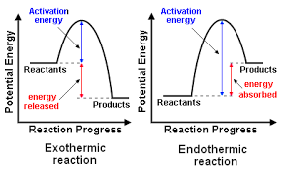
You can draw reaction diagrams for Endothermic Reactions (absorbing energy) and Exothermic Reactions (releasing energy). When you are trying to determine if it is endo or exothermic, you only look at the START versus FINISH place of the reaction. We don’t care about the activation energy bump! All reactions need a little bit of energy for the reaction to start, they have to get the molecules colliding and have to make sure they are turned the right direction when they do hit. So endo versus exo is only talking
about the energy present
at the start versus end of
the reaction, not what
happens in the middle.

Slide 18
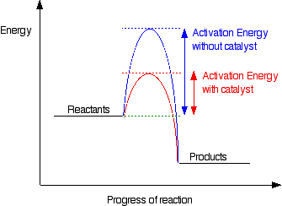
Sometimes you can add a chemical to the reaction called a “catalyst” in order to speed up the reaction. A catalyst is a chemical that doesn’t get used up during the reaction (it is not a reactant), it is just a “helper” – it will be there when you start, it will help the reaction happen in a slightly different way, and then it will be there when you finish and can then be reused over and over again! A catalyst helps you lower the activation energy. A lower activation energy means that it can get over the peak faster, so you will have a faster rate of reaction.
Without Catalyst
With Catalyst

