Slide 1
Jumpstart
Get new intro pages from my lab bench
Glue them in
Get KCQ notes set up on p. 223

Slide 2
Thermo vs. Kinetics
Thermo
Energy (heat)
Q: is a reaction GOING to happen?
YES NO
Kinetics
Speed
Q: How FAST is the reaction going to happen?
FAST SLOW

Slide 3
SLOW = DOESN’T HAPPEN
Does the reaction happen?
YES (Thermo) NO
FAST (Kinetics) SLOW

Slide 4
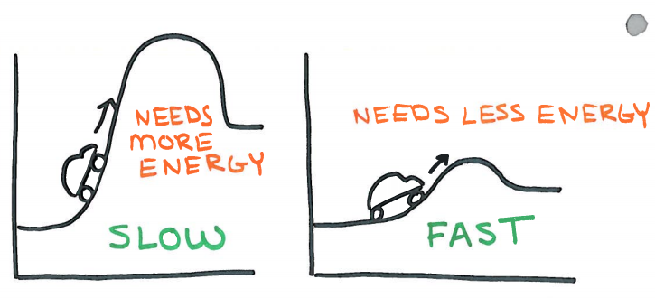
This is where THERMO turns into KINETICS

Slide 5
Where | Units | Equation | Issue
Car | Miles Hour | Δ Distance Δ Time | SPEED
Thermo | Joules | mCΔT mL | ENERGY
Kinetics | Molarity M Second sec | Concentration Time | SPEED
Using up reactants = decrease in # molecules = NEGATIVE rate
Making more products = increase in # molecules = POSTIVE rate

