Slide 1
Acids, Bases, and Buffers
Interactive Card Sort
Please make sure you ARE NOT in present mode. You must be editing the slides in order to move the molecules appropriately. You should be able to see structures along the sides of slides 4, 5, 6, and 8.

Slide 2
Directions
Once you submit in Classroom, you will get a private comment back with the answer key. Please check your answers and fix whatever is incorrect! (Then turn it back in once everything is corrected.)
Slide 3: Categorize each substance as acidic, basic, or neutral.
Slide 4: Using the particle diagrams, order the acids from weakest to strongest. Explain your ordering in the space at the bottom of the slide.
Slide 5: Review properties of buffers.
Slide 6: Classify each particle diagram as a buffer or not a buffer.
Slide 7: Explain why solutions ARE NOT buffers.
Slide 8: Explain why solutions ARE buffers.
Slide 9: Answer the short answer question about two buffer solutions.

Slide 5
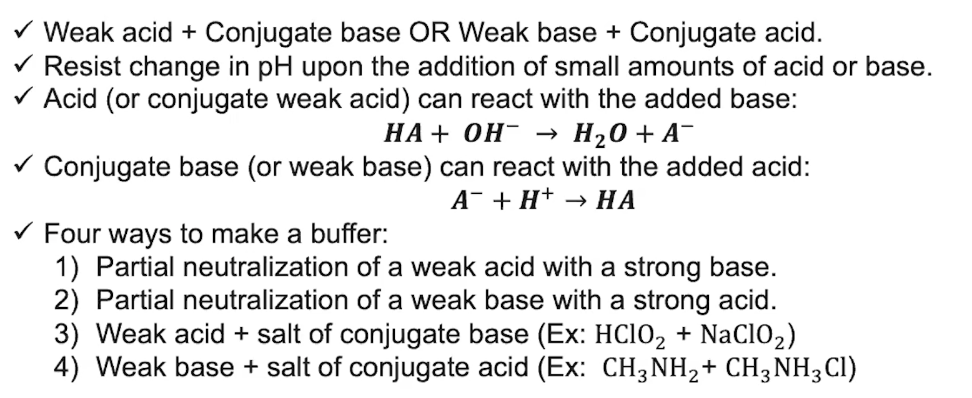
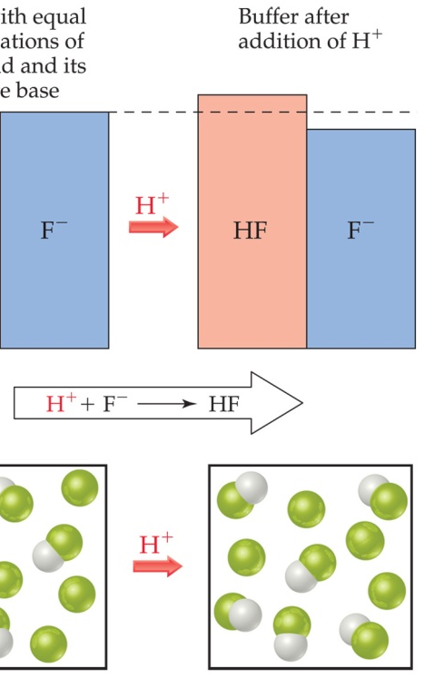
Buffer Solutions
An acid and base are present in all buffer solutions.
If a small amount of strong acid is added to the buffer, there is a base component ready to neutralize the “invader”.
If a small amount of strong base is added to the buffer, there is an acid component ready to neutralize the “invader”.
Notes:
Information adapted from AP Daily videos

Slide 6
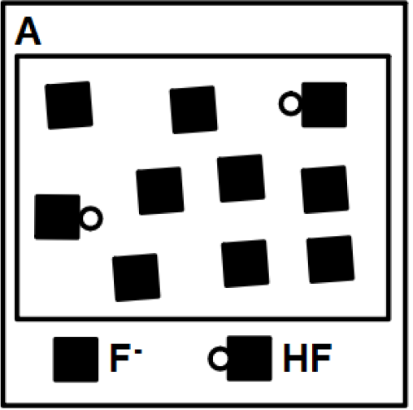
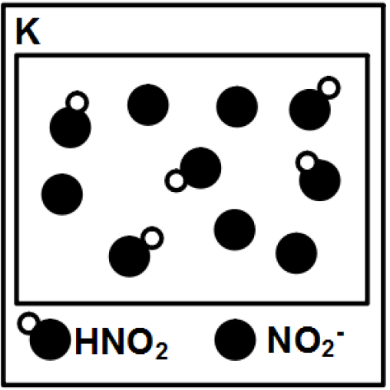
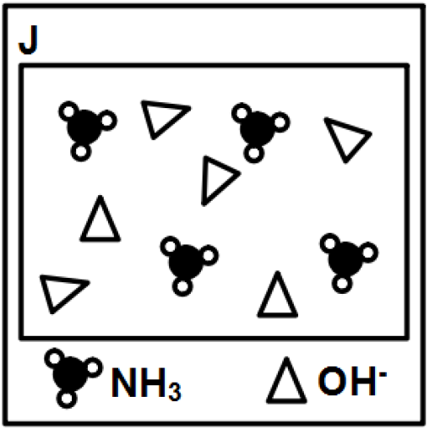
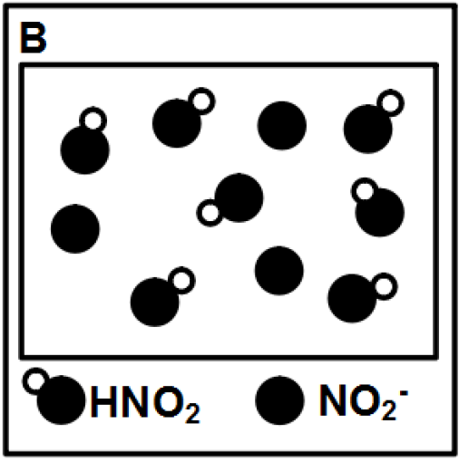
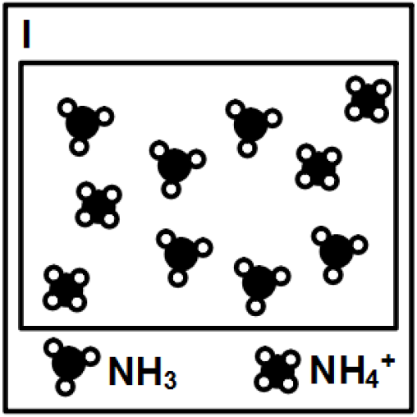
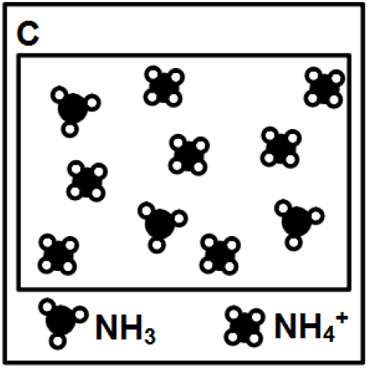
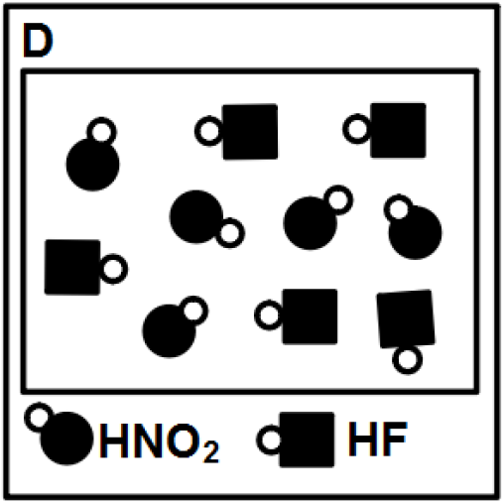
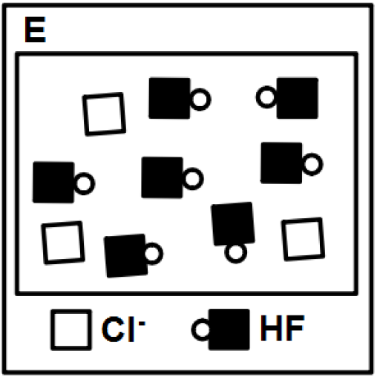
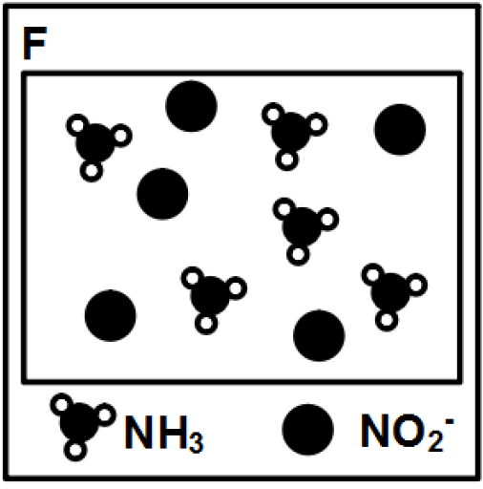
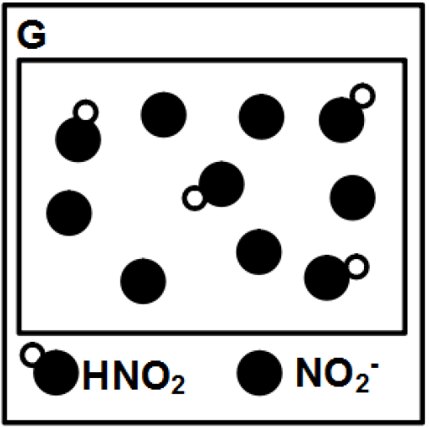
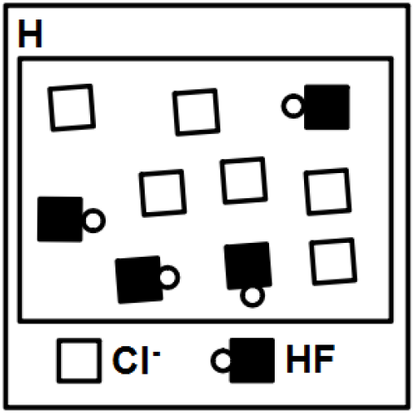

Slide 7
Enter text here
Type your explanation here
Enter text here
Type your explanation here
Enter text here
Type your explanation here
Enter text here
Type your explanation here
Enter text here
Type your explanation here

Slide 8
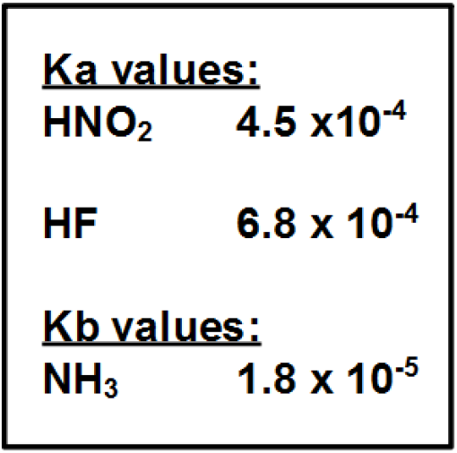
Type the letter
Type your explanation here
Type your answer here
Type the letter
Type your explanation here
Type your answer here
Type the letter
Type your explanation here
Type your answer here
Type the letter
Type your explanation here
Type your answer here
Type the letter
Type your explanation here
Type your answer here
Type the letter
Type your explanation here
Type your answer here

Slide 9
Type your response here.

