Slide 1
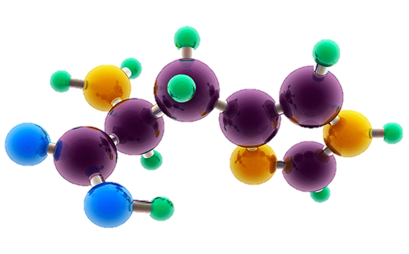
PUT IN
PRESENTATION
MODE TO VIEW CORRECTLY

Slide 2
AP Chemistry
Exam Review Revised Unit 1-9

Slide 3
JUMP TO:
Unit #1 – Atomic Structure and Properties
Unit # 2 – Molecular/Ionic Struct./Props.
Unit #3 – IMFs and Properties
Unit #4 – Chemical Reactions
Unit #5 – Kinetics
Unit #6 – Thermochemistry
Unit #7 – Equilibrium
Unit #8 – Acid Base
Unit #9 – Applications of Thermochemistry
Write This, Not That

Slide 4
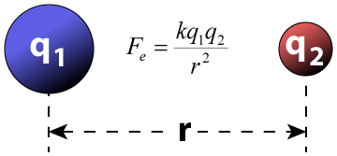
Unit #1
Atomic Structure and Properties
7 – 9%

Slide 5
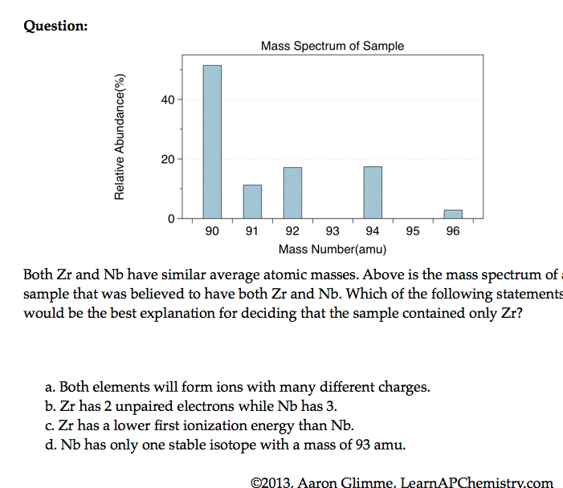
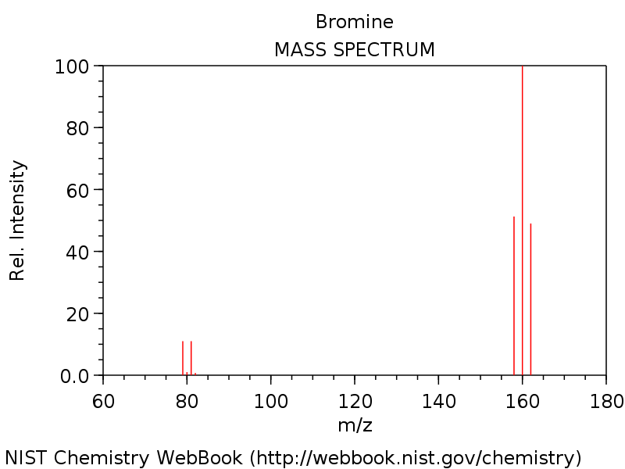
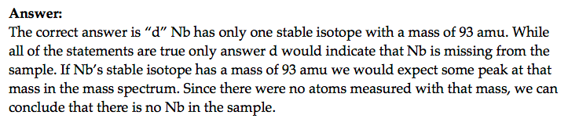

Mass Spectrometry - evidence for isotopes
Source
Mass spectrometry showed
that elements have isotopes
This contradicted Dalton’s early model of the atom which stated that all atoms of an element are identical
3 Br₂ & two Br isotopes shown in diagram
The average atomic mass of the element can be estimated from mass spectroscopy
Video
LO 1.14: The student is able to use the data from mass spectrometry to identify the elements and the masses of individual atoms of a specific element

Slide 6
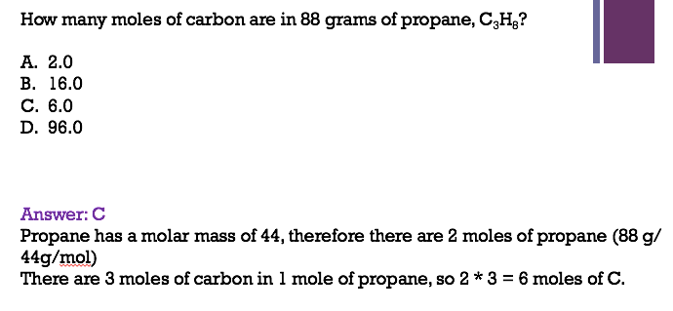
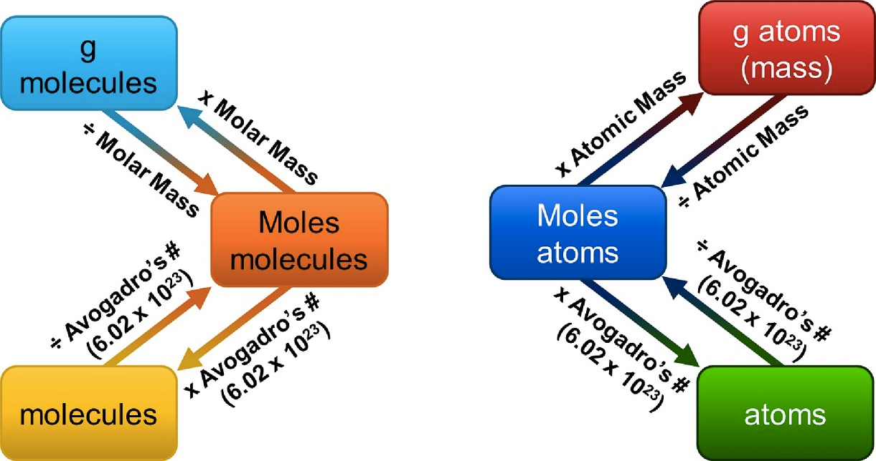
Mole Calculations
Source
1 mole = 6.02 x 10²³ representative particles
1 mole = molar mass of a substance
1 mole = 22.4 L of a gas at STP
Video
Click reveals answer and explanation.
LO 1.4: The student is able to connect the number of particles, moles, mass and volume of substances to one another, both qualitatively and quantitatively.

Slide 7
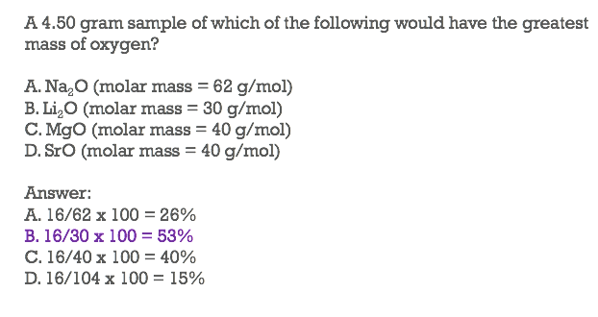

Ratio of Masses in a Pure Sample
Source
All elements and molecules are made up of atoms
Substances with the same atomic makeup will have same average masses
The ratio of masses of the same substance is independent of size of the substance
Molecules with the same atomic makeup (ex: H₂O) will have the same ratio of average atomic masses
  H₂O₂ ratio would be different than H₂O due to the different chemical makeup
H₂O
Video
108 g/mol
Click reveals answer and explanation.
LO 1.1: Justify the observation that the ratio of the masses of the constituent elements in any pure sample of that compound is always identical on the basis of the atomic molecular theory.

Slide 8
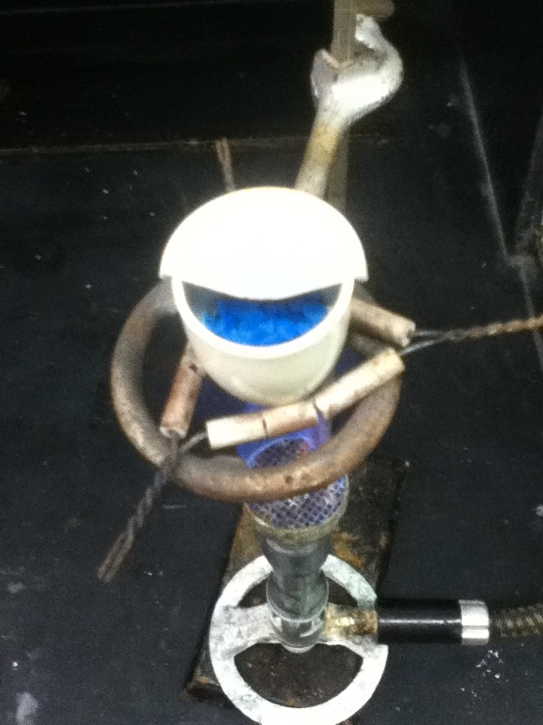
Identifying Purity of a Substance
Source
Impurities in a substance can change the percent composition by mass
If more of a certain element is added from an impurity, then the percent mass of that element will increase and vice versa
When heating a hydrate, the substance is heated several times to ensure the water is driven off
  Then you are simply left with the pure substance and no excess water
Video
The mass percent of oxygen in pure glucose, C₆H₁₂O₆ is 53.3 percent. A chemist analyzes a sample of glucose that contains impurities and determines that the mass percent of oxygen is 49.7 percent. Which of the follow impurities could account for the low mass percent of oxygen in the sample?
n-eicosane (C₂₀H₄₂)
ribose C₅H₁₀O₅
fructose, C₆H₁₂O₆
sucrose C₁₂H₂₂O₁₁
a. Is the only option with a %O lower than 49.7%
LO 1.3: The student is able to select and apply mathematical relationships to mass data in order to justify a claim regarding the identity and/or estimated purity of a substance.

Slide 9
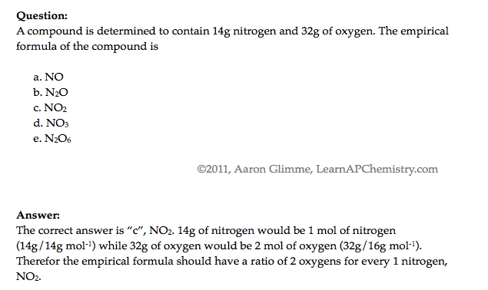
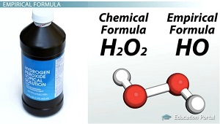
Composition of Pure Substances and/or Mixtures
Source
Percent mass can be used to determine the composition of a substance
  % mass can also be used to find the empirical formula
The empirical formula is the simplest formula of a substance
  It is a ratio between the moles of each element in the substance
  Quick steps to solve!
    % to mass, mass to moles, divide by the smallest and multiply ‘til whole!)
  The molecular formula is the actual formula of a substance
    It is a whole number multiple of the empirical formula
Video
Click reveals answer and explanation.
LO 1.2: Select and apply mathematical routines to mass data to identify or infer the composition of pure substances and/or mixtures.

Slide 10
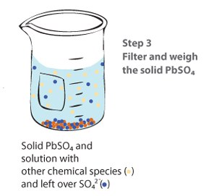
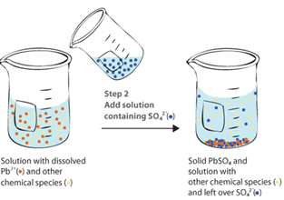
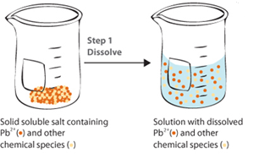
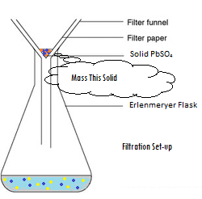
Gravimetric Analysis
Source
What It Determines:
  amount of analyte by mass measurements
  % composition
  empirical formulas
How It Can Be Done:
  Dehydration of a hydrate
  Forming a precipitate, which is then isolated and massed
Analysis:
  Remember to ALWAYS go to moles!
  use mole ratios to convert between various components
Video
Virtual Lab
Possible Source of Error | Contamination in solid | Incomplete Precipitation | Solid not fully dehydrated
Impact on Results | measured mass too large | Lose ion in filtrate – mass too small | measured mass too large
  Science Practices
  1.5 The student can re-express key elements of natural phenomena across multiple representations in the domain.
  2.2 The student can apply mathematical routines to quantities that describe natural phenomena.
  4.2 The student can design a plan for collecting data to answer a particular scientific question.
  5.1 The student can analyze data to identify patterns or relationships.
  6.1 The student can justify claims with evidence.
Learning Objectives
1.3: The student is able to select and apply mathematical relationships to mass data in order to justify a claim regarding the identity and/or estimated purity of a substance.
1.17: The student is able to express the law of conservation of mass quantitatively and qualitatively using symbolic representations and particulate drawings.
1.19: The student can design, and/or interpret data from, an experiment that uses gravimetric analysis to determine the concentration of an analyte in a solution.

Slide 11
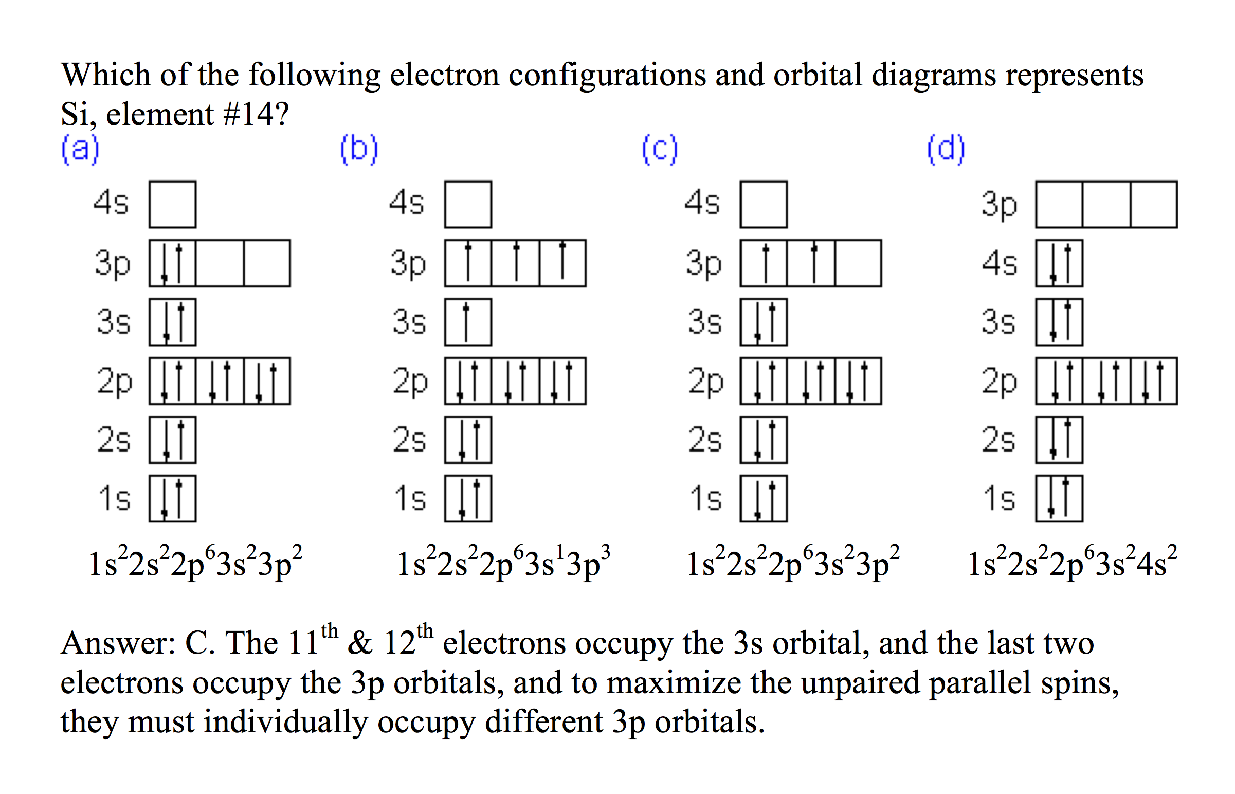
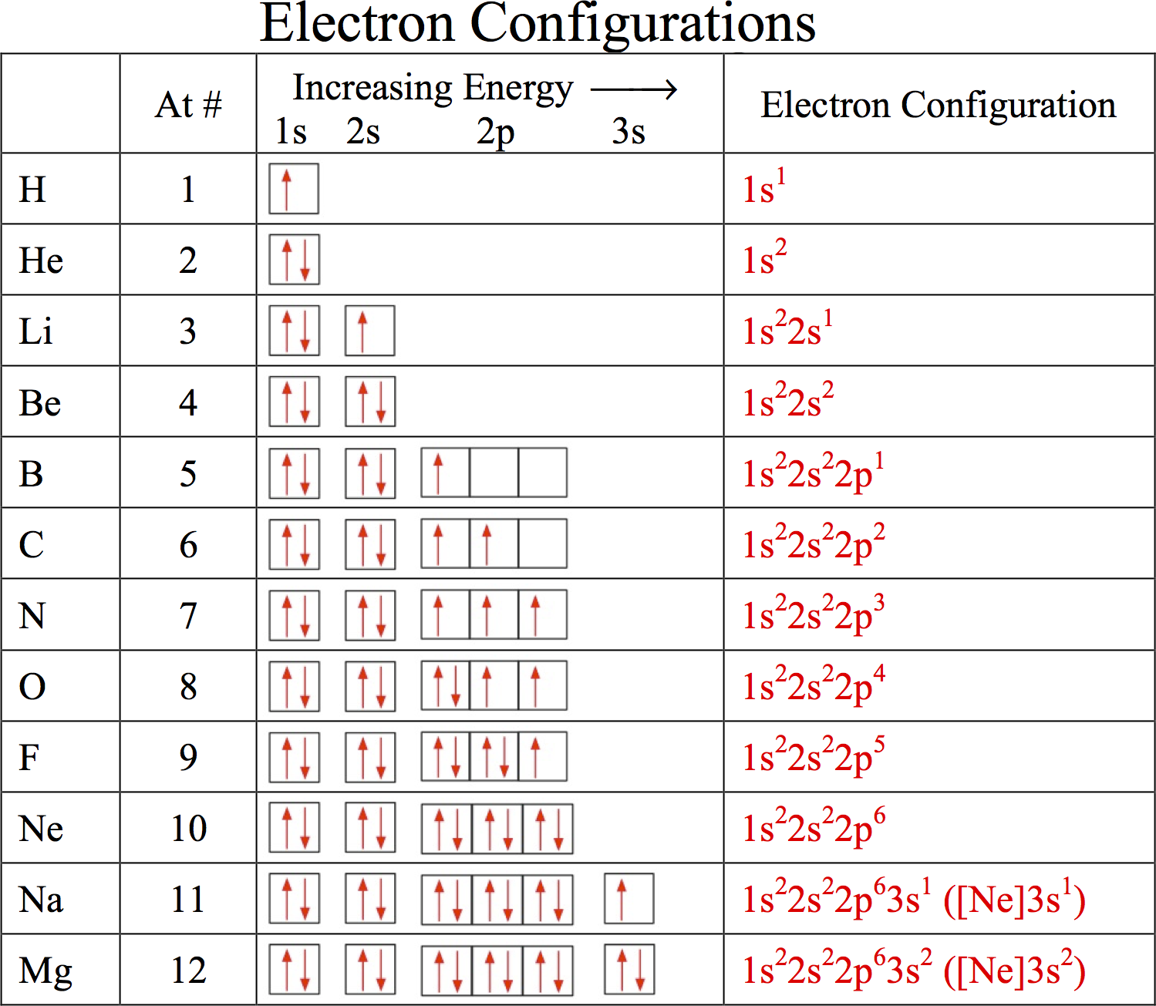
Electronic Structure of the Atom: Electron Configurations
Source
Electrons in occupy orbitals whose energy level depends on the nuclear charge and average distance to the nucleus
Electron configurations & orbital diagrams indicate the arrangement of electrons with the lowest energy (most stable):
  Electrons occupy lowest available energy levels
  A maximum of two electrons may occupy an energy level
    Each must have opposite spin (±½)
  In orbitals of equal energy, electrons maximize parallel unpaired spins
Video
Click reveals answer and explanation.
LO 1.5: The student is able to explain the distribution of electrons in an atom or ion based upon data.

Slide 12
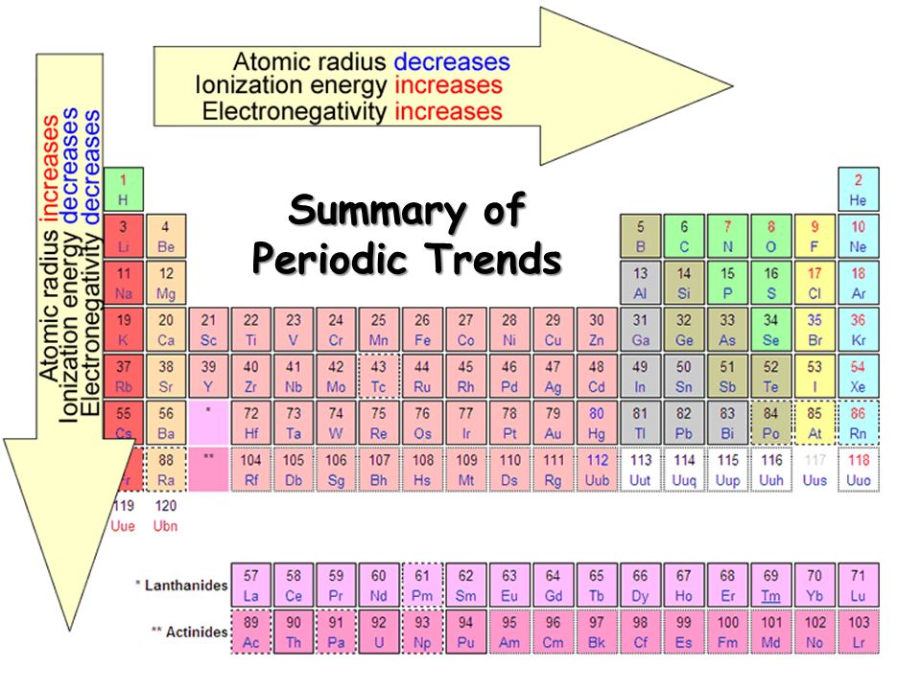
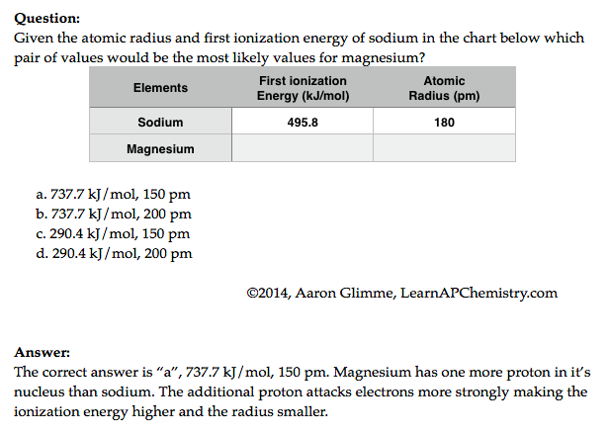
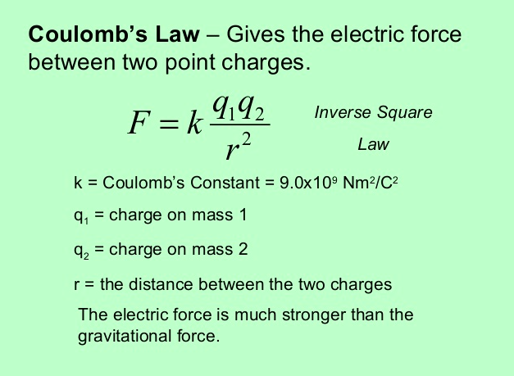
Predictions with Periodic Trends
Sources
Video
The following explains these trends:
  Electrons attracted to the protons in the nucleus of an atom
    So the closer an electron is to a nucleus, the more strongly it is attracted (Coulomb’s law)
    The more protons in a nucleus (effective nuclear force), the more strongly it attracts electrons
  Electrons are repelled by other electrons in an atom. If valence electrons are shielded from nucleus by other electrons, you will have less attraction of the nucleus (again Coulomb’s law-greater the atomic radius, the greater the distance)
Click reveals answer and explanation.
its
attracts
L.O. 1.9 The student is able to predict and/or justify trends in atomic properties based on location on periodic table and/or the shell model

Slide 13
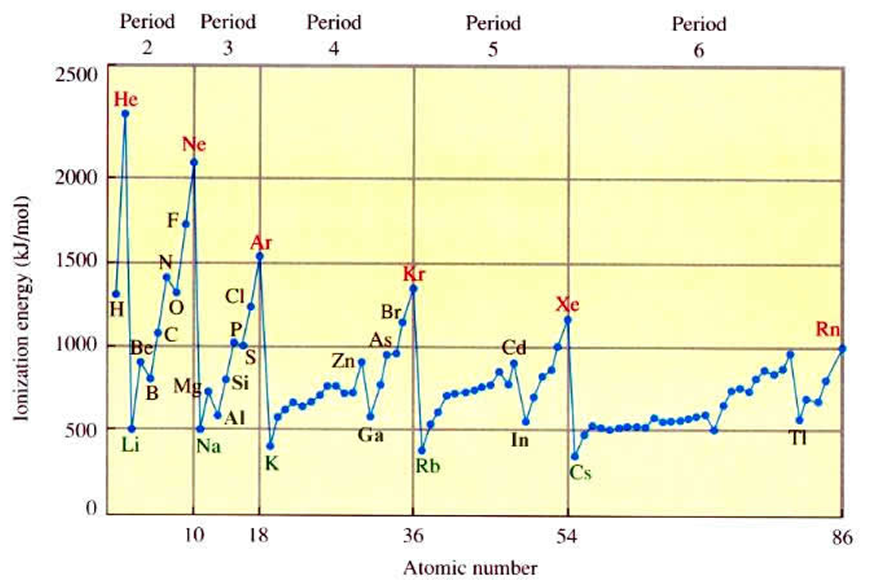
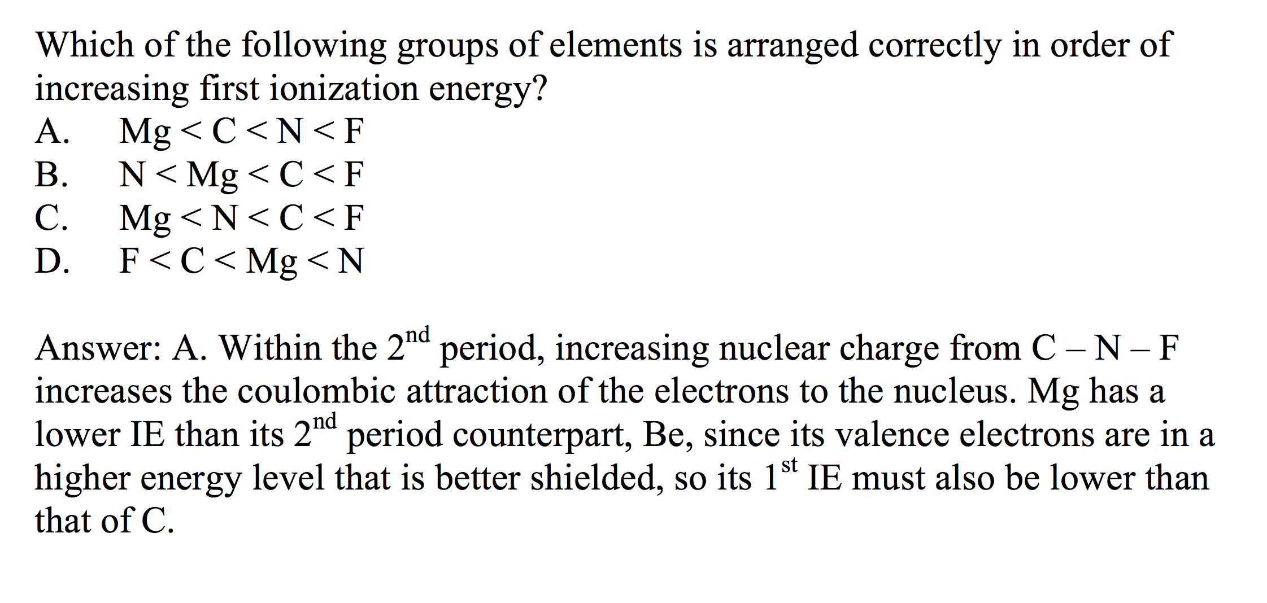
Electronic Structure of the Atom:
1st Ionization Energy
Source
1st Ionization Energy Energy (IE) indicates the strength of the coulombic attraction of the outermost, easiest to remove, electron to the nucleus:
X(g) + IE X⁺(g) + e–
  1st IE generally increases across a period and decreases down a group
    IE generally increases as #protons increases in same energy level
    IE decreases as e– in higher energy level: increased shielding, e– farther from nucleus
Video
Click reveals answer and explanation.
LO 1.6: The student is able to analyze data relating to electron energies for patterns and relationships.

Slide 14
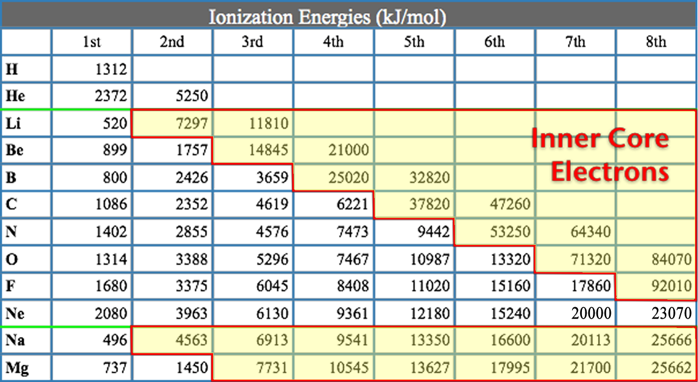
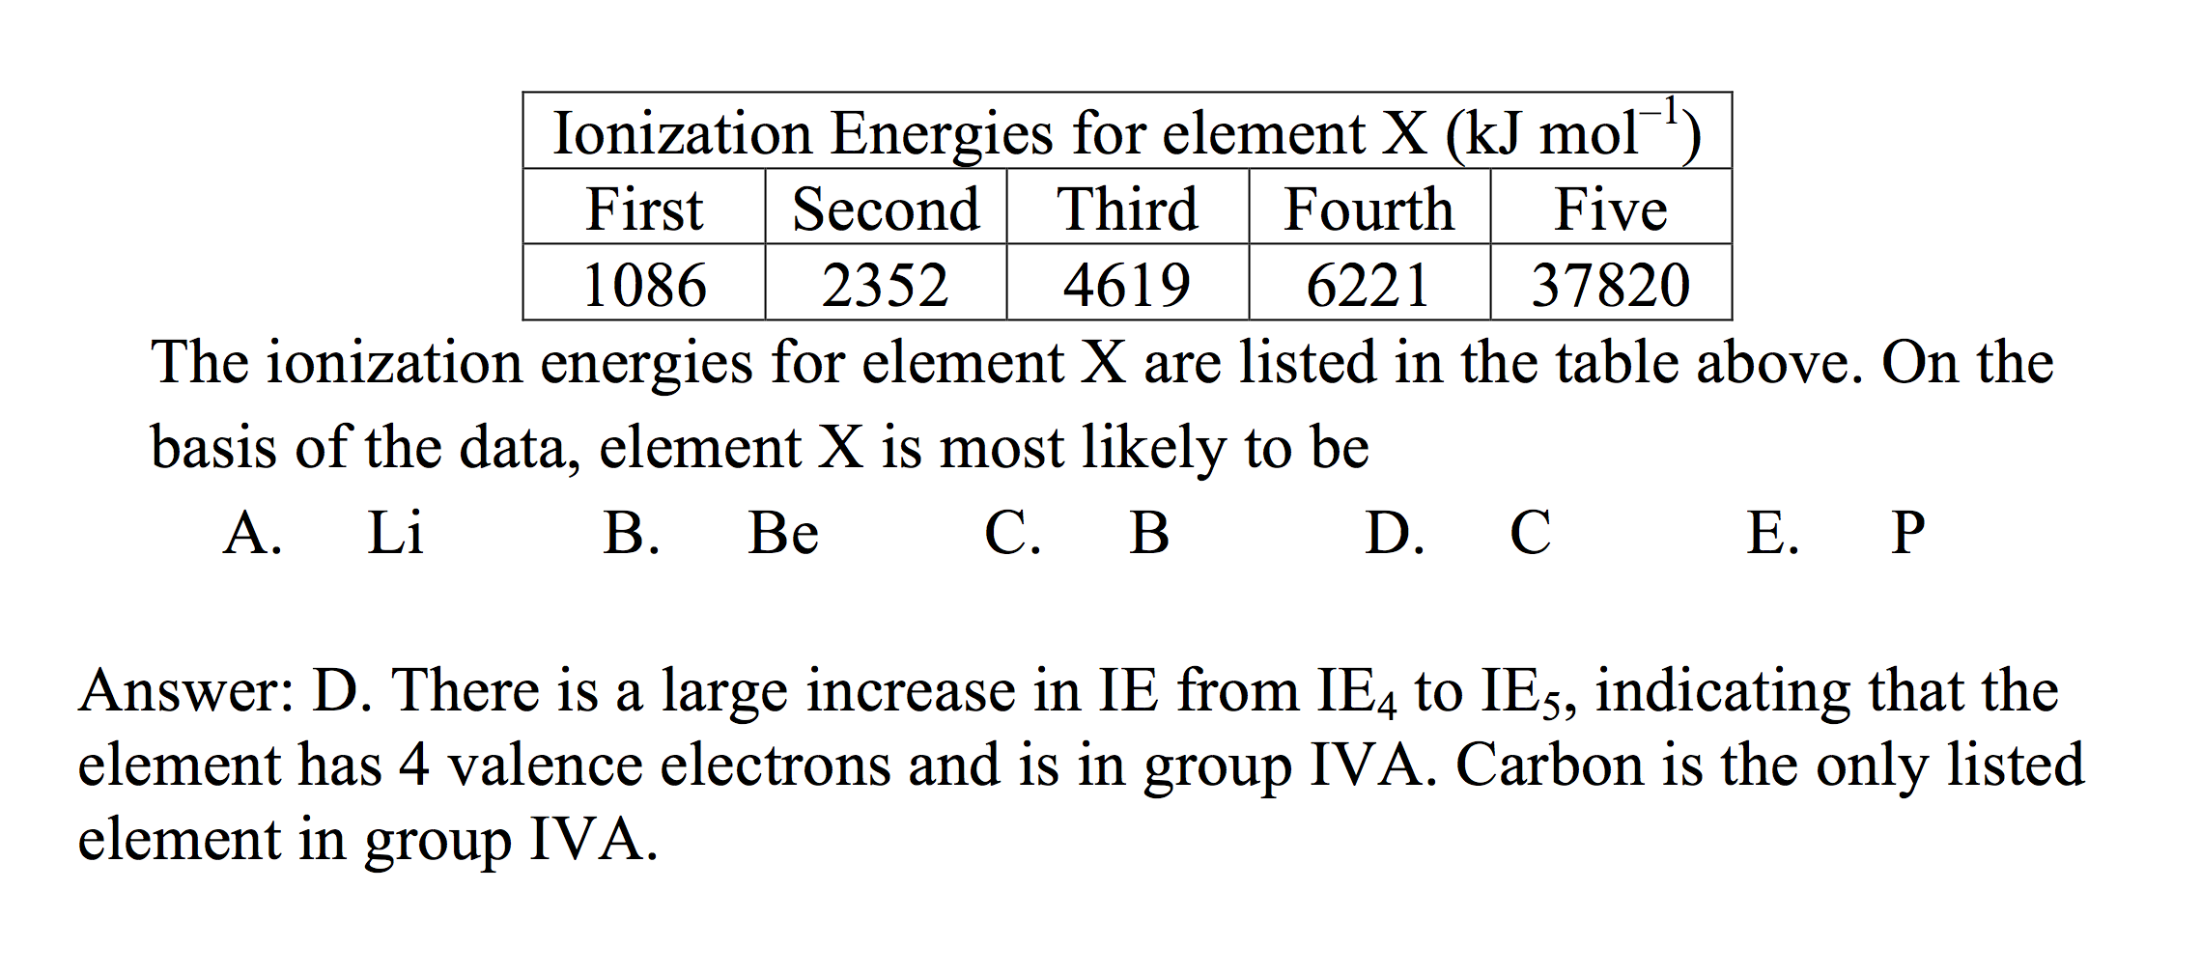
Electronic Structure of the Atom: Higher Ionization Energies
Source
2nd & subsequent IE’s increase as coulombic attraction of remaining e–’s to nucleus increases
X⁺ + IE X²⁺ + e–
X²⁺ + IE X³⁺ + e–
  Large jump in IE when removing less-shielded core electrons
Video
Click reveals answer and explanation.
LO 1.8: The student is able to explain the distribution of electrons using Coulomb’s law to analyze measured energies.

Slide 15
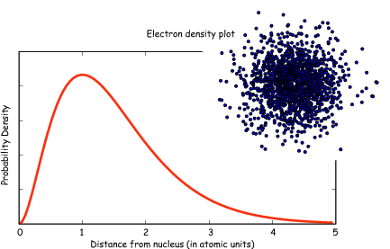
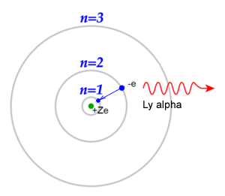
Classic Shell Model of Atom vs
Quantum Mechanical Model
Source
Quantum Mechanical Model
Developed by Schrodinger and the position of an electron is now
represented by a wave equation
Most probable place of finding an electron is called an ORBITAL (90% probability)
Each orbital can only hold 2 electrons with opposing spins (S, P, D & F orbitals)
Evidence for this theory:
Work of DeBroglie and PLanck that electron had wavelike characteristics
Heisenberg Uncertainty Principle - impossible to predict exact location of electron- contradicted Bohr
This new evidence caused the Shell Theory to be replaced by the Quantum Mechanical Model of the atom
Shell Model - Bohr
Developed by Schrodinger and the position of an electron is now
represented by a wave equation
Most probable place of finding an electron is called an ORBITAL (90% probability)
Each orbital can only hold 2 electrons with opposing spins (S, P, D & F orbitals)
Evidence for this theory:
Work of DeBroglie and PLanck that electron had wavelike characteristics
Heisenberg Uncertainty Principle - impossible to predict exact location of electron- contradicted Bohr
This new evidence caused the Shell Theory to be replaced by the Quantum Mechanical Model of the atom
Video
LO 1.12: Explain why data suggests (or not) the need to refine a model from a classical shell model with the quantum mechanical model

Slide 16
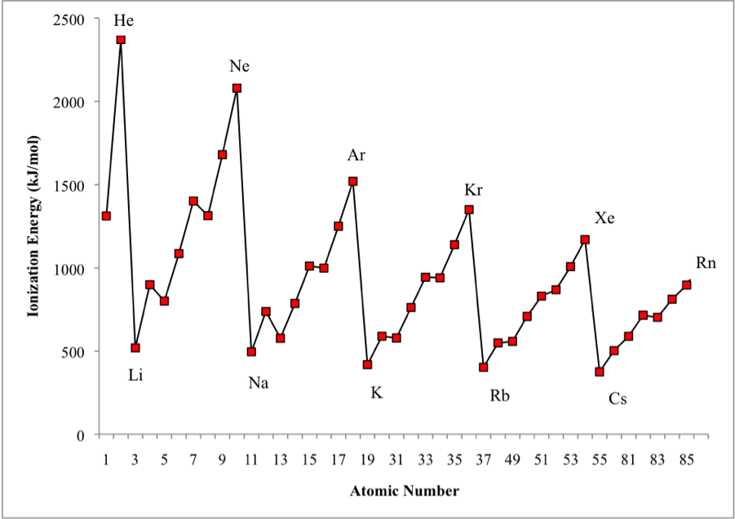
Shell Model is consistent with Ionization Energy Data
Source
The patterns shown by
the IE graph can be
explained by Coulomb’s law
As atomic number increases, would expect the ionization energy to constantly increase
Graph shows that this is NOT observed. WHY NOT?
The data implies that a shell becomes full at the end of each period
Therefore the next electron added must be in a new shell farther away from the nucleus.
This is supported by the fact that the ionization energy drops despite the addition positive charge in the nucleus
Video
LO: 1.13 Given information about a particular model of the atom, the student is able to determine if the model is consistent with specified evidence

Slide 17
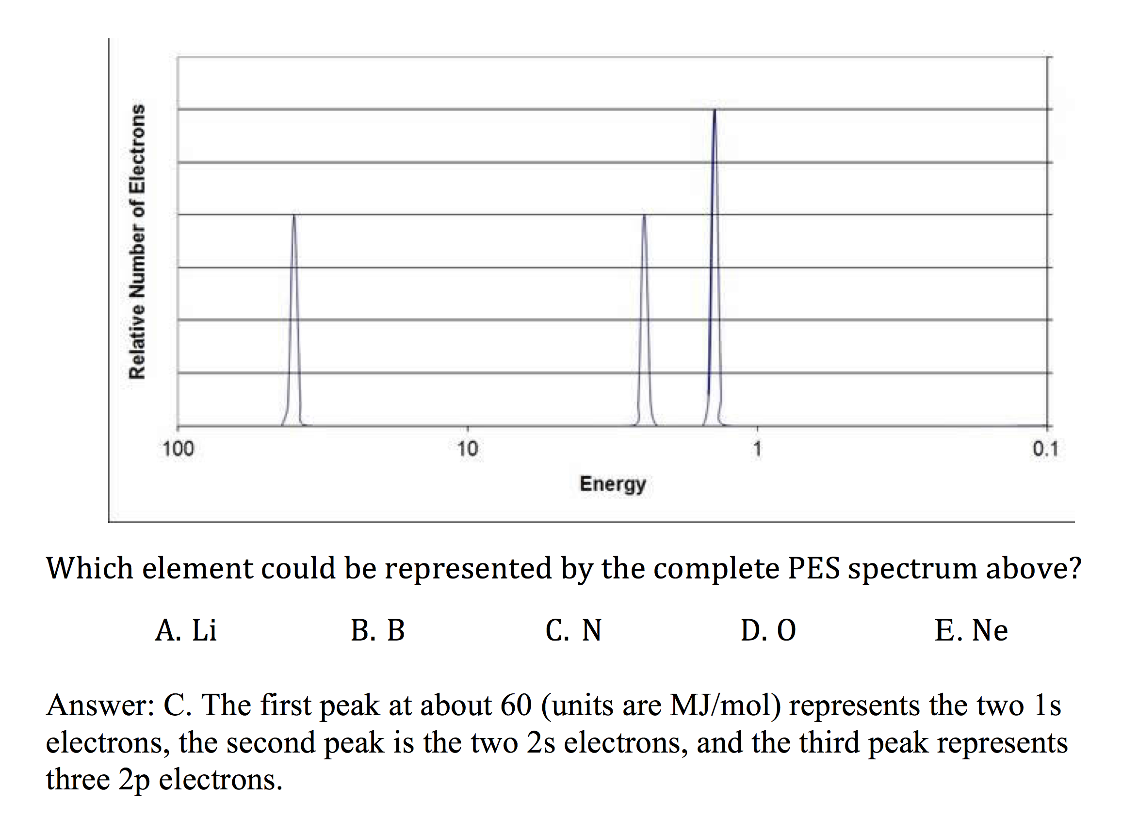
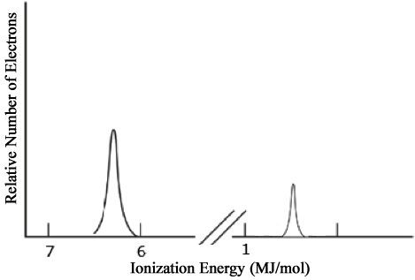
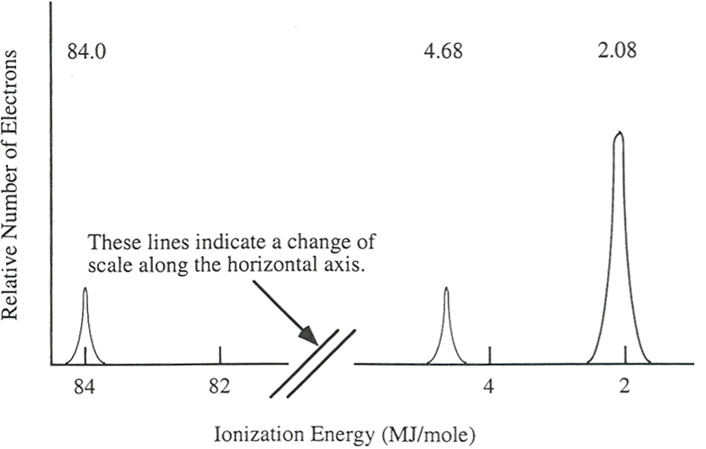
Electronic Structure of the Atom: Photoelectron Spectroscopy (PES)
Source
Li
PES uses high-energy (X-ray) photon to excite random e– from atom
KE of ejected electron indicates binding energy (coulombic attraction) to nucleus:
BE = hϖ_{photon} – KE
Direct measurement of energy and number of each electron
  Lower energy levels have higher BE
  Signal size proportional to number of e– in energy level
Elements with more protons have stronger coulombic attraction, higher BE at each energy level
1s²
Video
2s¹
Ne
2p⁶
1s²
2s²
Click reveals answer and explanation.
LO 1.7: The student is able to describe the electronic structure of the atom, using PES data, ionization energy data, and/or Coulomb’s law to construct explanations of how the energies of electrons within shells in atoms vary.

Slide 18
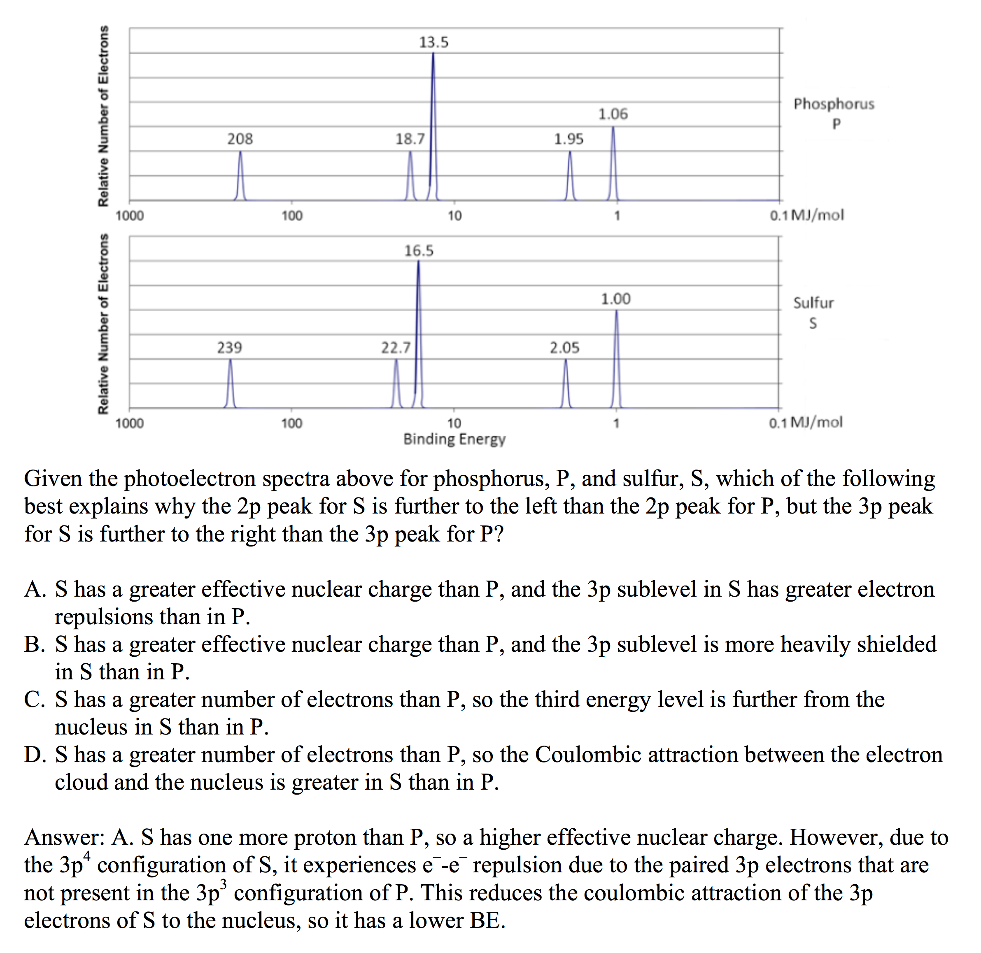
Electronic Structure of the Atom:
1st Ionization Energy Irregularities
Source
1st Ionization Energy Energy (IE) decreases from Be to B and Mg to Al
  Electron in 2p or 3p shielded by 2s² or 3s² electrons, decreasing coulombic attraction despite additional proton in nucleus.
  Same effect seen in 3d¹⁰-4p, 4d¹⁰-5p and 5d¹⁰-6p
1st Ionization Energy decreases from N to O and P to S
  np⁴ contains first paired p electrons, e–-e– repulsion decreases coulombic attraction despite additional proton
Video
Click reveals answer and explanation.
LO 1.8: The student is able to explain the distribution of electrons using Coulomb’s law to analyze measured energies.

Slide 19
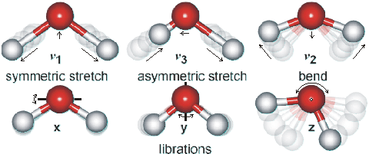
Using Spectroscopy to measure properties associated with vibrational or electronic motions of molecules
Source
IR Video
UV Video
IR Radiation - detects different types of bonds by analyzing molecular vibrations
UV or X-Ray Radiation
Photoelectron Spectroscopy(PES)
Causes electron transitions
Transitions provides info on
electron configurations
LO: 1.15 Justify the selection of a particular type of spectroscopy to measure properties associated with vibrational or electronic motions of molecules

Slide 20
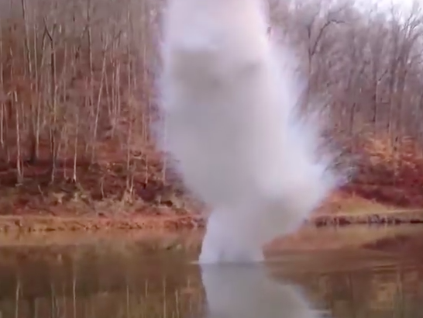
Chemical Reactivity
Source
Using Trends
Nonmetals have higher electronegativities than metals --> causes the formation of ionic solids
Compounds formed between nonmetals are molecular
  Usually gases, liquids, or volatile solids at room temperature
Elements in the 3rd period and below can accommodate a larger number of bonds
The first element in a group (upper most element of a group) forms pi bonds more easily (most significant in 2nd row, non-metals)
  Accounts for stronger bonds in molecules containing these elements
  Major factor in determining the structures of compounds formed from these elements
Elements in periods 3-6 tend to form only single bonds
Reactivity tends to increase as you go down a group for metals and up a group for non-metals.
46) Of the elements below, __________ is the most chemically reactive.
A) sodium
B) barium
C) calcium
D) cesium
E) magnesium
Video
L.O. 1.10: Students can justify with evidence the arrangement of the periodic table and can apply periodic properties to chemical reactivity

Slide 21
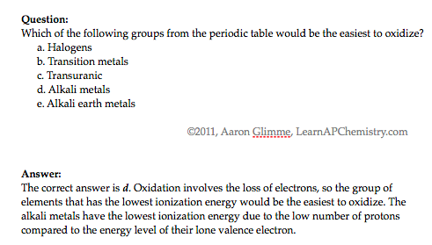
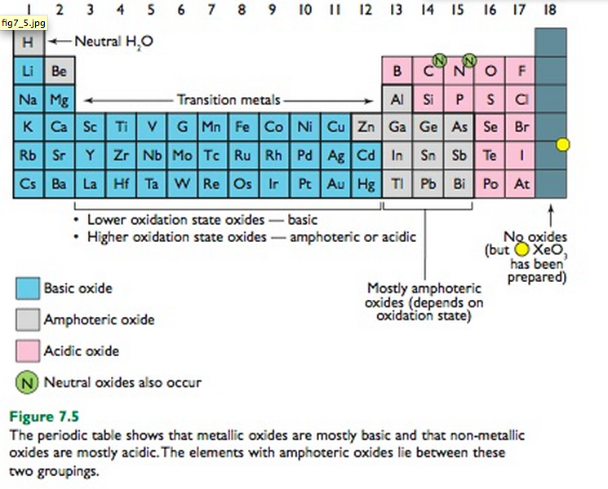
Chemical Properties within a Group and across a Period
Source
Group 1 metals more
reactive than group 2
metals
Reactivity increases as you go down a group
Metals on left form basic oxides
  Ex. Na₂O + H₂O → 2 NaOH
Nonmetals on right form form acidic oxides
  Ex. SO₃ + H₂O → H₂SO₄
Elements in the middle, like Al, Ga, etc can behave amphoterically
If SiO₂ can be a ceramic then SnO₂ may be as well since both in the same group
Video
Click reveals answer and explanation.
its
attracts
LO 1.11: Analyze data, based on periodicity & properties of binary compounds, to identify patterns & generate hypotheses related to molecular design of compounds

Slide 22
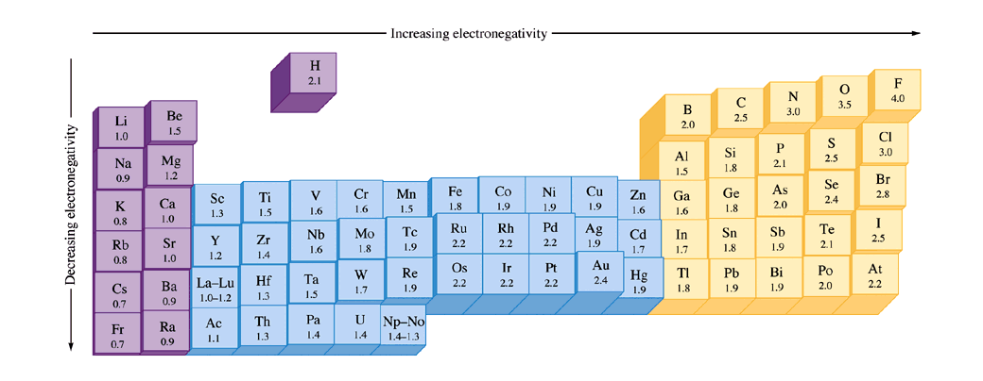
Bonding and Electronegativity
Source
Differences in electronegativities lead to different types of bonding*:
0.0 – 0.4: Bond is generally considered nonpolar
0.5 – 1.7: Bond is generally considered polar
> 1.7: Bond is generally considered ionic
Video
Electronegativities are assigned values and are relative to fluorine. Electronegativity is a function of shielding / effective nuclear charge.
*Values presented are one possibility – other scales exist.
LO 2.17: The student can predict the type of bonding present between two atoms in a binary compound based on position in the periodic table and the electronegativity of the elements.

Slide 23
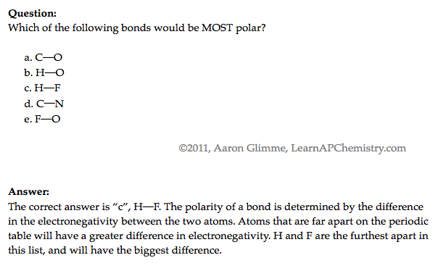
Ranking Bond Polarity
Source
Video
LO 2.18: The student is able to rank and justify the on the ranking of bond polarity on the basis of the locations of the bonded atoms in the periodic table.

Slide 24
Unit #2
Molecular and Ionic Compound Structures and Properties
7-9%

Slide 25
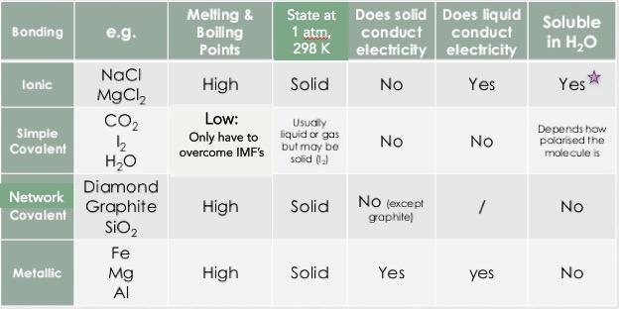
Properties Based on Bonding
Source
Video 1
Video 2
Video 3
Video 4
Visit the Virtual Lab to explore properties based on bond type (click on perform)
Not all ionic compounds are soluble, but those containing ammonium, nitrate, alkali metals, and halogens (except bonded to Ag, Hg and Pb) are typically
LO 2.1: Students can predict properties of substances based on their chemical formulas, and provide explanations of their properties based on particle views

Slide 26
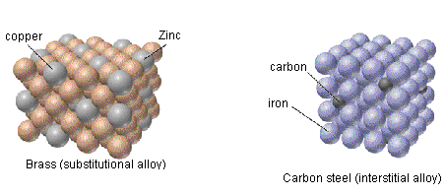
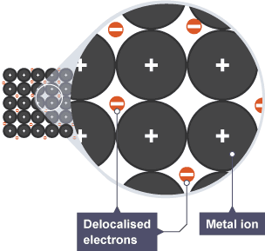
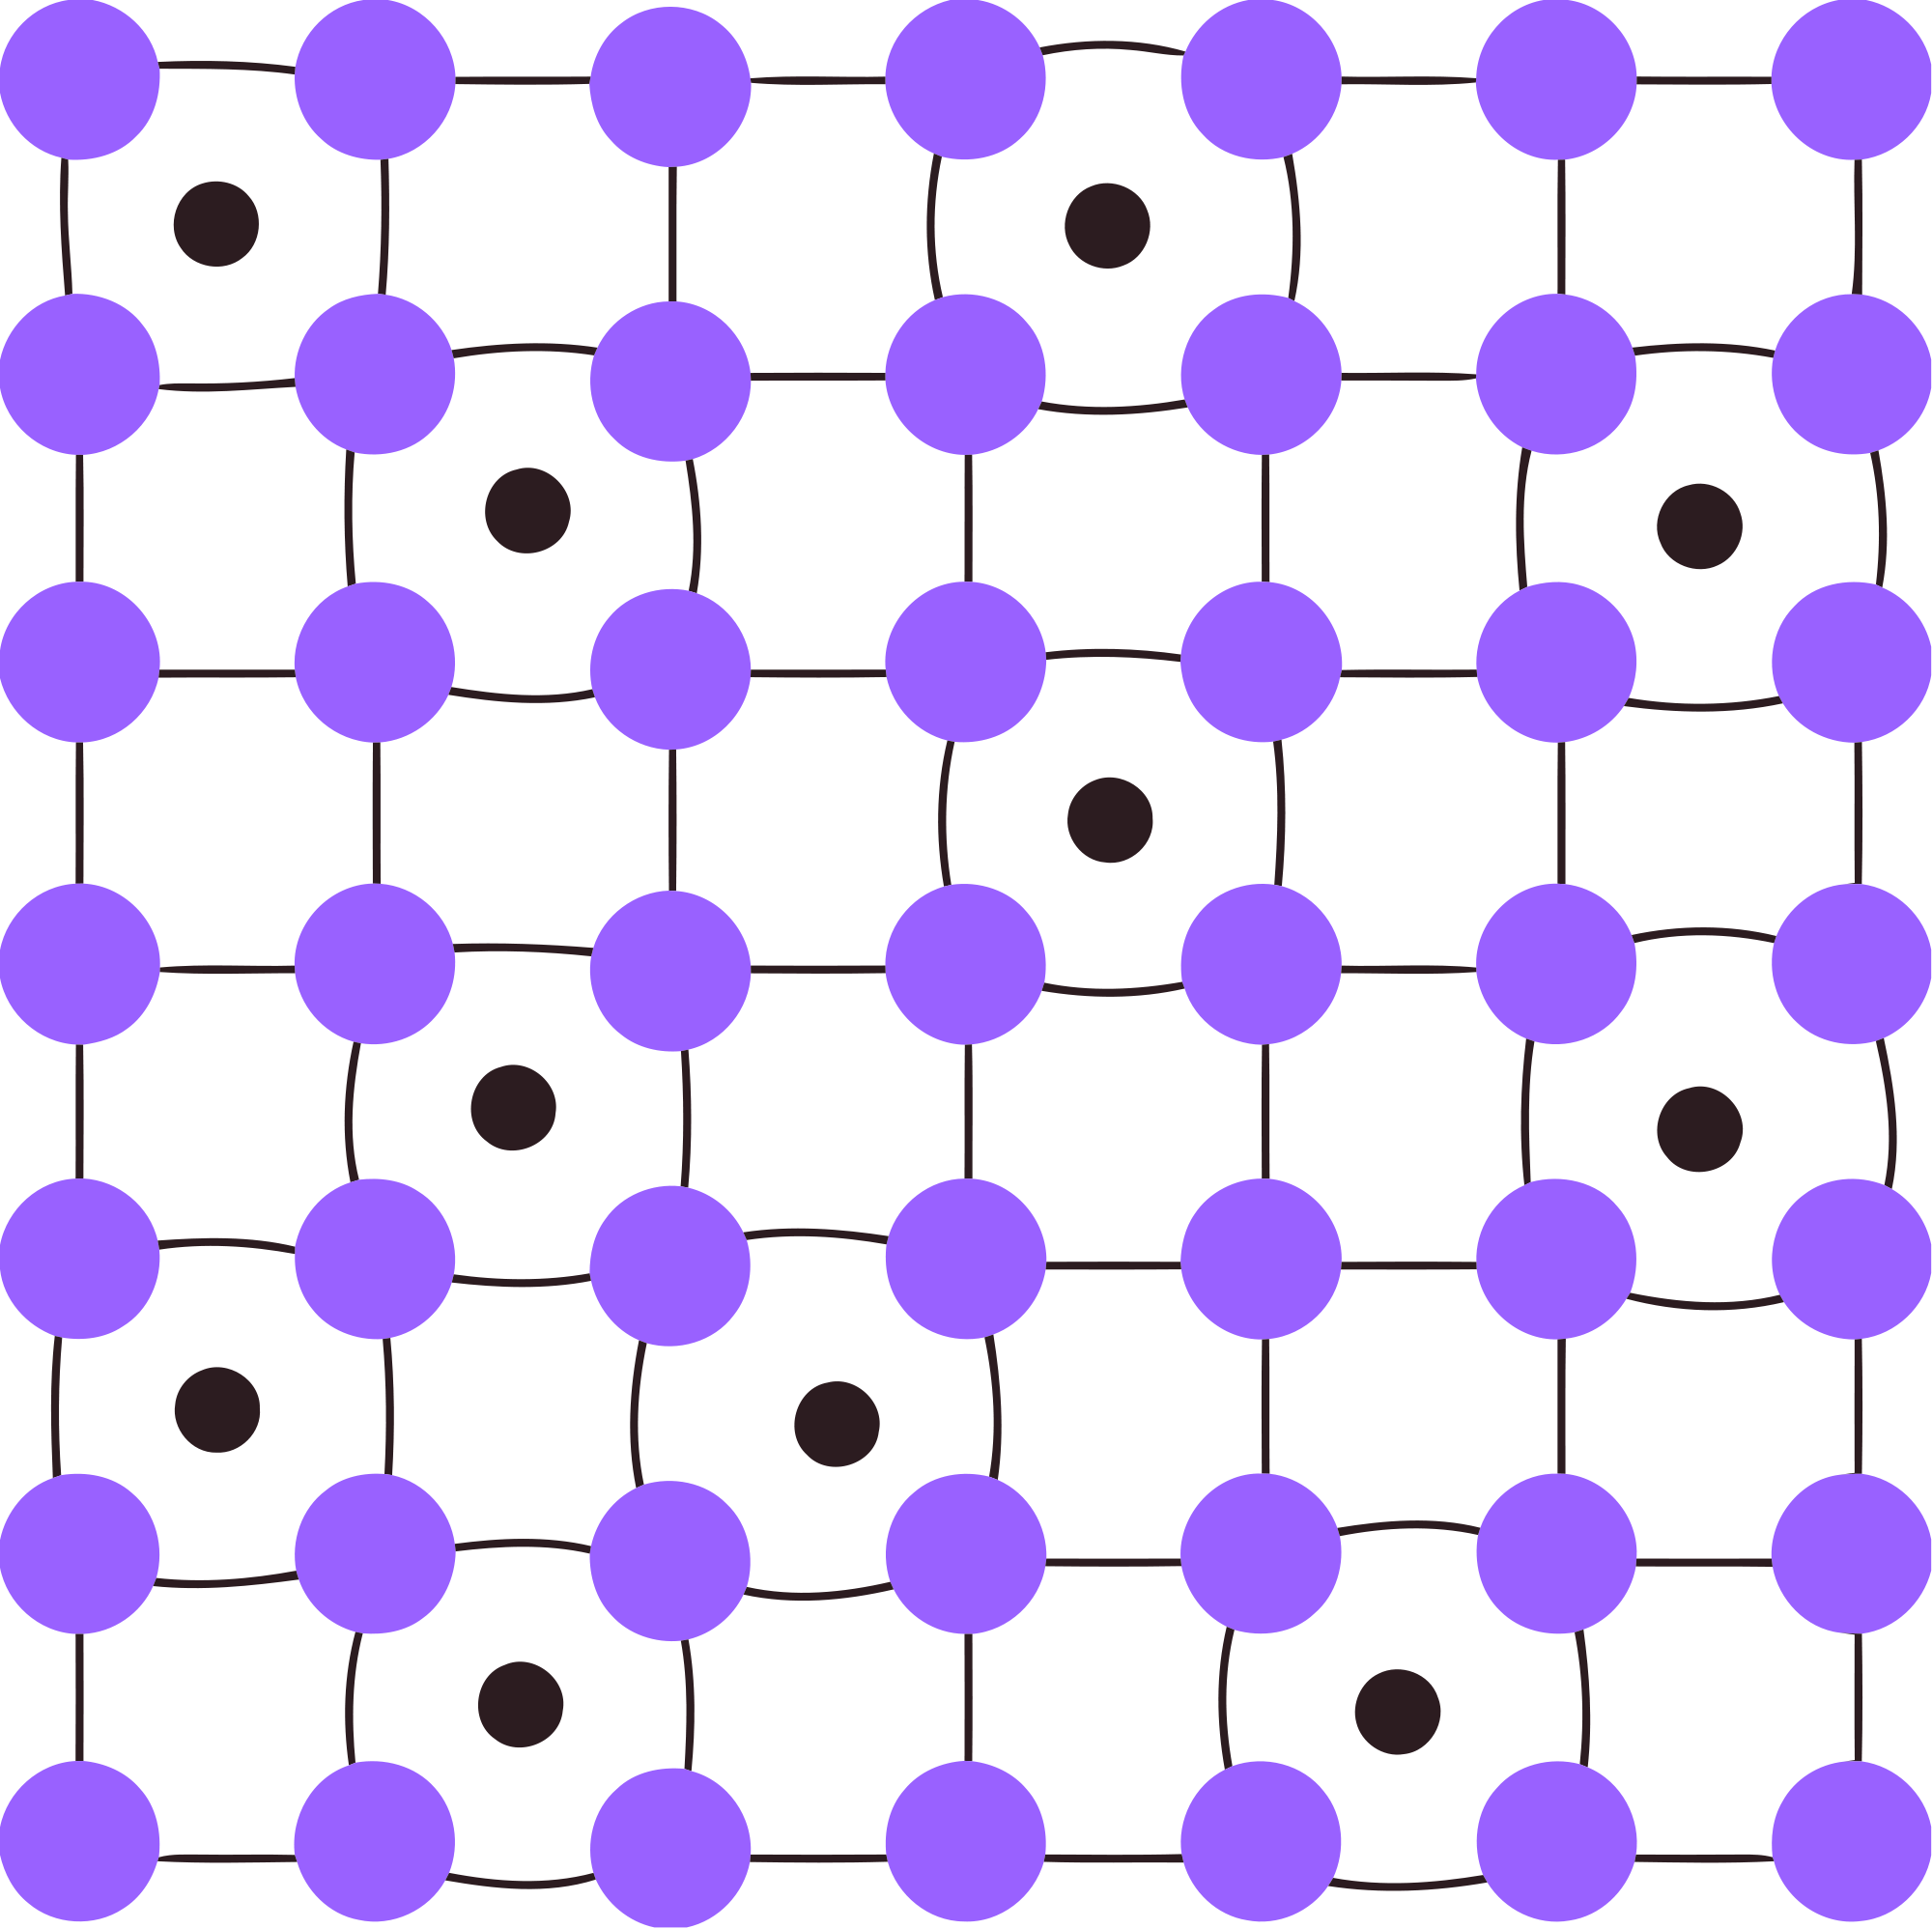
Metallic Solids - Characteristics
Source
Video
LO 2.27: The student can create a representation of a metallic solid that shows essential characteristics of the structure and interactions present in the substance.

Slide 27
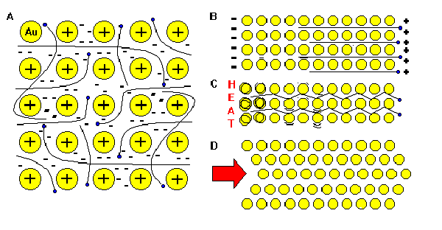
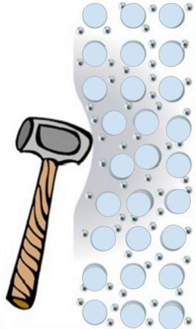
Metallic Properties – Sea of Electrons
Source
Video
“The metallic bond is not the easiest type of bond to understand, so an analogy may help. Imagine filling your bathtub with golf balls. Fill it right up to the top. The golf balls will arrange themselves in an orderly fashion as they fill the space in the tub. Do you see any spaces between the balls? If you turn on the faucet and plug the drain, the water will fill up those spaces. What you now have is something like metallic bonding. The golf balls are the metal kernals, and the water represents the valence electrons shared by all of the atoms.”
LO 2.20: The student is able to explain how a bonding model involving delocalized electrons is consistent with macroscopic properties of metals (e.g., conductivity, malleability, ductility, and low volatility) and the shell model of the atom.

Slide 28
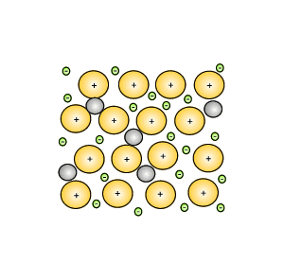
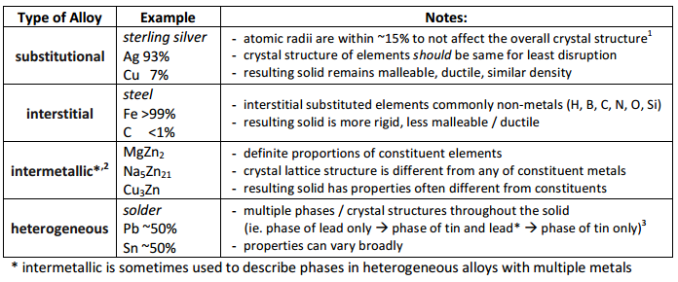
Alloys!
Source
Video
LO 2.26: Students can use the electron sea model of metallic bonding to predict or make claims about macroscopic properties of metals or alloys.

Slide 29
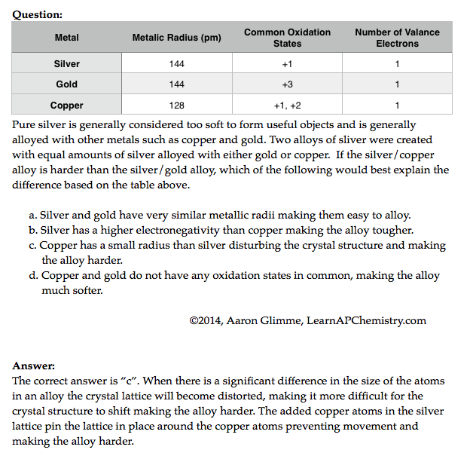


Alloys and their Properties
Source
Video
LO 2.25: The student is able to compare the properties of metal alloys with their constituent elements to determine if an alloy has formed, identify the type of alloy formed, and explain the differences in properties using particulate level reasoning.

Slide 30
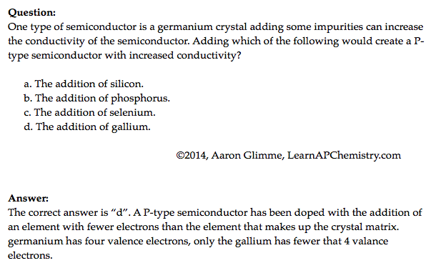
Properties of Metallic Solids
Source
Video
LO 2.28: The student is able to explain a representation that connects properties of a metallic solid to its structural attributes and to the interactions present at the atomic level.

Slide 31
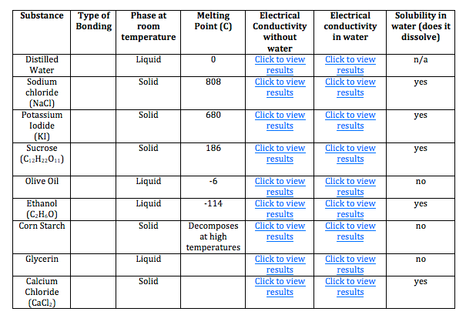
Ionic or Covalent? Bonding Tests
Great Lab Example
Properties | Ionic Compounds | Covalent Compounds
Melting/Boiling Points | High | Low except for some giant covalent molecules
Electrical Conductivity | Conduct electricity in molten and in aqueous solution | Does not conduct electricity in any state when pure, may conduct in aqueous solution (i.e., acids)
Solubility in water and organic solvents | Soluble in water Insoluble in organic solvent | Insoluble in water, except for some simple molecule Soluble in organic solvent
Volatility | Not volatile | Highly volatile
As the type of particles and forced of attraction in ionic and covalent compounds differ, their properties also differ!
Video
Source
Click here to do a virtual lab on bonding type (chart pictured below)
Use properties of compounds to differentiate them from one another. Other tests may be performed to positively identify the compound, but are not necessary to observe types of bonds present.
LO 2.22: The student is able to design or evaluate a plan to collect and/or interpret data needed to deduce the type of bonding in a sample of a solid.

Slide 32
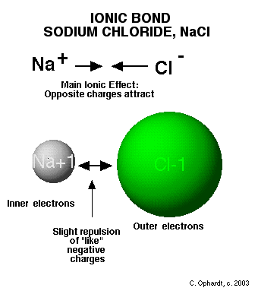
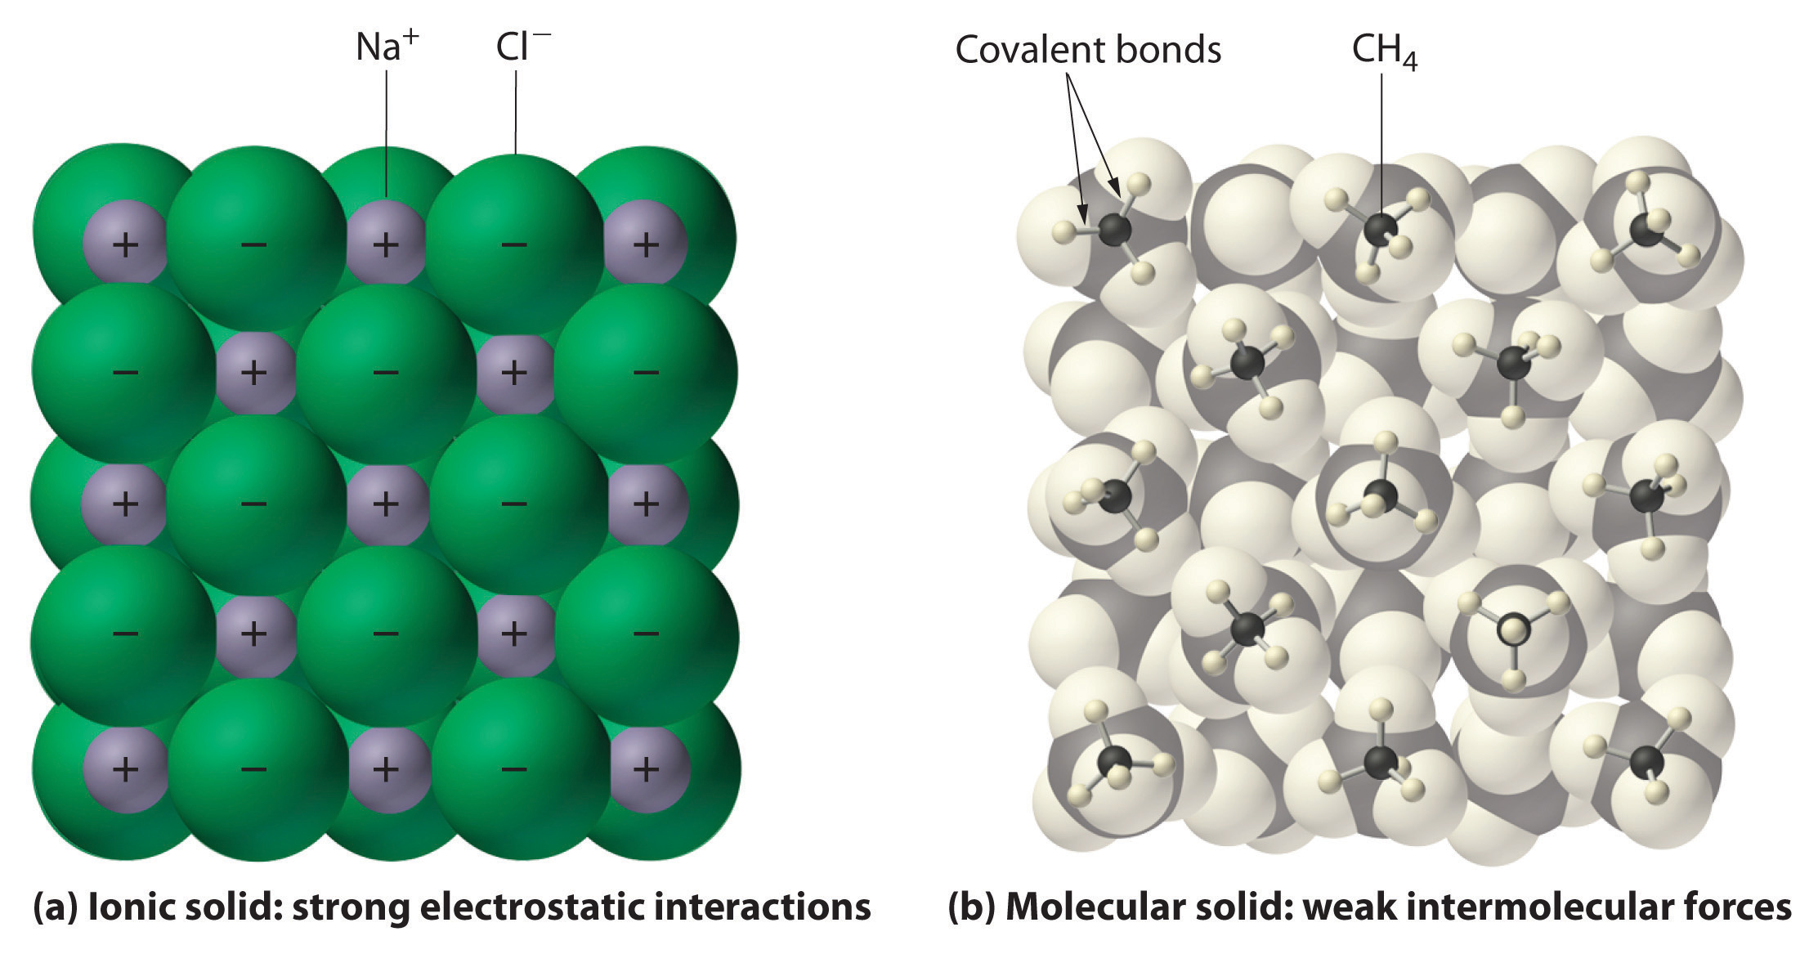
Crystal Structure of Ionic Compounds
Source
Video
LO 2.23: The student can create a representation of an ionic solid that shows essential characteristics of the structure and interactions present in the substance.

Slide 33


Ionic Substances and their Properties
Source
Ionic compounds are brittle. As the crystal structure is struck, the ions become displaced. The displaced ions will repel like charges and fracture.
Video
LO 2.19: The student can create visual representations of ionic substances that connect the microscopic structure to macroscopic properties and/or use representations to connect microscopic structure to macroscopic properties (e.g., boiling point, solubility, hardness, brittleness, low volatility, lack of malleability, ductility, or conductivity).

Slide 34

Crystal Structure of Ionic Compounds
Source
Video
The +2 and -2 ions attract each other more strongly than +1 attracts -1.
The ions Mg⁺² and O⁻² are smaller than Na⁺¹ and Cl⁻¹, therefore the ions can get closer together, increasing their electrostatic attractions.
LO 2.24: The student is able to explain a representation that connects properties of an ionic solid to its structural attributes and to the interactions present at the atomic level.

Slide 35



Lewis Diagrams / VSEPR
Source
Video
LO 2.21: The student is able to use Lewis diagrams and VSEPR to predict the geometry of molecules, identify hybridization, and make predictions about polarity.

Slide 36

Covalent Compounds - Interactions
Source
Graphite are sheets of carbon atoms bonded together and stacked on top of one another. The interactions between sheets is weak, much like the substance itself.
Diamond’s carbon atoms are more connected in a three dimensional structure, adding strength to the network.
Video
LO 2.29: The student can create a representation of a covalent solid that shows essential characteristics of the structure and interactions present in the substance.

Slide 37
Unit #3
Intermolecular Forces and Properties
18-22%

Slide 38



Electrostatic forces exist between molecules as well as between atoms or ions, and breaking these intermolecular interactions requires energy.
Source
The Stronger the IMF the more energy required to break it, the Higher the Boiling Point, the Lower the Vapor Pressure.
Intermolecular Forces Listed from weakest to strongest. Thus the boiling points and vapor pressure of molecular substances can be ordered based on IMF strength:
Dispersion (Induced Dipole- Induced Dipole): Caused by distortion of electron cloud. The larger the electron cloud, and the more surface area, the more polarizable the cloud, the stronger the dispersion force. Thus the boiling point trend in halogens is I₂ >Br₂>Cl₂> F₂ and n-butane (30.2° C) has a higher boiling point than isobutane (-11 °C). All substances have dispersion forces, as all electron clouds distort. Nonpolar molecules and atoms have only dispersion forces, as they have no permanent dipoles.
Dipole- Induced Dipole: Occurs between a polar molecule (HCl) and a nonpolar molecule. (Cl₂) The nonpolar molecule’s cloud distorts when affected by a dipole.
Dipole-Dipole: Occurs between 2 polar molecules. (HCl-HCl)
Hydrogen Bond: An extreme case of Dipole – Dipole. Occurs between molecules containing a H covalently bonded to F,O, or N. The “bond” occurs between the lone pair of F, O, or N, and the H which is attached to one of those elements.
Video
Weaker IMF, Lower Boiling, Higher Vapor Pressure
Stronger IMF, Higher Boiling, Lower Vapor Pressure
LO 5.9: Make claims and/or predictions regarding relative magnitudes of the forces acting within collections of interacting molecules based on the distribution of electrons within the molecules and the types of intermolecular forces through which the molecules interact.

Slide 39





Inter vs Intra
Chemical vs. Physical
Source
Source
Source
Source
Interstates- Between States
IMF- Between Molecules
Video
Chemical vs. Physical Changes
A physical change doesn’t produce a new substance. Phase changes are the most common. It involves IMF changes.
A chemical change produces new substances. Bonds are broken and new bonds are formed! The Intra-molecular forces are changed.
Strong IMF= High BP, High MP, High viscosity, high surface tension, low vapor pressure!
LO 5.10: The student can support the claim about whether a process is a chemical or physical change (or may be classified as both) based on whether the process involves changes in intramolecular versus intermolecular interactions.

Slide 40


London Dispersion Forces and Noble and Nonpolar Gases
Source
This answer is VITAL! Remember with increased number of ELECTRONS a particle becomes more polarizable, not with increased mass!
Video
Click reveals answer and explanation.
LO 2.11: The student is able to explain the trends in properties/predict properties of samples consisting of particles with no permanent dipole on the basis of LDF’s.

Slide 41


Hydrogen Bonding
Source
Hydrogen bonding is seen in the following molecules: water, DNA, ammonia, HF, and alcohols. H-bonding is an attraction or force not a true intramolecular bond.
Hydrogen bonds are like a sandwich with N, O, and/or F as the bread. H will be in a intramolecular (same molecule) bond with one N, O, and/or F and have an intermolecular attraction (different molecule) with the other.
Video
Remember this tip:
hydrogen bonds just wanna have FON
LO 2.13: The student is able to describe the relationships between the structural features of polar molecules and the forces of attraction between the particles.

Slide 42


Physical Properties and IMF’s
Source
Video
Hg
Click reveals answer and explanation.
LO 2.16: Explain the properties (phase, vapor pressure, viscosity, etc.) of small and large molecular compounds in terms of the strengths and types of IMF’s.

Slide 43


Molecular Compound Interactions
Source
a. Covalent bonds
b. Hydrogen bonds
c. Dipole-dipole interactions
d. London Dispersion Forces
Video
LO 2.32: The student is able to explain a representation that connects properties of a molecular solid to its structural attributes and to the interactions present at the atomic level.

Slide 44



Molecular Compounds - Interactions
Source
Water (H₂O)
Iodine (I₂)
Video
Polar Covalent compounds align according to dipole-dipole interactions.
Non-Polar Covalent compounds align according to LDF’s as a solid.
LO 2.31: The student can create a representation of a molecular solid that shows essential characteristics of the structure and interactions in the substance.

Slide 45


Covalent Solids Density Vs. Miscibility
Source
Video
Is PVC or PP more miscible in water?
PVC has similar IMF as H₂O
LO 2.30: The student is able to explain a representation that connects properties of a covalent solid to its structural attributes and to the interactions present at the atomic level.

Slide 46







IMF and Biological/Large Molecules
Source
Source
Source
Video
LO 5.11: The student is able to identify the noncovalent interactions within and between large molecules, and/or connect the shape and function of the large molecule to the presence and magnitude of these interactions.

Slide 47

Chromatography
Source
Video
LO 2.7: The student is able to explain how solutes can be separated by chromatography based on intermolecular interactions.

Slide 48



Chromatography
Click here to watch animation explaining column chromatography
Source
Video
Virtual Lab
Source (includes nice discussion of biological applications)
Main Error:
  Incomplete Separation
Can be caused by:
  Inconsistent spotting
  Overloading
  Improper packing (column)
  Poor solvent choice
Advantage: We can collect and use the fractions
  Science Practices
  4.2 The student can design a plan for collecting data to answer a particular scientific question.
  5.1The student can analyze data to identify patterns or relationships.
  6.2 The student can construct explanations of phenomena based on evidence produced through scientific practices.
Learning Objectives
LO 2.7: The student is able to explain how solutes can be separated by chromatography based on intermolecular interactions.
LO 2.10: The student can design and/or interpret the results of a separation experiment (filtration, paper chromatography, column chromatography, or distillation) in terms of the relative strength of interactions among and between the components.

Slide 49






Distillation to Separate Solutions
Source
Video
In the diagram above, ethanol has lower IMF’s and a resulting lower boiling point than water, so it can be heated, vaporized and condensed easily.
Ethanol hydrogen bonds as water does and is polar, but part of the ethanol has only weaker LDF’s because it’s nonpolar resulting in a lower boiling point
LO 2.10: Design/interpret the results of filtration, paper/column chromatography, or distillation in terms of the relative strength of interactions among the components.

Slide 50

Behaviors of Solids, Liquids, and Gases
Source
Video 1
Video 2
LO 2.3: The student is able to use particulate models to reason about observed differences between solid and liquid phases and among solid and liquid materials.

Slide 51

Kinetic
Molecular
Theory
(KMT)
Source
Video 1
Video 2
IF the temperature is not changed, no matter what else is listed in the problem, the average kinetic energy of a gas does not change. That is the definition of temperature!
All gases begin to act non-ideally (aka real) when they are at low temperatures and/or high pressures because these conditions increase particle interactions
Under the same conditions, the stronger the intermolecular attractions between gas particles, the LESS ideal the behavior of the gas
LO 2.4: The student is able to use KMT and IMF’s to make predictions about the macroscopic properties of gases, including both ideal and non-ideal behaviors

Slide 52

Properties of a Gas - Factors
Source
Don’t worry about individual gas law names, but do worry about the effect of changing moles, pressure and temperature on a sample of gas
Virtual Lab
LO 2.5: Refine multiple representations of a sample of matter in the gas phase to accurately represent the effect of changes in macroscopic properties on the sample

Slide 53


The Ideal Gas Law
Source
Video
LO 2.6: The student can apply mathematical relationships or estimation to determine macroscopic variables for ideal gases
Click reveals answer and explanation.

Slide 54

Deviations from Ideal Gas Behavior
Source
Video
When watching the video, don’t concern yourself with Van der Walls – AP Exam focuses on LDF’s instead
Click reveals answer and explanation.
LO 2.12: The student can qualitatively analyze data regarding real gases to identify deviations from ideal behavior and relate these to molecular interactions

Slide 55






Gas Laws Labs
  After rxn, eudiometer lowered into water until levels equal so pressure inside room and tube are same
  Use Dalton’s Law to subtract P_{water}
  Sources of error:
    Mg left: moles of H₂ too low
    Air bubble at start: volume of gas too high
Source 1
Determination of Molar Mass of a Volatile Liquid
How It’s Done/Analysis:
  Volatile liquid heated until completely vaporized
  PV=nRT to solve for n:
    Temperature of water bath=T
    Small hole in stopper means Pressure = room pressure
    Volume=volume of flask
  Divide Mass of recondensed unknown by moles, compare to known molar mass to ID unknown
  Assume vapor completely recondenses
  🡪If lose vapor, then mass would be too low, and moles would be low
Determination of Molar Volume of a Gas
Source 2
Video 1
Video 2
Video 3
http://chemskills.com/?q=ideal_gas_law
Diffusion : Graham’s Law
Demo
How It’s Done/Analysis:
  Ends of glass tube plugged with soaked cotton
  White ring is NH₄Cl ppt
  Ppt will not be exactly in middle…
    Molar mass of NH₃ is lower than MM of HCl, so ring will be toward right side of tube
    Graham’s Law can be used to establish ratios which can be applied to distances
  Science Practices
  1.4 The student can use representations and models to analyze situations or solve problems qualitatively and quantitatively.
  2.2 The student can apply mathematical routines to quantities that describe natural phenomena.
  2.3 The student can estimate numerically quantities that describe natural phenomena.
  6.4 The student can make claims and predictions about natural phenomena based on scientific theories and models.
Learning Objectives
LO 2.4: The student is able to use KMT and concepts of intermolecular forces to make predictions about the macroscopic properties of gases, including both ideal and nonideal behaviors.
LO 2.6: The student can apply mathematical relationships or estimation to determine macroscopic variables for ideal gases.

Slide 56

Dissolving/Dissociation: Solute and Solvent
Source
Video
When drawing solute ions:
pay attention to size (Na⁺ is smaller than Cl⁻)
Draw charges on ion, but not on water
draw at least 3 water molecules around each
the negative dipole (oxygen side) points toward cation and the postive dipoles (H side) points towards the anion
LO 2.8: The student can draw and/or interpret representations of solutions that show the interactions between the solute and solvent.

Slide 57

Molarity and Particle Views
Source
Video
QUESTION: Rank the six solutions above in order of increasing molarity. Pay attention to volume, and some have equal concentration
C,D, and E (tied); A and F (tied); most concentrated is B
Click reveals answer
LO 2.9: The student is able to create or interpret representations that link the concept of molarity with particle views of solutions

Slide 58

Coulomb’s Law and Solubility
Source
Ionic compounds can dissolve in polar liquids like water because the ions are attracted to either the positive or negative part of the molecule.
There is a sort of tug-of-war involved with species dissolved in water. The water pulls individual ions away from the solid. The solid is pulling individual ions back out of the water. There exists an equilibrium based on how strongly the water attracts the ions, versus how strong the ionic solid attracts the ions.
We can predict the degree of solubility in water for different ionic compounds using Coulomb's law. The smaller the ions, the closer together they are, and the harder it is for the water molecules to pull the ions away from each other. The greater the charge of the ions, the harder it is for the water to pull them away as well.
Video
QUESTION: Predict which of the following pairs should be more soluble in water, based on Coulombic attraction.
LiF or NaF
NaF or KF
BeO or LiF
LO 2.14: Apply Coulomb’s law to describe the interactions of ions, & the attractions of ions/solvents to explain the factors that contribute to solubility of ionic compounds.

Slide 59



Beer-Lambert Law - used to measure the concentration of colored solutions
Source 1, 2
Video
A = abc
A = absorbance
a = molar absorptivity (constant for material being tested)
b = path length (cuvette = 1 cm)
c = concentration
Taken at fixed wavelength
Click reveals answer and explanation.
LO1.16: Design and/or interpret the results of an experiment regarding the absorption of light to determine the concentration of an absorbing species in solution

Slide 60

Unit #4
Chemical Reactions
7-9%

Slide 61


Changes in matter involve the rearrangement and/or reorganizations of atoms and/or the transfer of electrons.

Slide 62




Types of Chemical Reactions
Source
Synthesis
A + B 🡪 AB
Decomposition
AB 🡪 A + B
Video
Single Displacement
A + BC 🡪 AC + B
Double Displacement
AB + CD🡪 AD + CB
Images from: Wilbraham, Antony C. Pearson Chemistry. Boston, MA: Pearson, 2012. Print.
LO 3.1: Students can translate among macroscopic observations of change, chemical equations, and particle views.

Slide 63




Types of Chemical Reactions
Source
Combustion
C_{x}H_{x} + O₂ 🡪 CO₂ + H₂O
Acid-Base (Neutralization)
HA + BOH 🡪 H₂O + BA
Video
C. Pearson Chemistry. Boston, MA: Pearson, 2012. Print.
Oxidation-Reduction
A ⁺ + e⁻ 🡪 A
B 🡪 B + e⁻
Precipitation
AB (aq) + CD (aq)🡪 AD (aq) + CB (s)
LO 3.1: Students can translate among macroscopic observations of change, chemical equations, and particle views.

Slide 64


Evidence of Chemical Change
Source
Note: it is a common misconception that boiling water makes O₂ and H₂ gas. Notice that the water molecule stays intact as the water boils. Covalent bonds are not broken with this physical change- only intermolecular attractions (hydrogen bonds) between water molecules.
Video
Video
Video
Chemical Changes:
Production of a gas:
2KClO₃ _{(s)} + heat → 2KCl _{(s)} + 3O_{2 (g)}
Formation of a precipitate:
AgNO₃) _{(aq)} + KCl _{(aq)} → AgCl _{(s)}+ 2KNO_{3 (aq)}
Change in color:
Two white solids react to produce a mixture of a yellow and a white solid when shaken forcefully!
Pb(NO₃)_{2 (s)} + 2KI _{(s)} → PbI₂ _{(s)}+ 2KNO_{3 (s)}
Production of heat*:
2 Mg _{(s)} + O_{2 (s)} → 2MgO _{(s)} + heat
*can also include the absorption of heat
Physical Changes:
may produce similar visible evidence (i.e. boiling water creates “bubbles,” but bonds are not broken and reformed. No new substances are made.
LO 3.10: Evaluate the classification of a process as a physical, chemical, or ambiguous change based on both macroscopic observations and the distinction between rearrangement of covalent interactions and noncovalent interactions.

Slide 65

Balanced Equations
Source
Complete Molecular: | AgNO₃ (aq) + KCl (aq) ⎯→ AgCl (s) + KNO₃ (aq)
Complete Ionic : | Ag⁺(aq) + NO₃⁻(aq) + K⁺(aq) + Cl⁻(aq) ⎯→ AgCl (s) + K⁺(aq) + NO₃⁻(aq)
Net Ionic : | Ag⁺(aq) + Cl⁻(aq) ⎯→ AgCl (s)
Video
Quizlet
Spectator ions should not be included in your balanced equations.
Remember, the point of a Net Ionic Reaction is to show only those ions that are involved in the reaction. Chemists are able to substitute reactants containing the same species to create the intended product.
You only need to memorize that compounds with nitrate, ammonium, halides and alkali metals are soluble.
LO 3.2: The student can translate an observed chemical change into a balanced chemical equation and justify the choice of equation type (molecular, ionic, or net ionic) in terms of utility for the given circumstances.

Slide 66

Use Mole Ratio in balanced equation to calculate moles of unknown substance
Source
Video
LO1.18: Apply the conservation of atoms to the rearrangement of atoms in various processes.

Slide 67


Law of Conservation of Mass
Source
Video
N₂ + 3H₂ → 2NH₃
Click reveals answer and explanation.
LO1.17: Express the law of conservation of mass quantitatively and qualitatively using symbolic representations and particulate drawings

Slide 68
Experimental Design
Source
Synthesis
A sample of pure Cu is heated in excess pure oxygen. Design an experiment to determine quantitatively whether the product is CuO or Cu₂O.
Find the mass of the copper. Heat in oxygen to a constant new mass. Subtract to find the mass of oxygen that combined with the copper. Compare the moles of oxygen atoms to the moles of original copper atoms to determine the formula.
Video
Click reveals basic steps
Decomposition CaCO₃(s) 🡪 CaO(s) + CO₂(g)
Design a plan to prove experimentally that this reaction illustrates conservation of mass.
Find the mass of calcium carbonate and seal it in a rigid container. Evacuate the container of remaining gas. Heat the container and take pressure readings (this will be the pressure exerted by the CO₂). Using PV=nRT, calculate the moles of carbon dioxide gas present in the container and compare it to the molar relationships afforded by the balanced chemical equation.
Click reveals basic steps
LO3.5: The student is able to design a plan in order to collect data on the synthesis or decomposition of a compound to confirm the conservation of matter and the law of definite proportions.

Slide 69
Data Analysis
Source
When tin is treated with concentrated nitric acid, and the resulting mixture is strongly heated, the only
remaining product is an oxide of tin. A student wishes to find out whether it is SnO or SnO2.
Mass of pure tin 5.200 grams.
Mass of dry crucible 18.650 g
Mass of crucible + oxide after first heating 25.500 g
Mass after second heating 25. 253 g
Mass after third heating 25. 252 g
How can you use this data, and the law of conservation of mass, to determine the formula of the product?
Video
  1) Determine the number of moles of tin. 5.200/118.7 = 0.0438 moles. Sn
  2) Subtract the mass of the crucible from the mass after the third heating. 25.252-18.650 = 6.602 g SnO_{x}
  3) Subtract the mass of tin from the mass of oxide to get the mass of oxygen. 6.602-5.200 = 1.402 grams of oxygen.
  4) Calculate the moles of oxygen atoms, and divide by the moles of tin atoms to get the formula ratio.
  1.402 g/16.00 g/mol of atoms = 0.0876 moles. 0.0876/0.0438 = 2.00
  The formula must be SnO₂.
Click reveals answer and explanation.
LO 3.6: The student is able to use data from synthesis or decomposition of a compound to confirm the conservation of matter and the law of definite proportions.

Slide 70
Making Predictions
Source
Solid copper carbonate is heated strongly:
CuCO₃ (s) 🡪 CuO (s) + CO₂ (g)
What evidence of a chemical change would be observed with this reaction?
One would observe a color change and evolution of a gas
What is the percent yield of CO₂ if you had originally heated 10.0g CuCO₃ and captured 3.2g CO₂ ?
Step 1: Find the Theoretical Yeild
10.0g CuCO₃ x(1mol/123.555g) x (1mol CO₂ /1 molCuCO₃ ) X 44.01gCO₂/mol = 3.562 gCO₂
Step 2: Find Percent Yield
(3.2 g / 3.562 g) * 100 = 89.8 % 🡪 90% with correct sig figs
How could you improve your percent yield?
-reheat the solid, to see if there is any further mass loss
-make sure you have pure CuCO₃
Click reveals answer and explanation.
Video
Click reveals answer and explanation.
Click reveals answer and explanation.
Click reveals answer and explanation.
LO 3.3: The student is able to use stoichiometric calculations to predict the results of performing a reaction in the laboratory and/or to analyze deviations from the expected results.

Slide 71














Synthesis
Source
Inorganic Synthesis Examples:
  Synthesis of Coordination Compound
  Synthesis of Alum from aluminum
Organic Synthesis Example:
  Synthesis of Aspirin
Syntheses are done in solution, and require purification by filtration, recrystalization, column chromatography or a combination
% Yield is calculated; analysis is done by melting point, NMR, IR
Video
Virtual Lab
Synthesizing Alum Procedure:
Source of aluminum is reacted with KOH
Possible Error Sources: impurity in Al (such as plastic coating) prevents complete rxn
H₂SO₄ is added to ppt Al(OH)₃
Possible Error Sources: incomplete precipitation
Mixture heated until no Al(s) is left
Possible Error Sources: some Al(s) remains undissolved
Filter and collect alum crystals
Possible Error Sources: crystals escape to filtrate, crystals not washed well and remain wet
Recrystallize alum in ice bath
Possible Error Sources: crystals form too quickly, incomplete recrystallization
  Science Practices
  2.1 The student can justify the selection of a mathematical routine to solve problems.
  2.2 The student can apply mathematical routines to quantities that describe natural phenomena.
  4.2 The student can design a plan for collecting data to answer a particular scientific question.
  6.1 The student can justify claims with evidence.
Learning Objectives
LO 3.5: The student is able to design a plan in order to collect data on the synthesis or decomposition of a compound to confirm the conservation of matter and the law of definite proportions.
LO 3.6: The student is able to use data from synthesis or decomposition of a compound to confirm the conservation of matter and the law of definite proportions.
LO:

Slide 72
Gravimetric Analysis
Source
What It Determines:
  amount of analyte by mass measurements
  % composition
  empirical formulas
How It Can Be Done:
  Dehydration of a hydrate
  Forming a precipitate, which is then isolated and massed
Analysis:
  Remember to ALWAYS go to moles!
  use mole ratios to convert between various components
Video
Virtual Lab
Possible Source of Error | Contamination in solid | Incomplete Precipitation | Solid not fully dehydrated
Impact on Results | measured mass too large | Lose ion in filtrate – mass too small | measured mass too large
  Science Practices
  1.5 The student can re-express key elements of natural phenomena across multiple representations in the domain.
  2.2 The student can apply mathematical routines to quantities that describe natural phenomena.
  4.2 The student can design a plan for collecting data to answer a particular scientific question.
  5.1 The student can analyze data to identify patterns or relationships.
  6.1 The student can justify claims with evidence.
Learning Objectives
1.3: The student is able to select and apply mathematical relationships to mass data in order to justify a claim regarding the identity and/or estimated purity of a substance.
1.17: The student is able to express the law of conservation of mass quantitatively and qualitatively using symbolic representations and particulate drawings.
1.19: The student can design, and/or interpret data from, an experiment that uses gravimetric analysis to determine the concentration of an analyte in a solution.

Slide 73

Gravimetric Analysis- Double Displacement Reaction
Source
Buchner Filtration Apparatus
Video
How much lead
(Pb²⁺) in water?
Pb²⁺(aq) + 2Cl⁻(aq) → PbCl₂ (s)
By adding excess Cl- to the sample, all of the Pb²⁺ will precipitate as PbCl₂
Solid product is filtered using a Buchner Filter and then dried to remove all water
Mass of PbCl₂is then determined
This can be used to calculate the original amount of lead in the water
LO 1.19: Design and/or interpret data from, an experiment that uses gravimetric analysis to determine the the concentration of an analyte in a solution.

Slide 74
Limiting Reactants – D.A.
Source
Al₂S₃ + 6 H₂O ---> 2Al(OH)₃ + 3 H₂S
15.00 g aluminum sulfide and 10.00 g water react
Identify the Limiting Reactant
Video
Sim
pHet
Click reveals answer and explanation.
15.00g Al₂S₃ x (1mol/ 150.158 g) x (6mol H₂O/1mol Al₂S₃) x (18g/mol H₂0 ) = 10.782 g H₂0 needed
10g H₂0 x (1mol/ 18.015 g) x (1 mol Al₂S₃ / 6mol H₂O) x (150.158 g/mol) = 13.892g Al₂S₃ needed
H₂0 is limiting, because we need more than we were given
b) What is the maximum mass of H₂S which can be formed from these reagents?
Theoretical Yield
10.00 g H₂0 x (1mol/ 18.015 g) x (3/6) x (34.0809 g/mol ) = 9.459 g H₂S produced
Click reveals answer and explanation.
c) How much excess reactant is left in the container?
Click reveals answer and explanation.
15.00 g – 13.892 g = 1.11g Al₂S₃
**Dimensional Analysis is not the only way to solve these problems. You can also use BCA tables (modified ICE charts), which may save time on the exam 🡪
LO 3.4: The student is able to relate quantities (measured mass of substances, volumes of solutions, or volumes and pressures of gases) to identify stoichiometric relationships for a reaction, including situations involving limiting reactants and situations in which the reaction has not gone to completion.

Slide 75
Limiting Reactants – BCA Table
Source
15.00 g aluminum sulfide and 10.00 g water react according to the following equation:
Al₂S₃ + 6 H₂O ---> 2Al(OH)₃ + 3 H₂S
Identify the Limiting Reactant
Video
Click reveals answer and explanation.
15.00g Al₂S₃ x (1mol/ 150.158 g) = .100mol
10g H₂0 x (1mol/ 18.015 g) = .555
Water is the limiting reactant.
 | Al₂S₃ | 6 H₂O | 2Al(OH)₃ | 3 H₂S
Before | .0999 | .5551 | 0 | 0
Change | -.0925 | -.5551 | + .1850 | + .2775
After | .0074 | 0 | .1850 | .2775
Complete the table using the molar relationships
b) What is the maximum mass of H₂S which can be formed from these reagents?
0.2775 mol H₂S x (34.0809 g/mol ) = 9.459 g H₂S produced
Click reveals answer and explanation.
c) How much excess reactant is left in the container?
Click reveals answer and explanation.
.0074mol Al₂S₃ x 150.158 g/mol = 1.11g Al₂S₃
LO 3.4: The student is able to relate quantities (measured mass of substances, volumes of solutions, or volumes and pressures of gases) to identify stoichiometric relationships for a reaction, including situations involving limiting reactants and situations in which the reaction has not gone to completion.

Slide 76
Acid Base Reaction: Neutralization
Strong acid + Strong base → salt + water
A 25.0 mL sample of HCl is titrated with 0.15 M Ca(OH)₂ to the equivalence point. What is the molar concentration of the HCl?
If the student accidentally overshot the equivalence point, how would this affect the calculation of the molar concentration of the unknown?
0.15 M Ca(OH)₂ | volume (mL)
Initial | 0.10
Final | 23.50

Slide 77





Redox Reactions
Source
When an electron is transferred, it is called a redox reaction. When something is reduced, the RED part of redox, it gains electrons. You may have a difficult time with this definition because when something is reduced, it usually means that it is losing something. In this case, it is a reduction in charge. Remember, electrons are negatively charged so if something is being reduced, it's getting more negatively charged by receiving more electrons. The other reaction that is coupled with this is called oxidation--the "OX" part of redox. Whenever something is reduced, the electron it gains has to come from somewhere. The oxidation is the loss of an electron, so if an atom is oxidized it loses its electron to another atom. And these are always coupled reactions. If one molecule is oxidized, another molecule must be reduced and vice versa: the electron must go somewhere.
Video
OILRIG
LO 3.8: The student is able to identify redox reactions and justify the identification in terms of electron transfer

Slide 78

Redox Titrations
Source
A redox titration (also called an
oxidation-reduction titration) can accurately determine the concentration of an unknown analyte by measuring it against a standardized titrant. A common example is the redox titration of a standardized solution of potassium permanganate (KMnO₄) against an analyte containing an unknown concentration of iron (II) ions (Fe²⁺). The balanced reaction in acidic solution is as follows:
MnO₄⁻ + 5Fe²⁺ + 8H⁺ → 5Fe³⁺ + Mn²⁺ + 4H₂O
In this case, the use of KMnO₄ as a titrant is particularly useful, because it can act as its own indicator; this is due to the fact that the KMnO₄ solution is bright purple, while the Fe²⁺ solution is colorless. It is therefore possible to see when the titration has reached its endpoint, because the solution will remain slightly purple from the unreacted KMnO₄
Video
LO 3.9: The student is able to design and/or interpret the results of an experiment involving a redox titration

Slide 79







REDOX Titration
Source 1
Endpoint can be determined by potentiometer:
Or REDOX indicator:
Applications/Methods of REDOX Titrations:
Or an indicator that shows the presence of a particular species:
Vitamin C Content
Concentration of a redox species
Back Titrations
Video
Virtual Lab
Source
Starch indicates presence of iodine
Source
Source
Done when the endpoint can be hard to ID – add an excess, and then back titrate to determine how much is in excess
  Science Practices
  4.2 The student can design a plan for collecting data to answer a particular scientific question.
  5.1 The student can analyze data to identify patterns or relationships.
Learning Objectives
LO 1.20: The student can design, and/or interpret data from, an experiment that uses titration to determine the concentration of an analyte in a solution.
LO 3.9: The student is able to design and/or interpret the results of an experiment involving a redox titration.

Slide 80

Unit #5
Kinetics
7- 9%
Good Review!!

Slide 81

Factors Affecting Reaction Rate
Source
Factors that Affect Reaction Rate
  State of reactants
    Rate increases as state changes from solid 🡪 gas as increased molecular movement allows for more opportunity for collision
    Greater surface area of solids will increase rate as more reactant is exposed and able participate in collisions
  Temperature - more kinetic energy leads to more successful collisions between molecules
  Concentration – more reactants 🡪 more collisions
  Use of a catalyst – affect the mechanism of reaction leading to faster rate
Video
Collision theory states that reactants must collide in the correct orientation and with enough energy for the molecules to react; changing the number of collisions will affect the reaction rate
Rate is the change in concentration over time
Δ[A] / t
LO 4.1: The student is able to design and/or interpret the results of an experiment regarding the factors (i.e., temperature, concentration, surface area) that may influence the rate of a reaction.

Slide 82

Determining Rate Order
Source
Rate law for a reaction has the form: rate = k [A]^{m}[B]^{n}… (only reactants are part of the rate law)
  Exponents (m, n, etc. ) are determined from examining data, not coefficients:
  for A + B 🡪 C
                The overall rate expression for the reaction is rate = k [B]
  k is the rate constant and is determined experimentally by plugging in data into the rate expression
When [A] is doubled, the rate do not change, so the reaction is zero order with respect to A
When [B] is doubled, the rate doubles, so the reaction is first order with respect to B
Trial | Initial [A] (mol/L) | Initial [B] (mol/L) | Initial Rate (mol/(L•s)
1 | 0.100 | 0.100 | 0.002
2 | 0.200 | 0.100 | 0.002
3 | 0.200 | 0.200 | 0.004
Video
Plot to create a straight line graph:
Zeroth Order First Order Second Order
[A] / Time ln[A] / Time 1/[A] / time
The first and second order integrated rate laws can be found on the Kinetics section of the AP Equations Sheet
LO 4.2: The student is able to analyze concentration vs. time data to determine the rate law for a zeroth-, first-, or second-order reaction.

Slide 83

Half-life (First Order)
Source
Time needed for the concentration of reactant to reach half its initial value
  Time to reach half concentration is dependent on k, not initial concentration
  Half life remains constant in a first order reaction
Example: when t_{1/2}= 30 sec, the concentration is halved each 30 seconds
Video
The first order half life equation is derived from the first order integrated rate law
Initial Conditions After 30 seconds After 60 seconds
(12 molecules) (6 molecules) (3 molecules)
LO 4.3: The student is able to connect the half-life of a reaction to the rate constant of a first-order reaction and justify the use of this relation in terms of the reaction being a first-order reaction.

Slide 84
Reaction Mechanisms
Source
X₂ + Y₂ → X₂Y₂ rate = k[X₂]
A reaction and its experimentally determined rate law are represented above. A chemist proposes two different possible mechanisms for the reaction, which are given below.
Mechanism 1 Mechanism 2
X₂ → 2X (slow) X₂ → 2X (slow)
X + Y₂ → XY₂ (fast) X + Y₂ → XY + Y (fast)
X + XY₂ → X₂Y₂ (fast) X + XY → X₂Y (fast)
X₂Y + Y → X₂Y₂ (fast)
Based on the information above, which of the mechanisms is/are consistent with the rate law? List the intermediates in each mechanism:
Video
Answer: Both are consistent. In both mechanisms, the molecularity of the slow, rate determining step is consistent with the rate law. Furthermore, the sum of the elementary steps for both mechanisms gives the overall balanced equation for the reaction.
Intermediates in mechanism 1: X, XY2. Intermediates in mechanism 2: X, XY, Y, X2Y
LO 4.7: Evaluate alternative explanations, as expressed by reaction mechanisms, to determine which are consistent with data regarding the overall rate of a reaction, and data that can be used to infer the presence of a reaction intermediate.

Slide 85
Reaction Mechanisms
Source
The rate law for a reaction is found to be Rate = k[A]²[B]. What is the intermediate? Which of the following mechanisms gives this rate law?
I. A + B ⇄ E (fast)
E + B → C + D (slow)
II. A + B ⇄ E (fast)
E + A → C + D (slow)
III. A + A → E (slow)
E + B → C + D (fast)
A. I
B. II
C. III
D. Two of these
Video
Answer: E is the intermediate. Only Mechanism II is consistent with the rate law. Whenever a fast equilibrium step producing an intermediate precedes the slow rate determining step and we want to remove the intermediate from the rate law, we can solve for the concentration of the intermediate by assuming that an equilibrium is established in the fast step. The concentration of the intermediate in the rate determining slow step can be replaced with an expression derived from the equilibrium constant [E] =K_{eq}[A][B]. This substitution gives us the desired rate law: rate = k’[A]²[B]
LO 4.7 The student is able to evaluate alternative explanations, as expressed by reaction mechanisms, to determine which are consistent with data regarding the overall rate of a reaction, and data that can be used to infer the presence of a reaction intermediate.

Slide 86
  Draw and label axes for the energy profiles below. Match the curves with the appropriate description.
Reaction Mechanisms and Energy Profiles – Practice Problem
exothermic reaction with a 2 step mechanism where the first step is slow. | endothermic reaction with a 2 step mechanism where the first step is slow.
endothermic reaction with a 2 step mechanism where the second step is slow. | exothermic reaction with a 1 step mechanism.
exothermic reaction with a 2 step mechanism where the second step is slow. | endothermic reaction with a 1 step mechanism.
D
C
F
Potential Energy
Potential Energy
Potential Energy
Reaction pathway
Reaction pathway
Reaction pathway
E
B
A
Potential Energy
Potential Energy
Potential Energy
Reaction pathway
Reaction pathway
Reaction pathway
LO 4.7 Cont. Dena K. Leggett, PhD Advanced Chemistry Teacher Allen High School Copyright 2015

Slide 87



Catalysts
Source
A catalyst can stabilize a transition state, lowering
the activation energy.
A catalyst can participate in the formation of a new reaction intermediate,
providing a new reaction pathway.
Video
The rate of the Haber process for the synthesis of ammonia is increased
by the use of a heterogeneous catalyst which provides a lower energy pathway.
N₂(g) + 2H₂ (g) 🡪 iron-based catalyst + 2NH₃ (g)
Iron based catalyst
LO 4.8 The student can translate among reaction energy profile representations, particulate representations, and symbolic representations (chemical equations) of a chemical reaction occurring in the presence and absence of a catalyst.

Slide 88

Catalysts
Source
catalysts provide alternative mechanisms with lower activation energy
In acid-base catalysis, a reactant either gains or loses a proton,
changing the rate of the reaction.
b. In surface catalysis, either a new reaction intermediate is formed or the probability of successful collisions is increased.
Video
c. In Enzyme catalysis enzymes bind to reactants in a way that lowers the activation energy. Other enzymes react to form new reaction intermediates.
Homogeneous catalysis
of the decomposition of H2O2
LO 4.9 The student is able to explain changes in reaction rates arising from the use of acid-base catalysts, surface catalysts, or enzyme catalysts, including selecting appropriate mechanisms with or without the catalyst present.

Slide 89







Kinetics; Collision Theory Factors
Virtual Lab 1
Virtual Lab 2
Video
Source 1
Using Spectrometry:
Data:
  Analysis
    rate law from straight-line graph
    k from integrated rate law
    E_{a} from Arrhenius Equation
Clock Reactions
  Reactions that have a delayed physical change due to mechanism which only has a later step show color change
  Concentration vs. time data can be gathered
    It is important that there is a relatively low [S₂O₃⁻] so that the I₃⁻ will accumulate and show the color change
Time (s)
Zero Order Plot | 1st Order Plot | 2nd Order Plot
Blue in the presence of starch
  Science Practices
  2.1 The student can justify the selection of a mathematical routine to solve problems.
  2.2 The student can apply mathematical routines to quantities that describe natural phenomena.
  5.1 The student can analyze data to identify patterns or relationships.
Learning Objectives
LO 4.2: The student is able to analyze concentration vs. time data to determine the rate law for a zeroth-, first-, or second-order reaction.
LO 4.3: The student is able to connect the half-life of a reaction to the rate constant of a first-order reaction and justify the use of this relation in terms of the reaction being a first-order reaction.

Slide 90

Unit #6
Thermodynamics
7 – 9%

Slide 91

Thermodynamic vocabulary
Source
Universe: The sum of the system and surroundings
System: The species we want to study
Surroundings: the environment outside the system
Endothermic: Heat flows to the system from the surroundings (surroundings temperature drops-i.e. beaker feels cold)
Exothermic: Heat flows from the system to the surroundings. (surroundings temperature rises-i.e. beaker feels hot)
Video
LO 5.3: The student can generate explanations or make predictions about the transfer of thermal energy between systems based on this transfer being due to a kinetic energy transfer between systems arising from molecular collisions.

Slide 92

Heat Transfer
Source
Kinetic energy transferred between particles of varying temperature is heat energy.
Heat flows from particles of higher energy (hot) to those of lower energy (cold) when particles collide.
When the temperature of both particles are equal the substances are in thermal equilibrium.
Not all particles will absorb or release the same amount of heat per gram.
Specific Heat Capacity is a measure of the amount of heat energy in Joules that is absorbed to raise the temperature of 1 gram of a substance by 1 degree Kelvin.
Heat transfer can be measured q=mc_{p}∆T
Video
LO 5.3: The student can generate explanations or make predictions about the transfer of thermal energy between systems based on this transfer being due to a kinetic energy transfer between systems arising from molecular collisions.

Slide 93

Conservation of Energy
Source
1st Law of Thermodynamics: Energy is conserved
Temperature is a measure of the average Kinetic energy of particles in a substance
Energy can be transferred as Work or Heat
∆E = q+w
Work = -P∆V (this is the work a gas does on the surroundings i:e the volume expanding a piston) a gas does no work in a vacuum.
Video
LO 5.4: The student is able to use conservation of energy to relate the magnitude of the energy changes occurring in two or more interacting systems, including identification of the systems, the type (heat vs. work), or the direction of the energy flow.

Slide 94

Conservation of Energy
Source
Video
Expansion/Compression of a gas
Volume increases, work is done by the gas
Volume decreases, work is done on the gas
LO 5.4: The student is able to use conservation of energy to relate the magnitude of the energy changes occurring in two or more interacting systems, including identification of the systems, the type (heat vs. work), or the direction of the energy flow.

Slide 95

Energy Changes
Source
Chemical reactions involve the formation of new products
Bonds between atoms or ions in the reactants must be BROKEN (the enthalpy of the system is increasing … ENDOTHERMIC process)
Bonds are then FORMED between atoms or ions to make the producsts of the reaction. (the enthalpy of hte system is decreasing...EXOTHERMIC process)
Video
Video
LO 3.11: The student is able to interpret observations regarding macroscopic energy changes associated with a reaction or process to generate a relevant symbolic and/or graphical representation of the energy changes.

Slide 96

Maxwell –Boltzmann Distributions
Source
Temperature is a measure of the average Kinetic Energy of a sample of substance.
Particles with larger mass will have a lower velocity but the same Average KE at the same Temperature.
Kinetic Energy is directly proportional to the temperature of particles in a substance. (if you double the Kelvin Temp you double the KE)
The M-B Distribution shows that the distribution of KE becomes greater at higher temperature.
The areas under the curve are equal and therefore the number of molecules is constant
Increasing Temperature (KE) increases the number of particles with the Activation Energy necessary to react.
Activation Energy is not changed with temperature but may be changed with a catalyst.
Video
LO 5.2: The student is able to relate Temp to motions of particles in particulate representations including velocity , and/ or via KE and distributions of KE of the particles.

Slide 97


Bond Energy, Length & Strength
Source
Bond strength is determined by the distance between the atoms in a molecule and bond order. Multiple bonds shorten the distance & increase the force of attraction between atoms in a molecule.
Bond Energy is ENDOTHERMIC –the energy needed to break the bond.
Video
3 Factors
1) Size: H-Cl is smaller than
H-Br
2) Polarity: HCl is more polar than H-C
3) Bond order (length) C=C involves more e- is shorter than C-C.
Lowest PE =Bond Energy
LO: 5.1 The student is able to create or use graphical representations in order to connect the dependence of potential energy to the distance between atoms and factors, such as bond order and polarity, which influence the interaction strength.

Slide 98

The net energy change during a reaction is the sum of the energy required to break the reactant bonds and the energy released in forming the product bonds. The net energy change may be positive for endothermic reactions where energy is required, or negative for exothermic reactions where energy is released.
Source
Any bond that can be formed can be broken. These processes are in opposition. (their enthalpy changes are equal in magnitude, opposite sign)
ΔH bonds breaking 🡪 ENDOTHERMIC (+)
ΔH bonds forming 🡪 EXOTHERMIC (-)
To find ΔHrxn, apply Hess’s Law:
ΔHrxn = ΣΔH bonds breaking (+) + Σ ΔH bonds forming (-)
To calculate or estimate ΔHrxn from Bond Energy:
Draw the Lewis Structure. Don’t forget about double and triple bonds!
Add up ΔH bonds breaking. It’s + (kJ)
Add up ΔH bonds forming. It’s - (kJ).
Add the two terms. Units are kJ/mol rxn.
To calculate ΔH°_{rxn} from a table of standard enthalpies of formation:
ΔH°_{rxn} = ΣΔH°_{f} products - ΣΔH°_{f} reactants
.
Video
If a reaction is EXOTHERMIC, there is a net release in energy, since weaker bonds break and stronger bonds form. Product has higher kinetic energy and lower potential energy than reactant.
If a reaction is ENDOTHERMIC, there is a net absorption of energy, since stronger bonds break, and weaker bonds form. Product has lower kinetic energy, and higher potential energy than reactant.
LO 5.8: The student is able to draw qualitative and quantitative connections between the reaction enthalpy and the energies involved in the breaking and formation of chemical bonds.

Slide 99

Chemical Systems undergo 3 main processes that change their energy: heating/cooling, phase transitions, and chemical reactions.
Source
1. Heat Transfer due to Temperature Change: (kJ)
Q= mcΔT
m= mass (g), c= specific heat capacity (J/g-°C), ΔT= Temp. change in °C
Q is + for Heating, - for cooling
2. Heat Transfer due to Phase Change: (kJ/mol )
Q= ΔH phase change
Q phase change = + for ΔH fusion, ΔH vaporizing, ΔH subliming, - for ΔH freezing, ΔH condensing, ΔH deposition
3. Q for a chemical reaction at constant pressure = ΔH rxn
When calculating ΔH rxn from Q, remember ΔH rxn must agree with the stoichiometric coefficients in the reaction. Units of ΔH rxn are kJ/mol rxn.
4. When a gas expands or contracts in a chemical reaction, energy is transferred in the form of Pressure- Volume work. W= -PΔV (l-atm)
Gas Expands – Does work on surroundings (system loses energy)
Gas Contracts – Work done on the gas (system gains energy) No change in volume, no work done.
Video
LO 5.6: The student is able to use calculations or estimations to relate energy changes associated with heating/cooling a substance to the heat capacity, relate the energy changes associated with a phase transition to the enthalpy of fusion/vaporization, relate energy changes associated with a chemical reaction to the enthalpy of the reaction, and relate the energy changes to PΔV work.

Slide 100



Salt dissolution: ∆H and ∆S
Source
The enthalpy (∆H_{soln}) of dissolution is dependent upon the intermolecular forces of the solute and solvent.
Video
Java Tutorial
The entropy (∆S_{soln}) of dissolution generally increases the disorder of the system.
LO 6.24: The student can analyze the enthalpic and entropic changes associated with the dissolution of a salt, using particulate level interactions and representations.

Slide 101

Conservation of Energy when Mixing
Source
Energy is transferred between systems in contact with one another
Energy lost by one system is gained by the other so that total energy is always conserved.
-Q lost by system = +Q gained by surroundings
For example :
  When room temperature water T1 (system) is mixed with cold water T2 (surroundings), the final temperature T3 will be in-between.
Q1 + Q 2 = 0 and energy is conserved
Video
LO 5.5: The student is able to use conservation of energy to relate the magnitudes of the energy changes when two non reacting substances are mixed or brought into contact with one another.

Slide 102

Calorimetry: an experimental technique used to determine the heat transferred in a chemical system. System can be a chemical reaction or physical process.
Source
Can use Calorimetry to solve for Heat Capacity of a calorimeter (C),, specific heat of a substance, (c), and ΔHvap, Δfus, ΔHrxn.
The data handling and math:
  Law of Conservation of Energy: Q system + Qsurroundings = 0
  Qsystem = - Qsurroundings where System = reaction, Surroundings = calorimeter
  SO: Q rxn = - Q calorimeter
  Heat Transfer due to Temperature Change in the Calorimeter:
  Q= CΔT, or Q= mc ΔT where Q in J, C in J/K, m in g, c in J/g-K, ΔT in K
Q rxn = - Q calorimeter = - CΔT if the calorimeter Heat Capacity is Known, or can be determined.
Q rxn = - Q calorimeter = - mcΔT for reactions in solution.
When calculating ΔH, must take into account the mass of reactant that caused Q rxn.
Video
Example problem in video
LO 5.5: The student is able to use conservation of energy to relate the magnitudes of the energy changes when two non-reacting substances are brought into contact with one another.

Slide 103


Calorimetry: an experimental technique used to determine the heat transferred in a chemical system. System can be a chemical reaction or physical process.
Source
Video
LO 5.7 The student is able to design and/or interpret the results of an experiment in which calorimetry is used to determine the change in enthalpy of a chemical process. (heating/cooling, phase transition, or chemical reaction) at constant pressure.

Slide 104



Calorimetry
Application of Law of Conservation of Energy: All heat produced/consumed during reaction (system) is exchanged with the surroundings.
Source 1
Applications:
Coffee Cup Calorimeter
Assumption:
the calorimeter is isolated
so the surroundings are only the calorimeter setup, which includes the water
the calorimeter itself has a heat capacity, as it will absorb some heat.
So…
q_{surr} = -q_{rxn}
q_{surr} = q_{cal}+q_{H2O+sys}
q_{cal} = CcalΔT
Therefore:
-q_{rxn}= C_{cal}ΔT + m_{H2O+sys}cΔT
Then we can use q_{rxn} find ΔH_{rxn}:
ΔH_{rxn} =q_{rxn}/mol_{react}
Specific Heat of Material
  Can be used to ID unknown
Heat of reaction
Energy content of food
  This is usually done in a bomb calorimeter (constant V)
Video
Virtual Lab
  Constant P
Source
Source
  Science Practices
  1.4 The student can use representations and models to analyze situations or solve problems qualitatively and quantitatively.
  2.2 The student can apply mathematical routines to quantities that describe natural phenomena.
  4.2 The student can design a plan for collecting data to answer a particular scientific question.
  5.1 The student can analyze data to identify patterns or relationships.
Learning Objectives
LO 5.4: The student is able to use conservation of energy to relate the magnitudes of the energy changes occurring in two or more interacting systems, including identification of the systems, the type (heat versus work), or the direction of energy flow.
LO 5.7: The student is able to design and/or interpret the results of an experiment in which calorimetry is used to determine the change in enthalpy of a chemical process (heating/cooling, phase transition, or chemical reaction) at constant pressure.

Slide 105

Unit #7
Equilibrium
7-9%

Slide 106


What is chemical equilibrium?
Source
Systems that have reached the state where the rates of the forward reaction and the reverse reaction are constant and equal.
It is a dynamic process where reactants continuously form products and vice versa, but the net amounts of reactants and products remain constant.
The proportions of products and reactants formed in a system at a specific temperature that has achieved equilibrium is represented by K, the equilibrium constant.
Video
LO 6.1: Given a set of experimental observations regarding processes that are reversible, construct an explanation that connects the observations to the reversibility of the underlying chemical reactions or processes.

Slide 107



Manipulating Q and K
Source
K (equilibrium constant) represents the relative amounts of products to reactants at equilibrium at a given temperature.
Q (reaction progress) describes the relative amounts of products to reactants present at any point in the reaction at a given temperature.
Q and K only include substances that are gases or in aqueous solutions. No solids or liquids are ever included in these expressions.
Video
Similar reactions will have related K values at the same temperature.
Click reveals answer.
2.9
LO 6.2: The student can, given a manipulation of a chemical reaction or set of reactions (e.g., reversal of reaction or addition of two reactions), determine the effects of that manipulation on Q or K.

Slide 108

Kinetics and Equilibrium
Source
Kinetics examines the rate at which reactions proceed. Rate laws are used to describe how reactant concentrations affect a reaction’s rate. Rate constants (k) in rate law expressions are determined experimentally at a given temperature.
Equilibrium describes the state at which the rates of the forward reaction and the reverse reaction are constant and equal.
If the rates are initially unequal (the system is not at equilibrium), the faster direction depletes its reactants, which feeds back to slow down that direction.
At the same time, the slower direction accumulates its reactants, speeding up the slower direction.
Video
These loops continue until the faster rate and the slower rate have become equal.
In the graph to the right, after equilibrium has been achieved, additional hydrogen gas is added to the system. The system then consumes both H₂ and N₂ to form additional NH₃ molecules, eventually reestablishing equilibrium.
LO 6.3: The student can connect kinetics to equilibrium by using reasoning, such as LeChatelier’s principle, to infer the relative rates of the forward and reverse reactions.

Slide 109

Q vs. K
Source
Equilibrium is reacted when the rates of the forward reaction and the rates of the reverse reaction are equal, which is when Q is equal to K.
Comparing Q to K enables us to determine if a chemical system has achieved equilibrium or will need to move towards reactants or products to reach equilibrium.
- if Q < K, the reaction will proceed in the forward direction until Q = K
- if Q > K, the reaction will proceed in the reverse direction until Q = K
- if Q = K, the reaction is at equilibrium, and the concentrations of
reactants and products remain constant
Video
LO 6.4: Given a set of initial conditions and the equilibrium constant, K, use the tendency of Q to approach K to predict and justify the prediction as to whether the reaction will proceed toward products or reactants as equilibrium is approached.

Slide 110


Calculating K
Source
Source
Equilibrium constants can be determined using experimental concentrations of reactants and products at equilibrium.
Steps:
1) Write an equilibrium expression
2) Determine equilibrium molar concentrations or partial pressures for all
substances in expression
3) Substitute quantities into equilibrium expression and solve.
Video
Example: Calculate K for the following system if 0.1908 mol CO₂, 0.0908 mol H₂, 0.0092 CO, and 0.0092 mol H₂O vapor are present in a 2.00 L vessel at equilibrium:
Click reveals answer and explanation.
LO 6.5: The student can, given data (tabular, graphical, etc.) from which the state of a system at equilibrium can be obtained, calculate the equilibrium constant, K.

Slide 111

Calculating K
Source
Source
Equilibrium constants can also be determined from both initial and equilibrium concentrations using an ICE chart.
Steps:
1) Write an equilibrium expression
2) Determine molar concentrations or partial pressures for all
substances in expression
3) Determine equilibrium concentrations or partial pressures using an ICE
chart.
4) Substitute quantities into equilibrium expression and solve.
Video
Example: Initially, a mixture of 0.100 M NO, 0.050 M H2, and 0.100 M H2O was allowed to reach equilibrium. No N2 was present initially. At equilibrium, NO had a concentration of 0.062 M. Determine the value of K for the reaction:
Click reveals answer and explanation.
LO 6.5: Given data (tabular, graphical, etc.) from which the state of a system at equilibrium can be obtained, calculate the equilibrium constant, K.

Slide 112

Calculating Equilibrium Concentrations with K
Source
Equilibrium concentrations can be calculated using a K expression, the K constant, and initial concentrations or partial pressures of substances.
Steps:
1) Write an equilibrium expression for the reaction
2) Set up an ICE table and fill in “initial” quantities
3) Determine “changes” in the system in terms of x needed for the
system to achieve equilibrium
4) Determine the “equilibrium” values for the system by adding the
“initial” and “change” values together
5) Solve for x using the K expression and the “equilibrium” values.
Verify if the change in initial concentrations is negligible using the
5% rule.
6) Determine all equilibrium quantities using the value of x
Example: Given the following reaction at 1373 K: Cl₂(g) 2Cl(g), determine the equilibrium partial pressures of all species if
0.500 atm Cl₂ is present initially. K = 1.13x10⁻⁴ for the reaction
at 1373 K.
Video
Click reveals answer.
0.497 atm Cl₂ and
0.00752 atm Cl
LO 6.6: Given a set of initial conditions (concentrations or partial pressures) and K, use stoichiometric relationships and the law of mass action (Q equals K at equilibrium) to determine qualitatively and/or quantitatively the conditions at equilibrium for a system involving a single reversible reaction.

Slide 113

Magnitude of K
Source
For many reactions involving aqueous solutions, K is either very large (favoring the forward reaction) or very small (favoring the reverse reaction)
The size of K can be used to describe the relationship between the numbers of reactant and product particles present at equilibrium.
Video
LO 6.7: The student is able, for a reversible reaction that has a large or small K, to determine which chemical species will have very large versus very small concentrations at equilibrium.

Slide 114
Le Chatelier’s Principle
Animation
Source
This principle is used to describe changes that occur in a system that has achieved equilibrium. There are three factors that can cause shifts in a system at equilibrium: concentration, pressure, and temperature.
Change | Direction System Shifts to Reestablish Equilibrium
Adding a reactant | Shifts towards products
Adding a product | Shifts towards reactants
Removing a reactant | Shifts towards reactants
Removing a product | Shifts towards products
Increasing pressure (decreasing volume) | Shifts toward less gas molecules
Decreasing pressure (increasing volume) | Shifts towards more gas molecules
Adding an inert gas | No effect
Increasing the temperature | Endothermic: shifts towards products Exothermic: shifts towards products
Decreasing the temperature | Endothermic: shifts towards reactants Exothermic: shifts towards products
Video
LO 6.8: The student is able to use LeChatelier’s principle to predict the direction of the shift resulting from various possible stresses on a system at chemical equilibrium.

Slide 115



Experimentally Examining
Le Chatelier’s Principle
Animation
Source
Systems at equilibrium can be examined using Le Chatelier’s Principle by measuring its properties, including pH, temperature, solution color (absorbance)
Video
Fe⁺³(aq) + SCN⁻(aq) FeSCN²⁺(aq)
LO 6.9: The student is able to use LeChatelier’s principle to design a set of conditions that will optimize a desired outcome, such as product yield.

Slide 116
Changes to Q and K for a System at Equilibrium
Animation
Some changes that occur to a system at equilibrium will affect the reaction’s current position (Q). Others will affect the value of K
Change | Direction System Shifts to Reestablish Equilibrium | Effect on Q or K
Adding a reactant | Shifts towards products | Q decreases
Adding a product | Shifts towards reactants | Q increases
Removing a reactant | Shifts towards reactants | Q increases
Removing a product | Shifts towards products | Q decreases
Increasing pressure (decreasing volume) | Shifts toward less gas molecules | Q can increase, decrease, or remain constant depending on ratio of gas molecules between reactants and products
Decreasing pressure (increasing volume) | Shifts towards more gas molecules
Adding an inert gas | No effect | Q doesn’t change
Increasing the temperature | Endothermic: shifts towards products Exothermic: shifts towards reactants | Endothermic: K increases Exothermic: K decreases
Decreasing the temperature | Endothermic: shifts towards reactants Exothermic: shifts towards products | Endothermic: K decreases Exothermic: K increases
Video
Source
LO 6.10: The student is able to connect LeChatelier’s principle to the comparison of Q to K by explaining the effects of the stress on Q and K.

Slide 117
K_{sp} and Solubility Calculations
Source
Question:
What is the maximum number of moles of AgBr that will fully dissolve in 1.0 L of water, if the Ksp value of silver bromide is 4.0 x 10⁻¹²?
4.0 x 10⁻¹² b. 2.0 x 10⁻¹² c. 4.0 x 10⁻⁶ d. 2.0 x 10⁻⁶
Answer:
The correct answer is “d” 2.0 x 10⁻⁶ . To determine the solubility of AgBr we need to determine the maximum concentrations of Ag+ and Br- that will equal the equilibrium constant. The Ksp equation is
Ksp = [Ag+][Br-] with [Ag+] = [Br-] = X, so to solve for X we need to take the square root of 4.0 x 10⁻¹²
Video
Click reveals answer and explanation.
LO 6.21: The student can predict the solubility of a salt, or rank the solubility of salts,
given the relevant K_{sp} values.

Slide 118

Find a K_{sp} from solubility data
Source
Video
Click reveals answer and explanation.
LO 6.22: The student can interpret data regarding solubility of salts to determine, or
rank, the relevant Ksp values.

Slide 119
Common Ion Effect
Source
The solubility of a sparingly soluble hydroxide can be greatly increased by the addition of an acid. For example, the hydroxide salt Mg(OH)₂ is relatively insoluble in water:
Mg(OH)_{2(s)} ⇌ Mg²⁺_{(aq)} + 2OH⁻_{(aq)} With Ksp=5.61×10⁻¹²
When acid is added to a saturated solution that contains excess solid Mg(OH)₂, the following reaction occurs, removing OH− from solution:
H⁺_{(aq)} + OH⁻_{(aq)}→H₂O_{(l)}
The overall equation for the reaction of Mg(OH)₂ with acid is thus
Mg(OH)_{2(s)} + 2H⁺_{(aq)} ⇌ Mg²⁺_{(aq)} + 2H₂O_{(l}) (18.7.7)
As more acid is added to a suspension of Mg(OH)₂, the equilibrium shown in Equation 18.7.7 is driven to the right, so more Mg(OH)₂ dissolves.
Video
In contrast, the solubility of a sparingly soluble salt may be decreased greatly by the addition of a common ion. For example, if MgCl₂ is added to a saturated Mg(OH)₂ solution, additional Mg(OH)₂ will precipitate out. The additional Mg²⁺ ions will shift the original equilibrium to the left, thus reducing the solubility of the magnesium hydroxide.
LO 6.23: The student can interpret data regarding the relative solubility of salts in terms of factors (common ions, pH) that influence the solubility.

Slide 120




Qualitative Analysis
Virtual Lab 1
Virtual Lab 2
Video
Source
Remember that the lower the K_{sp}, the less soluble the substance. Qualitative analysis then also allows a ranking of salts by K_{sp}, and demonstrates the effect of pH on solubility.
  Science Practices
  2.2 The student can apply mathematical routines to quantities that describe natural phenomena.
  2.3 The student can estimate numerically quantities that describe natural phenomena.
  5.1 The student can analyze data to identify patterns or relationships.
  6.4 The student can make claims and predictions about natural phenomena based on scientific theories and models.
Learning Objectives
LO 6.21: The student can predict the solubility of a salt, or rank the solubility of salts, given the relevant Ksp values.
LO 6.22: The student can interpret data regarding solubility of salts to determine, or rank, the relevant Ksp values.
LO 6.23: The student can interpret data regarding the relative solubility of salts in terms of factors (common ions, pH) that influence the solubility.

Slide 121
Unit #8
Acids and Bases
11-15%

Slide 122





Acid/Base Particulates
Source
Select Acid-Base Ionization
Video
LO 6.11: The student can generate or use a particulate representation of an acid (strong or weak or polyprotic) and a strong base to explain the species that will have large versus small concentrations at equilibrium.

Slide 123


Oxyacid Strength
Binary Acid Strength
Source
LO 2.2: student is able to explain the
relative strengths of acids and bases based on
structure, IMF’s, & equilibrium.
Reading
The increased number of oxygen atoms pulls negative charge away from the O-H bond, weakening the attraction of the proton for the electron pair and thus strengthening the acid.
The greater the size of the negative ion, the weaker its attraction for the proton, and so the stronger the acid, and the weaker the conjugate base. HI is the strongest binary acid.

Slide 124



Bronsted-Lowery Acids & Bases
Source
According to Bronsted-Lowery (B.L.) an acid is a "proton donor" and a base is a "proton acceptor.“ The proton here is shown as a hydrogen.
The acid’s conjugate base is the anion.
The base’s conjugate acid now has the proton (hydrogen ion).
Video
Quizlet
Amphoteric nature of water
Water acts as both an acid & a base.
H₂O 🡨🡪 H⁺ + OH⁻
2H₂O 🡨🡪 H₃O⁺ + OH⁻
LO 3.7: The student is able to identify compounds as Bronsted-Lowry acids, bases and/or conjugate acid-base pairs, using proton-transfer reactions to justify the identification.

Slide 125


pH of Weak or Strong Acid
Source
Note the similar pH values of both monoprotic acids.
pH= 3.00
pH= 3.00
Video
This is a particulate picture of a weak acid whose [HA] = 1.00M and K_{a} = 1.00x10⁻⁶.
pH is a measure of the [H⁺] in solution. More moles of a weak acid are needed to achieve equivalent [H⁺] values of a strong acid of the same pH, since a weak acid only partially ionizes.
This is a particulate picture of a strong acid whose [HA] = 0.00100M.
Note the 100% ionization of this acid.
If similar volumes of both acids above were titrated with the same strong base, the weak acid would require a larger volume of base to reach its equivalence point.
LO 6.12: Reason about the distinction between strong and weak acid solutions with similar values of pH, including the percent ionization of the acids, the concentrations needed to achieve the same pH, and the amount of base needed to reach the equivalence point in a titration.

Slide 126



K_{w} and Temperature
Source
Video
E +
As T increases, pH of pure water decreases. The water is NOT becoming more acidic. A solution is only acidic if [H+] > [OH-].
At 50°C, the pH of pure water is 6.63, which is defined as “neutral”, when [H⁺] = [OH⁻]. A solution with a pH of 7 at this temperature is slightly basic b/c it is higher than the neutral value of 6.63.
The dissociation of water is endothermic. An increase of energy will shift the reaction to the right, increasing the forward reaction, and increase the value of K_{w}.
LO 6.14: The student can, based on the dependence of K_{w} on temperature, reason that neutrality requires [H⁺] = [OH⁻] as opposed to requiring pH = 7, including especially the application to biological systems.

Slide 127

Acid/Base reaction species
Source
Ask yourself:
Is it strong? Weak? A salt? A buffer? What will it do in water?
See Source link for more details
Video
Deal w/strong A/B first. These will react to completion with the available species.
LO 6.17: The student can, given an arbitrary mixture of weak and strong acids and bases (including polyprotic systems), determine which species will react strongly with one another (i.e., with K>1) and what species will be present in large concentrations at equilibrium.

Slide 128
Acid/Base Mixtures and its pH
Source
A 25 mL sample of hydrofluoric acid (HF) is titrated with 25 mL of 0.30M sodium hydroxide (NaOH). At the equivalence point of the titration, what would the pH of the solution be? Justify with a reaction.
pH < 7
pH = 7
pH > 7
pH = pK_{a}
Video
Click reveals answer and explanation.
The correct answer is “c” pH>7. At the equivalence point, the moles of acid equal the moles of base. The remaining species would be Na⁺ and F⁻. The conjugate base, F⁻ will hydrolyze with water, producing OH⁻ in solution: F⁻(aq) + H₂O(l) ⮀ HF(aq) + OH⁻(aq) Select the Source link to see more calculations in this titration.
LO 6.15: The student can identify a given solution as containing a mixture of strong acids and/or bases and calculate or estimate the pH (and concentrations of all chemical species) in the resulting solution.

Slide 129





Titrations
Source
This illustration shows the titration curve of a strong acid with a strong base.
Video
This illustration shows the titration curve of
a weak acid with a strong base with indicator changes.
This illustration shows the titration curves
of several weak acids with a strong base
See Source link to review titration calculations.
This illustration shows the titration curve of a weak base with a strong acid with indicator changes.
This illustration shows the titration curve of a polyprotic weak acid with a strong base.
LO 6.13: The student can interpret titration data for monoprotic or polyprotic acids involving titration of a weak or strong acid by a strong base (or a weak or strong base by a strong acid) to determine the concentration of the titrant and the pK_{a} for a weak acid, or the pK_{b} for a weak base.

Slide 130



Using titrations to determine concentration of an analyte
Source
Video
At the equivalence point, the stoichiometric molar ratio is reached
Click reveals answer and explanation.
LO1.20: Design and/or interpret data from an experiment that uses titration to determine the concentration of an analyte in a solution.

Slide 131
Finding the Major Species
Source
A 50.0 mL sample of 0.50 M HC₂H₃O₂ is titrated to the half equivalence point with 25.0 mL of 0.50 M NaOH. Which of the following options shows the correct ranking of the molarities of the species in solution?
        (pKa for HC₂H₃O₂ is 4.7)
  a. [HC₂H₃O₂] > [C₂H₃O₂ ¹⁻] > [ H⁺ ] > [ OH⁻ ]
  b. [HC₂H₃O₂] = [C₂H₃O₂ ¹⁻] > [ H⁺ ] > [ OH⁻ ]
  c. [HC₂H₃O₂] > [C₂H₃O₂ ¹⁻] = [ H⁺ ] > [ OH⁻ ]
  d. [C₂H₃O₂ ¹⁻] > [HC₂H₃O₂] > [ OH⁻ ] > [ H⁺ ]
  Option B is correct.
  At the half equivalence point, the concentrations of the weak acid and its conjugate base are equal because the OH⁻ ion has reacted with half of the original acetic acid. The pH of the buffer is equal to the pKa at that point, so the [H+] is 10^{-4.7} which is far lower than the concentrations of the conjugates but far higher than the [OH-] which has a value of 10^{-9.3}.
Video
Click reveals answer and explanation.
LO 6.19: The student can relate the predominant form of a chemical species involving a labile proton (i.e., protonated/deprotonated form of a weak acid) to the pH of a solution and the pKa associated with the labile proton.

Slide 132









Titration- Acid/Base
Source 1
Assumption: Endpoint is equivalence point
  This is not true – we actually “overshoot” before indicator changes
Possible Sources of Error:
  Overshoot Endpoint
    Moles of titrant (and therefore analyte) too high
  Not reading to bottom of meniscus
    Moles of titrant too low
  Concentration of titrant not what expected
    Be sure to rinse buret with titrant first to control for this
Source 2
Video
Source
Virtual Lab
Strength of Acids affects shape of graph:
Polyprotic acids have multiple end points:
  Science Practices
  1.4 The student can use representations and models to analyze situations or solve problems qualitatively and quantitatively.
  5.1 The student can analyze data to identify patterns or relationships.
Learning Objectives
LO 6.12: The student can reason about the distinction between strong and weak acid solutions with similar values of pH, including the percent ionization of the acids, the concentrations needed to achieve the same pH, and the amount of base needed to reach the equivalence point in a titration.
LO 6.13: The student can interpret titration data for monoprotic or polyprotic acids involving titration of a weak or strong acid by a strong base (or a weak or strong base by a strong acid) to determine the concentration of the titrant and the pKa for a weak acid, or the pKb for a weak base.

Slide 133

How to Build a Buffer:
Source
Estimating Buffer Capacity:
A buffer is only effective as long as it has sufficient amounts of both members of the conjugate acid-base pair to allow equilibrium to shift during a stress.
Getting the pH correct:
The pH of a buffer is primarily determined by the pKa of the weak acid in the conjugate acid-base pair.
When both species in the conjugate acid-base pair have equal concentrations, the pH of the buffer is equal to the pKa.
Choose a conjugate acid-base pair that has a pKa closest to the pH you desire and then adjust concentrations to fine tune from there.
Video
LO 6.18: The student can design a buffer solution with a target pH and buffer capacity by selecting an appropriate conjugate acid-base pair and estimating the concentrations needed to achieve the desired capacity.

Slide 134
The Buffer Mechanism
Source
A buffer is able to resist pH change because the two components (conjugate acid and conjugate base) are both present in appreciable amounts at equilibrium and are able to neutralize small amounts of other acids and bases (in the form of H₃O⁺ and OH⁻) when they are added to the solution. Take, for example, a fluoride buffer made from hydrofluoric acid and NaF. A model fluoride buffer would contain equimolar concentrations of HF and NaF. Since they are a weak acid and a weak base, respectively, the amount of hydrolysis is minimal and both buffer species are present at, effectively, their initial supplied concentrations.
Video
If a strong acid is added to the HF/F⁻ buffer, then the the added acid will react completely with the available base, F⁻. This results in a nearly unchanged [H₃O⁺] and a nearly unchanged pH.
H₃O⁺_{(aq)} + F⁻_{(aq)} 🡪 HF_{(aq)} + H₂O_{(l)}
If a strong base is added to the HF/F⁻ buffer, then the added base will react completely with the available acid, HF. This results in a nearly unchanged [H₃O⁺] and a nearly unchanged pH.
HF_{(aq)} + OH⁻_{(aq)} 🡪 F⁻_{(aq)} + H₂O_{(l)}
The slight shift in pH after challenge is governed by the hydrolysis equilibrium of HF, based on the new HF and F⁻ concentrations:
HF_{(aq)} + H₂O_{(l)} ⇌ F⁻_{(aq)} + H₃O⁺_{(aq)}
LO 6.20: The student can identify a solution as being a buffer solution and explain the buffer mechanism in terms of the reactions that would occur on addition of acid/base.

Slide 135
Unit #9
Application of Thermodynamics
7-9%

Slide 136


Entropy- Embrace the Chaos!
Source
Source
Entropy Changes that result in a + S:
Increasing moles
Increasing temperature
Increasing volume
Solid to liquid to gas
Forming more complicated molecules. (More moles of electrons)
Video
LO 5.12: The student is able to use representations and models to predict the sign and relative magnitude of the entropy change associated with chemical or physical processes.

Slide 137

Entropy in Solutions
Source
Video
Do NOT say “like dissolves like.” You’ll, like... get no points.
DO refer to LDF’s, hydrogen bonding and dipole-dipole interactions
Generally speaking. There are exceptions
LO 2.15: Explain observations of the solubility of ionic solids/molecules in water and other solvents on the basis of particle views that include IMF’s and entropic effects.

Slide 138
Salt dissolution: ∆H and ∆S
Source
The enthalpy (∆H_{soln}) of dissolution is dependent upon the intermolecular forces of the solute and solvent.
Video
Java Tutorial
The entropy (∆S_{soln}) of dissolution generally increases the disorder of the system.
LO 6.24: The student can analyze the enthalpic and entropic changes associated with the dissolution of a salt, using particulate level interactions and representations.

Slide 139




Predicting How Reactions Will Go
Video #1
Video #2
Source
Entropy is typically given in J/K so you MUST convert to kJ!
LO 5.13: The student is able to predict whether or not a physical or chemical process is thermodynamically favored by determination of (either quantitatively or qualitatively) the signs of both delta Hº and delta Sº, and calculation or estimation of delta Gº when needed.

Slide 140



K, ∆G° and thermodynamic favorability
Source
G°_{reactants}
Video
∆G°rxn <0
Q=1,
m = ∆G
G°_{products}
Extent of Reaction
The key to understanding the relationship between ∆G° and K is recognizing that the magnitude of ∆G° tells us how far the standard-state is from equilibrium. The smaller the value of ∆G° , the closer the standard-state is to equilibrium. The larger the value of ∆G°, the further the reaction has to go to reach equilibrium.
LO 6.25: The student is able to express the equilibrium constant in terms of ∆G ° and RT and use this relationship to estimate the magnitude of K and, consequently, the thermodynamic favorability of the process.

Slide 141







How can I calculate ΔG?
Source
Source
Video
Video
Video
LO 5.14: Determine whether a chemical or physical process is thermodynamically favorable by calculating the change in standard Gibbs free energy

Slide 142



Is it thermo, kinetics, or K?
Video
Source
Source
L 5.18: Explain why a thermodynamically favored chemical reaction may not produce large amounts of product (based on consideration of both initial conditions and kinetic effects), or why a thermodynamically unfavored chemical reaction can produce large amounts of product for certain sets of initial conditions.

Slide 143

Galvanic Cell Potential
Source
Video
Video
Click reveals answer and explanation.
LO 3.12: Make qualitative or quantitative predictions about galvanic or electrolytic reactions based on half-cell reactions and potentials and/or Faraday’s laws.

Slide 144

Redox Reactions and Half Cells
Source
Video
Video
LO 3.13: The student can analyze data regarding galvanic or electrolytic cells to identify properties of the underlying redox reactions

Slide 145






Coupling
Reactions
Source
Video #1
ChooChoo
Exothermic Reaction
Endothermic Reaction
LO: 5.15 The student is able to explain the application the coupling of favorable with unfavorable reactions to cause processes that are not favorable to become favorable.

Slide 146


Source
Coupled Reactions and LeChatelier
Video
LO: 5.16 The student can use LeChatelier's principle to make qualitative predictions for systems in which coupled reactions that share a common intermediate drive formation of a product.

Slide 147
Write This, NOT That

Slide 148
For All Questions
Write This… | …Not That! | Rationale
Handwriting that is clear, legible, dark enough and large enough to be read by someone who doesn’t know you | Messy, illegible, light, tiny writing that cannot be read | Answers deemed illegible by a reader and the table leader will earn no points on corresponding parts/questions
Variables that are clearly denoted and appropriately used | Variables that are incorrectly represented | Variables have specific meaning and must be correctly denoted/abbreviated; case matters for many variables: M (not m) for molarity, K (equilibrium constant) vs k (rate constant) m is meters, not minutes, moles or molarity, etc.
Abbreviations that are generally accepted (M, min, s, IMF, LDF, etc.) | Abbreviations that are not generally accepted/ are incorrect/ change the meaning (ex: mol for molecule, CL instead of Coulomb’s Law, etc) | Abbreviations still must convey the correct information; if in doubt, avoid them – don’t create ambiguity in an answer by using an abbreviation
Answer the specific question first, then “justify”, “explain” etc. | Burying the answer in the text of the response | Make it easy to follow your answer and give you points
Answers that are concise and direct | Burying the answer in a long response | Make it easy to follow your answer and give you points
Names of specific elements and compounds, “reactants”, “products”, etc. | “it” | Ambiguous
“Species” | “It”, “stuff”, etc. | Be formal in language

Slide 149
For All Questions (cont.)
Write This… | …Not That! | Rationale
A justification or explanation when it is part of the question | Only the answer without supporting it | Justification/explanation required to earn point
“mass”, “volume”, etc. | “size” | Be specific to indicate understanding
References to specific data or graphs when prompted to “explain how the data…”, “using the table below…” or something similar | Generalizations about the data without specifically citing provided data or trials | Required to earn point
Particle view diagrams with ions and polar molecules orientated in the correct direction relative to each other | Incorrectly oriented dipoles | Drawings must demonstrate understanding of interactions at the molecular level (ex. 2015 #4)
An answer with units if “include units” is stated in the problem | An answer without units | If “include units” is written in the prompt, a unit is required to earn full points
Complete dimensional analysis/work with units | Incomplete dimensional analysis without units | Including units clearly shows intended work, and allows points for “implied” calculations to be earned
Values with units that match constants and that are the same throughout the equation | Values with units that do not match other values/constants | Values must be the same unit through an equation, for both constants and variables
Answers expressed to the correct number of significant figures, based on data given in the problem | Answers with an incorrect number of significant figures or significant figures limited by molar mass, constants, etc. | 1 pt traditionally is assessed somewhere in the FR for significant figures (typically found in a laboratory data question)

Slide 150
For All Questions (cont.)
Write This… | …Not That! | Rationale
Answers that only refer to substances/data included in the prompt | Answers with justifications based on situations or data that are not indicated in the prompt | Do not claim something happened that was not present in prompt– any valid assumptions would be stated
Analysis of given data in a thoughtful way that is based on chemical principals | Saying that data is wrong, that the data is impossible, calling the test writers liars, etc. | The AP Exam is never going to try to trick you- it will not give false or impossible data
Answers that refer to specific and correct glassware and interpret figures correctly | Answers that use incorrect glassware for the task, particularly with regard to precision and/or misread figures of glassware | Glassware has different specialized uses, and should be appropriately referenced/used/read based on the task
Explanation of an application of usage of a term | Definition of a term | A definition is not required on the exam – an explanation of how this term applies is needed
An explanation of the reason behind an observation of phenomena. | Stating a law/rule or observation without explaining the chemical principles or phenomena behind the law/rule/trend. | Simply stating the end result without discussing the reason for that result does not fully answer the question. Evidence and reasoning must both be included. (ex. 2019 #4)
Using deductive reasoning to make conclusions or approximate values when the terms “estimate” or “justify” are in the prompt | Using long, time-intensive math reasoning when “calculate” is not indicated in the prompt | While correct calculations will earn credit, the loss in this type of answer is the amount of time spent on the calculations when an assessment without lengthy calculations can be done instead (ex: 2018 #2e-f, 2019 #3g)
Answers that pay attention to the relative scale on graphs | Answers that make assumptions on the scale without examining data | Don’t assume that marked lines automatically are increments of 1, 10, etc. – use the data to determine the scale (ex. 2019 #5a)

Slide 151
Unit 1: Atomic Structure and Properties
Write This… | …Not That! | Rationale
“period” | “shell” when referring to elements and their location on the Periodic Table | Elements are in a period, electrons are in a shell
Ion electron configurations that show electrons were removed from valence shell orbitals | Ion electron configurations that show electrons were removed from inner orbitals | Ions form by electrons being lost from the outermost shell; this may or may not be the electrons that were filled last in the electron configuration (ref. 2018 #3a)
Reference reasons for periodic trends (i.e. effective nuclear charge, Coulomb’s law, polarizability, etc.) | Stating the trend as the reason (“because it is to the left”, “because it is further down the periodic table”, etc.) | State the actual reason not the memory aid
“Effective nuclear charge increases” | “It wants to have a full octet”; “it’s close to having a full octet” | State the actual reason not the memory aid
“It has a more polarizable cloud of electrons” | “It has more electrons”, “it has more mass”, “it has more surface area”, “it is bigger”, “it has more protons” | State the actual reason not the memory aid
“Electrons in higher energy levels are farther from the nucleus, resulting in a larger atom/ion.” | “More electrons/more energy levels makes the atom/ion bigger.” | Explanation of reason, not just statement of fact, required for point (Ref 2016 #1)

Slide 152
Unit 2: Molecular and Ionic Compound Structure and Properties
Write This… | …Not That! | Rationale
“ionic compound” | “molecule” when discussing an ionic compound | A molecule is a covalent compound
“ions” | “atoms” when discussing ionic compounds | Ionic compounds contain ions – this shows the understanding that it is the charges that form the bond
“atoms” | “ions” when discussing covalent compounds | Covalent compounds do not contain ions
“Coulombic attraction” | “Opposites attract” | State the actual reason not the memory aid
Lewis structures that are complete with necessary lone pairs and/or resonance | Lewis structures that are missing lone pairs and/or resonance (if needed for correct structures) | Lewis structures are incorrect without necessary lone pairs/resonance
Multiple bonds when there are not enough valence electrons to satisfy the octet rule | Multiple bonds when the octet rule for the structure would have been satisfied without them | Multiple bonds are only needed when there are not enough valence electrons to satisfy the octet rule
Stating a VSEPR geometry/hybridization that thinks about the 3D arrangement of atoms in a molecule | State a VSEPR geometry/hybridization that thinks about a molecule based on its 2D representation | VSEPR/hybridization are used to describe the 3D arrangement of atoms in a molecule; failing to recognize the difference between the way a Lewis structure is drawn and the way the actual molecule is arranged may lead to an incorrect analysis of structure (ref. 2018 #2d)

Slide 153
Unit 3: Intermolecular Forces and Properties
Write This… | …Not That! | Rationale
Hydrogen bonding, dipole-dipole, London dispersion forces, etc. when asked to identify intermolecular forces | Ionic bonds, covalent bonds, metallic bonds when asked to identify intermolecular forces | Intermolecular forces are attractions between molecules; bonds are intramolecular forces (within molecules)
Discussion of ALL intermolecular forces when prompted to do so | Neglecting IMFs that may be weaker | If asked to state all IMFs, all points will not be earned if some of the IMFs are not stated (ref. 2018 #4a and 2019 #2c)
“Has hydrogen bonds between the molecules” | “Has hydrogen bonds” | Is unambiguous - Shows that you understand hydrogen bonds are not actually bonds
Electrical conductivity is a property of an ionic solution due to the charges on the dissociated ions | Electrical conductivity is due to the ionic precipitate, electrical conductivity is due to the water | Conductivity is due to the ability of a ion to carry charge; precipitate would not influence in solid form; pure water is non-conductive, (ref. 2019 #3e)
“Overcome intermolecular forces” | “break up” a solid/liquid, break covalent bonds | IMFs should be used to justify phase changes
“Stronger intermolecular forces increase boiling point” | “Stronger covalent bonds increase boiling point” | IMF’s, not bonds, are what must be overcome during phase changes
Ion interactions when discussing ionic compounds | LDF’s when discussing ionic compounds | Ionic compounds have ions with whole charges, which dominate interactions
“Coulombic attraction” | “Opposites attract” | State the actual reason not the memory aid
Describe the process of overcoming intermolecular forces/polarity | “Like dissolves like” | State the actual reason not the memory aid

Slide 154
Unit 3: Intermolecular Forces and Properties (cont.)
Write This… | …Not That! | Rationale
Identify specific intermolecular forces at play | “stronger intermolecular forces” | Shows your understanding of the particulate-level chemistry
LDFs increase with an increasing number of electrons and therefore polarizability | LDFs increase with increasing size/mass | Increased number of electrons in an atom is what increases LDF; increased size is not the reason for increased strength of LDF
Intermolecular forces in discussing physical properties (MP, BP, etc) | Intramolecular forces (“bonds”) in discussing physical properties | Bonds are not broken and so intramolecular forces are not the determining factors (ref. 2018 #4a and 2019 #2c)
Pressure is caused by the collision of gas particles with the walls of a container. | Pressure is caused by the collision of gas particles. | Unclear wording – implies pressure is caused by gas particles colliding with each other not with the container (ref. 2019 #4c)
Use R with corresponding units to those used in work (and correctly report final unit) | R value with mismatched units | Units used in Ideal Gas Law must match units on the R value (ref. 2018 #4b and 2019 #2d)
Comparison of R_{f} values in chromatography | Comparison of absolute height of spots on chromatograms | Take into account a difference in the distance the solvent front travelled between different chromatograms (ref. 2017 #4)
Discussion of intermolecular forces between analyte molecules and stationary/mobile phases | Repulsions between analyte molecules and stationary/mobile phases | The movement in chromatography is determined by the attraction for the stationary/mobile phase (ref. 2017 #4)
“Solution” when an ionic compound is dissolved in water | “Liquid” instead of solution | An ionic compound dissolved in water is a solution, not a liquid (the word liquid indicates a molten compound) (ref. 2019 #3e)

Slide 155
Unit 4: Chemical Reactions
Write This… | …Not That! | Rationale
Net ionic equations only containing species that change | Aqueous ionic compounds in their undissociated form, spectator ions | Including these is not a net ionic, it’s a molecular or complete ionic
Polyatomic ions that are shown as a compound with the correct charge in solution | Polyatomic ions that are broken down into elemental ions in solution | Polyatomic ions themselves do not dissociate in solution, they only dissociate from the other ion in an ionic compound
Net ionic equations with correct species, ionic charges and stoichiometric coefficients | Net ionic equations that contain incorrect formulas or ions without associated charges or that are not stoichiometrically balanced | Net ionic equations must correctly represent the ions and other species (ref. 2018 #6a and 2019 #3a)
Determination of the concentration of an analyte in a titration that takes into account the stoichiometry of the reaction | Applying M₁V₁=M₂V₂ as a blanket method for determining concentration at an end point if the stoichiometry is not 1:1 | While acid-base titrations are often 1:1, not all titrations (especially REDOX titrations) follow this stoichiometry; in situations that are not 1:1, the stoichiometric ratios must be accounted for in calculations (ref. 2018 #3e)
Justification of whether a species is oxidized/reduced by referencing oxidation numbers | A justification of oxidation/reduction that uses charge on an ion | Oxidation numbers are assigned to individual atoms in the reaction, and they are not automatically the same as the charge in a polyatomic ion (ref. 2019 #7a)

Slide 156
Unit 5: Kinetics
Write This… | …Not That! | Rationale
A rate law based only on reactants | A rate law that includes products | Rate laws are based only on reactants
A rate law that includes the rate constant k as part of it | A rate law without k being included | Incomplete rate law if k is not included
Value of k with units | Value of k without units | Units required to earn point
Specific parts of the molecules that must collide in order for the reaction to occur | “Collision must occur in the correct orientation” | Show your understanding of the chemistry at play
A validation of a proposed mechanism by showing that the rate law matches the slow (rate-determining step) and the mechanism matching the overall stoichiometry for the reaction. | A justification of a mechanism just by saying “it matches the rate law” or “the intermediates cancel to give the overall process”. | The rate law must be discussed as matching the rate-determining step, and the overall stoichiometry should always match for any proposed mechanism – an understanding of the rate determining step must be demonstrated. (ref. 2019 #6b)

Slide 157
Unit 6: Thermodynamics
Write This… | …Not That! | Rationale
“Thermodynamically favorable”, “thermodynamically feasible” | “Spontaneous” | Preferred AP language
Values with correct signs | Values with incorrect signs | Necessary for correct calculations and determinations – watch signs based on bonds breaking/forming, heat flow in calorimetry indicated by temperature changes, signs that may change in application of Hess’ Law, etc.
Using values of q recognizing that it is the amount of energy absorbed/released during a thermodynamic change | Using values of q interchangeably as values of ΔH without taking the entire situation into account. | ΔH and q do not have identical meaning; ΔH is the enthalpy change for a reaction, q is the overall amount of heat exchanged ; Stoichiometric relationships, the component of the system being examined, etc. may influence how q should be manipulated to determine ΔH (ref. 2018 #1)
In using q=mcΔT for solutions, using mass of ENTIRE solution for m | Using mass of only one component of solution | When using q=mcΔT, the mass of the entire system being examined must be used
Use a thermometer to measure temperature values, and then subtract to find ΔT | Use a thermometer to measure ΔT | A thermometer doesn’t measure ΔT, it measures T values that can then be used to calculate ΔT (ref. 2019 #1e)
ΔH°=Σ(enthalpies of bonds broken) –Σ(enthalpies of bonds formed) when calculating ΔH°_{rxn} from bond energies | ΔH°_{rxn} = ΔH_{products} – ΔH_{reactants} when calculating ΔH°_{rxn} from bond energies | Applying the wrong formula will give an incorrect sign for the ΔH°_{rxn} (ref. 2017 #2b)
Multiplying bond energy values by stoichiometric factors as well as number of bonds in a molecule when calculating ΔH from bond energies | Only using number of bonds in a single molecule without taking stoichiometric factors into account | Stoichiometry factors represent the number of molecules taking part in the reaction, so number of bonds in a single molecule must be multiplied by this coefficient (ref. 2019 #2g)

Slide 158
Unit 7: Equilibrium
Write This… | …Not That! | Rationale
Correct formulas (including charges!) for all species in equilibrium expressions | Substitutions, abbreviations, chargeless ions, other shorthand that may work out in calculations but does not represent the correct species | Equilibrium expressions must be written formally when requested
In K_{p} expressions: P_{species} | In K_{p} expressions: [species] | Concentration (which is indicated by brackets around the species) is not used in K_{p} - partial pressures are
K expressions with EITHER concentration “[ ]” or partial pressures “P” | K expressions that include both concentration “[ ]” and partial pressures “P” in the same expression | Equilibrium expressions are written for either concentration values or partial pressure values, not both at the same time in a single expression (ref. 2019 #2e)
K without units | K with units | K is a unitless constant
“K is greater than 1, indicating that the products are present in a higher concentration and therefore equilibrium lies to the right” | “K is large” | Use specific values to demonstrate understanding about the meaning of K relative to the equilibrium position (ref. 2017 #2d)
“Proceeds” | “Shift” – if equilibrium has not yet been established (i.e. a precipitate has not yet been formed when evaluating K_{sp}) | If equilibrium is not yet established, then it cannot “shift” – rxn will proceed in a certain direction until equilibrium is established

Slide 159
Unit 7: Equilibrium (cont.)
Write This… | …Not That! | Rationale
Calculations of K expressions that use concentrations/partial pressures at equilibrium | Calculations of K expressions that use initial concentrations/partial pressures | K values can only be calculated using equilibrium values; if initial values are given, an ICE table (or similar method) should be used to determine equilibrium values before calculating the K value (ref. 2018 #5b)
Using stoichiometric factors in ICE tables | Neglecting stoichiometry when calculating change in equilibrium scenarios | Stoichiometry ratios impact how much an initial value is changed during the establishment of equilibrium (ref. 2019 #2f)
“x has been assumed to be so small relative to the original concentrations that it can be ignored” | Nothing about why you ignore x to avoid quadratics | Show you understand why you are making the decision
Discussion of Q vs. K | “reduce the stress”, or “due to Le Châtelier’s Principle” | Preferred AP language-shows a deeper understanding of chemical principals (ref. 2018 #5c)
K_{sp} expressions that only contain the ions | K_{sp} expressions that contain or imply a species in the denominator | Solids and liquids are not included in equilibrium expressions

Slide 160
Unit 8: Acids and Bases
Write This… | …Not That! | Rationale
“The solution is neutral when [H₃O⁺] = [OH⁻].” | “The solution is neutral when pH=7.” | True definition of neutral – neutral is only pH of 7 when K_{w} = 1.0 x 10⁻¹⁴ (at 298 K)
“The pH > 7 because the salt produced in the neutralization behaves as a base: A⁻ + H₂O HA + OH⁻ ” | “The pH > 7 because it’s a battle between weak acid and strong base and strong base wins.” | State the actual reason not the memory aid
HCl, HBr, HI, HClO₄, HNO₃ as strong acids | Any other acid as strong | These are the strong acids listed in the Course and Exam Description
K_{w} = K_{a} x K_{b} for a conjugate pair | K_{w} = K_{a} x K_{b} for an unrelated acid/base pair | This equation only holds true for conjugate acid-base pairs
A buffer system containing a weak acid and its conjugate base (or a weak base and its conjugate acid) | A buffer system that contains a strong acid or base; a buffer containing any acid/base with a common ion | A buffer results from the presence of a weak acid or base and its conjugate; a strong-strong system will neutralize without buffering
“This buffer has a higher buffering capacity because it contains a higher concentration of weak acid/base and its conjugate to react with added H⁺ or OH⁻ ions.” | “Higher volume of weak acid/base” | Buffering capacity is related to the presence of both the weak species and its conjugate.
Identifying a salt as making a good choice for a specified buffer because the pK_{a} is close to the desired pH for the buffer. | Identifying a salt as making a good choice for a specified buffer because the pK_{b} is close to the desired pH for the buffer. | An effective buffer is one in which is pKa of the weak acid is approximately equal to the target pH. (ref. 2019 #3h)

Slide 161
Unit 9: Applications of Thermodynamics
Write This… | …Not That! | Rationale
Reference number of molecules and phases when justifying a change in ΔS based on a reaction | Making vague references to “similar structures” or no justification | An increase in ΔS is due to an increase in number of gaseous products (ref. 2017 #2c)
Justify thermodynamic favorability in terms of both enthalpy and entropy | A thermodynamic favorability discussion referencing only enthalpy or entropy | Thermodynamic favorability depends on both ΔH and ΔS
Arrangement/Dispersions of matter or energy along with particle-level reasoning for explaining the sign of ΔS | Disorder, chaos | Disorder is the effect, not the cause, of an increase in entropy (ref. 2019 #1g)
ΔG determines thermodynamic favorability | Referencing ΔH or ΔS alone as determining thermodynamic favorability | All the thermodynamic properties contribute to favorability – hence using ΔG = ΔH-TΔS which takes all into account (ref. 2019 #1h)
Use of correct value of R with thermodynamic data (that corresponds to energy units) | R value that does not correspond to the units needed in the problem | Units of the R value must match those used in the problem, and correct units must be applied at the end, or the answer is incorrect (ref. 2018 #2b)
“Ions flow through the salt bridge to maintain a charge balance in each half-cell.” | “Electrons flow through the salt bridge to equilibrate charge.” | Electrons do not flow through the salt bridge; ions flow through the salt bridge, electrons flow through the wire (ref. 2018 #6a)
Loss of mass of electrode is due to atoms of electrode going into solution as ions | Loss of mass of electrode is due to loss of electrons | Electrons have extremely small (negligible in this case) mass (ref. 2014 #3)
Discussion of Q vs. K for changes in cell potential after a change, or qualitative discussion of Nernst Equation | Discussion of Le Châtelier’s principle | An galvanic cell does not attain equilibrium while working – when it does, it stops producing current (is “dead”) (ref. 2014 #3)

Slide 162
Unit 9: Applications of Thermodynamics (cont.)
Write This… | …Not That! | Rationale
An equation that is balanced with respect to both number of atoms and charge | An equation that is unbalanced in atoms, charge or both; an equation that shows electrons | Recognize that equations need to be balanced with respect to both atoms and charge – this means that half-reactions may need to multiplied by a coefficient to balance charge for the overall reaction, even if atoms are already balanced, and then the electrons on both sides cancel out and are not written (ref. 2018 #3d)
E° value not multiplied by stoichiometric factors | E° value that has been multiplied by a stoichiometric value | E° is intensive and therefore does not change if the half-cell is multiplied by a stoichiometric factor to balance charge (ref. 2018 #6b)
Standard cell potential when discussing a REDOX reaction | Standard reduction potential when discussing a REDOX reaction | A redox reaction contains both oxidation and reduction; therefore the E° for the reaction is the sum of the standard reduction potentials of both the oxidation and reduction half-reactions
When writing E°_{cell} for redox reactions, one rxn must be reversed so that E°_{cell} is positive | An E°_{cell} that is negative | There has to be thermodynamic favorability, which depends on the +E°_{cell}, in order for the rxn to work (ref. 2019 #2b)
Using the cell potential for E° in ΔG = -nFE° calculations | Using a half-cell potential for E° in ΔG = -nFE° calculations | This equation uses the full cell potential, not for a half-reaction (ref. 2018 #6b)

Slide 163
Project Contributors
Big Idea 1 | Big Idea 2 | Big Idea 3
Kristie Chiscano, MD | Thomas Comey, Ma | Tom Michocki, MEd
Orla Thomas, MEd | Brandie Freeman*, EdS | Suzanne Adams, MEd
Louis Casagrande, PhD | Ronald Brandt, PhD | Ali McDillon, MEd
Anne Marie Norman, MAT | Michelle Winesett, MEd | Christina Cummings, MEd
 |  | Tricia Miller, MS
Big Idea 4 | Big Idea 5 | Big Idea 6
Kaleb Underwood, BA | Christine Taylor, MEd | Kate Smola, MEd
Brian Stagg, MCLFS | Liz Gosky, MEd | Jill Barker*,EdD
Bonnie Buchak, MS | Pam Kimber, MEd | Chris Sterman, MEd
Sohum Bhatt, BSE | Ouida Dunton, EdS | Glen Arnold, MEd
 | Dave Foy, MEd | Cheryl Vanicek, MEd
Labs and Write This Not That
Nora Walsh, MS
Realignment to 2019 CED
Janet Tuohy

Slide 164
Project Contributors, Continued
Final Editors
Paul Cohen *^,MA
Russ Maurer, PhD
Bridget Adkins*, MEd
Russ Kohnken* , PhD
Matt Kennedy* , PhD
Dena Leggett* , PhD
Project Coordinator
Brandie Freeman, EdS Questions or Comments? Contact Brandie.Freeman@Bartowk.12.ga.us
*AP Reader, ^ Table Leader, * Question Writer

