Slide 1
AP Chem Warm-Ups
Click Any Day to Begin
25
Mn
117
Ts
74
W
90
Th
87
Fr
Multiple Choice Mondays
Test Technique Tuesdays
Word Equation Wednesdays
Free Response Fridays
Throwback Thursdays
Contents and Directions
Credits and Disclaimers

Slide 2
AP Chem Daily Warm-ups Table of Contents
Directions For Use
Word Equation Wednesdays Overview
74
W
Directions to Create Slides
Word Equation Wednesday Template
25
Mn
Multiple Choice Mondays Overview
Throwback Thursdays Overview
90
Th
Multiple Choice Monday Template
Throwback Thursday Template
117
Ts
Test Technique Tuesdays Overview
Free Response Fridays Overview
87
Fr
Test Technique Tuesday Template
Free Response Friday Template
More detailed contents will be created as slides are added

Slide 3
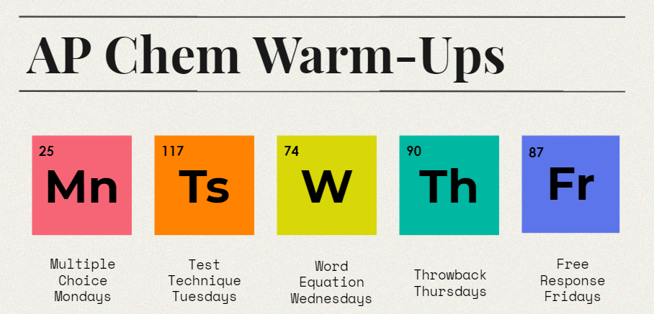
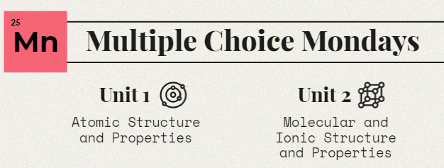
Directions For Use
Home Page
1. Click on a Day/Question Type
2. Click on a Unit or Reaction type
3. You’ll be taken to the first question of the unit*
*An index of questions will be compiled as more are added
Creating Slides

Slide 4
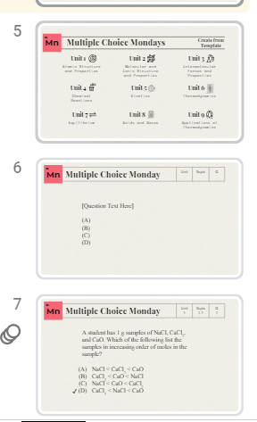
Directions to Create Slides
Home Page
1. Click on a Day/Question Type
2. Click on “Create from Template”
3. Duplicate the template,
then create your slide
4. Drag and Drop your slide to the correct Unit/Topic/Question location

Slide 5
Multiple Choice Monday 3/21
25
Mn
Which of the following process involves an entropy decrease?
melting
dissolving
(C) condensation
(D) sublimation
***Bring in a gallon of distilled water this week for a bonus point on the Ch 19 Test***
Notes:
-DUPLICATE THIS SLIDE BEFORE EDITING.
-Move the check mark next to the correct answer
-Add any answer notes in this section

Slide 6
Multiple Choice Monday 3/14
25
Mn
What is the value of ΔH_{rxn} for the reaction shown below?
H₂ + I₂ → 2HI
(A) 11
(B) -11
(C) 330
(D) -330
Bond | kJ/mol
H-H | 436
I-I | 151
H-I | 299
Notes:
-DUPLICATE THIS SLIDE BEFORE EDITING.
-Move the check mark next to the correct answer
-Add any answer notes in this section

Slide 7
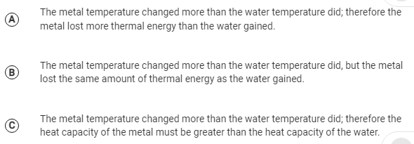
Multiple Choice Monday
25
Mn
6 | 3
✔
Notes:
-DUPLICATE THIS SLIDE BEFORE EDITING.
-Move the check mark next to the correct answer
-Add any answer notes in this section

Slide 8
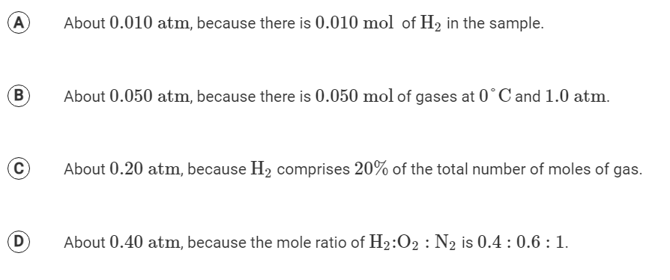
Multiple Choice Monday
25
Mn
✔
✔

Slide 9
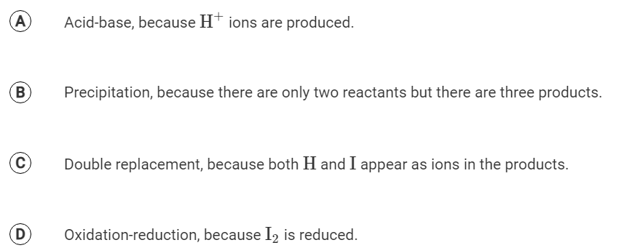
Multiple Choice Monday
25
Mn
4 | 5
✔

Slide 10
Multiple Choice Monday
25
Mn
✔
Notes:
-DUPLICATE THIS SLIDE BEFORE EDITING.
-Move the check mark next to the correct answer
-Add any answer notes in this section

Slide 11
Multiple Choice Mondays
25
Mn

Slide 12
Multiple Choice Monday
25
Mn
4
1. Which of the following experiments led to determining the mass of an electron?
i. Millikan’s oil-drop experiment
ii. Thomson’s cathode ray tube experiment
iii. Rutherford’s gold foil experiment
a. I only
b. II only
c. III only
d. I and II
e. II and III
✔

Slide 13
Multiple Choice Monday
25
Mn
✔

Slide 14
Multiple Choice Monday
25
Mn
2 | 4
Steel is an alloy made by adding small amounts of carbon to iron. The addition of carbon makes the metal lattice more rigid. The alloy is less malleable and ductile than pure iron. Which of the following properties of carbon most accurately explains the behavior of the alloy?
Carbon atoms are harder and more stable than iron atoms
Carbon has four valence electrons, allowing each carbon atom to form bonds with four iron atoms
Carbon nuclei are smaller than iron nuclei and can fit in the spaces between them
The higher electronegativity of carbon attracts electrons away from iron, strengthening metallic bonding
✔
Notes:
-DUPLICATE THIS SLIDE BEFORE EDITING.
-Move the check mark next to the correct answer
-Add any answer notes in this section

Slide 15
Multiple Choice Monday
25
Mn
1 | 1.1 | 1
A student has 1 g samples of NaCl, CaCl₂, and CaO. Which of the following list the samples in increasing order of moles in the sample?
NaCl < CaCl₂ < CaO
CaCl₂ < CaO < NaCl
NaCl < CaO < CaCl₂
CaCl₂ < NaCl < CaO
✔

Slide 16
Multiple Choice Monday
25
Mn
4
Which of the following pairs of substances will NOT react with each other?
Lithium and Lead (II) chloride
Nickel and Copper (II) nitrate
Copper and Silver Nitrate
Zinc and hydrobromic acid

Slide 17
Test Technique Tuesdays
General Exam Overview and Test Taking Techniques
117
Ts

Slide 18
Test Technique Tuesday
117
Ts
[Question Text Here]
(A)
(B)
(C)
(D)
✔
Notes:
-DUPLICATE THIS SLIDE BEFORE EDITING.
-Move the check mark next to the correct answer (or delete for free response)
-Add any answer notes in this section

Slide 19
Test Technique Tuesday 3/15
117
Ts
The enthalpy change for the reaction 2Al(s) + Fe2O3(s)→2Fe(s)+Al2O3(s) is −860 kJ/mol. Based on the standard enthalpies of formation ΔH∘f provided in the table, what is the approximate ΔH∘f for Fe2O3(s)?
Notes:
-DUPLICATE THIS SLIDE BEFORE EDITING.
-Move the check mark next to the correct answer (or delete for free response)
-Add any answer notes in this section

Slide 20
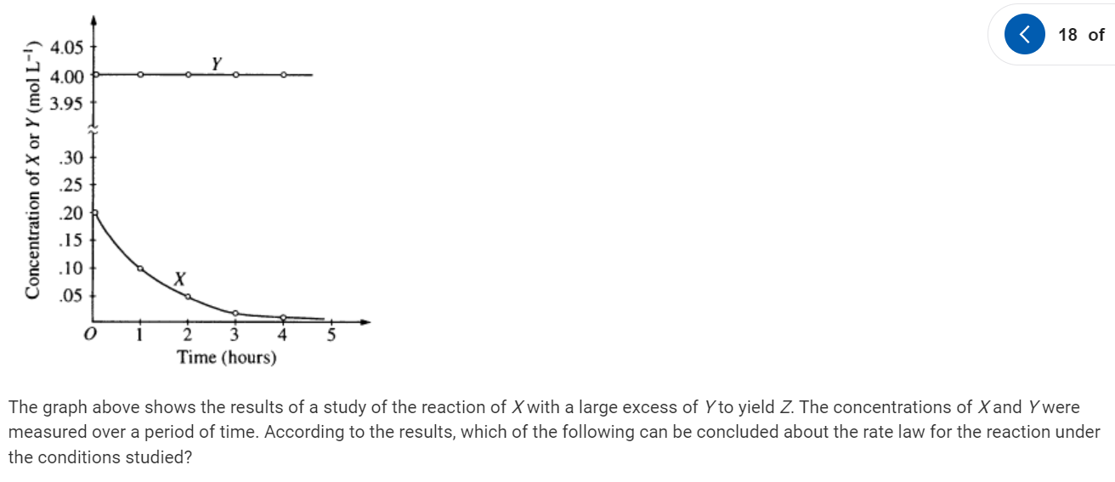
Test Technique Tuesday
117
Ts
5
✔
Notes:
-DUPLICATE THIS SLIDE BEFORE EDITING.
-Move the check mark next to the correct answer (or delete for free response)
-Add any answer notes in this section

Slide 21
Test Technique Tuesday
117
Ts
Should you memorize the equations on the reference sheet?
Yes
No
Only Some
Notes:
-DUPLICATE THIS SLIDE BEFORE EDITING.
-Move the check mark next to the correct answer (or delete for free response)
-Add any answer notes in this section

Slide 22
Test Technique Tuesday
117
Ts
How many times does the college board recommend you pass through the MCQ section?
1
2
3
4
✔
Notes:
https://apstudents.collegeboard.org/courses/ap-chemistry/exam-tips
For even pacing and maximizing your score, try the following strategy:
Examine each question for a maximum of 40 seconds (on the average, some will take less time allowing more time for others, like item sets).
Quickly determine the subject of the question. Remember that there will be some math questions but their solutions will be based on basic calculations, rounding, estimating, and approximation.
By the end of the 40 seconds either:
Mark the correct answer from one of the 4 answer choices.
Mark a “Y” next to the questions that you know how to work but need more time.
Mark an “N” next to the questions that you don’t have any idea how to work.
Force yourself to move through 15 questions each 10 minutes and the full 60 questions in 40 minutes.
Now make a second pass concentrating on the “Y” questions only. Do not spend any time on the “N” questions. If you don’t know the correct answer see if some key piece of knowledge will allow you eliminate 2 or 3 of the choices. Complete this pass in 40 minutes.
Now make your third pass. Focus only on the “N” questions. Attempt to eliminate at least 2 choices. Make an intelligent guess. Any correct “guesses” on this pass are bonus points. You have only 10 minutes, so make it count!
You should try to answer all questions. Remember that there is no penalty for guessing.

Slide 23
Test Technique Tuesday
117
Ts
If you’re feeling frustrated by a question or don’t even know where to start, what should you do?
Notes:
-DUPLICATE THIS SLIDE BEFORE EDITING.
-Move the check mark next to the correct answer (or delete for free response)
-Add any answer notes in this section

Slide 24
Test Technique Tuesday
117
Ts
What do you think the following terms mean to the CB? What would they expect in your answer?
Describe Make a claim
Determine Represent
Explain Justify
Notes:
Describe: Provide the relevant characteristics of a specified topic.
Determine: Make a decision or arrive at a conclusion after reasoning, observation, or applying mathematical routines (calculations).
Explain: Provide information about how or why a relationship, process, pattern, position, situation, or outcome occurs, using evidence and/or reasoning to support or qualify a claim. Explain “how” typically requires
analyzing the relationship, process, pattern, position, situation, or outcome; whereas, explain “why” typically requires analysis of motivations or reasons for the relationship, process, pattern, position, situation, or outcome. Also
phrased as “give one reason.”
Justify: Provide evidence to support, qualify, or defend a claim and/or provide reasoning to explain how that evidence supports or qualifies the claim.
Make a claim: Make an assertion that is based on evidence or knowledge.
Represent/Draw/Write an Equation/Complete a Diagram: Use appropriate graphs, symbols, words, and/or models to describe phenomena, characteristics, and/or relationships.

Slide 25
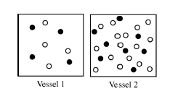
Test Technique Tuesday
117
Ts
If Vessel 1 is 1 M KCl_{(aq)} what could be in Vessel 2?
KCl at higher concentration
CaCl₂ at higher concentration
✔
Notes:
Tip: Don’t count circles! It’s a waste of time. Clearly there are more open circles in Vessel 2 than filled in circles. If your answer choices only include KCl and CaCl₂ the right answer must be a choice with CaCl₂. You don’t need to confirm the actual ratio by counting.

Slide 26
Test Technique Tuesday
117
Ts
How many multiple choice questions are on the exam and how long do you have to take it?
50 questions, 60 minutes
60 questions, 60 minutes
60 questions, 90 minutes
100 questions, 90 minutes
✔

Slide 27
Test Technique Tuesday
117
Ts
How many short FRQs are there? How many long FRQs?
(A) 3 and 4
(B) 4 and 3
(C) 2 and 5
(D) 5 and 2
✔

Slide 28
Test Technique Tuesday
117
Ts
When are you allowed to use your calculator?
MC questions only
FR questions only
MC and FR questions
You are not allowed a calculator for either part
✔

Slide 29
Create from Template
Word Equation Wednesdays
74
W
Synthesis
Decomposition
Single Replacement
Precipitate
Acid/Base
Redox
Combustion

Slide 30
Word Equation Wednesday
74
W
Notes:
-DUPLICATE THIS SLIDE BEFORE EDITING.
-Add any answer notes in this section
-Tip: go to Insert>Special Characters for arrows, etc. → ⇋ Δ

Slide 31
Word Equation Wednesday 3/23
74
W
Write a balanced equation for the reaction between Iron(III) and aqueous copper(II) sulfate. Label oxidation and reduction.
Notes:
-DUPLICATE THIS SLIDE BEFORE EDITING.
-Add any answer notes in this section
-Tip: go to Insert>Special Characters for arrows, etc. → ⇋ Δ

Slide 32
Word Equation Wednesday 3/16
74
W
Write the net ionic equation for the reaction between aqueous solutions of silver nitrate and barium hydroxide.

Slide 33
Word Equation Wednesday
74
W
Balance the half reactions and write the complete reaction. The reaction is taking place in an acidic solution.
MnO₄–(aq) --> Mn²⁺(aq) + H₂O(l)
Fe²⁺(aq) --> Fe³⁺(aq)

Slide 34
Word Equation Wednesday
74
W
Predict the products, write a complete ionic equation and answer the question.
A small piece of sodium metal is added to distilled water.
If the same mass of potassium metal were used, would the moles of product(s) increase, decrease or remain the same? Justify your answer.
Notes:
Na(s) + H2O -> NaOH + H2(g)
2Na(S) + 2H2O(l) --> 2Na+(aq) + 2OH-(aq) + H2(g)
If K were used, moles of product would decrease. K has higher molar mass than Na, therefore equal masses of K and Na would contin less moles of K. Less moles of the reactant K would results in fewer moles of the products.

Slide 35
Word Equation Wednesday
74
W
Solutions of lead(II) nitrate and sodium iodide are mixed.
Write the net ionic equation for the reaction above
Notes:
-DUPLICATE THIS SLIDE BEFORE EDITING.
-Add any answer notes in this section
-Tip: go to Insert>Special Characters for arrows, etc. → ⇋ Δ

Slide 36
Word Equation Wednesday
74
W
Cd(NO₃)_{2(aq)} + Na₂S_{(aq)}→ CdS_{(s)} + 2NaNO_{3(aq)}
Write the complete ionic equation and the net ionic equation for the reaction above
Notes:
-DUPLICATE THIS SLIDE BEFORE EDITING.
-Add any answer notes in this section
-Tip: go to Insert>Special Characters for arrows, etc. → ⇋ Δ

Slide 37
Word Equation Wednesday
74
W
Predict the products, balance the equation and answer the question.
Molten silicon tetrachloride reacts with magnesium metal.
What type of reaction is this?
Notes:
-DUPLICATE THIS SLIDE BEFORE EDITING.
-Add any answer notes in this section
-Tip: go to Insert>Special Characters for arrows, etc. → ⇋ Δ

Slide 38
Word Equation Wednesday
74
W
Solutions of sodium hydroxide and acetic acid are mixed
Acetic acid is a weak acid if equal volumes of acid and base are mixed will the ph= 7, >7, <7
Solid barium oxide is added to distilled water
Is the resulting solution acidic, basic or neutral?
Solid dinitrogen pentoxide is added to water?
Is the final solution acidic, basic or neutral?
Lithium metal is burned in air
Besides synthesis what type of reaction can this be classified as?
A solution of hydrogen peroxide is catalytically decomposed
Name the element being reduced and the element being oxidized
Notes:
-DUPLICATE THIS SLIDE BEFORE EDITING.
-Add any answer notes in this section
-Tip: go to Insert>Special Characters for arrows, etc. → ⇋ Δ

Slide 39
Word Equation Wednesday
74
W
Complete and balance the equation below:
CH₄ + O₂ →
What type of reaction is this?
What is the name of CH₄?
Notes:
CH₄ + 2O₂ → CO₂ + 2H₂O
Combustion
methane

Slide 40
Word Equation Wednesday
74
W
Complete and balance the equation below:
H₂O₂→
What type of reaction is this?
Notes:
2H2O2(aq) => 2DH2O + O2

Slide 41
Throwback Thursdays
90
Th
These will become links as slides are added

Slide 42
Throwback Thursday
90
Th

Slide 43
Throwback Thursday 3/17
90
Th
1
List the following elements by increasing ionization energy:
Iodine, Hydrogen, Iridium, Sulfur

Slide 44
Free Response Fridays
87
Fr

Slide 45
Free Response Friday
87
Fr
TEMPLATE--PLEASE DUPLICATE BEFORE EDITING
Notes:
-DUPLICATE THIS SLIDE BEFORE EDITING.
-Add any answer notes in this section

Slide 46
Free Response Friday 3/18
87
Fr
Explain why the process of breaking chemical bonds is endothermic.
Notes:
-DUPLICATE THIS SLIDE BEFORE EDITING.
-Add any answer notes in this section

Slide 47
Free Response Friday
87
Fr
5

Slide 48
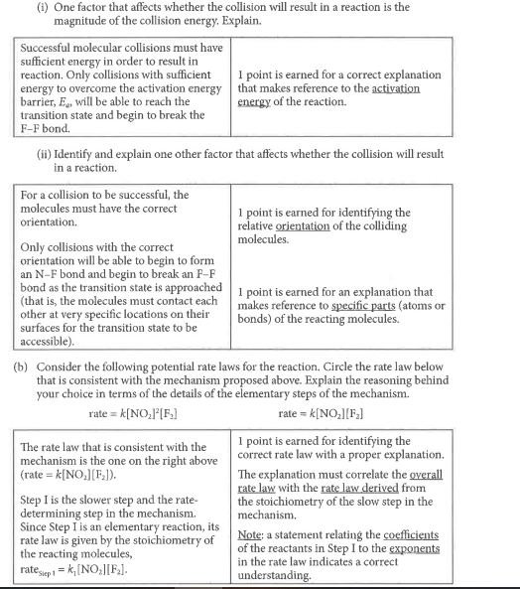
Free Response Friday
87
Fr
TEMPLATE--PLEASE DUPLICATE BEFORE EDITING
Notes:
-DUPLICATE THIS SLIDE BEFORE EDITING.
-Add any answer notes in this section

Slide 49
Free Response Friday
87
Fr
4 4.2
While investigating the chemical and physical properties of metallic element E, a student conducts an experiment by combining E(s) and HBr(aq), which react according to the following equation.
2 E(s) + 2 HBr(aq)→2 EBr(aq) + H2(g)
Write the net ionic equation
1 of 3

Slide 50
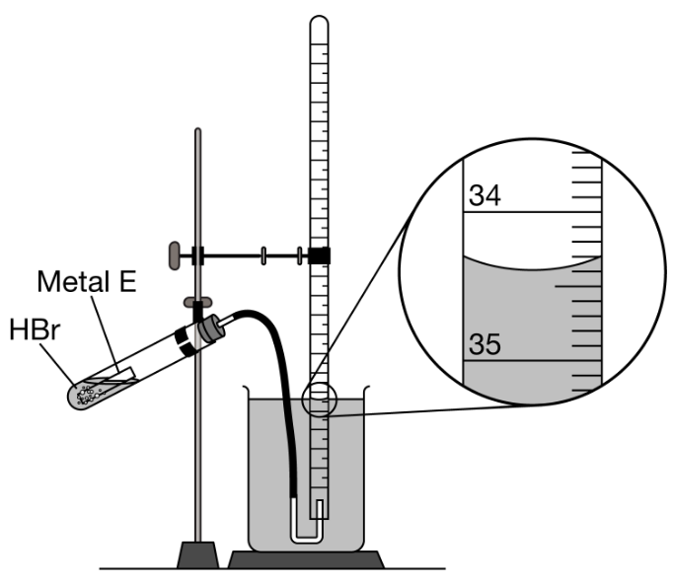
Free Response Friday
87
Fr
4 4.2
10.00 mL samples of HBr(aq) are added to different quantities of E(s) in a closed test tube. At the start of each trial, the gas-collecting tube is filled completely with distilled water. The samples of E(s) react with HBr(aq), and the H2(g) produced is collected in the gas-collecting tube.
The enlarged view of the gas-collecting tube at the end of trial 3 is shown in the diagram. What should the student record as the volume, in mL, of H2(g) collected in trial 3?
2 of 3

Slide 51
Free Response Friday
87
Fr
4 4.5
The data from all three trials are given above. A student claims that HBr(aq) is the limiting reactant in trial 1. Do you agree or disagree? Justify your answer with information in the data table.
3 of 3

Slide 52
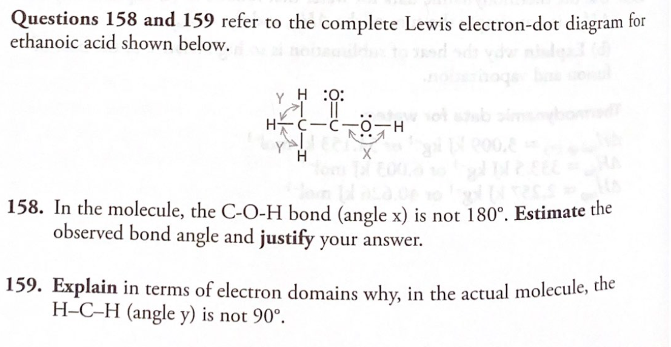
Free Response Friday
87
Fr
2 7

Slide 53
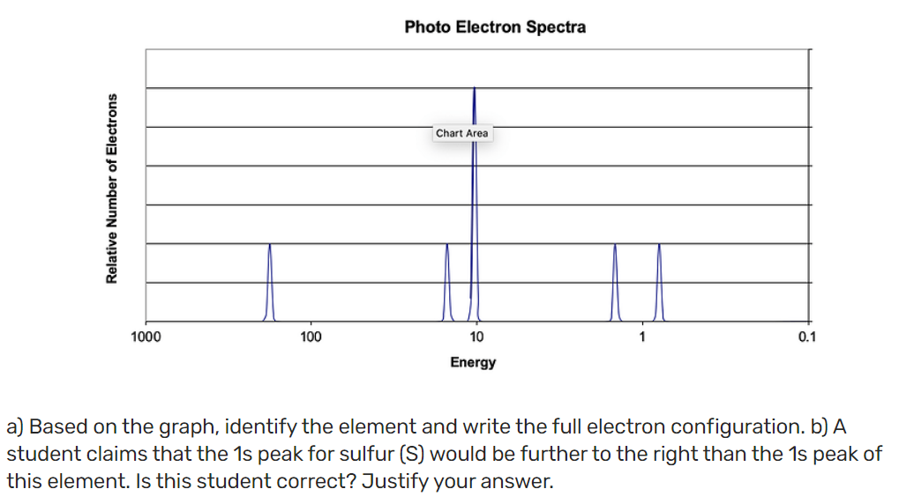
Free Response Friday
87
Fr
1 | 1.6 | 1
Notes:
Source
a) The element is silicon. It has an electron configuration of 1s²2s²2p⁶3s²3p²
b) This student is incorrect. The 1s peak for sulfur would be further to the left on the photoelectron spectra. This is due to the fact that sulfur has more protons in the nucleus and therefore has a greater nuclear charge. This greater positive charge attracts the electrons in sulfur more than in silicon, which would then require more energy to eject the electrons.

Slide 54
Free Response Friday
87
Fr
1 | 1.1 | 2
For parts of the free response question that require calculations, clearly show the method used and the steps involved in arriving at your answers. You must show your work to receive credit for your answer. Examples and equations may be included in your answers where appropriate.
Answer the following questions related to the analysis of CaBr2
(a) A student has a 10.0g sample of CaBr2. Show the setup of the calculation to determine the number of moles of CaBr2 in the sample. Include units in the setup. (You do not need to do any calculations.)
(b) What number, in addition to the answer to part (a), is needed to determine the number of atoms of Ca in the sample?
Notes:
Gives 1 of the following:
1.10g CaBr2 X 1mol CaBr2/199.88g CaBr2= Number of moles of CaBr2 (right side of eq not necessary)
2.1 molol CaBr2/199.88g = xmol CaBr2/10.0g
3.10g CaBr2/ 199.88g CaBr2/mol
(b) the response gives the term “Avogadro’s number” or the value of Avogadro’s number 6.022x10^23 (w/ any number of sig figs

Slide 55
Free Response Friday
87
Fr
1 | 1.1 | 3
In a reaction vessel, 0.600 mol of Ba(NO₃)₂(s) and 0.300 mol of H₃PO₄(aq) are combined with deionized water to a final volume of 2.00L. The reaction represented below occurs.
3 Ba(NO₃ )₂ (aq) + 2 H₃PO₄(aq) → Ba₃(PO₄)₂(s) + 6 HNO₃(aq)
(i) Calculate the mass of Ba₃(PO₄)₂(s) formed.
Notes:
) In a reaction vessel, 0.600 mol of Ba(NO3 ) 2 (s) and 0.300 mol of H3 PO4 (aq) are combined with deionized water to a final volume of 2.00 L. The reaction represented below occurs. 3 Ba(NO3 ) 2 (aq) + 2 H3 PO4 (aq) → Ba3 (PO4 ) 2 (s) + 6 HNO3 (aq) (i) Calculate the mass of Ba3 (PO4 ) 2 (s) formed.

Slide 56
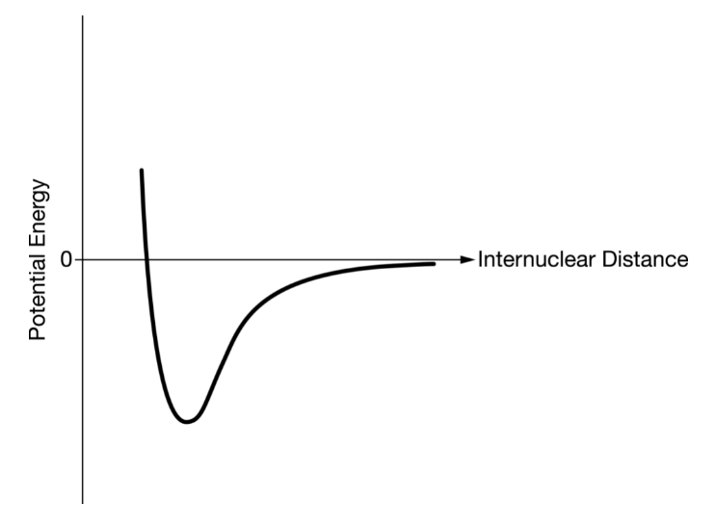
Free Response Friday
87
Fr
2 | 2.1-.2 | 1
Answer the following questions related to the chemical bonding in substances containing Cl.
(a) What type of chemical bond is present in the Cl₂ molecule?
(b) Cl₂ reacts with the element Sr to form an ionic compound. Based on periodic properties, identify a molecule, X₂, that is likely to to react with Sr in a way similar to how Cl₂ reacts with Sr. Justify your choice.
(c) A graph of potential energy versus internuclear distance for two Cl atoms is given below. On the same graph, carefully sketch a curve that corresponds to potential energy versus internuclear distance for two Br atoms.
Notes:
Nonpolar covalent
Any element is group 17. Elements in the same group have similar chemical properties due to them having the same number of valence electrons.
The graph should depict the minimum for the PE to be to the right of that for Cl₂ and with a higher minimum PE.

Slide 57
Free Response Friday
87
Fr
3 4
Molar Mass of a Gas Lab:
Suppose a student recorded the temperature of the room, but then used cold water in their container and graduated cylinder. Would that make the calculated molar mass higher, lower, or have no effect? Justify your answer.
Notes:
If the water temp were lower than what was actually recorded, then the vapor pressure of water used in the partial pressures equation would be too high (Pt = Pvap + Pgas). This would cause the calculated pressure of the gas to be too low. If the gas pressure is lower that will lower the calculated number of moles (n = PV/RT). This will cause an increase in the calculated molar mass (MM = mass/n).

Slide 58
Free Response Friday
87
Fr
4 | 4.5
Water is added to 4.267 grams of UF₆. The only products are 3.730 grams of a solid containing only uranium, oxygen and fluorine and 0.970 gram of a gas. The gas is 95.0% fluorine, and the remainder is hydrogen
From these data, determine the empirical formula of the gas.
What fraction of fluorine of the original compound is in the solid and what fraction in the gas after the reaction?
What is the formula of the solid product?
Write a balanced equation for the reaction between UF₆ and H₂O. Assume that the empirical formula of the gas is the true formula.

Slide 59
Thank You!
Disclaimer: These slides are for personal use only and may not be sold in any form. Design copyrights are the properties of their respective owners and are used here under creative commons permission.
90
Th
19
K
92
U

Slide 60
Additional Resources
chemical reaction by Llisole from the Noun Project
Graph by Bastien Delmare from the Noun Project
Stopwatch by Dmitry Mirolyubov from the Noun Project
equilibrium by PNGEGG
Thermometer by Juraj Sedlák from the Noun Project
acid by Martin from the Noun Project
testing by Shakeel Ch. from the Noun Project
Home by Arif Arif from the Noun Project
sign post by Linker from the Noun Project
4
Be
72
Hl
85
At

Slide 61
Symbols

Slide 62
Fonts & colors used
This presentation has been made using the following fonts:
Playfair Display
(https://fonts.google.com/specimen/Playfair+Display)
Space Mono
(https://fonts.google.com/specimen/Space+Mono)
#1d1d1d
#f2efe8
#d9d1c0
#d8d708
#ff8200
#f66576
#00b7a1
#5c75ea

