Slide 1
IMFs
Chem Club 1/29/2020

Slide 2
IMF Basics
Arise from the attraction or repulsion of charges (temporary dipole, dipole, ion)
Higher IMFs means higher boiling point
Must break IMFs of liquid to boil it

Slide 3
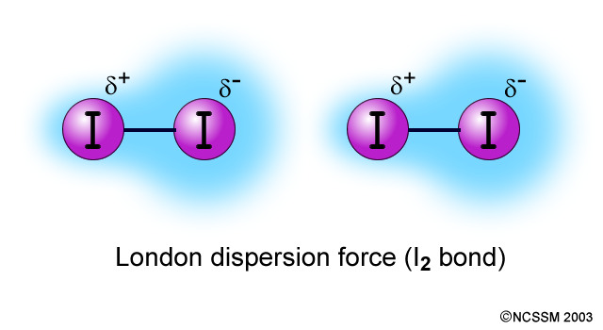
London Dispersion Forces
Electrons in random motion, will sometimes cluster on one side of atom/molecule
Leads to temporary dipole
Temporary dipole induces dipole on neighboring atoms/molecules

Slide 4
London Dispersion Forces, cont.

