Slide 1
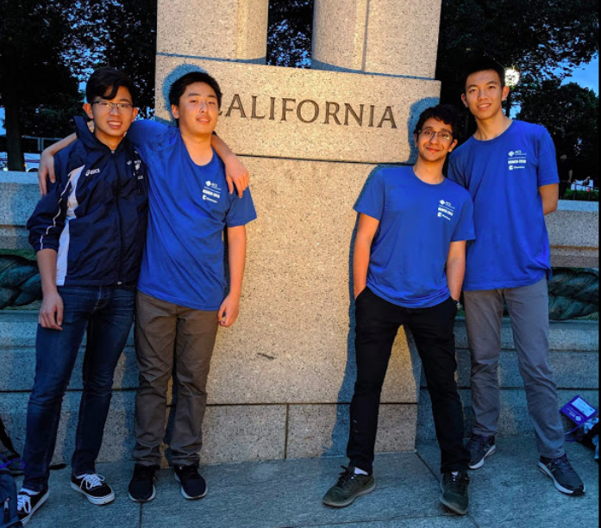
Chemistry Club
2019-20

Slide 2
What do we do?
Yes, this is the ‘Chemistry Olympiad Club’
No, that is not all that we do
Main focuses:
Help with Honors/AP
Labs
Tutoring SAT/AP/whatever standardized chemistry exists
Olympiad

Slide 3
OFFICERS
Dedicated to helping you

Slide 4
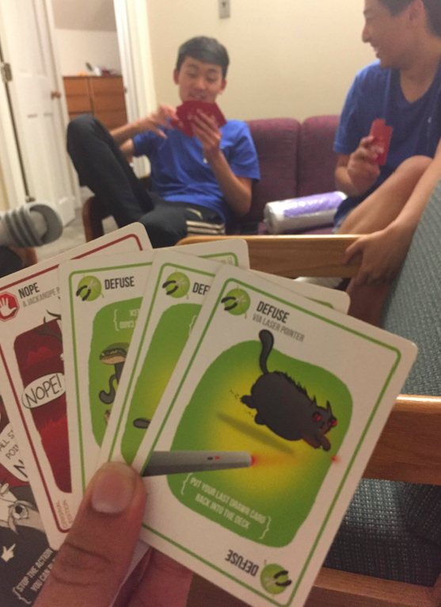
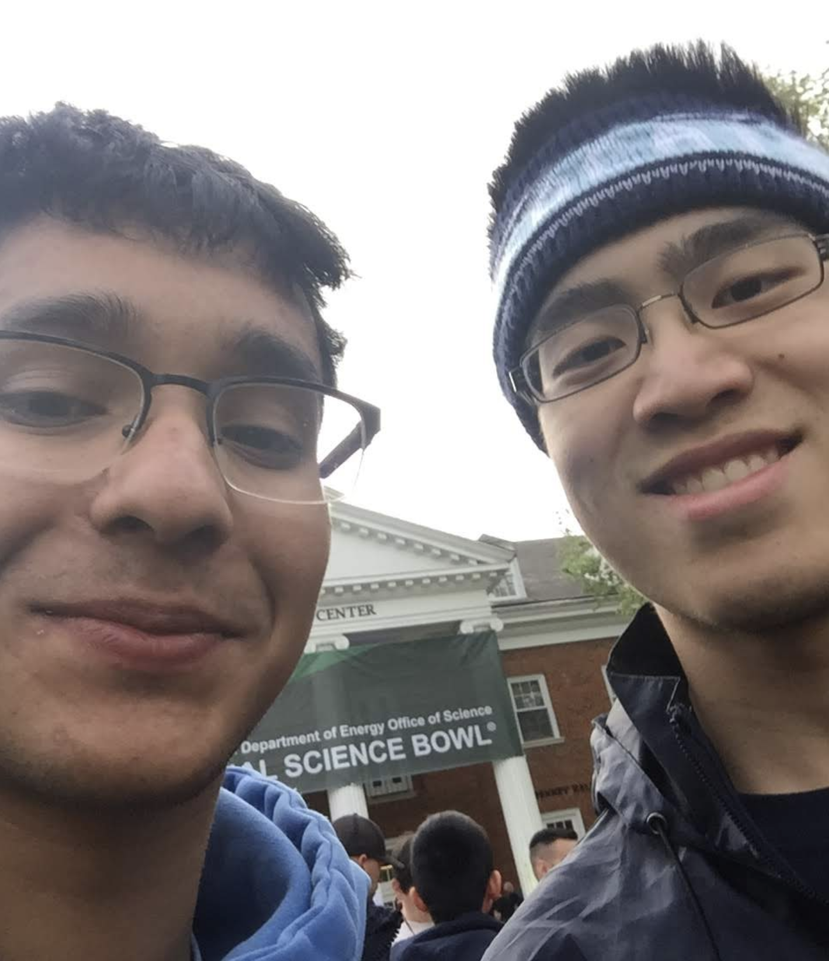
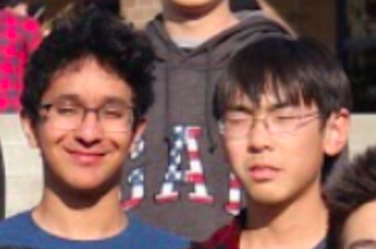
About the Officers - Anugrah
Officer Position: President, Senior
Favorite Reaction: P₂S₅ demethylation
Favorite Subject (besides Chemistry): Astrology
Favorite Class (besides Chemistry): Poetry Memeing (Lit)
Fun Facts:
Likes Hot Cheetos & Caramel Corn
Likes La La Land, Coco, To All The Boys, & Venom
Likes writing about Allusions and making fun of
‘O captain my captain’ in Lit
Interested in ‘Aerodynamically Planar Weapons’

Slide 5
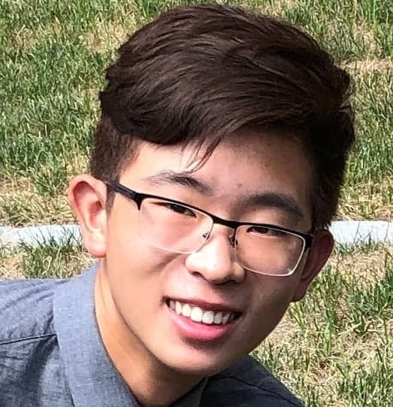
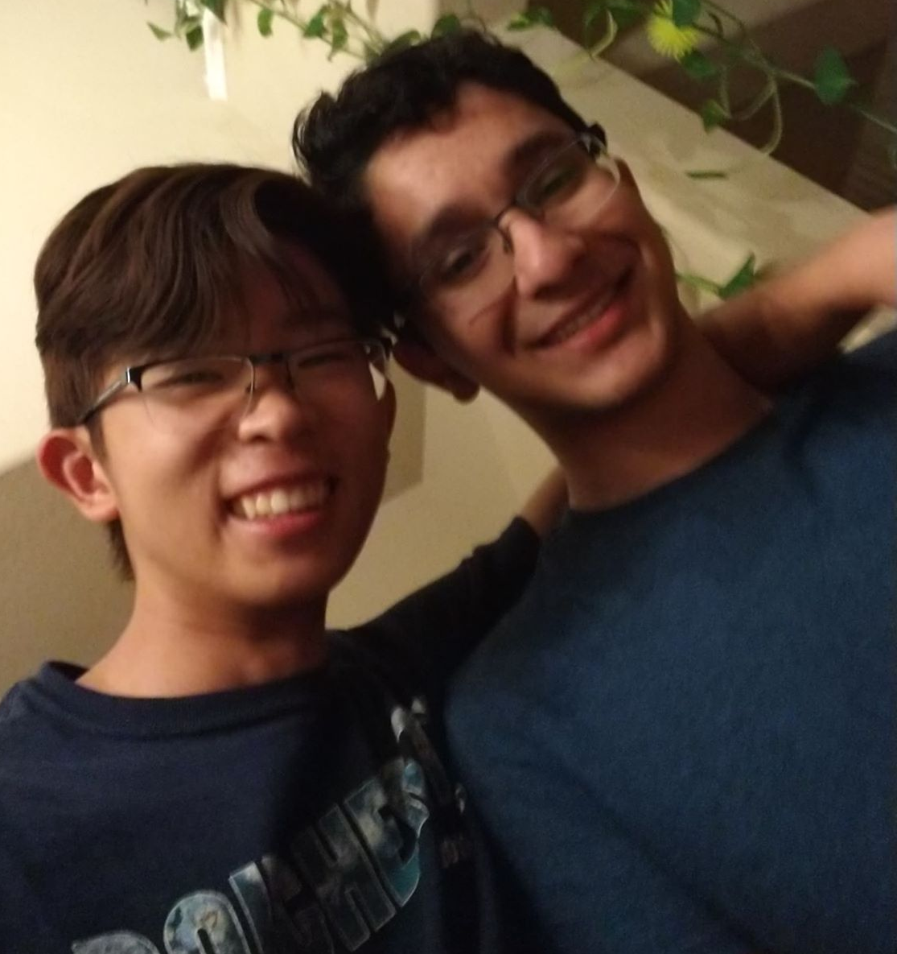
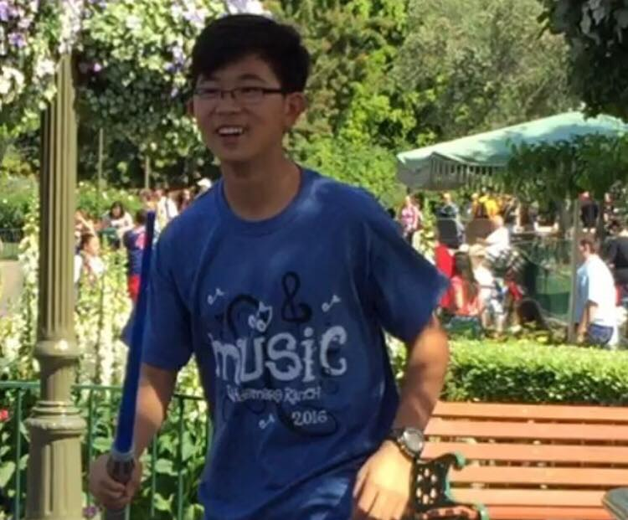
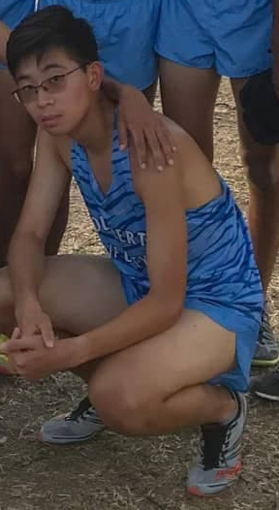
About the Officers - Michael
Officer Position: Vice President, Senior
Favorite Reaction: H₂Cl₂ Decarbonization
Favorite Subject (besides Chemistry): Astrology (Aries)
Favorite Class (besides Chemistry): Journalism
Fun Facts:
Likes bad jokes and terrible references
Die-hard fan of Parts 1 and 2
Is often asleep (except when deadlines are approaching)
(Oh, you’re approaching me?)
Runs cross country and track

Slide 6
About the Officers -Risha
Officer Position: Secretary, Junior
Favorite Reaction: Indigo Carmine Redoxes
Favorite Non-chem subject: BiOlOgY
Favorite Non-chem class: LIT LIT LIT
Fun facts:
NERVE DAMAGE on big toe Uh-Oh
Suprachiasmatic nucleus is constantly whacked
Always 5 days late to the latest greatest MeMe
That jawline tho

Slide 7
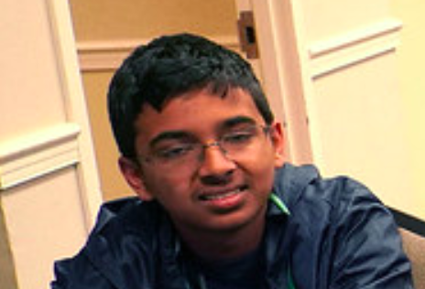
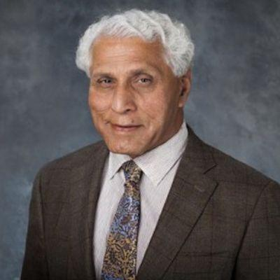
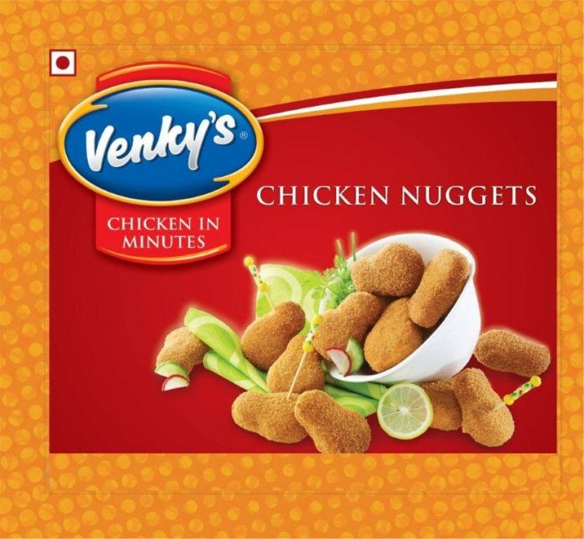
About the Officers - Venkat
Officer Position: Treasurer, Suffer-more
Favorite Reaction: Belousov-Zhabotinsky
Favorite Subject (besides Chemistry): Earth Science
Haha Earth Science isn’t a subject, let alone a science -mh
Favorite Class (besides Chemistry): Euro
Fun Facts:
eArtH SciEnCe iNvOlvEs a LoT oF cHeMIstRy
Venky’s Chicken Nuggets is a thing
The Bergeron process is a cloud droplet formation process occuring in cold clouds
(this guy comes up on google
When you search for my name)

Slide 8
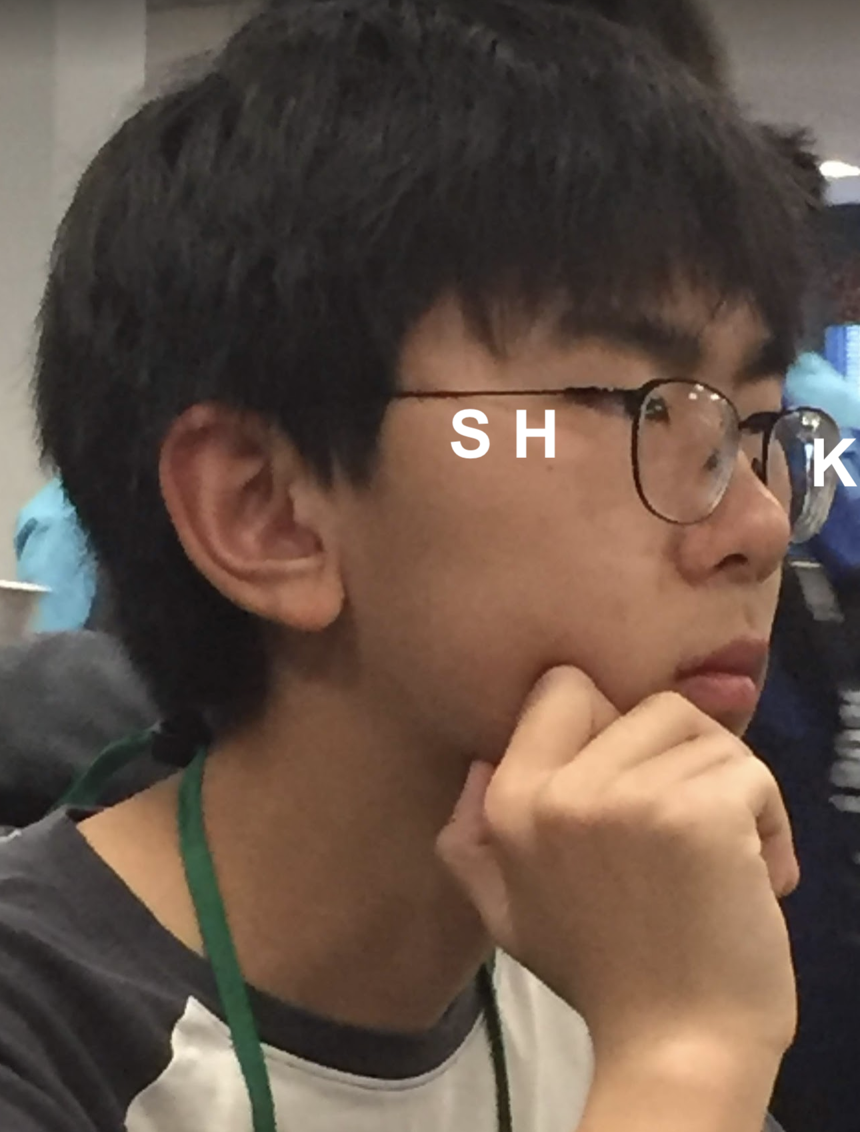
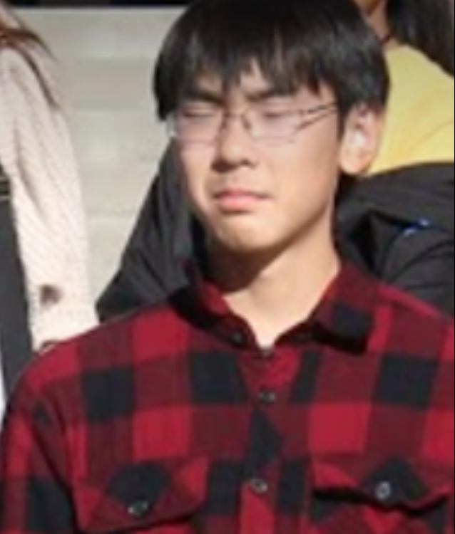
About the Officers - Kenneth
Officer Position: Lab Assistant
Grade: Junior
Favorite Reaction: (undecided)
Favorite Subject (besides Chemistry): CS
Favorite Class (besides Chemistry): AP CS
Fun Facts:
had croissant sandwiches for lunch for the past 10 years
likes programming
likes old video games (sometimes)

Slide 9
REMIND
Text @dvchem1920 to 81010

Slide 10
Meeting Content-Honors/AP School
Wednesday During Lunch 2209 Mr. Estes’ room (This room!)
Specific Details/Meeting Plan will be sent out each week
Meeting content will be tailored to subjects being taught in DV Chemistry classes at that time
Test/Quiz preparation meetings (with practice problems to prepare)
General Lectures on Honors/AP topics (with practice problems to prepare)
Fun activities/games like Jeopardy
Tutoring
Small group tutoring going through school materials/lecture topics with an officer
Members can request topics that the officers will address at the subsequent tutoring meeting

Slide 11
Meeting Content- Advanced
Tuesday After School 2209 Mr. Estes’ room (This room!)
General Topics & Content
Advanced Kinetics, Thermodynamics, Equilibrium etc.
Lab Demonstrations and Discussion of underlying chemistry
Problem Solving Techniques (very useful!)
Meeting Style
Lectures by Officers about theoretical topics
Lab Demonstrations with accompanying presentations
Practice Problems and Fun Contests of varying difficulty with small prizes

Slide 12
LABS
This year we will have hands on lab activities
During ‘Advanced meetings’ we will be holding open-ended lab activities where you attempt to solve a chemistry related problem
Build problem solving skills
Anyone can participate (not just for ‘advanced’)
Fun chance to relax and explore a laboratory setting

Slide 13
Chemistry Olympiad (USNCO)
An annual national competition that involves thousands of chemists and is composed of a local and national examination followed by a two week boot camp to select the team for the International Chemistry Olympiad.
3 Levels (Local, National, Study Camp)
Covers topics from throughout AP chemistry at a higher level
Lots of fun to participate in and learn cool stuff!
Past Experience (ask us questions!)

Slide 14
REMIND(er) again...
Text @dvchem1920 to 81010

Slide 15
Weak-ly Nucleophile
In Honors Chemistry we learn how to compute the pH of the solution of a weak acid such as Acetic Acid (Ka=1.8 x 10⁻⁵) using an ICE table. What if we have more than one acid in solution?
Consider a 1 L solution that has 0.1 mol of Acetic Acid, and 0.1 mol of Nitrous Acid (Ka=7.2 x 10⁻⁴)
What is the pH of this solution?

