Slide 1
Gases and Solutions

Slide 2
Gas Properties and Kinetic Molecular Theory(know it!)
Particles of matter are ALWAYS in motion
Volume of individual particles is ≈ zero.
Collisions of particles with container walls cause pressure exerted by gas.
Particles exert no forces on each other.
Average kinetic energy ∝ Kelvin temperature of a gas.
Describe properties of ideal gases
Pressure is caused by the collisions of molecules with the walls of a container
Compressible and expand to fill container
Fluid

Slide 3
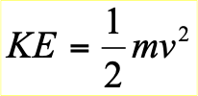
Ideal Gases
Gases consist of tiny particles that are far apart relative to their size.
Collisions between gas particles and between particles and the walls of the container are elastic collisions (no kinetic energy loss in collisions).
Gas particles are in constant, rapid motion. They therefore possess kinetic energy, the energy of motion
There are no forces of attraction between gas particles
The average kinetic energy of gas particles depends on temperature, not on the identity of the particle.

Slide 4
Gas Laws
Gases occupy 22.4 L at STP(1 atm/760 torr, 0 C/273 K)
Boyle’s Law: P₁V₁= P₂V₂
Charles’ Law: V₁/T₁ = V₂/T₂
Gay-Lussac’s Law: P₁/T₁ = P₂/T₂
Combined gas Law: P₁V₁/T₁ = P₂V₂/T₂
Avogadro’s Law: V₁/n₁ = V₂/n₂
Dalton’s Law of Partial Pressure: P_{Total} = P₁ + P₂ + P₃ + . . .
Ideal gas law: PV = nRT (R = 0.08206 L atm/ mol·Κ (this class), 8.314 L Kpa/ mol·Κ, 62.4 L mmHg/ mol·Κ)

Slide 5
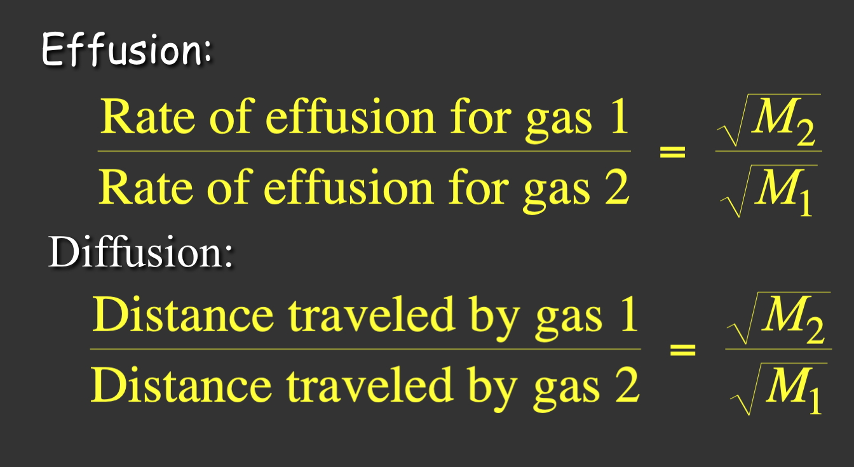
Effusion and Diffusion Laws
Diffusion: gas mixing -> rate of diffusion is rate of gas mixing
Effusion: passage of gas into an evacuated chamber

Slide 6
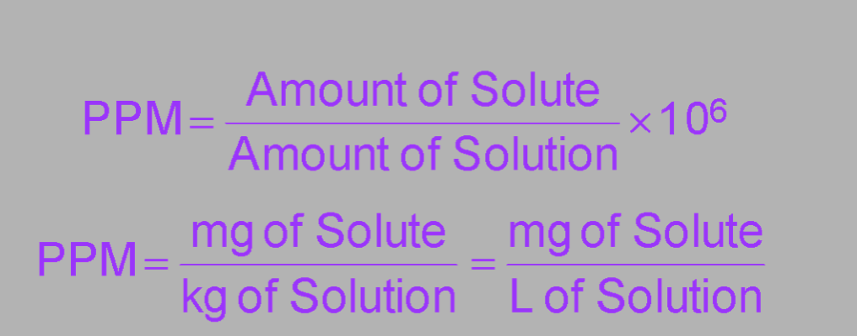
Solutions
X_{a} =
Solutions: solutes dissolved in solvents
Described by type of solute, solvent, and concentration

Slide 7
Heat of Solution
For the solvent and solute to mix you must overcome
1. all of the solute–solute attractive forces, or
2. some of the solvent–solvent attractive forces.
Both processes are endothermic
At least some of the energy to do this comes from making new solute–solvent attractions, which is exothermic.

Slide 8
Solution Formation Depends On...
Nonpolar solutes dissolve best in nonpolar solvents
Polar and ionic solutes dissolve best in polar solvents
Negative value of ΔH_{sol’n}
Increase entropy
For positive values of ΔH_{sol’n} it is the increase in entropy that outweighs the increase in energy and causes the solution process of occur
The solubility of MOST solids increases with temperature.
The rate at which solids dissolve increases with increasing surface area of the solid.
The solubility of gases decreases with increases in temperature.
The solubility of gases increases with the pressure above the solution.

Slide 9
Saturation
A solution that has the solute and solvent in dynamic equilibrium is said to be saturated.
If you add more solute it will not dissolve.
The saturation concentration depends on the temperature and pressure of gases.
A solution that has less solute than saturation is said to be unsaturated.
More solute will dissolve at this temperature.
A solution that has more solute than saturation is said to be supersaturated.

Slide 10
Solution Laws
Henry’s Law: The solubility of a gas (S_{gas}) is directly proportional to its partial pressure, (P_{gas}). k is Henry’s Constant
S_{gas} = k_{H}P_{gas}
Raoult’s Law: The difference between the vapor pressure of the pure solvent and the vapor pressure of the solvent in solution is called the vapor pressure lowering.

Slide 11
Ideal Solution and Deviations
Liquid-liquid solution that obeys Raoult's law
a. No solution is perfectly ideal, though some are close
2. Negative deviations from Raoult's law (lower than predicted vapor pressure for the solution)
a. Solute and solvent are similar, with strong forces of attraction
b. ΔHsol'n is large and negative
3. Positive deviations from Raoult's law (higher than predicted vapor pressure for the solution)
a. Solute and solvent are dissimilar, with only weak forces of attraction
b. Particles easily escape attractions in solution to enter the vapor phase

Slide 12
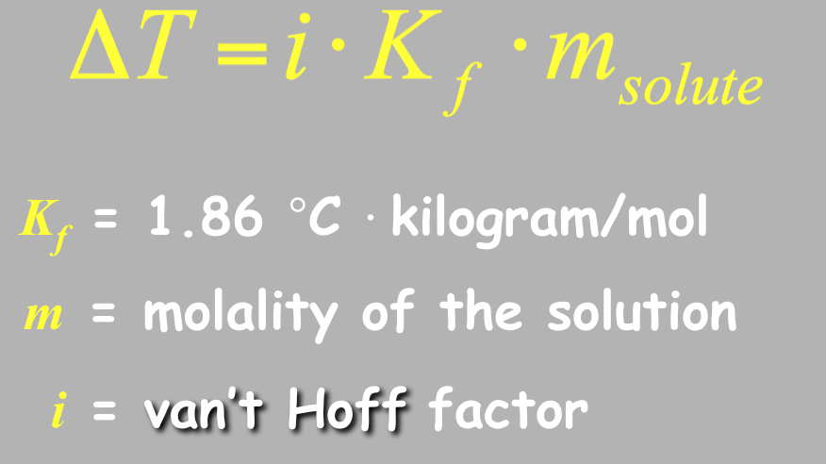
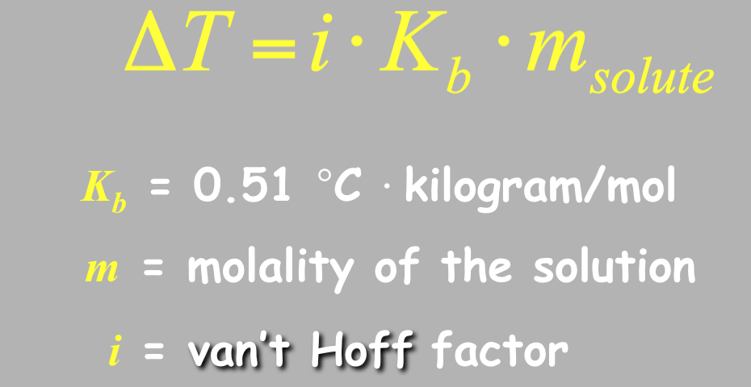
Colligative Properties
Freezing point Depression:
Boiling Point Elevation
Osmotic Pressure

