Slide 1
Video Instructions if Interested
https://youtu.be/FkEX56_sZOk

Slide 2
Crash Course: N1 - Honors Chem Review
Basics and Atomic Structure
Nuclear Chemistry
Electrons
Periodic Table
Bonding and Structure
Reactions
Stoich.
Advanced Chemical Ratios
Gas Laws
Thermo.
Solutions
Kinetics
Equilibrium
Acids and Bases
Redox

Slide 3
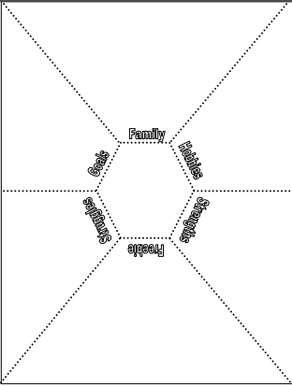
How to set up your composition notebook
Your notebook should look like this so far...
Safety Notes
Should be notes on safety video and safety contract
Page 1
Page 2
Page 3

Slide 4
How to set up your composition notebook
Add a bold, obvious, underlined title to the top of your page 3. “N1 – Crash Course Review of Honors Chem”
N1 - Crash Course Review of Honors Chem
Safety Notes
Page 1
Page 2
Page 3

Slide 5
How to set up your composition notebook
In RED pen, add the “Target” under the title “Target: I can review Honors Chemistry Topics
N1 - Crash Course Review of Honors Chem
Safety Notes
Target: I can review Honors Chemistry Topics
Page 1
Page 2
Page 3

Slide 6
You will divide Pages 3 – 9 in half
You can use the top and side margin space!
N1 - Crash Course Review of Honors Chem
Safety Notes
Target: I can review Honors Chemistry Topics
Page 1
Page 2
Page 3

Slide 7
You will divide Pages 3 – 9 in half
You can use the top and side margin space!
Page 4
Page 5
Page 6
Page 7

Slide 8
You will divide Pages 3 – 9 in half
Title Page 10 “#15 - Summer Assignment Topics”
#15 – Summer Assignment Topics
Leave blank for now!
Page 8
Page 9
Page 10
Page 11

Slide 9
Now you will label the boxes so you have one box per chapter taught in Honors Chemistry
#1 – Basics and Atomic Structure | #8 – Advanced Chemical Ratios
#2 – Nuclear Chemistry | #9 – Gas Laws
#3 – Electrons | #10 – Thermochemistry
#4 – Periodic Table | #11 – Solutions
#5 – Bonding and Structure | #12 – Kinetics
#6 – Reactions | #13 – Equilibrium
#7 – Stoichiometry | #14 – Acids and Bases
 | #15 – Summer Assignment Topics

Slide 10
Now you will label the boxes so you have one box per chapter taught in Honors Chemistry
Example shown →
Chapter #’s and Titles on the next slide for you to finish.
All boxes pages 3-10 should end up with Chapter #’s and Titles
N1 - Crash Course Review of Honors Chem
Safety Notes
Target: I can review Honors Chemistry Topics
#1 – Basics & Atomic Structure
#2 – Nuclear Chem
Page 2
Page 3

Slide 11
Time for some self guided review notes!
The rest of this PowerPoint has screen shots of key pieces of information from the Honors Chem Lectures.
Please scroll through and jot down notes into your composition book, in the boxes that match the chapter.
You do NOT need to take super detailed notes on every little thing. This is just a place to jog your memory, write down key equations you might want to remember, etc. Do NOT panic that this PowerPoint is almost 300 slides long! ☺
If you find that you need MORE info on a topic, then use the class website to pull up the full lecture, or even rewatch lectures on my YouTube Channel. www.mychemistryclass.net
You will have until the end of the 3rd week of school to complete this assignment. Chip away at it here and there.

Slide 12
*Note about remote learning impacts on topics covered
In March 2020 school transitioned to “Remote Learning”
Due to the school closing in March 2020 some topics were not covered in as much detail as a normal year, or not covered at all.
Therefore two years of Honors Chem students did not cover the topics needed to start AP Chem like normal.
All required topics are talked about on the Summer Assignment so you should be caught up.
Items marked with a (*) were not covered in class during the 2019-2020 school year due to school closing in March 2020.
Items marked with a (**) were not covered in the 2020-2021 school year due to “remote teaching” limiting what we could cover because of reduced instructional minutes.

Slide 13
Unit #1 Chemistry Basics and Atomic Structure
Scientific notation
Metric system
Dimensional analysis
Significant figures
Chemical/Physical properties/changes
Types of matter
Atomic numbers and Isotopes
Models of the atom
Average Atomic Mass Calculations

Slide 14
Scientific Notation
Jump back to title slide

Slide 15
Metric System
Jump back to title slide

Slide 16
Metric System
Jump back to title slide

Slide 17
Derived Units
Jump back to title slide

Slide 18
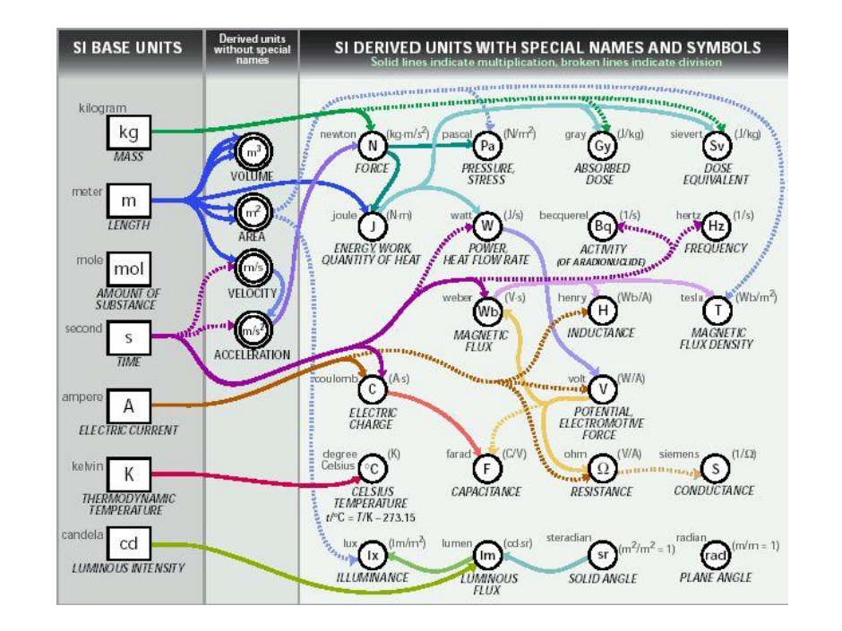
Derived Units
Jump back to title slide

Slide 19
Dimensional Analysis
Jump back to title slide

Slide 20
Dimensional Analysis
Jump back to title slide

Slide 21
Dimensional Analysis
Jump back to title slide

Slide 22
Dimensional Analysis
Jump back to title slide

Slide 23
Significant Figures
Jump back to title slide

Slide 24
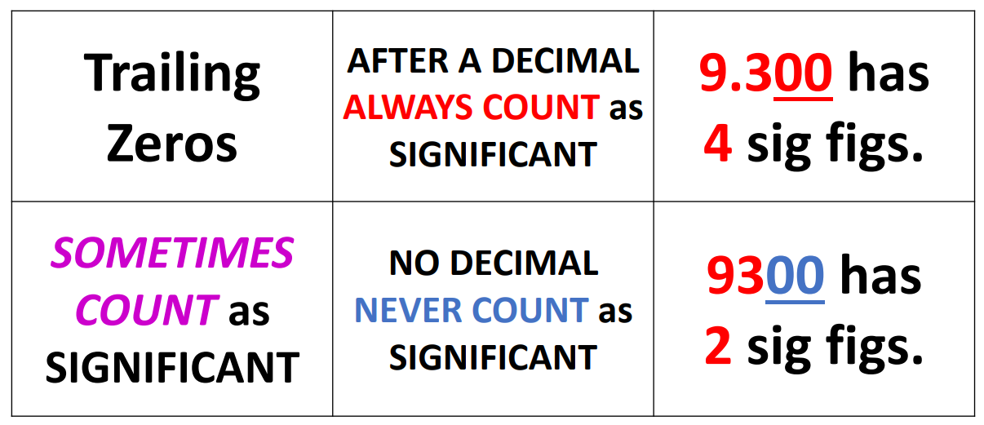
Significant Figures
Jump back to title slide

Slide 25
Significant Figures
Jump back to title slide

Slide 26
Properties and Changes
Jump back to title slide

Slide 27
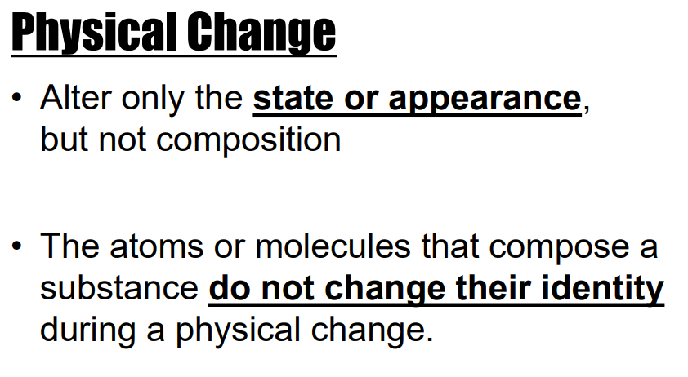
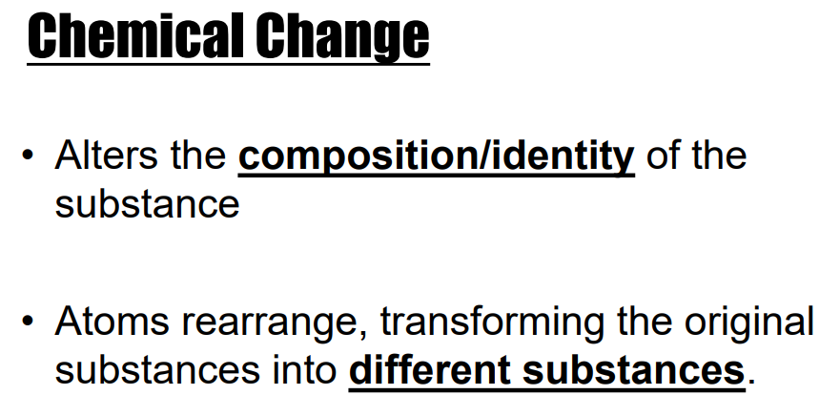
Properties and Changes
Jump back to title slide

Slide 28
Types of Matter
Jump back to title slide

Slide 29
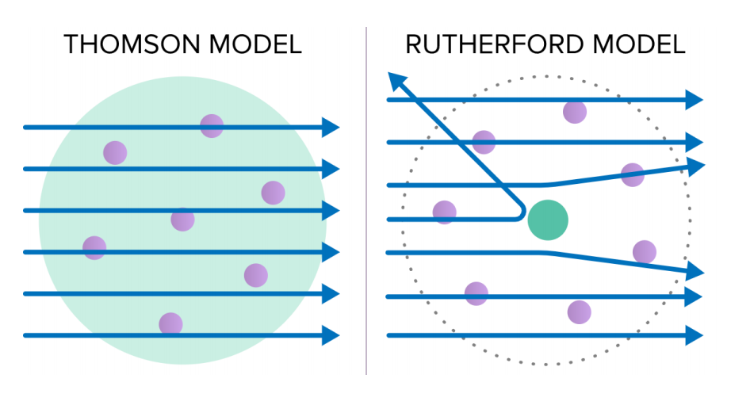
Atomic Models
Jump back to title slide

Slide 30
Atomic Numbers
Jump back to title slide

Slide 31
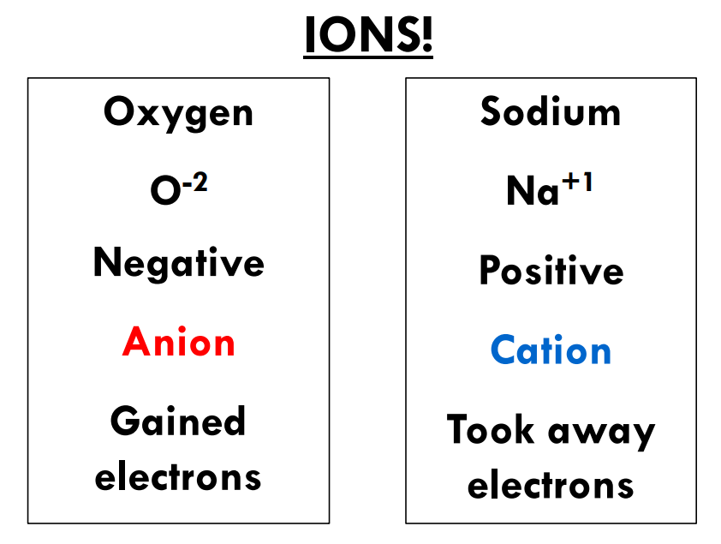
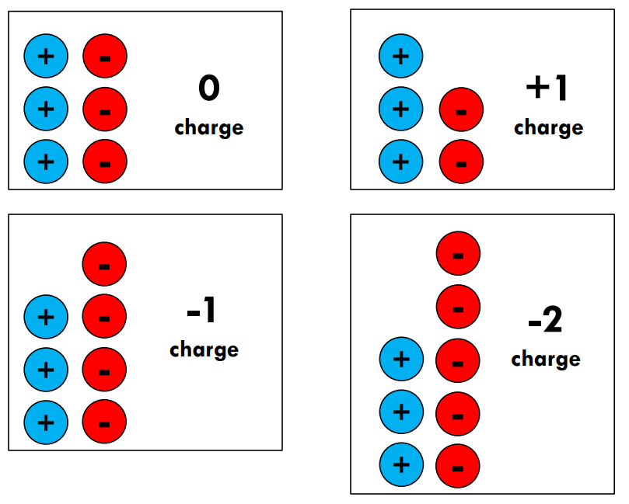
Atomic Numbers
Jump back to title slide

Slide 32
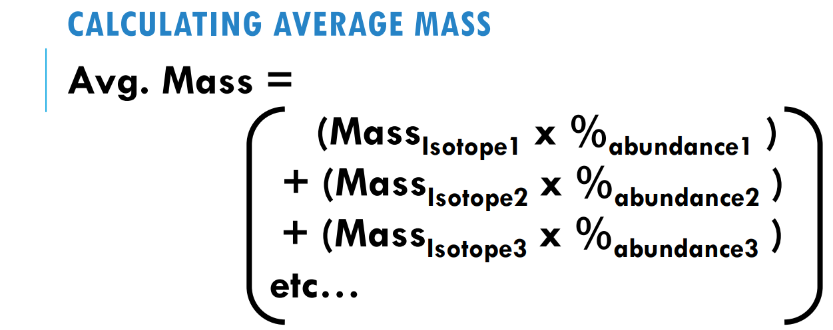
Average Mass Calcs.
Jump back to title slide

Slide 33
Average Mass Calcs.
Jump back to title slide

Slide 34
Unit #2 Nuclear Chemistry
**
Why things are radioactive
Types of radioactive particles
Writing and balancing nuclear equations
Decay series
Half Life

Slide 35
Nuclear Chemistry
Jump back to title slide

Slide 36
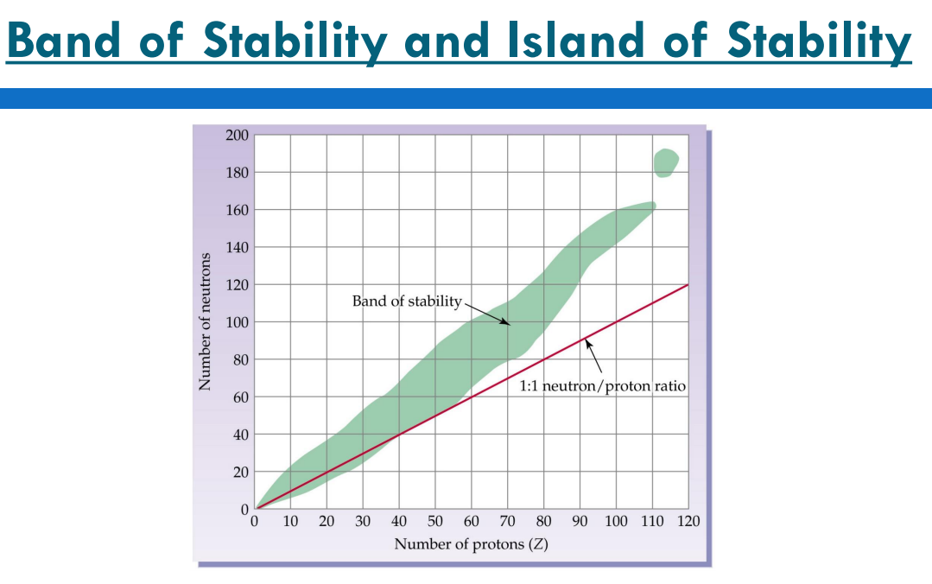
Nuclear Chemistry
Jump back to title slide

Slide 37
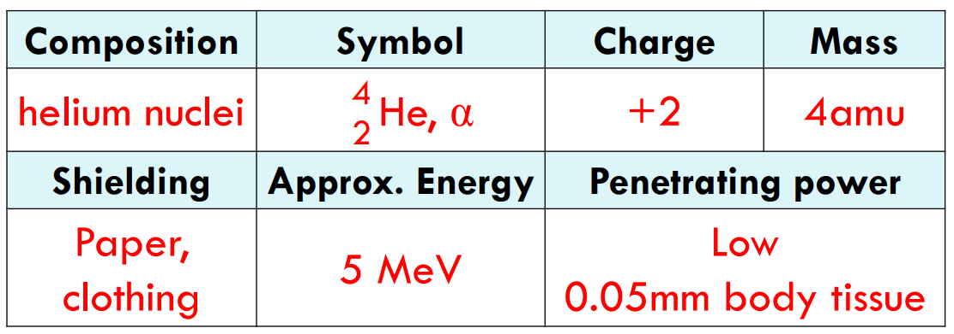
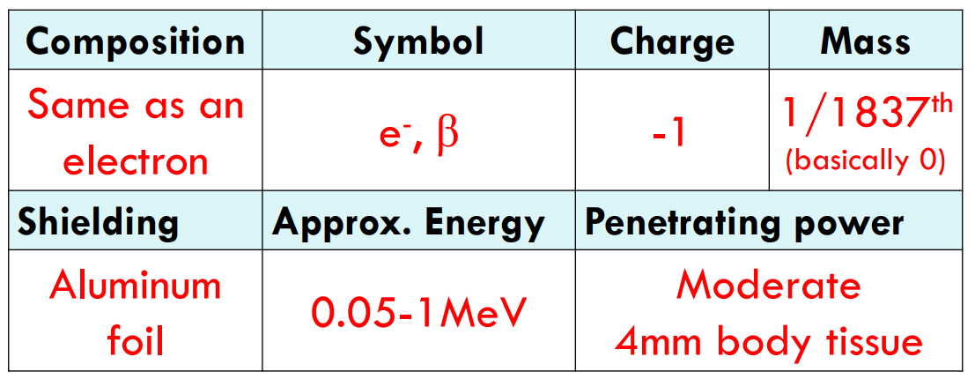
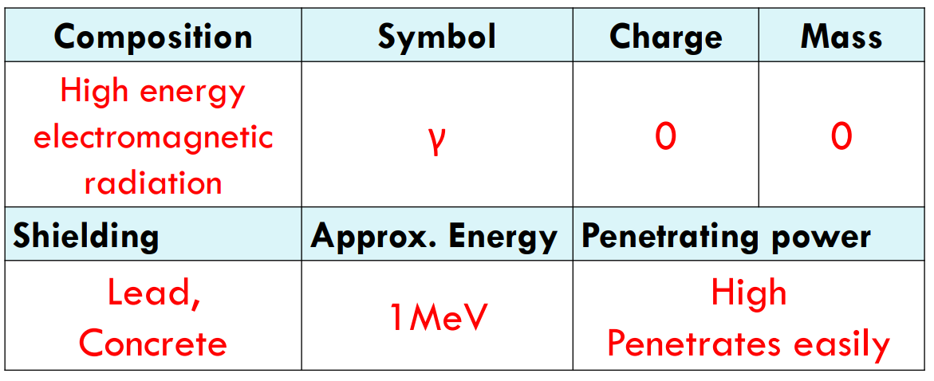
Radioactive particles
Jump back to title slide
Alpha
Beta
Gamma

Slide 38
Writing Nuclear Equations
Alpha
Jump back to title slide
Beta

Slide 39
Writing Nuclear Equations
Jump back to title slide

Slide 40
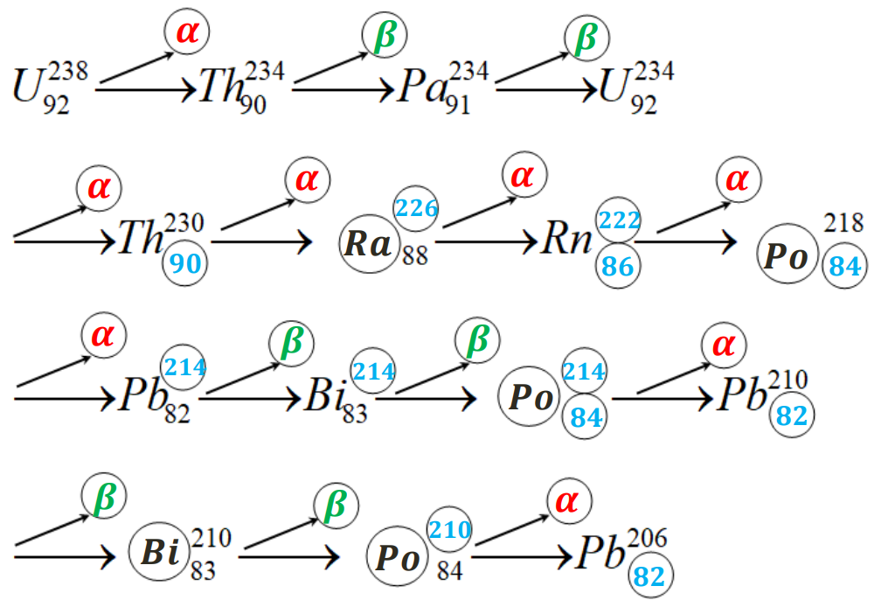
Decay Series
Jump back to title slide

Slide 41
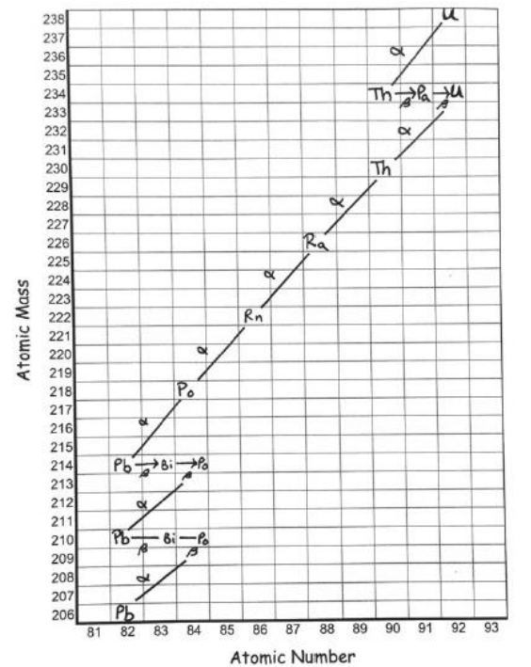
Decay Series
Jump back to title slide

Slide 42
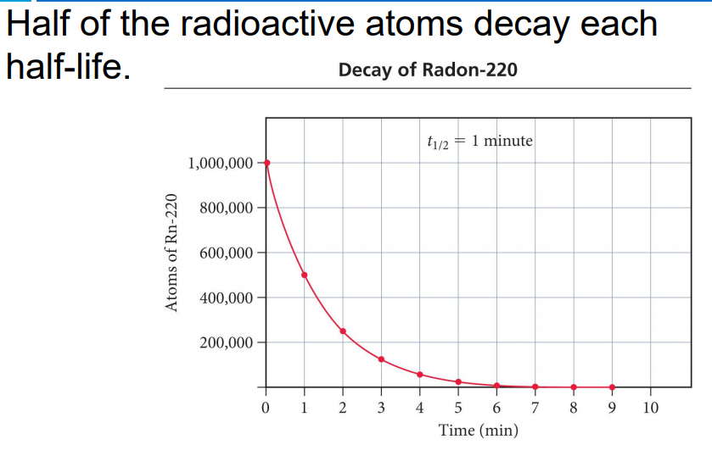
Half Life
Jump back to title slide

Slide 43
Half Life
Jump back to title slide

Slide 44
Half Life
Jump back to title slide

Slide 45
Half Life
Jump back to title slide

Slide 46
Unit #3 Electrons
Quantum mechanical theory
Orbital diagrams
Writing electron configurations
Noble Gas configuration
Configuration of ions
Absorption and emission

Slide 47
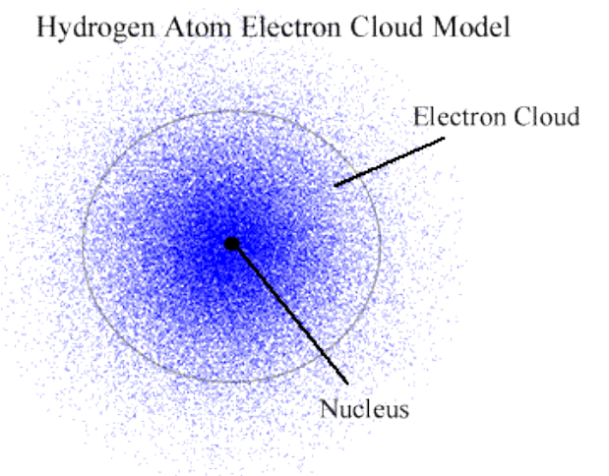
Quantum Mechanical Model
Jump back to title slide

Slide 48
Orbital Diagrams
Jump back to title slide

Slide 49
Orbital Diagrams
Jump back to title slide

Slide 50
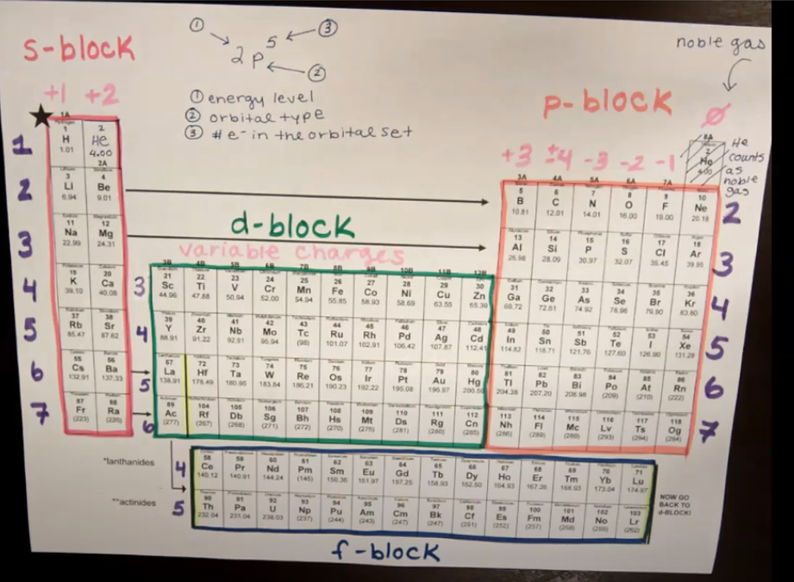
Writing Electron Config.
Jump back to title slide

Slide 51
Noble Gas Config.
Jump back to title slide

Slide 52
Config. of Ions
Jump back to title slide

Slide 53
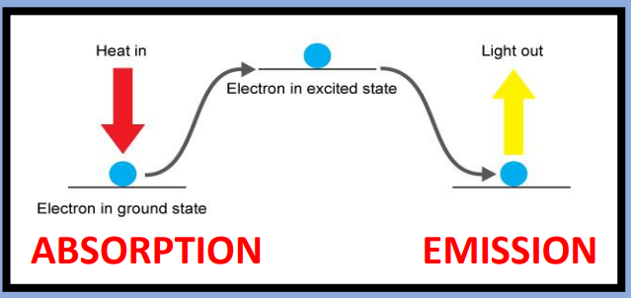
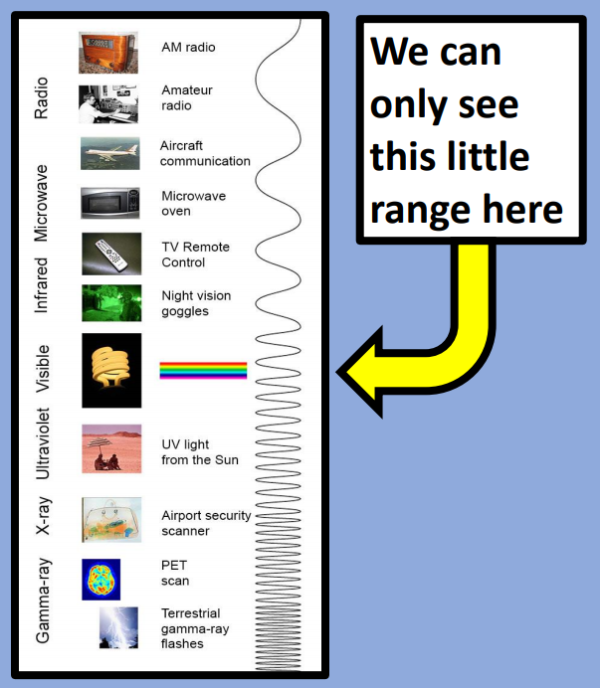
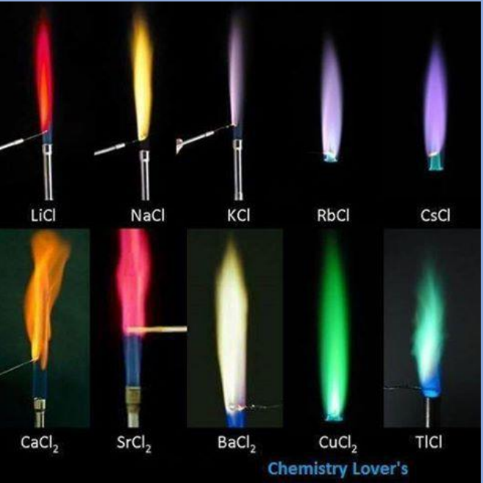
Absorption and Emission
Jump back to title slide

Slide 54
Unit #4 Periodic Table
Structure of the periodic table
Periodic trends

Slide 55
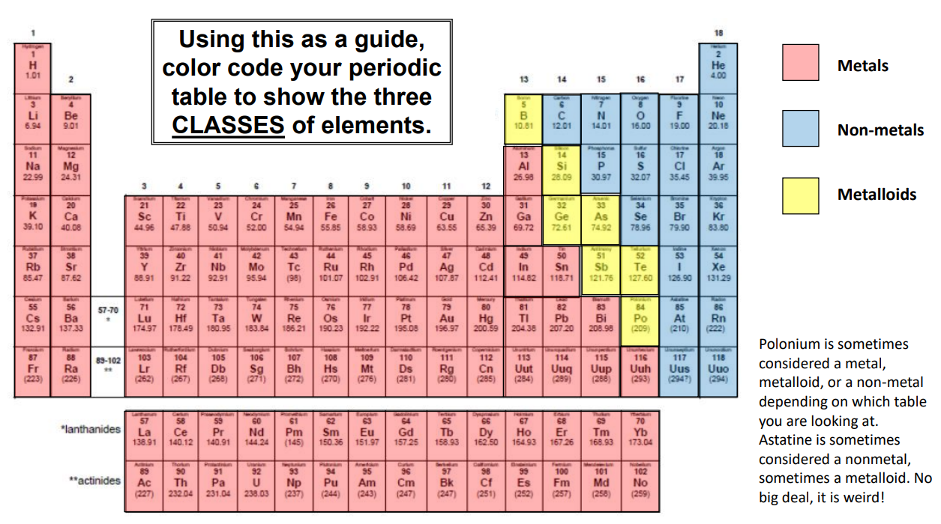
Periodic Table Structure
Jump back to title slide

Slide 56
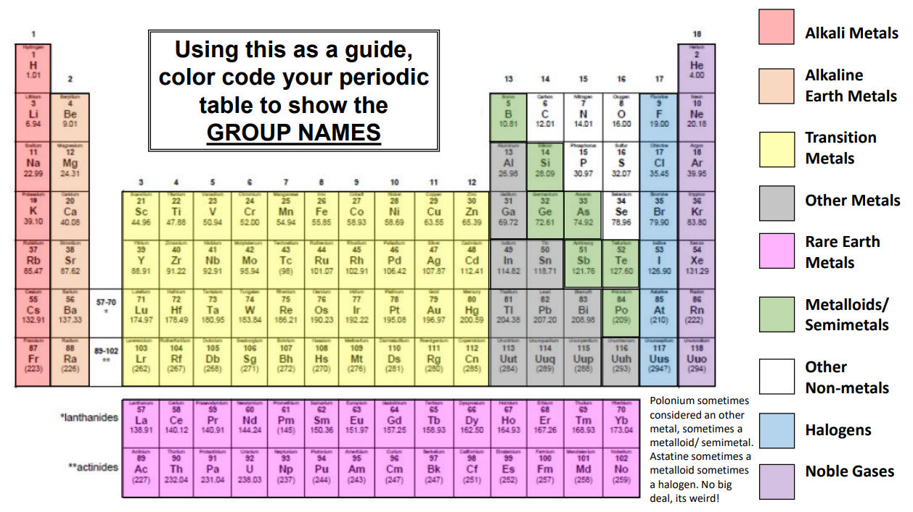
Periodic Table Structure
Jump back to title slide

Slide 57
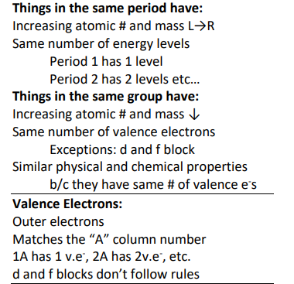
Periodic Table Structure
Jump back to title slide

Slide 58
Periodic Trends
Jump back to title slide

Slide 59
Periodic Trends
Jump back to title slide

Slide 60
Periodic Trends
Jump back to title slide

Slide 61
Periodic Trends
Jump back to title slide

Slide 62
Periodic Trends
Jump back to title slide

Slide 63
Periodic Trends
Jump back to title slide

Slide 64
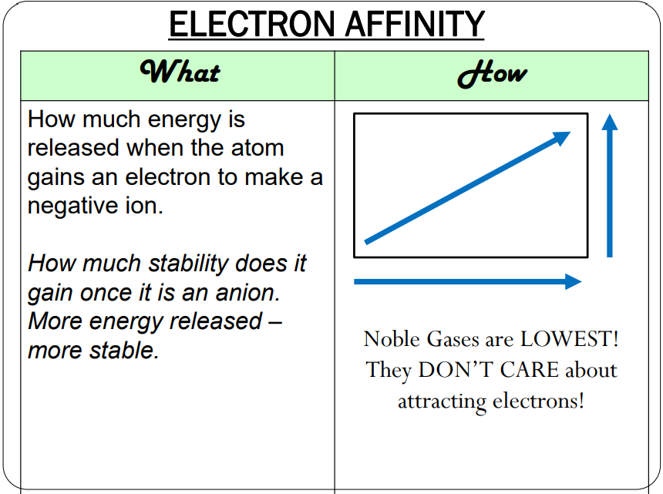
Periodic Trends
Jump back to title slide

Slide 65
Periodic Trends
Jump back to title slide

Slide 66
Periodic Trends
Jump back to title slide

Slide 67
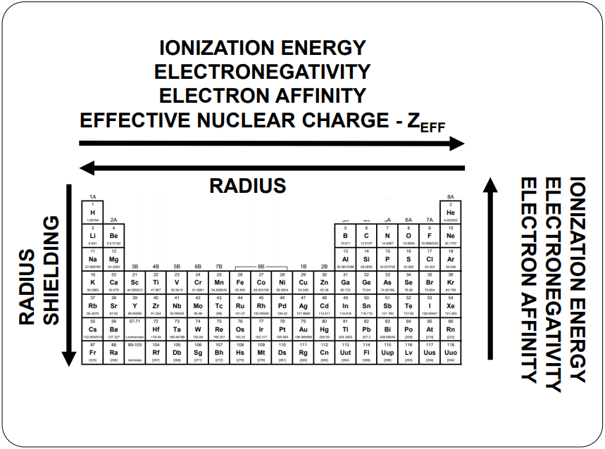
Periodic Trends
Jump back to title slide

Slide 68
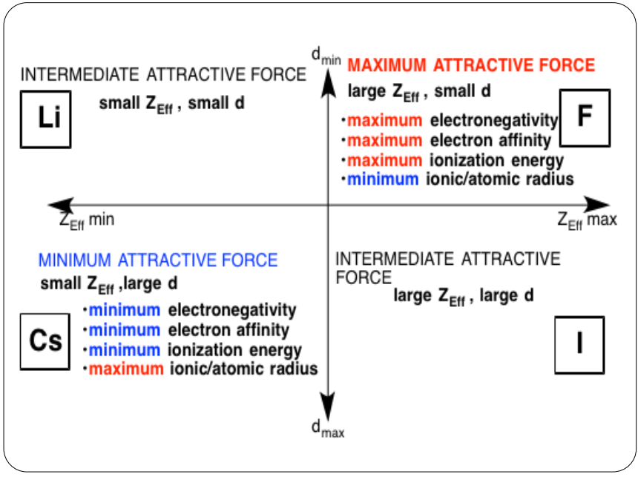
Periodic Trends
Jump back to title slide

Slide 69
Unit #5 Bonding and Structure
Why bonds form
Types of bonds
Naming formulas
Writing neutral formulas
Lewis structures
VSPER
Hybridization
Polarity
Intermolecular forces

Slide 70
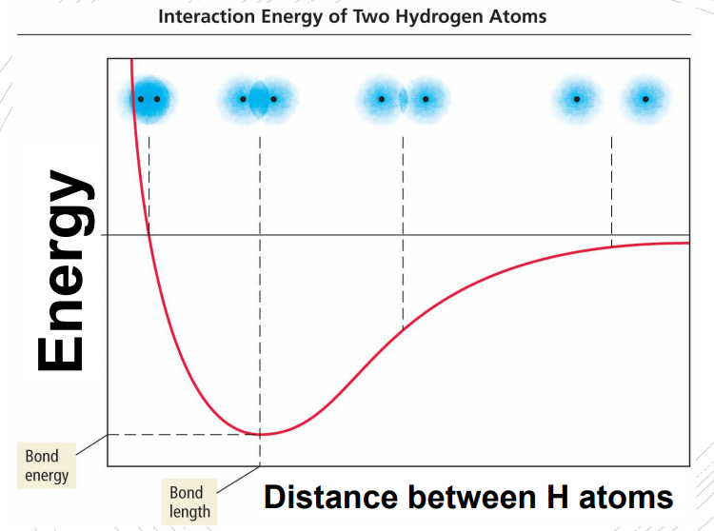
Why Bonds Form
Jump back to title slide

Slide 71
Types of Bonds
Jump back to title slide

Slide 72
Naming formulas
Jump back to title slide

Slide 73
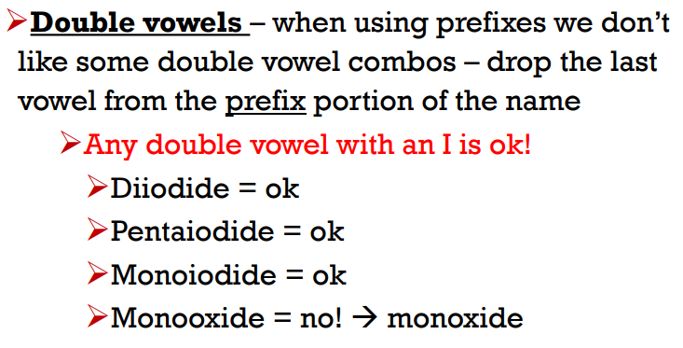
Naming formulas
Jump back to title slide

Slide 74
Naming formulas
Jump back to title slide

Slide 75
Naming formulas
Jump back to title slide

Slide 76
Neutral Formulas
Jump back to title slide

Slide 77
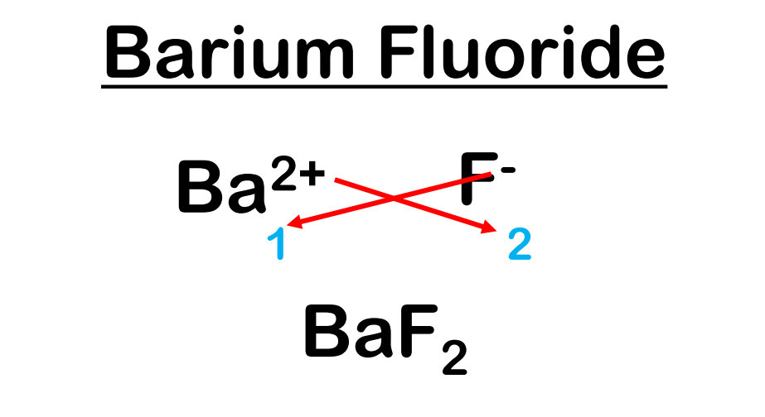
Neutral Formulas
Jump back to title slide

Slide 78
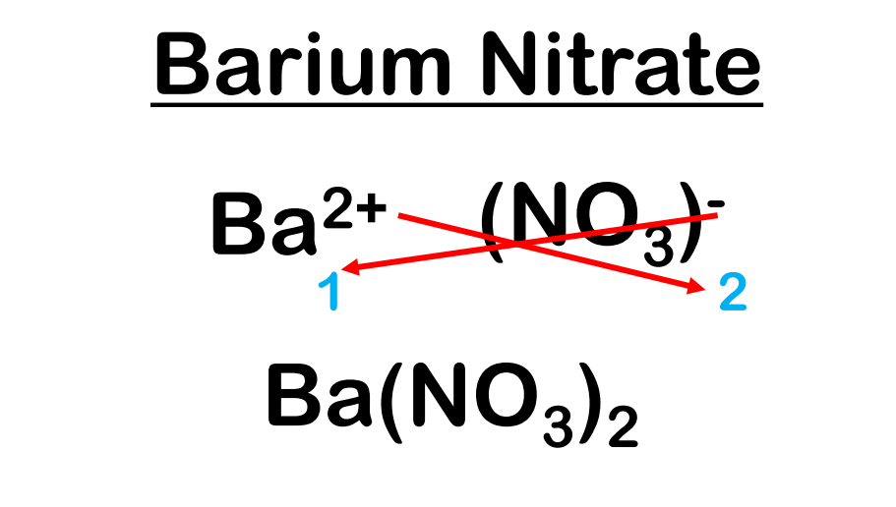
Neutral Formulas
Jump back to title slide

Slide 79
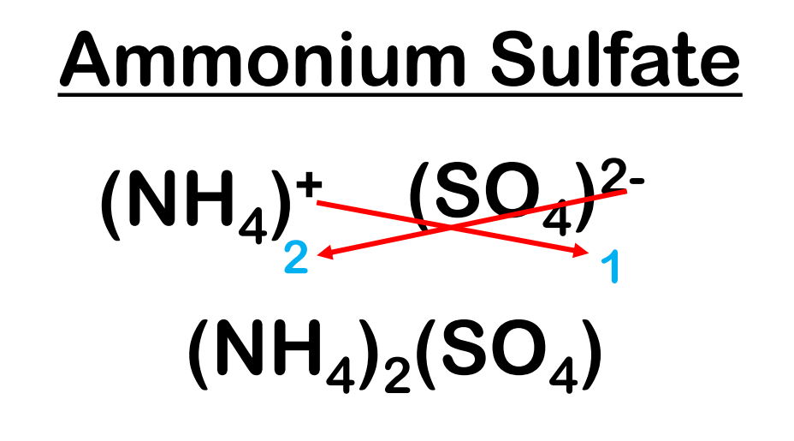
Naming formulas
Jump back to title slide

Slide 80
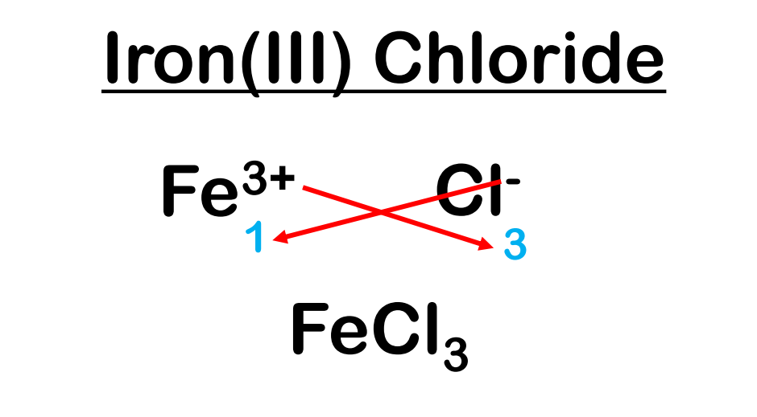
Neutral Formulas
Jump back to title slide

Slide 81
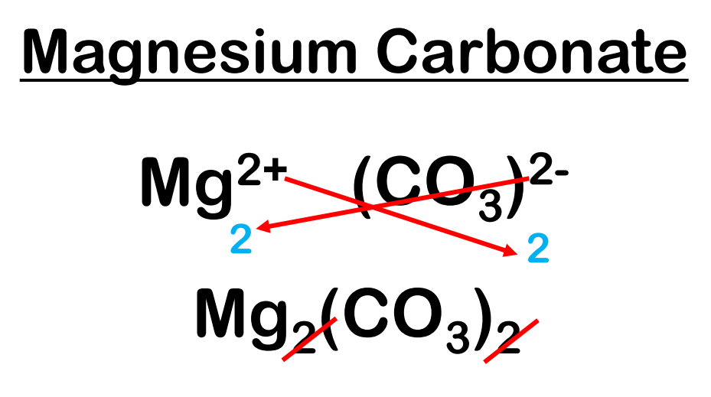
Neutral Formulas
Jump back to title slide

Slide 82
Lewis Structures
Jump back to title slide

Slide 83
Lewis Structures
Jump back to title slide

Slide 84
Lewis Structures
Jump back to title slide

Slide 85
VSEPR
Jump back to title slide

Slide 86
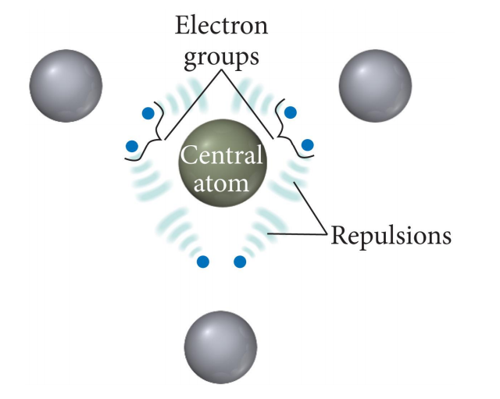
VSEPR
Jump back to title slide

Slide 87
VSEPR
Jump back to title slide

Slide 88
VSEPR
Jump back to title slide

Slide 89
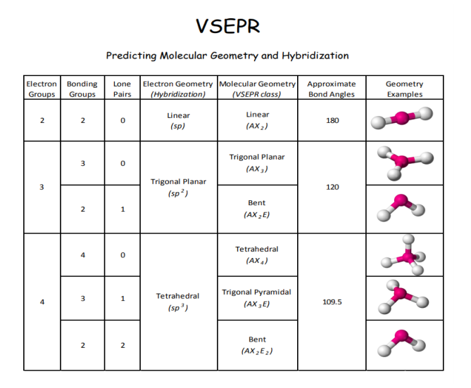
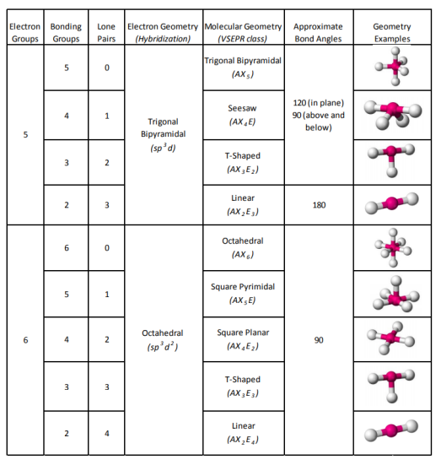
VSEPR
Jump back to title slide

Slide 90
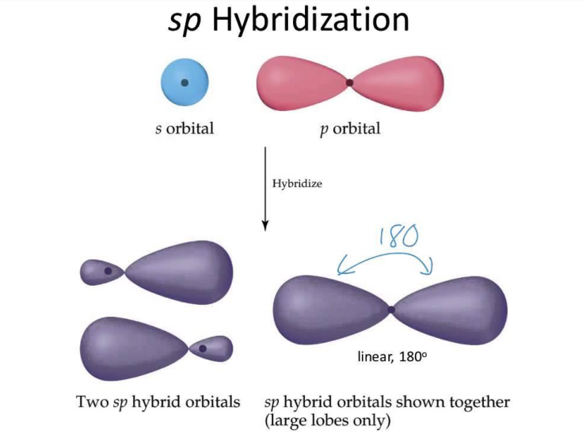
Hybrid- ization
Jump back to title slide

Slide 91
Polarity
Jump back to title slide

Slide 92
Polarity
Jump back to title slide

Slide 93
Polarity
Jump back to title slide

Slide 94
Polarity
Jump back to title slide

Slide 95
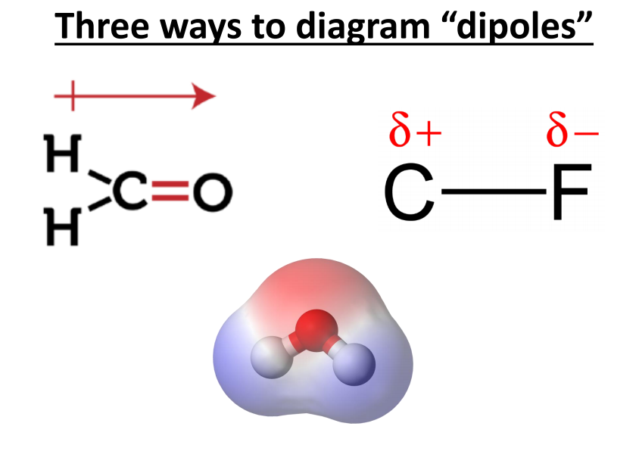
Polarity
Jump back to title slide

Slide 96
IMFs
Jump back to title slide

Slide 97
IMFs
Jump back to title slide

Slide 98
IMFs
Jump back to title slide

Slide 99
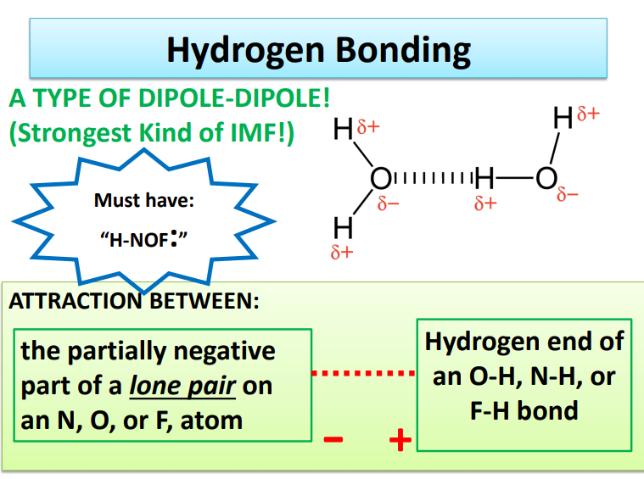
IMFs
Jump back to title slide

Slide 100
IMFs
Jump back to title slide

Slide 101
IMFs
Jump back to title slide

Slide 102
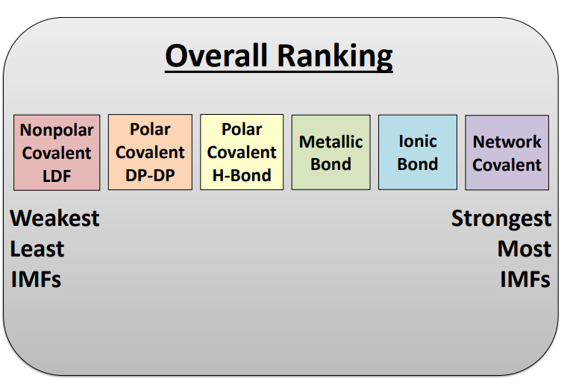
IMFs
Jump back to title slide

Slide 103
Unit #6 Reactions
Signs of a chemical reaction
Balancing equations
Types of reactions
Predicting products
Net ionic equations

Slide 104
Signs of a Reaction
Jump back to title slide

Slide 105
Balancing
Jump back to title slide

Slide 106
Balancing
Jump back to title slide

Slide 107
Balancing
Jump back to title slide

Slide 108
Balancing
Jump back to title slide

Slide 109
Balancing
Jump back to title slide

Slide 110
Types of Reactions
Jump back to title slide

Slide 111
Types of Reactions, Predicting Products
Jump back to title slide

Slide 112
Types of Reactions, Predicting Products
Jump back to title slide

Slide 113
Types of Reactions, Predicting Products
Jump back to title slide

Slide 114
Types of Reactions, Predicting Products
Jump back to title slide

Slide 115
Types of Reactions, Predicting Products
Jump back to title slide

Slide 116
Types of Reactions, Predicting Products
Jump back to title slide

Slide 117
Types of Reactions, Predicting Products
Jump back to title slide

Slide 118
Net Ionic
Jump back to title slide

Slide 119
Net Ionic
Jump back to title slide

Slide 120
Net Ionic
Jump back to title slide

Slide 121
Unit #7 Stoichiometry
The mole
Molar mass
Molar conversions
Mole ratio
Stoichiometry

Slide 122
The Mole
Jump back to title slide

Slide 123
Molar Mass
Jump back to title slide

Slide 124
Molar Mass
Jump back to title slide

Slide 125
Molar Conv.s
Jump back to title slide

Slide 126
Stoich.
Jump back to title slide

Slide 127
Mole Ratio
Jump back to title slide

Slide 128
Mole Ratio
Jump back to title slide

Slide 129
Mole Ratio
Jump back to title slide

Slide 130
Stoich.
Jump back to title slide

Slide 131
Stoich.
Jump back to title slide

Slide 132
Unit #8 Advanced Chemical Ratios
Limiting reagent stoichiometry
Percent composition
Empirical formulas
Combustion analysis
**

Slide 133
Limiting Reagent Stoich.
Jump back to title slide

Slide 134
Limiting Reagent Stoich.
Jump back to title slide

Slide 135
Limiting Reagent Stoich.
Jump back to title slide

Slide 136
Limiting Reagent Stoich.
Jump back to title slide

Slide 137
Limiting Reagent Stoich.
Jump back to title slide

Slide 138
Limiting Reagent Stoich.
Jump back to title slide

Slide 139
Limiting Reagent Stoich.
Jump back to title slide

Slide 140
Limiting Reagent Stoich.
Jump back to title slide

Slide 141
Limiting Reagent Stoich.
Jump back to title slide

Slide 142
Limiting Reagent Stoich.
Jump back to title slide

Slide 143
Limiting Reagent Stoich.
Jump back to title slide

Slide 144
Percent Comp.
Jump back to title slide

Slide 145
Percent Comp.
Jump back to title slide

Slide 146
Empirical Formulas
Jump back to title slide

Slide 147
Empirical Formulas
Jump back to title slide

Slide 148
Empirical Formulas
Jump back to title slide

Slide 149
Empirical Formulas
Jump back to title slide

Slide 150
Empirical Formulas
Jump back to title slide

Slide 151
Empirical Formulas
Jump back to title slide

Slide 152
Empirical Formulas
Jump back to title slide

Slide 153
Empirical Formulas
Jump back to title slide

Slide 154
Combust. Analysis
Jump back to title slide

Slide 155
Combust. Analysis
Jump back to title slide

Slide 156
Combust. Analysis
Jump back to title slide

Slide 157
Combust. Analysis
Jump back to title slide

Slide 158
Combust. Analysis
Jump back to title slide

Slide 159
Combust. Analysis
Jump back to title slide

Slide 160
Combust. Analysis
Jump back to title slide

Slide 161
Combust. Analysis
Jump back to title slide

Slide 162
Combust. Analysis
Jump back to title slide

Slide 163
Combust. Analysis
Jump back to title slide

Slide 164
Combust. Analysis
Jump back to title slide

Slide 165
Unit #9 Gas Laws
KMT theory
Basic gas law equations
Ideal gas law equation
Dalton’s law of partial pressures
Gas stoichiometry
**
**

Slide 166
KMT Theory
Jump back to title slide

Slide 167
KMT Theory
Jump back to title slide

Slide 168
KMT Theory
Jump back to title slide

Slide 169
Gas Laws
Jump back to title slide

Slide 170
Gas Laws
Jump back to title slide

Slide 171
Gas Laws
Jump back to title slide

Slide 172
Gas Laws
Jump back to title slide

Slide 173
Gas Laws
Jump back to title slide

Slide 174
Gas Laws
Jump back to title slide

Slide 175
Ideal Gas Law
Jump back to title slide

Slide 176
Ideal Gas Law
Jump back to title slide

Slide 177
Dalton’s Law
Jump back to title slide

Slide 178
Dalton’s Law
Jump back to title slide

Slide 179
Dalton’s Law
Jump back to title slide

Slide 180
Dalton’s Law
Jump back to title slide

Slide 181
Dalton’s Law
Jump back to title slide

Slide 182
Dalton’s Law
Jump back to title slide

Slide 183
Gas Stoich.
Jump back to title slide

Slide 184
Gas Stoich.
Jump back to title slide

Slide 185
Gas Stoich.
Jump back to title slide

Slide 186
Unit #10 Thermochemistry
*
Endo versus Exo
Specific heat
Calorimetry
Heating/cooling curves
Heat of Reaction
Reaction Diagrams
Heat of Formation
Bond Energy
Hess’s Law

Slide 187
Endo vs. Exo
Jump back to title slide

Slide 188
Endo vs. Exo
Jump back to title slide

Slide 189
Endo vs. Exo
Jump back to title slide

Slide 190
Thermo
Jump back to title slide

Slide 191
Thermo
Jump back to title slide

Slide 192
Specific Heat
Jump back to title slide

Slide 193
Calorimetry
Jump back to title slide

Slide 194
Calorimetry
Jump back to title slide

Slide 195
Calorimetry
Jump back to title slide

Slide 196
Heating Curves
Jump back to title slide

Slide 197
Heating Curves
Jump back to title slide

Slide 198
Heating Curves
Jump back to title slide

Slide 199
Heating Curves
Jump back to title slide

Slide 200
Heating Curves
Jump back to title slide

Slide 201
Heat of Reaction
Jump back to title slide

Slide 202
Heat of Reaction
Jump back to title slide

Slide 203
Reaction Diagrams
Jump back to title slide

Slide 204
Heat of Formation
Jump back to title slide

Slide 205
Bond Energy
Jump back to title slide

Slide 206
Hess’s Law
Jump back to title slide

Slide 207
Hess’s Law
Jump back to title slide

Slide 208
Unit #11 Solutions
*
Solution vocabulary
Solubility
Solutions calculations

Slide 209
Solutions Vocabulary
Jump back to title slide

Slide 210
Solutions Vocabulary
Jump back to title slide

Slide 211
Solutions Vocabulary
Jump back to title slide

Slide 212
Solubility
Jump back to title slide

Slide 213
Solubility
Jump back to title slide

Slide 214
Solubility
Jump back to title slide

Slide 215
Solubility
Jump back to title slide

Slide 216
Solubility
Jump back to title slide

Slide 217
Solutions Calcs.
Jump back to title slide

Slide 218
Solutions Calcs.
Jump back to title slide

Slide 219
Solutions Calcs.
Jump back to title slide

Slide 220
Solutions Calcs.
Jump back to title slide

Slide 221
Solutions Calcs.
Jump back to title slide

Slide 222
Solutions Calcs.
Jump back to title slide

Slide 223
Solutions Calcs.
Jump back to title slide

Slide 224
Unit #12 Kinetics
*
Collision Theory
Rate affecting factors
Average rates
Rate expressions
Instantaneous rates
Rate laws
Method of initial rates

Slide 225
Collision Theory
Jump back to title slide

Slide 226
Rate Affecting Factors
Jump back to title slide

Slide 227
Rate Affecting Factors
Jump back to title slide

Slide 228
Rate Affecting Factors
Jump back to title slide

Slide 229
Rate Affecting Factors
Jump back to title slide

Slide 230
Rate
Jump back to title slide

Slide 231
Average Rate
Jump back to title slide

Slide 232
Rate Expression
Jump back to title slide

Slide 233
Rate Expression
Jump back to title slide

Slide 234
Instan-taneous Rate
Jump back to title slide

Slide 235
Rate Law
Jump back to title slide

Slide 236
Rate Law
Jump back to title slide

Slide 237
Rate Law
Jump back to title slide

Slide 238
Rate Law
Jump back to title slide

Slide 239
Rate Law
Jump back to title slide

Slide 240
Method of Initial Rates
Jump back to title slide

Slide 241
Method of Initial Rates
Jump back to title slide

Slide 242
Unit #13 Equilibrium
*
Le Chatelier’s principle
Equilibrium constant
Equilibrium quotient
ICE Tables

Slide 243
Equilibrium
Jump back to title slide

Slide 244
Equilibrium
Jump back to title slide

Slide 245
Equilibrium
Jump back to title slide

Slide 246
Le Chatelier
Jump back to title slide

Slide 247
Le Chatelier
Jump back to title slide

Slide 248
Le Chatelier
Jump back to title slide

Slide 249
Le Chatelier
Jump back to title slide

Slide 250
Le Chatelier
Jump back to title slide

Slide 251
Equilibrium Constant
Jump back to title slide

Slide 252
Equilibrium Constant
Jump back to title slide

Slide 253
Equilibrium Constant
Jump back to title slide
Jump back to title slide

Slide 254
Equilibrium Constant
Jump back to title slide

Slide 255
Equilibrium Constant
Jump back to title slide

Slide 256
Equilibrium Constant
Jump back to title slide

Slide 257
Equilibrium Constant
Jump back to title slide

Slide 258
Equilibrium Constant
Jump back to title slide

Slide 259
Equilibrium Quotient
Jump back to title slide

Slide 260
Equilibrium Quotient
Jump back to title slide

Slide 261
ICE Tables
Jump back to title slide

Slide 262
ICE Tables
Jump back to title slide

Slide 263
ICE Tables
Jump back to title slide

Slide 264
ICE Tables
Jump back to title slide

Slide 265
ICE Tables
Jump back to title slide

Slide 266
ICE Tables
Jump back to title slide

Slide 267
ICE Tables

Slide 268
Unit #14 Acids and Bases
*
**
Acid Base concepts
pH calculations
Strong acids and bases
Self ionization of water
Weak acids and bases
Salts
Titrations
**
**

Slide 269
Concepts
Jump back to title slide

Slide 270
Concepts
Jump back to title slide

Slide 271
Concepts
Jump back to title slide

Slide 272
Concepts
Jump back to title slide

Slide 273
pH Calcs.
Jump back to title slide

Slide 274
pH Calcs.
Jump back to title slide

Slide 275
Strong Acids and Bases
Jump back to title slide

Slide 276
Strong Acids and Bases
Jump back to title slide

Slide 277
Strong Acids and Bases
Jump back to title slide

Slide 278
Strong Acids and Bases
Jump back to title slide

Slide 279
Self Ionization of Water
Jump back to title slide

Slide 280
Self Ionization of Water
Jump back to title slide

Slide 281
Weak Acids and Bases
Jump back to title slide

Slide 282
Weak Acids and Bases
Jump back to title slide

Slide 283
Weak Acids and Bases
Jump back to title slide

Slide 284
Weak Acids and Bases
Jump back to title slide

Slide 285
Weak Acids and Bases
Jump back to title slide

Slide 286
Salts
Jump back to title slide

Slide 287
Salts
Jump back to title slide

Slide 288
Salts
Jump back to title slide

Slide 289
Salts
Jump back to title slide

Slide 290
Salts
Jump back to title slide

Slide 291
Salts
Jump back to title slide

Slide 292
Salts
Jump back to title slide

Slide 293
Salts
Jump back to title slide

Slide 294
Salts
Jump back to title slide

Slide 295
Titrations
Jump back to title slide

Slide 296
Titrations
Jump back to title slide

Slide 297
Titrations
Jump back to title slide

Slide 298
Titrations
Jump back to title slide

Slide 299
Titrations
Jump back to title slide

Slide 300
Titrations
Jump back to title slide

Slide 301
Titrations
Jump back to title slide

Slide 302
Unit #15 Redox (part of Summer Assignment always)
Oxidation and Reduction
Oxidation number
Oxidation vs reduction
Writing half reactions
Balancing redox reactions in an acidic or basic solution

Slide 303
Oxidation and Reduction
Jump back to title slide

Slide 304
Oxidation and Reduction
Jump back to title slide

Slide 305
Half Reactions
Jump back to title slide

Slide 306
Oxidation Numbers
Jump back to title slide

Slide 307
Oxidation Numbers
Jump back to title slide

Slide 308
Half Reactions, Balancing
Jump back to title slide

Slide 309
Half Reactions, Balancing
Jump back to title slide

Slide 310
Electro chem

Slide 311
Electro chem

