Slide 1
Video Instructions if Interested
https://youtu.be/2KJuI4YnTGU

Slide 2
Crash Course: N1 - Honors Chem Review
Basics and Atomic Structure
Nuclear Chemistry
Electrons
Periodic Table
Bonding and Structure
Reactions
Stoich.
Advanced Chemical Ratios
Gas Laws
Thermo.
Solutions
Kinetics
Equilibrium
Acids and Bases
Redox

Slide 3
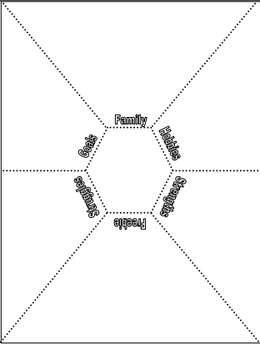
How to set up your composition notebook
Your notebook should look like this so far...
Safety Notes
Should be notes on safety video and safety contract
Page 1
Page 2
Page 3

Slide 4
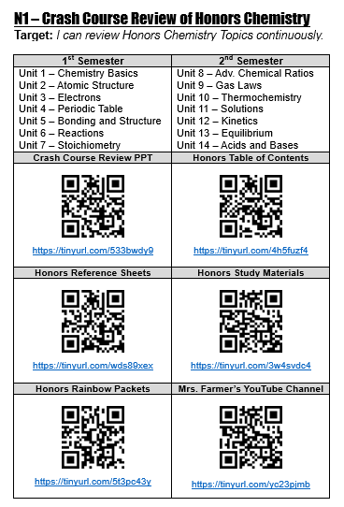
Add the N1 “Glue In” to page 3
Now your notebook should look like this!
Safety Notes
Should be notes on safety video and safety contract
Page 1
Page 2
Page 3

Slide 5
You MUST remember your Honors Chem material !!! It is SO important. You need to know it AND be able to do it FAST !
#1 – Basics and Atomic Structure | #8 – Advanced Chemical Ratios
#2 – Nuclear Chemistry | #9 – Gas Laws
#3 – Electrons | #10 – Thermochemistry
#4 – Periodic Table | #11 – Solutions
#5 – Bonding and Structure | #12 – Kinetics
#6 – Reactions | #13 – Equilibrium
#7 – Stoichiometry | #14 – Acids and Bases
 | #15 – Summer Assignment Topics

Slide 6
Time for some self guided review !
The rest of this PowerPoint has screen shots of key pieces of info from the Honors Chem Lectures. Your glue in has links to the full Honors Lectures if you want/need more detail.
PLEASE scroll through and review things as needed!
When we start a new AP Chem chapter, PLEASE go back and review the Honors version of the chapter!
I cannot stress enough how important this is!
Make mature choices about what and when to review old material! Set yourself up for success!

Slide 7
Unit #1 Chemistry Basics and Atomic Structure
Scientific notation
Metric system
Dimensional analysis
Significant figures
Chemical/Physical properties/changes
Types of matter
Atomic numbers and Isotopes
Models of the atom
Average Atomic Mass Calculations

Slide 8
Scientific Notation
Jump back to title slide

Slide 9
Metric System
Jump back to title slide

Slide 10
Metric System
Jump back to title slide

Slide 11
Derived Units
Jump back to title slide

Slide 12
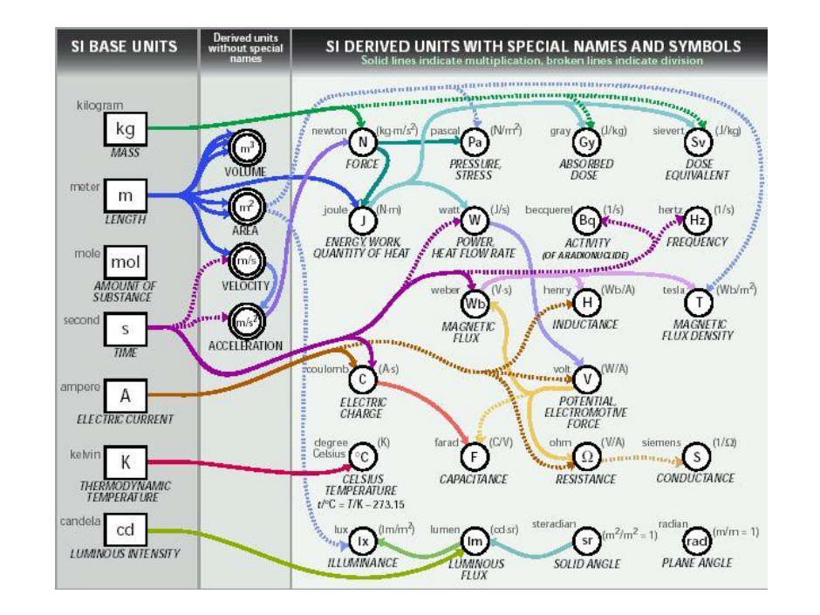
Derived Units
Jump back to title slide

Slide 13
Dimensional Analysis
Jump back to title slide

Slide 14
Dimensional Analysis
Jump back to title slide

Slide 15
Dimensional Analysis
Jump back to title slide

Slide 16
Dimensional Analysis
Jump back to title slide

Slide 17
Significant Figures
Jump back to title slide

Slide 18
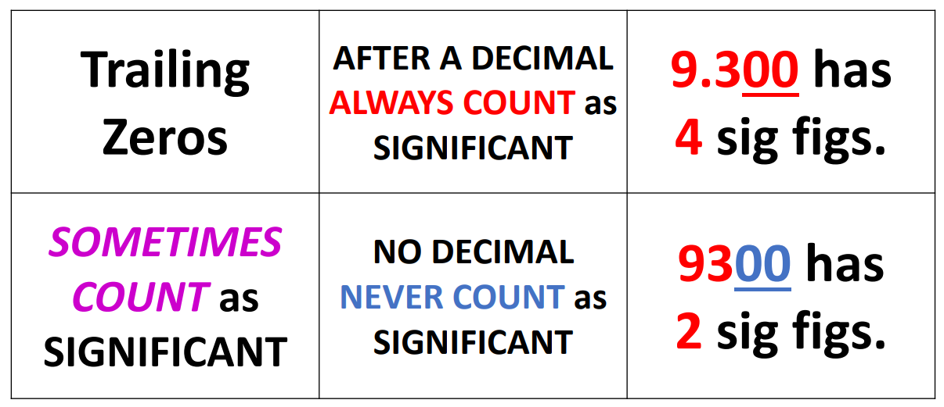
Significant Figures
Jump back to title slide

Slide 19
Significant Figures
Jump back to title slide

Slide 20
Properties and Changes
Jump back to title slide

Slide 21
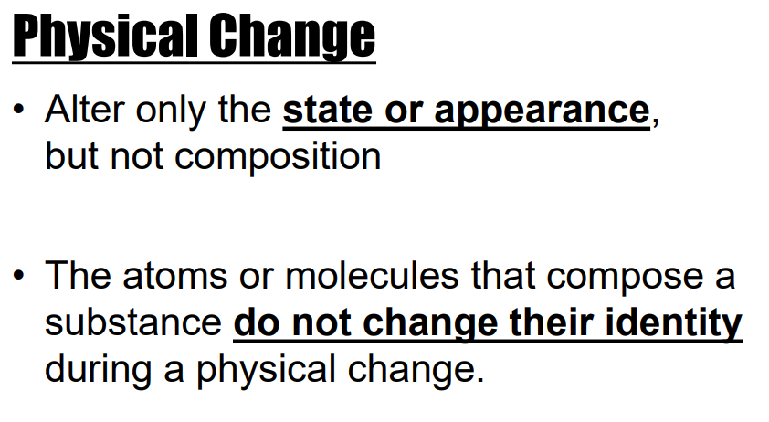
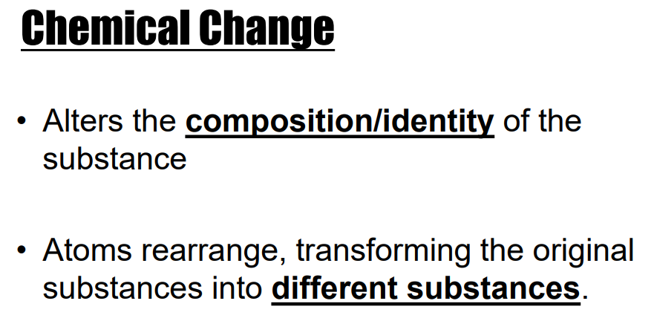
Properties and Changes
Jump back to title slide

Slide 22
Types of Matter
Jump back to title slide

Slide 23
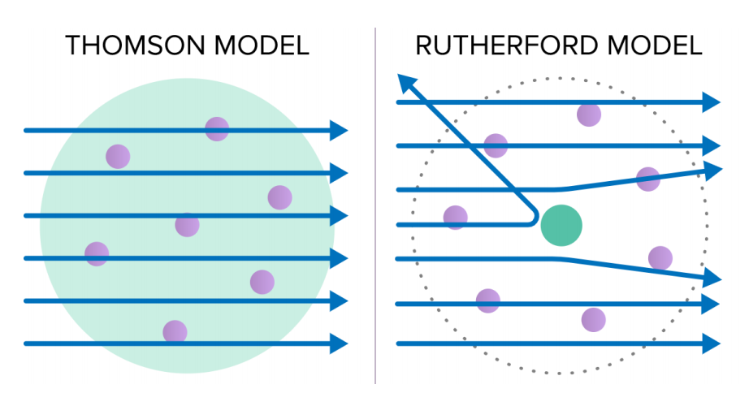
Atomic Models
Jump back to title slide

Slide 24
Atomic Numbers
Jump back to title slide

Slide 25
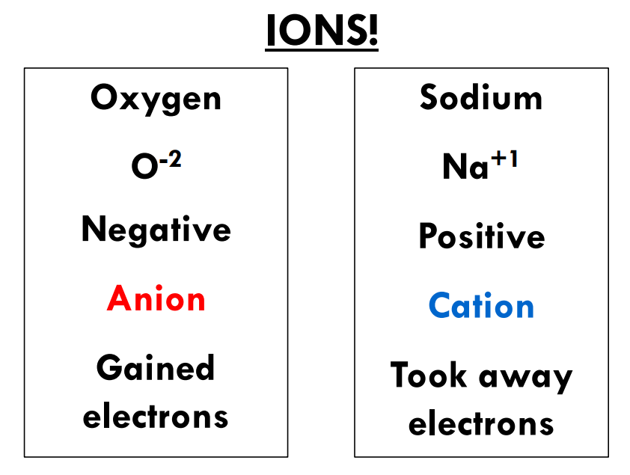
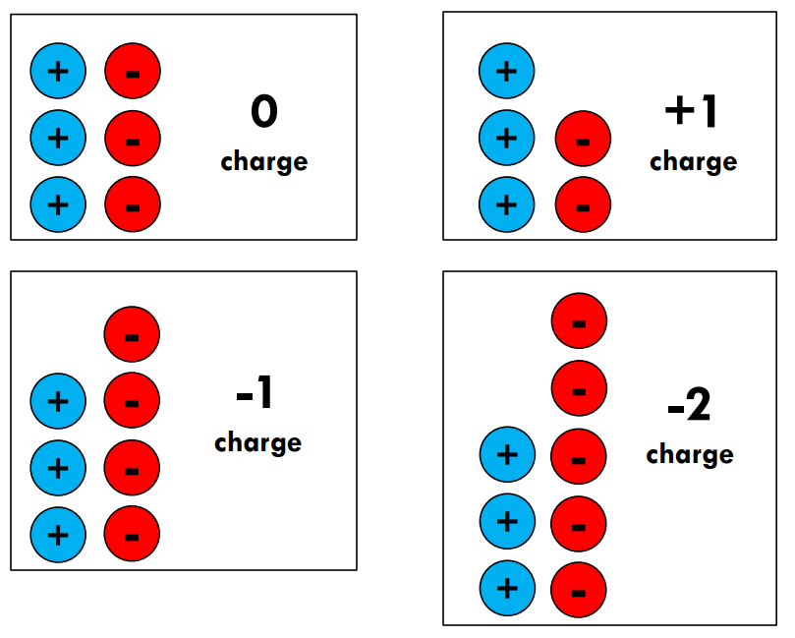
Atomic Numbers
Jump back to title slide

Slide 26
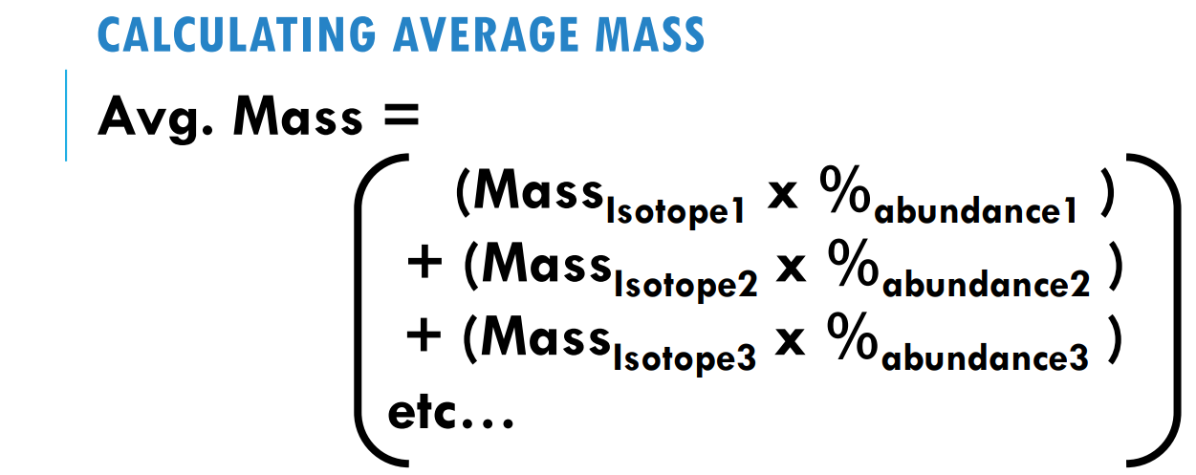
Average Mass Calcs.
Jump back to title slide

Slide 27
Average Mass Calcs.
Jump back to title slide

Slide 28
Unit #2 Nuclear Chemistry
Why things are radioactive
Types of radioactive particles
Writing and balancing nuclear equations
Decay series
Half Life

Slide 29
Nuclear Chemistry
Jump back to title slide

Slide 30
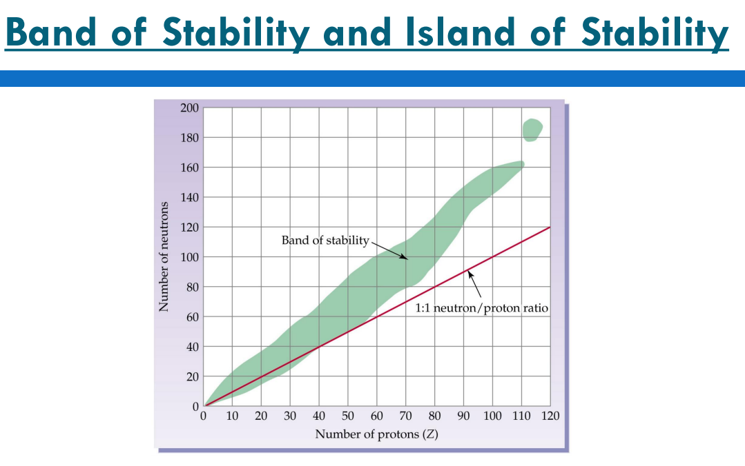
Nuclear Chemistry
Jump back to title slide

Slide 31
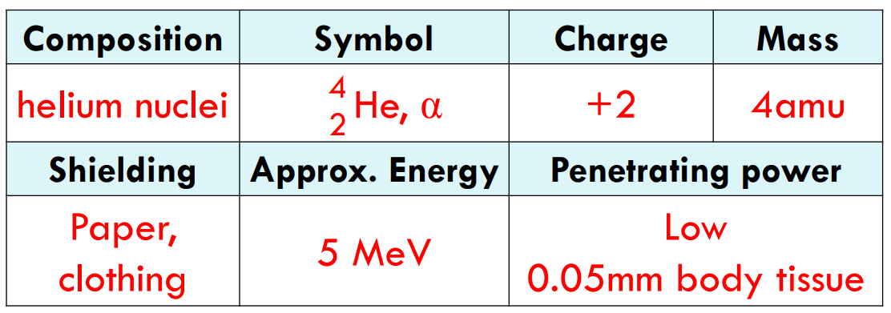
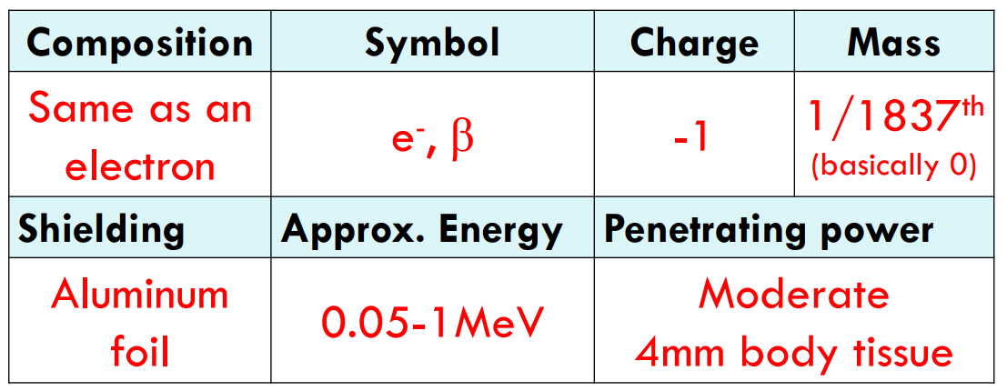
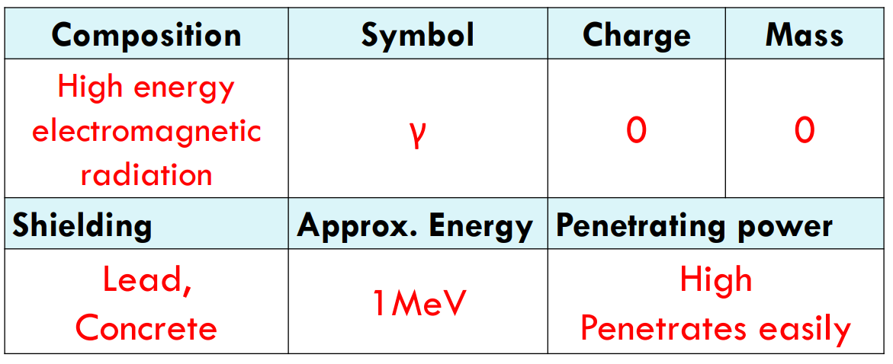
Radioactive particles
Jump back to title slide
Alpha
Beta
Gamma

Slide 32
Writing Nuclear Equations
Alpha
Jump back to title slide
Beta

Slide 33
Writing Nuclear Equations
Jump back to title slide

Slide 34
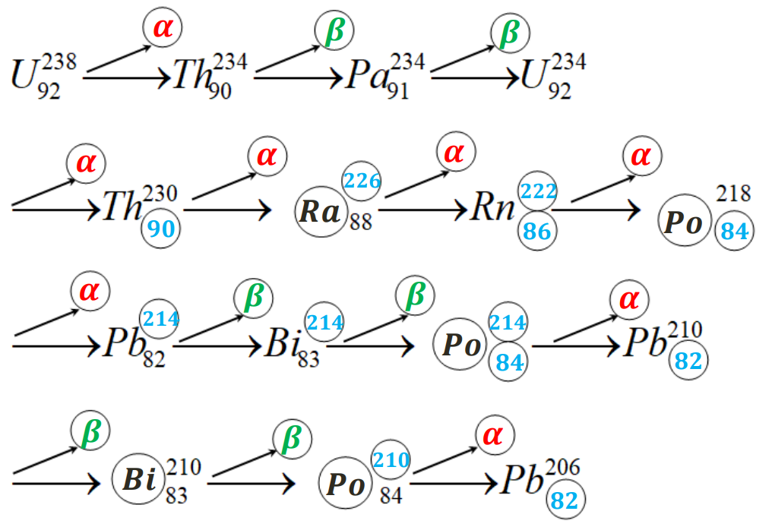
Decay Series
Jump back to title slide

Slide 35
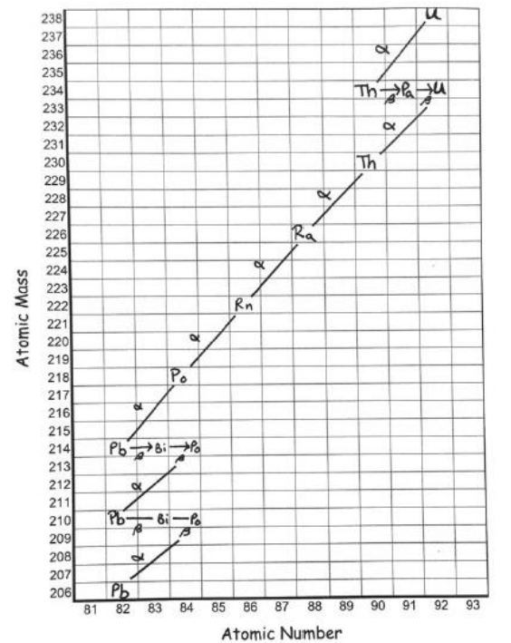
Decay Series
Jump back to title slide

Slide 36
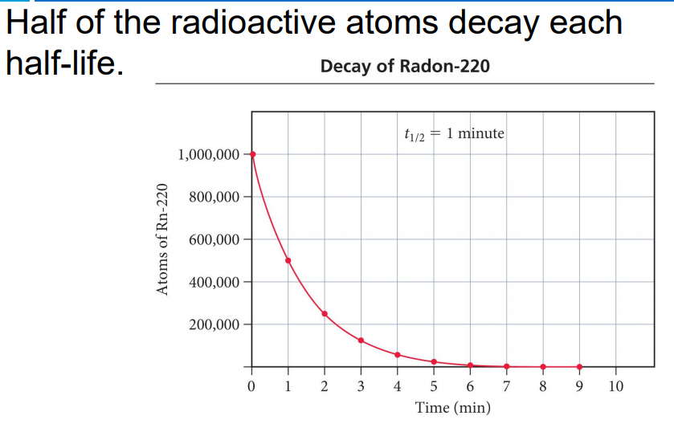
Half Life
Jump back to title slide

Slide 37
Half Life
Jump back to title slide

Slide 38
Half Life
Jump back to title slide

Slide 39
Half Life
Jump back to title slide

Slide 40
Unit #3 Electrons
Quantum mechanical theory
Orbital diagrams
Writing electron configurations
Noble Gas configuration
Configuration of ions
Absorption and emission

Slide 41
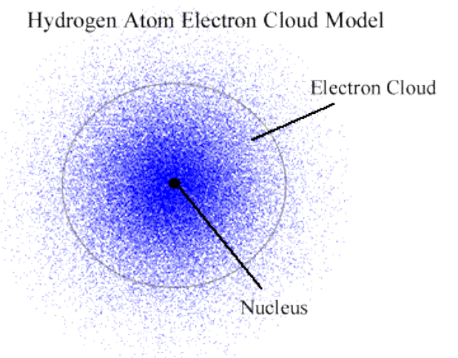
Quantum Mechanical Model
Jump back to title slide

Slide 42
Orbital Diagrams
Jump back to title slide

Slide 43
Orbital Diagrams
Jump back to title slide

Slide 44
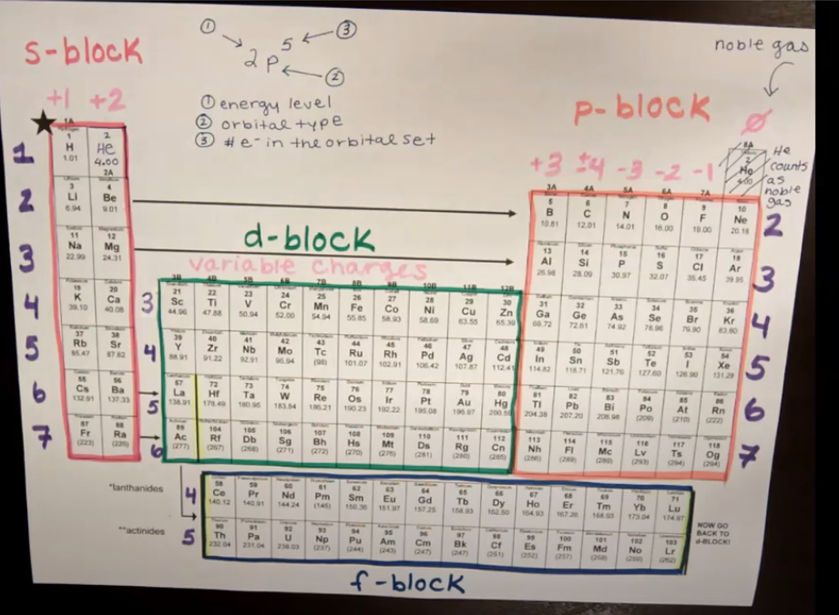
Writing Electron Config.
Jump back to title slide

Slide 45
Noble Gas Config.
Jump back to title slide

Slide 46
Config. of Ions
Jump back to title slide

Slide 47
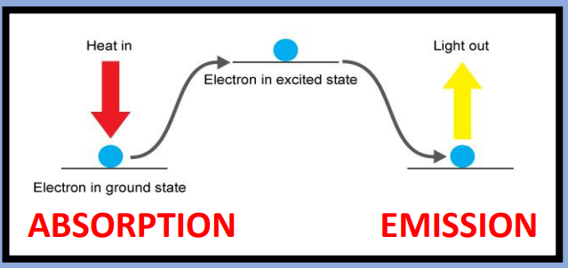
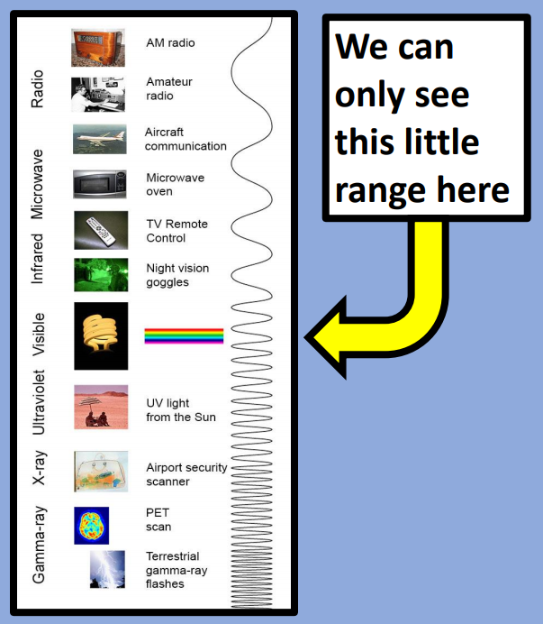
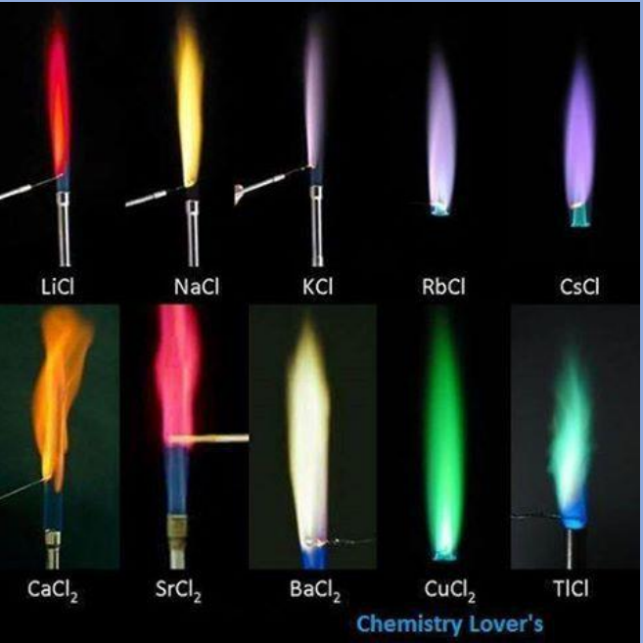
Absorption and Emission
Jump back to title slide

Slide 48
Unit #4 Periodic Table
Structure of the periodic table
Periodic trends

Slide 49
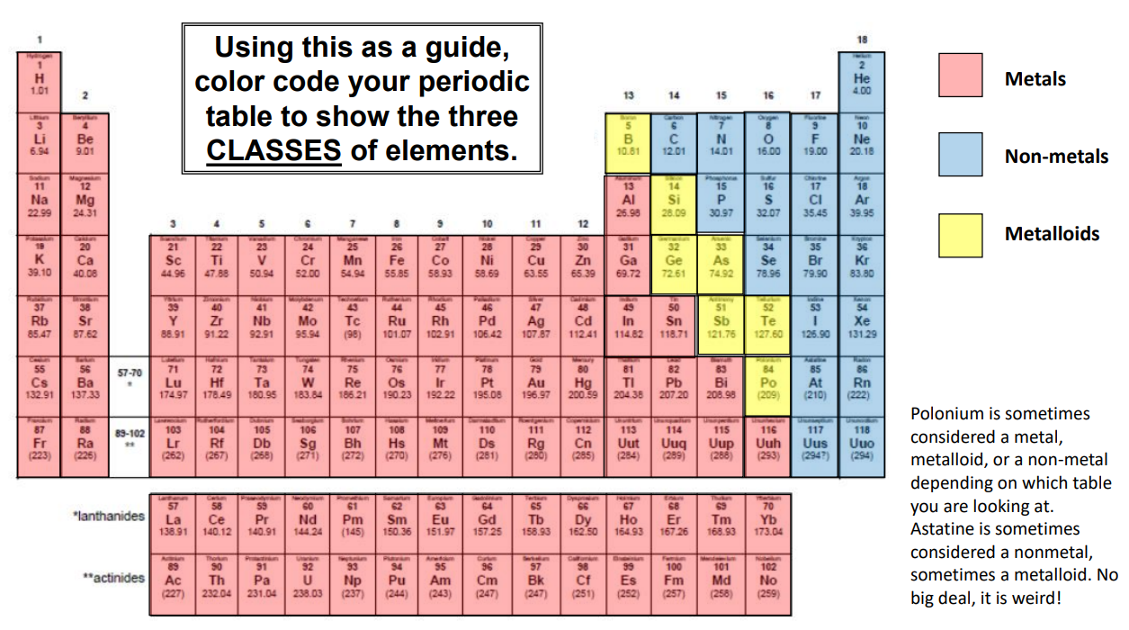
Periodic Table Structure
Jump back to title slide

Slide 50
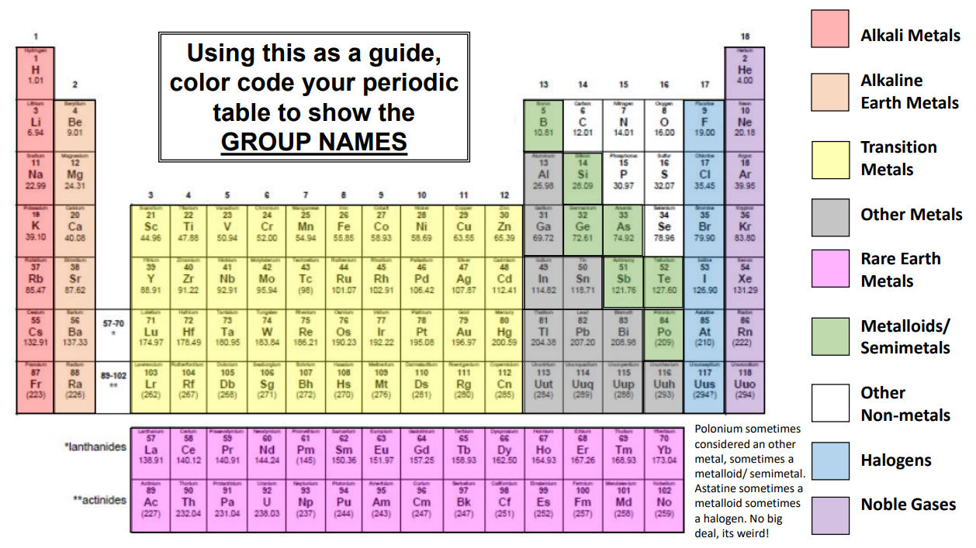
Periodic Table Structure
Jump back to title slide

Slide 51
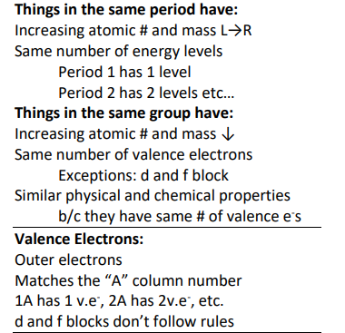
Periodic Table Structure
Jump back to title slide

Slide 52
Periodic Trends
Jump back to title slide

Slide 53
Periodic Trends
Jump back to title slide

Slide 54
Periodic Trends
Jump back to title slide

Slide 55
Periodic Trends
Jump back to title slide

Slide 56
Periodic Trends
Jump back to title slide

Slide 57
Periodic Trends
Jump back to title slide

Slide 58
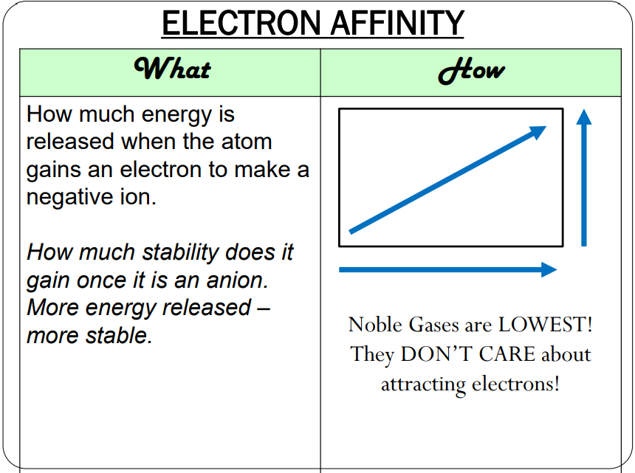
Periodic Trends
Jump back to title slide

Slide 59
Periodic Trends
Jump back to title slide

Slide 60
Periodic Trends
Jump back to title slide

Slide 61
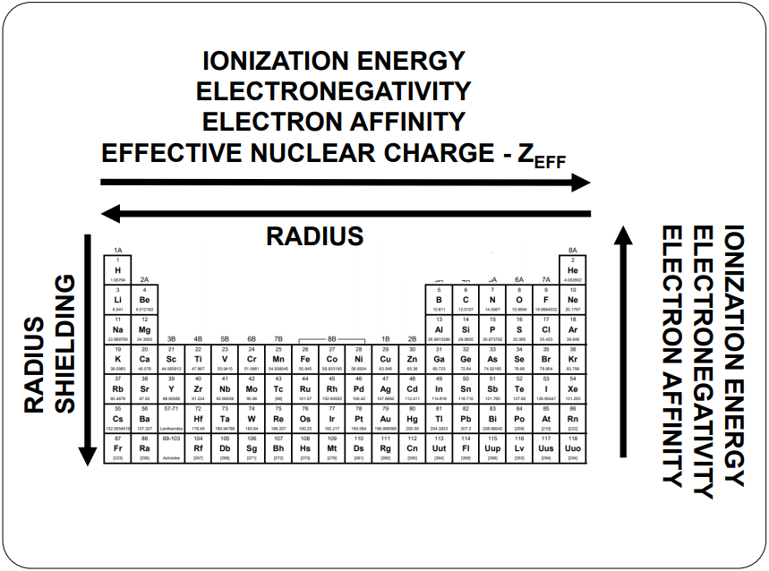
Periodic Trends
Jump back to title slide

Slide 62
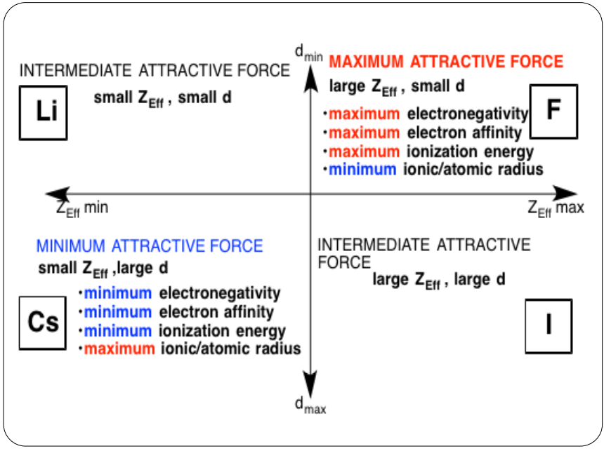
Periodic Trends
Jump back to title slide

Slide 63
Unit #5 Bonding and Structure
Why bonds form
Types of bonds
Naming formulas
Writing neutral formulas
Lewis structures
VSPER
Hybridization
Polarity
Intermolecular forces

Slide 64
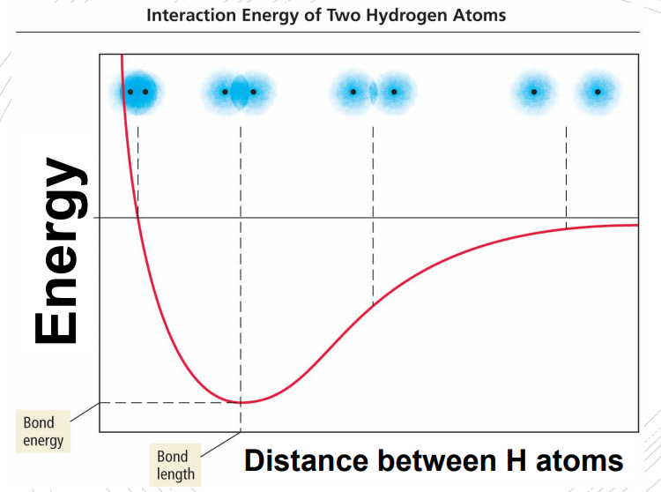
Why Bonds Form
Jump back to title slide

Slide 65
Types of Bonds
Jump back to title slide

Slide 66
Naming formulas
Jump back to title slide

Slide 67
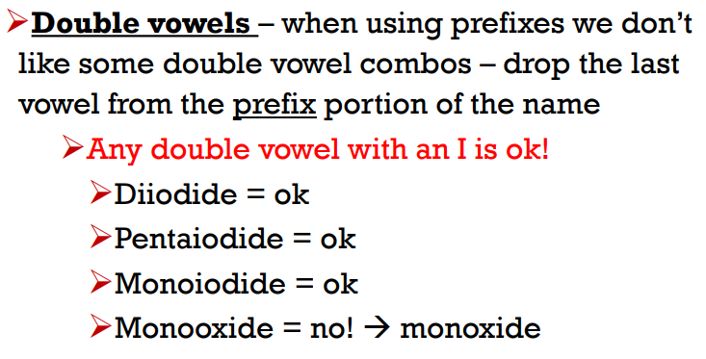
Naming formulas
Jump back to title slide

Slide 68
Naming formulas
Jump back to title slide

Slide 69
Naming formulas
Jump back to title slide

Slide 70
Neutral Formulas
Jump back to title slide

Slide 71
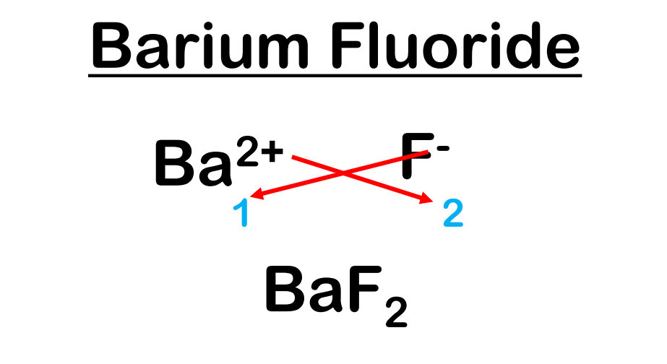
Neutral Formulas
Jump back to title slide

Slide 72
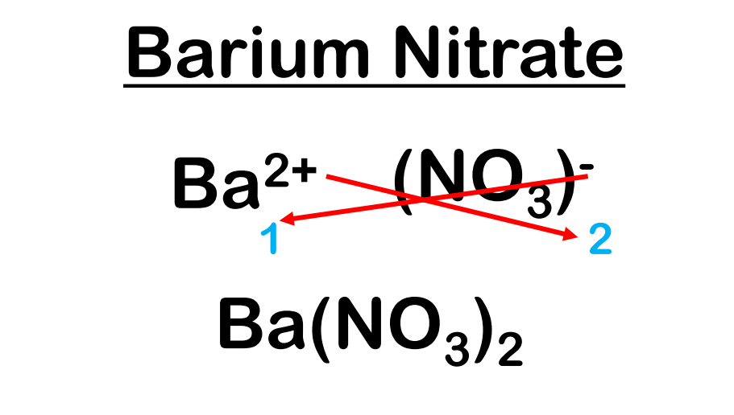
Neutral Formulas
Jump back to title slide

Slide 73
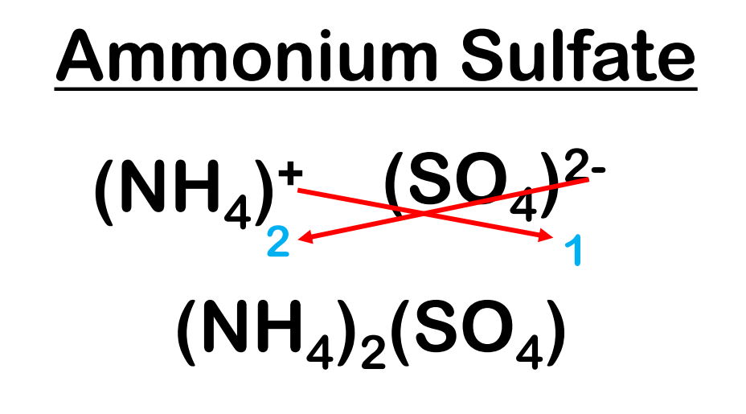
Naming formulas
Jump back to title slide

Slide 74
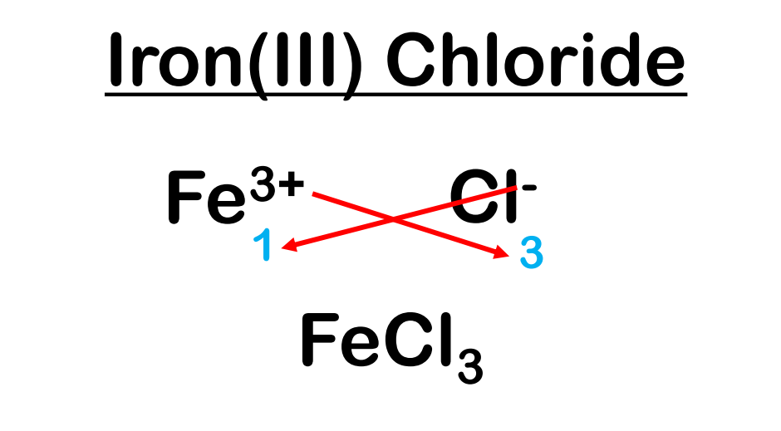
Neutral Formulas
Jump back to title slide

Slide 75
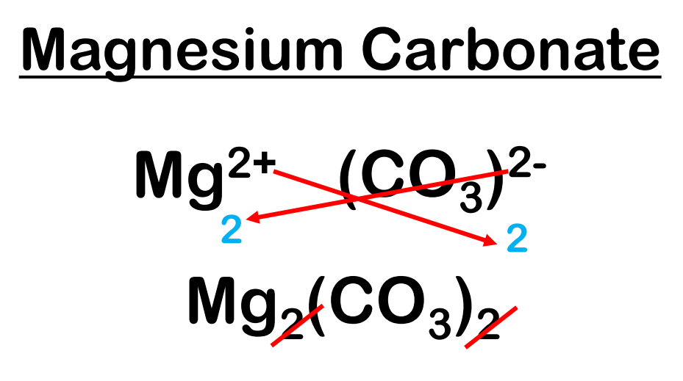
Neutral Formulas
Jump back to title slide

Slide 76
Lewis Structures
Jump back to title slide

Slide 77
Lewis Structures
Jump back to title slide

Slide 78
Lewis Structures
Jump back to title slide

Slide 79
VSEPR
Jump back to title slide

Slide 80
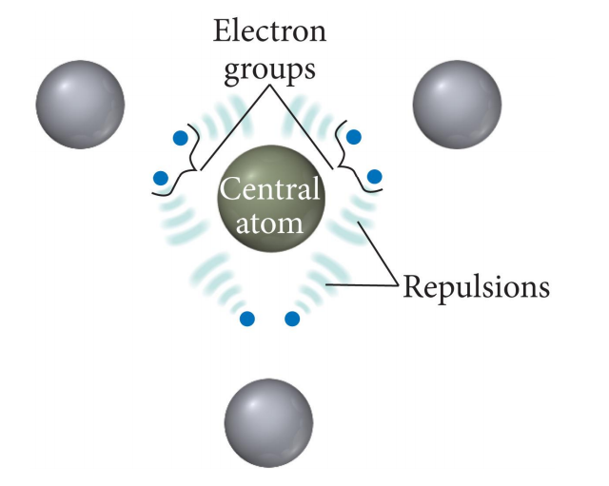
VSEPR
Jump back to title slide

Slide 81
VSEPR
Jump back to title slide

Slide 82
VSEPR
Jump back to title slide

Slide 83
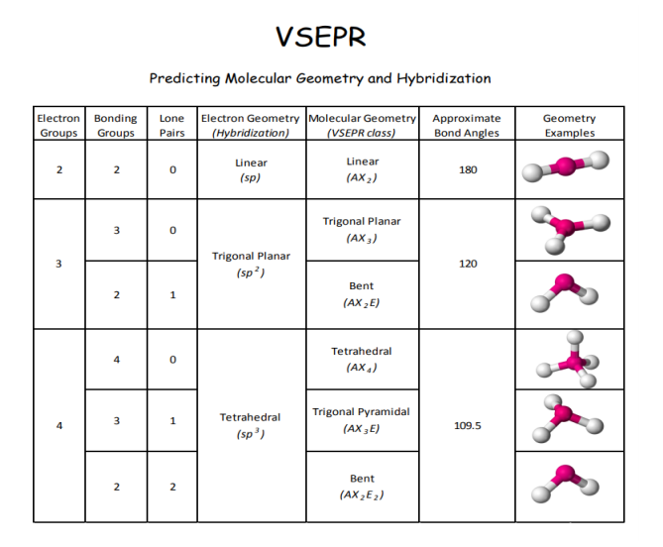
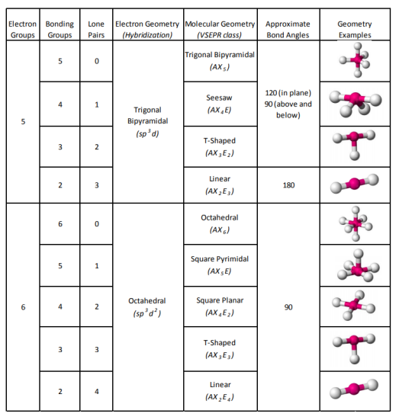
VSEPR
Jump back to title slide

Slide 84
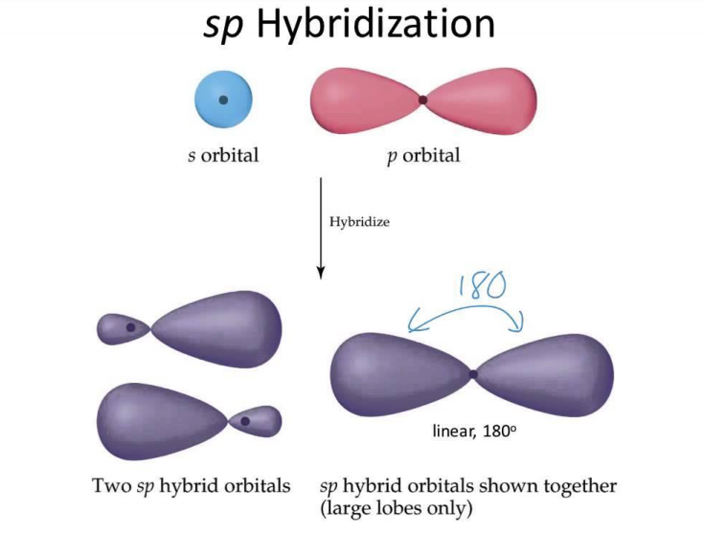
Hybrid- ization
Jump back to title slide

Slide 85
Polarity
Jump back to title slide

Slide 86
Polarity
Jump back to title slide

Slide 87
Polarity
Jump back to title slide

Slide 88
Polarity
Jump back to title slide

Slide 89
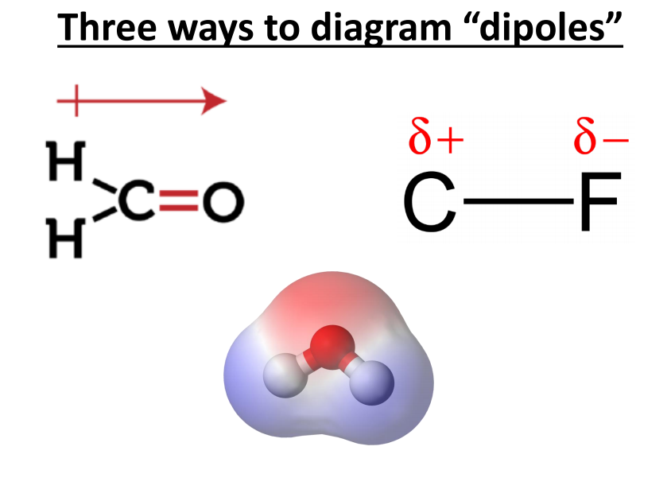
Polarity
Jump back to title slide

Slide 90
IMFs
Jump back to title slide

Slide 91
IMFs
Jump back to title slide

Slide 92
IMFs
Jump back to title slide

Slide 93
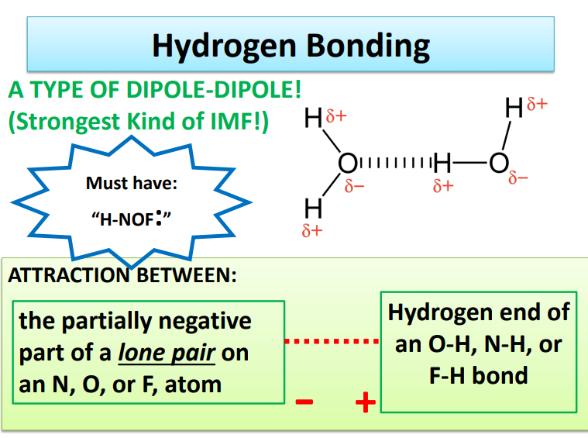
IMFs
Jump back to title slide

Slide 94
IMFs
Jump back to title slide

Slide 95
IMFs
Jump back to title slide

Slide 96
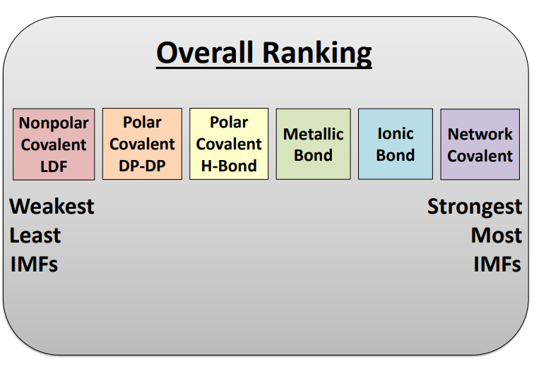
IMFs
Jump back to title slide

Slide 97
Unit #6 Reactions
Signs of a chemical reaction
Balancing equations
Types of reactions
Predicting products
Net ionic equations

Slide 98
Signs of a Reaction
Jump back to title slide

Slide 99
Balancing
Jump back to title slide

Slide 100
Balancing
Jump back to title slide

Slide 101
Balancing
Jump back to title slide

Slide 102
Balancing
Jump back to title slide

Slide 103
Balancing
Jump back to title slide

Slide 104
Types of Reactions
Jump back to title slide

Slide 105
Types of Reactions, Predicting Products
Jump back to title slide

Slide 106
Types of Reactions, Predicting Products
Jump back to title slide

Slide 107
Types of Reactions, Predicting Products
Jump back to title slide

Slide 108
Types of Reactions, Predicting Products
Jump back to title slide

Slide 109
Types of Reactions, Predicting Products
Jump back to title slide

Slide 110
Types of Reactions, Predicting Products
Jump back to title slide

Slide 111
Types of Reactions, Predicting Products
Jump back to title slide

Slide 112
Net Ionic
Jump back to title slide

Slide 113
Net Ionic
Jump back to title slide

Slide 114
Net Ionic
Jump back to title slide

Slide 115
Unit #7 Stoichiometry
The mole
Molar mass
Molar conversions
Mole ratio
Stoichiometry

Slide 116
The Mole
Jump back to title slide

Slide 117
Molar Mass
Jump back to title slide

Slide 118
Molar Mass
Jump back to title slide

Slide 119
Molar Conv.s
Jump back to title slide

Slide 120
Stoich.
Jump back to title slide

Slide 121
Mole Ratio
Jump back to title slide

Slide 122
Mole Ratio
Jump back to title slide

Slide 123
Mole Ratio
Jump back to title slide

Slide 124
Stoich.
Jump back to title slide

Slide 125
Stoich.
Jump back to title slide

Slide 126
Unit #8 Advanced Chemical Ratios
Limiting reagent stoichiometry
Percent composition
Empirical formulas
Combustion analysis

Slide 127
Limiting Reagent Stoich.
Jump back to title slide

Slide 128
Limiting Reagent Stoich.
Jump back to title slide

Slide 129
Limiting Reagent Stoich.
Jump back to title slide

Slide 130
Limiting Reagent Stoich.
Jump back to title slide

Slide 131
Limiting Reagent Stoich.
Jump back to title slide

Slide 132
Limiting Reagent Stoich.
Jump back to title slide

Slide 133
Limiting Reagent Stoich.
Jump back to title slide

Slide 134
Limiting Reagent Stoich.
Jump back to title slide

Slide 135
Limiting Reagent Stoich.
Jump back to title slide

Slide 136
Limiting Reagent Stoich.
Jump back to title slide

Slide 137
Limiting Reagent Stoich.
Jump back to title slide

Slide 138
Percent Comp.
Jump back to title slide

Slide 139
Percent Comp.
Jump back to title slide

Slide 140
Empirical Formulas
Jump back to title slide

Slide 141
Empirical Formulas
Jump back to title slide

Slide 142
Empirical Formulas
Jump back to title slide

Slide 143
Empirical Formulas
Jump back to title slide

Slide 144
Empirical Formulas
Jump back to title slide

Slide 145
Empirical Formulas
Jump back to title slide

Slide 146
Empirical Formulas
Jump back to title slide

Slide 147
Empirical Formulas
Jump back to title slide

Slide 148
Combust. Analysis
Jump back to title slide

Slide 149
Combust. Analysis
Jump back to title slide

Slide 150
Combust. Analysis
Jump back to title slide

Slide 151
Combust. Analysis
Jump back to title slide

Slide 152
Combust. Analysis
Jump back to title slide

Slide 153
Combust. Analysis
Jump back to title slide

Slide 154
Combust. Analysis
Jump back to title slide

Slide 155
Combust. Analysis
Jump back to title slide

Slide 156
Combust. Analysis
Jump back to title slide

Slide 157
Combust. Analysis
Jump back to title slide

Slide 158
Combust. Analysis
Jump back to title slide

Slide 159
Unit #9 Gas Laws
KMT theory
Basic gas law equations
Ideal gas law equation
Dalton’s law of partial pressures
Gas stoichiometry

Slide 160
KMT Theory
Jump back to title slide

Slide 161
KMT Theory
Jump back to title slide

Slide 162
KMT Theory
Jump back to title slide

Slide 163
Gas Laws
Jump back to title slide

Slide 164
Gas Laws
Jump back to title slide

Slide 165
Gas Laws
Jump back to title slide

Slide 166
Gas Laws
Jump back to title slide

Slide 167
Gas Laws
Jump back to title slide

Slide 168
Gas Laws
Jump back to title slide

Slide 169
Ideal Gas Law
Jump back to title slide

Slide 170
Ideal Gas Law
Jump back to title slide

Slide 171
Dalton’s Law
Jump back to title slide

Slide 172
Dalton’s Law
Jump back to title slide

Slide 173
Dalton’s Law
Jump back to title slide

Slide 174
Dalton’s Law
Jump back to title slide

Slide 175
Dalton’s Law
Jump back to title slide

Slide 176
Dalton’s Law
Jump back to title slide

Slide 177
Gas Stoich.
Jump back to title slide

Slide 178
Gas Stoich.
Jump back to title slide

Slide 179
Gas Stoich.
Jump back to title slide

Slide 180
Unit #10 Thermochemistry
Endo versus Exo
Specific heat
Calorimetry
Heating/cooling curves
Heat of Reaction
Reaction Diagrams
Heat of Formation
Bond Energy
Hess’s Law

Slide 181
Endo vs. Exo
Jump back to title slide

Slide 182
Endo vs. Exo
Jump back to title slide

Slide 183
Endo vs. Exo
Jump back to title slide

Slide 184
Thermo
Jump back to title slide

Slide 185
Thermo
Jump back to title slide

Slide 186
Specific Heat
Jump back to title slide

Slide 187
Calorimetry
Jump back to title slide

Slide 188
Calorimetry
Jump back to title slide

Slide 189
Calorimetry
Jump back to title slide

Slide 190
Heating Curves
Jump back to title slide

Slide 191
Heating Curves
Jump back to title slide

Slide 192
Heating Curves
Jump back to title slide

Slide 193
Heating Curves
Jump back to title slide

Slide 194
Heating Curves
Jump back to title slide

Slide 195
Heat of Reaction
Jump back to title slide

Slide 196
Heat of Reaction
Jump back to title slide

Slide 197
Reaction Diagrams
Jump back to title slide

Slide 198
Heat of Formation
Jump back to title slide

Slide 199
Bond Energy
Jump back to title slide

Slide 200
Hess’s Law
Jump back to title slide

Slide 201
Hess’s Law
Jump back to title slide

Slide 202
Unit #11 Solutions
Solution vocabulary
Solubility
Solutions calculations

Slide 203
Solutions Vocabulary
Jump back to title slide

Slide 204
Solutions Vocabulary
Jump back to title slide

Slide 205
Solutions Vocabulary
Jump back to title slide

Slide 206
Solubility
Jump back to title slide

Slide 207
Solubility
Jump back to title slide

Slide 208
Solubility
Jump back to title slide

Slide 209
Solubility
Jump back to title slide

Slide 210
Solubility
Jump back to title slide

Slide 211
Solutions Calcs.
Jump back to title slide

Slide 212
Solutions Calcs.
Jump back to title slide

Slide 213
Solutions Calcs.
Jump back to title slide

Slide 214
Solutions Calcs.
Jump back to title slide

Slide 215
Solutions Calcs.
Jump back to title slide

Slide 216
Solutions Calcs.
Jump back to title slide

Slide 217
Solutions Calcs.
Jump back to title slide

Slide 218
Unit #12 Kinetics
Collision Theory
Rate affecting factors
Average rates
Rate expressions
Instantaneous rates
Rate laws
Method of initial rates

Slide 219
Collision Theory
Jump back to title slide

Slide 220
Rate Affecting Factors
Jump back to title slide

Slide 221
Rate Affecting Factors
Jump back to title slide

Slide 222
Rate Affecting Factors
Jump back to title slide

Slide 223
Rate Affecting Factors
Jump back to title slide

Slide 224
Rate
Jump back to title slide

Slide 225
Average Rate
Jump back to title slide

Slide 226
Rate Expression
Jump back to title slide

Slide 227
Rate Expression
Jump back to title slide

Slide 228
Instan-taneous Rate
Jump back to title slide

Slide 229
Rate Law
Jump back to title slide

Slide 230
Rate Law
Jump back to title slide

Slide 231
Rate Law
Jump back to title slide

Slide 232
Rate Law
Jump back to title slide

Slide 233
Rate Law
Jump back to title slide

Slide 234
Method of Initial Rates
Jump back to title slide

Slide 235
Method of Initial Rates
Jump back to title slide

Slide 236
Unit #13 Equilibrium
Le Chatelier’s principle
Equilibrium constant
Equilibrium quotient
ICE Tables

Slide 237
Equilibrium
Jump back to title slide

Slide 238
Equilibrium
Jump back to title slide

Slide 239
Equilibrium
Jump back to title slide

Slide 240
Le Chatelier
Jump back to title slide

Slide 241
Le Chatelier
Jump back to title slide

Slide 242
Le Chatelier
Jump back to title slide

Slide 243
Le Chatelier
Jump back to title slide

Slide 244
Le Chatelier
Jump back to title slide

Slide 245
Equilibrium Constant
Jump back to title slide

Slide 246
Equilibrium Constant
Jump back to title slide

Slide 247
Equilibrium Constant
Jump back to title slide
Jump back to title slide

Slide 248
Equilibrium Constant
Jump back to title slide

Slide 249
Equilibrium Constant
Jump back to title slide

Slide 250
Equilibrium Constant
Jump back to title slide

Slide 251
Equilibrium Constant
Jump back to title slide

Slide 252
Equilibrium Constant
Jump back to title slide

Slide 253
Equilibrium Quotient
Jump back to title slide

Slide 254
Equilibrium Quotient
Jump back to title slide

Slide 255
ICE Tables
Jump back to title slide

Slide 256
ICE Tables
Jump back to title slide

Slide 257
ICE Tables
Jump back to title slide

Slide 258
ICE Tables
Jump back to title slide

Slide 259
ICE Tables
Jump back to title slide

Slide 260
ICE Tables
Jump back to title slide

Slide 261
ICE Tables

Slide 262
Unit #14 Acids and Bases
Acid Base concepts
pH calculations
Strong acids and bases
Self ionization of water
Weak acids and bases
Salts
Titrations

Slide 263
Concepts
Jump back to title slide

Slide 264
Concepts
Jump back to title slide

Slide 265
Concepts
Jump back to title slide

Slide 266
Concepts
Jump back to title slide

Slide 267
pH Calcs.
Jump back to title slide

Slide 268
pH Calcs.
Jump back to title slide

Slide 269
Strong Acids and Bases
Jump back to title slide

Slide 270
Strong Acids and Bases
Jump back to title slide

Slide 271
Strong Acids and Bases
Jump back to title slide

Slide 272
Strong Acids and Bases
Jump back to title slide

Slide 273
Self Ionization of Water
Jump back to title slide

Slide 274
Self Ionization of Water
Jump back to title slide

Slide 275
Weak Acids and Bases
Jump back to title slide

Slide 276
Weak Acids and Bases
Jump back to title slide

Slide 277
Weak Acids and Bases
Jump back to title slide

Slide 278
Weak Acids and Bases
Jump back to title slide

Slide 279
Weak Acids and Bases
Jump back to title slide

Slide 280
Salts
Jump back to title slide

Slide 281
Salts
Jump back to title slide

Slide 282
Salts
Jump back to title slide

Slide 283
Salts
Jump back to title slide

Slide 284
Salts
Jump back to title slide

Slide 285
Salts
Jump back to title slide

Slide 286
Salts
Jump back to title slide

Slide 287
Salts
Jump back to title slide

Slide 288
Salts
Jump back to title slide

Slide 289
Titrations
Jump back to title slide

Slide 290
Titrations
Jump back to title slide

Slide 291
Titrations
Jump back to title slide

Slide 292
Titrations
Jump back to title slide

Slide 293
Titrations
Jump back to title slide

Slide 294
Titrations
Jump back to title slide

Slide 295
Titrations
Jump back to title slide

Slide 296
Unit #15 Redox (part of Summer Assignment always)
Oxidation and Reduction
Oxidation number
Oxidation vs reduction
Writing half reactions
Balancing redox reactions in an acidic or basic solution

Slide 297
Oxidation and Reduction
Jump back to title slide

Slide 298
Oxidation and Reduction
Jump back to title slide

Slide 299
Half Reactions
Jump back to title slide

Slide 300
Oxidation Numbers
Jump back to title slide

Slide 301
Oxidation Numbers
Jump back to title slide

Slide 302
Half Reactions, Balancing
Jump back to title slide

Slide 303
Half Reactions, Balancing
Jump back to title slide

Slide 304
Electro chem

Slide 305
Electro chem

