Slide 1
Crash Course: N1 - Honors Chem Review
Basics and Atomic Structure
Nuclear Chemistry
Electrons
Periodic Table
Bonding and Structure
Reactions
Stoich.
Advanced Chemical Ratios
Gas Laws
Thermo.
Solutions
Kinetics
Equilibrium
Acids and Bases
Redox

Slide 2
*Note about remote learning impacts on topics covered
In March 2020 school transitioned to “Remote Learning”
Due to the school closing in March 2020 some topics were not covered in as much detail as a normal year, or not covered at all.
Therefore two years of Honors Chem students did not cover the topics needed to start AP Chem like normal.
The missing topics were added to the Summer Assignments so you should be caught up.
Items marked with a (*) were not covered in class during the 2019-2020 school year due to school closing in March 2020.
Items marked with a (**) were not covered in the 2020-2021 school year due to “remote teaching” limiting what we could cover because of reduced instructional minutes.

Slide 3
Unit #1 Chemistry Basics and Atomic Structure
Scientific notation
Metric system
Dimensional analysis
Significant figures
Chemical/Physical properties/changes
Types of matter
Atomic numbers and Isotopes
Models of the atom
Average Atomic Mass Calculations

Slide 4
Scientific Notation

Slide 5
Metric System

Slide 6
Metric System

Slide 7
Derived Units

Slide 8
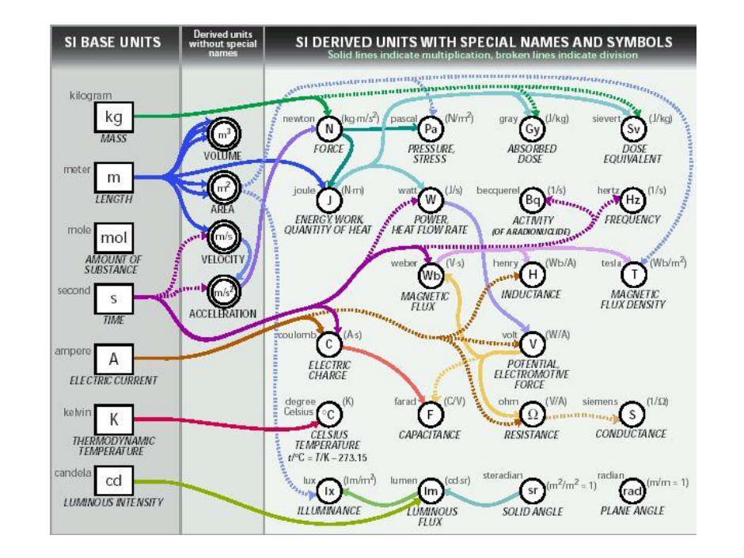
Derived Units

Slide 9
Dimensional Analysis

Slide 10
Dimensional Analysis

Slide 11
Dimensional Analysis

Slide 12
Dimensional Analysis

Slide 13
Significant Figures

Slide 14
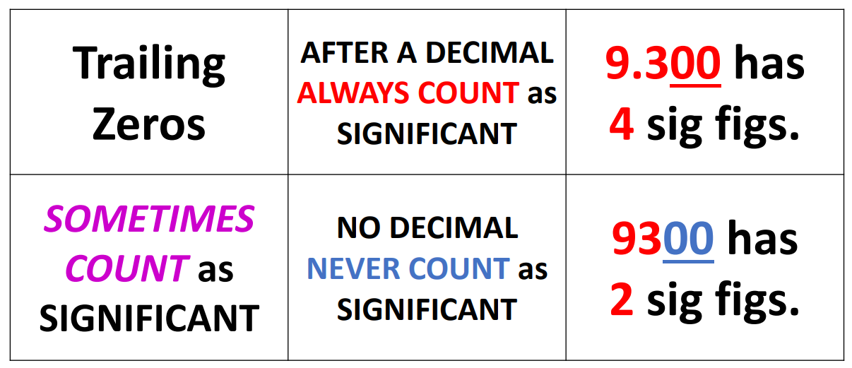
Significant Figures

Slide 15
Significant Figures

Slide 16
Properties and Changes

Slide 17
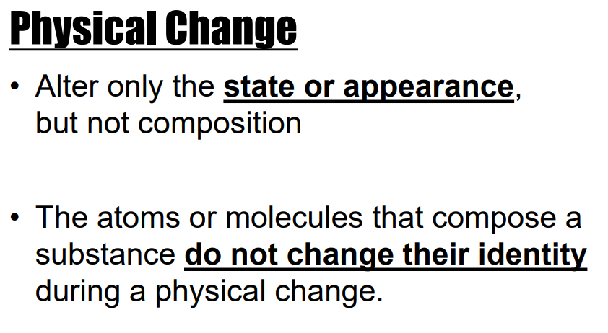
Properties and Changes

Slide 18
Types of Matter

Slide 19
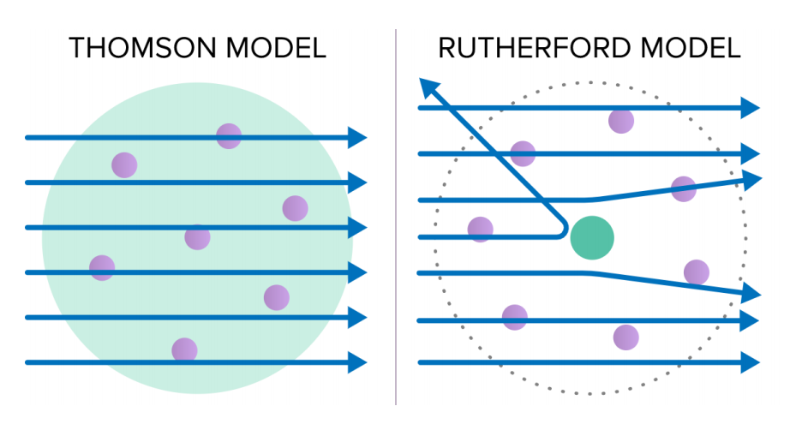
Atomic Models

Slide 20
Atomic Numbers

Slide 21
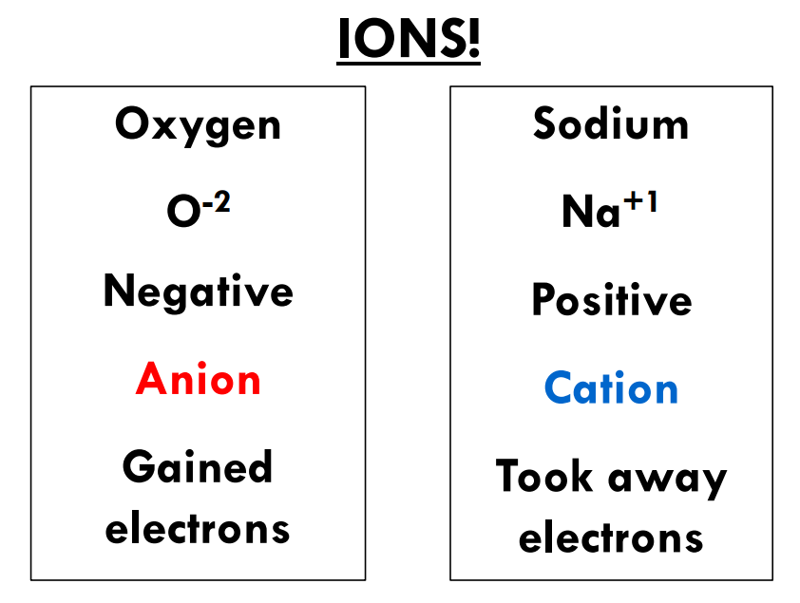
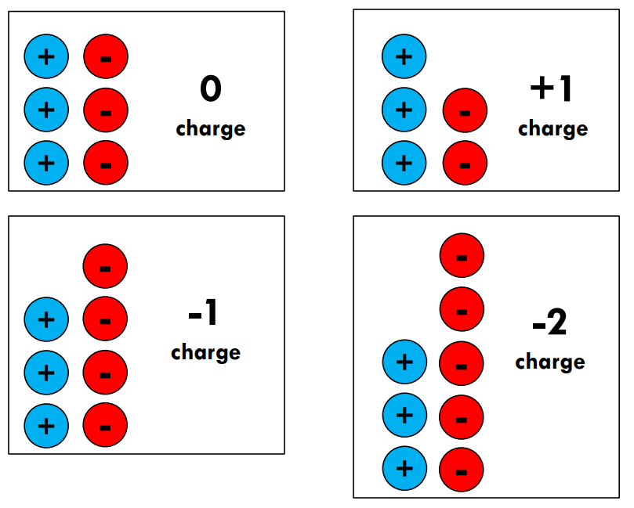
Atomic Numbers

Slide 22
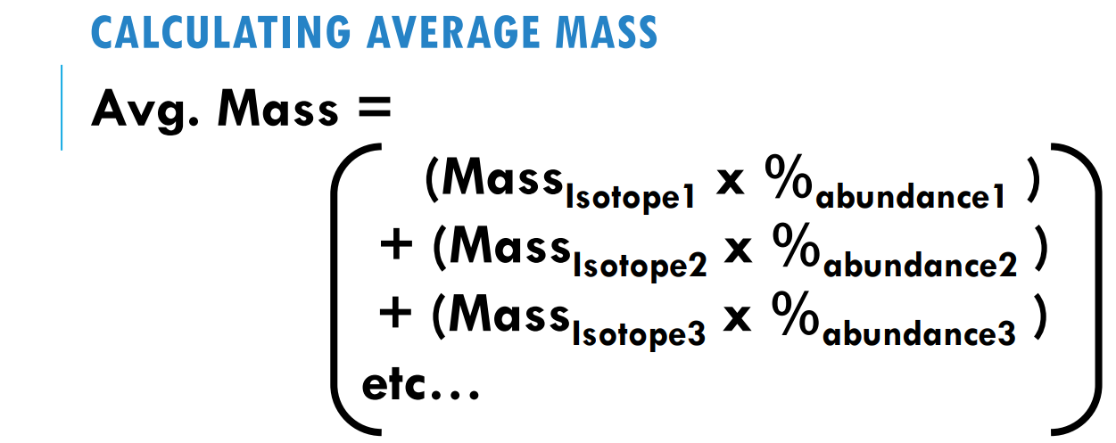
Average Mass Calcs.

Slide 23
Average Mass Calcs.

Slide 24
Unit #2 Nuclear Chemistry
**
Why things are radioactive
Types of radioactive particles
Writing and balancing nuclear equations
Decay series
Half Life

Slide 25
Nuclear Chemistry

Slide 26
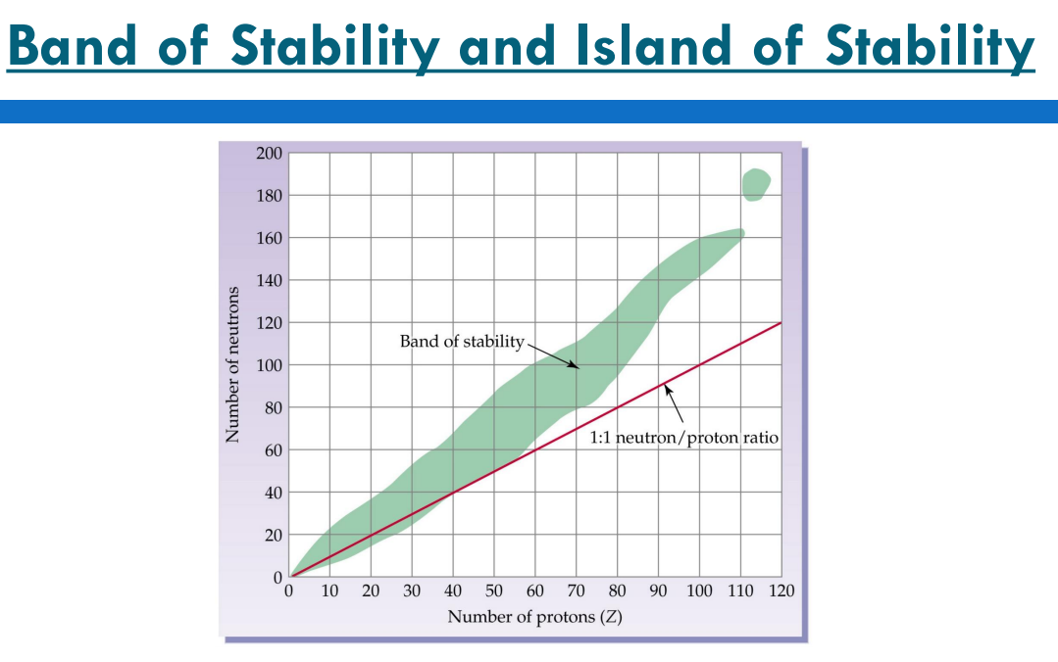
Nuclear Chemistry

Slide 27
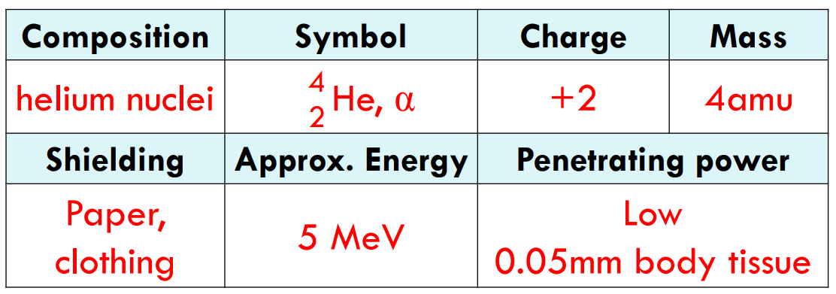
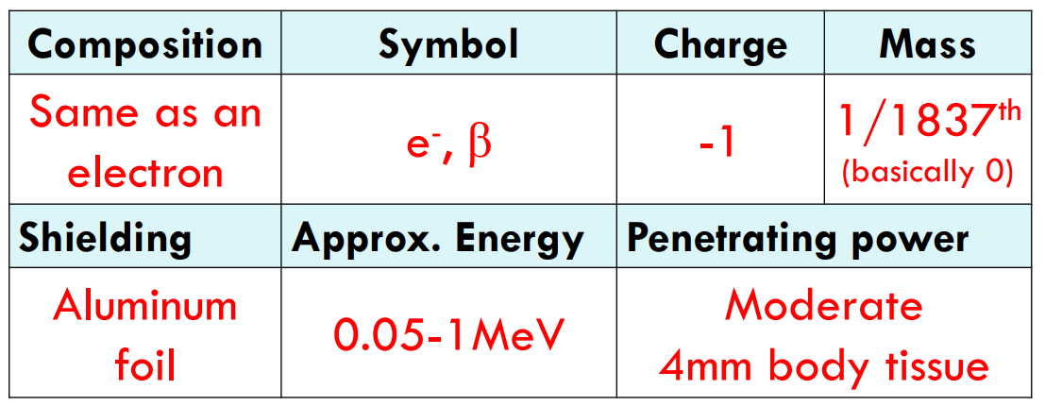
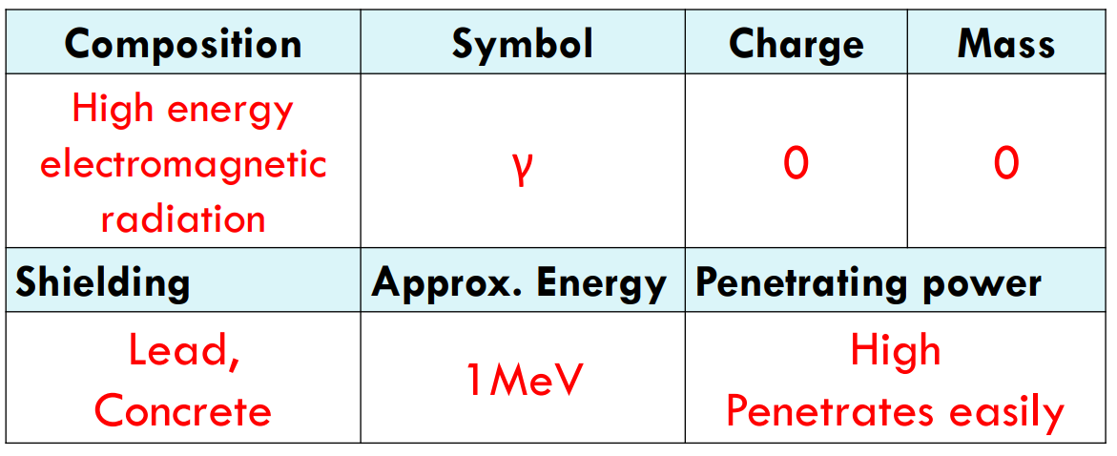
Radioactive particles
Alpha
Beta
Gamma

Slide 28
Writing Nuclear Equations
Alpha
Beta

Slide 29
Writing Nuclear Equations

Slide 30
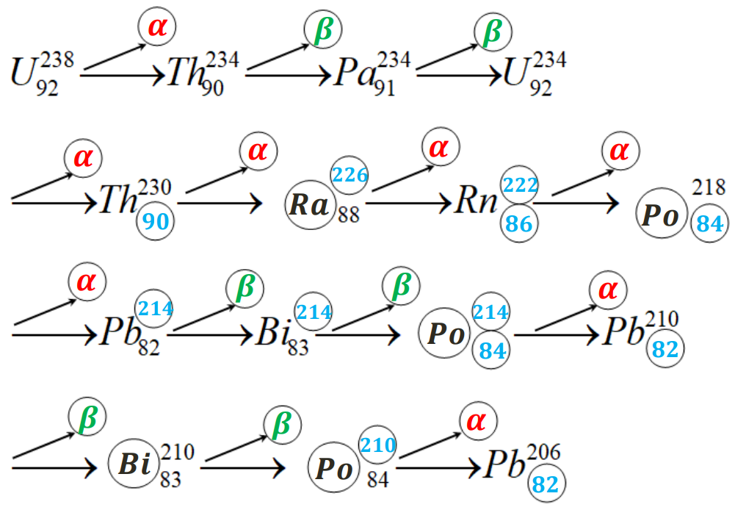
Decay Series

Slide 31
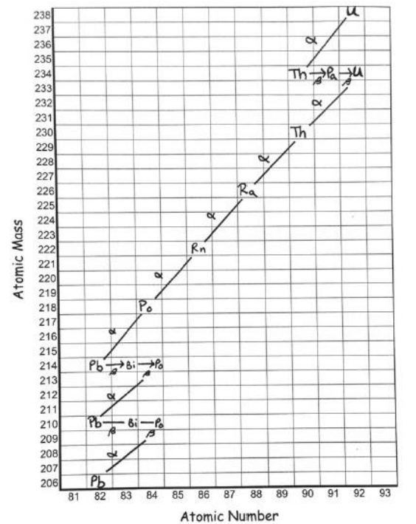
Decay Series

Slide 32
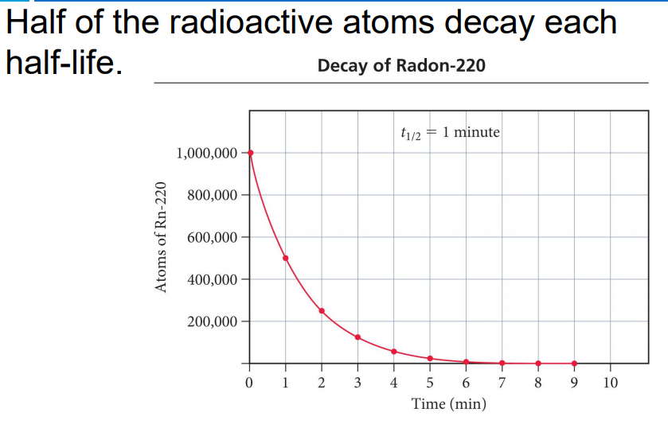
Half Life

Slide 33
Half Life

Slide 34
Half Life

Slide 35
Half Life

Slide 36
Unit #3 Electrons
Quantum mechanical theory
Orbital diagrams
Writing electron configurations
Noble Gas configuration
Configuration of ions
Absorption and emission

Slide 37
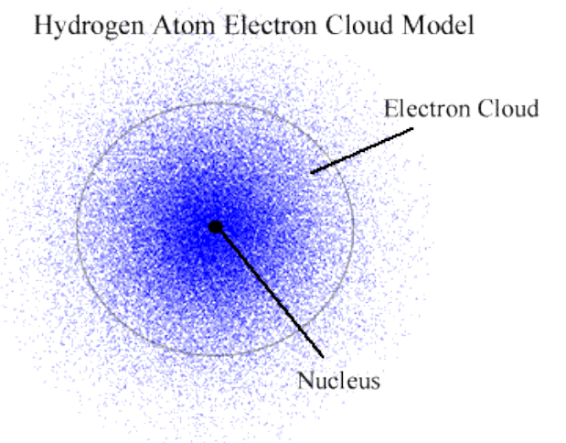
Quantum Mechanical Model

Slide 38
Orbital Diagrams

Slide 39
Orbital Diagrams

Slide 40
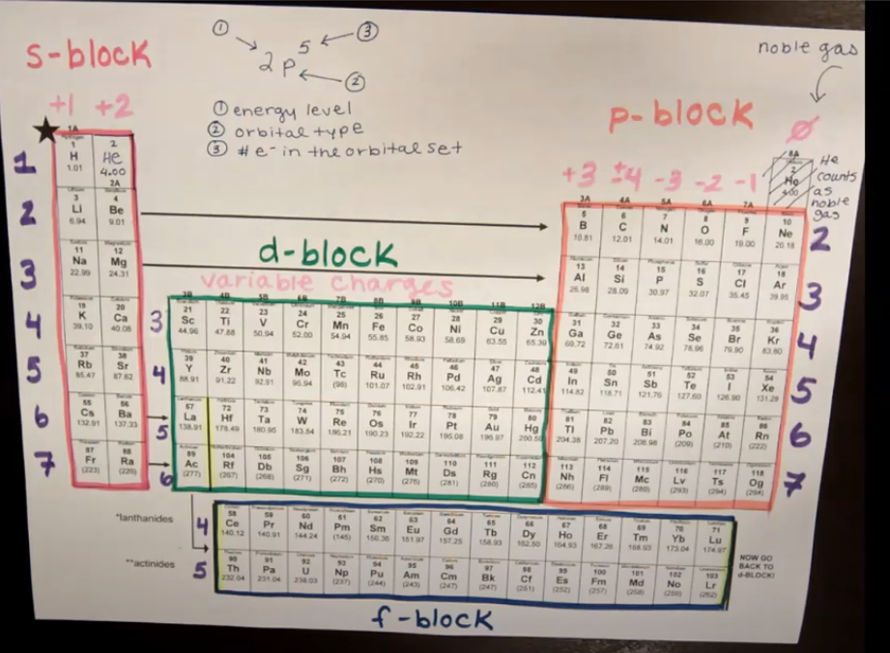
Writing Electron Config.

Slide 41
Noble Gas Config.

Slide 42
Config. of Ions

Slide 43
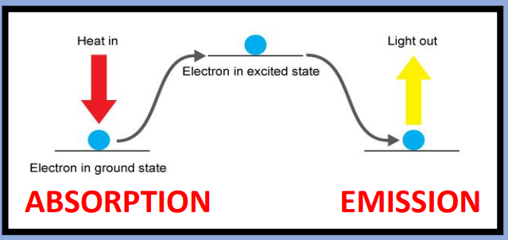
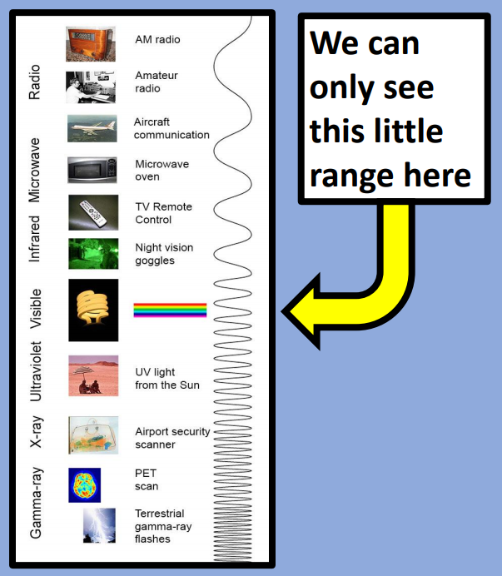
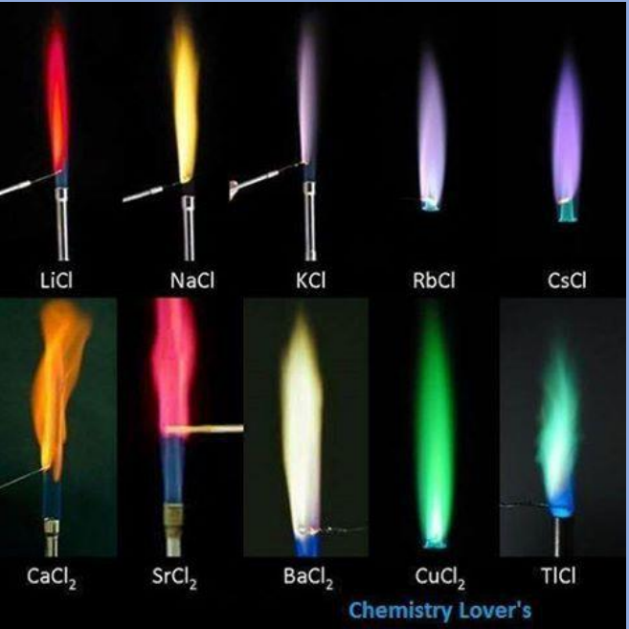
Absorption and Emission

Slide 44
Unit #4 Periodic Table
Structure of the periodic table
Periodic trends

Slide 45
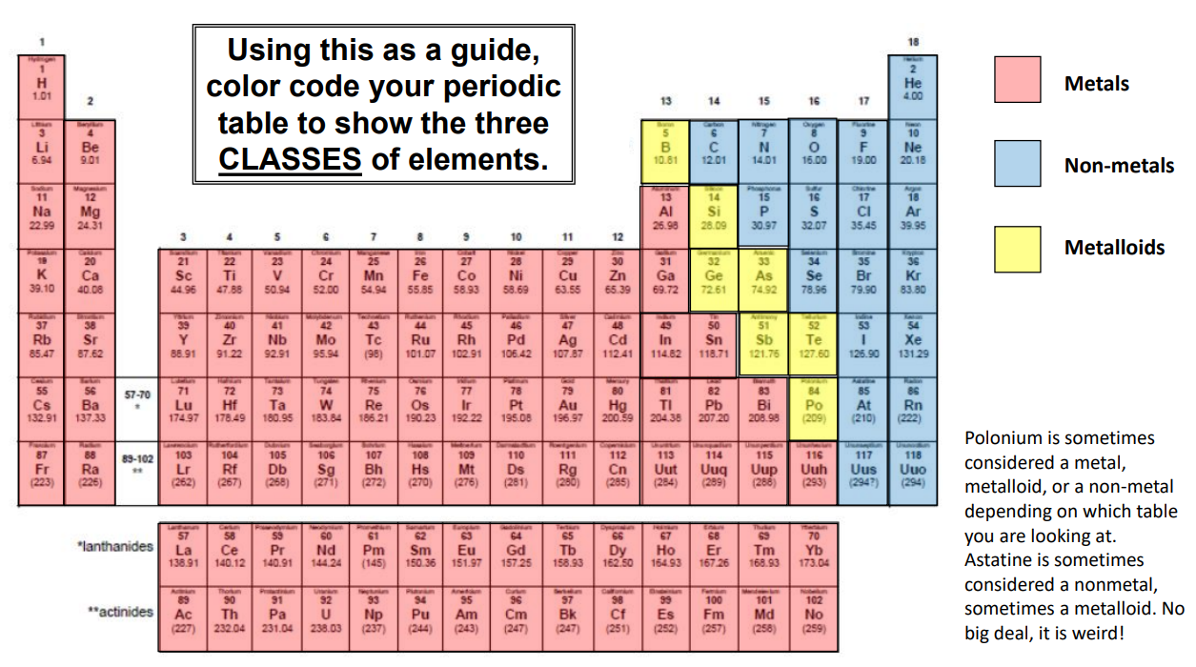
Periodic Table Structure

Slide 46
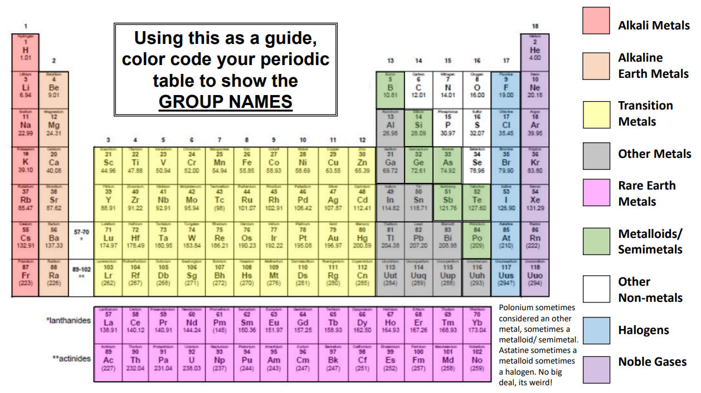
Periodic Table Structure

Slide 47
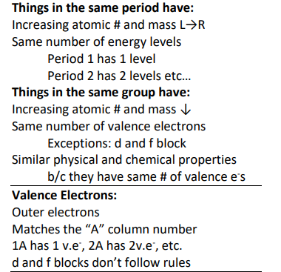
Periodic Table Structure

Slide 48
Periodic Trends

Slide 49
Periodic Trends

Slide 50
Periodic Trends

Slide 51
Periodic Trends

Slide 52
Periodic Trends

Slide 53
Periodic Trends

Slide 54
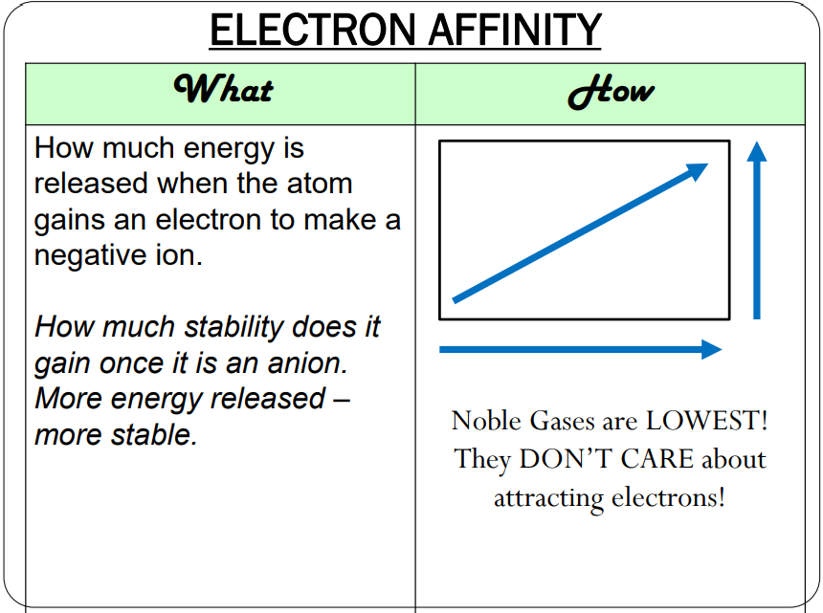
Periodic Trends

Slide 55
Periodic Trends

Slide 56
Periodic Trends

Slide 57
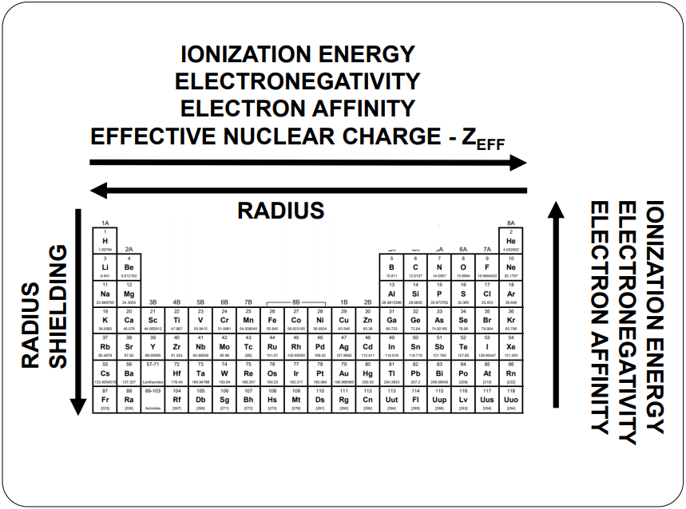
Periodic Trends

Slide 58
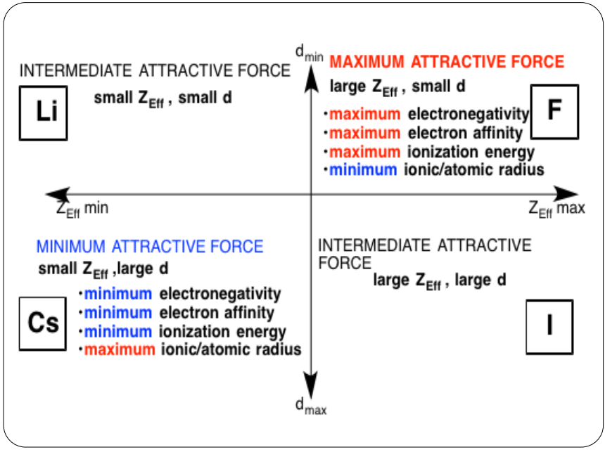
Periodic Trends

Slide 59
Unit #5 Bonding and Structure
Why bonds form
Types of bonds
Naming formulas
Writing neutral formulas
Lewis structures
VSPER
Hybridization
Polarity
Intermolecular forces

Slide 60
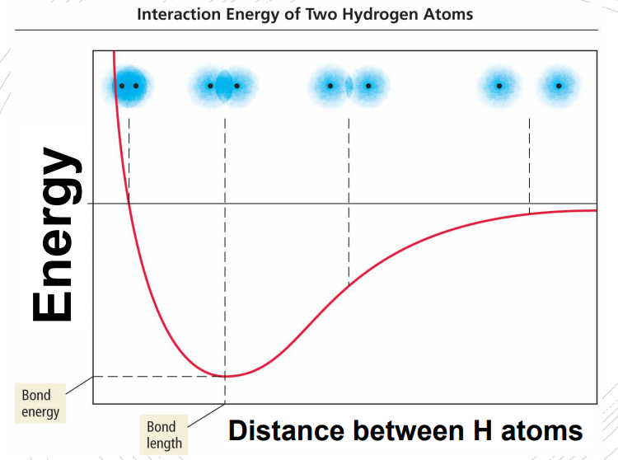
Why Bonds Form

Slide 61
Types of Bonds

Slide 62
Naming formulas

Slide 63
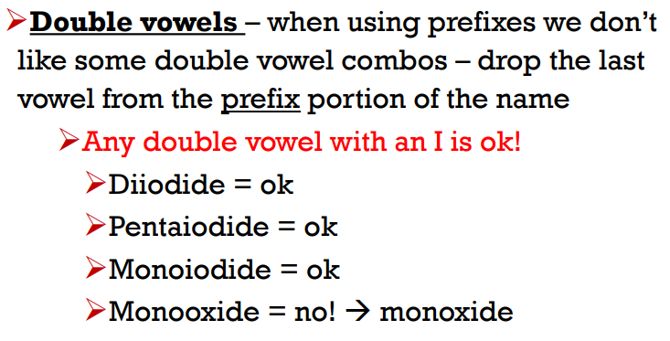
Naming formulas

Slide 64
Naming formulas

Slide 65
Naming formulas

Slide 66
Neutral Formulas

Slide 67
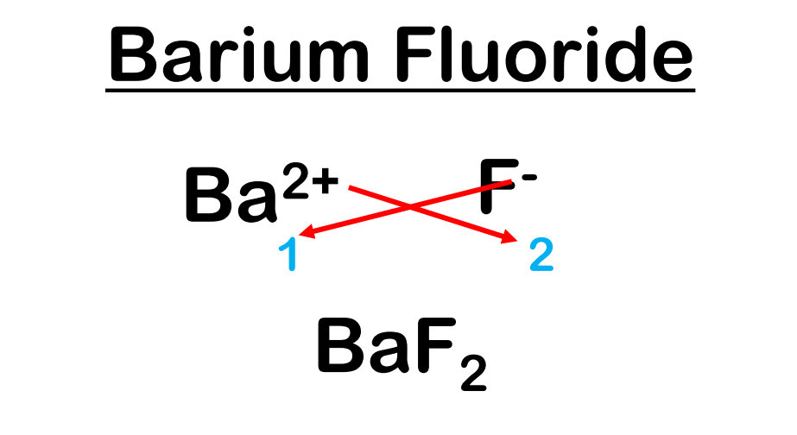
Neutral Formulas

Slide 68
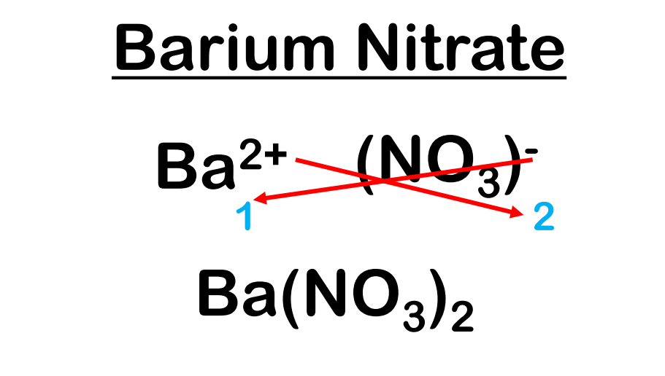
Neutral Formulas

Slide 69
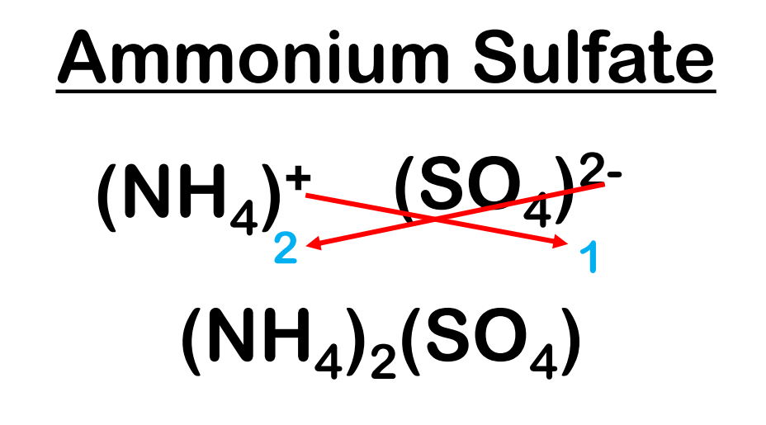
Naming formulas

Slide 70
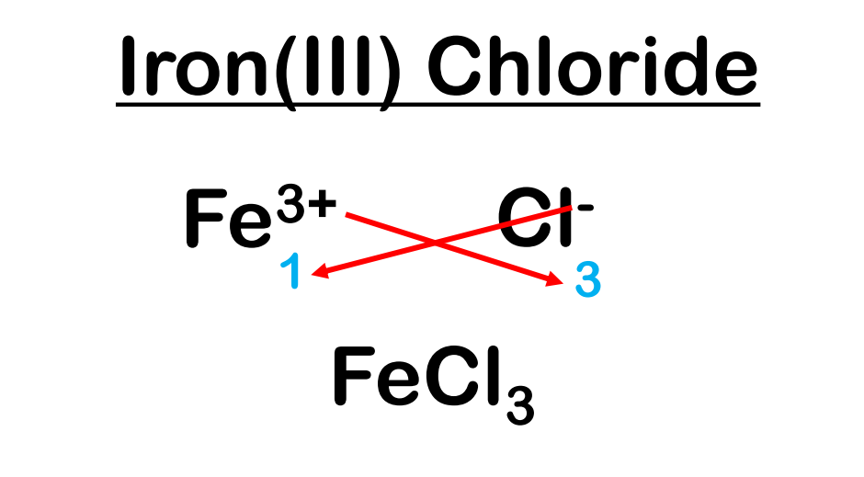
Neutral Formulas

Slide 71
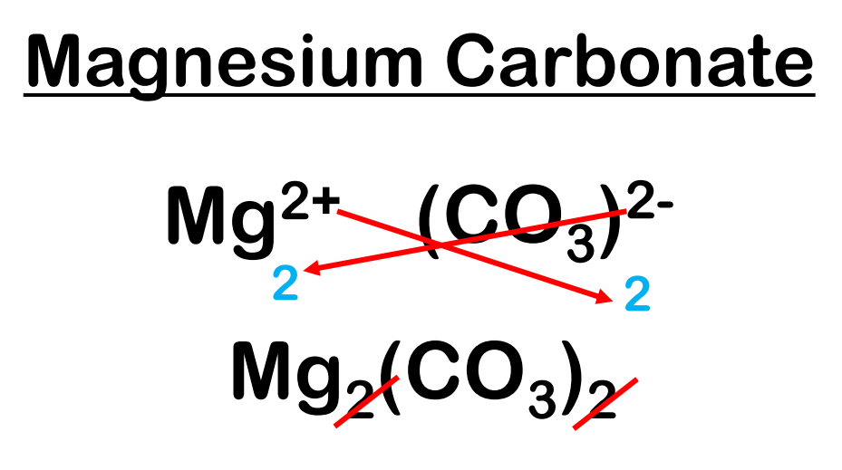
Neutral Formulas

Slide 72
Lewis Structures

Slide 73
Lewis Structures

Slide 74
Lewis Structures

Slide 75
VSEPR

Slide 76
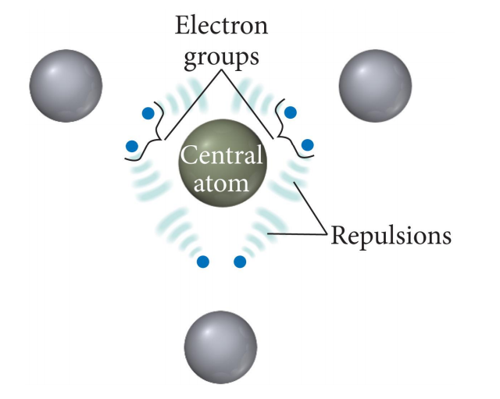
VSEPR

Slide 77
VSEPR

Slide 78
VSEPR

Slide 79
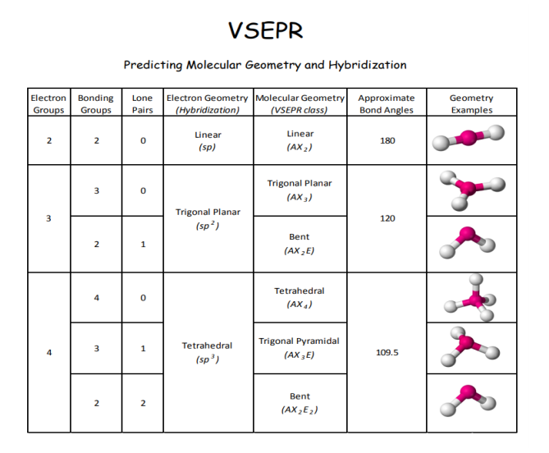
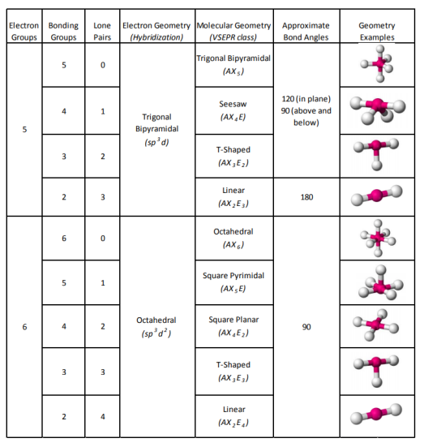
VSEPR

Slide 80
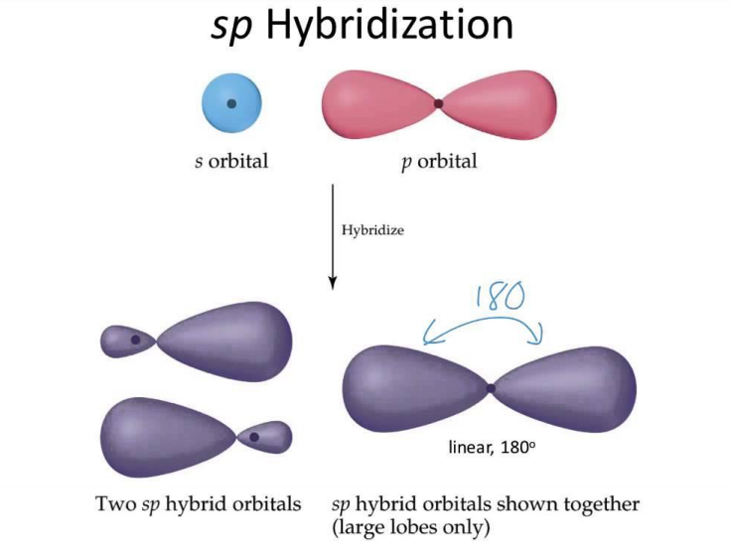
Hybrid- ization

Slide 81
Polarity

Slide 82
Polarity

Slide 83
Polarity

Slide 84
Polarity

Slide 85
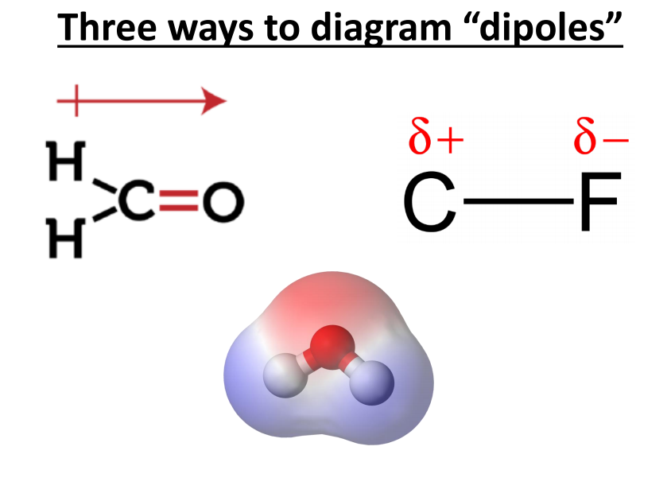
Polarity

Slide 86
IMFs

Slide 87
IMFs

Slide 88
IMFs

Slide 89
IMFs

Slide 90
IMFs

Slide 91
IMFs

Slide 92
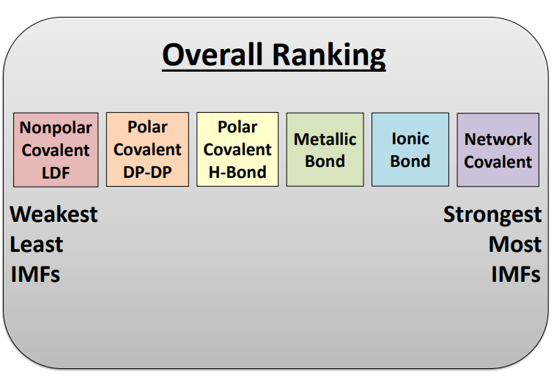
IMFs

Slide 93
Unit #6 Reactions
Signs of a chemical reaction
Balancing equations
Types of reactions
Predicting products
Net ionic equations

Slide 94
Reactions

Slide 95
Reactions

Slide 96
Reactions

Slide 97
Reactions

Slide 98
Reactions

Slide 99
Reactions

Slide 100
Reactions

Slide 101
Reactions

Slide 102
Reactions

Slide 103
Reactions

Slide 104
Reactions

Slide 105
Reactions

Slide 106
Reactions

Slide 107
Reactions

Slide 108
Reactions

Slide 109
Reactions

Slide 110
Reactions

Slide 112
Unit #7 Stoichiometry
The mole
Molar mass
Molar conversions
Mole ratio
Stoichiometry

Slide 113
Stoich.

Slide 114
Stoich.

Slide 115
Stoich.

Slide 116
Stoich.

Slide 117
Stoich.

Slide 118
Stoich.

Slide 120
Unit #8 Advanced Chemical Ratios
Limiting reagent stoichiometry
Percent composition
Empirical formulas
Combustion analysis

Slide 122
Unit #9 Gas Laws
KMT theory
Basic gas law equations
Ideal gas law equation
Dalton’s law of partial pressures
Gas stoichiometry
**
**

Slide 124
Unit #10 Thermochemistry
*
Specific heat
Calorimetry
Heating/cooling curves

Slide 126
Unit #11 Solutions
*
Solution vocabulary
Solubility
Solutions calculations

Slide 128
Unit #12 Kinetics
*
Rate affecting factors
Rate expressions
Average rates
Instantaneous rates
Rate laws
Method of initial rates

Slide 130
Unit #13 Equilibrium
*
Le Chatelier’s principle
Equilibrium constant
Equilibrium quotient
ICE Tables

Slide 132
Unit #14 Acids and Bases
*
**
Acid Base concepts
pH calculations
Strong acids and bases
Self ionization of water
Weak acids and bases
Salts
Titrations
**
**

Slide 134
Unit #15 Redox (part of Summer Assignment always)
Oxidation number
Oxidation vs reduction
Oxidizer vs reducer
Writing half reactions
Balancing redox reactions in an acidic or basic solution

