Slide 1
N2 - THERMOCHEMISTRY
A Quick Review
(and a little new stuff)
Link to YouTube Presentation: https://youtu.be/KMr6JO8JqBc

Slide 2
Reminder...
There are going to be WAY more words on these slides than you need to write down. WAY more than in my Honors Chem lecture slides. A huge part of AP Chem is constantly going back and reviewing previous material, self studying, etc. So my slides are formatted so that when you come back to them you have a bit more “verbiage” there to help you!
DO NOT COPY EVERYTHING DOWN DURING LECTURE!
If you think you need to add more detail after class, that is why we do annotations as a homework assignment after we’ve taken the notes! Listen to me talking, take down *notes* and review and add to your notes later.
You are not a PHOTOCOPIER! You are a NOTE TAKER!

Slide 3
Notes Requirements
Highlighter line after KCQ boxes to separate next assignment
Big, bold, obvious title and number
Example: N2 – Thermochem a Quick Review
Target in RED PEN
Do NOT squish your notes! Do NOT write everything!
Add annotations in three different colors.
Not JUST highlighting everything!
KCQ boxes added at the end of the notes
K = key terms. List them, don’t define them.
C = connection. Write a SPECIFIC connection to something you already know from another class, a TV show, real life, etc.
Q = two questions, one “higher level” not just a definition based question. Do not have to answer them.

Slide 4
N2 - THERMOCHEMISTRY
A Quick Review (and a little new stuff)
Target: I can remember my Thermochem topics from Honors Chem, and can apply the 1st Law of Thermodynamics to various problems.

Slide 5
Things to Remember from Honors Chem...
If you are not comfortable, proficient, and QUICK at these then go back and review Honors Chem notes/videos/worksheets, etc.

Slide 6
Things to Remember from Honors Chem...
DON’T NEED TO WRITE DOWN
If you are not comfortable, proficient, and QUICK at these then go back and review Honors Chem notes/videos/worksheets, etc.
Specific Heat Calculations q = mC∆T Molar Heats are the same concept, just with # moles of material not mass – UNITS! | Endothermic vs. Exothermic Endo, absorbed, q = + Exo, released, q = - How to draw a reaction coordinate diagram for each
Calorimetry Calculations q_{absorbed} = - q_{released} | Heating Curve Calculations Heating/cooling q = mC∆T Phase changes, q = mL

Slide 7
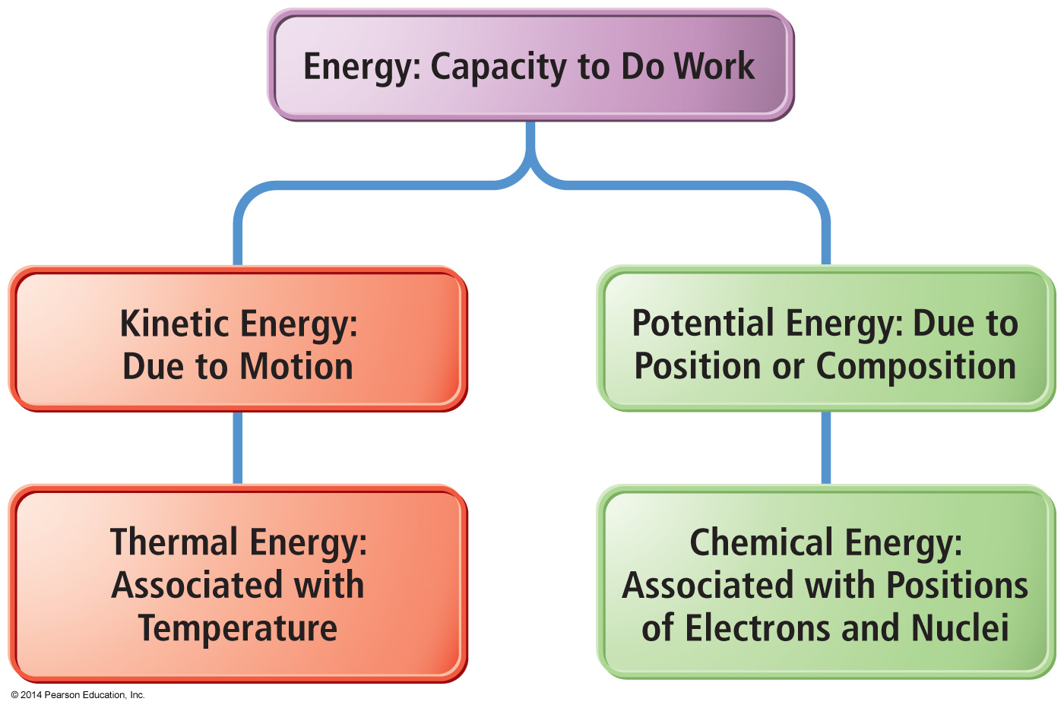
Manifestations of Energy
DON’T NEED TO WRITE DOWN

Slide 8
Some Forms of Energy
Electrical Kinetic energy → flow of electrical charge | Heat or thermal energy Kinetic energy → molecular motion
Light or radiant energy Kinetic energy → energy transitions in atom | Nuclear Potential energy → in the nucleus of atoms
Chemical Potential energy → structure of the atoms, attachment between atoms, position of atoms relative to each other in the molecule, and/or the position of the molecule relative to the larger structure

Slide 9
Calculating Kinetic Energy
Amount of kinetic energy an object has is directly proportional to its mass and velocity.
Mass | kg
Velocity | m/s
Kinetic energy
$$KE= \frac{1}{2}mv^{2}$$
$$\frac{kg •m^{2}}{s^{2}}$$
$$1 Joule =1 \frac{kg {• m}^{2}}{s^{2}}$$
= amount of energy needed to move a 1 kg mass at a speed of 1 m/s.

Slide 10
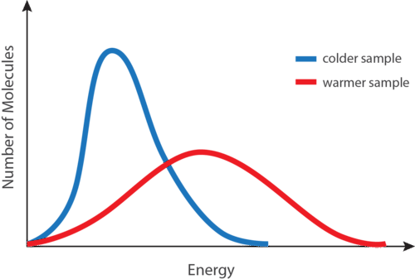
Connecting KE to Temperature
Particles in a warmer object have higher average KE

Slide 11
KE and Speed are NOT the same thing!
Things at the same temperature have the same (average) kinetic energy, but not necessarily the same velocity!
A sample of He and Ne are at 25°C. Which element has the higher velocity?
He
$$KE= \frac{1}{2}mv^{2}$$
Ne
They both are the same

Slide 12
KE and Speed are NOT the same thing!
Things at the same temperature have the same (average) kinetic energy, but not necessarily the same velocity!
A sample of He and Ne are at 25°C. Which element has the higher velocity?
He
$$KE= \frac{1}{2}mv^{2}$$
Ne
They both are the same

Slide 13
KE and Speed are NOT the same thing!
Things at the same temperature have the same (average) kinetic energy, but not necessarily the same velocity!
A sample of He and Ne are at 25°C. Which element has the higher kinetic energy?
He
$$KE= \frac{1}{2}mv^{2}$$
Ne
They both are the same

Slide 14
KE and Speed are NOT the same thing!
Things at the same temperature have the same (average) kinetic energy, but not necessarily the same velocity!
A sample of He and Ne are at 25°C. Which element has the higher kinetic energy?
He
$$KE= \frac{1}{2}mv^{2}$$
Ne
They both are the same

Slide 15
Important Laws!
Law of conservation of energy, 1st Law of Thermodynamics
Energy cannot be created nor destroyed. The total energy content of the universe is constant
Can only transfer or convert energy
Amount of energy when starting must equal energy at the end.

Slide 16
Convenient!
Allows us to be creative with our measurements and calculations! Can measure things INDIRECTLY!
Energy_{absorbed} = - Energy_{released}
Sometimes it is difficult to measure the system you are actually interested in, but it might be easy to measure the surroundings! If you know info about one, you can determine the other!

Slide 17
System and Surroundings
We study the exchange of energy between the system and the surroundings.
System | Surroundings
The material or process which we are studying the energy changes within.
Everything else with which the system can exchange energy.

Slide 18
Energy Change in Chemical Processes
Endothermic
System absorbs energy
Surroundings release energy
System energy increases
Surrounding energy decr.
+ q_{system}
- q_{surroundings}
If you touch the container YOU feel cold – system is taking heat away from YOU! Your thermometer is in the SURROUNDNGS so the temperature it reads decreases!

Slide 19
Endothermic Reactions
+ q_{system}
- q_{surroundings}

Slide 20
Energy Change in Chemical Processes
Exothermic
System releases energy
Surroundings absorb energy
System energy decreases
Surrounding energy incr.
- q_{system}
+ q_{surroundings}
If you touch the container YOU feel hot – system is releasing heat towards YOU! Your thermometer is in the SURROUNDINGS so the temperature it reads increases!

Slide 21
Exothermic Reactions
- q_{system}
+ q_{surroundings}

Slide 22
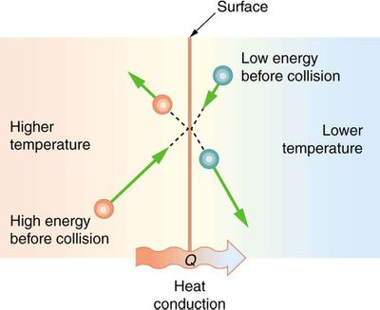
Heat Transfer
Particles will collide with each other. Energy can be transferred during these collisions.
Some particles will slow down, some will speed up.
Heat transfers from HOT → COLD

Slide 23
Heat Transfer
Eventually, thermal equilibrium is reached.
Average KE of both substances will be the same.
Temperatures are the same.
That’s why T_{final} for both substances is the same at the end of a calorimetry experiment!

Slide 24
Calorimetry
Measuring heat absorbed or released.
Usually by change in temp for a known mass of water.
We are measuring the reaction energy INDIRECTLY – can’t measure the system but we CAN measure the surroundings easily!
Water = Surroundings (usually)
1 calorie is the heat required to raise the temp of 1 gram of water by 1 °C
1 BTU is the heat required to raise the temp of 1 pound of water by 1 °F

Slide 25
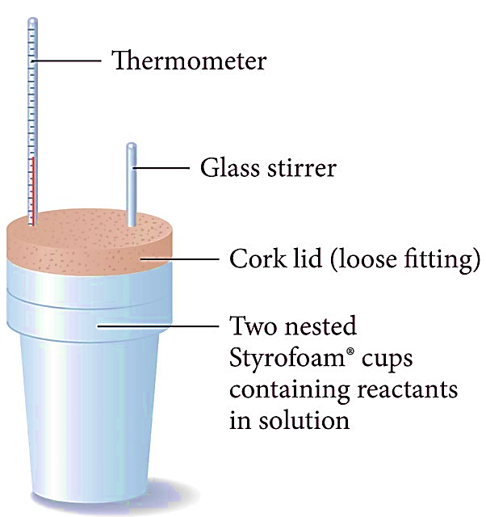
A Cheap Calorimeter – Coffee Cup!

Slide 26
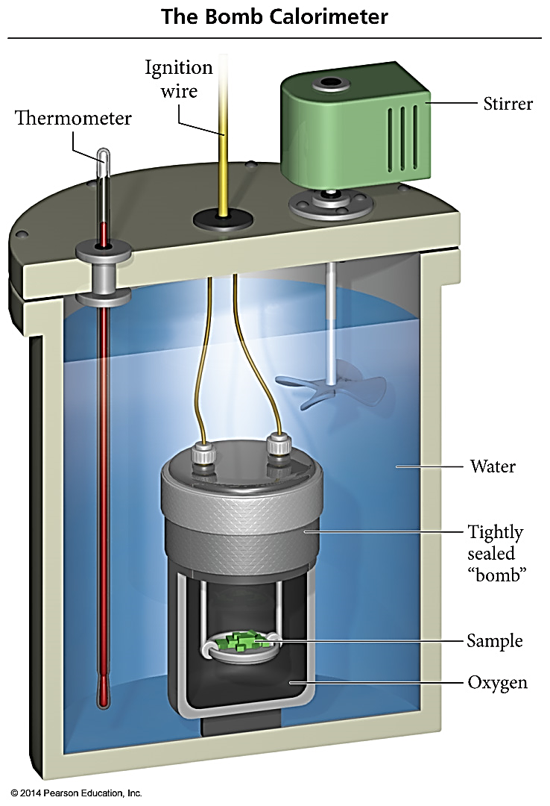
Bomb Calorimeter
Used to measure ΔE because it is a constant volume system.
The heat capacity of the calorimeter = amount of heat absorbed by the calorimeter for each degree rise in temperature = calorimeter constant.
C_{cal}, kJ/ºC
C_{cal} has different units! It is NOT J/g°C because there is no mass portion! So NOT Q = mC∆T ........ just Q = C∆T !

Slide 27
State Functions
Two trails to the top:
Long and winding
Short but steep
Regardless of the trail, when you reach the top you will be 10,000 ft above the base.
The elevation change is a state function. It depends only on the starting and ending heights, not on which trail!
The time it takes would NOT be a state function.

Slide 28
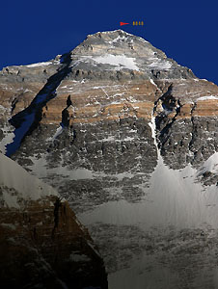
Depend ONLY on the present state of the system
State Functions
ENERGY IS A STATE FUNCTION
A person standing at the top of Mt. Everest has the same potential energy whether they got there by hiking up, or by falling down from a plane!
WORK IS NOT A STATE FUNCTION

Slide 29
Some Practice Problems and Reminders on Specific Heat, Latent Heat, Molar Heat, and Calorimetry

Slide 30
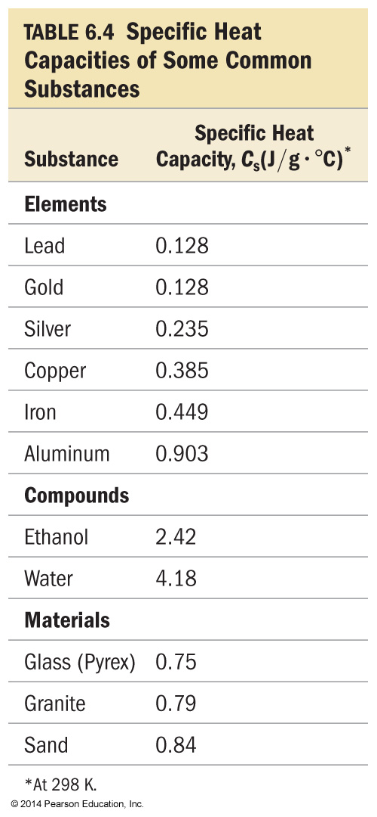
Specific Heat Capacity
Measure of a substance’s intrinsic ability to absorb heat.
Specific heat capacity - amount of heat energy required to raise the temp of one gram of a substance 1 °C.
C_{s} Units J/(g ∙ °C)
Molar heat capacity - amount of heat energy required to raise the temp of one mole of a substance 1 °C.

Slide 31
Calculations Involving Specific Heat
OR
q = Heat lost or gained
m = Mass
c = Specific Heat Capacity
ΔT = Temperature change

Slide 32
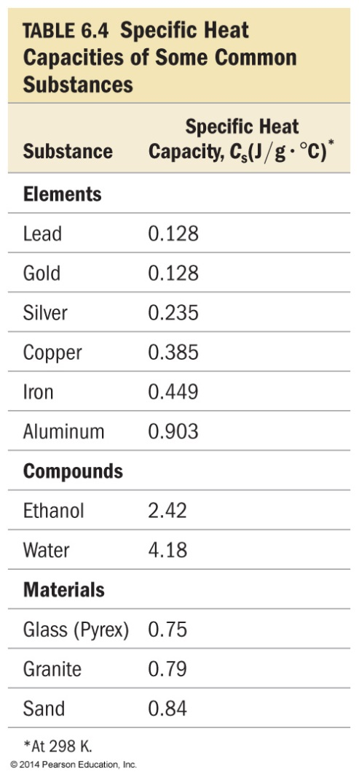
Q#1 Identical amounts of heat are applied to 50 g blocks of lead, silver, and copper, all at an initial temp of 25°C. Which block will have the largest increase in temp?
Lead
Silver
Copper
None, all will be at the same temp
Notes:
Answer: c

Slide 33
Q#1 Identical amounts of heat are applied to 50 g blocks of lead, silver, and copper, all at an initial temp of 25°C. Which block will have the largest increase in temp?
Lead
$$Q=mC∆T$$
$$∆T= \frac{Q}{mC}$$
Silver
Copper
None, all will be at the same temp
Smallest C gives you largest ∆T
Notes:
Answer: c

Slide 34
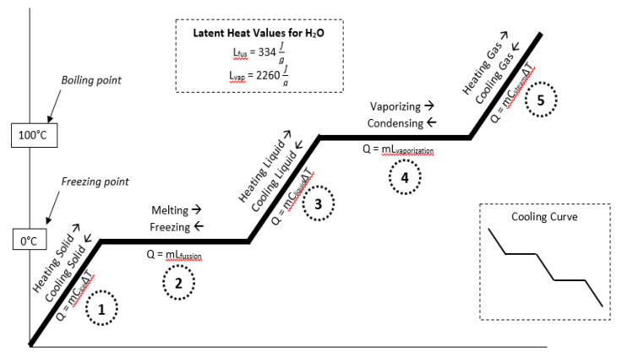
Heating Curves and Latent Heat

Slide 35
Heating Curves and Latent Heat

Slide 36
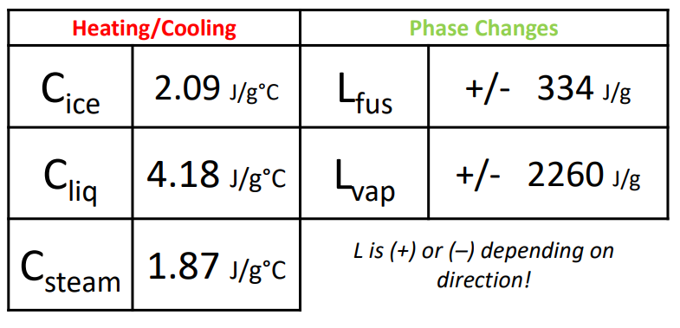
Heating Curves and Latent Heat

Slide 37
Q#2 Determine the energy required to convert 21.1 grams of ice at -6°C to steam at 100°C
63.8 kJ
46.7 kJ
68.8 kJ
8.82 kJ
9.35 kJ

Slide 38
Q#2 Determine the energy required to convert 21.1 grams of ice at -6.00°C to steam at 100.°C
63.8 kJ
46.7 kJ
68.8 kJ
8.82 kJ
9.35 kJ

Slide 39
Molar Heat
Energy required to raise the temp of one MOLE of a substance by one degree.
Q = nC∆T

Slide 40
Q#3 A sample of barium chloride is increased in temperature by 3.8C when the sample absorbed 2.4 x 10²J of heat energy. Calculate the number of moles of barium chloride in the sample if its molar heat capacity is 75.1 J/mol•K
6.8 x 10⁴ mol
4.7 x 10³ mol
1.2 mol
0.84 mol
3.7 mol

Slide 41
Q#3 A sample of barium chloride is increased in temperature by 3.8C when the sample absorbed 2.4 x 10²J of heat energy. Calculate the number of mole sof barium chloride in the sample if its molar heat capacity is 75.1 J/mol•K
6.8 x 10⁴ mol
4.7 x 10³ mol
1.2 mol
0.84 mol
3.7 mol

Slide 42
Thermal Energy Transfer (Calorimetry)
A block of metal at 55 °C is added to water at 25 °C.
Thermal energy transfers heat from the metal to the water.
The exact temperature change depends on:
Mass of the metal
Mass of water
Specific heat capacities of the metal and of water
Equal but OPPOSITE !!!
So if q = mC∆T...
$$−q_{metal}=+q_{water}$$
-

Slide 43
Q#4 The temperature of a 700.0-g bar of iron decreases by 10.0°C when the iron is plunged into 500.0 g of water. What is the temperature increase of the water, assuming that no heat is lost in the transfer? (C_{Fe} = 0.45 J/g°C)
3.0°C
1.5°C
1.7°C
1.3°C
None of the above

Slide 44
Q#4 The temperature of a 700.0-g bar of iron decreases by 10.0°C when the iron is plunged into 500.0 g of water. What is the temperature increase of the water, assuming that no heat is lost in the transfer? (C_{Fe} = 0.45 J/g°C)
3.0°C
$$Qwater=−Qmetal$$
$$mC∆T=−mC∆T$$
$$\left(500\right)\left(4.18\right)\left(∆T\right)=−\left(700\right)\left(0.45\right)\left(−10\right)$$
$$∆T=1.51 ℃$$
1.5°C
1.7°C
1.3°C
None of the above

Slide 45
Q#5 50.0 g of water at 22 °C is mixed with 125 g of water initially at 36 ° C. What is the final temperature of the water after mixing, assuming no heat is lost to the surroundings?
*THINK* - Use this to check your work! 50g @ 22°C and 125g @ 36°C with same C…
Won’t end exactly halfway. Will end closer to 36°C than 22°C. Cant end at 36°C or higher than 36°C…
29°C
42°C
32°C
30°C
None of the above
Notes:
Answer: c

Slide 46
Q#5 50.0 g of water at 22 °C is mixed with 125 g of water initially at 36 ° C. What is the final temperature of the water after mixing, assuming no heat is lost to the surroundings?
*THINK* - Use this to check your work! 50g @ 22°C and 125g @ 36°C with same C…
Won’t end exactly halfway. Will end closer to 36°C than 22°C. Cant end at 36°C or higher than 36°C…
$$Q1=−Q2$$
$$mC∆T=−mC∆T$$
$$\left(50\right)\left(4.18\right)\left(Tf−22℃\right)=−\left(125\right)\left(4.18\right)\left(Tf−36\right)$$
$$Tf=32 ℃$$
29°C
42°C
32°C
30°C
None of the above
Notes:
Answer: c

Slide 47
YouTube Link to Presentation
https://youtu.be/KMr6JO8JqBc

