Slide 1
N3 - THERMOCHEMISTRY
Hess’s Law
Link to YouTube Presentation: https://youtu.be/5NDv9TwaVXw

Slide 2
Reminder...
There are going to be WAY more words on these slides than you need to write down. WAY more than in my Honors Chem lecture slides. A huge part of AP Chem is constantly going back and reviewing previous material, self studying, etc. So my slides are formatted so that when you come back to them you have a bit more “verbiage” there to help you!
DO NOT COPY EVERYTHING DOWN DURING LECTURE!
If you think you need to add more detail after class, that is why we do annotations as a homework assignment after we’ve taken the notes! Listen to me talking, take down *notes* and review and add to your notes later.
You are not a PHOTOCOPIER! You are a NOTE TAKER!

Slide 3
N3 - THERMOCHEMISTRY
Hess’s Law
Target: I can use Hess’s Law to calculate the unknown total enthalpy change during a reaction by adding together individual baby steps that I do know the enthalpy change for.

Slide 4
Its just a puzzle!
Sometimes it’s a really hard puzzle… but it’s still just a puzzle!
All the pieces are there, you just have to figure out how to put them together…
Unfortunately, no real “tricks” for how to figure out which parts to put together.

Slide 5
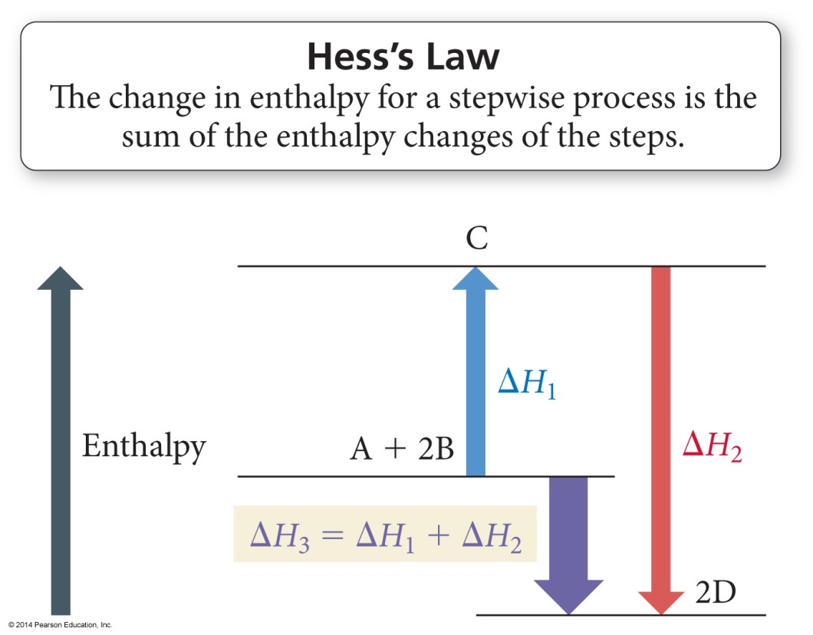
Hess’s Law
“In going from a particular set of reactants to a particular set of products, the change in enthalpy is the same whether the reaction takes place in one step or a series of steps.”

Slide 6
First...What is “Enthalpy” ????
It is related to energy.
It takes into account any change in pressure and volume.
E = energy
H = E + PV (pressure, volume)
We assume our reactions are not at crazy high pressures, and that they do not have crazy changes in volume.
So.... PV is negligible.
So from a practical standpoint in this class... H = E

Slide 7
Hess’s Law
Path A – Mrs. Farmer cleaning the house.
Path B – Mr. Farmer cleaning the house.
Regardless of the path taken, you still get to the same place.
Although Path B drives Mrs. Farmer bonkers – Ha!

Slide 8
Relationships Involving ΔH_{rxn}
Multiplying Rxn by a # to Change Coefficients ΔH_{rxn} is multiplied by that factor.
Because ΔH_{rxn} is extensive – depends on the amount of substance
C(s) + O₂(g) → CO₂(g) ΔH = −393.5 kJ/mol_{rxn}
2 C(s) + 2 O₂(g) → 2 CO₂(g) ΔH = 2 x (−393.5 kJ) = −787.0 kJ/mol_{rxn}
Reversing a rxn to flip which side the products/reactants are on Flip the sign of ΔH, if positive now negative, if negative, now positive
C(s) + O₂(g) → CO₂(g) ΔH = −393.5 kJ/mol_{rxn}
CO₂(g) → C(s) + O₂(g) ΔH = − (−393.5) = + 393.5 kJ/mol_{rxn}

Slide 9
Standard Conditions
Standard State The state of a material at a defined set of conditions.
Pure gas at 1 atm pressure
Substances in a solution with a 1M concentration
Pure solid or liquid in its most stable form at 1 atm pressure and temperature of interest (usually 25°C)

Slide 10
Standard Enthalpy Change
Standard Enthalpy Change ∆H° - the Enthalpy change when all reactants and products are in their standard states.
That’s what the ° symbol means – that it is under the standard conditions. You can have ∆H values that are not at standard conditions, then you leave the ° off.

Slide 11
Standard Enthalpy of Formation
Standard Enthalpy of Formation ∆H°_{f} - the Enthalpy change for the reaction forming 1 mole of a pure compound from its elements.
NO! 2H₂ + O₂ → 2 H₂O ∆H_{f} = -572 kJ/mol_{rxn}
YES! H₂ + ½ O₂ → H₂O ∆H°_{f} = -286 kJ/mol_{rxn}
Elements must be in their standard states
∆H°_{f} for a pure element in its standard state = 0 kJ/mol_{rxn}
That includes diatomic gases! They are still pure elements!

Slide 12
Hess’s Law Example Problem #1
Calculate ΔH for the combustion of methane, CH₄:
CH₄ + 2O₂ → CO₂ + 2H₂O
# | Reaction | ΔHº
1 | C + 2H₂ → CH₄ | -74.80 kJ
2 | C + O₂ → CO₂ | -393.50 kJ
3 | H₂ + ½ O₂ → H₂O | -285.83 kJ
Step #1: CH₄ must appear on the reactant side, so we reverse reaction #1 and change the sign on ΔH.
- rxn 1
CH₄ → C + 2H₂ +74.80 kJ

Slide 13
Hess’s Law Example Problem #1
Calculate ΔH for the combustion of methane, CH₄:
CH₄ + 2O₂ → CO₂ + 2H₂O
# | Reaction | ΔHº
1 | C + 2H₂ → CH₄ | -74.80 kJ
2 | C + O₂ → CO₂ | -393.50 kJ
3 | H₂ + ½ O₂ → H₂O | -285.83 kJ
Step #2: Keep reaction #2 unchanged, because CO₂ belongs on the product side
- rxn 1
CH₄ → C + 2H₂ +74.80 kJ
rxn 2
C + O₂ → CO₂ -393.50 kJ

Slide 14
Hess’s Law Example Problem #1
Calculate ΔH for the combustion of methane, CH₄:
CH₄ + 2O₂ → CO₂ + 2H₂O
# | Reaction | ΔHº
1 | C + 2H₂ → CH₄ | -74.80 kJ
2 | C + O₂ → CO₂ | -393.50 kJ
3 | H₂ + ½ O₂ → H₂O | -285.83 kJ
Step #3: Use reaction #3 to get water as a product,
but multiply it by 2 since you have 2 H₂O
- rxn 1
CH₄ → C + 2H₂ +74.80 kJ
rxn 2
C + O₂ → CO₂ -393.50 kJ
2 x rxn 3
2H₂ + O₂ → 2H₂O 2 x (-285.83 kJ)

Slide 15
Hess’s Law Example Problem #1
Calculate ΔH for the combustion of methane, CH₄:
CH₄ + 2O₂ → CO₂ + 2H₂O
# | Reaction | ΔHº
1 | C + 2H₂ → CH₄ | -74.80 kJ
2 | C + O₂ → CO₂ | -393.50 kJ
3 | H₂ + ½ O₂ → H₂O | -285.83 kJ
Step #4: Cross out things that show up on both sides, then sum up your ∆H values
- rxn 1
CH₄ → C + 2H₂ +74.80 kJ
rxn 2
C + O₂ → CO₂ -393.50 kJ
2 x rxn 3
2H₂ + O₂ → 2H₂O 2 x (-285.83 kJ)
CH₄ + 2O₂ → CO₂ + 2H₂O -890.36 kJ
/mol_{rxn}

Slide 16
Rxn #1) ½ N₂ (g) + ½ O₂ (g) → NO (g) ΔH = 90.3 kJ Rxn #2) NO (g) + ½ Cl₂ (g) → NOCl (g) ΔH = –38.6 kJ
Hess’s Law Example Problem #2
2 NOCl (g) → N₂ (g) + O₂ (g) + Cl₂ (g) ΔH = ?
-51.7 kJ
51.7 kJ
-103.4 kJ
103.4 kJ
142.0 kJ
Notes:
Answer: c

Slide 17
Rxn #1) ½ N₂ (g) + ½ O₂ (g) → NO (g) ΔH = 90.3 kJ Rxn #2) NO (g) + ½ Cl₂ (g) → NOCl (g) ΔH = –38.6 kJ
Hess’s Law Example Problem #2
2 NOCl (g) → N₂ (g) + O₂ (g) + Cl₂ (g) ΔH = ?
-51.7 kJ
Rxn # | How to change it | Rxn | ∆H
2 | - and x 2 | 2 NOCl → 2NO + Cl₂ | -2 (-38.6)
1 | - and x 2 | 2NO → N₂ + O₂ | - 2 (90.3)
 |  | 2NOCl → N₂ + O₂ + Cl₂ | -103.4 kJ
51.7 kJ
-103.4 kJ
103.4 kJ
142.0 kJ
Notes:
Answer: c

Slide 18
Rxn #1) 3Fe₂O₃ + CO (g) → 2Fe₃O₄ + CO₂ (g) ΔH°= -47 kJ Rxn #2) Fe₂O₃ + 3CO (g) → 2Fe (s) + 3CO₂ (g) ΔH°= -25 kJ Rxn #3) Fe₃O₄ + CO (g) → 3FeO (s) + CO₂ (g) ΔH°= 19 kJ
Hess’s Law Example Problem #3
FeO(s) + CO(g) → Fe(s) + CO₂(g) Calculate ΔH°_{rxn}
-53 kJ
-3 kJ
-41 kJ
22 kJ
-11 kJ
Notes:
Answer: c

Slide 19
Rxn #1) 3Fe₂O₃ + CO (g) → 2Fe₃O₄ + CO₂ (g) ΔH°= -47 kJ Rxn #2) Fe₂O₃ + 3CO (g) → 2Fe (s) + 3CO₂ (g) ΔH°= -25 kJ Rxn #3) Fe₃O₄ + CO (g) → 3FeO (s) + CO₂ (g) ΔH°= 19 kJ
Hess’s Law Example Problem #3
FeO(s) + CO(g) → Fe(s) + CO₂(g) Calculate ΔH°_{rxn}
-53 kJ
Rxn # | How to change it | Rxn | ∆H
3 | - and x 1/3 | FeO + ¹/₃CO₂ → ¹/₃Fe₃O₄ + ¹/₃CO | -¹/₃ (19)
2 | x 1/2 | ¹/₂Fe₂O₃ + ³/₂CO → Fe + ³/₂CO₂ | ¹/₂ (-25)
1 | - and x 1/6 | ¹/₃Fe₃O₄ + ¹/₆CO₂→ ¹/₂Fe₂O₃ + ¹/₆CO | -¹/₆ (-47)
 |  | FeO + CO → Fe + CO₂ | -11 kJ
-3 kJ
-41 kJ
22 kJ
-11 kJ
Notes:
Answer: c

Slide 20
Reminder About Units
Usually people just use: kJ or kJ/mol
College board started using: kJ/mol_{rxn}
Which makes sense in terms of doing good dimensional analysis. It is the energy released when you perform the reaction ONE TIME THE WAY IT IS WRITTEN. The energy released when you do the reaction once with the mole ratios given. If you double the moles, you double the energy because you are doing the reaction twice.

Slide 21
Reminder About Units
Usually people just use: kJ or kJ/mol
College board started using: kJ/mol_{rxn}
Example:
H₂ + ½ O₂ → H₂O ∆H°_{f} = -286 kJ/mol_{rxn}
What if you wanted to know the energy released when forming water if you had 100g O₂(g) to start with?
100 g O₂ | 1 mol O₂ | 1 mol_{rxn} | -286 kJ | = -1788 kJ
 | 32 g O₂ | 0.5 mol O₂ | 1 mol_{rxn}

Slide 22
Reminder About Units
Usually people just use: kJ or kJ/mol
College board started using: kJ/mol_{rxn}
Example:
H₂ + ½ O₂ → H₂O ∆H°_{f} = -286 kJ/mol_{rxn}
What if you wanted to know the energy released when forming water if you had 100g O₂(g) to start with?
100 g O₂ | 1 mol O₂ | 1 rxn | -286 kJ | = -1788 kJ
 | 32 g O₂ | 0.5 mol O₂ | 1 rxn

Slide 23
Reminder About Units
Usually people just use: kJ or kJ/mol
College board started using: kJ/mol_{rxn}
I admit, I often don’t use kJ/mol_{rxn} because it isn’t as traditional. I’ve gone a lot of years using kJ or kJ/mol. You should be better and use what college board likes because they are the ones grading your AP Exam! Ha! Also, on harder problems it actually can make things easier when trying to convert units.

Slide 24
Its just a puzzle!
Keep calm and do the puzzle!
Erase when needed!
Don’t squish your work!
Count carefully!
Ask for help!

Slide 25
YouTube Link to Presentation
https://youtu.be/5NDv9TwaVXw

