Slide 1
THERMOCHEMISTRY
A Quick Review

Slide 2
Definitions #1
Energy: The capacity to do work or produce heat
Potential Energy: Energy due to position or composition
Kinetic Energy: Energy due to the motion of the object
$$KE= \frac{1}{2}mv^{2}$$

Slide 3
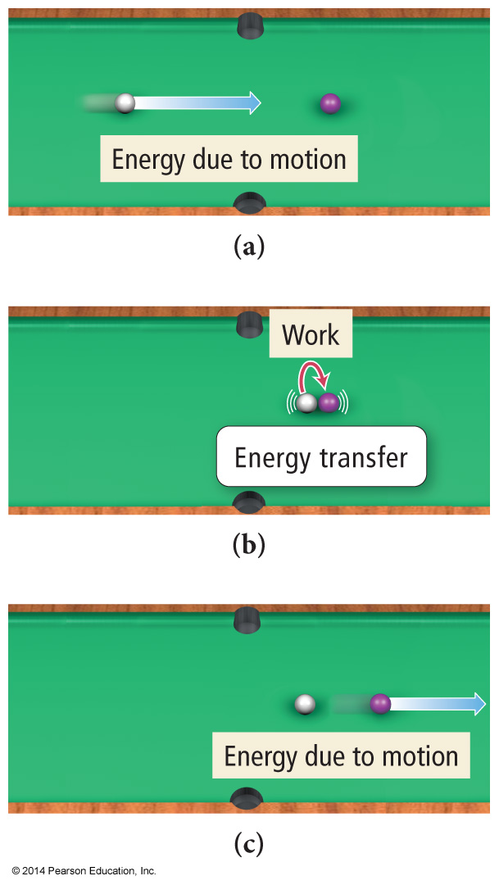
Classification of Energy
Kinetic energy is energy of motion or energy that is being transferred.
Thermal energy is the energy associated with temperature.
Thermal energy is a form of kinetic energy.

Slide 4
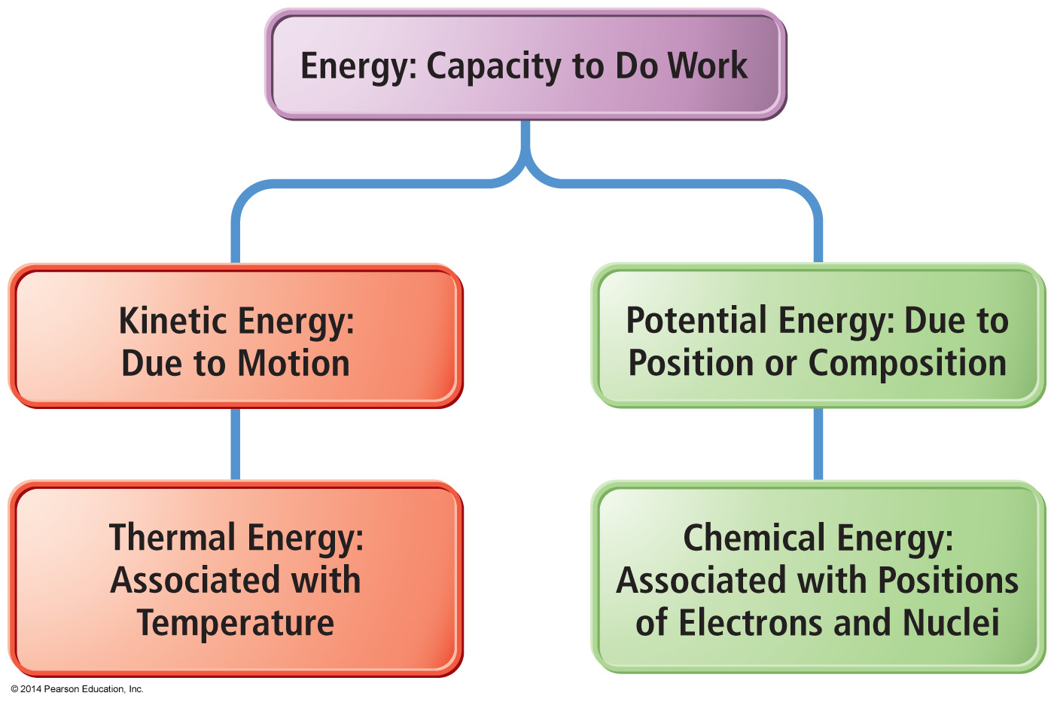
Manifestations of Energy

Slide 5
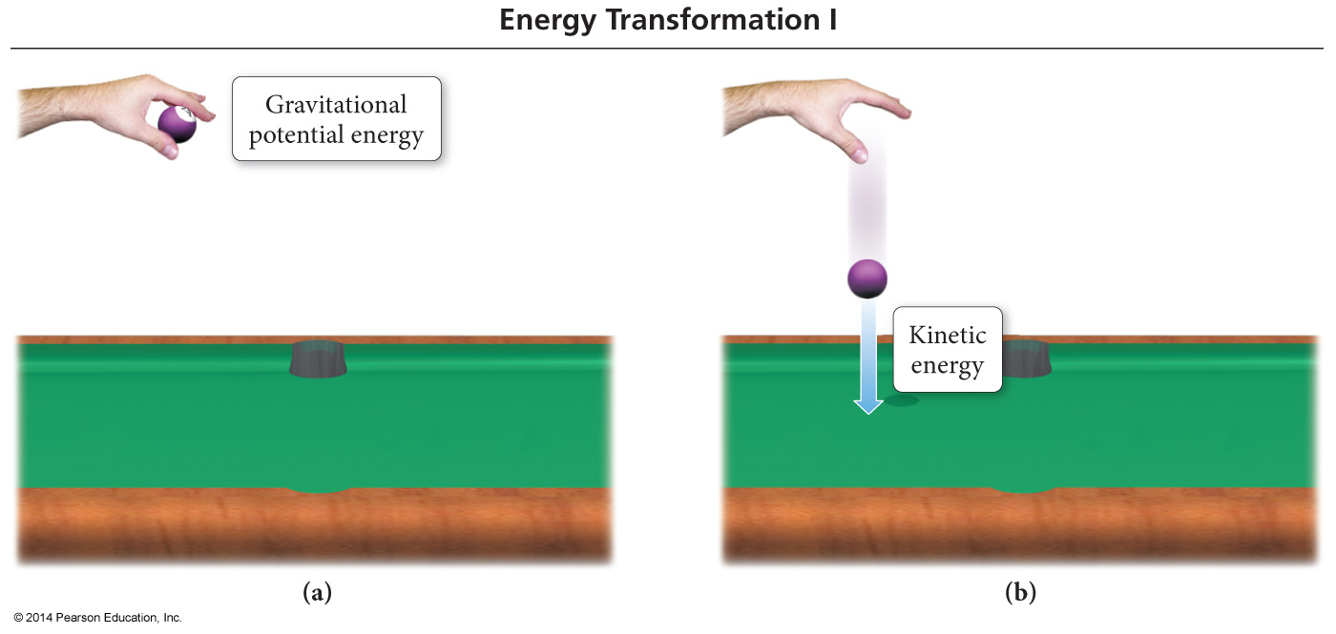
Classifications of Energy
Potential energy is energy that is stored in an object, or energy associated with the composition and position of the object.
Energy stored in the structure of a compound is potential energy.

Slide 6
Some Forms of Energy
Electrical
Kinetic energy associated with the flow of electrical charge
Heat or thermal energy
Kinetic energy associated with molecular motion
Light or radiant energy
Kinetic energy associated with energy transitions in an atom
Nuclear
Potential energy in the nucleus of atoms
Chemical
Potential energy due to the structure of the atoms, the attachment between atoms, the atoms’ positions relative to each other in the molecule, or the molecules’ relative positions in the structure

Slide 7
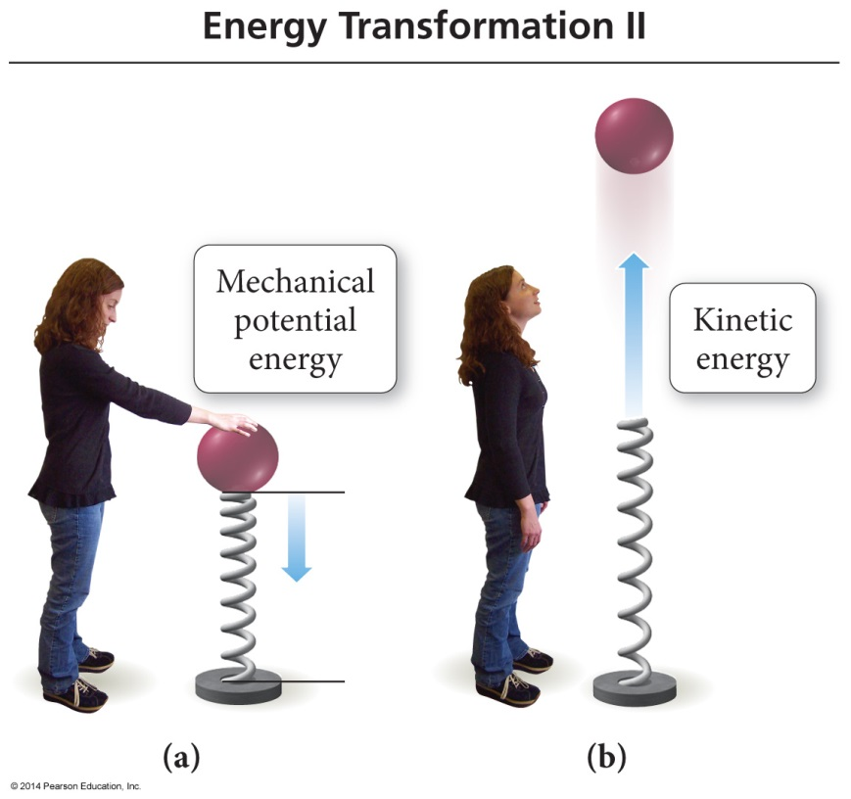
Definitions #2
Law of conservation of energy states that energy cannot be created nor destroyed.
The First Law of Thermodynamics: The total energy content of the universe is constant
When energy is transferred between objects, or converted from one form to another, the total amount of energy present at the beginning must be present at the end.

Slide 8
The First Law of Thermodynamics: Law of Conservation of Energy
Thermodynamics is the study of energy and its interconversions.
The first law of thermodynamics is the law of conservation of energy.
This means that the total amount of energy in the universe is constant.
Therefore, you can never design a system that will continue to produce energy without some source of energy.

Slide 9
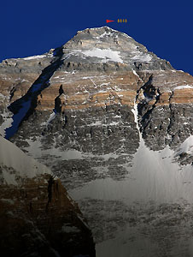
Depend ONLY on the present state of the system
State Functions
ENERGY IS A STATE FUNCTION
A person standing at the top of Mt. Everest has the same potential energy whether they got there by hiking up, or by falling down from a plane!
WORK IS NOT A STATE FUNCTION

Slide 10
State Function
To reach the top of the mountain there are two trails:
Long and winding
Short but steep
Regardless of the trail, when you reach the top you will be 10,000 ft above the base.
The distance from the base to the peak of the mountain is a state function. It depends only on the difference in elevation between the base and the peak, not on how you arrive there!

Slide 11
Energy Change in Chemical Processes
Endothermic:
Rxns in which energy flows into the system as the rxn proceeds.
+ q_{system}
- q_{surroundings}
Exothermic:
Rxns in which energy flows out of system as the rxn proceeds.
- q_{system}
+ q_{surroundings}

Slide 12
System and Surroundings
System - the material or process which we are studying the energy changes within.
Surroundings - everything else with which the system can exchange energy.
What we study is the exchange of energy between the system and the surroundings.

Slide 13
Endothermic Reactions

Slide 14
Exothermic Reactions

Slide 15
Calorimetry
The amount of heat absorbed or released during a physical or chemical change can be measured…
…usually by the change in temperature of a known quantity of water
1 calorie is the heat required to raise the temp of 1 gram of water by 1 °C
1 BTU is the heat required to raise the temp of 1 pound of water by 1 °F

Slide 16
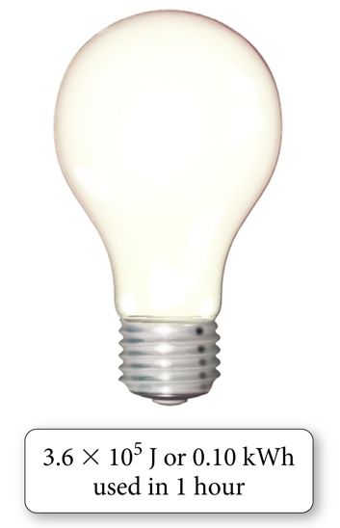
Units of Energy
The amount of kinetic energy an object has is directly proportional to its mass and velocity.
KE = ½mv²
When the mass is in kg and velocity is in m/s, the unit for kinetic energy is
$$\frac{kg •m^{2}}{s^{2}}$$
1 joule of energy is the amount of energy needed to move a 1 kg mass at a speed of 1 m/s.
$$1 J=1 \frac{kg {• m}^{2}}{s^{2}}$$

Slide 17
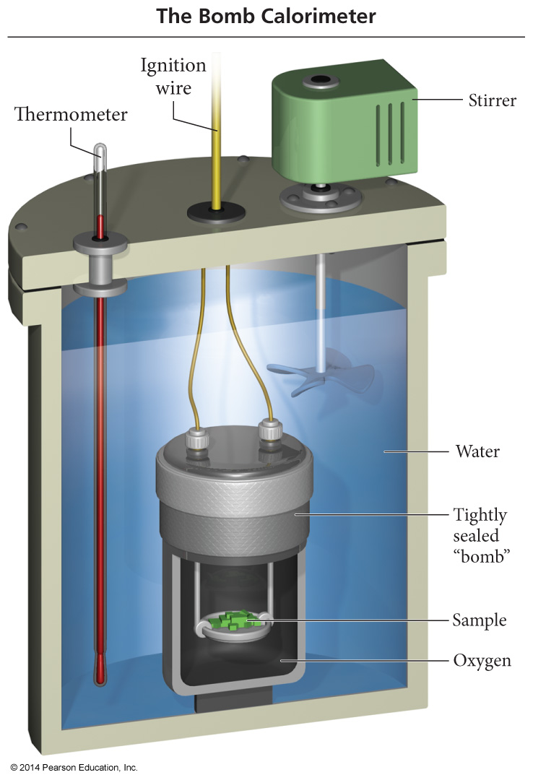
Bomb Calorimeter
It is used to measure ΔE because it is a constant volume system.
The heat capacity of the calorimeter is the amount of heat absorbed by the calorimeter for each degree rise in temperature and is called the calorimeter constant.
C_{cal}, kJ/ºC
Notice how the Ccal has different units! It isn’t J/g°C – there is no mass portion! So not Q = mC∆T, just Q = C∆T !

Slide 18
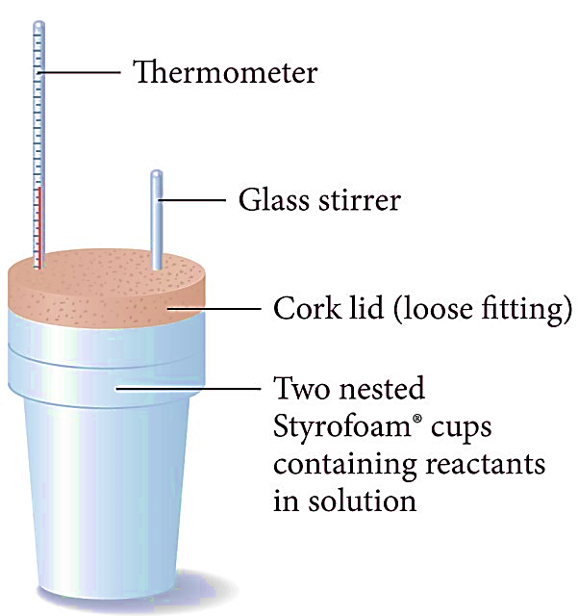
A Cheaper Calorimeter – Coffee Cup!

Slide 19
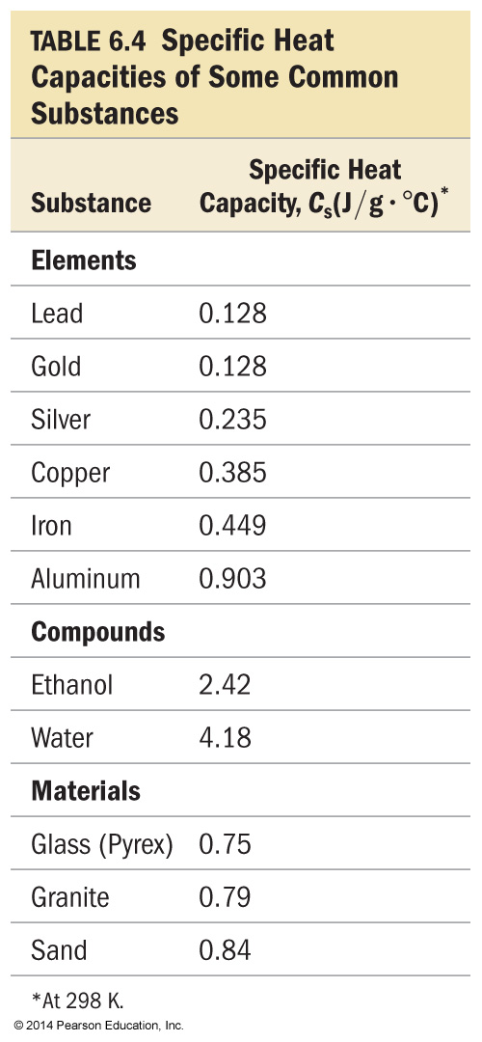
Specific Heat Capacity
Measure of a substance’s intrinsic ability to absorb heat.
Specific heat capacity - the amount of heat energy required to raise the temp of one gram of a substance 1 °C.
C_{s} Units J/(g ∙ °C)
Molar heat capacity - the amount of heat energy required to raise the temp of one mole of a substance 1 °C.

Slide 20
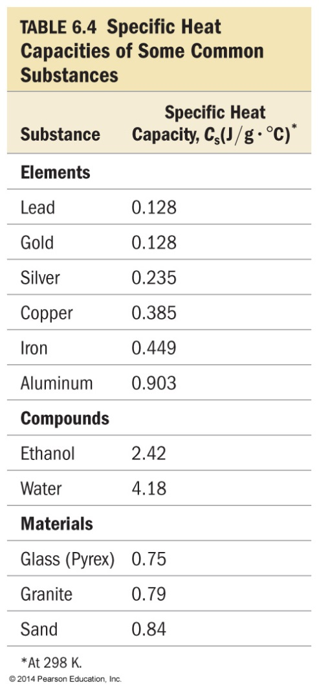
Identical amounts of heat are applied to 50 g blocks of lead, silver, and copper, all at an initial temp of 25°C. Which block will have the largest increase in temp?
Lead
Silver
Copper
None, all will be at the same temp
Notes:
Answer: c

Slide 21
Identical amounts of heat are applied to 50 g blocks of lead, silver, and copper, all at an initial temp of 25°C. Which block will have the largest increase in temp?
Lead
$$Q=mC∆T$$
$$∆T= \frac{Q}{mC}$$
Silver
Copper
None, all will be at the same temp
Smallest C gives you largest ∆T
Notes:
Answer: c

Slide 22
Calculations Involving Specific Heat
OR
c = Specific Heat Capacity
q = Heat lost or gained
ΔT = Temperature change

Slide 23
Thermal Energy Transfer
A block of metal at 55 °C is added to water at 25 °C.
Thermal energy transfers heat from the metal to the water.
The exact temperature change depends on the following:
The mass of the metal
The mass of water
Specific heat capacities of the metal and of water

Slide 24
The temperature of a 700.0-g bar of iron decreases by 10.0°C when the iron is plunged into 500.0 g of water. What is the temperature increase of the water, assuming that no heat is lost in the transfer? (C_{Fe} = 0.45 J/g°C)
3.0°C
1.5°C
1.7°C
1.3°C
None of the above

Slide 25
The temperature of a 700.0-g bar of iron decreases by 10.0°C when the iron is plunged into 500.0 g of water. What is the temperature increase of the water, assuming that no heat is lost in the transfer? (C_{Fe} = 0.45 J/g°C)
3.0°C
$$Qwater=−Qmetal$$
$$mC∆T=−mC∆T$$
$$\left(500\right)\left(4.18\right)\left(∆T\right)=−\left(700\right)\left(0.45\right)\left(−10\right)$$
$$∆T=1.51 ℃$$
1.5°C
1.7°C
1.3°C
None of the above

Slide 26
50.0 g of water at 22 °C is mixed with 125 g of water initially at 36 ° C. What is the final temperature of the water after mixing, assuming no heat is lost to the surroundings?
29°C
42°C
32°C
30°C
None of the above
Notes:
Answer: c

Slide 27
50.0 g of water at 22 °C is mixed with 125 g of water initially at 36 ° C. What is the final temperature of the water after mixing, assuming no heat is lost to the surroundings?
*THINK* - Use this to check your work! 50g @ 22°C and 125g @ 36°C with same C…
Won’t end exactly halfway. Will end closer to 36°C than 22°C. Cant end at 36°C or higher than 36°C…
$$Q1=−Q2$$
$$mC∆T=−mC∆T$$
$$\left(50\right)\left(4.18\right)\left(Tf−22℃\right)=−\left(125\right)\left(4.18\right)\left(Tf−36\right)$$
$$Tf=32 ℃$$
29°C
42°C
32°C
30°C
None of the above
Notes:
Answer: c

