Slide 1
THERMOCHEMISTRY
Heat of Formation

Slide 2
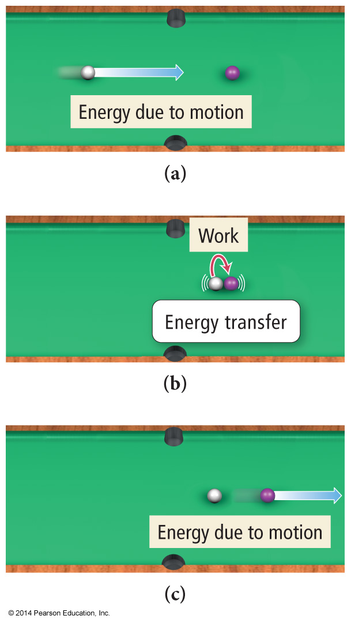
Classification of Energy
Kinetic energy is energy of motion or energy that is being transferred.
Thermal energy is the energy associated with temperature.
Thermal energy is a form of kinetic energy.

Slide 3
Formation Reactions
Reactions of elements in their “standard state” to form 1 mole of a pure compound.
Standard State of an element - find the form in Appendix IIB that has ΔH_{f}° = 0.
Coefficients of the reactants may be fractions!
Because the definition requires 1 mole of compound be made.

Slide 4
Writing Formation Reactions
Write the formation reaction for CO (g)
The formation reaction is the reaction between the elements in the compound, which are C and O.
C + O → CO(g)

Slide 5
Writing Formation Reactions
Write the formation reaction for CO (g)
The elements must be in their standard state.
There are several forms of solid C, but the one with ΔH_{f}° = 0 is graphite.
Oxygen’s standard state is the diatomic gas.
C(s, graphite) + O₂(g) → CO(g)

Slide 6
Writing Formation Reactions
Write the formation reaction for CO (g)
The equation must be balanced, but the coefficient of the product compound must be 1.
Use whatever coefficient in front of the reactants is necessary to make the atoms on both sides equal without changing the product coefficient.
C(s, graphite) + ½ O₂(g) → CO(g)

Slide 7
Calculating Standard Enthalpy Change For a Rxn
Any reaction can be written as the sum of formation reactions (or the reverse of formation reactions) for the reactants and products.
The ∆H° for the reaction is then the sum of the ∆H_{f}° for the component reactions.
$∆H^{°}=Σn∆H_{f}^{°}\left(products\right)− Σn∆H_{f}^{°}$(reactants)
Σ means sum.
n is the coefficient of the reaction.

Slide 8
Calculating Heat of Rxn from Heats of Formation
Calculate ΔH for the combustion of methane, CH₄ CH₄(g) + 2O₂(g) → CO₂(g) + 2H₂O(l)
$∆H^{°}=Σn∆H_{f}^{°}\left(products\right)− Σn∆H_{f}^{°}$(reactants)
Substance | ΔH_{f} (kJ)
CH₄ | -74.80
O₂ | 0
CO₂ | -393.50
H₂O | -285.83
ΔH_{rxn} = [-393.50kJ + 2(-285.83kJ)] – [-74.80kJ]
ΔH_{rxn} = -890.36 kJ

Slide 9
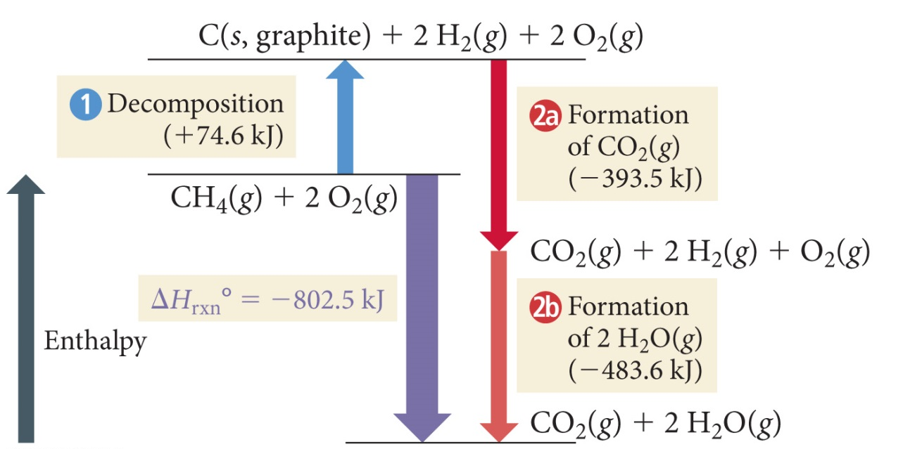
CH₄(g)+ 2 O₂(g)→ CO₂(g) + 2H₂O(g)
$$∆H^{°}=\left[∆H_{f}^{°}\left(CO_{2}\right)+2∙∆H_{f}^{°}\left(H_{2}O\right)\right]−[∆H_{f}^{°}\left({CH}_{4}\right)+2∙∆H_{f}^{°}\left(O_{2}\right)]$$
ΔH° = [((−393.5 kJ)+ 2(−241.8 kJ)− ((−74.6 kJ)+ 2(0 kJ))] = −802.5 kJ
CH₄(g) + 2 O₂(g) → CO₂(g) + 2 H₂O(g) ΔH°= −802.5 kJ
Notes:
9

Slide 10
Notice anything about the #’s on last two slides?
The numbers can vary slightly based on the appendix used. Always use numbers given to you in the problem, otherwise look them up and don’t stress if they don’t exactly match someone else’s One H₂O was gas, one was liquid! Phase matters! Be careful!

Slide 11
Ethanol is used as an additive in many fuels today. What is ΔHº_{rxn} (kJ) for the combustion of ethanol? 2 C₂H₅OH (l ) + 6 O₂ (g) → 4 CO₂ (g) + 6 H₂O (l )
Formula | ΔHº_{f}
C₂H₅OH (l) | –277.6
CO₂ (g) | –393.5
H₂O (g) | –241.8
H₂O (l) | –285.8
- 401.7
+ 401.7
- 2469
+ 2734
- 2734
Notes:
Answer: e

Slide 12
Ethanol is used as an additive in many fuels today. What is ΔHº_{rxn} (kJ) for the combustion of ethanol? 2 C₂H₅OH (l ) + 6 O₂ (g) → 4 CO₂ (g) + 6 H₂O (l )
Formula | ΔHº_{f}
C₂H₅OH (l) | –277.6
CO₂ (g) | –393.5
H₂O (g) | –241.8
H₂O (l) | –285.8
- 401.7
∆H°_{rxn =} Products – Reactants
$$\left[4\left(−393.5\right)+6\left(−285.8\right)\right]−\left[2\left(−277.6\right)+6\left(0\right)\right]$$
= -2734 kJ/mol
+ 401.7
- 2469
+ 2734
- 2734
Notes:
Answer: e

Slide 13
Bond Energy
Slightly different than Enthalpy of Formation.
Values will be given to you in a chart
Two Ways to think about it:
ΣH_{(Bonds Broken)} – ΣH_{(Bonds Formed)}
The reason this way can be tricky, is because almost everything in chemistry is thought of as “products minus reactants” and this is one of the very few times it is backwards! A lot of mistakes happen here.

Slide 14
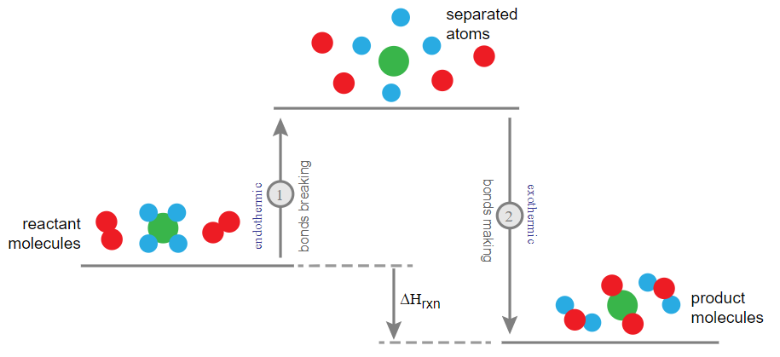
Bond Energy
Slightly different than Enthalpy of Formation.
Values will be given to you in a chart
ΣH_{(Bonds Broken)} – ΣH_{(Bonds Formed)}

Slide 15
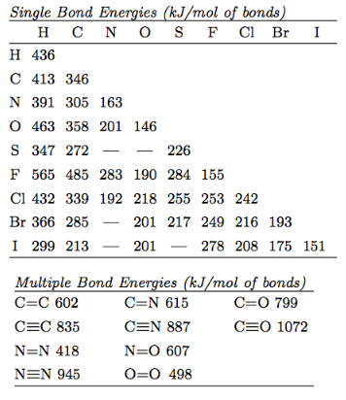
1st Way to Think About It
ΣH_{(Bonds Broken)} – ΣH_{(Bonds Formed)}
2H₂ + O₂ → 2H₂O
You have to break: 2 H-H bond and 1 O=O bond
You have to form: 4 H-O bonds
[ 2(436) + (498) ] – [ 4(463) ] = - 482 kJ/mol (exo)
Can be tricky though because almost everything in chemistry is thought of as “Products minus Reactants” and this is one of the few times it is the opposite!

Slide 16
2nd Way to Think About It
Action | Algebraic Sign | How to Remember
Break a Bond | + | Takes to Break
Form a Bond | - | Free to Form
Nice thing about this method is that it doesn’t matter if you do broken or formed first – see?
You have to form: 4 H-O bonds
You have to break: 2 H-H bond and 1 O=O bond
4(-463) + 2(436) + (498) = - 482 kJ/mol (exo)
Same answer as before! Doesn’t matter which way you do it as long as you are explicit with what you are doing. Either write the equation from the 1st way, or something about takes to break, free to form for the 2nd way.

