Slide 1
THERMOCHEMISTRY
Hess’s Law

Slide 2
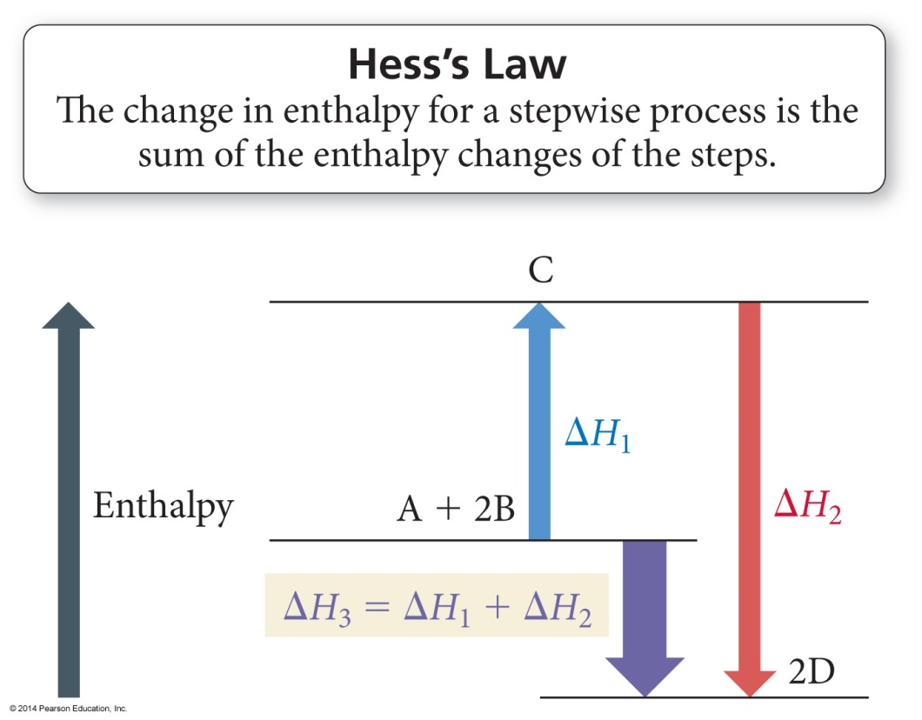
Hess’s Law
“In going from a particular set of reactants to a particular set of products, the change in enthalpy is the same whether the reaction takes place in one step or a series of steps.”

Slide 3
Hess’s Law
Path A – Mrs. Farmer cleaning the house.
Path B – Mr. Farmer cleaning the house.
Regardless of the path
taken, you still get to the
same place. Although Path B drives Mrs. Farmer bonkers – Ha!

Slide 4
Relationships Involving ΔH_{rxn}
Multiplying Rxn by a # to Change Coefficients ΔH_{rxn} is multiplied by that factor.
Because ΔH_{rxn} is extensive – depends on the amount of substance
C(s) + O₂(g) → CO₂(g) ΔH = −393.5 kJ
2 C(s) + 2 O₂(g) → 2 CO₂(g) ΔH = 2 x (−393.5 kJ) = −787.0 kJ.
Reversing a rxn to flip which side the products/reactants are on Flip the sign of ΔH, if positive now negative, if negative, now posititve C(s) + O₂(g) → CO₂(g) ΔH = −393.5 kJ
CO₂(g) → C(s) + O₂(g) ΔH = − (−393.5) = + 393.5 kJ

Slide 5
Standard Conditions
Standard State The state of a material at a defined set of conditions.
Pure gas at 1 atm pressure
Pure solid or liquid in its most stable form at 1 atm pressure and temperature of interest (usually 25°C)
Substances in a solution with a 1M concentration

Slide 6
Standard Enthalpy Change
Standard Enthalpy Change ∆H° - the Enthalpy change when all reactants and products are in their standard states. That’s what the ° symbol means – that it is under the standard conditions. You can have ∆H values that are not at standard conditions, then you leave the ° off.

Slide 7
Standard Enthalpy of Formation
Standard Enthalpy of Formation ∆H°_{f} - the Enthalpy change for the reaction forming 1 mole of a pure compound from its constituent elements.
Elements must be in their standard states
∆H°_{f} for a pure element in its standard state = 0 kJ/mol
That includes diatomic gases! They are still pure elements!

Slide 8
Hess’s Law Example Problem #1
Calculate ΔH for the combustion of methane, CH₄:
CH₄ + 2O₂ → CO₂ + 2H₂O
# | Reaction | ΔHº
1 | C + 2H₂ → CH₄ | -74.80 kJ
2 | C + O₂ → CO₂ | -393.50 kJ
3 | H₂ + ½ O₂ → H₂O | -285.83 kJ
Step #1: CH₄ must appear on the reactant side, so we reverse reaction #1 and change the sign on ΔH.
CH₄ → C + 2H₂ +74.80 kJ

Slide 9
Hess’s Law Example Problem #1
Calculate ΔH for the combustion of methane, CH₄:
CH₄ + 2O₂ → CO₂ + 2H₂O
# | Reaction | ΔHº
1 | C + 2H₂ → CH₄ | -74.80 kJ
2 | C + O₂ → CO₂ | -393.50 kJ
3 | H₂ + ½ O₂ → H₂O | -285.83 kJ
Step #2: Keep reaction #2 unchanged, because CO₂ belongs on the product side
CH₄ → C + 2H₂ +74.80 kJ
C + O₂ → CO₂ -393.50 kJ

Slide 10
Hess’s Law Example Problem #1
Calculate ΔH for the combustion of methane, CH₄:
CH₄ + 2O₂ → CO₂ + 2H₂O
# | Reaction | ΔHº
1 | C + 2H₂ → CH₄ | -74.80 kJ
2 | C + O₂ → CO₂ | -393.50 kJ
3 | H₂ + ½ O₂ → H₂O | -285.83 kJ
Step #3: Use reaction #3 to get water as a product,
but multiply it by 2 since you have 2 H₂O
CH₄ → C + 2H₂ +74.80 kJ
C + O₂ → CO₂ -393.50 kJ
2H₂ + O₂ → 2H₂O 2 x (-285.83 kJ)

Slide 11
Hess’s Law Example Problem #1
Calculate ΔH for the combustion of methane, CH₄:
CH₄ + 2O₂ → CO₂ + 2H₂O
# | Reaction | ΔHº
1 | C + 2H₂ → CH₄ | -74.80 kJ
2 | C + O₂ → CO₂ | -393.50 kJ
3 | H₂ + ½ O₂ → H₂O | -285.83 kJ
Step #4: Cross out things that show up on both sides, then sum up your ∆H values
CH₄ → C + 2H₂ +74.80 kJ
C + O₂ → CO₂ -393.50 kJ
2H₂ + O₂ → 2H₂O 2 x (-285.83 kJ)
CH₄ + 2O₂ → CO₂ + 2H₂O -890.36 kJ

Slide 12
Rxn #1) ½ N₂ (g) + ½ O₂ (g) → NO (g) ΔH = 90.3 kJ Rxn #2) NO (g) + ½ Cl₂ (g) → NOCl (g) ΔH = –38.6 kJ
Hess’s Law Example Problem #2
2 NOCl (g) → N₂ (g) + O₂ (g) + Cl₂ (g) ΔH = ?
-51.7 kJ
51.7 kJ
-103.4 kJ
103.4 kJ
142.0 kJ
Notes:
Answer: c

Slide 13
Rxn #1) ½ N₂ (g) + ½ O₂ (g) → NO (g) ΔH = 90.3 kJ Rxn #2) NO (g) + ½ Cl₂ (g) → NOCl (g) ΔH = –38.6 kJ
Hess’s Law Example Problem #2
2 NOCl (g) → N₂ (g) + O₂ (g) + Cl₂ (g) ΔH = ?
-51.7 kJ
Rxn # | How to change it | Rxn | ∆H
2 | - and x 2 | 2 NOCl → 2NO + Cl₂ | -2 (-38.6)
1 | - and x 2 | 2NO → N₂ + O₂ | - (90.3)
 |  | 2NOCl → N₂ + O₂ + Cl₂ | -103.4 kJ
51.7 kJ
-103.4 kJ
103.4 kJ
142.0 kJ
Notes:
Answer: c

Slide 14
Rxn #1) 3Fe₂O₃ + CO (g) → 2Fe₃O₄ + CO₂ (g) ΔH°= -47 kJ Rxn #2) Fe₂O₃ + 3CO (g) → 2Fe (s) + 3CO₂ (g) ΔH°= -25 kJ Rxn #3) Fe₃O₄ + CO (g) → 3FeO (s) + CO₂ (g) ΔH°= 19 kJ
Hess’s Law Example Problem #3
FeO(s) + CO(g) → Fe(s) + CO₂(g) Calculate standard enthalpy change
-53 kJ
-3 kJ
-41 kJ
22 kJ
-11 kJ
Notes:
Answer: c

Slide 15
Rxn #1) 3Fe₂O₃ + CO (g) → 2Fe₃O₄ + CO₂ (g) ΔH°= -47 kJ Rxn #2) Fe₂O₃ + 3CO (g) → 2Fe (s) + 3CO₂ (g) ΔH°= -25 kJ Rxn #3) Fe₃O₄ + CO (g) → 3FeO (s) + CO₂ (g) ΔH°= 19 kJ
Hess’s Law Example Problem #3
FeO(s) + CO(g) → Fe(s) + CO₂(g) Calculate standard enthalpy change
-53 kJ
Rxn # | How to change it | Rxn | ∆H
3 | - and x 1/3 | FeO + ¹/₃CO₂ → ¹/₃Fe₂O₄ + ¹/₃CO | -¹/₃ (19)
1 | - and x 1/6 | ¹/₃Fe₃O₄ + ¹/₆CO₂→ ¹/₂Fe₂O₃ + ¹/₆CO | -¹/₆ (-47)
2 | x 1/2 | ¹/₂Fe₂O₃ + ³/₂CO → Fe + ³/₂CO₂ | ¹/₂ (-25)
 |  | FeO + CO → Fe + CO₂ | -11 kJ
-3 kJ
-41 kJ
22 kJ
-11 kJ
Notes:
Answer: c

Slide 16
Its just a puzzle!
Sometimes it’s a really hard puzzle… but it’s still just a puzzle! All the pieces are there, you just have to figure out how to put them together…unfortunately no real “tricks” for how to figure out which parts to put together.

