Slide 1
THERMOCHEMISTRY
Hess’s Law

Slide 2
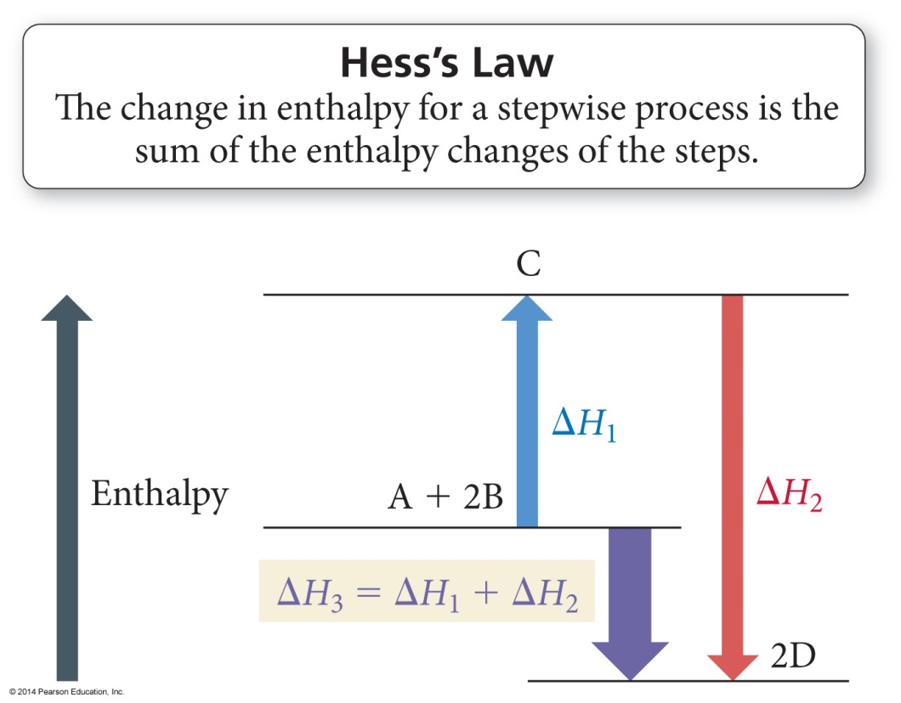
Hess’s Law
“In going from a particular set of reactants to a particular set of products, the change in enthalpy is the same whether the reaction takes place in one step or a series of steps.”

Slide 3
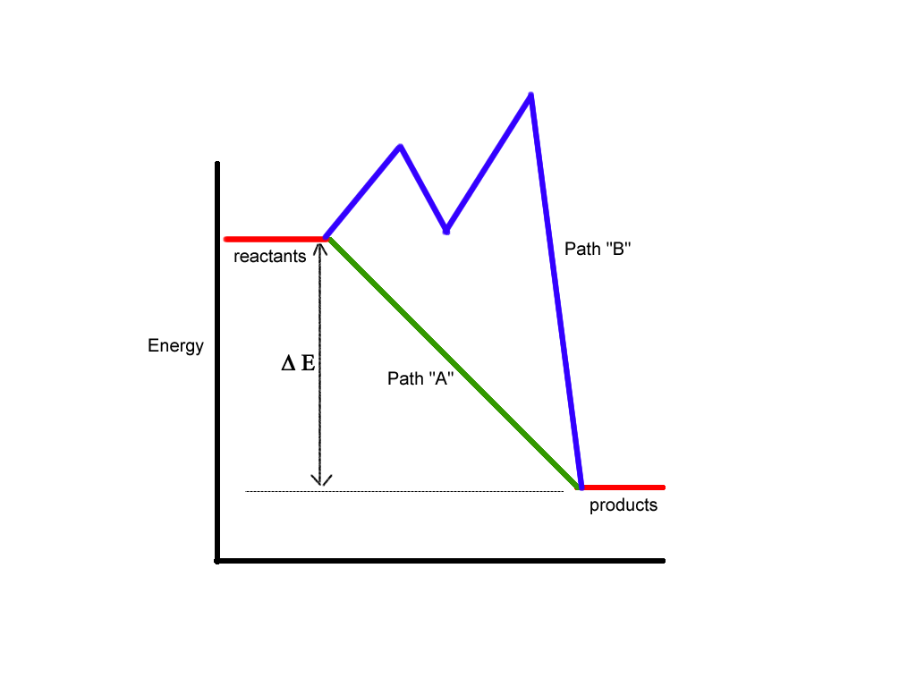
Hess’s Law

Slide 4
Relationships Involving ΔH_{rxn}
When reaction is multiplied by a factor, ΔH_{rxn} is multiplied by that factor.
Because ΔH_{rxn} is extensive,
C(s) + O₂(g) → CO₂(g)
ΔH = −393.5 kJ
2 C(s) + 2 O₂(g) → 2 CO₂(g)
ΔH = 2(−393.5 kJ) = −787.0 kJ.
If a reaction is reversed, then the sign of ΔH is changed.
CO₂(g) → C(s) + O₂(g) ΔH = +393.5 kJ

Slide 5
Standard Conditions
The standard state is the state of a material at a defined set of conditions.
Pure gas at exactly 1 atm pressure
Pure solid or liquid in its most stable form at exactly 1 atm pressure and temperature of interest
Usually 25 °C
Substance in a solution with concentration 1 M

Slide 6
Standard Conditions
The standard enthalpy change, ΔH°, is the enthalpy change when all reactants and products are in their standard states.

Slide 7
Standard Conditions
The standard enthalpy of formation, ΔH_{f}°, is the enthalpy change for the reaction forming 1 mole of a pure compound from its constituent elements.
The elements must be in their standard states.
The ΔH_{f}° for a pure element in its standard state = 0 kJ/mol.

Slide 8
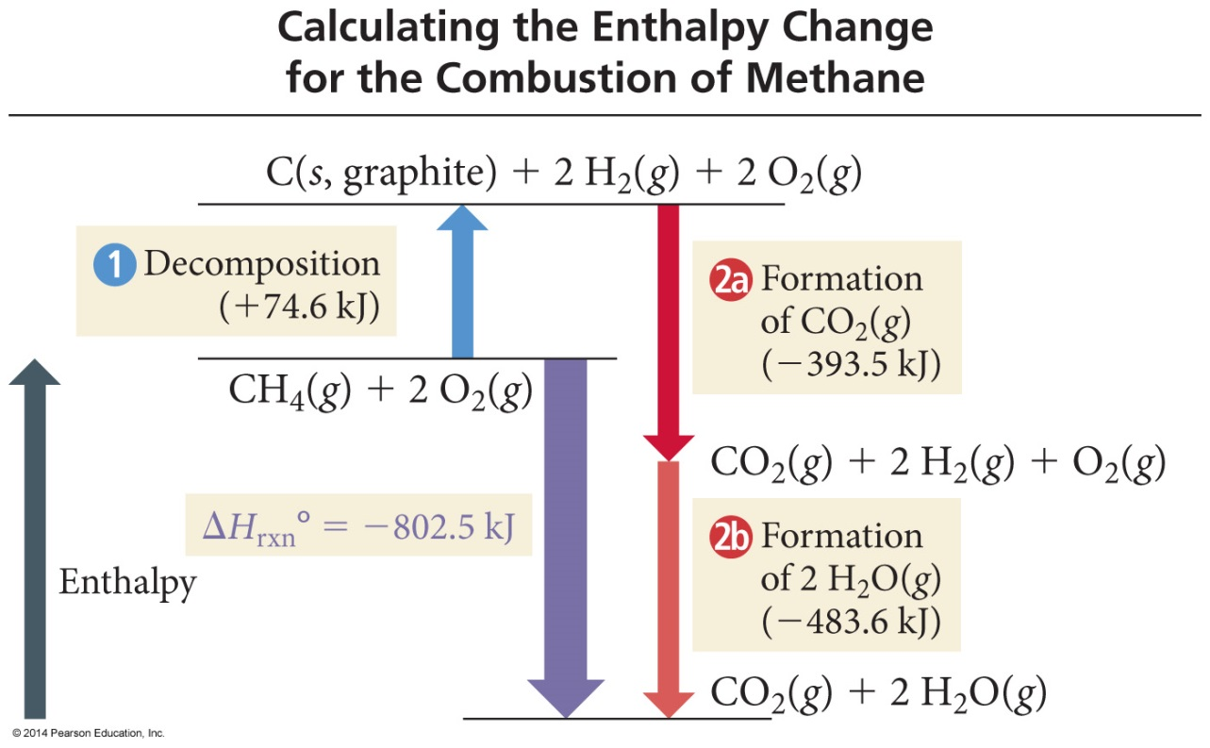
CH₄(g)+ 2 O₂(g)→ CO₂(g) + 2H₂O(g)
C(s, graphite) + 2 H₂(g) → CH₄(g) ΔH_{f}°= − 74.6 kJ/mol CH₄
C(s, graphite) + O₂(g) → CO₂(g) ΔH_{f}°= −393.5 kJ/mol CO₂
H₂(g) + ½ O₂(g) → H₂O(g) ΔH_{f}°= −241.8 kJ/mol H₂O

Slide 9
CH₄(g)+ 2 O₂(g)→ CO₂(g) + 2H₂O(g)
CH₄(g) → C(s, graphite) + 2 H₂(g) Δ H° = + 74.6 kJ
C(s, graphite) + O₂(g) → CO₂(g) ΔH_{f}° = −393.5 kJ/mol CO₂
2 H₂(g) + O₂(g) → 2 H₂O(g) ΔH° = −483.6 kJ
CH₄(g) + 2 O₂(g) → CO₂(g) + 2 H₂O(g) ΔH° = −802.5 kJ
Notes:
9

Slide 10
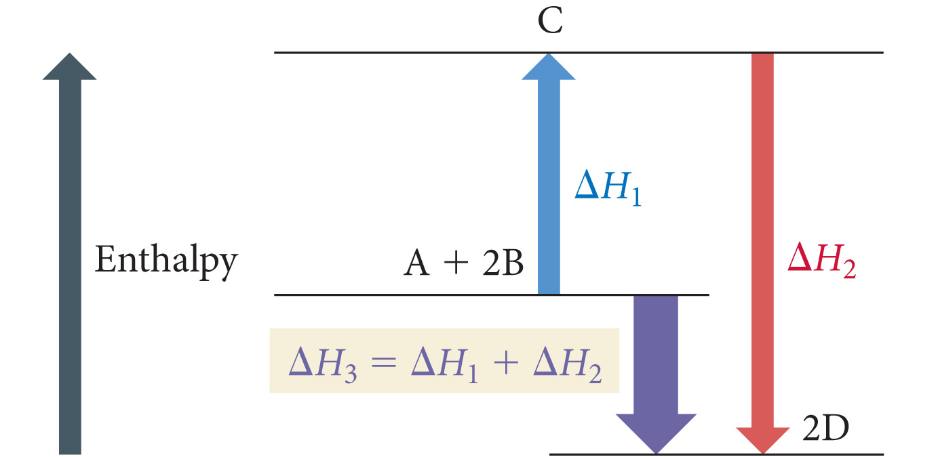
Use Hess’s Law to determine ΔH for the following target reaction. ½ N₂ (g) + ½ O₂ (g) → NO (g) ΔH = 90.3 kJ NO (g) + ½ Cl₂ (g) → NOCl (g) ΔH = –38.6 kJ 2 NOCl (g) → N₂ (g) + O₂ (g) + Cl₂ (g) ΔH = ?
–51.7 kJ
51.7 kJ
–103.4 kJ
103.4 kJ
142.0 kJ
Notes:
Answer: c

Slide 11
Use Hess’s Law to determine ΔH for the following target reaction. ½ N₂ (g) + ½ O₂ (g) → NO (g) ΔH = 90.3 kJ NO (g) + ½ Cl₂ (g) → NOCl (g) ΔH = –38.6 kJ 2 NOCl (g) → N₂ (g) + O₂ (g) + Cl₂ (g) ΔH = ?
–51.7 kJ
51.7 kJ
–103.4 kJ
103.4 kJ
142.0 kJ
Notes:
Answer: c

Slide 12
FeO (s) + CO (g) → Fe (s) + CO₂ (g)
Calculate the standard enthalpy change for this Rx from these Rx’s of Iron Oxides w/ CO:
[1] 3Fe₂O₃ + CO (g) → 2Fe₃O₄ + CO₂ (g) ΔH°= -47 kJ
[2] Fe₂O₃ + 3CO (g) → 2Fe (s) + 3CO₂ (g) ΔH°= -25 kJ
[3] Fe₃O₄ + CO (g) → 3FeO (s) + CO₂ (g) ΔH°= 19 kJ
-53 kJ
-3 kJ
-41 kJ
22 kJ
-11 kJ

Slide 13
FeO (s) + CO (g) → Fe (s) + CO₂ (g)
Calculate the standard enthalpy change for this Rx from these Rx’s of Iron Oxides w/ CO:
[1] 3Fe₂O₃ + CO (g) → 2Fe₃O₄ + CO₂ (g) ΔH°= -47 kJ
[2] Fe₂O₃ + 3CO (g) → 2Fe (s) + 3CO₂ (g) ΔH°= -25 kJ
[3] Fe₃O₄ + CO (g) → 3FeO (s) + CO₂ (g) ΔH°= 19 kJ
-53 kJ
-3 kJ
-41 kJ
22 kJ
-11 kJ

