Slide 1
Acids and Bases

Slide 2
Acid/Base Definitions
Arrhenius Model
Acids produce hydrogen ions in aqueous solutions
Bases produce hydroxide ions in aqueous solutions
Bronsted-Lowry Model
Acids are proton donors
Bases are proton acceptors
Lewis Acid Model
Acids are electron pair acceptors
Bases are electron pair donors

Slide 3
Problems with Arrhenius Theory
It does not explain why molecular substances, such as NH₃, dissolve in water to form basic solutions, even though they do not contain OH– ions.
It does not explain how some ionic compounds, such as Na₂CO₃ or Na₂O, dissolve in water to form basic solutions, even though they do not contain OH– ions.
It does not explain why molecular substances, such as CO₂, dissolve in water to form acidic solutions, even though they do not contain H⁺ ions.
It does not explain acid–base reactions that take place outside aqueous solution.

Slide 4
Brønsted–Lowry Acid–Base Theory
It defines acids and bases based on what happens in a reaction.
Any reaction involving H⁺ (proton) that transfers from one molecule to another is an acid–base reaction, regardless of whether it occurs in aqueous solution or if there is OH⁻ present.
All reactions that fit the Arrhenius definition also fit the Brønsted–Lowry definition.

Slide 5
Brønsted–Lowry Theory
The acid is an H⁺ donor.
The base is an H⁺ acceptor.
Base structure must contain an atom with an unshared pair of electrons.
In a Brønsted–Lowry acid–base reaction, the acid molecule donates an H⁺ to the base molecule.
H–A + :B ⇔ :A– + H–B⁺

Slide 6
Brønsted–Lowry Acids
Brønsted–Lowry acids are H⁺ donors.
Any material that has H can potentially be a Brønsted–Lowry acid.
Because of the molecular structure, often one H in the molecule is easier to transfer than others.
When HCl dissolves in water, the HCl is the acid because HCl transfers an H⁺ to H₂O, forming H₃O⁺ ions.
Water acts as base, accepting H⁺.
HCl(aq) + H₂O(l) → Cl–(aq) + H₃O⁺(aq)
Acid. base

Slide 7
Amphoteric Substances
Amphoteric substances can act as either an acid or a base because they have both a transferable H and an atom with lone pair electrons.
Water acts as base, accepting H⁺ from HCl.
HCl(aq) + H₂O(l) → Cl–(aq) + H₃O⁺(aq)
Water acts as acid, donating H⁺ to NH₃.
NH₃(aq) + H₂O(l) ⇔ NH₄⁺(aq) + OH–(aq)

Slide 8
Conjugate Acid–Base Pairs
In a Brønsted-–Lowry acid–base reaction,
the original base becomes an acid in the reverse reaction.
the original acid becomes a base in the reverse process.
Each reactant and the product it becomes is called a conjugate pair.

Slide 9
Conjugate Pairs
A base accepts a proton and becomes a conjugate acid.
An acid donates a proton and becomes a conjugate base.

Slide 10
Acid Dissociation
HA → H⁺ + A⁻
Acid Proton Conjugate
base
Alternately, H⁺ may be written in its hydrated form, H₃O⁺ (hydronium ion)

Slide 11
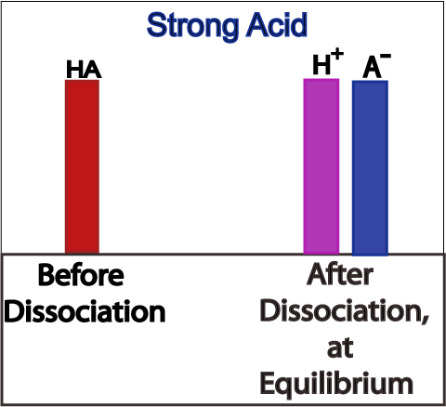
Dissociation of Strong Acids
Strong acids are assumed to dissociate completely in solution.
Large K_{a} or small K_{a}?
Reactant favored or product favored?

Slide 12
Dissociation Constants: Strong Acids
Acid | Formula | Conjugate Base | K_{a}
Perchloric | HClO₄ | ClO₄⁻ | Very large
Hydriodic | HI | I⁻ | Very large
Hydrobromic | HBr | Br⁻ | Very large
Hydrochloric | HCl | Cl⁻ | Very large
Nitric | HNO₃ | NO₃⁻ | Very large
Sulfuric | H₂SO₄ | HSO₄⁻ | Very large
Hydronium ion | H₃O⁺ | H₂O | 1.0

Slide 13
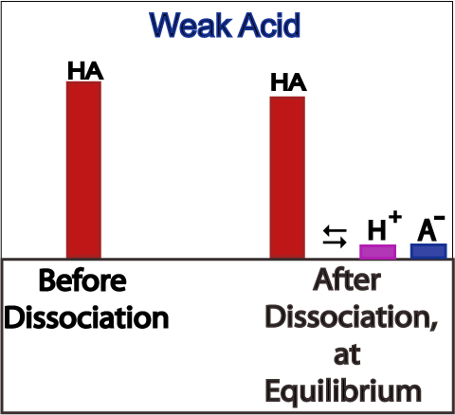
Dissociation of Weak Acids
Weak acids are assumed to dissociate only slightly (less than 5%) in solution.
Large K_{a} or small K_{a}?
Reactant favored or product favored?

Slide 14
Dissociation Constants: Weak Acids
Acid | Formula | Conjugate Base | K_{a}
Iodic | HIO₃ | IO₃⁻ | 1.7 x 10⁻¹
Oxalic | H₂C₂O₄ | HC₂O₄⁻ | 5.9 x 10⁻²
Sulfurous | H₂SO₃ | HSO₃⁻ | 1.5 x 10⁻²
Phosphoric | H₃PO₄ | H₂PO₄⁻ | 7.5 x 10⁻³
Citric | H₃C₆H₅O₇ | H₂C₆H₅O₇⁻ | 7.1 x 10⁻⁴
Nitrous | HNO₂ | NO₂⁻ | 4.6 x 10⁻⁴
Hydrofluoric | HF | F⁻ | 3.5 x 10⁻⁴
Formic | HCOOH | HCOO⁻ | 1.8 x 10⁻⁴
Benzoic | C₆H₅COOH | C₆H₅COO⁻ | 6.5 x 10⁻⁵
Acetic | CH₃COOH | CH₃COO⁻ | 1.8 x 10⁻⁵
Carbonic | H₂CO₃ | HCO₃⁻ | 4.3 x 10⁻⁷
Hypochlorous | HClO | ClO⁻ | 3.0 x 10⁻⁸
Hydrocyanic | HCN | CN⁻ | 4.9 x 10⁻¹⁰

Slide 15
Self-Ionization of Water
H₂O + H₂O  H₃O⁺ + OH⁻
At 25°, [H₃O⁺] = [OH⁻] = 1 x 10⁻⁷
K_{w} is a constant at 25 °C:
K_{w} = [H₃O⁺][OH⁻]
K_{w} = (1 x 10⁻⁷)(1 x 10⁻⁷) = 1 x 10⁻¹⁴

Slide 16
Calculating pH, pOH
pH = -log₁₀(H₃O⁺)
pOH = -log₁₀(OH⁻)
Relationship between pH and pOH
pH + pOH = 14
Finding [H₃O⁺], [OH⁻] from pH, pOH
[H₃O⁺] = 10^{-pH}
[OH⁻] = 10^{-pOH}

Slide 17
pH and pOH Calculations

Slide 18
pH Scale

