Slide 1
Applications of Aqueous Equilibria ***Titration***

Slide 2
Weak Acid/Strong Base Titration
Endpoint is above pH 7
A solution that is
0.10 M CH₃COOH
is titrated with
0.10 M NaOH

Slide 3
Strong Acid/Strong Base Titration
Endpoint is at
pH 7
A solution that is
0.10 M HCl is titrated with
0.10 M NaOH

Slide 4
Strong Acid/Strong Base Titration
A solution that is
0.10 M NaOH is titrated with
0.10 M HCl
Endpoint is at
pH 7
It is important to recognize that titration curves are not always increasing from left to right.

Slide 5
Strong Acid/Weak Base Titration
A solution that is
0.10 M HCl is titrated with
0.10 M NH₃
Endpoint is below
pH 7

Slide 6
Titration Calcs…
Lets look at the titration of acetic acid w/ NaOH
Starting point:’
25 ml of 0.15M Acetic Acid (K_{a} = 1.8E⁻⁵)
Calculate pH before any titrant is added
2.78
Add 10ml of .1M NaOH
Determine stoichiometry
Notice! You have a buffer now. Use HH equ.
↔
C₂H₃OH | OH⁻ | H₂O | C₂H₃O⁻
3.75 mmol | 1 mmol | 0 | 0
2.75 mmol | 0 mmol | 1mmol | 1mmol

Slide 7
Titration continued…
↔
Add 25ml of 0.1M NaOH
Still a buffer…use HH
Add 37.5ml of 0.1M NaOH
Problem! No more buffer
Equivalent pt!!
What Next? Reverse the Rx. Solve
H₂O source of H⁺
What is Reacting?
Must use K_{b}, solve for
C₂H₃OH | OH⁻ | H₂O | C₂H₃O⁻
3.75 mmol | 2.5 mmol | 0 | 0
1.25 mmol | 0 mmol | 2.5 mmol | 2.5 mmol
↔
C₂H₃OH | OH⁻ | H₂O | C₂H₃O⁻
3.75 mmol | 3.75 mmol | 0 | 0
0 mmol | 0 mmol | 3.75 mmol | 3.75 mmol
↔
C₂H₃O⁻ | H₂O | C₂H₃OH | OH⁻
3.75 mmol | 3.75 | 0 | 0

Slide 8
Titration continued…
↔
Add 50ml of 0.1M NaOH
Still no buffer…but…
Excess OH⁻
C₂H₃OH | OH⁻ | H₂O | C₂H₃O⁻
3.75 mmol | 5 mmol | 0 | 0
0 mmol | 1.25 mmol | 3.75 mmol | 3.75 mmol

Slide 9
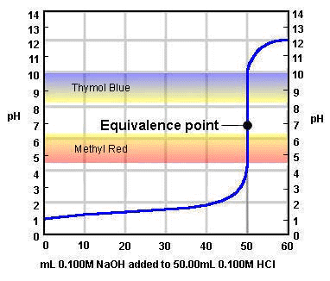
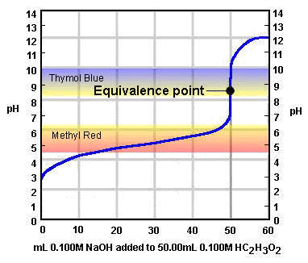
Selection of Indicators

Slide 10
Some Acid-Base Indicators
Indicator | pH Range in which Color Change Occurs | Color Change as pH Increases
Crystal violet Thymol blue Orange IV Methyl orange Bromcresol green Methyl red Chlorophenol red Bromthymol blue Phenol red Neutral red Thymol blue Phenolphthalein Thymolphthalein Alizarin yellow Indigo carmine | 0.0 - 1.6 1.2 - 2.8 1.4 - 2.8 3.2 - 4.4 3.8 - 5.4 4.8 - 6.2 5.2 - 6.8 6.0 - 7.6 6.6 - 8.0 6.8 - 8.0 8.0 - 9.6 8.2 - 10.0 9.4 - 10.6 10.1 - 12.0 11.4 - 13.0 | yellow to blue red to yellow red to yellow red to yellow yellow to blue red to yellow yellow to red yellow to blue yellow to red red to amber yellow to blue colourless to pink colourless to blue yellow to blue blue to yellow

Slide 11
pH Indicators and their ranges

