Slide 1
N36 – Acid Base
Quick Review
Link to YouTube Presentation: https://youtu.be/uS0P-Qp9tB8

Slide 2
N36 – Acid Base
Quick Review
Target: I can review Acid Base definitions and perform pH calculations for strong acids/bases

Slide 3
Acid/Base Definitions
Arrhenius Model Acids produce H⁺ Bases produce OH⁻
Bronsted-Lowry Model Acids are proton donors Bases are proton acceptors
Lewis Acid Model Acids are electron pair acceptors Bases are electron pair donors

Slide 4
Acid/Base Definitions
Arrhenius Model Acids produce H⁺ Bases produce OH⁻
Bronsted-Lowry Model Acids are proton donors Bases are proton acceptors
Lewis Acid Model Acids are electron pair acceptors Bases are electron pair donors

Slide 5
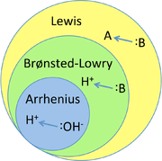
Acid/Base Definitions
Arrhenius is MOST specific
Brønsted-Lowry is less specific
Lewis is LEAST specific

Slide 6
Problems with Arrhenius Theory
Does not explain why:
Some molecular substances, (NH₃) dissolve in water to form basic solutions, even though they do not contain OH– ions.
How some ionic comp, (Na₂CO₃ or Na₂O) dissolve in water to form basic sol’ns, even though they don’t contain OH⁻
Why some molecular substances, (CO₂) dissolve in water to form acidic solutions, even though they do not contain H⁺ ions.
Acid–base reactions that take place outside aqueous solution.

Slide 7
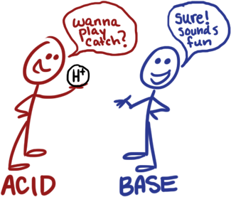
Brønsted–Lowry Acid–Base Theory
It defines acids and bases based on what happens in a rxn.
Any reaction involving H⁺ (proton) that transfers from one molecule to another is an acid–base reaction, regardless of whether it occurs in aqueous solution or if there is OH⁻ present.
All reactions that fit the Arrhenius definition also fit the Brønsted–Lowry definition.

Slide 8
Brønsted–Lowry Theory
In a Brønsted–Lowry acid–base reaction, the acid molecule donates an H⁺ to the base molecule.
H–A + :B ↔ :A– + H–B⁺
HCl + NH₃ ↔ Cl⁻ + NH₄⁺
The acid is an H⁺ donor.
The base is an H⁺ acceptor.
Base structure must contain an atom with an unshared pair of electrons.

Slide 9
Brønsted–Lowry Acids
H⁺ donors.
Any material that has H can potentially be a Brønsted–Lowry acid.
Because of the molecular structure, often one H in the molecule is easier to transfer than others.
When HCl dissolves in water, the HCl is the acid because HCl transfers an H⁺ to H₂O, forming H₃O⁺ ions.
Water acts as base, accepting H⁺.
HCl(aq) + H₂O(l) → Cl–(aq) + H₃O⁺(aq)
Acid Base

Slide 10
Amphoteric Substances
Amphoteric substances can act as either an acid or a base because they have both a transferable H and an atom with lone pair electrons.
NH₃ + H(OH) → NH₄⁺ + OH⁻
Water is donating a proton…ACID!
HCl + H(OH) → H₃O⁺ + Cl⁻
Water is accepting a proton…BASE!

Slide 11
Conjugate Acid–Base Pairs
Acids turn into “Conjugate Bases” once they have lost their proton/hydrogen
Bases turn into “Conjugate Acids” once they have gained a proton/hydrogen

Slide 12
Conjugate Acid–Base Pairs
Each reactant and the product it becomes is called a conjugate pair.

Slide 13
Conjugate Pairs
NH₃ + HBr → NH₄⁺ + Br⁻
Base
Acid
Conjugate Acid
Conjugate Base
Tips for Finding Each
- Find the Acid First – usually easiest!
- Find It’s Conjugate Base – the part left after donating its H+!
- Repeat with Base and Conjugate Acid

Slide 14
Acid Dissociation Back to equilibrium!!!! Woohoo!
HA → H⁺ + A⁻
Acid Proton Conjugate
base
Can also H⁺ be written in its hydrated form, H₃O⁺ (hydronium ion)

Slide 15
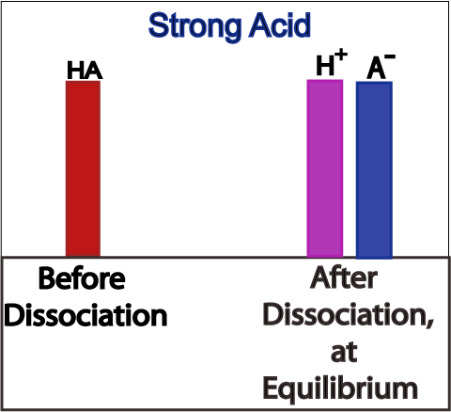
Dissociation of Strong Acids
Strong acids are assumed to dissociate completely in solution.
Reactant favored or product favored?
Product Favored
Large K_{a} or small K_{a}?
Large K_{a}

Slide 16
Dissociation Constants: Strong Acids
Acid | Formula | Conjugate Base | K_{a}
Perchloric | HClO₄ | ClO₄⁻ | Very large
Hydriodic | HI | I⁻ | Very large
Hydrobromic | HBr | Br⁻ | Very large
Hydrochloric | HCl | Cl⁻ | Very large
Nitric | HNO₃ | NO₃⁻ | Very large
Sulfuric | H₂SO₄ | HSO₄⁻ | Very large
Hydronium ion | H₃O⁺ | H₂O | 1.0

Slide 17
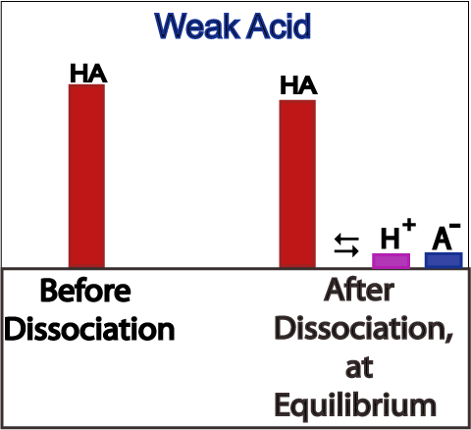
Dissociation of Weak Acids
Weak acids are assumed to dissociate only slightly (less than 5%) in solution.
Reactant favored or product favored?
Reactant Favored
Large K_{a} or small K_{a}?
Small K_{a}

Slide 18
Dissociation Constants: Weak Acids
Acid | Formula | Conjugate Base | K_{a}
Iodic | HIO₃ | IO₃⁻ | 1.7 x 10⁻¹
Oxalic | H₂C₂O₄ | HC₂O₄⁻ | 5.9 x 10⁻²
Sulfurous | H₂SO₃ | HSO₃⁻ | 1.5 x 10⁻²
Phosphoric | H₃PO₄ | H₂PO₄⁻ | 7.5 x 10⁻³
Citric | H₃C₆H₅O₇ | H₂C₆H₅O₇⁻ | 7.1 x 10⁻⁴
Nitrous | HNO₂ | NO₂⁻ | 4.6 x 10⁻⁴
Hydrofluoric | HF | F⁻ | 3.5 x 10⁻⁴
Formic | HCOOH | HCOO⁻ | 1.8 x 10⁻⁴
Benzoic | C₆H₅COOH | C₆H₅COO⁻ | 6.5 x 10⁻⁵
Acetic | CH₃COOH | CH₃COO⁻ | 1.8 x 10⁻⁵
Carbonic | H₂CO₃ | HCO₃⁻ | 4.3 x 10⁻⁷
Hypochlorous | HClO | ClO⁻ | 3.0 x 10⁻⁸
Hydrocyanic | HCN | CN⁻ | 4.9 x 10⁻¹⁰
*Random fact*
Weak acids will dissociate more when they are dilute! The lower the concentration the higher % dissociation they will have.

Slide 19
Self-Ionization of Water
K_{w} is a constant at 25 °C:
K_{w} = [H₃O⁺][OH⁻]
At 25°, [H₃O⁺] = [OH⁻] = 1 x 10⁻⁷
K_{w} = (1 x 10⁻⁷)(1 x 10⁻⁷) = 1 x 10⁻¹⁴

Slide 20
Self-Ionization of Water
K_{w} is only 1 x 10⁻¹⁴ when at 25 °C
Neutral is only pH 7 when at 25 °C
K_{w} increases as temp increases – more dissociates!
pH of neutral gets lower as temp increases

Slide 21
pH and pOH Calculations
pH = -log [H⁺] | pOH = -log [OH⁻]
[H⁺] = 10^{-pH} | [OH⁻] = 10^{-pOH}
pH + pOH = 14
[H⁺][OH⁻] = 1 x 10⁻¹⁴
With these calculations you can plug in, rearrange, substitute and find everything no matter what you are given in the problem!

Slide 22
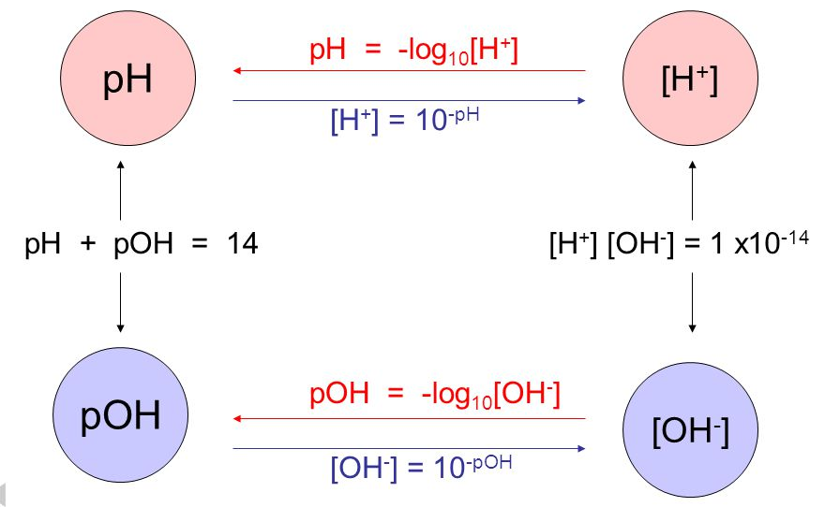
pH and pOH Calculations

Slide 23
pH and pOH Calculations

Slide 24
pH Scale

Slide 25
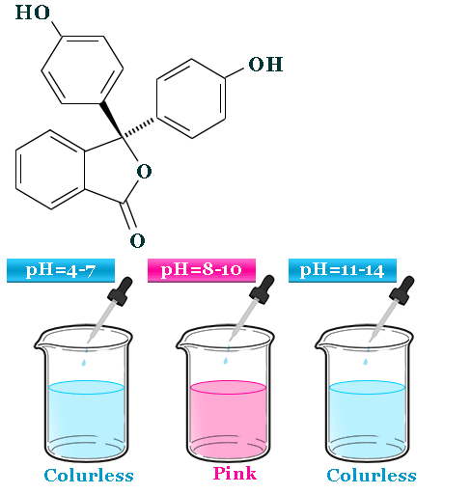
pH Indicators
Some substances turn colors when the pH changes into a certain range, because their structure is changing. This is a very handy tool for us!
Example:
Phenolphthalein turns from clear to pink when the pH reaches ~ 8 - 10.

Slide 26
pH Indicators
You can predict the effective color change region of an indicator by looking at it’s pKa.
Color Change Region = +/- 1 pH unit from the indicator’s pKa.
The pKa of phenolphthalein is 9.3, therefore it will change colors between a pH of ~ 8 - 10

Slide 27
YouTube Link to Presentation
https://youtu.be/uS0P-Qp9tB8

