Slide 1
N37 – Acid Base
Weak Problems
Link to YouTube Presentation: https://youtu.be/WwZBnDhd9J0

Slide 2
N37 – Acid Base
Weak Problems
Target: I can review Acid Base definitions and perform pH calculations for weak acids/bases

Slide 3
N37 – Acid Base
Yay, ICE Tables are back!

Slide 4
A Weak Acid Equilibrium Problem
What is the pH of a 0.50 M solution of acetic acid, HC₂H₃O₂, K_{a} = 1.8 x 10⁻⁵ ?
Step #1: Write the dissociation equation
HC₂H₃O₂  C₂H₃O₂⁻ + H⁺

Slide 5
A Weak Acid Equilibrium Problem
What is the pH of a 0.50 M solution of acetic acid, HC₂H₃O₂, K_{a} = 1.8 x 10⁻⁵ ?
Step #2: ICE it!
HC₂H₃O₂  C₂H₃O₂⁻ + H⁺
I
C
E
0.50
0
0
- x
+x
+x
0.50 - x
x
x

Slide 6
A Weak Acid Equilibrium Problem
What is the pH of a 0.50 M solution of acetic acid, HC₂H₃O₂, K_{a} = 1.8 x 10⁻⁵ ?
Step #3: Set up the law of mass action
HC₂H₃O₂  C₂H₃O₂⁻ + H⁺
Can use the 5% rule because
K < 1 and K at least 1000 time smaller than [initial]
E
0.50 - x
x
x

Slide 7
A Weak Acid Equilibrium Problem
What is the pH of a 0.50 M solution of acetic acid, HC₂H₃O₂, K_{a} = 1.8 x 10⁻⁵ ?
Step #4: Solve for x, which is also [H⁺]
HC₂H₃O₂  C₂H₃O₂⁻ + H⁺
E
0.50 - x
x
x
[H⁺] = 3.0 x 10⁻³ M

Slide 8
A Weak Acid Equilibrium Problem
What is the pH of a 0.50 M solution of acetic acid, HC₂H₃O₂, K_{a} = 1.8 x 10⁻⁵ ?
Step #5: Convert [H⁺] to pH
HC₂H₃O₂  C₂H₃O₂⁻ + H⁺
E
0.50 - x
x
3.0 x 10⁻³ M
x
$$pH=−log\left(3.0 x{ 10}^{−3}\right)=2.52$$

Slide 9
Reaction of Weak Bases with Water
The base reacts with water, producing its conjugate acid and hydroxide ion:
CH₃NH₂ + H₂O  CH₃NH₃⁺ + OH⁻ K_{b} = 4.38 x 10⁻⁴

Slide 10
K_{b} for Some Common Weak Bases
Many students struggle with identifying weak bases and their conjugate acids. What patterns do you see that may help you?
Base | Formula | Conjugate Acid | K_{b}
Ammonia | NH₃ | NH₄⁺ | 1.8 x 10⁻⁵
Methylamine | CH₃NH₂ | CH₃NH₃⁺ | 4.38 x 10⁻⁴
Ethylamine | C₂H₅NH₂ | C₂H₅NH₃⁺ | 5.6 x 10⁻⁴
Diethylamine | (C₂H₅)₂NH | (C₂H₅)₂NH₂⁺ | 1.3 x 10⁻³
Triethylamine | (C₂H₅)₃N | (C₂H₅)₃NH⁺ | 4.0 x 10⁻⁴
Hydroxylamine | HONH₂ | HONH₃⁺ | 1.1 x 10⁻⁸
Hydrazine | H₂NNH₂ | H₂NNH₃⁺ | 3.0 x 10⁻⁶
Aniline | C₆H₅NH₂ | C₆H₅NH₃⁺ | 3.8 x 10⁻¹⁰
Pyridine | C₅H₅N | C₅H₅NH⁺ | 1.7 x 10⁻⁹

Slide 11
Reaction of Weak Bases with Water
The generic reaction for a base reacting with water, producing its conjugate acid and hydroxide ion:
B + H₂O  BH⁺ + OH⁻
Yes, all weak bases do this –
DO NOT make this more complicated then it needs to be.

Slide 12
A Weak Base Equilibrium Problem
What is the pH of a 0.50 M solution of ammonia, NH₃,
K_{b} = 1.8 x 10⁻⁵ ?
Step #1: Write the equation for the reaction
NH₃ + H₂O  NH₄⁺ + OH⁻

Slide 13
A Weak Base Equilibrium Problem
What is the pH of a 0.50 M solution of ammonia, NH₃,
K_{b} = 1.8 x 10⁻⁵ ?
Step #2: ICE it!
NH₃ + H₂O  NH₄⁺ + OH⁻
I
C
E
0.50
0
0
- x
+x
+x
0.50 - x
x
x

Slide 14
A Weak Base Equilibrium Problem
What is the pH of a 0.50 M solution of ammonia, NH₃,
K_{b} = 1.8 x 10⁻⁵ ?
Step #3: Set up the law of mass action
Can use the 5% rule because
K < 1 and K at least 1000 time smaller than [initial]
NH₃ + H₂O  NH₄⁺ + OH⁻
E
0.50 - x
x
x

Slide 15
A Weak Base Equilibrium Problem
What is the pH of a 0.50 M solution of ammonia, NH₃,
K_{b} = 1.8 x 10⁻⁵ ?
Step #4: Solve for x, which is also [OH⁻]
NH₃ + H₂O  NH₄⁺ + OH⁻
E
0.50 - x
x
x
[OH⁻] = 3.0 x 10⁻³ M

Slide 16
A Weak Base Equilibrium Problem
What is the pH of a 0.50 M solution of ammonia, NH₃,
K_{b} = 1.8 x 10⁻⁵ ?
Step #5: Convert [OH⁻] to pH
NH₃ + H₂O  NH₄⁺ + OH⁻
E
0.50 - x
x
x
3.0 x 10⁻³ M
$$pOH=−log\left(3.0 x{ 10}^{−3}\right)=2.52$$
$$pH=14−pOH=14 −2.52=11.48$$

Slide 17
Remember! Everyone always forgets!
You can convert back and forth from Ka to Kb and vice versa. If you are given Ka for an acid but are doing problems with the acid’s conjugate base you can use that Ka to find the Kb that you need.
Ka x Kb = Kw
Ka x Kb = (1 x 10⁻¹⁴)

Slide 18
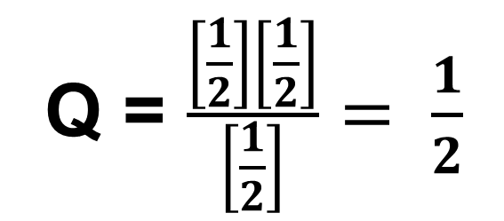
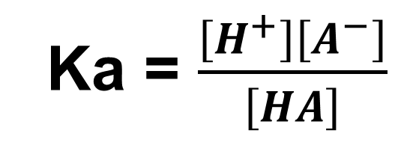
Weird Fact!
Ka = $\frac{\left[H^{+}\right]\left[A^{−}\right]}{\left[HA\right]}$
The % ionization for a weak acid
INCREASES as concentration DECREASES!
Let’s pretend we cut the [ ] in half
Q = $\frac{\left[\frac{1}{2}\right]\left[\frac{1}{2}\right]}{\left[\frac{1}{2}\right]}= \frac{1}{2}$
(of whatever the original was)
If Q decreases...
Reaction shifts to make more products...
More ionization! Higher % ionization!

Slide 19
YouTube Link to Presentation
https://youtu.be/WwZBnDhd9J0

