Slide 1
N39 – Acid Base
Henderson-Hasselbalch
“He-Ha”
Link to YouTube Presentation: https://youtu.be/1c8eybhSmck

Slide 2
N39 – Acid Base
Henderson-Hasselbalch
“He-Ha”
Target: I can identify when a solution is a buffer and can perform calculations for buffered solutions.

Slide 3
Buffered Solutions
Buffer - A solution that resists a change in pH when either hydroxide ions or protons are added.
Buffered solutions contain:
A weak acid and some extra conjugate A⁻
A weak base and some extra conjugate BH⁺

Slide 4
Buffered Solutions
How do you make/form a buffer?
Buffered solutions contain either:
A weak acid and its “matching” salt (A⁻ in salt)
A weak base and its “matching” salt (BH⁺ in salt)
A weak acid and smaller amount of a strong base
A weak base and smaller amount of strong acid

Slide 5
Buffered Solutions
How do you make/form a buffer?
Buffered solutions contain either:
A weak acid and its “matching” salt (A⁻ in salt)
A weak base and its “matching” salt (BH⁺ in salt)
A weak acid and smaller amount of a strong base
A weak base and smaller amount of strong acid
Because those end up with leftover weak A/B and forming some conjugate ions (so you don’t need to add a salt)!

Slide 6
Acid/Salt Buffering Pairs
The salt will contain the anion of the acid, A⁻ and the cation of a strong base (NaOH, KOH)
Weak Acid | Formula of the acid | Example of a salt of the weak acid
Hydrofluoric | HF | KF – Potassium fluoride
Formic | HCOOH | KHCOO – Potassium formate
Benzoic | C₆H₅COOH | NaC₆H₅COO – Sodium benzoate
Acetic | CH₃COOH | NaH₃COO – Sodium acetate
Carbonic | H₂CO₃ (HHCO₃) | NaHCO₃ - Sodium bicarbonate
Propanoic | HC₃H₅O₂ | NaC₃H₅O₂ - Sodium propanoate
Hydrocyanic | HCN | KCN - potassium cyanide

Slide 7
Base/Salt Buffering Pairs
The salt will contain the cation of the base, BH⁺ (base plus an extra hydrogen), and the anion of a strong acid (HCl, HNO₃)
Weak Base | Formula of the base | Formula of the cation of the base | Example of a salt of the weak acid
Ammonia | NH₃ | NH₄ ⁺ | NH₄Cl - ammonium chloride
Methylamine | CH₃NH₂ | CH₃NH₃ ⁺ | CH₃NH₃Cl – methylammonium chloride
Ethylamine | C₂H₅NH₂ | C₂H₅NH₃⁺ | C₂H₅NH₃NO₃ - ethylammonium nitrate
Aniline | C₆H₅NH₂ | C₆H₅NH₃ ⁺ | C₆H₅NH₃Cl – aniline hydrochloride
Pyridine | C₅H₅N | C₅H₅NH ⁺ | C₅H₅NHCl – pyridine hydrochloride

Slide 8
Titration of an Unbuffered Solution
A solution that is
0.10 M CH₃COOH
is titrated with
0.10 M NaOH

Slide 9
Titration of a Buffered Solution
What do you notice about the shape of the curve?
A solution that is
0.10 M CH₃COOH and
0.10 M NaCH₃COO is titrated with
0.10 M NaOH

Slide 10
Comparing Results
Unbuffered
Buffered
In what ways are the graphs different?
In what ways are the graphs similar?

Slide 11
Comparing Results
A buffered solution “resists changes in pH” as you add the acid or base! Slower pH change.
Buffered
Unbuffered

Slide 12
One way of doing these calculations
Rearrange your Law of Mass Action:
$$Ka= \frac{\left[H^{+}\right]\left[A^{−}\right]}{[HA]}→$$
$$[H^{+}]=Ka\frac{\left[HA\right]}{[A^{−}]}$$
$$→ = Ka\frac{\left[Acid\right]}{\begin{aligned}[conj. Base ] \\ salt\end{aligned}}$$
$$Kb=\frac{\left[{BH}^{+}\right][{OH}^{−}]}{[B]}→$$
$$[{OH}^{−}]=Kb\frac{\left[B\right]}{[{BH}^{+}]}$$
$$→ = Kb\frac{\left[Base\right]}{\begin{aligned}[conj. Acid] \\ salt\end{aligned}}$$

Slide 13
Calculate the [H⁺] in a solution that is 0.10 M in NaF and 0.20 M in HF. (K_{a} = 7.2 ×10⁻⁴)
7.2 x 10⁻⁴ M
HF ↔ H⁺ + F⁻
2.0 M
1.4 x 10⁻³ M
0.20 M
none of these

Slide 14
Calculate the [H⁺] in a solution that is 0.10 M in NaF and 0.20 M in HF. (K_{a} = 7.2 ×10⁻⁴)
Common Ion Effect!
7.2 x 10⁻⁴ M
HF ↔ H⁺ + F⁻
2.0 M
I | 0.20 | 0 | 0.10
C
E
5%
1.4 x 10⁻³ M
0.20 M
none of these

Slide 15
Calculate the [H⁺] in a solution that is 0.10 M in NaF and 0.20 M in HF. (K_{a} = 7.2 ×10⁻⁴)
Common Ion Effect!
7.2 x 10⁻⁴ M
HF ↔ H⁺ + F⁻
2.0 M
I | 0.20 | 0 | 0.10
C | -x | +x | +x
E
5%
1.4 x 10⁻³ M
0.20 M
none of these

Slide 16
Calculate the [H⁺] in a solution that is 0.10 M in NaF and 0.20 M in HF. (K_{a} = 7.2 ×10⁻⁴)
Common Ion Effect!
7.2 x 10⁻⁴ M
HF ↔ H⁺ + F⁻
2.0 M
I | 0.20 | 0 | 0.10
C | -x | +x | +x
E | 0.20 – x | x | 0.10 + x
5%
1.4 x 10⁻³ M
0.20 M
none of these

Slide 17
Calculate the [H⁺] in a solution that is 0.10 M in NaF and 0.20 M in HF. (K_{a} = 7.2 ×10⁻⁴)
Common Ion Effect!
7.2 x 10⁻⁴ M
HF ↔ H⁺ + F⁻
2.0 M
I | 0.20 | 0 | 0.10
C | -x | +x | +x
E | 0.20 – x | x | 0.10 + x
5% | 0.20 | x | 0.10
1.4 x 10⁻³ M
0.20 M
none of these

Slide 18
Calculate the [H⁺] in a solution that is 0.10 M in NaF and 0.20 M in HF. (K_{a} = 7.2 ×10⁻⁴)
7.2 x 10⁻⁴ M
HF ↔ H⁺ + F⁻
F⁻ present when you start because of the salt!
2.0 M
1.4 x 10⁻³ M
$$Ka= \frac{\left[H^{+}\right]\left[F^{−}\right]}{[HF]}$$
0.20 M
none of these

Slide 19
Calculate the [H⁺] in a solution that is 0.10 M in NaF and 0.20 M in HF. (K_{a} = 7.2 ×10⁻⁴)
7.2 x 10⁻⁴ M
$$7.2{ x 10}^{−4}=\frac{\left[H^{+}\right][0.10]}{[0.20]};$$
2.0 M
1.4 x 10⁻³ M
$$\left[H^{+}\right]=1.44{ x 10}^{−3}M$$
0.20 M
none of these

Slide 20
Calculate the [H⁺] in a solution that is 0.10 M in NaF and 0.20 M in HF. (K_{a} = 7.2 ×10⁻⁴)
7.2 x 10⁻⁴ M
$$7.2{ x 10}^{−4}=\frac{\left[H^{+}\right][0.10]}{[0.20]};$$
2.0 M
1.4 x 10⁻³ M
$$\left[H^{+}\right]=1.44{ x 10}^{−3}M$$
0.20 M
none of these

Slide 21
Now...calculate the pH in a solution that is 0.10 M in NaF and 0.20 M in HF. (K_{a} = 7.2 ×10⁻⁴)
2.84
$$\left[H^{+}\right]=1.44{ x 10}^{−3}M$$
0.70
$$pH=−log(1.44{ x 10}^{−3}M)$$
11.2
3.14
$$pH=2.84$$
none of these

Slide 22
Now...calculate the pH in a solution that is 0.10 M in NaF and 0.20 M in HF. (K_{a} = 7.2 ×10⁻⁴)
2.84
$$\left[H^{+}\right]=1.44{ x 10}^{−3}M$$
0.70
$$pH=−log(1.44{ x 10}^{−3}M)$$
11.2
3.14
$$pH=2.84$$
none of these

Slide 23
Another way to do these calculations!
Henderson-Hasselbalch Equation
A helpful shortcut equation to find the pH or pOH of a buffered solution.
You could also do ICE Tables but those can be really time consuming.
He-Ha!

Slide 24
Henderson-Hasselbalch Equation
$$pH=pKa+log\left(\frac{{[A}^{−}]}{[HA]}\right)$$
$$=pKa+log\left(\frac{[Base]}{[Acid]}\right)$$
$$pOH=pKb+log\left(\frac{{[BH}^{+}]}{[B]}\right)$$
$$=pKb+log\left(\frac{[Acid]}{[Base]}\right)$$
pKa = -log(Ka)
pKb = -log(Kb)
Just like pH = -log[H⁺]
The acids or bases may be conjugates from the salt!

Slide 25
Henderson-Hasselbalch Equation
$$pH=pKa+log\left(\frac{{[A}^{−}]}{[HA]}\right)$$
$$=pKa+log\left(\frac{[Base]}{[Acid]}\right)$$
$$pOH=pKb+log\left(\frac{{[BH}^{+}]}{[B]}\right)$$
$$=pKb+log\left(\frac{[Acid]}{[Base]}\right)$$
pKa = -log(Ka)
pKb = -log(Kb)
Just like pH = -log[H⁺]
The acids or bases may be conjugates from the salt!

Slide 26
Careful!
$$pH=pKa+log\left(\frac{{[A}^{−}]}{[HA]}\right)$$
$$=pKa+log\left(\frac{[Base]}{[Acid]}\right)$$
$$pOH=pKb+log\left(\frac{{[BH}^{+}]}{[B]}\right)$$
$$=pKb+log\left(\frac{[Acid]}{[Base]}\right)$$
People get these backwards all the time!
If you want pH then ACID goes on the BOTTOM.
If you want pOH then BASE goes on the BOTTOM

Slide 27
Other ways to think about He-Ha
Acid with a buffer:
$$pH=pKa+log\left(\frac{[salt]}{[Acid]}\right)=pKa+log\left(\frac{\begin{aligned}salt \\ [conj. Base]\end{aligned}}{[Acid]}\right)$$
Base with a buffer:
$$pOH=pKb+log\left(\frac{[salt]}{[Base]}\right)=pKb+log\left(\frac{\begin{aligned}salt \\ [conj. Acid]\end{aligned}}{[Base]}\right)$$

Slide 28
Careful!
Check your formulas!
1.00 M MgCl₂
= 2.00 M Cl⁻
Be on the lookout for salts that have a van’t Hoff factor of more than 2...is your [salt] the same as your [ion]

Slide 29
Calculate the [H⁺] in a solution that is 0.10 M in NaF and 0.20 M in HF. (K_{a} = 7.2 ×10⁻⁴)
7.2E⁻⁴ M
2.0 M
1.4E⁻³ M
0.20 M
none of these

Slide 30
Calculate the [H⁺] in a solution that is 0.10 M in NaF and 0.20 M in HF. (K_{a} = 7.2 ×10⁻⁴)
7.2E⁻⁴ M
Acid solution with a salt added.
HF = acid
NaF = salt
The salt has the conjugate base of the acid.
F⁻
2.0 M
1.4E⁻³ M
0.20 M
$$pH=pKa+Log\frac{[conj. Base Salt]}{[Acid]}$$
none of these

Slide 31
Calculate the [H⁺] in a solution that is 0.10 M in NaF and 0.20 M in HF. (K_{a} = 7.2 ×10⁻⁴)
$$pH=pKa+Log\frac{\left[conj. Base salt\right]}{[Acid]}$$
$$pH=−log\left[7.2E^{−4}\right]+log\frac{\left[0.1M\right]}{\left[0.2M\right]}$$
$$=2.84$$
[H⁺] = 10^{-pH} = 10^{-2.84} = $0.00144M$
7.2E⁻⁴ M
2.0 M
1.4E⁻³ M
0.20 M
none of these

Slide 32
Calculate the [H⁺] in a solution that is 0.10 M in NaF and 0.20 M in HF. (K_{a} = 7.2 ×10⁻⁴)
$$pH=pKa+Log\frac{[conj. Base salt]}{[Acid]}$$
$$pH=−log\left[7.2E^{−4}\right]+log\frac{\left[0.1M\right]}{\left[0.2M\right]}$$
$$=2.84$$
[H⁺] = 10^{-pH} = 10^{-2.84} = $0.00144M$
7.2E⁻⁴ M
2.0 M
1.4E⁻³ M
0.20 M
none of these

Slide 33
Adding Acid or Base to a Buffer
Buffer - A solution that resists a change in pH when either hydroxide ions or protons are added.
That means...
If I add acid (H⁺) something in the buffer will react with the H⁺ to use it up!
If I add base (OH⁻) something in the buffer will react with the OH⁻ to use it up!

Slide 34
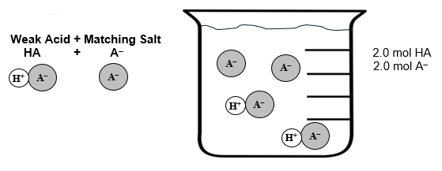
ACID BUFFER

Slide 35
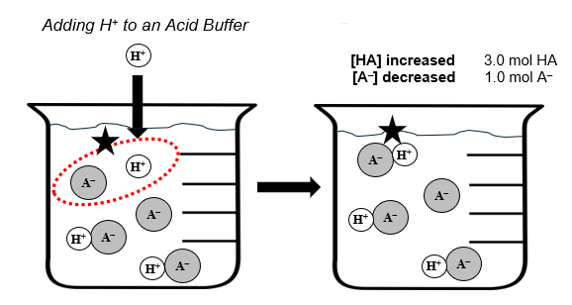
ACID BUFFER – Add H⁺
?

Slide 36
ACID BUFFER – Add H⁺

Slide 37
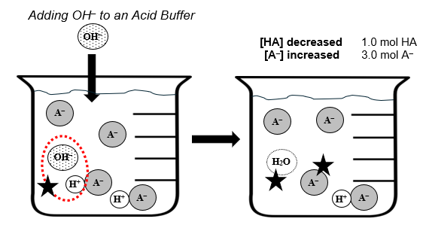
ACID BUFFER – Add OH⁻
?

Slide 38
ACID BUFFER – Add OH⁻

Slide 39
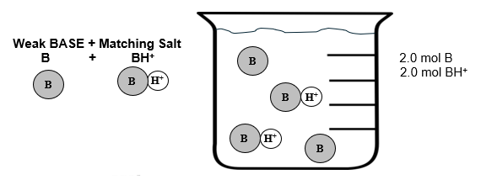
BASE BUFFER

Slide 40
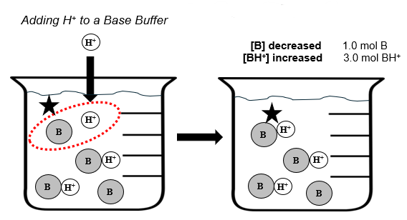
BASE BUFFER – Add H⁺
?

Slide 41
BASE BUFFER – Add H⁺

Slide 42
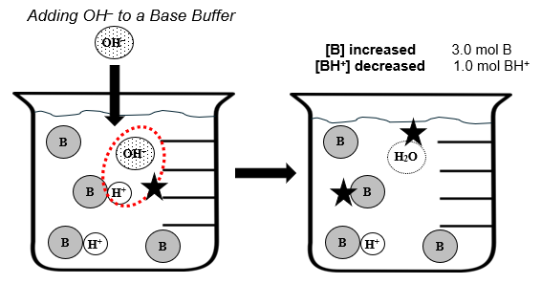
BASE BUFFER – Add OH⁻
?

Slide 43
BASE BUFFER – Add OH⁻

Slide 44
Buffer Capacity
The degree to which a solution resists change in pH when adding acid/base is called the buffer capacity.
If you keep the RATIO of salt to acid the same
but increase the QUANTITIES of each,
the pH will stay the same but you have a greater buffer capacity – you can add more acid/base before the pH starts to change
$$pH=pKa+log\left(\frac{A^{−}}{HA}\right)$$

Slide 45
Buffer Capacity
Two solutions are made with the same type of acid and same type of salt. Which has a higher buffer capacity?
$$\frac{[A^{−}]}{[HA]}$$
Max buffer capacity if you want it to work best for BOTH adding acid OR base, the “best” buffer would be a 1:1 ratio of salt to acid (or base)
$$\frac{[0.05]}{[0.10]}$$
$$\frac{[0.20]}{[0.40]}$$
Will the pH of the buffered solution be the same or different if these were made with the same acid and the same salt? Why?
The same pH. The pKa will be the same and the ratio of the salt to acid is the same. So, no change in pH

Slide 46
Buffer Capacity

Slide 47
Buffer Capacity

Slide 48
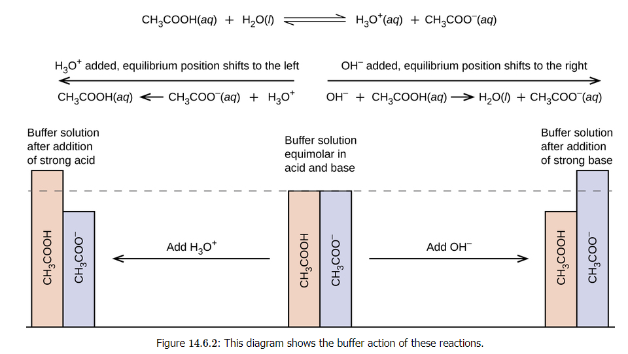

Slide 49
Suggestions…
Repetition to build muscle memory is more important than ever with buffer problems.
Commit to eating, sleeping, and doing buffer problems for a few weeks. Your time/efforts will build muscle memory!
When you are in a play you have periods of higher time commitment as you get closer to the play. Must practice!
When you have a big game coming up you have periods of higher time commitment. Must practice!

Slide 50
Suggestions…
Find your preferred method. They all have pros and cons.
Ice tables
Pro = familiar Con = takes forever, lots of steps
He-Ha
Pro = fast, on the Con = Have to recognize to use it, AP eq. sheet not always solving for pH
Rearranging Law of Mass Action
Pro = simple Con = Have to recognize to use it, extra step to get to pH or pOH

Slide 51
Suggestions…
Make sure to practice ALL methods once in a while.
You never know which info they will give you…
You want to be able to solve any variety of problems!
YES, it is fine if I used one method on a key and you used another method. No big deal.
Just make sure you are careful about rounding issues.

Slide 52
Suggestions…
Make sure to practice ALL methods once in a while.
You never know which info they will give you…
You want to be able to solve any variety of problems!
YES, it is fine if I used one method on a key and you used another method. No big deal.
Just make sure you are careful about rounding issues.
Example - Some people like to always use the pH version of He-Ha instead of pOH version when dealing with a base, so they just need to convert K_{b} into K_{a} and be careful of where you put your base and conjugate acid.

Slide 53
Suggestions…
These can get long, hard, and overwhelming
Skip it and come back if you need to!
Sometimes you need to do stoichiometry first!
Keep track of when you are using moles versus concentration!

Slide 54
Example with Stoichiometry
When things react – use stoich to see what is made and what is left over. Write the chemical reaction out if you need to!
“Mole tables” can be helpful. Sometimes called BCA tables or “Stoichiometry tables.” Just a way of organizing your numbers. LABEL if a mole table, do NOT call it an ICE table!
Make sure you go BACK to [ ] values for He-Ha or Law of Mass Action type calculations! BE CAREFUL!

Slide 55
Example with Stoichiometry
(a) Calculate the pH of a 0.500 L buffer solution composed of 0.700 M formic acid (HCOOH , Ka = 1.77 x 10⁻⁴) and 0.500 M sodium formate (NaCOOH)
$$pH=pKa+Log\frac{[conj. Base salt]}{[Acid]}$$
$$pH=−log\left[1.77 x {10}^{−4}\right]+log\frac{\left[0.500 M\right]}{\left[0.700 M\right]}$$
$$=3.61$$

Slide 56
Example with Stoichiometry
(a) Calculate the pH of a 0.500 L buffer solution composed of 0.700 M formic acid (HCOOH , Ka = 1.77 x 10⁻⁴) and 0.500 M sodium formate (NaCOOH) 3.61
(b) Calculate the pH after adding 60.0 mL of a 1.00 M NaOH solution

Slide 57
Example with Stoichiometry
(a) Calculate the pH of a 0.500 L buffer solution composed of 0.700 M formic acid (HCOOH , Ka = 1.77 x 10⁻⁴) and 0.500 M sodium formate (NaCOOH) 3.61
(b) Calculate the pH after adding 60.0 mL of a 1.00 M NaOH solution
HCOOH + NaOH → H₂O + Na⁺ + COOH⁻
Weak
Acid
Strong
Base
Weak Conj.
Acid
Conj. Base SALT
Weak Acid + corresponding Salt = BUFFER!

Slide 58
Example with Stoichiometry
(a) Calculate the pH of a 0.500 L buffer solution composed of 0.700 M formic acid (HCOOH , Ka = 1.77 x 10⁻⁴) and 0.500 M sodium formate (NaCOOH) 3.61
(b) Calculate the pH after adding 60.0 mL of a 1.00 M NaOH solution
HCOOH + NaOH → H₂O + Na⁺ + COOH⁻
Time for some stoichiometry to figure out how many moles of everything we have to start with

Slide 59
Example with Stoichiometry
(a) Calculate the pH of a 0.500 L buffer solution composed of 0.700 M formic acid (HCOOH , Ka = 1.77 x 10⁻⁴) and 0.500 M sodium formate (NaCOOH) 3.61
(b) Calculate the pH after adding 60.0 mL of a 1.00 M NaOH solution
HCOOH + NaOH → H₂O + Na⁺ + COOH⁻
0.500 L HCOOH | 0.700 mol | = 0.350 mol HCOOH
 | 1 L | to start with
0.060 L OH⁻ | 1 mol
 | 1 L
= 0.060 mol OH⁻ added
0.500 L COOH⁻ | 0.500 mol | = 0.250 mol COOH⁻ (and also mol Na⁺)
 | 1 L | salt to start with

Slide 60
Example with Stoichiometry
(a) Calculate the pH of a 0.500 L buffer solution composed of 0.700 M formic acid (HCOOH , Ka = 1.77 x 10⁻⁴) and 0.500 M sodium formate (NaCOOH) 3.61
(b) Calculate the pH after adding 60.0 mL of a 1.00 M NaOH solution
Mole table!
HCOOH + NaOH → H₂O + Na⁺ + COOH⁻
0.350 mol | 0.060 mol | 0 | 0.250 mol | 0.250 mol

Slide 61
Example with Stoichiometry
(a) Calculate the pH of a 0.500 L buffer solution composed of 0.700 M formic acid (HCOOH , Ka = 1.77 x 10⁻⁴) and 0.500 M sodium formate (NaCOOH) 3.61
(b) Calculate the pH after adding 60.0 mL of a 1.00 M NaOH solution
Mole table!
HCOOH + NaOH → H₂O + Na⁺ + COOH⁻
0.350 mol | 0.060 mol | 0 | 0.250 mol | 0.250 mol
-0.060 | -0.060 | +0.060 | +0.060 | +0.060

Slide 62
Example with Stoichiometry
(a) Calculate the pH of a 0.500 L buffer solution composed of 0.700 M formic acid (HCOOH , Ka = 1.77 x 10⁻⁴) and 0.500 M sodium formate (NaCOOH) 3.61
(b) Calculate the pH after adding 60.0 mL of a 1.00 M NaOH solution
Mole table!
HCOOH + NaOH → H₂O + Na⁺ + COOH⁻
0.350 mol | 0.060 mol | 0 | 0.250 mol | 0.250 mol
-0.060 | -0.060 | +0.060 | +0.060 | +0.060
0.290 | 0 | 0.060 | 0.310 | 0.310
BACK TO [ ] FOR THE HE-HA CALCULATIONS!

Slide 63
Example with Stoichiometry
Mole table!
HCOOH + NaOH → H₂O + Na⁺ + COOH⁻
0.290 | 0 | 0.060 | 0.310 | 0.310
Yes, I know the volumes cancel out... but the eq. is a [ ] equation!
$$pH=pKa+Log\frac{[conj. Base salt]}{[Acid]}$$
$$pH=−log\left[1.77 x {10}^{−4}\right]+log\frac{\left[0.310 mol/(0.500 L+0.060 L\right]}{\left[0.290 mol/(0.500 L+0.060L)\right]}$$
$=3.78$
Back to [ ] !
TOTAL solution volume!!! Your volume changed as you added the NaOH!

Slide 64
Crash Course Video Buffers, the Acid Rain Slayer
https://youtu.be/8Fdt5WnYn1k?si=gaA6JxbNHhhIN-Nt
Bozeman Science Video pH and Buffers
https://youtu.be/rIvEvwViJGk?si=CrPu5FtV0xLr8Amu
Professor Dave Video Acid-Base Equilibria and Buffer Solutions
https://youtu.be/jdmHjFp_35I?si=jncpa2ZIOWpPH72Z

Slide 68
YouTube Link to Presentation
https://youtu.be/1c8eybhSmck

