Slide 1
N40 – Acid Base
K_{sp}
Link to YouTube Presentation: https://youtu.be/LWIR91gx-ac

Slide 2
N40 – Acid Base
K_{sp}
Target: I can perform K_{sp} calculations to determine the solubility of different salts.

Slide 3
Mostly Review!
Equilibrium constants and ICE Tables.
Only real difference is that your reactant is always a solid so it doesn’t show up in the Law of Mass Action.
But that isn’t “new” – we’ve known that forever!

Slide 4
K_{sp} Values for Some Salts at 25°C
Name | Formula | K_{sp}
Barium carbonate | BaCO₃ | 2.6 x 10⁻⁹
Barium chromate | BaCrO₄ | 1.2 x 10⁻¹⁰
Barium sulfate | BaSO₄ | 1.1 x 10⁻¹⁰
Calcium carbonate | CaCO₃ | 5.0 x 10⁻⁹
Calcium oxalate | CaC₂O₄ | 2.3 x 10⁻⁹
Calcium sulfate | CaSO₄ | 7.1 x 10⁻⁵
Copper(I) iodide | CuI | 1.3 x 10⁻¹²
Copper(II) iodate | Cu(IO₃)₂ | 6.9 x 10⁻⁸
Copper(II) sulfide | CuS | 6.0 x 10⁻³⁷
Iron(II) hydroxide | Fe(OH)₂ | 4.9 x 10⁻¹⁷
Iron(II) sulfide | FeS | 6.0 x 10⁻¹⁹
Iron(III) hydroxide | Fe(OH)₃ | 2.6 x 10⁻³⁹
Lead(II) bromide | PbBr₂ | 6.6 x 10⁻⁶
Lead(II) chloride | PbCl₂ | 1.2 x 10⁻⁵
Lead(II) iodate | Pb(IO₃)₂ | 3.7 x 10⁻¹³
Lead(II) iodide | PbI₂ | 8.5 x 10⁻⁹
Lead(II) sulfate | PbSO₄ | 1.8 x 10⁻⁸
Name | Formula | K_{sp}
Lead(II) bromide | PbBr₂ | 6.6 x 10⁻⁶
Lead(II) chloride | PbCl₂ | 1.2 x 10⁻⁵
Lead(II) iodate | Pb(IO₃)₂ | 3.7 x 10⁻¹³
Lead(II) iodide | PbI₂ | 8.5 x 10⁻⁹
Lead(II) sulfate | PbSO₄ | 1.8 x 10⁻⁸
Magnesium carbonate | MgCO₃ | 6.8 x 10⁻⁶
Magnesium hydroxide | Mg(OH)₂ | 5.6 x 10⁻¹²
Silver bromate | AgBrO₃ | 5.3 x 10⁻⁵
Silver bromide | AgBr | 5.4 x 10⁻¹³
Silver carbonate | Ag₂CO₃ | 8.5 x 10⁻¹²
Silver chloride | AgCl | 1.8 x 10⁻¹⁰
Silver chromate | Ag₂CrO₄ | 1.1 x 10⁻¹²
Silver iodate | AgIO₃ | 3.2 x 10⁻⁸
Silver iodide | AgI | 8.5 x 10⁻¹⁷
Strontium carbonate | SrCO₃ | 5.6 x 10⁻¹⁰
Strontium fluoride | SrF₂ | 4.3 x 10⁻⁹
Strontium sulfate | SrSO₄ | 3.4 x 10⁻⁷
Zinc sulfide | ZnS | 2.0 x 10⁻²⁵

Slide 5
Solubility
We typically describe the solubility in how much solute can you dissolve in how much solvent.
Moles / Liter
Grams / Liter
Etc…
Always check what units it wants answers in!
Usually represented by “s”

Slide 6
Solving Solubility Problems
For the salt AgI at 25°C, K_{sp} = 1.5 x 10⁻¹⁶
AgI(s) → Ag⁺(aq) + I⁻(aq)
$$Ksp=\left[{Ag}^{+}\right][I^{−}]$$
I
C
E
O
O
Nothing on the denominator because the reactant was a solid!
+x
+x
x
x
1.5 x 10⁻¹⁶ = x²
x = s = solubility of AgI in mol/L
= 1.2 x 10⁻⁸ M

Slide 7
Solving Solubility Problems When Not 1:1
For the salt PbCl₂ at 25°C, K_{sp} = 1.6 x 10⁻⁵
PbCl₂(s) → Pb²⁺(aq) + 2Cl⁻(aq)
I
C
E
O
O
Be careful with the stoichiometry!
+s
+2s
s
2s
1.6 x 10⁻⁵ = (s)(2s)² = 4s³
= 1.6 x 10⁻² M
s = solubility of PbCl₂ in mol/L

Slide 8
Common Ion Effect
What happens to the solubility of a substance if one of its ions is already present in the solution?
Will the solubility increase or decrease????
It decreases!
Let’s redo this problem but this time let’s have some I- already in the solution. x should end up less than 1.2 x 10⁻⁸ mol/L
For the salt AgI at 25°C, K_{sp} = 1.5 x 10⁻¹⁶
AgI(s) → Ag⁺(aq) + I⁻(aq)
s = solubility of AgI in mol/L
= 1.2 x 10⁻⁸ M

Slide 9
Solving Solubility with a Common Ion
For the salt AgI at 25°C, K_{sp} = 1.5 x 10⁻¹⁶
What is its solubility in 0.05 M NaI?
AgI(s) → Ag⁺(aq) + I⁻(aq)
I
C
E
O
0.05
+s
+s
s
0.05+s
5% rule!
1.5 x 10⁻¹⁶ = (s)(0.05+s) ≅ (s)(0.05)
s = solubility of AgI in mol/L
= 3.0 x 10⁻¹⁵ M

Slide 10
The molar solubility of PbI₂ is 1.50 × 10⁻³ M.
Calculate the value of K_{sp} for PbI₂.
3.38E⁻⁹
4.50E⁻⁶
1.35E⁻⁸
1.50E⁻³
none of these

Slide 11
The molar solubility of PbI₂ is 1.50 × 10⁻³ M.
Calculate the value of K_{sp} for PbI₂.
3.38E⁻⁹
PbI_{2 (s)} ↔ | Pb²⁺ _{(aq)} | + 2I⁻ _{(aq)}
- | 0 | 0
- | + s | + 2s
4.50E⁻⁶
1.35E⁻⁸
$$Ksp=(s){(2s)}^{2}$$
$$Ksp=4\left(s\right)3$$
1.50E⁻³
$$Ksp=4\left(1.5 ×{10}^{−3}\right)3$$
none of these
$$Ksp=1.35 x {10}^{−8}$$

Slide 12
Will Something Precipitate?
Have to check Q versus K !
If Q < K then no precipitate yet!
All ions are dissociated still.
As soon as Q > K_{sp} you will have a precipitate!
The maximum amount will be dissociated, but the leftover will “crash out” as a solid precipitate.

Slide 13
Qualitatively describing how adding something changes solubility
Another Salt:
Look to see if the dissociated ions are in common
BaCl₂ + NaCl
Ba²⁺ 2Cl⁻ Na⁺ Cl⁻
Cl⁻ is in common with BaCl2, so it will decrease the solubility.
BaCl₂ + NaF
Ba²⁺ 2Cl⁻ Na⁺ F⁻
F⁻ is NOT in common with BaCl₂, so it will not change the solubility.

Slide 14
Qualitatively describing how adding something changes solubility
Adding an Acid:
Look to see if the dissociated ions will react with one of the ions from the salt.
BaCl₂ + HNO₃
Ba²⁺ 2Cl⁻ H⁺ NO₃⁻
H⁺ and Cl⁻ make a strong acid which stays dissociated. Doesn’t affect the solubility of BaCl₂
CaF₂ + HNO₃
Ca²⁺ 2F⁻ H⁺ NO₃⁻
H⁺ and F⁻ make a weak acid which doesn’t dissociate fully! Removes F- ions from solution. Increases the solubility of CaF2, trying to replace F- ions

Slide 15
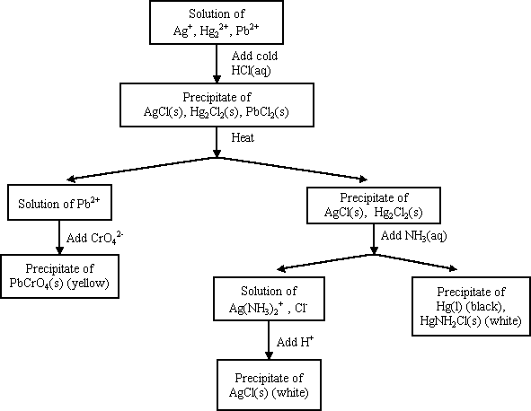
Precipitation and Qualitative Analysis
Not in the class anymore!

Slide 16
FYI - Complex Ions
Complex ion - a charged species composed of:
1. A metallic cation
2. Ligands
Ligand – Lewis bases that have a lone electron pair that can form a covalent bond with an empty orbital belonging to the metallic cation

Slide 17
NH₃, CN⁻, and H₂O are Common Ligands
[ ]⁻
*NOTE* A lot of Lewis acids/bases act as ligands. They are often involved in solubility problems, which is why we tend to put Ksp in the Acid Base chapter and not always Equilibrium chapter.

Slide 18
Coordination Number
Coordination number
The number of ligands attached to the cation
2, 4, and 6 are the most common coordination numbers
Coordination # | Example(s)
2 | Ag(NH₃)₂⁺
4 | CoCl₄²⁻ Cu(NH₃)₄²⁺
6 | Co(H₂O)₆²⁺ Ni(NH₃)₆²⁺

Slide 19
Complex Ions and Solubility
AgCl(s)  Ag⁺ + Cl⁻ K_{sp} = 1.6 x 10⁻¹⁰
Ag⁺ + NH₃  Ag(NH₃)⁺ K₁ = 2.1 x 10³
Ag(NH₃)⁺ NH₃  Ag(NH₃)₂⁺ K₂ = 8.2 x 10³
AgCl + 2NH₃  Ag(NH₃)₂⁺ + Cl⁻
K = K_{sp}⋅K₁⋅K₂

Slide 20
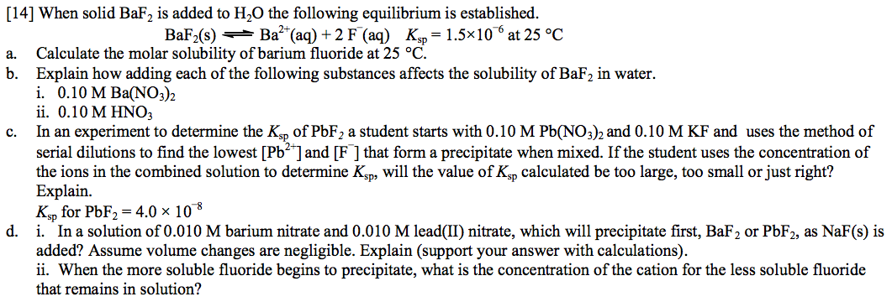
Practice to Glue In

Slide 21
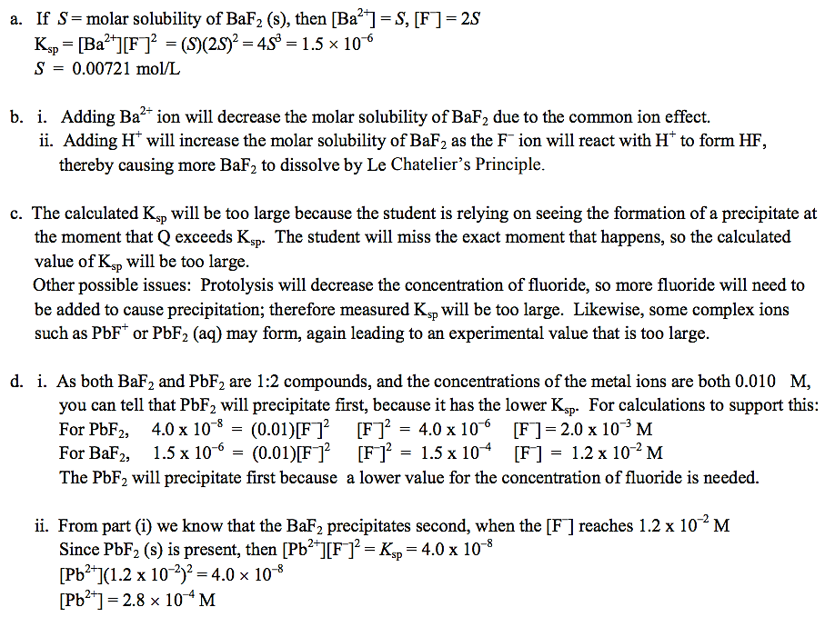
Key

Slide 22
Key

Slide 23
YouTube Link to Presentation
https://youtu.be/LWIR91gx-ac

