Slide 1
N41 – Acid Base
Target: I can perform Ksp calculations to determine the solubility of different salts.

Slide 2
N41 – Acid Base
Ksp

Slide 3
K_{sp} Values for Some Salts at 25°C
Name | Formula | K_{sp}
Barium carbonate | BaCO₃ | 2.6 x 10⁻⁹
Barium chromate | BaCrO₄ | 1.2 x 10⁻¹⁰
Barium sulfate | BaSO₄ | 1.1 x 10⁻¹⁰
Calcium carbonate | CaCO₃ | 5.0 x 10⁻⁹
Calcium oxalate | CaC₂O₄ | 2.3 x 10⁻⁹
Calcium sulfate | CaSO₄ | 7.1 x 10⁻⁵
Copper(I) iodide | CuI | 1.3 x 10⁻¹²
Copper(II) iodate | Cu(IO₃)₂ | 6.9 x 10⁻⁸
Copper(II) sulfide | CuS | 6.0 x 10⁻³⁷
Iron(II) hydroxide | Fe(OH)₂ | 4.9 x 10⁻¹⁷
Iron(II) sulfide | FeS | 6.0 x 10⁻¹⁹
Iron(III) hydroxide | Fe(OH)₃ | 2.6 x 10⁻³⁹
Lead(II) bromide | PbBr₂ | 6.6 x 10⁻⁶
Lead(II) chloride | PbCl₂ | 1.2 x 10⁻⁵
Lead(II) iodate | Pb(IO₃)₂ | 3.7 x 10⁻¹³
Lead(II) iodide | PbI₂ | 8.5 x 10⁻⁹
Lead(II) sulfate | PbSO₄ | 1.8 x 10⁻⁸
Name | Formula | K_{sp}
Lead(II) bromide | PbBr₂ | 6.6 x 10⁻⁶
Lead(II) chloride | PbCl₂ | 1.2 x 10⁻⁵
Lead(II) iodate | Pb(IO₃)₂ | 3.7 x 10⁻¹³
Lead(II) iodide | PbI₂ | 8.5 x 10⁻⁹
Lead(II) sulfate | PbSO₄ | 1.8 x 10⁻⁸
Magnesium carbonate | MgCO₃ | 6.8 x 10⁻⁶
Magnesium hydroxide | Mg(OH)₂ | 5.6 x 10⁻¹²
Silver bromate | AgBrO₃ | 5.3 x 10⁻⁵
Silver bromide | AgBr | 5.4 x 10⁻¹³
Silver carbonate | Ag₂CO₃ | 8.5 x 10⁻¹²
Silver chloride | AgCl | 1.8 x 10⁻¹⁰
Silver chromate | Ag₂CrO₄ | 1.1 x 10⁻¹²
Silver iodate | AgIO₃ | 3.2 x 10⁻⁸
Silver iodide | AgI | 8.5 x 10⁻¹⁷
Strontium carbonate | SrCO₃ | 5.6 x 10⁻¹⁰
Strontium fluoride | SrF₂ | 4.3 x 10⁻⁹
Strontium sulfate | SrSO₄ | 3.4 x 10⁻⁷
Zinc sulfide | ZnS | 2.0 x 10⁻²⁵

Slide 4
Mostly Review!
Equilibrium constants and ICE Tables.
Only real difference is that your reactant is always a solid so it doesn’t show up in the Law of Mass Action.
But that isn’t “new” – we’ve known that forever!

Slide 5
Solubility
We typically describe the solubility in how much solute can you dissolve in how much solvent.
Moles / Liter
Grams / Liter
Etc…
Always check what units it wants answers in!
Usually represented by “S”

Slide 6
Solving Solubility Problems
For the salt AgI at 25°C, K_{sp} = 1.5 x 10⁻¹⁶
AgI(s) → Ag⁺(aq) + I⁻(aq)
$$Ksp=\left[{Ag}^{+}\right][I^{−}]$$
I
C
E
O
O
Nothing on the denominator because the reactant was a solid!
+x
+x
x
x
1.5 x 10⁻¹⁶ = x²
x = solubility of AgI in mol/L
= 1.2 x 10⁻⁸ M

Slide 7
Solving Solubility Problems When Not 1:1
For the salt PbCl₂ at 25°C, K_{sp} = 1.6 x 10⁻⁵
PbCl₂(s) → Pb²⁺(aq) + 2Cl⁻(aq)
I
C
E
O
O
Be careful with the stoichiometry!
+x
+2x
x
2x
1.6 x 10⁻⁵ = (x)(2x)² = 4x³
= 1.6 x 10⁻² M
x = solubility of PbCl₂ in mol/L

Slide 8
Common Ion Effect
What happens to the solubility of a substance if one of its ions is already present in the solution?
Will the solubility increase or decrease????
It decreases!
Let’s redo this problem but this time let’s have some I- already in the solution. x should end up less than 1.2 x 10⁻⁸ mol/L
For the salt AgI at 25°C, K_{sp} = 1.5 x 10⁻¹⁶
AgI(s) → Ag⁺(aq) + I⁻(aq)
x = solubility of AgI in mol/L
= 1.2 x 10⁻⁸ M

Slide 9
Solving Solubility with a Common Ion
For the salt AgI at 25°C, K_{sp} = 1.5 x 10⁻¹⁶
What is its solubility in 0.05 M NaI?
AgI(s) → Ag⁺(aq) + I⁻(aq)
I
C
E
O
0.05
+x
0.05+x
x
0.05+x
5% rule!
1.5 x 10⁻¹⁶ = (x)(0.05+x) ≅ (x)(0.05)
x = solubility of AgI in mol/L
= 3.0 x 10⁻¹⁵ M

Slide 10
The molar solubility of PbI₂ is 1.50 × 10⁻³ M.
Calculate the value of K_{sp} for PbI₂.
3.38E⁻⁹
4.50E⁻⁶
1.35E⁻⁸
1.50E⁻³
none of these

Slide 11
The molar solubility of PbI₂ is 1.50 × 10⁻³ M.
Calculate the value of K_{sp} for PbI₂.
3.38E⁻⁹
PbI_{2 (s)} ↔ | Pb²⁺ _{(aq)} | + 2I⁻ _{(aq)}
- | 0 | 0
- | + x | + 2x
4.50E⁻⁶
$$Ksp=\left(x\right)\left(2x\right)2$$
1.35E⁻⁸
$$1.50 x{ 10}^{−3}=\left(x\right)\left(2x\right)2$$
1.50E⁻³
$$1.50 x{ 10}^{−3}=4x3$$
none of these
$$x=1.35 x {10}^{−8}$$

Slide 12
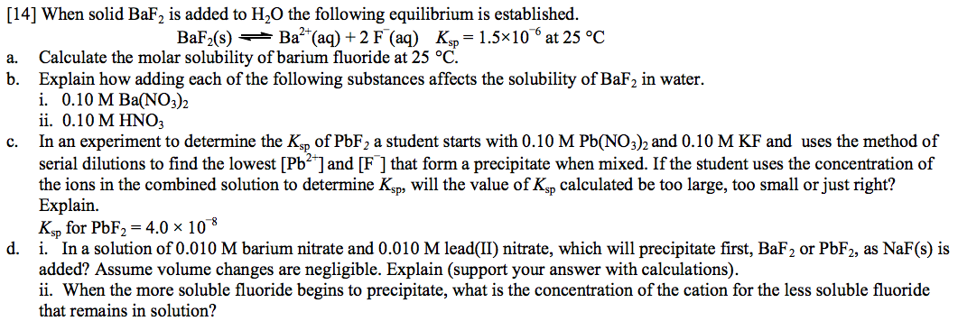
Practice to Glue In

Slide 13
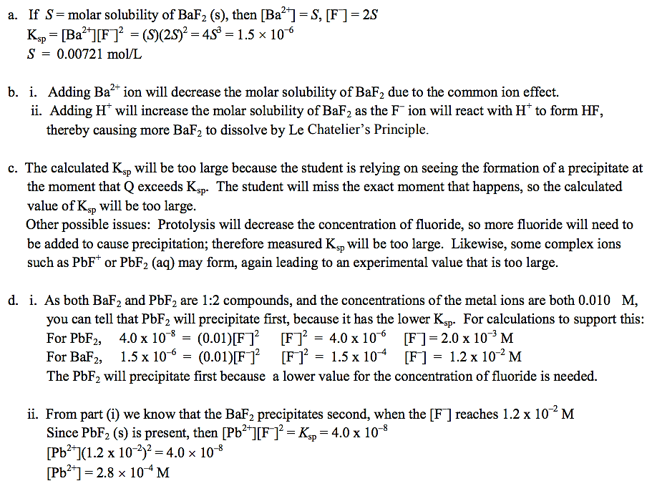
Key

Slide 14
Key

Slide 15
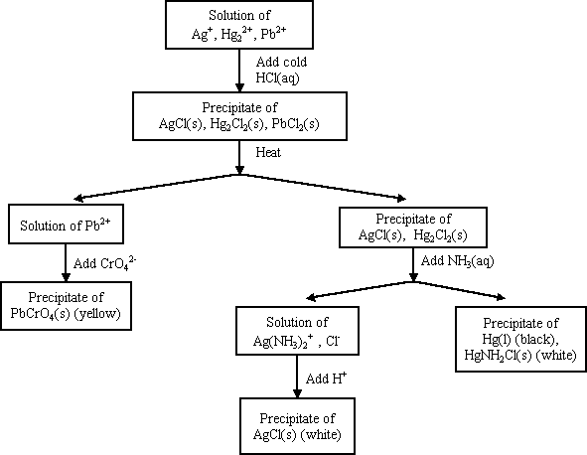
Precipitation and Qualitative Analysis

Slide 16
FYI - Complex Ions
Complex ion - a charged species composed of:
1. A metallic cation
2. Ligands
Ligand – Lewis bases that have a lone electron pair that can form a covalent bond with an empty orbital belonging to the metallic cation

Slide 17
NH₃, CN⁻, and H₂O are Common Ligands
[ ]⁻
*NOTE* A lot of Lewis acids/bases act as ligands. They are often involved in solubility problems, which is why we tend to put Ksp in the Acid Base chapter and not always Equilibrium chapter.

Slide 18
Coordination Number
Coordination number
The number of ligands attached to the cation
2, 4, and 6 are the most common coordination numbers
Coordination # | Example(s)
2 | Ag(NH₃)₂⁺
4 | CoCl₄²⁻ Cu(NH₃)₄²⁺
6 | Co(H₂O)₆²⁺ Ni(NH₃)₆²⁺

Slide 19
Complex Ions and Solubility
AgCl(s)  Ag⁺ + Cl⁻ K_{sp} = 1.6 x 10⁻¹⁰
Ag⁺ + NH₃  Ag(NH₃)⁺ K₁ = 2.1 x 10³
Ag(NH₃)⁺ NH₃  Ag(NH₃)₂⁺ K₂ = 8.2 x 10³
AgCl + 2NH₃  Ag(NH₃)₂⁺ + Cl⁻
K = K_{sp}⋅K₁⋅K₂

Slide 20
YouTube Link to Presentation
www.

