Slide 1
N41 – Acid Base
Titration
Link to YouTube Presentation: https://youtu.be/9p9wnazGp9I

Slide 2
N41 – Acid Base
Titration
Target: I can perform titration calculations.

Slide 3
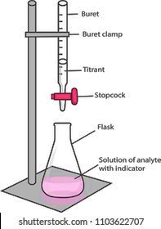
Titration Set Up
Burette filled with Titrant
Burette clamp
Ring Stand
Stopcock
Flask
Analyte solution with indicator added

Slide 4
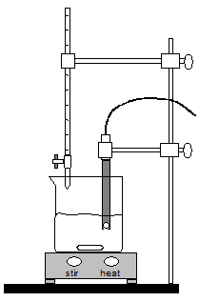
Titration Set Up
Burette filled with Titrant
Burette clamp
pH probe
Stopcock
Ring Stand
Beaker with stir bar
Analyte Solution
Stir Plate

Slide 5
Strong Acid/Strong Base Titration
Endpoint is at pH 7
A solution that is
0.10 M HCl is titrated with
0.10 M NaOH

Slide 6
Weak Acid/Strong Base Titration
Endpoint is above pH 7
A solution that is
0.10 M CH₃COOH
is titrated with
0.10 M NaOH

Slide 7
Strong Acid/Weak Base Titration
Endpoint is below pH 7
A solution that is
0.10 M HCl is titrated with
0.10 M NH₃

Slide 8
Strong Acid/Strong Base Titration
A solution that is
0.10 M NaOH is titrated with
0.10 M HCl
Endpoint is at pH 7
It is important to recognize that titration curves are not always increasing from left to right.

Slide 9
Titration Calculations…

Slide 10
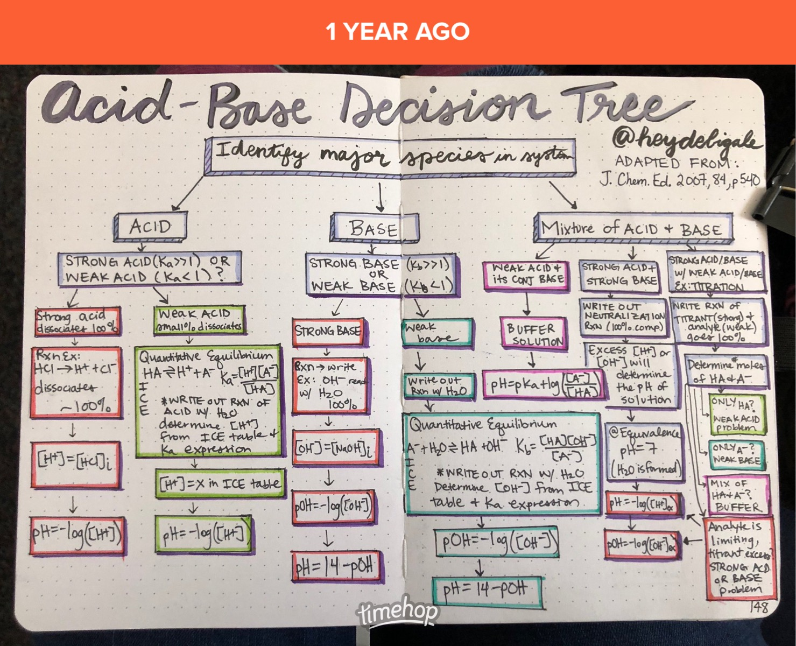
Titration Calculations…

Slide 11
Titration Calculations…

Slide 12
Titration Calculations…

Slide 13
Calculations to Plot a Titration Curve
Starting pH
If weak, then ICE table then pH
Early on during titration
Stoich then He-Ha
Equivalence Point
mol acid = mol base
No more buffer! Reverse rxn
Calc new K value - ICE then pH
½ Way Point
½ moles @ eq.pt
pH = pKa
Towards end of titration
Extra titrant left over
Stoich then simple pH
5
3
2
4
1

Slide 14
Titration Calculations
1
Lets look at the titration of acetic acid w/ NaOH
BEFORE TITRATION
Starting point:
25 ml of 0.15M Acetic Acid (K_{a} = 1.8E⁻⁵)
Calculate pH before any titrant is added
ICE TABLE! Then pH calculation
$$K= \frac{\left[H^{+}\right]\left[{C2H3O2}^{−}\right]}{\left[C2H3O2H\right]}$$
C₂H₃O₂H | ↔ H⁺ | C₂H₃O₂⁻
0.15 M | 0 M | 0 M
- x | + x | + x
0.15 – x | x | x
0.15 | x | x
$$pH=−log[H^{+}]$$
$$pH=−log(1.64 x {10}^{−3})$$
$$1.8 x{ 10}^{−5}= \frac{(x)(x)}{0.15}$$
$$pH @ starting point$$
= 2.78
$$x=1.64 x {10}^{−3}$$

Slide 15
Titration Calculations
2
People like to use these “mole tables” – they are NOT ICE TABLES! They have moles not concentrations. BE CAREFUL!
DURING THE TITRATION
Add 10ml of 0.10 M NaOH
Determine stoichiometry
Notice! You have a buffer now.
You have a conjugate base!
Use He-Ha eq.
↔
C₂H₃O₂H | OH⁻ | H₂O | C₂H₃O₂⁻
3.75 mmol | 1 mmol | 0 | 0
-1 mmol | -1 mmol | +1 mmol | +1 mmol
2.75 mmol | 0 mmol | 1mmol | 1mmol
MOLE TABLE!
Have to convert to M before using He-Ha!
25 mL
1 L
0.15 mol
$$\left[C2H3O2H\right]= \frac{2.75 x {10}^{−3}mol}{(0.025 L+0.010 L)}=0.0786 M$$
= 3.75x10⁻³ mol acid
1000 mL
1 L
$$\left[C2H3O2−\right]= \frac{1.00 x {10}^{−3}mol}{(0.025 L+0.010 L)}=0.0286 M$$
10 mL
1 L
0.10 mol
= 1.0 x10⁻³ mol base
1000 mL
1 L
NOW you can use He-Ha

Slide 16
Titration Calculations
2
DURING THE TITRATION
Add 10ml of 0.10 M NaOH
Determine stoichiometry
Notice! You have a buffer now.
You have a conjugate base!
Use He-Ha eq.
$$\left[C2H3O2H\right]= \frac{2.75 x {10}^{−3}mol}{(0.025 L+0.010 L)}=0.0786 M$$
$$\left[C2H3O2−\right]= \frac{1.00 x {10}^{−3}mol}{(0.025 L+0.010 L)}=0.0286 M$$
$$pH=pKa+log\left(\frac{[A^{−}]}{[HA]}\right)$$
$$pH=−log(1.8x{10}^{−5})+log\left(\frac{0.0286 M}{0.0786 M}\right)$$
pH = 4.31

Slide 17
Titration Calculations
2
People like to use these “mole tables” – they are NOT ICE TABLES! They have moles not concentrations. BE CAREFUL!
DURING THE TITRATION AGAIN
Add 25ml of 0.10 M NaOH
Determine stoichiometry
Notice! You have a buffer now.
You have a conjugate base!
Use He-Ha eq.
↔
C₂H₃O₂H | OH⁻ | H₂O | C₂H₃O₂⁻
3.75 x10⁻³ | 2.5 x10⁻³ | 0 | 0
-2.5 x10⁻³ | -2.5 x10⁻³ | +2.5 x10⁻³ | +2.5 x10⁻³
1.25 x10⁻³ | 0 | 2.5 x10⁻³ | 2.5 x10⁻³
MOLE TABLE!
Have to convert to M before using He-Ha!
25 mL
1 L
0.15 mol
$$\left[C2H3O2H\right]= \frac{1.25 x {10}^{−3}mol}{(0.025 L+0.025 L)}=0.025 M$$
= 3.75x10⁻³ mol acid
1000 mL
1 L
$$\left[C2H3O2−\right]= \frac{2.50 x {10}^{−3}mol}{(0.025 L+0.025 L)}=0.050 M$$
25 mL
1 L
0.10 mol
= 2.5 x10⁻³ mol base
1000 mL
1 L
NOW you can use He-Ha

Slide 18
Titration Calculations
2
DURING THE TITRATION AGAIN
Add 25ml of 0.10 M NaOH
Determine stoichiometry
Notice! You have a buffer now.
You have a conjugate base!
Use He-Ha eq.
$$\left[C2H3O2H\right]= \frac{1.25 x {10}^{−3}mol}{(0.025 L+0.025 L)}=0.025 M$$
$$\left[C2H3O2−\right]= \frac{2.50 x {10}^{−3}mol}{(0.025 L+0.025 L)}=0.050 M$$
$$pH=pKa+log\left(\frac{[A^{−}]}{[HA]}\right)$$
$$pH=−log(1.8x{10}^{−5})+log\left(\frac{0.050 M}{0.025 M}\right)$$
pH = 5.05

Slide 19
Titration Calculations
3
AT EQUIVALENCE POINT
Add ? ml of 0.10 M NaOH
Determine stoichiometry
25 mL
1 L
0.15 mol
= 3.75x10⁻³ mol acid
1000 mL
1 L
3.75x10⁻³ mol
1 L
1000 mL
= 37.5 mL base to get to equivalence point
0.10 mol
1 L

Slide 20
Titration Calculations
3
People like to use these “mole tables” – they are NOT ICE TABLES! They have moles not concentrations. BE CAREFUL!
AT EQUIVALENCE POINT
Add 37.5 ml of 0.10 M NaOH
Determine stoichiometry
Notice! You have NO BUFFER LEFT!
You have NO weak acid left!!
↔
MOLE TABLE!
C₂H₃O₂H | OH⁻ | H₂O | C₂H₃O₂⁻
3.75 x10⁻³ | 3.75 x10⁻³ | 0 | 0
-3.75 x10⁻³ | -3.75 x10⁻³ | +3.75 x10⁻³ | +3.75 x10⁻³
0 | 0 | 3.75 x10⁻³ | 3.75 x10⁻³
Have to Reverse the Rxn, new ICE table!
25 mL
1 L
0.15 mol
= 3.75x10⁻³ mol acid
1000 mL
1 L
37.5mL
1 L
0.10 mol
= 3.75 x10⁻³ mol base
1000 mL
1 L

Slide 21
Titration Calculations
3
People like to use these “mole tables” – they are NOT ICE TABLES! They have moles not concentrations. BE CAREFUL!
AT EQUIVALENCE POINT
Add 37.5 ml of 0.10 M NaOH
Determine stoichiometry
Notice! You have NO BUFFER LEFT!
You have NO weak acid left!!
↔
C₂H₃O₂H | OH⁻ | H₂O | C₂H₃O₂⁻
3.75 x10⁻³ | 3.75 x10⁻³ | 0 | 0
-3.75 x10⁻³ | -3.75 x10⁻³ | +3.75 x10⁻³ | +3.75x10⁻³
0 | 0 | 3.75 x10⁻³ | 3.75x10⁻³
Have to Reverse the Rxn, new ICE table!
Remember to use M in ICE Table not moles!
↔
C₂H₃O₂⁻ | H₂O | C₂H₃O₂H | OH-
0.06 M | - | 0 | 0
- x | - | + x | + x
0.06 | - | x | x
$$\left[C2H3O_{2}−\right]= \frac{3.75 x {10}^{−3}mol}{(0.025 L+0.0375 L)}=0.060 M$$

Slide 22
Titration Calculations
3
People like to use these “mole tables” – they are NOT ICE TABLES! They have moles not concentrations. BE CAREFUL!
AT EQUIVALENCE POINT
Add 37.5 ml of 0.10 M NaOH
Determine stoichiometry
Notice! You have NO BUFFER LEFT!
You have NO weak acid left!!
↔
C₂H₃O₂H | OH⁻ | H₂O | C₂H₃O₂⁻
3.75 x10⁻³ | 3.75 x10⁻³ | 0 | 0
-3.75 x10⁻³ | -3.75 x10⁻³ | +3.75 x10⁻³ | +3.75 x10⁻³
0 | 0 | 3.75 x10⁻³ | 3.75 x10⁻³
Have to Reverse the Rxn, new ICE table!
Remember to use Kb this time!
↔
$$Kb=\frac{Kw}{Ka}$$
C₂H₃O₂⁻ | H₂O | C₂H₃O₂H | OH-
0.06 M | - | 0 | 0
- x | - | + x | + x
0.06 | - | x | x
$$Kw=Ka x Kb$$
$$Kb=\frac{(1 x{ 10}^{−14})}{(1.8 x {10}^{−5})}=5.56 x {10}^{−10}$$

Slide 23
Titration Calculations
3
AT EQUIVALENCE POINT
Add 37.5 ml of 0.10 M NaOH
Determine stoichiometry
Notice! You have NO BUFFER LEFT!
You have NO weak acid left!!
↔
C₂H₃O₂⁻ | H₂O | C₂H₃O₂H | OH-
0.06 M | - | 0 | 0
- x | - | + x | + x
0.06 | - | x | x
$$5.56 x {10}^{−10}= \frac{(x)(x)}{0.06}$$
Remember to use Kb this time!
$$Kb=\frac{Kw}{Ka}$$
$$Kw=Ka x Kb$$
$$x=5.77 x {10}^{−6}=[{OH}^{−}]$$
Now you can do pH calculation!
$$Kb=\frac{(1 x{ 10}^{−14})}{(1.8 x {10}^{−5})}=5.56 x {10}^{−10}$$

Slide 24
Titration Calculations
3
Stop and check that it makes sense!
Weak Acid + Strong Base
Equivalence Point should be Basic
Yes, 8.76 makes sense!
AT EQUIVALENCE POINT
Add 37.5 ml of 0.10 M NaOH
Determine stoichiometry
Notice! You have NO BUFFER LEFT!
You have NO weak acid left!!
Now you can do pH calculation!
$$x=5.77 x {10}^{−6}=[{OH}^{−}]$$
$$pOH=−log\left(5.77 x {10}^{−6}\right)=5.24$$
$$pH=14 −pOH$$
$$pH=14 −5.24$$
pH = 8.76

Slide 25
Titration Calculations
4
AT ½ WAY POINT
It took 37.5 ml of NaOH to get to eq.pt
So half way to eq. pt. would be 18.75 mL of NaOH
@ ½ way point pH = pKa
$$pH=−log\left(1.8 x {10}^{−5}\right)$$
pH = 4.74
Why calculate pH at the ½ way point? It is a nice point to plot on a graph to help get the curve. Also - when doing a titration, you can figure out the Ka by finding the pH at the halfway point.

Slide 26
Titration Calculations
5
AT THE END OF TITRATION
Add 50mL of 0.10 M NaOH
Still no buffer anymore…used up all the weak acid.
BUT…you are past the equivalence point!
Now you have excess OH-
Remember to use M in pH calculations!
$$[{OH}^{−}]=\frac{1.25 x {10}^{−3} mol}{(0.025 L+0.050 L)}$$
50mL
1 L
0.10 mol
= 5 x10⁻³ mol base
$$\left[{OH}^{−}\right]=0.0167 M$$
1000 mL
1 L
$$pOH=−log\left(0.0167\right)=1.78$$
Do stoich to find how much left
↔
$$pH=14−pOH$$
$$=14−1.78$$
C₂H₃O₂H | OH⁻ | H₂O | C₂H₃O₂⁻
3.75 x10⁻³ | 5 x10⁻³ | 0 | 0
-3.75 x10⁻³ | – 3.75 x10⁻³ | +3.75 x10⁻³ | +3.75 x10⁻³
0 | 1.25 x10⁻³ | 3.75 x10⁻³ | 3.75 x10⁻³
pH = 12.22

Slide 27
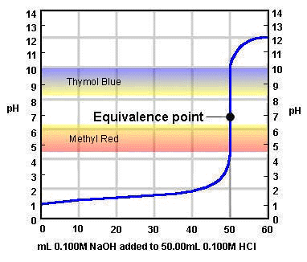
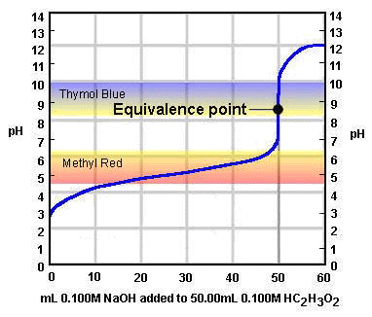
Selection of Indicators

Slide 28
pH Indicators and Ranges
How do you know which indicator to pick for a reaction?
Pick the one that changes color in a pH range that is near where your equivalence point is,
If you know the pKa of an indicator, it will change color in a pH range +/- 1 from that pKa
Example: pKa of phenolphthalein is 9.3. So it is a good indicator if your equivalence point is between 8.3-10.3

Slide 29
Some Acid-Base Indicators
Indicator | pH Range in which Color Change Occurs | Color Change as pH Increases
Crystal violet Thymol blue Orange IV Methyl orange Bromcresol green Methyl red Chlorophenol red Bromthymol blue Phenol red Neutral red Thymol blue Phenolphthalein Thymolphthalein Alizarin yellow Indigo carmine | 0.0 - 1.6 1.2 - 2.8 1.4 - 2.8 3.2 - 4.4 3.8 - 5.4 4.8 - 6.2 5.2 - 6.8 6.0 - 7.6 6.6 - 8.0 6.8 - 8.0 8.0 - 9.6 8.2 - 10.0 9.4 - 10.6 10.1 - 12.0 11.4 - 13.0 | yellow to blue red to yellow red to yellow red to yellow yellow to blue red to yellow yellow to red yellow to blue yellow to red red to amber yellow to blue colourless to pink colourless to blue yellow to blue blue to yellow

Slide 30
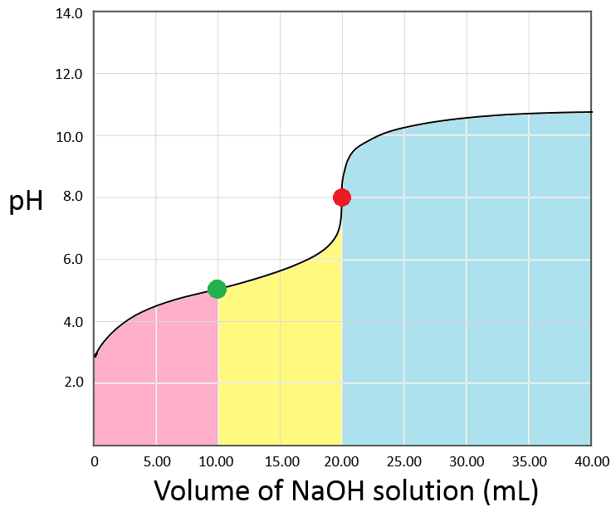
What is Higher [ ] at Each Point in Titration
Before ½ Way Point
[HA] > [A⁻]
Half Way Point
[HA] = [A⁻]
After ½ Way Pt, before Eq. Pt
[A⁻] > [HA]
Equivalence Point
[HA] = 0 mol A⁻ = mol OH⁻ added
Over Shoot Past Eq. Pt.
Excess [OH⁻] , [A⁻]

Slide 31
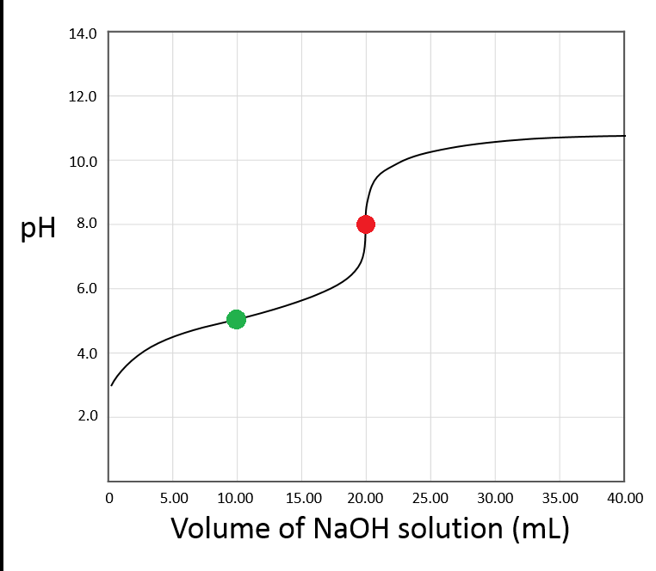
Effective Buffer Region
Buffer Region
pH = +/- 1 from pKa
pKa = pH @ ½ Way Point
pH @ ½ Way Point = 5

Slide 32
Effective Buffer Region
Buffer Region
pH = +/- 1 from pKa
pKa = pH @ ½ Way Point
pH @ ½ Way Point = 5
+/- 1 pH = 4 – 6

Slide 33
Effective Buffer Region
Buffer Region
pH = +/- 1 from pKa
pKa = pH @ ½ Way Point
pH @ ½ Way Point = 5
+/- 1 pH = 4 – 6

Slide 34
Effective Buffer Region
Buffer Region
pH = +/- 1 from pKa
pKa = pH @ ½ Way Point
pH @ ½ Way Point = 5
+/- 1 pH = 4 – 6

Slide 35
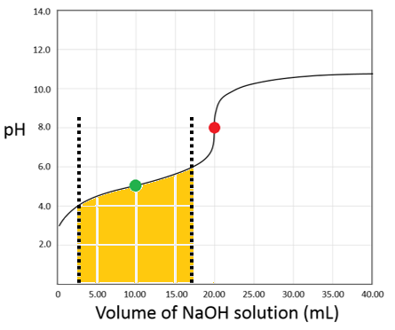
Effective Buffer Region
Buffer Region
pH = +/- 1 from pKa
pKa = pH @ ½ Way Point
pH @ ½ Way Point = 5
+/- 1 pH = 4 – 6

Slide 36
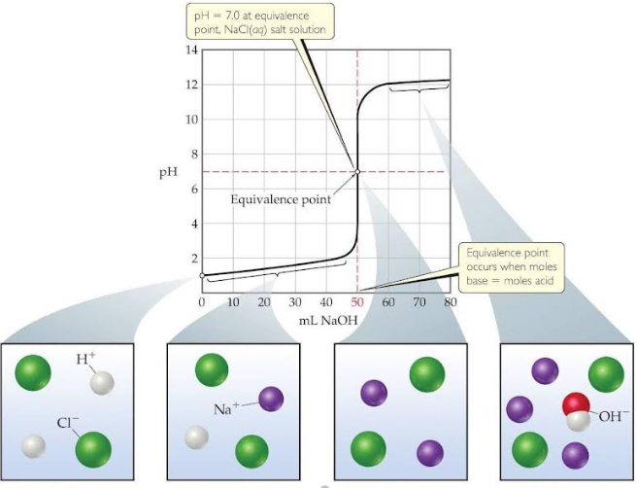
Only HCl(aq) present before titration
H⁺ consumed as OH⁻ added, forming H₂O. Still have HCl. Some conjugate is formed. BUFFER
H⁺ completely neutralized by OH⁻. Only conjugate left
No H⁺ left to react with excess OH-, now there is conjugate and excess OH⁻

Slide 37
Careful with ½ way point on a base titration!
pH @ ½ Way Point = 9.75
That is the pKa for BH⁺ !!!
So pKb for B is...
pKb = 14 – pKa
= 14 – 9.75 = 4.25

Slide 38
Extra Titration Calculation Practice

Slide 39
15 ml of 0.25M Acetic Acid (K_{a} = 1.8E⁻⁵) is titrated with 0.15 M NaOH
pH before any NaOH is added
pH after 5 mL NaOH added
mL of NaOH added to reach Equivalence point
pH at the Equivalence Point
mL of NaOH to reach half way point
pH at the half way point
pH after 60mL NaOH added

Slide 40
pH = 2.67
pH = 4.14
25 mL
pH = 8.86
12.5 mL
pH = 4.74
pH = 12.85
*Note – answers were autogenerated. If you think there is a typo let me know!

Slide 41
30 ml of 0.15 M Methanoic Acid (K_{a} = 1.6E⁻⁵) is titrated with 0.45 M NaOH
Concentration of H+ before any NaOH is added
pH before any NaOH is added
pH after 15 mL NaOH added
mL of NaOH added to reach Equivalence point
pH at the Equivalence Point
mL of NaOH to reach half way point
pH at the half way point
pH after 40mL NaOH added

Slide 42
[H⁺] = 1.5 x 10⁻³ M
pH = 2.81
pH = 12.7
10 mL
pH = 8.92
5 mL
pH = 4.8
pH = 13.29
*Note – answers were autogenerated. If you think there is a typo let me know!

Slide 43
12 ml of 0.85 M Methanoic Acid (K_{a} = 1.6E⁻⁵) is titrated with 0.35 M NaOH
Concentration of H⁺ before any NaOH is added
pH before any NaOH is added
pH after 8 mL NaOH added
mL of NaOH added to reach Equivalence point
pH at the Equivalence Point
mL of NaOH to reach half way point
pH at the half way point
pH after 58mL NaOH added

Slide 44
[H⁺] = 3.7 x 10⁻³
pH = 2.43
pH = 4.38
29.1 mL
pH = 9.1
14.6 mL
pH = 4.8
pH = 13.16
*Note – answers were autogenerated. If you think there is a typo let me know!

Slide 45
15 ml of 0.1 M Methylamine (K_{b} = 4.4E⁻⁴) is titrated with 0.05 M HCl
pH before any HCl is added
pH after 5 mL HCl added
mL of HCl added to reach Equivalence point
pH at the Equivalence Point
mL of HCl to reach half way point
pH at the half way point
pH after 50mL HCl added

Slide 46
pH = 11.81
pH = 11.34
30 mL
pH = 6.06
15 mL
pH = 10.64
pH = 1.81
*Note – answers were autogenerated. If you think there is a typo let me know!

Slide 47
YouTube Link to Presentation
https://youtu.be/okVYe933E4k

