Slide 1
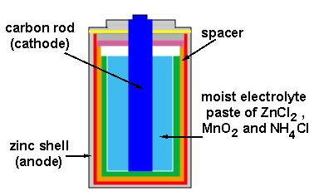
Electrochemistry – Cell Potential

Slide 2
Cell Potential
The difference in potential energy between the anode and the cathode in a voltaic cell is called the cell potential.
The cell potential depends on the relative ease with which the oxidizing agent is reduced at the cathode and the reducing agent is oxidized at the anode.
The cell potential under standard conditions is called the standard emf, E°_{cell}.
25 °C, 1 atm for gases, 1 M concentration of solution
Sum of the cell potentials for the half-reactions

Slide 3
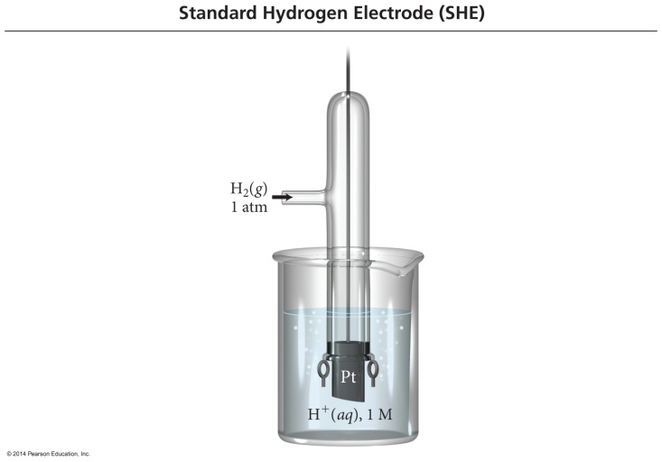
Standard Reduction Potential
We cannot measure the absolute tendency of a half-reaction, we can only measure it relative to another half-reaction.
We select as a standard half-reaction the reduction of H⁺ to H₂ under standard conditions, which we assign a potential difference = 0 v.
Standard hydrogen electrode, SHE

Slide 4
Half-Cell Potentials
SHE reduction potential is defined to be exactly 0 V.
Standard reduction potentials compare the tendency for a particular reduction half-reaction to occur relative to the reduction of H⁺ to H₂.
Under standard conditions
Half-reactions with a stronger tendency toward reduction than the SHE have a positive value for E°_{red}.
Half-reactions with a stronger tendency toward oxidation than the SHE have a negative value for E°_{red}.
For an oxidation half-reaction, E°_{oxidation} = − E°_{reduction}.

Slide 5
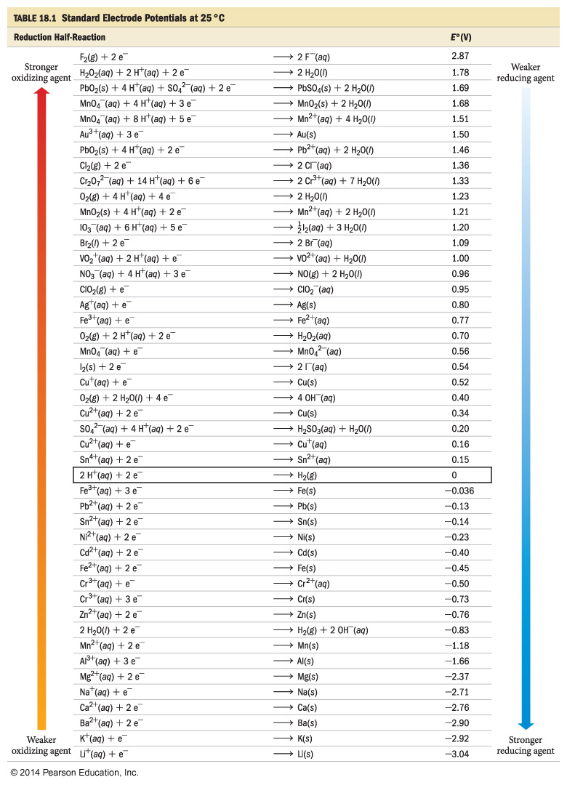

Slide 6
Calculating Cell Potentials under Standard Conditions
E°_{cell} = E°_{oxidation} + E°_{reduction}
When adding E° values for the half-cells, do not multiply the half-cell E° values, even if you need to multiply the half-reactions to balance the equation.

Slide 7
Tendencies from the Table of Standard Reduction Potentials
A redox reaction will be spontaneous when there is a strong tendency for the oxidizing agent to be reduced and the reducing agent to be oxidized.
Higher on the table of standard reduction potentials = stronger tendency for the reactant to be reduced
lower on the table of standard reduction potentials = stronger tendency for the product to be oxidized

