Slide 1
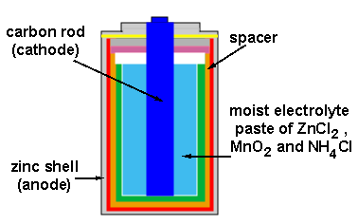
Electrochemistry - CELLS

Slide 2
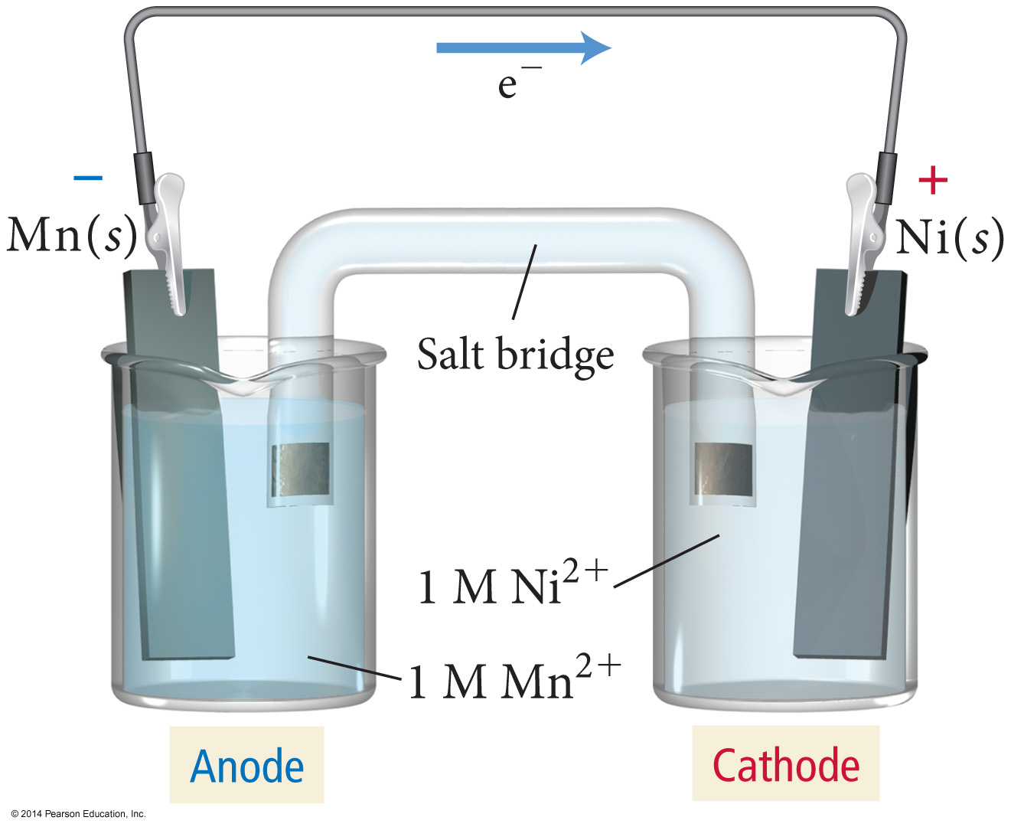
Electric Current Flowing Directly between Atoms

Slide 3
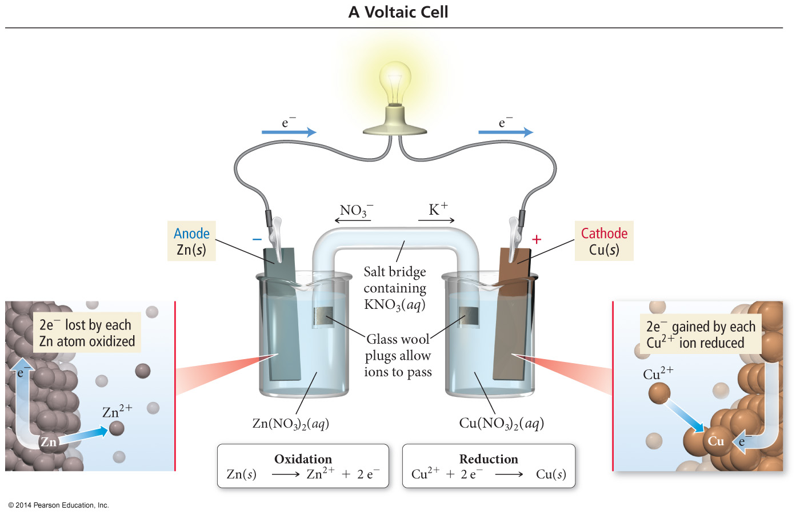
Electric Current Flowing Indirectly between Atoms
Figure 18.2 pg 867

Slide 4
Electrodes
Anode
Electrode where oxidation occurs
Anions attracted to it
Connected to positive end of battery in an electrolytic cell
Loses weight in electrolytic cell
Cathode
Electrode where reduction occurs
Cations attracted to it
Connected to negative end of battery in an electrolytic cell
Gains weight in electrolytic cell
Electrode where plating takes place in electroplating

Slide 5
Voltaic Cell
The salt bridge is required to complete the circuit and maintain charge balance.

Slide 6
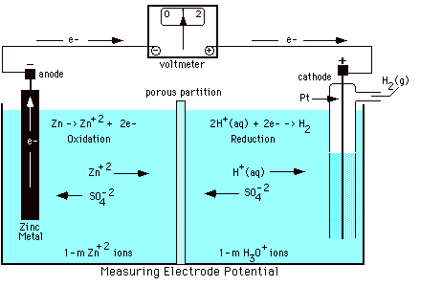
Measuring Standard Electrode Potential
Potentials are measured against a hydrogen ion reduction reaction, which is arbitrarily assigned a potential of zero volts.

Slide 7
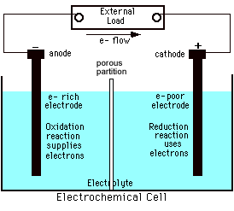
Galvanic (Electrochemical) Cells
Spontaneous redox processes have:
A positive
cell potential, E⁰
A negative free energy change, (-ΔG)

Slide 8
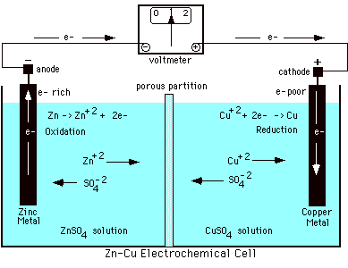
Zn - Cu Galvanic Cell
From a table of reduction potentials:
Zn²⁺ + 2e⁻ → Zn E = -0.76V
Cu²⁺ + 2e⁻ → Cu E = +0.34V

Slide 9
Zn - Cu Galvanic Cell
The less positive, or more negative reduction potential becomes the oxidation…
Cu²⁺ + 2e⁻ → Cu E = +0.34V
Zn → Zn²⁺ + 2e⁻ E = +0.76V
Zn + Cu²⁺ → Zn²⁺ + Cu E⁰ = + 1.10 V

Slide 10
Cell (Line) Notation
Shorthand description of a voltaic cell
Electrode | electrolyte || electrolyte | electrode
Oxidation half-cell on the left; reduction half-cell on the right
Single | = phase barrier
If multiple electrolytes in same phase, a comma is used rather than |
Often use an inert electrode
Double line || = salt bridge

Slide 11
Line Notation
An abbreviated representation of an electrochemical cell
Zn(s) | Zn²⁺(aq) || Cu²⁺(aq) | Cu(s)
Anode
material
|
Anode
solution
||
Cathode
solution
|
Cathode
material

