Slide 1
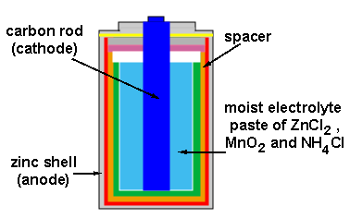
Electrochemistry – Variables Unite

Slide 2
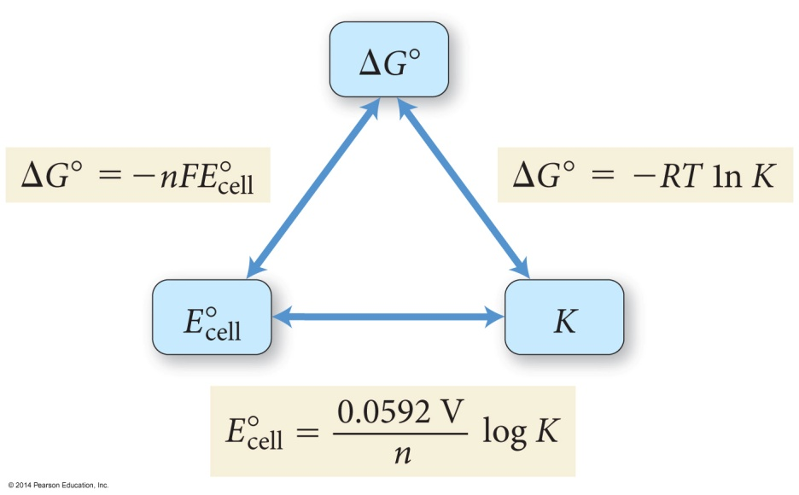
E°_{cell}, ΔG°, and K
For a spontaneous reaction
one that proceeds in the forward direction with the chemicals in their standard states
ΔG° < 0 (negative)
E° > 0 (positive)
K > 1
ΔG° = −RTln(K) = −nFE°_{cell}
n = the number of electrons
F = Faraday’s constant = 96,485 C/mol e⁻

Slide 3
Calculating ΔG⁰ for a Cell
ΔG⁰ = -nFE⁰
n = moles of electrons in balanced redox equation
F = Faraday constant = 96,485 coulombs/mol e⁻
Zn + Cu²⁺ → Zn²⁺ + Cu E⁰ = + 1.10 V

Slide 4
The Nernst Equation
Standard potentials assume a concentration of 1 M. The Nernst equation allows us to calculate potential when the two cells are not 1.0 M.
R = 8.31 J/(mol⋅K)
T = Temperature in K
n = moles of electrons in balanced redox equation
F = Faraday constant = 96,485 coulombs/mol e⁻

Slide 5
Deriving the Nernst Equation

Slide 6
Nernst Equation Simplified
At 25 °C (298 K) the Nernst Equation is simplified this way:

Slide 7
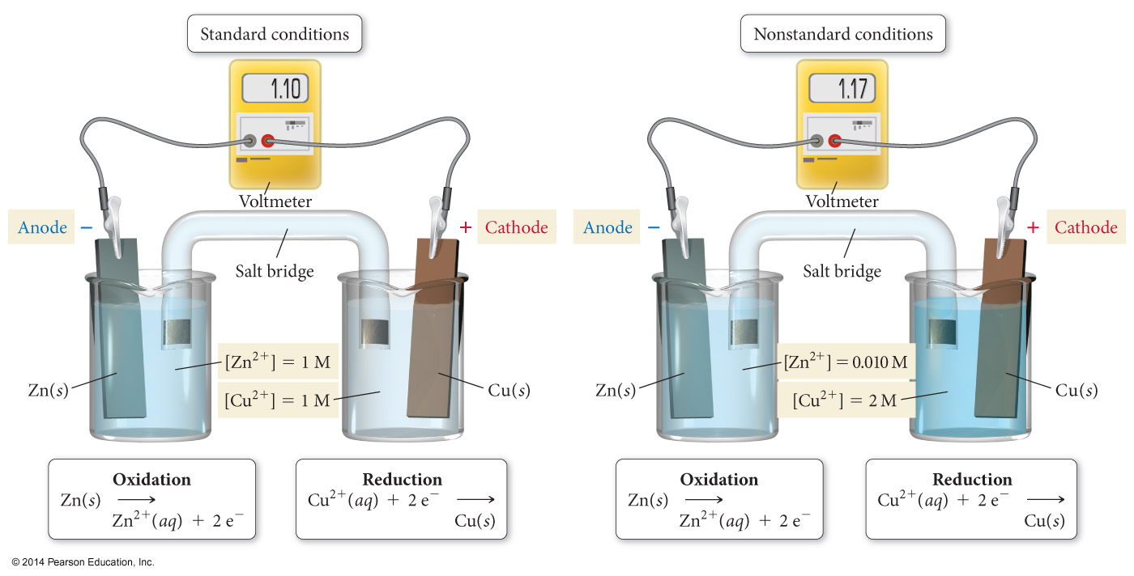
E_{cell} When Ion Concentrations Are Not 1 M

Slide 8
Equilibrium Constants and Cell Potential
At equilibrium, forward and reverse reactions occur at equal rates, therefore:
The battery is “dead”
The cell potential, E, is zero volts
Modifying the Nernst Equation (at 25 °C):

Slide 9
Calculating an Equilibrium Constant from a Cell Potential
Zn + Cu²⁺ → Zn²⁺ + Cu E⁰ = + 1.10 V

Slide 10
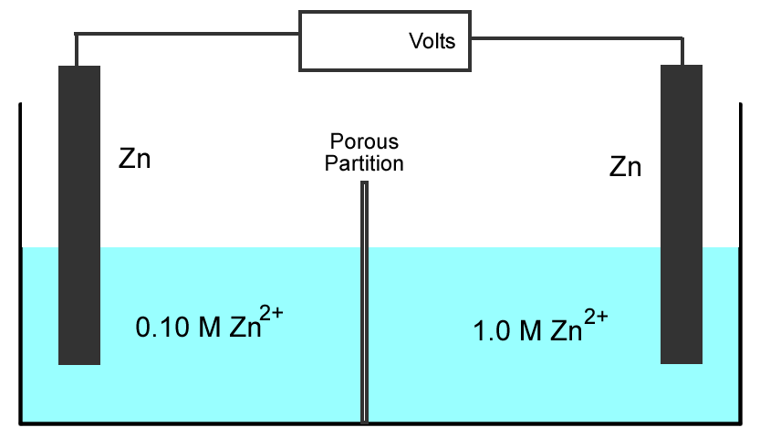
Concentration Cell
???
Both sides have the same components but at different concentrations.
Step 1: Determine which side undergoes oxidation, and which side undergoes reduction.

Slide 11
Concentration Cell
???
Both sides have the same components but at different concentrations.
Anode
Cathode
The 1.0 M Zn²⁺ must decrease in concentration, and the 0.10 M Zn²⁺ must increase in concentration
Zn²⁺ (1.0M) + 2e⁻ → Zn (reduction)
Zn → Zn²⁺ (0.10M) + 2e⁻ (oxidation)
Zn²⁺ (1.0M) → Zn²⁺ (0.10M)

Slide 12
Concentration Cell
???
Concentration Cell
Both sides have the same components but at different concentrations.
Anode
Cathode
Step 2: Calculate cell potential using the Nernst
Equation (assuming 25 °C).
Zn²⁺ (1.0M) → Zn²⁺ (0.10M)

Slide 13
Nernst Calculations
Zn²⁺ (1.0M) → Zn²⁺ (0.10M)

Slide 14
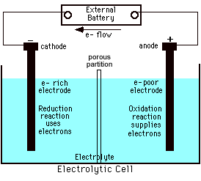
Electrolytic Processes
Electrolytic processes are NOT spontaneous. They have:
A negative
cell potential, (-E⁰)
A positive free energy change, (+ΔG)

Slide 15
Electrochemical Cells
In all electrochemical cells, oxidation occurs at the anode, reduction occurs at the cathode.
In voltaic cells
Anode is the source of electrons and has a (−) charge.
Cathode draws electrons and has a (+) charge.
In electrolytic cells
Electrons are drawn off the anode, so it must have a place to release the electrons—the positive terminal of the battery.
Electrons are forced toward the anode, so it must have a source of electrons—the negative terminal of the battery.

Slide 16
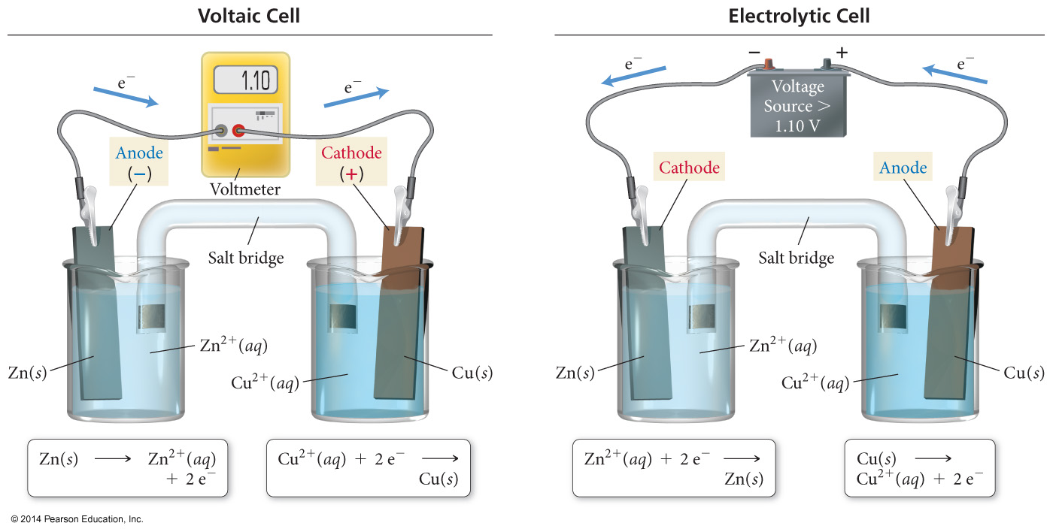
Voltaic versus Electrolytic Cells

Slide 17
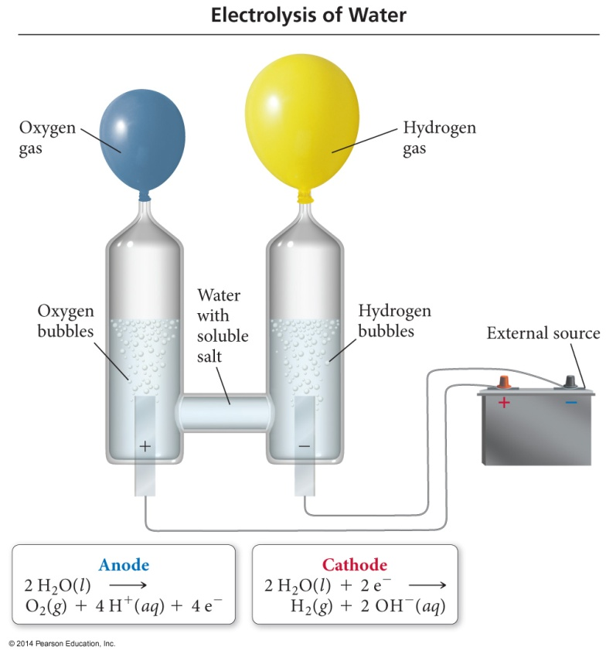
Electrolysis
Electrolysis is the process of using electrical energy to break a compound apart.
Electrolysis is done in an electrolytic cell.
Electrolytic cells can be used to separate elements from their compounds.

Slide 18
Electrolysis of Water

Slide 19
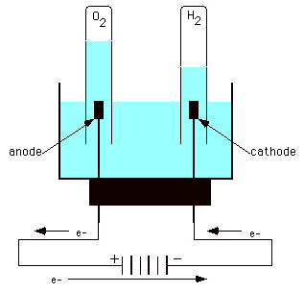
Electrolysis of Water
In acidic solution
Anode rxn:
-1.23 V
Cathode rxn:
-0.83 V
-2.06 V

Slide 20
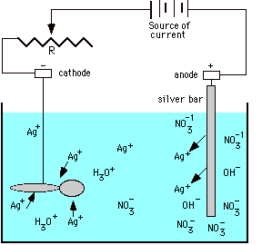
Electroplating of Silver
Anode reaction:
Ag → Ag⁺ + e⁻
Cathode reaction:
Ag⁺ + e⁻ → Ag
Electroplating requirements:
1. Solution of the plating metal
2. Anode made of the plating metal
3. Cathode with the object to be plated
4. Source of current

Slide 21
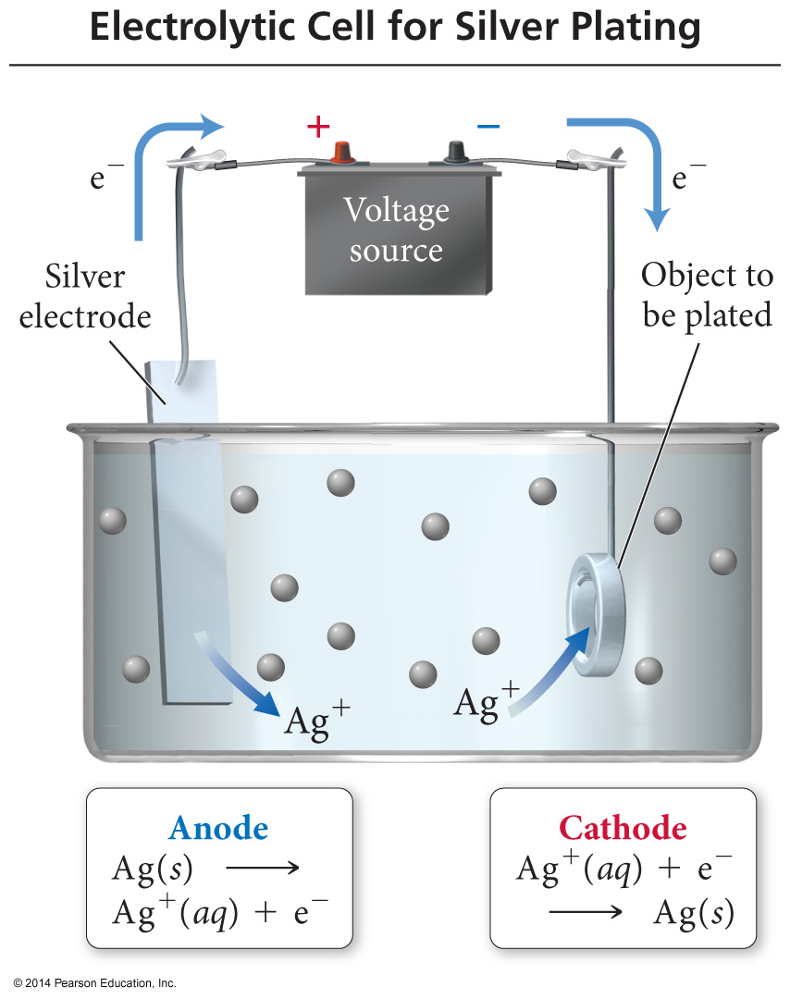
Electroplating
In electroplating, the work piece is the cathode.
Cations are reduced at cathode and plate to the surface of the work piece.
The anode is made of the plate metal. The anode oxidizes and replaces the metal cations in the solution.

Slide 22
Solving an Electroplating Problem
Q: How many seconds will it take to plate out 5.0 grams of silver from a solution of AgNO₃ using a 20.0 Ampere current?
Ag⁺ + e⁻ → Ag
5.0 g
1 mol Ag
1 mol e⁻
96 485 C
1 s
107.87 g
1 mol Ag
1 mol e⁻
20.0 C
= 2.2 x 10² s

Slide 23
Half-Reactions
We generally split the redox reaction into two separate half-reactions—a reaction just involving oxidation or reduction.
The oxidation half-reaction has electrons as products.
The reduction half-reaction has electrons as reactants.
3 Cl₂ + I⁻ + 3H₂O → 6 Cl⁻ + IO₃⁻ + 6 H⁺
0 −1 +1 −2 −1 +5 −2 +1
Oxidation: I⁻ → IO₃⁻ + 6 e⁻
Reduction: Cl₂ + 2 e⁻ → 2 Cl⁻

Slide 24
Balancing Redox Reactions by the Half-Reaction Method
In this method, the reaction is broken down into two half-reactions, one for oxidation and another for reduction.
Each half-reaction includes electrons.
Electrons go on the product side of the oxidation half-reaction—loss of electrons.
Electrons go on the reactant side of the reduction half-reaction—gain of electrons.
Each half-reaction is balanced for its atoms.
Then the two half-reactions are adjusted so that the electrons lost and gained will be equal when combined.

