Slide 1
N42 - Electrochemistry
Concepts

Slide 2
N42 - Electrochemistry
Concepts
Target: I can assign oxidation numbers and balance redox reactions.

Slide 3
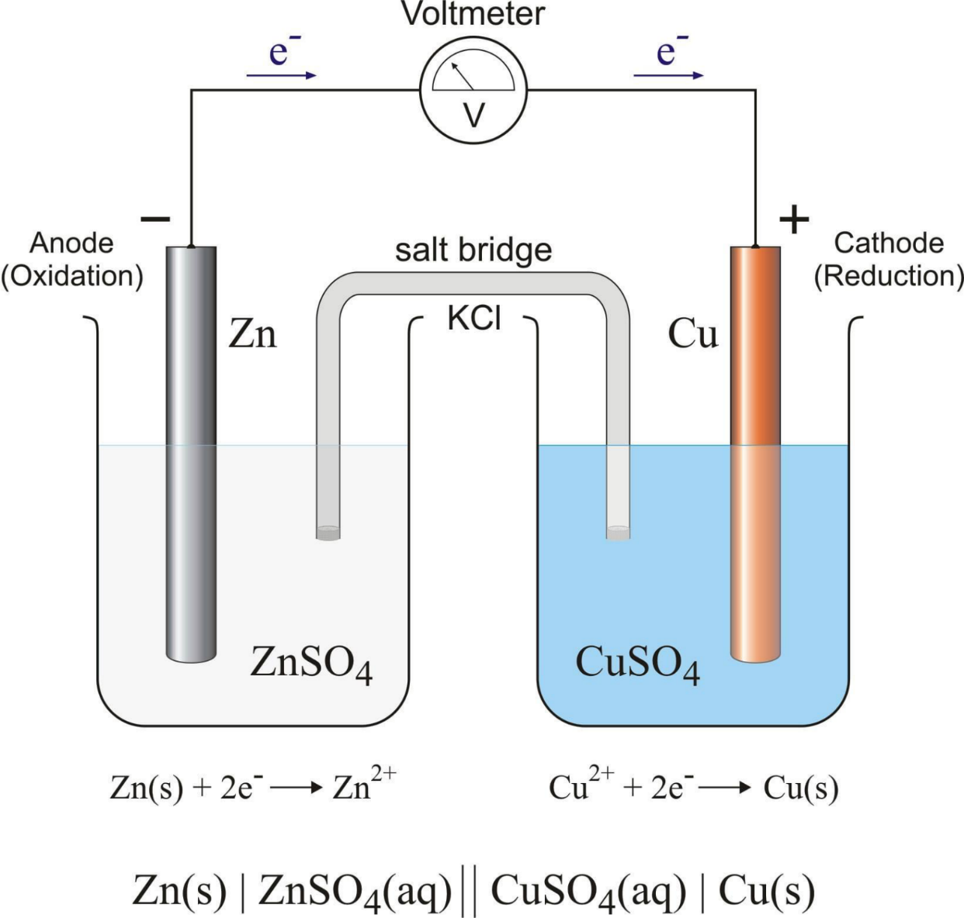
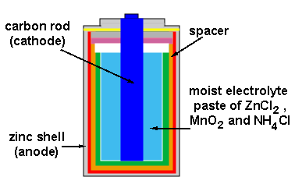

Slide 4
Electrochemistry
The study of the interchange of chemical and electrical energy.
Concerned with:
the generation of an electrical current from a spontaneous chemical reaction
the use of an electrical current to produce a non-spontaneous chemical change

Slide 5
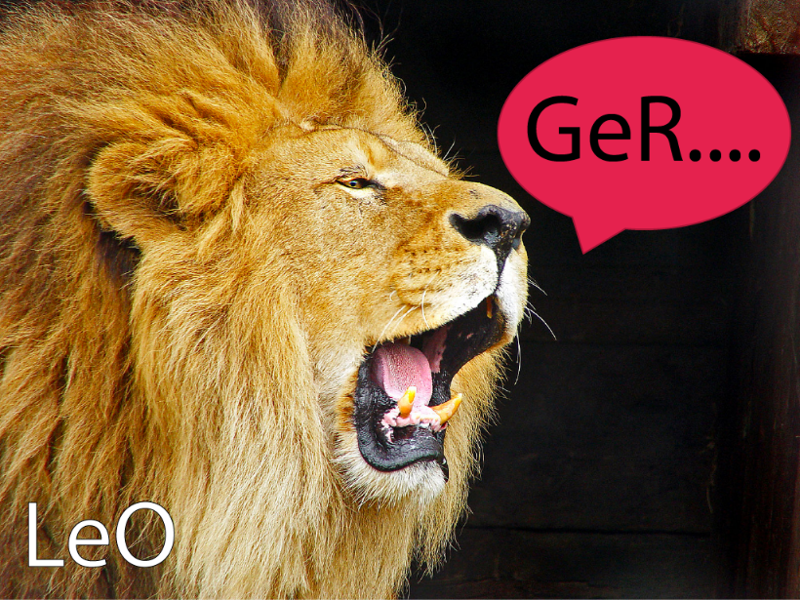
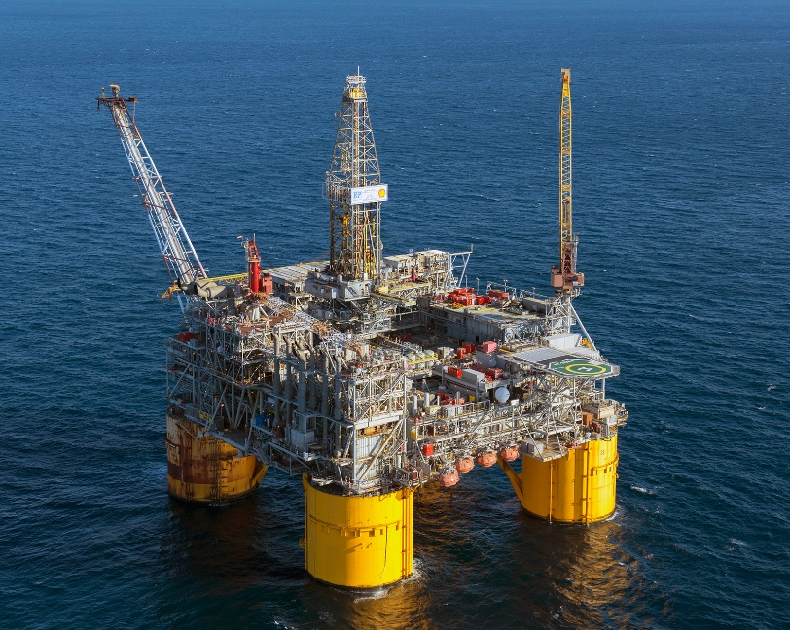
Mnemonics
LEO goes GER
Loss of Electrons is Oxidation
Gain of Electrons is Reduction
OIL RIG
Oxidation is Loss of Electrons
Reduction is Gain of Electrons

Slide 6
Examples
Oxidation
Ag → Ag⁺ + e⁻
Cu → Cu²⁺ + 2e⁻
Reduction
Ag⁺ + e⁻ → Ag
Cu²⁺ + 2e⁻ → Cu

Slide 7
Oxidation Numbers
The charge an atom in a compound would have IF the compound was composed of ions.
Helps track how the electrons are moving around during a reaction.
Sometimes easy to determine, sometimes complex.
KF → K⁺ + F⁻ K ox # = +1, F ox # = -1

Slide 8
Rules for Assigning Oxidation Numbers
Any uncombined element is 0.
Monatomic ion equals the charge on the ion.
The more-electronegative element in a binary compound is assigned the number equal to the charge it would have if it were an ion.
Fluorine in a compound is always -1
Oxygen is -2 unless it is combined with F, when it is +2, or it is in a peroxide, such as H₂O₂, when it is -1

Slide 9
Hydrogen in most of its compounds is +1 unless it is combined with a metal, in which case it is -1
In compounds, the elements of groups 1 and 2 as well as aluminum have oxidation numbers +1, +2 and +3 respectively.
The sum of the oxidation numbers of all atoms in a neutral compound is 0.
The sum of the oxidation numbers of all atoms in a polyatomic ion equals charge of the ion.

Slide 10
Balancing Redox Equations
More complicated than balancing normal reactions.
You have to balance the electrons, not just the atoms!
Steps
Assign oxidation numbers to determine which things are oxidized and which are reduced.
Split the rxn into two halves – oxidation half and reduction half. Include electrons.
Balance the atoms.
Balance the charge by balancing the number of electrons.
Add half reactions back together, simplify, and CHECK.

Slide 11
Balancing Redox Reactions
Yes, I know this isn’t balanced! That is what we are working on!
1
Assign oxidation states
Determine the element oxidized and the element reduced.
oxygen -2, not in one of the exceptions.
Cl₂ + I⁻ → 2Cl⁻ + IO₃⁻
0
-1
-1
+5
-2
elements are 0
monoatomic ions match their charge
monoatomic ions match their charge
x + 3(-2) = -1
sum must equal the overall charge on ion
x = +5

Slide 12
Balancing Redox Reactions
1
Assign oxidation states
Determine the element oxidized and the element reduced.
Cl₂ + I⁻ → 2Cl⁻ + IO₃⁻
0
-1
-1
+5
-2
LEO goes GER
I⁻ lost electrons = oxidized, -1 → +5
Cl gained electrons = reduced, 0 → -1

Slide 13
Balancing Redox Reactions
2
Write oxidation and reduction half-reactions, including electrons
Oxidation electrons being lost, products
Reduction electrons being gained, reactants
I went from -1 → +5, that’s a loss of…
Yes, I know these are not balanced! That is what we are still working on! It takes a while!
6e⁻
Oxidation: I⁻ → IO₃⁻ + _____
2e⁻
Reduction: Cl₂ + ____→ 2Cl⁻
Each Cl went from 0 → -1, that’s a gain of…

Slide 14
Balancing Redox Reactions
3
Balance the atoms in the half reactions
First balance elements other than H and O.
Add H₂O where O is needed.
Add H⁺ where H is needed
3H₂O
6H⁺
Oxidation: I⁻ + ______ → IO₃⁻ + 6e⁻ + _______
Reduction: Cl₂ + 2e⁻ → 2Cl⁻

Slide 15
Balancing Redox Reactions
4
Balance the charge by balancing the # of e⁻
Balance electrons between half-reactions. Least Common Multiple
1 x
Oxidation: ( I⁻ + 3H₂O → IO₃⁻ + 6 e⁻ + 6H⁺ )
3 x
Reduction: ( Cl₂ + 2 e⁻ → 2 Cl⁻ )
Oxidation: I⁻ + 3H₂O → IO₃⁻ + 6 e⁻ + 6H⁺
Reduction: 3Cl₂ + 6 e⁻ → 6 Cl⁻

Slide 16
Balancing Redox Reactions
5
Add half reactions together, simplify, check
Make sure the atoms balance AND the charges
Oxidation: I⁻ + 3H₂O → IO₃⁻ + 6 e⁻ + 6H⁺
Reduction: 3Cl₂ + 6 e⁻ → 6 Cl⁻
I⁻ + 3H₂O + 3Cl₂ + 6 e⁻ → IO₃⁻ + 6 e⁻ + 6H⁺ + 6 Cl⁻
I⁻ + 3H₂O + 3Cl₂ → IO₃⁻ + 6H⁺ + 6 Cl⁻
CHECK:
Atoms balanced – yes!
Charges balanced – yes!

Slide 17
Best Advice…
USE PENCIL!
DON’T CRAM YOUR WORK! USE LOTS OF SPACE!
DON’T PANIC!
STUCK??? ERASE AND START OVER.

Slide 18
Oxidation and Reduction Recap
Oxidation is the process that occurs when
the oxidation number of an element increases,
an element loses electrons,
a compound adds oxygen,
a compound loses hydrogen, or
a half-reaction has electrons as products.
Reduction is the process that occurs when
the oxidation number of an element decreases,
an element gains electrons,
a compound loses oxygen,
a compound gains hydrogen, or
a half-reaction has electrons as reactants.

Slide 19
A Few More Electrochemistry Terms
Oxidizing agent
The substance that is DOING the oxidizing of the other substance. The substance that is BEING REDUCED!
Reducing agent
The substance that is DOING the reducing of the other substance. The substance that is BEING OXIDIZED!

Slide 20
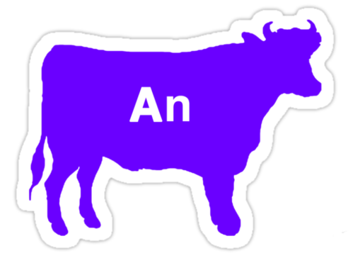
A Few More Electrochemistry Terms
Anode
The electrode where oxidation occurs
Cathode
The electrode where reduction occurs
Anode
is
Oxidation
Reduction
at the
Cathode

Slide 21
A Few More Electrochemistry Terms
Current - the number of electrons that flow through the system per second.
Unit = ampere, amp, A
Electrode surface area dictates the # of e- that can flow.
Larger batteries produce larger currents.
$$1 A=\frac{1 Coulomb }{1 second}=\frac{6.242 x {10}^{18}e−}{1 second}$$

Slide 22
A Few More Electrochemistry Terms
Cell Potential, potential difference, electromotive force
All terms for the difference in potential energy between the reactants and products
The voltage needed to drive electrons through the external circuit
Amount of force pushing the electrons through the wire
Unit = volts
1 V = 1 J of energy per coulomb of charge

Slide 23
Useful Conversions
$$1 A=\frac{1 Coulomb }{1 second}=\frac{6.242 x {10}^{18}e−}{1 second}$$
$$1 Volt=\frac{1 Joule}{1 Coulomb}$$
$$1 Faraday=\frac{96,500 Coulombs}{1 mol e^{−}}$$
Example: How many minutes does a 4.00 A current need to be applied to a Cu²⁺ solution to make 15.00 g of Cu?
15.00g
1 mol
2 mol e-
96,500 C
1 s
1 min
= 189.8 min
63.55 g
1 mol Cu
1 mol e-
4 C
60 s

Slide 24
YouTube Link to Presentation
https://youtu.be/-y2xTX_BVsA

