Slide 1
N43 - Electrochemistry
Cell Potential

Slide 2
N43 - Electrochemistry
Cell Potential
Target: I can calculate the cell potential using standard reduction values.

Slide 3
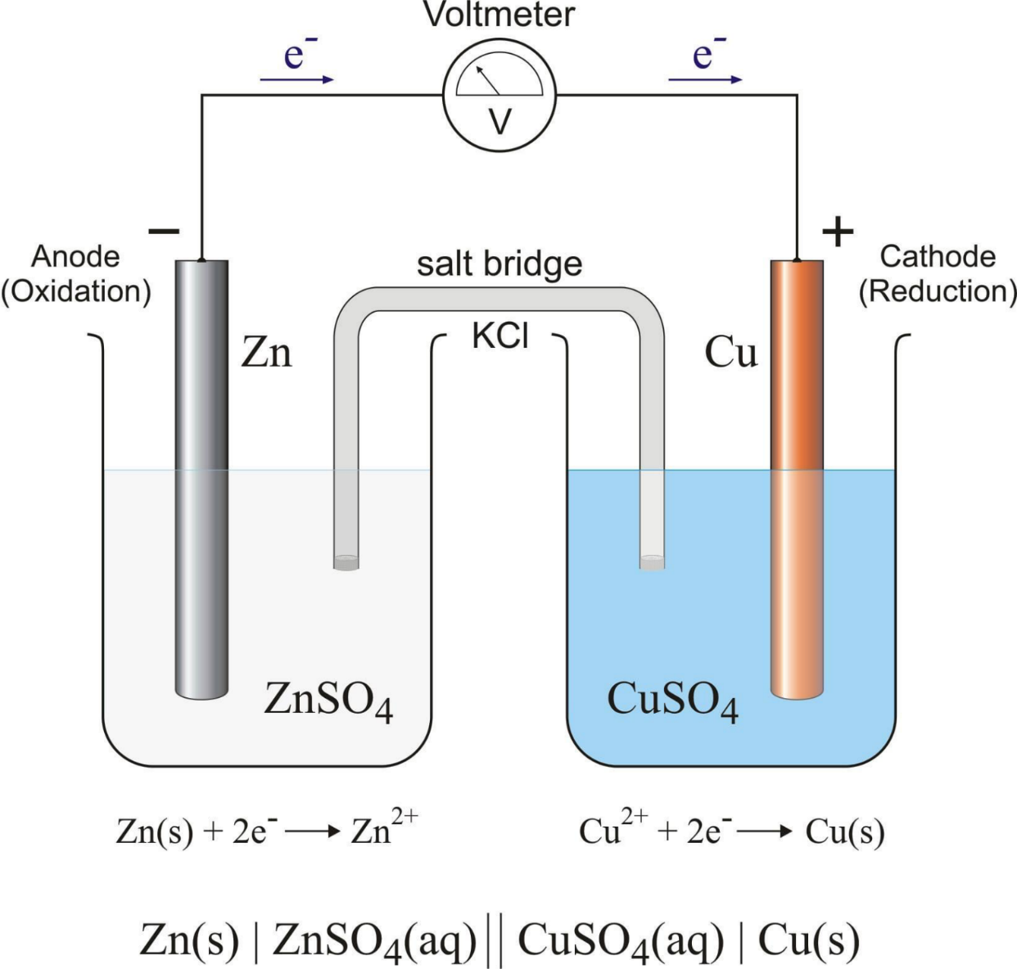
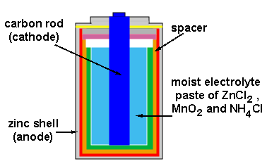

Slide 4
Mnemonics
LEO goes GER
Loss of Electrons is Oxidation
Gain of Electrons is Reduction
OIL RIG
Oxidation is Loss of Electrons
Reduction is Gain of Electrons

Slide 5
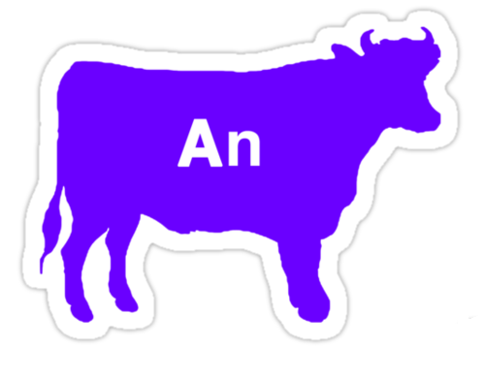
A Few More Electrochemistry Terms
Anode
The electrode where oxidation occurs
Cathode
The electrode where reduction occurs
Anode
is
Oxidation
Reduction
at the
Cathode

Slide 6
Cell Potential
Cell Potential - The difference in potential energy between the anode and the cathode in a voltaic cell
Depends on how easy one substance is reduced at the cathode and how easy the other is oxidized at the anode.
Standard emf, E°_{cell} = Cell potential @ standard conditions ( 25 °C, 1 atm for gases, 1 M concentration of solution)
You add the cell potentials for each half reaction

Slide 7
Standard Reduction Potential
We cannot measure the absolute tendency of a half-reaction, we can only measure it relative to another half-reaction.
We select as a standard half-reaction the reduction of H⁺ to H₂ under standard conditions, which we assign a potential difference = 0 v. (An arbitrary choice!)
Standard hydrogen electrode, SHE
2H⁺ + 2e⁻ → H₂(g)

Slide 8
Half-Cell Potentials
SHE reduction potential is defined to be exactly 0 V.
Standard reduction potentials compare the tendency for a particular reduction half-reaction to occur relative to the reduction of H⁺ to H₂.
Under standard conditions
Half-reactions with a stronger tendency toward oxidation than the SHE have a negative value for E°_{red}
Half-reactions with a stronger tendency toward reduction than the SHE have a positive value for E°_{red}
For an oxidation half-reaction, E°_{oxidation} = − E°_{reduction}

Slide 9
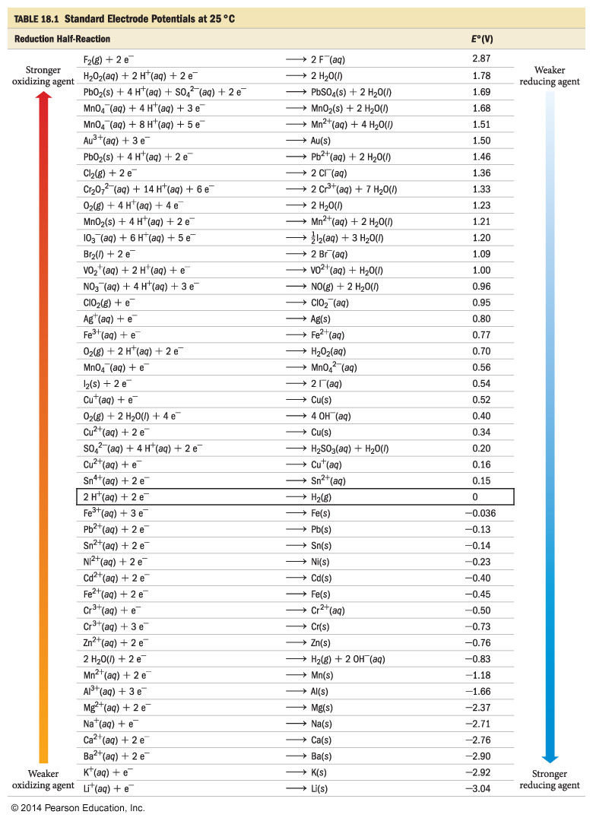
Reduction Values
More + means more easily reduced
If you need to flip a rxn, make sure to flip the sign on E.
If you multiply a rxn, do NOT multiply E. It is a “state function” and does not change based on quantity!!!!

Slide 10
Reduction Table
More + means more easily reduced
More NIO
More Negative Is Oxidation
More PER
More Positive Is Reduction

Slide 11
Reduction Values Oxidation
Flip the equations?
NOW your values are Oxidation Values!
More positive NOW means more likely to be oxidized!
BE CAREFUL!

Slide 12
Reduction Table
Example:
Which rxn is more likely to happen at the cathode and which at the anode??
Anode = oxidation = loss e- = more (–) E = less (+)
Cathode = reduction = gain e- = more (+) E

Slide 13
Calculating Cell Potentials under Standard Conditions
E°_{cell} = E°_{oxidation} + E°_{reduction}
When looking up values on reduction table, flip the sign for the one that is being oxidized because you have the opposite reaction taking place compared to what is written on the chart.
When adding E° values for the half-cells, do not multiply the half-cell E° values, even if you need to multiply the half-reactions to balance the equation.

Slide 14
Calculating Cell Potential
Example:
What is the cell potential for a cell made with silver and gold?
Anode = oxidation = loss e- = more – E (less +)
Cathode = reduction = gain e- = more + E
Au³⁺ + 3e⁻ → Au +1.50 V
Flipped sign for Ag half rxn b/c oxidized but did NOT multiply it by 3.
(+1.50) + (-0.80) = 0.70 V
Ag → Ag⁺ + e⁻ - 0.80 V

Slide 15
Sneak Peak at Spontaneity...
If E°cell = ( + ) we will see why in a later lecture ☺
then ∆G° = ( – )
So it is spontaneous!
If E°cell = ( – )
then ∆G° = ( + )
So it is NON-spontaneous!

Slide 16
YouTube Link to Presentation
https://youtu.be/iqk4Li9toOQ

