Slide 1
N44 - Electrochemistry
Intro to Cells
Target: I can label cells and perform calculations for both Galvanic and Electrolytic cells.

Slide 2
N44 - Electrochemistry
Intro to Cells

Slide 3
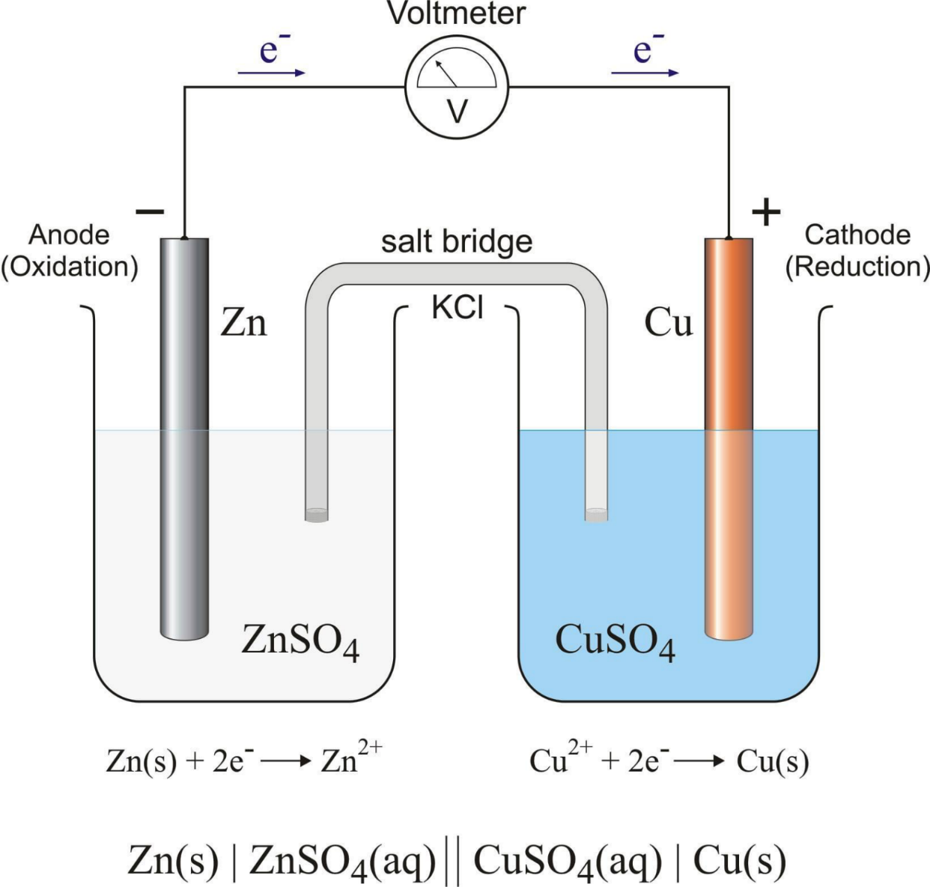
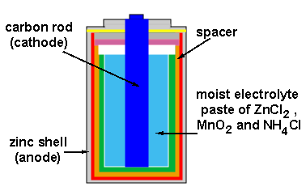

Slide 4
Galvanic/Voltaic Cells
Thermodynamically favorable
Reaction will take place spontaneously

Slide 5
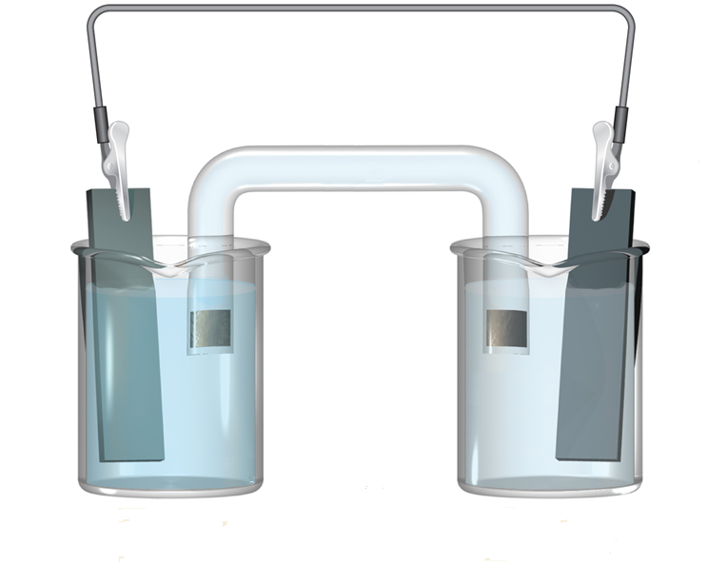
Example: Mn and Ni
Start with basics
Beakers
Wire
Electrodes
Salt bridge

Slide 6
Identifying Oxidation and Reduction
Mn and Ni electrodes
Which will oxidize, which will reduce?
Look at reduction tables!
Mn²⁺ + 2e⁻ → Mn E°_{red} = -1.18
Ni²⁺ + 2e⁻ → Ni E °_{red} = -0.25
Oxidize! Lose e⁻
Reduce! Gain e⁻

Slide 7
Identifying Anode, Cathode, Electrodes
Anode
e- are being lost.
Mn → Mn²⁺ + 2e⁻
LEO Oxidation
Cathode
e- are being gained.
Ni²⁺ + 2e⁻ → Ni
GER
Reduction
Mn(s)
Ni(s)
ANODE CATHODE

Slide 8
Identifying Solutions
Anode
e- are being lost.
Mn → Mn²⁺ + 2e⁻
LEO Oxidation
Cathode
e- are being gained.
Ni²⁺ + 2e⁻ → Ni
GER
Reduction
Mn(s)
Ni(s)
Mn²⁺ (aq)
Ni²⁺ (aq)
ANODE CATHODE

Slide 9
Identifying Direction of Current (e⁻) Flow
Anode
e- are being lost.
Mn → Mn²⁺ + 2e⁻
They leave anode and flow towards the Cathode.
Cathode
e- are being gained.
Ni²⁺ + 2e⁻ → Ni
e-
Mn(s)
Ni(s)
Mn²⁺ (aq)
Ni²⁺ (aq)
ANODE CATHODE

Slide 10
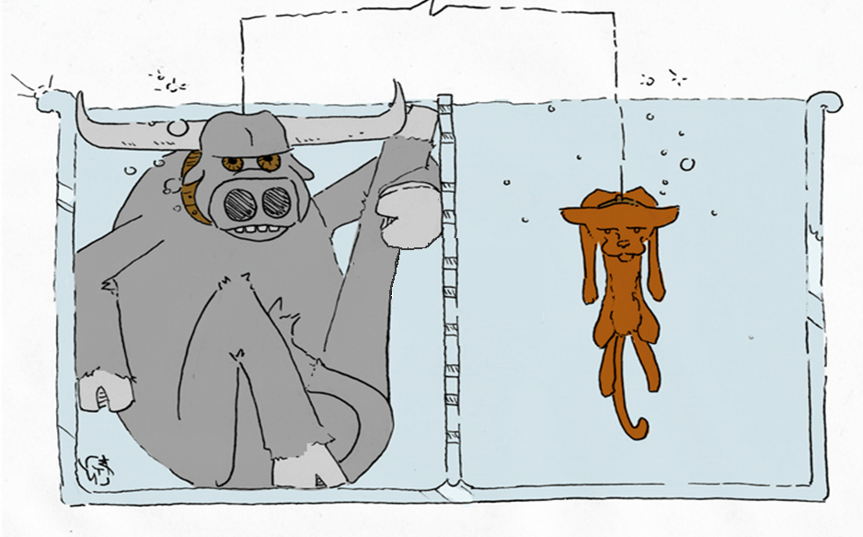
e-
a RED CAT gains, what AN OX loses
AN OX
RED CAT

Slide 11
Identifying Signs on Electrodes
Anode
e- are being lost.
Source of e-
“e- rich”
- sign
Cathode
e- are being gained.
Drawing e-
“e- deficient”
+ sign
e-
-
+
Mn(s)
Ni(s)
Mn²⁺ (aq)
Ni²⁺ (aq)
ANODE CATHODE

Slide 12
Identifying ∆ Mass of Electrodes
Anode
Mn → Mn²⁺ + 2e⁻
Solid Mn turning into Mn²⁺(aq)
Anode LOSES mass
Cathode
Ni²⁺ + 2e⁻ → Ni
Aqueous Ni²⁺ turning into solid Ni metal
Cathode GAINS mass
e-
-
+
Mn(s)
Ni(s)
Mn²⁺ (aq)
Ni²⁺ (aq)
ANODE CATHODE

Slide 13
Loses Mass
Gains Mass
a RED CAT gains, what AN OX loses
AN OX
RED CAT

Slide 14
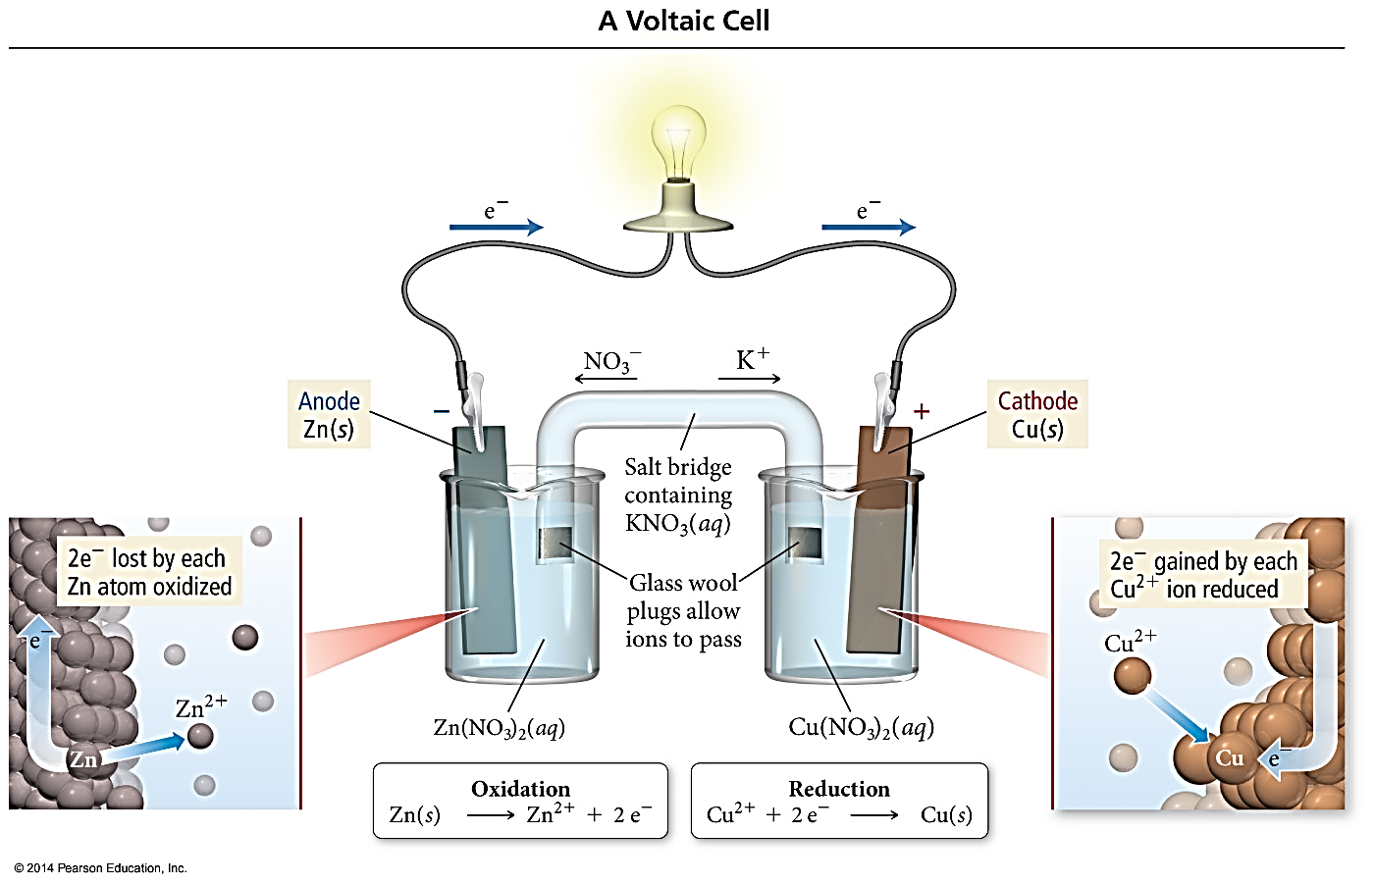
Atomic View (different electrodes)
The anode loses mass as cell runs.
Zn_{(s)} → Zn²⁺_{(aq)} + 2e⁻
The cathode gains mass as cell runs.
Cu²⁺_{(aq)} + 2e⁻→ Cu_{(s)}

Slide 15
Identifying Charge Balance – Salt Bridge
Anode
Mn → Mn²⁺ + 2e⁻
Making more Mn²⁺
Need anions to balance new charge
Cathode
Ni²⁺ + 2e⁻ → Ni
Using up Ni²⁺ Need cations to balance new charge
e-
-
+
← Cl⁻
K⁺→
Mn(s)
Ni(s)
KCl
Salt
Bridge
Mn²⁺ (aq)
Ni²⁺ (aq)
ANODE CATHODE

Slide 16
Identifying Charge Balance – Salt Bridge
No salt bridge?
Charge becomes imbalanced after some time...
Cell dies!!!! ☹
Required salt bridge
“completes the circuit”
and “maintains charge balance”
e-
-
+
← Cl⁻
K⁺→
Mn(s)
Ni(s)
KCl
Salt
Bridge
Mn²⁺ (aq)
Ni²⁺ (aq)
ANODE CATHODE

Slide 17
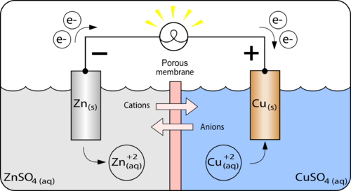
Identifying Charge Balance – Membranes
Sometimes you have a porous membrane partition instead of a salt bridge
Allows select ions to flow between sections
Still allows charge balance and complete circuit

Slide 18
Summary of Electrodes
Anode
Electrode where oxidation occurs (loss of e⁻)
Anions from salt bridge attracted to it because cations being made.
Loses weight
Cathode
Electrode where reduction occurs (gain of e-)
Cations from salt bridge attracted to it because losing cations.
Gains weight
- Electrode where “plating” takes place in electroplating

Slide 19
Electrolytic Cells
NOT Thermodynamically favorable
Reaction will NOT take place spontaneously
Requires an outside electrical source to force it to happen!

Slide 20
What would you predict for Red and Ox?
Zn and Cu
Zn²⁺ + 2e⁻ → Zn E°_{red} = -0.76
Cu²⁺ + 2e⁻ → Cu E°_{red} = 0.34
Oxidize! Lose e⁻
Reduce! Gain e⁻
BUT!
What if you WANT to do the opposite???
What if you want to make Zn(s) not Cu(s)???

Slide 21
Make it an Electrolytic Cell!
Force it to go the other way,
the non-thermodynamically favorable way!
Hook it up to an outside electrical source.
Will DRIVE the electrons the other direction, against their normal flow.

Slide 22
Make it an Electrolytic Cell!
STILL label loss of e- as anode
STILL label gain of e- as cathode
STILL show e- flow to cathode
STILL use salt bridge the same anions towards anode cations towards cathode
BUT...
Anode + Cathode –
e⁻ coming off anode need to go to the + end of the voltage source, and they leave – end of voltage source
-
+

Slide 23
Galvanic versus Electrolytic Cells
Galvanic
Converts chemical energy into electrical energy.
Positive cell potential, E°_{cell} = +
Spontaneous, ∆G = -
Anode = - and Cathode = +
Electrons supplied by the chemical being oxidized.
Electrons flow from anode to cathode.
Electrolytic
Converts electrical energy into chemical energy
Negative cell potential, E°_{cell} = -
NOT spontaneous, ∆G = +
Anode = + and Cathode = -
Electrons supplied by an external source
Electrons enter from the cathode and come out at the anode.

Slide 24
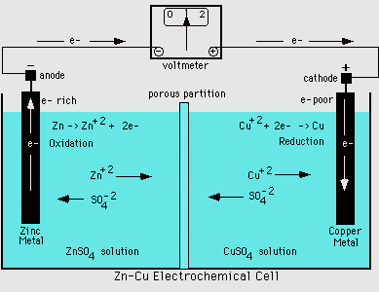
Galvanic or Electrolytic?
Zn - Cu
From a table of reduction potentials:
Zn²⁺ + 2e⁻ → Zn E = -0.76V
Cu²⁺ + 2e⁻ → Cu E = +0.34V
Cu more positive = reduced
Zn more negative = oxidized
flip eq and sign on E for Zn
Zn → Zn²⁺ + 2e⁻ E = +0.76V
Cu²⁺ + 2e⁻ → Cu E = +0.34V
E = (+0.76) + (+0.34) = +1.10 V
E = + so galvanic, spontaneous, ∆G = -

Slide 25
Galvanic or Electrolytic?
A cell is undergoing this rxn:
Na⁺ + e⁻ → Na E = -2.71V
Cl₂+ 2e⁻ → 2Cl⁻ E = 1.36V
2NaCl → 2Na + Cl₂
Careful!
Equation is telling you that Na is going from Na⁺ → Na
It is being reduced even though the table shows it would rather be oxidized!!!!
And 2Cl⁻ → Cl₂ so it is being oxidized even though it would rather be reduced!
Told that Na⁺ = reduced
Told that Cl- = oxidized
flip eq and sign on E for Cl⁻
Na⁺ + e⁻ → Na E = -2.71V
2Cl⁻ → Cl₂+ 2e⁻ E = -1.36V
E = (-2.71) + (-1.36) = -4.07 V
E = - so electrolytic, NON-spontaneous, ∆G = +

Slide 26
Galvanic or Electrolytic?
A cell is undergoing this rxn:
Na⁺ + e⁻ → Na E = -2.71V
Cl₂+ 2e⁻ → 2Cl⁻ E = 1.36V
2NaCl → 2Na + Cl₂
Told that Na⁺ = reduced
Told that Cl- = oxidized
flip eq and sign on E for Cl⁻
This cell won’t run by itself! You need to hook it up to an outside electrical supply!
Na⁺ + e⁻ → Na E = -2.71V
2Cl⁻ → Cl₂+ 2e⁻ E = -1.36V
E = (-2.71) + (-1.36) = -4.07 V
E = - so electrolytic, NON-spontaneous, ∆G = +

Slide 27
Cell (Line) Notation
Shorthand description of a voltaic cell
Electrode | electrolyte || electrolyte | electrode
Single | = phase barrier
If multiple electrolytes in same phase, a comma is used rather than |
Often use an inert electrode
Sometimes they put the concentrations in also
Double line || = salt bridge
Oxidation half cell side
Reduction half cell side

Slide 28
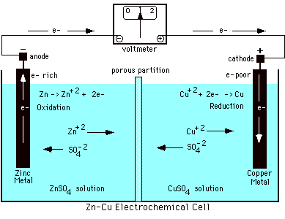
Line Notation
Zn(s) | Zn²⁺(aq) || Cu²⁺(aq) | Cu(s)
Anode
material
|
Anode
solution
||
Cathode
solution
|
Cathode
material

Slide 29
Requirements for Drawing/Labeling a Cell
Determine what is reduced vs. oxidized (E°_{cell} values, OR told which rxn to do)
Beaker/container for anode and cathode AND liquid line drawn for each beaker
Anode/cathode metal strips drawn submerged in liquid
Label which solution/ions are in each beaker
Label which beaker is anode and cathode
Label anode/cathode strips with which solid metal each is
Label anode and cathode with correct -/+ depending on if it is a galvanic cell (A-/C+) or electrolytic cell (A+/C-).
Write the half reactions for each beaker
Wire connecting anode/cathode strips together
Label direction of e- flow along wire at top of drawing (anode → cathode always)
Salt bridge submerged in liquid on both sides
Label direction of ion flow inside salt bridge (anions flowing to anode, cations flowing to cathode)

Slide 30
Practice! Zn and Cu electrodes, ZnSO₄, CuSO₄
Determine what is reduced vs. oxidized (E°_{cell} values, OR told which rxn to do)
Beaker/container for anode and cathode AND liquid line drawn for each beaker
Anode/cathode metal strips drawn submerged in liquid
Label which solution/ions are in each beaker
Label which beaker is anode and cathode
Label anode/cathode strips with which solid metal each is
Label anode and cathode with correct -/+ depending on if it is a galvanic cell (A-/C+) or electrolytic cell (A+/C-).
Write the half reactions for each beaker
Wire connecting anode/cathode strips together
Label direction of e- flow along wire at top of drawing (anode → cathode always)
Salt bridge submerged in liquid on both sides
Label direction of ion flow inside salt bridge (anions flowing to anode, cations flowing to cathode)
KCl salt bridge,
Galvanic

Slide 31
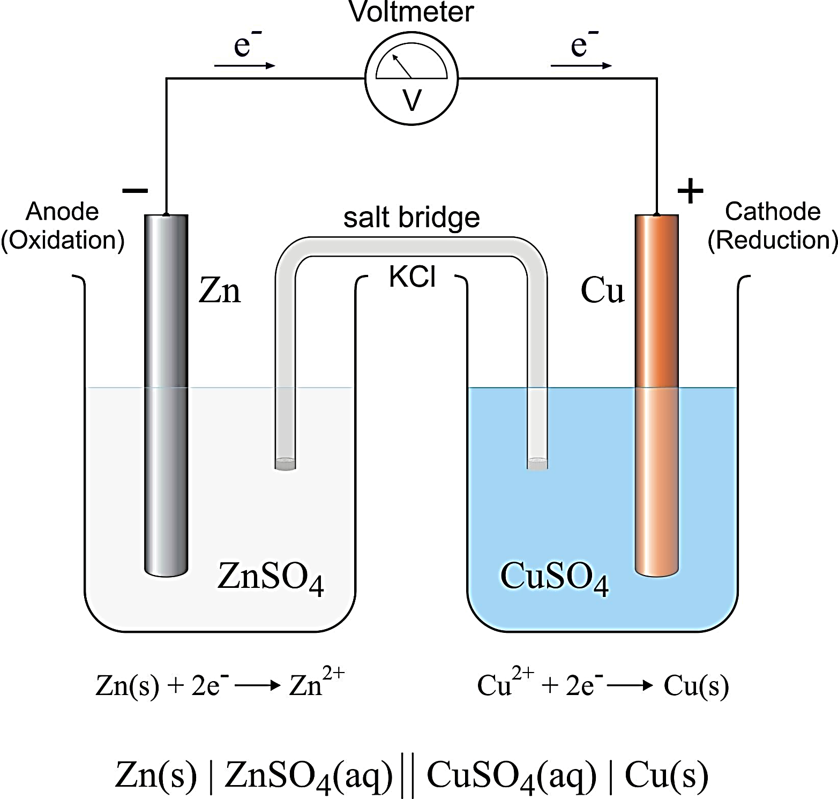
Zn²⁺ + 2e⁻ → Zn
E° _{cell} = -0.76
Oxidized - Anode
Cu²⁺ + 2e⁻ → Cu
E°_{cell} = 0.34
Reduced - Cathode
← Cl⁻
K⁺→
SO₄²⁻
SO₄²⁻
Zn²⁺
Cu²⁺
Zn(s) → Zn²⁺ + 2 e⁻

Slide 32
YouTube Link to Presentation
https://youtu.be/RRnWnKfYVDc

