Slide 1
N45 - Electrochemistry
Variables Unite!

Slide 2
N45 - Electrochemistry
Variables Unite!
Target: I can connect Thermodynamics, Equilibrium, and Electrochemistry. The big finale of the year!

Slide 3
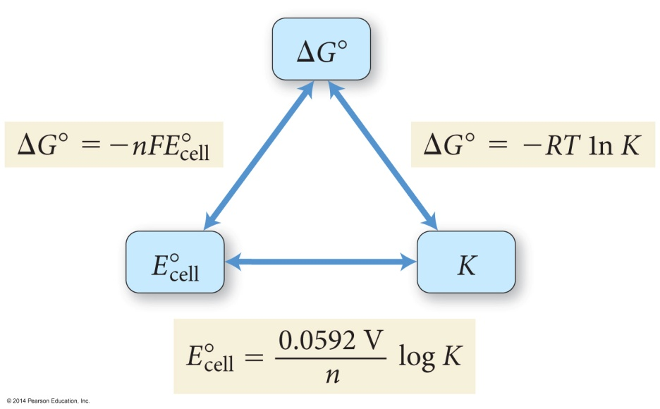

Slide 4
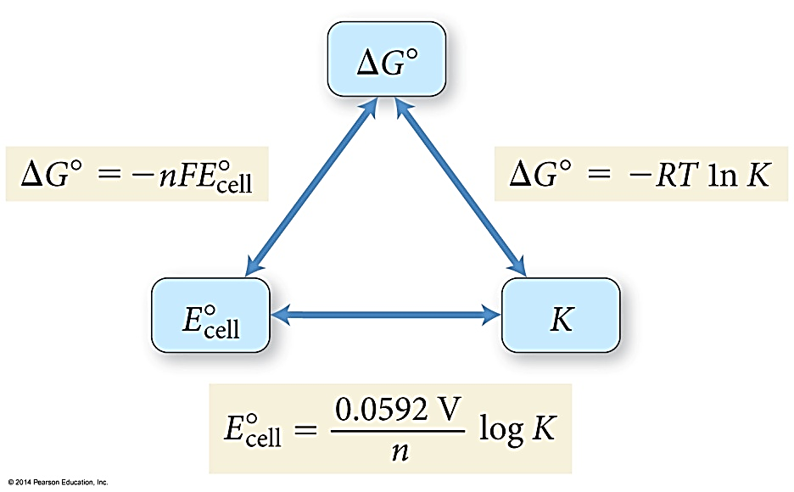
E°_{cell}, ΔG°, and K
For a spontaneous reaction
One that proceeds in the forward direction with the chemicals in their standard states
ΔG° < 0 (negative)
E° > 0 (positive)
K > 1
ΔG° = −RTln(K) = −nFE°_{cell}
n = the number of electrons
F = Faraday’s constant = 96,485 C/mol e⁻ (often see it as 96,500 C/mol e-

Slide 5
Calculating ΔG⁰ for a Cell
ΔG⁰ = -nFE°
n = moles of electrons in balanced redox equation
F = Faraday constant = 96,485 coulombs/mol e⁻
Zn + Cu²⁺ → Zn²⁺ + Cu E° = + 1.10 V

Slide 6
The Nernst Equation
Standard potentials assume a concentration of 1 M. The Nernst equation allows us to calculate potential when the two cells are not 1.0 M.
R = 8.31 J/(mol⋅K)
T = Temperature in K
n = moles of electrons in balanced redox equation
F = Faraday constant = 96,485 coulombs/mol e⁻

Slide 7
Deriving the Nernst Equation

Slide 8
Nernst Equation Simplified
At 25 °C (298 K) the Nernst Equation is simplified this way:
Sometimes you may see 0.0591 on a key or online. It should be 0.0592

Slide 9
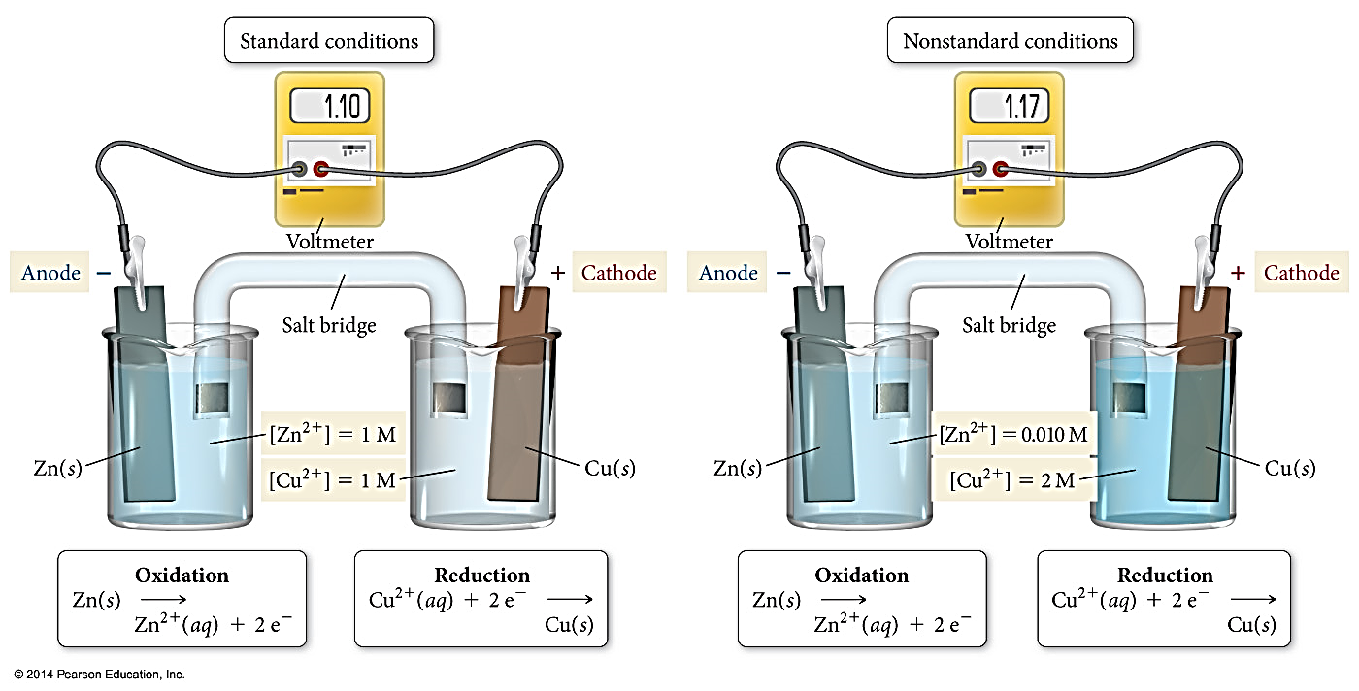
E_{cell} When Ion Concentrations Are Not 1 M

Slide 10
Equilibrium Constants and Cell Potential
At equilibrium, forward and reverse reactions occur at equal rates, therefore:
The battery is “dead” ☹
The cell potential, E, is zero volts
Modifying the Nernst Equation (at 25 °C):
$$0 volts= E^{°}−\frac{0.0592}{n}log(K)$$

Slide 11
Calculating an Equilibrium Constant from a Cell Potential
Zn + Cu²⁺ → Zn²⁺ + Cu E° = + 1.10 V
$$0 volts=1.10−\frac{0.0592}{2}log(K)$$
$$\frac{(1.10)(2)}{0.0592}=log(K)$$
$$37.2=log(K)$$
$${10}^{37.2}=K$$
$$=1.58 x {10}^{37}$$

Slide 13
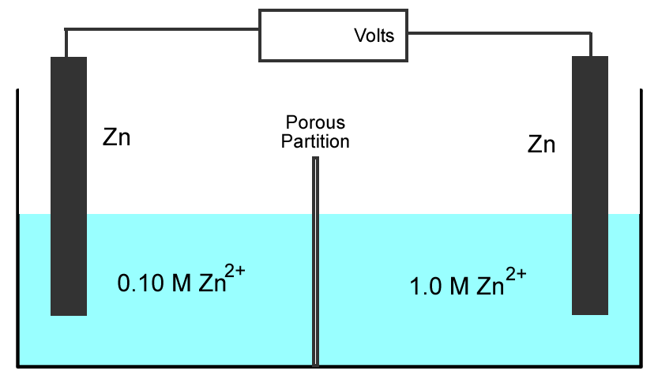
Concentration Cell
Both sides of the cell have the same components but at different concentrations.
???
Step 1:
Determine which side undergoes oxidation, and which side undergoes reduction.

Slide 14
Concentration Cell
The 1.0 M Zn²⁺ must decrease in concentration, and
the 0.10 M Zn²⁺ must increase in concentration
Zn²⁺ (1.0M) + 2e⁻ → Zn (reduction)
Zn → Zn²⁺ (0.10M) + 2e⁻ (oxidation)
Zn²⁺ (1.0M) → Zn²⁺ (0.10M)
???

Slide 15
Concentration Cell
Step 2:
Calculate cell potential using the Nernst Equation (assuming 25 °C).
Zn²⁺ (1.0M) → Zn²⁺ (0.10M)
???
$$E=E^{°}−\frac{0.0592}{n}log(Q)$$

Slide 16
Concentration Cell
$$E°=0$$
$$Q=\frac{[product]}{[reactant]}=\frac{[low]}{[high]}$$
Step 2:
Calculate cell potential using the Nernst Equation (assuming 25 °C).
???
Zn²⁺ (1.0M) → Zn²⁺ (0.10M)
$$E=E^{°}−\frac{0.0592}{n}log(Q)$$
$$E=0−\frac{0.0592}{2}log\left(\frac{0.10}{1.0}\right)$$
$$=0.030 volts$$

Slide 17
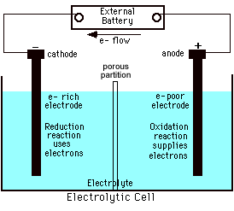
Reminder...Electrolytic Processes
Electrolytic processes are NOT spontaneous.
They have:
A negative cell potential, (-E°)
A positive free energy change, (+ΔG)

Slide 18
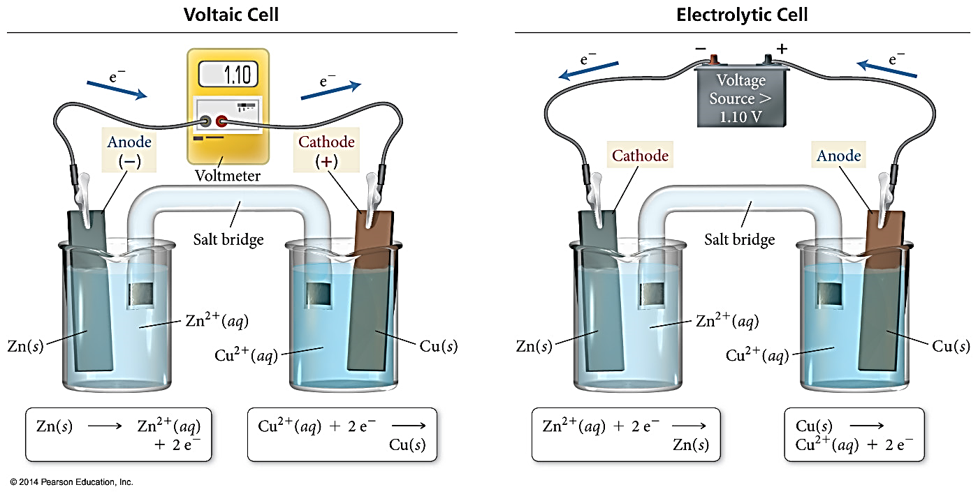
Voltaic versus Electrolytic Cells

Slide 19
Why Would We Want an Electrolytic Cell?
Can be useful!
Can make things happen that would not otherwise happen on their own.

Slide 20
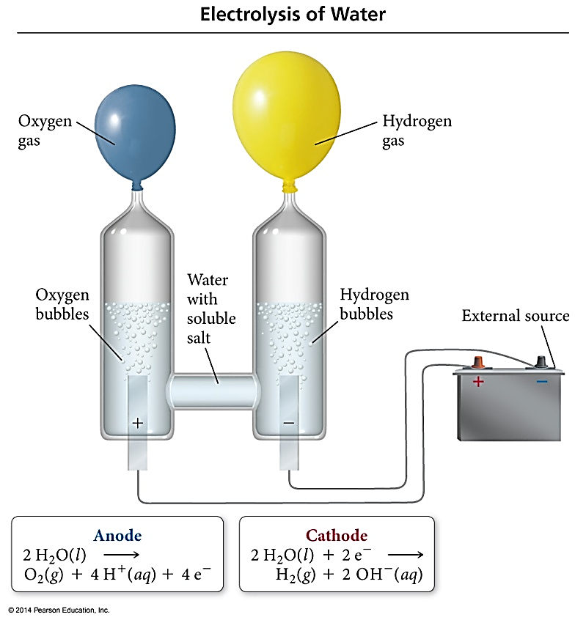
Electrolysis
Electrolysis is the process of using electrical energy to break a compound apart.
Electrolysis is done in an electrolytic cell.
Electrolytic cells can be used to separate elements from their compounds.

Slide 21
Electrolysis of Water
Anode – oxidation – loss e⁻
2H₂O_{(l)} → O_{2(g)} 4H⁺_{(aq)} + 4e⁻
Cathode – reduction – gain e⁻
2H₂O + 2e⁻ → H_{2(g)} + 2OH⁻_{(aq)}
Memorize which equations! Everyone always forgets it, even though it is on the standard reduction sheet.

Slide 22
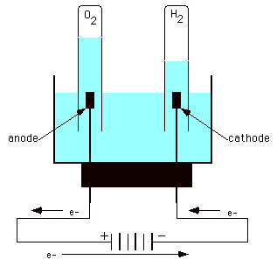
Electrolysis of Water
In acidic solution
Anode rxn:
-1.23 V
Cathode rxn:
-0.83 V
-2.06 V
E° = negative
Therefore ∆G = positive
Nonspontaneous!
That’s why you need to use electricity to make it happen!

Slide 23
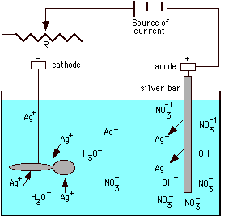
Electroplating of Silver
Anode reaction:
Ag → Ag⁺ + e⁻
Cathode reaction:
Ag⁺ + e⁻ → Ag
Electroplating requirements:
1. Solution of the plating metal
2. Anode made of the plating metal
3. Cathode with the object to be plated
4. Source of current

Slide 24
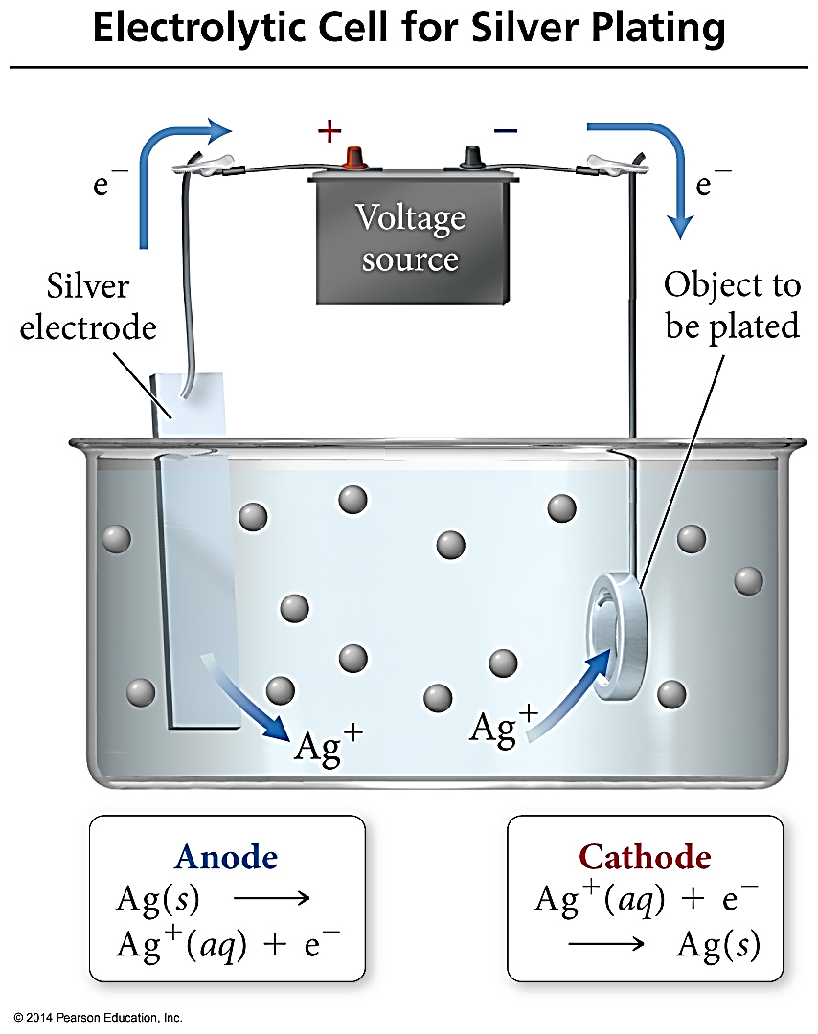
Electroplating
In electroplating, the work piece is the cathode.
Cations are reduced at cathode, turned into neutral (s) metal, and plate on to the surface of work piece.
The anode is made of the plate metal. The anode oxidizes and replaces the metal cations in the solution. The anode will get smaller over time as it is turned into aqueous cations.

Slide 25
Solving an Electroplating Problem
Q: How many seconds will it take to plate out 5.0 grams of silver from a solution of AgNO₃ using a 20.0 Ampere current?
Ag⁺ + e⁻ → Ag
5.0 g
1 mol Ag
1 mol e⁻
96 485 C
1 s
= 2.2 x 10² s
107.87 g
1 mol Ag
1 mol e⁻
20.0 C
1 amp = 1 Coulomb/sec
96485 Coulombs = 1 mol e⁻

Slide 26
YouTube Link to Presentation
https://youtu.be/9JrlJUUGopY

