Slide 1
N6 - THERMODYNAMICS
More About Entropy
Link to YouTube Presentation: https://youtu.be/I9S9UZAO5kA

Slide 2
N6 - THERMODYNAMICS
More About Entropy
Target: I can describe entropy and ways that a reaction may have an increase (or decrease) in entropy.

Slide 3
Key Concepts about Entropy
#1 - a thermodynamic function that increases as the number of energetically equivalent ways of arranging the components (microstates) increases, S.
Units are usually J/K or J/mol•K

Slide 4
Macrostate State vs Microstate
Right now each of these systems should look the same.
We don’t have a way to differentiate between particles.
We end up looking at only the “Macrostate” – each side of each container has two particles in it.

Slide 5
Macrostate State vs Microstate
These microstates all have the same macrostate.
There are six different particle arrangements that result in the same macrostate.
The individual unique particles make up the microstate, the overall “big picture” is the macrostate

Slide 6
Review of Concepts about Entropy
#2 – “Random” systems have more energy dispersal and are more energetically stable, lower energy, than ordered systems. Therefore, entropy change is favorable when the result is more energy dispersal, when there are more microstate arrangements.
When ΔS is positive.
∆S = S_{final} − S_{initial}

Slide 7
Review of Concepts about Entropy
#3 – Increase in entropy of the universe is the driving force for reactions.

Slide 8
Review of Concepts about Entropy
#4 – Nature proceeds toward the states that have the highest probabilities of existing. More microstates, more energy dispersal means more ways for the arrangement to be achieved, more likely to happen.

Slide 9
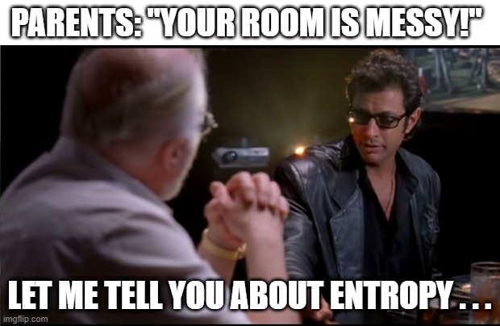

Slide 10
Standard Entropy Change, ∆S°
Standard entropy change - the difference in absolute entropy between the reactants and products under standard conditions.
∆Sº_{reaction} = ∑nSº_{products} − ∑nSº_{reactants}

Slide 11
Standard Entropy Change, ∆S°
*IMPORTANT*
Standard enthalpy of formation, ΔH_{f}°, of an element is 0 kJ/mol,
BUT the standard entropy, S°, is (almost) ALWAYS positive, NOT zero!
The standard entropy of some IONS can be negative due to the inability to separate them and measure them independently. So H⁺(aq) is designated as a reference point of 0, so some ions might end up with a negative S°.

Slide 12
For the Rx: 2NO(g) + O₂(g) → 2NO₂(g) ΔS°_{rxn}= -146.5 J/mol•K
Calculate the standard molar entropy of O₂(g).
S°_{NO(g)} = 210.8 J/mol•K , S°_{NO2(g)} = 240.1 J/mol•K
-175.8 J mol⁻¹K⁻¹
269.4 J mol⁻¹K⁻¹
-205.1 J mol⁻¹ K⁻¹
205.1 J mol⁻¹ K⁻¹
None of the above
Notes:
D

Slide 13
For the Rx: 2NO(g) + O₂(g) → 2NO₂(g) ΔS°_{rxn}= -146.5 J/mol•K
Calculate the standard molar entropy of O₂(g).
S°_{NO(g)} = 210.8 J/mol•K , S°_{NO2(g)} = 240.1 J/mol•K
$$∆S_{rxn}=Σ ∆{nS}_{Products}−Σ ∆{nS}_{reactants}$$
-175.8 J mol⁻¹K⁻¹
(-146.5) = [ 2(240.1) ] – [ 2(210.8) + S°_{O2} ]
S°_{O2} = 205.1 Jmol⁻¹K⁻¹
269.4 J mol⁻¹K⁻¹
-205.1 J mol⁻¹ K⁻¹
205.1 J mol⁻¹ K⁻¹
None of the above
Notes:
D

Slide 14
Some Changes that Increase Entropy

Slide 15
Some Changes that Increase Entropy
#1 - Products are in a more
dispersed arrangement.

Slide 16
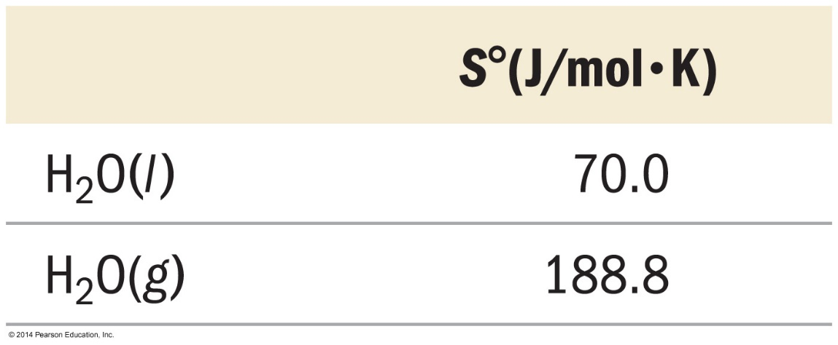
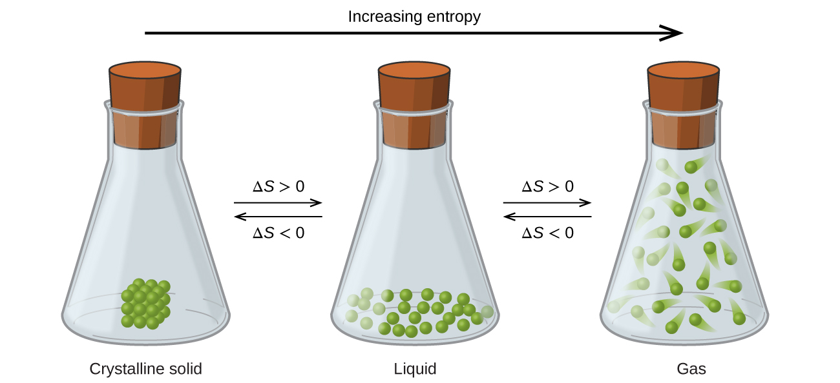
Example
State of Matter
Solid < Liquid < Gas
More arrangements possible

Slide 17
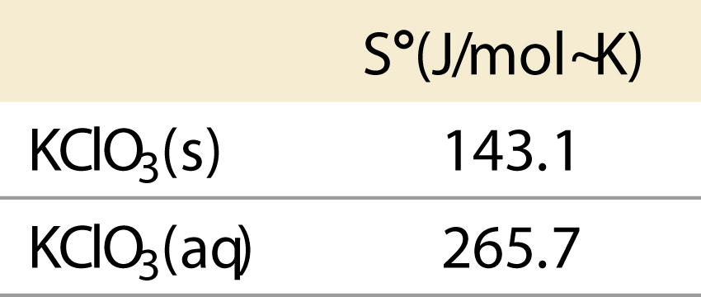
Example
Dissolution (s) $→$ (aq)
Dissolved solids usually have larger entropy, distributing particles throughout the mixture.

Slide 18
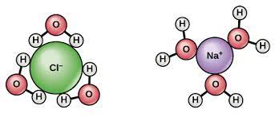
Example
Aqueous solutions
Sometimes it is trickier!
“Sphere of hydration” can add order...DECREASE in entropy!

Slide 19
Some Changes that Increase Entropy
#2 - Larger numbers of product molecules than reactant molecules
AB₂ → A + 2B

Slide 20
Some Changes that Increase Entropy
#3 - Rxn’s that have an increase in temperature (exothermic)

Slide 21
Some Changes that Increase Entropy
#4 – Products that have more degrees of movement

Slide 22
Example
Degree of Movement
Lots of types of movement

Slide 23
Example
Degree of Movement
More degrees of movement results in more entropy.
The chain can bend to form a hydrogen bond with itself
Now it has LESS entropy!

Slide 24
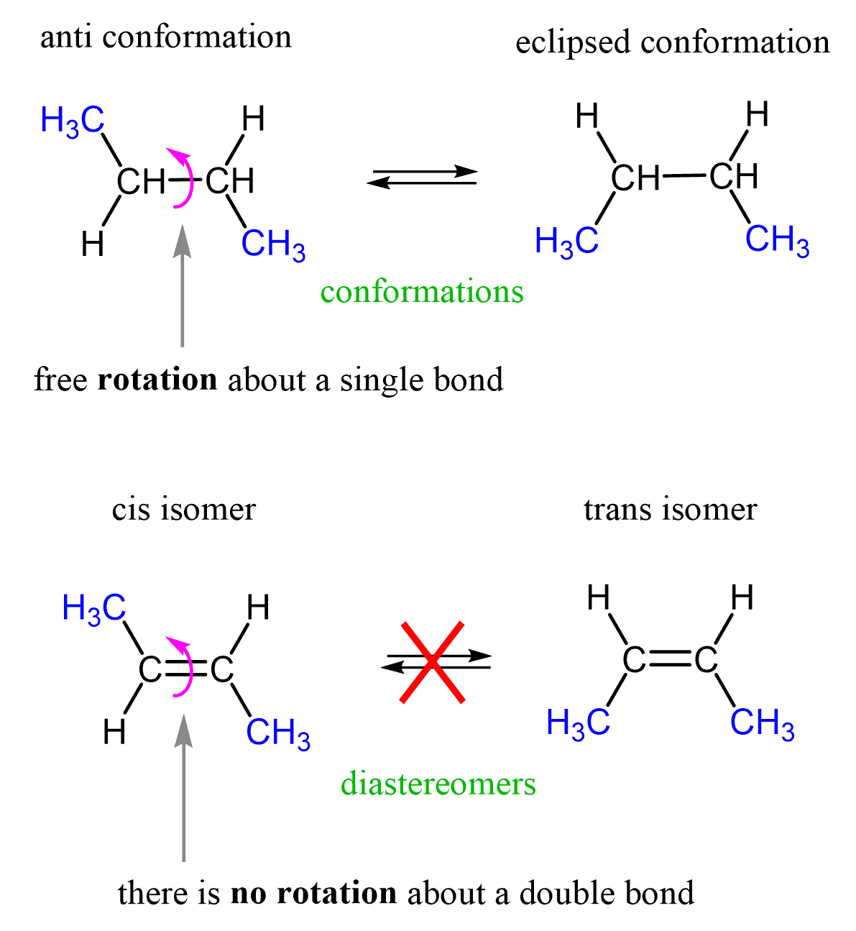
Example
Degree of Movement
Single bonds rotate more than double/triple bonds can.

Slide 25
Some Changes that Increase Entropy
#5 – Products that have more molecular complexity

Slide 26
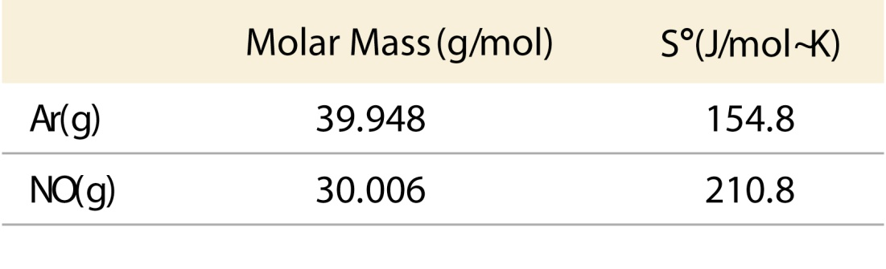
Changes in Entropy - Examples
Molecular Complexity
Larger, more complex molecules generally have larger entropy.
Larger/Complex doesn’t always mean molar mass!
More energy levels/states are available, allowing more dispersal of energy through the states.

Slide 27
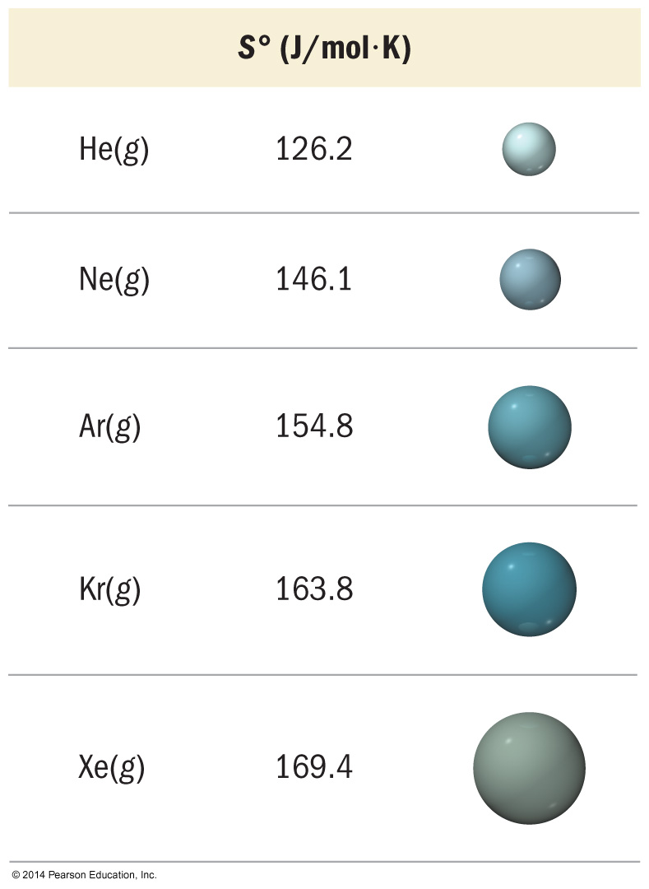
Changes in Entropy - Examples
Molar Mass
Commonly looks like the larger the molar mass, the larger the entropy...but the mass isn’t the direct reason
Seems a little counter intuitive…larger things can’t have as many places to be arranged in the same among of space, right?

Slide 28
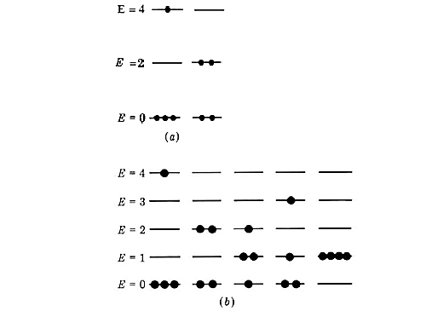
Changes in Entropy - Examples
Molar Mass
It’s because the mass affects the energy levels!
The larger the molar mass, the closer the energy levels/states.
The closer the energy states the more ways the energy can be dispersed through them.

Slide 29
A little bit about the “Entropy of the Universe”

Slide 30
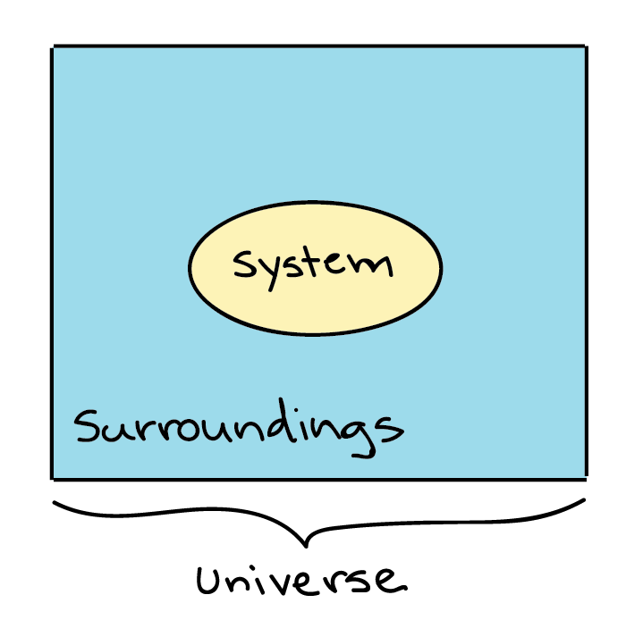
2nd Law of Thermodynamics
The total entropy change of the universe must be positive for a process to be spontaneous
ΔS_{universe} = ΔS_{system} + ΔS_{surroundings}
Reversible process ∆S_{univ} = 0
Irreversible spontaneous process ∆S_{univ} > 0

Slide 31
Yes, you can still have negative ΔS_{system}
ΔS_{universe} = ΔS_{system} + ΔS_{surroundings}
If the entropy of the system
Then the entropy of the surroundings must by a larger amount.
Do not need to write this down!

Slide 32
2nd Law of Thermodynamics
ΔS_{universe} = ΔS_{system} + ΔS_{surroundings}
When ΔS_{system} is negative,
ΔS_{surroundings} must be positive AND bigger for a spontaneous process.
Do not need to write this down!

Slide 33
2nd Law of Thermodynamics
ΔS_{universe} = ΔS_{system} + ΔS_{surroundings}
When ΔS_{surroundings} is negative,
ΔS_{system} must be positive AND bigger for a spontaneous process.
Do not need to write this down!

Slide 34
Relating Entropy to Heat Energy
The entropy change in the surroundings is proportional to the amount of heat gained or lost.
q_{surroundings} = −q_{system}
(Equal but opposite sign)
(Sometimes it is easier to measure surroundings than the system, or vice versa – our lab experiments can exploit this fact sometimes to make our life more convenient – calorimetry! )

Slide 35
Relating Entropy to Heat Energy
The entropy change in the surroundings is also inversely proportional to its temperature.
Meaning the impact of ∆H on entropy is more noticeable at lower temperatures.
$$∆S_{surroundings}=\frac{{−q}_{system}}{T}=\frac{{−∆H}_{system}}{T}$$
*remember* in this class q = ∆H because we are not dealing with changes to P or V

Slide 36
Can start to be creative with the equations
In my opinion, one of the things that makes topics like Thermodynamics difficult is that there is SO much substitution and rearrangement of equations.
Repetition and exposure helps these come more naturally and quickly. Sometimes a new equation isn’t actually new!
$$∆S_{universe}=∆S_{system}+∆S_{surroundings}$$
= $∆S_{system}+\frac{{−∆H}_{system}}{T}$

Slide 37
YouTube Link to Presentation
https://youtu.be/I9S9UZAO5kA

