Slide 1
N7 - THERMODYNAMICS
Gibbs Free Energy
Link to YouTube Presentation: https://youtu.be/9IUI6T5ynfU

Slide 2
N7 - THERMODYNAMICS
Gibbs Free Energy
Target: I can use the relationships between Gibbs Free Energy, Enthalpy, Entropy, and Equilibrium to solve for a variety of things.

Slide 3
PART 1
HOW WE GOT THE GIBBS EQUATION AND MENTAL MATH USING IT

Slide 4
Gibbs Free Energy
Gibbs free energy, G - the maximum amount of work energy that can be released to the surroundings by a system for a constant temp and pressure system.
Gibbs free energy is often called the chemical potential because it is similar to the storing of energy in a mechanical system.

Slide 5
Gibbs Free Energy
We saw last time that:
This turns into…
ΔS_{univ} = ΔS_{sys} - $\frac{\text{D}\text{H}\text{sys}}{\text{T}}$

Slide 6
Gibbs Free Energy
This should remind you of something!!!
−TΔS_{univ} = ΔH_{sys}−TΔS_{sys}

Slide 7
Gibbs Free Energy
−TΔS_{univ} = ΔH_{sys}−TΔS_{sys}
ΔG_{sys} = ΔH_{sys}−TΔS_{sys}
Therefore...
_{Another helpful rearrangement!}
ΔG_{sys} = −TΔS_{univ}

Slide 8
Gibbs Free Energy
Because ΔS_{univ} determines if a process is spontaneous, ΔG also determines spontaneity.
ΔS_{univ} is positive when spontaneous, so ΔG is negative when spontaneous
ΔG_{sys} = −TΔS_{univ}

Slide 9
Gibbs-Helmholtz Equation
Important Equation!!!
ΔG_{sys} = ΔH_{sys}−TΔS_{sys}

Slide 10
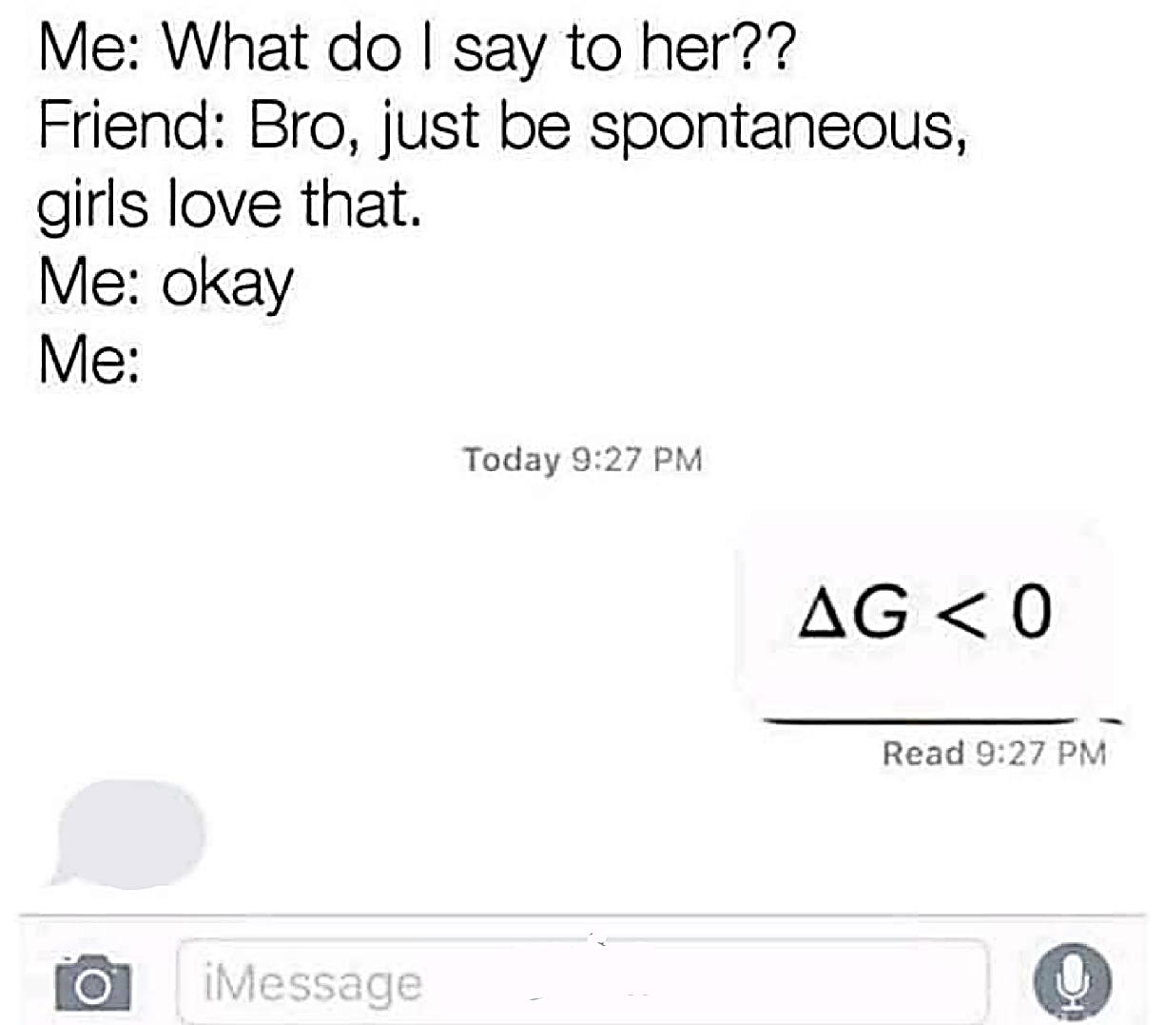
Gibbs Free Energy
A process will be spontaneous when ΔG is negative
Important fact that lets us do a lot of math!
Um…

Slide 11
Mental Math with Gibbs Free Energy
It is very common for them to ask you to predict if a reaction is spontaneous based on just the algebraic sign on ∆H and ∆S
You need to use the Gibbs equation to see if ∆G ends up + or -
ΔG_{sys} = ΔH_{sys}−TΔS_{sys}

Slide 12
Mental Math with Gibbs Free Energy
This always makes my brain feel scrambled… figure out what works for you.
Flat out memorize it (best, fastest)
Write out the equation and +/- and walk through the mental math each time (what I do because I’m lazy, and I’m not taking timed tests like you are – ha!)
Find/make a mnemonic? (Tell me if you find a good one!)
YOU CAN’T LET YOUR BRAIN SHUT DOWN Don’t let it feel confused and shut off… just walk through it slowly…

Slide 13
Mental Math with Gibbs Free Energy
ΔH_{sys}−TΔS_{sys} = ΔG_{sys}
ΔH | ΔS | ΔG | At…
− exothermic | + more disorder | − ALWAYS spont. | Any temperature
(Negative #) – _{any}T(Positive #) = Always Negative #
BEST COMBO!
Remember T is in Kelvin, always a positive number

Slide 14
Mental Math with Gibbs Free Energy
ΔH_{sys}−TΔS_{sys} = ΔG_{sys}
ΔH | ΔS | ΔG | At…
− exothermic | + more disorder | − ALWAYS spont. | Any temperature
(Negative #) – _{any}T(Positive #) = Always Negative #
BEST COMBO!
Remember T is in Kelvin, always a positive number

Slide 15
Mental Math with Gibbs Free Energy
ΔH_{sys}−TΔS_{sys} = ΔG_{sys}
ΔH | ΔS | ΔG | At…
+ endothermic | − less disorder | + NEVER spont. | Any temp
(Positive #) – _{any}T(Negative #) = Always Positive # Notice the double negative! → (Positive #) + (Positive #)
WORST COMBO!

Slide 16
Mental Math with Gibbs Free Energy
ΔH_{sys}−TΔS_{sys} = ΔG_{sys}
ΔH | ΔS | ΔG | At…
+ endothermic | − less disorder | + NEVER spont. | Any temp
(Positive #) – _{any}T(Negative #) = Always Positive # Notice the double negative! → (Positive #) + (Positive #)
WORST COMBO!

Slide 17
Mental Math with Gibbs Free Energy
ΔH_{sys}−TΔS_{sys} = ΔG_{sys}
ΔH | ΔS | ΔG | At…
+ endothermic | + more disorder | − spont. | High Temp
(Positive #) – _{large}T(Positive #) = Negative # ΔH needs to be a smaller positive number than TΔS_{sys} Small # - Big # = Negative # ΔH < TΔS_{sys}
VARIABLE COMBO!

Slide 18
Mental Math with Gibbs Free Energy
ΔH_{sys}−TΔS_{sys} = ΔG_{sys}
ΔH | ΔS | ΔG | At…
+ endothermic | + more disorder | − spont. | High Temp
(Positive #) – _{large}T(Positive #) = Negative # ΔH needs to be a smaller positive number than TΔS_{sys} Small # - Big # = Negative # ΔH < TΔS_{sys}
VARIABLE COMBO!

Slide 19
Mental Math with Gibbs Free Energy
ΔH_{sys}−TΔS_{sys} = ΔG_{sys}
ΔH | ΔS | ΔG | At…
− exothermic | − less disorder | − spont. | Low Temp
(Negative #) – _{small}T(Negative #) = Negative # Notice the double negative! → (Negative #) + (Positive #) ΔH needs to be a larger negative than TΔS_{sys} ΔH < TΔS_{sys}
VARIABLE COMBO!

Slide 20
Mental Math with Gibbs Free Energy
ΔH_{sys}−TΔS_{sys} = ΔG_{sys}
ΔH | ΔS | ΔG | At…
− exothermic | − less disorder | − spont. | Low Temp
(Negative #) – _{small}T(Negative #) = Negative # Notice the double negative! → (Negative #) + (Positive #) ΔH needs to be a larger negative than TΔS_{sys} ΔH < TΔS_{sys}
VARIABLE COMBO!

Slide 21
ΔH_{sys}−TΔS_{sys} = ΔG_{sys}
ΔH | ΔS | ΔG | At…
− exothermic | + more disorder | − ALWAYS spont. | Any temp
+ endothermic | − less disorder | + NEVER spont. | Any temp
− exothermic | − less disorder | − spont. | Low Temp
− exothermic | − less disorder | + NOT spont. | High Temp
+ endothermic | + more disorder | − spont. | High Temp
+ endothermic | + more disorder | + NOT spont. | Low Temp

Slide 22
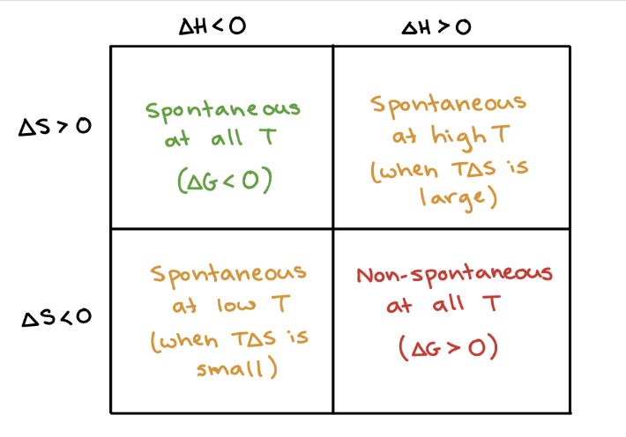
So many versions online, find one you like! If you find a good one, always share with me! ☺

Slide 23
Now it is time for some math!
Yay!

Slide 24
Calculating Free Energy
Method #1- Standard Free Energy of Formations
ΔG_{f}° of an element in its standard state is zero

Slide 25
Calculating Free Energy
Method #2- Gibbs-Helmohotz Equation
For reactions at a constant temperature
ΔG° = ΔH° - TΔS°

Slide 26
Calculating Free Energy
Method #3- A variation of Hess’s Law
C_{diamond}(s) + O₂(g) → CO₂(g) ΔG⁰ = -397 kJ
C_{graphite}(s) + O₂(g) → CO₂(g) ΔG⁰ = -394 kJ
C_{diamond}(s) + O₂(g) → CO₂(g) ΔG⁰ = -397 kJ
CO₂(g) → C_{graphite}(s) + O₂(g) ΔG⁰ = +394 kJ
C_{diamond}(s) → C_{graphite}(s)
ΔG⁰ =
-3 kJ

Slide 27
PART 2
CONNECTION TO EQUILIBRIUM

Slide 28
Free Energy and Equilibrium
The value of ∆G° can indicate the ratios of products to reactants at equilibrium.
The ratio of products to reactants is also indicated by a value you already know from equilibrium....
K

Slide 29
“Rat Link Equation”
where R=8.314J/mol•K
ΔG° = -RTLn(K)
CAREFUL!!!
∆ G° in kJ but.... R in J
CONVERT UNITS TO MATCH!

Slide 30
Solving for K
Isolate Ln(K).
Do you remember how to “undo” a natural logarithm???
Ln(K) = $\frac{− ∆G°}{RT}$
CAREFUL!!!
∆ G° in kJ but.... R in J
CONVERT UNITS TO MATCH!

Slide 31
Solving for K
Make sure it is an EXPONENT!
e raised to all that other “stuff” gives you what is inside the natural logarithm!
K = $e^{\frac{− ∆G°}{RT}}$
CAREFUL!!!
∆ G° in kJ but.... R in J
CONVERT UNITS TO MATCH!

Slide 32
Careful!
Not always at standard state!
In that case you would use ∆G instead of ∆G°
Like using Q instead of K if you weren’t at equilibrium!

Slide 33
Gibbs at Equilibrium
When ΔG = 0 the reaction is at equilibrium.
ΔG = 0 → @ equilibrium!
BUT ∆G° does NOT always = 0 at equilibrium!
∆G° = 0 only if [reactants] = [products] when at equilibrium.

Slide 34
ΔG = ΔH - T ΔS
1 G decreasing, forward direction “thermodynamically favorable,” spontaneous, will proceed.
3 G increasing, forward direction NOT “thermodynamically favorable.” Non-spontaneous, rxn won’t continue forward on its own.
2 ΔG, at equilibrium. No net change in rxn.
Reactants
-ΔG
Products
+ΔG
Equilibrium
ΔG=0

Slide 35
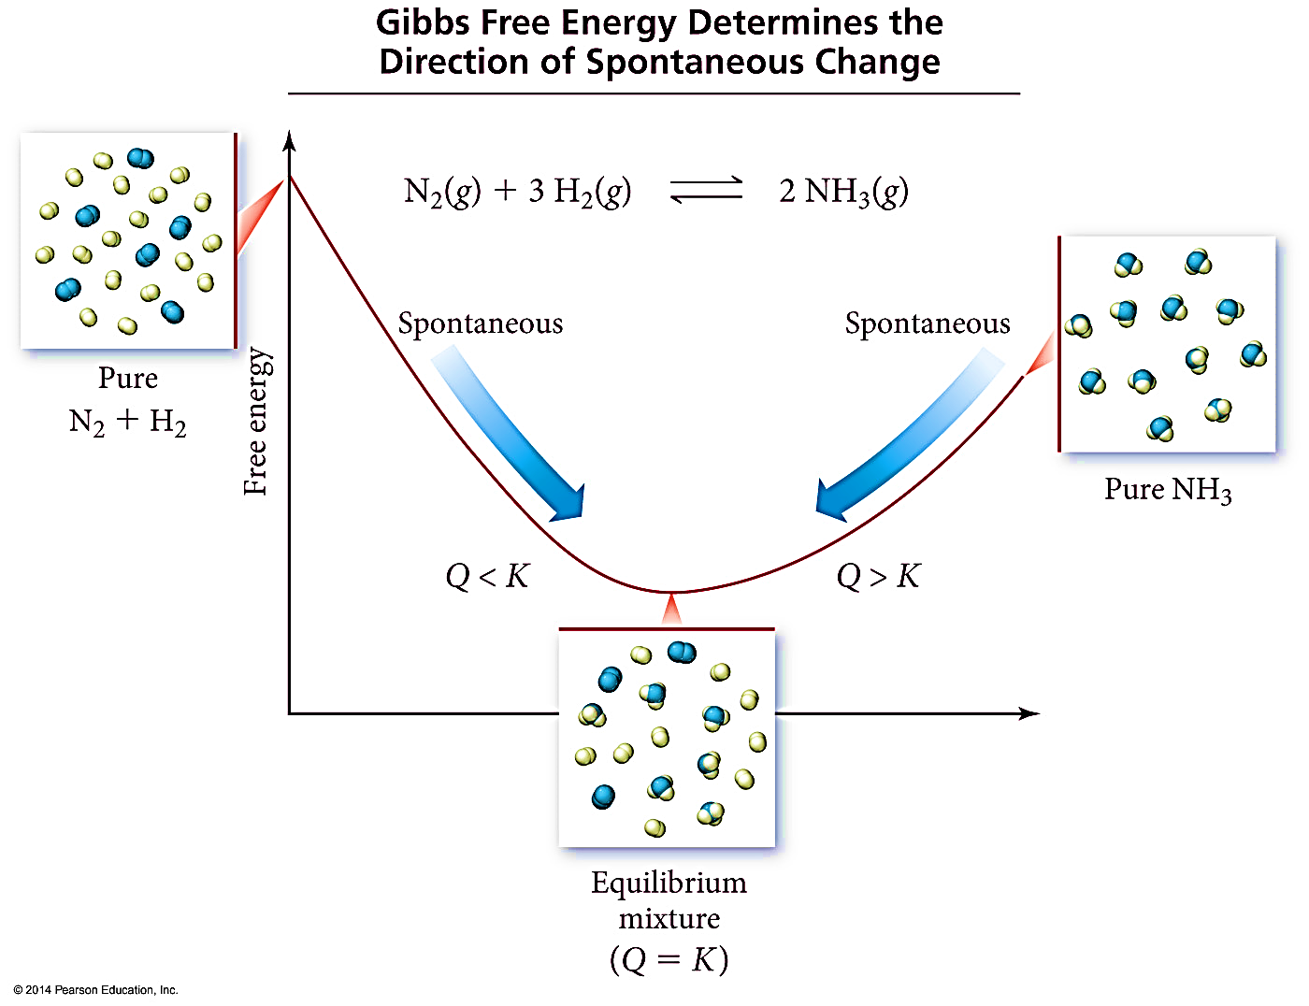
Gibbs at Equilibrium

Slide 36
Free Energy and Equilibrium
Equilibrium point occurs at the lowest value of free energy available to the reaction system
At equilibrium: ΔG = 0 and K = Q
ΔG | K vs Q
ΔG = 0 | K = Q | @ equilibrium
ΔG < 0 | K > Q | Shift right
ΔG > 0 | K < Q | Shift left

Slide 37
Free Energy and Equilibrium
Where ΔG is at some non standard condition,
and ΔG⁰ is standard 1 atm,
Q is some condition not at equilibrium
Remember K = equilibrium, Q = not at equilibrium K = Q at equilibrium
ΔG = ΔG° + RTLn(Q)

Slide 38
Free Energy and Equilibrium
ΔG = ΔG° + RTLn(Q)
So if at equilibrium ΔG = 0 and K = Q …
0 = ΔG° + RTLn(K)
Then rearrange…look what we are back to! ☺
where R=8.314J/mol•K
ΔG° = -RTLn(K)

Slide 39
Free Energy and Equilibrium
So if…
ΔG° = -RTLn(K)
And if…
ΔG° = ΔH° - TΔS°
Then…

Slide 40
Free Energy and Equilibrium
Rearrange to solve for ln(K)….
So…. ln(K) ∝ 1/T
AND…that equation looks like y = mx + b ….

Slide 41
Free Energy and Equilibrium
You can find ∆H° and ∆S° by graphing!
$$ln\left(K\right)= −\frac{∆H°}{R}\left(\frac{1}{T}\right)+\frac{∆S°}{R}$$
y = m x + b
1st - Graph ln(K) vs $\left(\frac{1}{T}\right)$
2nd - Find line of best fit (Excel or graphing calculator)
3rd - Slope = $−\frac{∆H°}{R}$ Intercept = $\frac{∆S°}{R}$

Slide 42
Soooo many rearrangements…
There are so many ways to rearrange, substitute, and solve for various things when it comes to Thermodynamics.
You HAVE to have decent algebra skills!
My best advice if algebra is not your strong suit…
Practice over and over until it becomes “muscle memory” how to rearrange.
Every time you have a question that requires a different equation rearrangement/substitution, write it down! Start making your own equation cheat sheet.

Slide 43
A Few Odds and Ends Reminders
If you use the Hess’s Law style method for Gibbs problems, where you have to add together various rxns, you need to edit your Keq value when you add/multiply your equations!
Multiplying an Equation – Raise K to that exponent
Double the Rxn = K² Half the Rxn = K^{½}
Adding Reactions at the End – Multiply K values
K_{overall} = K₁ x K₂ x K₃, etc
Reversing a reaction – take reciprocal of K value
K’ = 1/K
Then you can do things like ΔG° = -RTLn(K)

Slide 44
Free Energy and Pressure
Enthalpy, H, is not pressure dependent
Entropy, S – yes pressure dependent
Depends on volume, so also depends on pressure
So Gibbs will change because S changes
S_{large volume} > S_{small volume}
S_{low pressure} > S_{high pressure}

Slide 45
Phase Changes
Phase changes are equilibriums!
So during a phase change ∆G = 0
Helps you do calculations to figure out the temperature at which phase changes can happen!
Technically...
We shouldn’t be using ∆G = 0 with ∆H° and ∆S° values, since ∆H° and ∆S° would usually be at the “standard” 25°C...but we just pretend they are not temperature dependent to be able to approximate our answer. Is that “bad” ??? Sure...but do we care??? Apparently not! ☺

Slide 46
Some Practice Problems

Slide 47
#1 - For the following Rx: N₂(g) + 3H₂(g) → 2NH₃(g)
Calculate the standard Free Energy, ΔG° for the rxn at 25°C.
ΔH°= -264kJ/mol ΔS°= -278 J/mol•K
-82.5 KJ mol⁻¹
-181 KJ mol⁻¹
-6686 KJ mol⁻¹
181 KJ mol⁻¹
None of the above
Notes:
B

Slide 48
#1 - For the following Rx: N₂(g) + 3H₂(g) → 2NH₃(g)
Calculate the standard Free Energy, ΔG° for the rxn at 25°C.
ΔH°= -264kJ/mol ΔS°= -278 J/mol•K
∆G° = ∆H° - T∆S°
∆G° = (-264) – 298(-0.278)
∆G° = -181 KJ mol⁻¹
-82.5 KJ mol⁻¹
-181 KJ mol⁻¹
-6686 KJ mol⁻¹
Careful about units matching! H and S usually don’t match! Convert before you use them!
181 KJ mol⁻¹
None of the above
Notes:
B

Slide 49
#2 - Calculate the Boiling Point of BCl₃.
BCl_{3(l)} ↔ BCl_{3(g).} Given:
 | H_{f} kJ/mol | S J/mol k
BCl₃ (l) | -418 | 209
BCl₃ (g) | -395 | 290
352 K
275 K
322 K
284 K
10 K
Notes:
B

Slide 50
#2 - Calculate the Boiling Point of BCl₃.
BCl_{3(l)} ↔ BCl_{3(g).} Given:
 | H_{f} kJ/mol | S J/mol k
BCl₃ (l) | -418 | 209
BCl₃ (g) | -395 | 290
Phase change - at equilibrium!
So ∆G = 0
352 K
∆G = ∆H - T∆S
0 = (-395 – -418) – T(0.290 – 0.209)
T = 284 K
275 K
322 K
284 K
10 K
Notes:
B

Slide 51
#3 - Under standard conditions (1 atm of NH₃, N₂ and H₂) and at 298 K, what substance(s) will be formed? (∆G° = 33.4 kJ)
2 NH₃(g) → N₂(g) + 3 H₂(g)
NH₃
N₂ and H₂
Equal amounts of all three gases
Need more information
Notes:
A

Slide 52
#3 - Under standard conditions (1 atm of NH₃, N₂ and H₂) and at 298 K, which substance(s) will be formed? (∆G° = 33.4 kJ)
2 NH₃(g) → N₂(g) + 3 H₂(g)
∆G = + so not spontaneous in forward direction, reactants will be produced not products
NH₃
N₂ and H₂
Equal amounts of all three gases
Need more information
Notes:
A

Slide 53
#4 - Calculate the equilibrium constant for this reaction at 298 K.
2 NH₃(g) → N₂(g) + 3 H₂(g) (∆G° = 33.4 kJ)
1.014
609048.5
1.397 E-6
Need to know equilibrium [ ]’s to calculate Keq
Notes:
A

Slide 54
#4 - Calculate the equilibrium constant for this reaction at 298 K.
2 NH₃(g) → N₂(g) + 3 H₂(g) (∆G° = 33.4 kJ)
∆G° = -RT ln(K)
33400= -(8.314)(298)ln(K)
-13.48 = ln(K)
ln(y) = x e^{x} = y
e^{-13.48} = K
K = 1.397 x 10⁻⁶
1.014
609048.5
1.397 E-6
Need to know equilibrium [ ]’s to calculate Keq
Notes:
A

Slide 55
Link to YouTube Presentation
https://youtu.be/9IUI6T5ynfU
Notes:
A

