Slide 1
Spontaneity, Entropy and Free Energy

Slide 2
Spontaneous Processes and Entropy
First Law
“Energy can neither be created nor destroyed"
The energy of the universe is constant

Slide 3
Spontaneous Processes and Entropy
Spontaneous Processes
Processes that occur without outside intervention
Spontaneous processes may be fast or slow
Many forms of combustion are fast
Conversion of diamond to graphite is slow

Slide 4
Thermodynamics and Spontaneity
Thermodynamics predicts whether a process will occur under the given conditions.
Processes that will occur are called spontaneous.

Slide 5
Thermodynamics and Spontaneity
Spontaneity is determined by comparing the chemical potential energy of the system before the reaction with the free energy of the system after the reaction.
If the system after reaction has less potential energy than before the reaction, the reaction is thermodynamically favorable.

Slide 6
Thermodynamics and Spontaneity
Spontaneity ≠ fast or slow

Slide 7
Reversibility of Process
Any spontaneous process is irreversible because there is a net release of energy when it proceeds in that direction.
A reversible process will proceed back and forth between the two end conditions.
Any reversible process is at equilibrium.
This results in no change in free energy.

Slide 8
Reversibility of Process
If a process is spontaneous in one direction, it must be nonspontaneous in the opposite direction.

Slide 9
Spontaneous Processes
Spontaneous processes occur because they release energy from the system.
Most spontaneous processes are:
Exothermic
But there are some spontaneous processes that are:
Endothermic
[THINKING] How can something absorb potential energy, yet have a net release of energy?

Slide 10
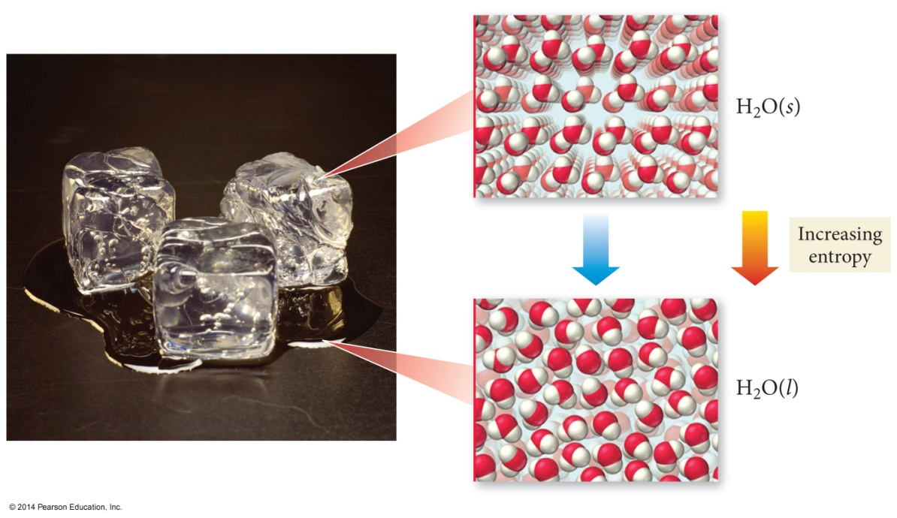
Melting Ice (Think, don’t write)
When a solid melts, the particles have more freedom of movement.
More freedom of motion increases the randomness of the system. When systems become more random, energy is released. We call this energy, entropy.

Slide 11
Melting Ice (Think, more…)
Melting is an endothermic process, yet ice will spontaneously melt above 0 °C.
More freedom of motion increases the randomness of the system. When systems become more random, energy is released. We call this energy, entropy.

Slide 12
Factors Affecting Whether a Reaction Is Spontaneous
There are two factors that determine whether a reaction is spontaneous. They are the enthalpy change and the entropy change of the system.

Slide 13
Factors Affecting Whether a Reaction Is Spontaneous
The enthalpy change, ΔH, is the difference in the sum of the internal energy and PV work energy of the reactants to the products.

Slide 14
Factors Affecting Whether a Reaction Is Spontaneous
The entropy change, ΔS, is the difference in randomness of the reactants compared to the products.

Slide 15
Enthalpy Change (review)
ΔH generally measured in kJ/mol
Stronger bonds = more stable molecules
A Rxn is generally exothermic if the bonds in the products are stronger than the bonds in the reactants.
Exothermic = energy released; ΔH is negative.

Slide 16
Enthalpy Change (review)
A Rxn is generally endothermic if the bonds in the products are weaker than the bonds in the reactants.
Endothermic = energy absorbed; ΔH is positive.
The enthalpy change is favorable for exothermic reactions and unfavorable for endothermic reactions.

