Slide 1
THERMODYNAMICS
Entropy

Slide 2
Concepts about Entropy
#1 - a thermodynamic function that increases as the number of energetically equivalent ways of arranging the components increases, S.
Units are usually J/mol K

Slide 3
Concepts about Entropy
#2 – Random systems are more energetically stable, lower energy, than ordered systems

Slide 4
Concepts about Entropy
#3 – Increase in entropy of the universe is the driving force for spontaneous reactions.

Slide 5
Concepts about Entropy
#4 – Nature proceeds toward the states that have the highest probabilities of existing.

Slide 6
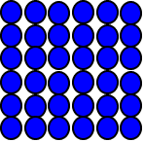
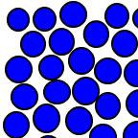
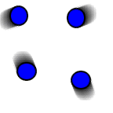
Positional Entropy
The probability of occurrence of a particular state depends on the number of ways (microstates) in which that arrangement can be achieved
S_{solid} < S_{liquid} << S_{gas}

Slide 7
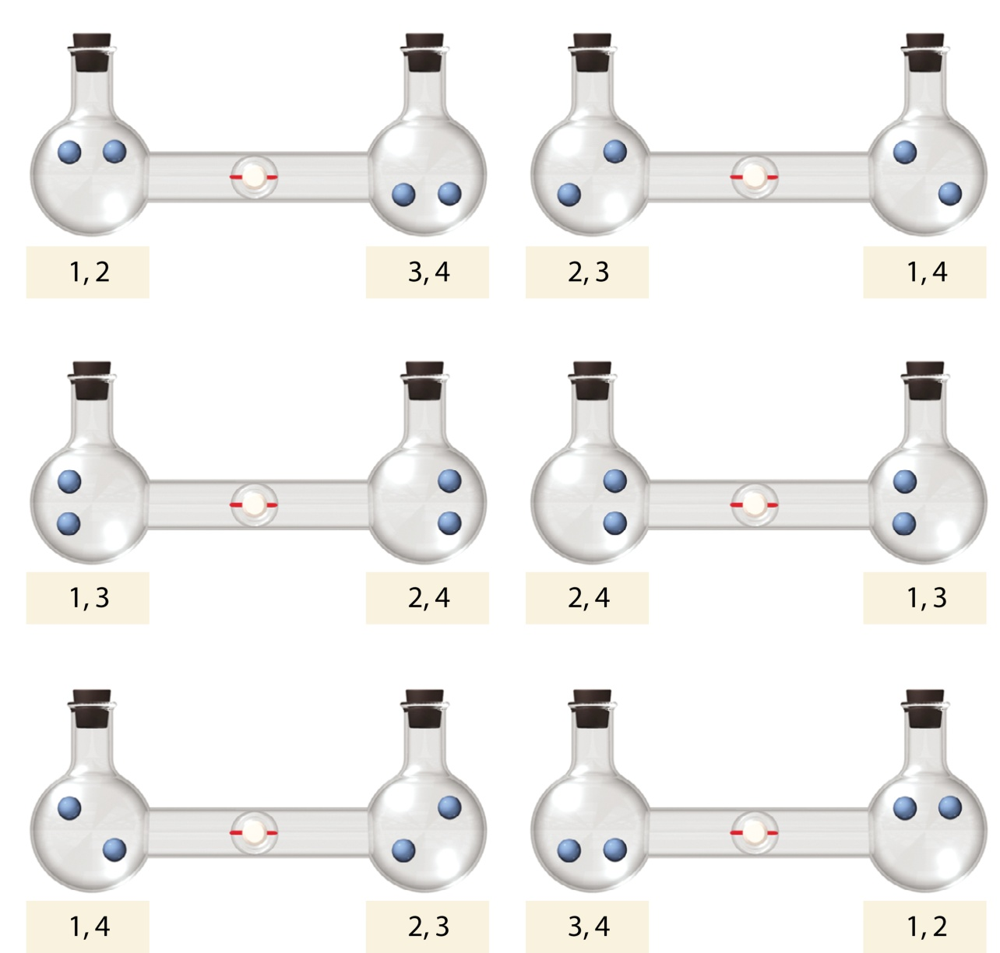
Macrostate State vs Microstate
These microstates all have the same macrostate.
So there are six different particle arrangements that result in the same macrostate.
The individual unique particles make up the microstate, the overall “big picture” is the macrostate

Slide 8
Changes in Entropy
ΔS = S_{final} − S_{initial}
Entropy change is favorable when the result is a more random system.
When ΔS is positive.

Slide 9
Changes in Entropy
Some changes that increase entropy:
#1 - Rxn’s whose products are in a more random state

Slide 10
Changes in Entropy
Some changes that increase entropy:
#2 - Rxn’s that have larger numbers of product molecules than reactant molecules

Slide 11
Changes in Entropy
Some changes that increase entropy:
#3 - Rxn’s that have an increase in temperature (exothermic)

Slide 12
Changes in Entropy
Some changes that increase entropy:
#4 - Rxn’s that have solids dissociating into ions

Slide 13
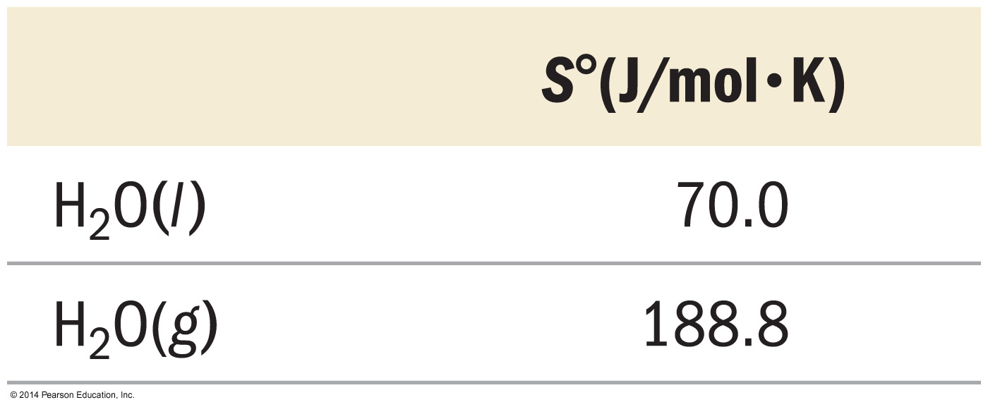
Changes in Entropy - Examples
State of Matter
(at a particular temperature)

Slide 14
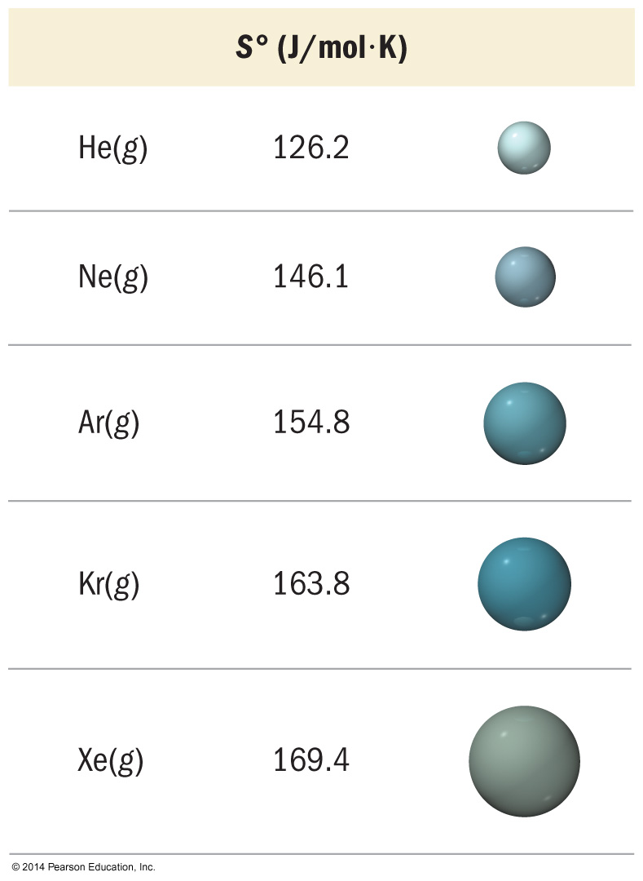
Changes in Entropy - Examples
Molar Mass
The larger the molar mass, the larger the entropy.
Seems a little counter intuitive…its complicated - Available energy states are more closely spaced, allowing more dispersal of energy through the states.
(at a particular temperature)

Slide 15
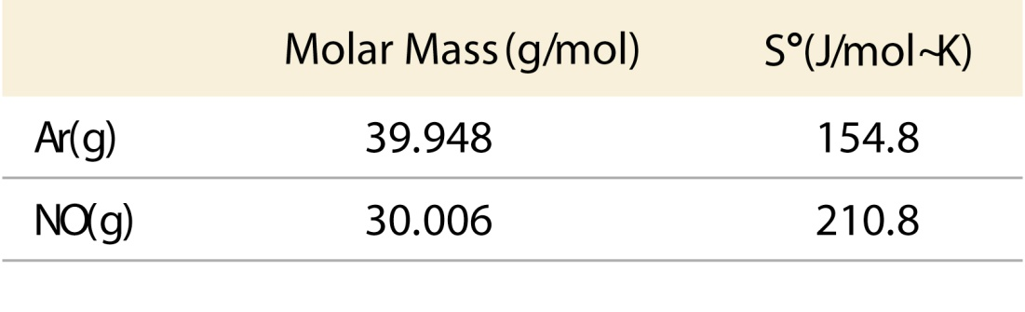
Changes in Entropy - Examples
Molecular Complexity
Larger, more complex molecules generally have larger entropy. – Larger/Complex doesn’t always mean molar mass!
More energy states are available, allowing more dispersal of energy through the states.

Slide 16
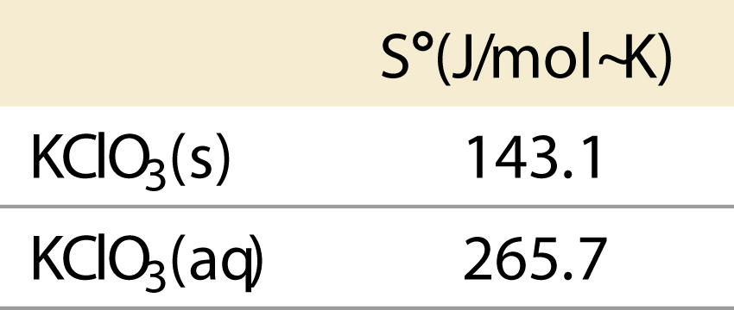
Changes in Entropy - Examples
Dissolution
Dissolved solids generally have larger entropy, distributing particles throughout the mixture.

Slide 17
2nd Law of Thermodynamics
The total entropy change of the universe must be positive for a process to be spontaneous
Reversible process - ∆S_{univ} = 0
Irreversible spontaneous process - ∆S_{univ} > 0

Slide 18
2nd Law of Thermodynamics
ΔS_{universe} = ΔS_{system} + ΔS_{surroundings}
If the entropy of the system ↓ Then the entropy of the surroundings must ↑ by a larger amount.

Slide 19
2nd Law of Thermodynamics
ΔS_{universe} = ΔS_{system} + ΔS_{surroundings}
When ΔS_{system} is negative, ΔS_{surroundings} must be positive and bigger for a spontaneous process.

Slide 20
Relating Entropy to Heat Energy
The entropy change in the surroundings is proportional to the amount of heat gained or lost.
q_{surroundings} = −q_{system}
(Equal but opposite sign)
(Sometimes it is easier to measure surroundings than the system, or vice versa – our lab experiments can exploit this fact sometimes to make our life more convenient. )

Slide 21
Relating Entropy to Heat Energy
The entropy change in the surroundings is also inversely proportional to its temperature.
At constant pressure and temperature:

Slide 22
Standard Entropy Change, ∆S°
Standard entropy change - the difference in absolute entropy between the reactants and products under standard conditions.
ΔSº_{reaction} = ∑n_{p}Sº_{products} − ∑n_{r}Sº_{reactants}
Remember - although the standard enthalpy of formation, ΔH_{f}°, of an element is 0 kJ/mol, the absolute entropy at 25 °C, S°, is always positive, not zero!

