Slide 1
THERMODYNAMICS
Gibbs Free Energy

Slide 2
Now it is time for some math!
Yay!

Slide 3
Gibbs Free Energy
Gibbs free energy, G - the maximum amount of work energy that can be released to the surroundings by a system for a constant temp and pressure system.
Gibbs free energy is often called the chemical potential because it is similar to the storing of energy in a mechanical system.

Slide 4
Gibbs Free Energy
It can be shown that:
−TΔS_{univ} = ΔH_{sys}−TΔS_{sys}
This turns into…

Slide 5
Gibbs Free Energy
It can be shown that:
−TΔS_{univ} = ΔH_{sys}−TΔS_{sys}
This turns into…

Slide 6
Gibbs Free Energy
ΔG_{sys} = ΔH_{sys}−TΔS_{sys}
Important Equation!!!

Slide 7
Gibbs Free Energy
−TΔS_{univ} = ΔH_{sys}−TΔS_{sys}
ΔG_{sys} = ΔH_{sys}−TΔS_{sys}
Because ΔS_{univ} determines if a process is spontaneous, ΔG also determines spontaneity.
ΔS_{univ} is positive when spontaneous, so ΔG is negative.

Slide 8
Gibbs Free Energy
A process will be spontaneous when ΔG is negative
Important fact that lets us do a lot of math!

Slide 9
Mental Math with Gibbs Free Energy
It is very common for them to ask you to predict if a reaction is spontaneous based on just the algebraic sign on ∆H and ∆S
You need to use the Gibbs equation to see if ∆G ends up + or -
ΔG_{sys} = ΔH_{sys}−TΔS_{sys}

Slide 10
Mental Math with Gibbs Free Energy
ΔH_{sys}−TΔS_{sys} = ΔG_{sys}
ΔH | ΔS | ΔG | At…
− exothermic | + more disorder | − ALWAYS spont. | Any temperature
(Negative #) – _{any}T(Positive #) = Always Negative #
BEST COMBO!
Remember T is in Kelvin, always a positive number

Slide 11
Mental Math with Gibbs Free Energy
ΔH_{sys}−TΔS_{sys} = ΔG_{sys}
ΔH | ΔS | ΔG | At…
+ endothermic | − less disorder | + NEVER spont. | Any temp
(Positive #) – _{any}T(Negative #) = Always Positive # Notice the double negative! → (Positive #) + (Positive #)
WORST COMBO!

Slide 12
Mental Math with Gibbs Free Energy
ΔH_{sys}−TΔS_{sys} = ΔG_{sys}
ΔH | ΔS | ΔG | At…
+ endothermic | + more disorder | − spont. | High Temp
(Positive #) – _{large}T(Positive #) = Negative # ΔH needs to be a smaller positive number than TΔS_{sys} Small # - Big # = Negative # ΔH < TΔS_{sys}
VARIABLE COMBO!

Slide 13
Mental Math with Gibbs Free Energy
ΔH_{sys}−TΔS_{sys} = ΔG_{sys}
ΔH | ΔS | ΔG | At…
− exothermic | − less disorder | − spont. | Low Temp
(Negative #) – _{small}T(Negative #) = Negative # Notice the double negative! → (Negative #) + (Positive #) ΔH needs to be a larger negative than TΔS_{sys} ΔH < TΔS_{sys}
VARIABLE COMBO!

Slide 14
Mental Math with Gibbs Free Energy
This always makes my brain feel scrambled… figure out what works for you.
Flat out memorize it (best, fastest)
Write out the equation and +/- and walk through the mental math each time (what I do because I’m lazy, and I’m not taking timed tests like you are – ha!)
Find/make a mnemonic? (Tell me if you find a good one!)
YOU CANT LET YOUR BRAIN SHUT DOWN Don’t let it feel confused and shut off… just walk through it slowly…

Slide 15
ΔH_{sys}−TΔS_{sys} = ΔG_{sys}
ΔH | ΔS | ΔG | At…
− exothermic | + more disorder | − ALWAYS spont. | Any temp
+ endothermic | − less disorder | + NEVER spont. | Any temp
− exothermic | − less disorder | − spont. | Low Temp
− exothermic | − less disorder | + NOT spont. | High Temp
+ endothermic | + more disorder | − spont. | High Temp
+ endothermic | + more disorder | + NOT spont. | Low Temp

Slide 16
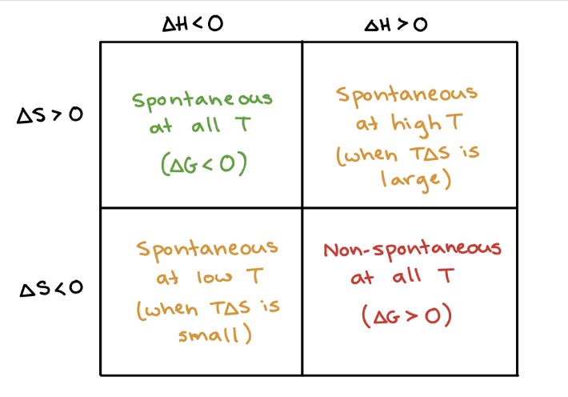
So many versions online, find one you like! If you find a good one, always share with me! ☺

Slide 17
Gibbs at Equilibrium
When ΔG = 0 the reaction is at equilibrium.

Slide 18
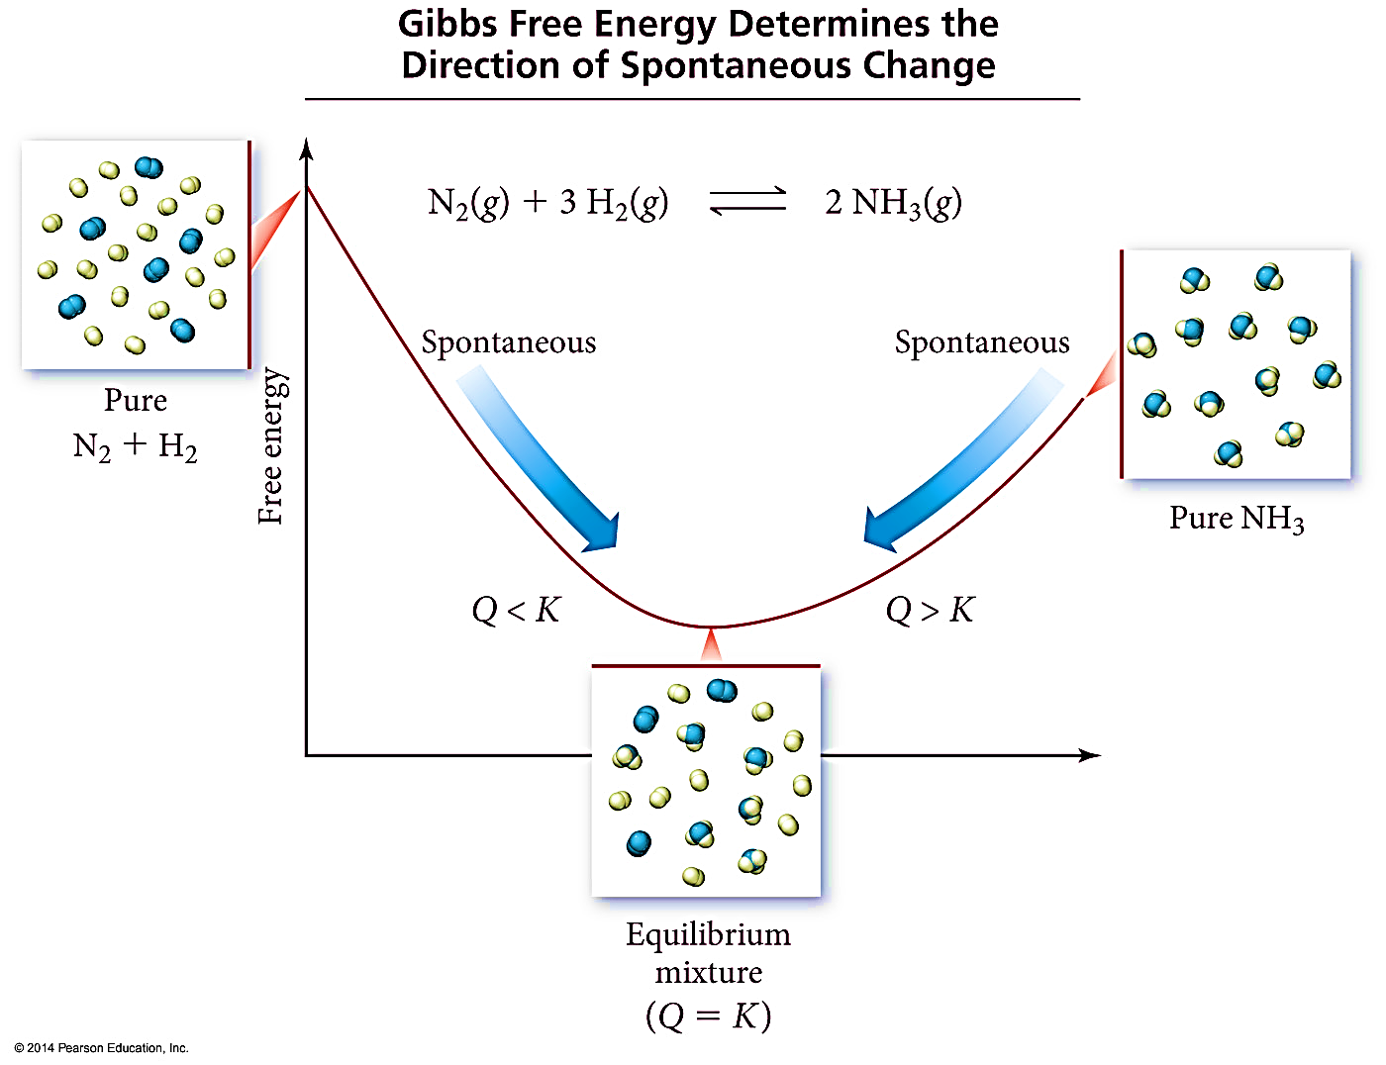
Gibbs at Equilibrium

Slide 19
Calculating Free Energy
Method #1- Gibbs-Helmohotz Equation
ΔG° = ΔH° - TΔS°
For reactions at a constant temperature

Slide 20
Calculating Free Energy
Method #2- A variation of Hess’s Law
C_{diamond}(s) + O₂(g) → CO₂(g) ΔG⁰ = -397 kJ
C_{graphite}(s) + O₂(g) → CO₂(g) ΔG⁰ = -394 kJ
C_{diamond}(s) + O₂(g) → CO₂(g) ΔG⁰ = -397 kJ
CO₂(g) → C_{graphite}(s) + O₂(g) ΔG⁰ = +394 kJ
C_{diamond}(s) → C_{graphite}(s)
ΔG⁰ =
-3 kJ

Slide 21
Calculating Free Energy
Method #3- Standard Free Energy of Formations
ΔG_{f}⁰ of an element in its standard state is zero

Slide 22
Free Energy and Pressure
Enthalpy, H, is not pressure dependent
Entropy, S – yes pressure dependent
Depends on volume, so also depends on pressure
So Gibbs will change because S changes
S_{large volume} > S_{small volume}
S_{low pressure} > S_{high pressure}

Slide 23
Free Energy and Equilibrium
ΔG = ΔG° + RTLn(Q),
Where ΔG is at some non standard condition, and ΔG⁰ is standard 1 atm, Q is some condition not at equilibrium
Remember – K = equilibrium, Q = not at equilibrium K = Q at equilibrium

Slide 24
Free Energy and Equilibrium
Equilibrium point occurs at the lowest value of free energy available to the reaction system
At equilibrium: ΔG = 0 and Q = K
ΔG⁰ | K
ΔG⁰ = 0 | K = 1
ΔG⁰ < 0 | K > 1
ΔG⁰ > 0 | K < 1

Slide 25
Free Energy and Equilibrium
ΔG = ΔG° + RTLn(Q)
So if at equilibrium ΔG = 0 and K = Q …
0 = ΔG° + RTLn(K)
Then rearrange…
ΔG° = -RTLn(K)
where R=8.314J/mol•K

Slide 26
Reminder….
If you use the Hess’s Law style method for Gibbs problems, where you have to add together various rxns, you need to edit your Keq value when you add/multiply your equations!
Multiplying an Equation – Raise K to that exponent
Double the Rxn = K² Half the Rxn = K^{½}
Adding Reactions at the End – Multiply K values
K_{overall} = K₁ x K₂ x K₃, etc
Then you can do things like - ΔG° = -RTLn(K)

Slide 27
Free Energy and Equilibrium
So if…
ΔG° = -RTLn(K)
And if…
ΔG° = ΔH° - TΔS°
Then…

Slide 28
Free Energy and Equilibrium
Rearrange to solve for ln(K)….
So…. ln(K) ∝ 1/T And that equation looks like y = mx + b ….

Slide 29
Free Energy and Equilibrium
You can find ∆H° and ∆S° by graphing!
$$ln\left(K\right)= −\frac{∆H°}{R}\left(\frac{1}{T}\right)+\frac{∆S°}{R}$$
y = m x + b
1st - Graph ln(K) vs $\left(\frac{1}{T}\right)$
2nd - Find line of best fit (Excel or graphing calculator)
3rd - Slope = $−\frac{∆H°}{R}$ Intercept = $\frac{∆S°}{R}$

Slide 30
Soooo many rearrangements…
There are so many ways to rearrange, substitute, and solve for various things when it comes to Thermodynamics.
You HAVE to have decent algebra skills!
My best advice if algebra is not your strong suit…
Practice over and over until it becomes “muscle memory” how to rearrange.
Every time you have a question that requires a different equation rearrangement/substitution, write it down! Start making your own equation cheat sheet.

Slide 31
For the Rx: 2NO(g) + O₂(g) → 2NO₂(g) ΔS°_{rxn}= -146.5 J/mol•K
Calculate the standard molar entropy of O₂(g).
ΔS°_{NO(g)} = 210.8 J/mol•K , ΔS°_{NO2(g)} = 240.1 J/mol•K
-175.8 J mol⁻¹K⁻¹
269.4 J mol⁻¹K⁻¹
-205.1 J mol⁻¹ K⁻¹
205.1 J mol⁻¹ K⁻¹
None of the above
Notes:
D

Slide 32
For the Rx: 2NO(g) + O₂(g) → 2NO₂(g) ΔS°_{rxn}= -146.5 J/mol•K
Calculate the standard molar entropy of O₂(g).
ΔS°_{NO(g)} = 210.8 J/mol•K , ΔS°_{NO2(g)} = 240.1 J/mol•K
$$∆S_{rxn}=Σ ∆S_{Products}−Σ ∆S_{reactants}$$
-175.8 J mol⁻¹K⁻¹
(-146.5) = [ 2(240.1) ] – [ 2(210.8) + ∆S°_{O2} ]
∆S°_{O2} = 205.1 Jmol⁻¹K⁻¹
269.4 J mol⁻¹K⁻¹
-205.1 J mol⁻¹ K⁻¹
205.1 J mol⁻¹ K⁻¹
None of the above
Notes:
D

Slide 33
For the following Rx: N₂(g) + H₂(g) → NH₃(g)
Calculate the standard Free Energy, ΔG° for the rxn at 25°C.
ΔH°= -264kJ/mol ΔS°= -278 J/mol•K
-82.5 KJ mol⁻¹
-181 KJ mol⁻¹
-6686 KJ mol⁻¹
181 KJ mol⁻¹
None of the above
Notes:
B

Slide 34
For the following Rx: N₂(g) + H₂(g) → NH₃(g)
Calculate the standard Free Energy, ΔG° for the rxn at 25°C.
ΔH°= -264kJ/mol ΔS°= -278 J/mol•K
∆G° = ∆H° - T∆S°
∆G° = (-264) – 298(-0.278)
∆G° = -181 KJ mol⁻¹
-82.5 KJ mol⁻¹
-181 KJ mol⁻¹
-6686 KJ mol⁻¹
Careful about units matching! H and S usually don’t match! Convert before you use them!
181 KJ mol⁻¹
None of the above
Notes:
B

Slide 35
Calculate the Boiling Point of BCl₃.
BCl_{3(l)} ↔ BCl_{3(g).} Given:
 | ΔH°_{f} kJ/mol | S° J/mol k
BCl₃ (l) | -418 | 209
BCl₃ (g) | -395 | 290
352 K
275 K
322 K
284 K
10 K
Notes:
B

Slide 36
Calculate the Boiling Point of BCl₃.
BCl_{3(l)} ↔ BCl_{3(g).} Given:
 | ΔH°_{f} kJ/mol | ΔS° J/mol k
BCl₃ (l) | -418 | 209
BCl₃ (g) | -395 | 290
Phase change - at equilibrium!
So ∆G = 0
352 K
∆G° = ∆H° - T∆S°
0 = (-395 – -418) – T(0.290 – 0.209)
T = 284 K
275 K
322 K
284 K
10 K
Notes:
B

Slide 37
What is ΔG° for the following Rx @ 25.0°C:
2 NH₃(g) → N₂(g) + 3 H₂(g) ΔH°= 92.4 kJ, ΔS°= 198 J/K
-58911.6 kJ
∆G° = ∆H° - T∆S°
∆G° = (92.4) – 298(0.198)
∆G° = 33.4 kJ
33.40 kJ
-497.64 kJ
87.45 kJ
-4857.6 kJ
Notes:
B

Slide 38
What is ΔG° for the following Rx @ 25.0°C:
2 NH₃(g) → N₂(g) + 3 H₂(g) ΔH°= 92.4 kJ, ΔS°= 198 J/K
-58911.6 kJ
∆G° = ∆H° - T∆S°
∆G° = (92.4) – 298(0.198)
∆G° = 33.4 kJ
33.40 kJ
-497.64 kJ
87.45 kJ
-4857.6 kJ
Notes:
B

Slide 39
Under standard conditions (1 atm of NH₃, N₂ and H₂) and at 298 K, what will be formed? (∆G° = 33.4 kJ)
2 NH₃(g) → N₂(g) + 3 H₂(g)
NH₃
N₂ and H₂
Equal amounts of all three gases
Need more information
Notes:
A

Slide 40
Under standard conditions (1 atm of NH₃, N₂ and H₂) and at 298 K, what will be formed? (∆G° = 33.4 kJ)
2 NH₃(g) → N₂(g) + 3 H₂(g)
∆G = + so not spontaneous in reverse direction, reactants will be produced not products
NH₃
N₂ and H₂
Equal amounts of all three gases
Need more information
Notes:
A

Slide 41
Calculate the equilibrium constant for this reaction at 298 K.
2 NH₃(g) → N₂(g) + 3 H₂(g) (∆G° = 33.4 kJ)
1.014
609048.5
1.397 E-6
Need to know equilibrium [ ]’s to calculate Keq
Notes:
A

Slide 42
Calculate the equilibrium constant for this reaction at 298 K.
2 NH₃(g) → N₂(g) + 3 H₂(g) (∆G° = 33.4 kJ)
∆G° = -RT ln(K)
33400= -(8.314)(298)ln(K)
-13.48 = ln(K)
e^{x} = y ln(y) = x e^{-13.48} = K
K = 1.397 x 10⁻⁶
1.014
609048.5
1.397 E-6
Need to know equilibrium [ ]’s to calculate Keq
Notes:
A

