Slide 1
THERMODYNAMICS
Spontaneity

Slide 2
Spontaneous Processes
Processes that occur without outside intervention
They can be fast or slow
Just because it can happen, doesn’t mean it will be fast! It could be very very slow!
Most combustion is fast.
Converting graphite to diamond is very slow.

Slide 3
Thermodynamics vs. Kinetics
Thermodynamics: Predicts whether a process will occur under the given conditions
Processes that will occur are called “spontaneous”
If it wont occur its called “non-spontaneous”
Kinetics: If a reaction can occur, kinetics predicts the speed of the reaction.

Slide 4
What determines spontaneity?
Spontaneity is determined by comparing the chemical potential energy of the system before the reaction, with the free energy of the system after the reaction.
Less potential energy after the reaction means the reaction is thermodynamically favorable

Slide 5
Remember!
Spontaneity ≠ Fast or Slow
Thermodynamics Kinetics

Slide 6
Reversibility of Processes
Any spontaneous process is IRREVERSIBLE
Because there is a net release of energy when it proceeds in that direction.
Can’t go back without outside intervention
A REVERSIBLE process will proceed back and forth between the two end conditions.
Any reversible process is at equilibrium.
This results in no change in free energy.

Slide 7
Reversibility of Processes
If a process is spontaneous in one direction, it MUST be non-spontaneous in the opposite direction.

Slide 8
Endo/Exo Considerations
Spontaneous processes occur because they release energy from the system.
Most spontaneous processes are:
Exothermic
But there are some spontaneous processes that are:
Endothermic
[THINK…] How can something absorb potential energy, yet have a net release of energy?!

Slide 9
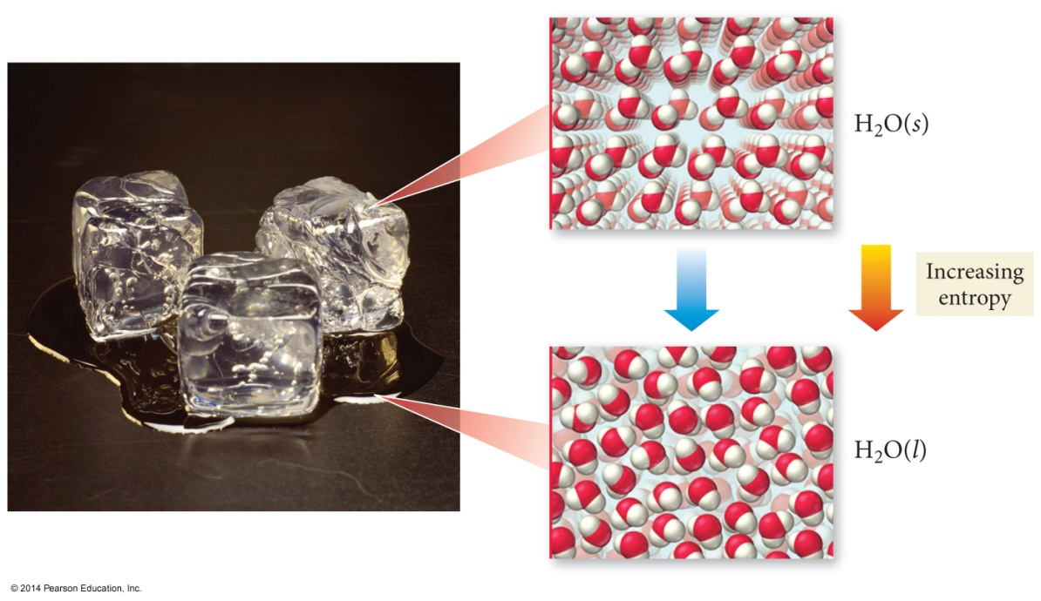
Think About Melting Ice…
When a solid melts, the particles have more freedom of movement.
More freedom of motion increases the randomness of the system. When systems become more random, energy is released. We call this type of energy, entropy.

Slide 10
Keep Thinking About Melting Ice…
Melting is an endothermic process, yet ice will spontaneously melt above 0 °C.
Even though it is endothermic which lends itself towards non-spontaneous, the increase in ENTROPY overcomes this problem, causing the reaction to end up spontaneous!

Slide 11
Enthalpy AND Entropy
There are two factors that determine whether a reaction is spontaneous.
Enthalpy change and the
Entropy change of the system.

Slide 12
Enthalpy Contribution
Enthalpy change, ΔH, - the difference in the sum of the internal energy and pressure/volume work energy of the reactants to the products.

Slide 13
Enthalpy Contribution
Enthalpy change, ΔH, - the difference in the sum of the internal energy and pressure/volume work energy of the reactants to the products.

Slide 14
Quick Enthalpy Review
ΔH generally measured in kJ/mol
Stronger bonds = more stable molecules
A Rxn is generally exothermic if the bonds in the products are stronger than the bonds in the reactants.
Exothermic = energy released; ΔH is negative.

Slide 15
Quick Enthalpy Review
A Rxn is generally endothermic if the bonds in the products are weaker than the bonds in the reactants.
Endothermic = energy absorbed; ΔH is positive.
Enthalpy change is favorable for exothermic rxns and unfavorable for endothermic rxns

Slide 16
Entropy Contribution
Entropy change, ΔS, - the difference in randomness of the reactants compared to the products. The number of “microstate arrangements” possible in a system. More “disorder” means there are more ways to arrange the particles – more microstate arrangements.

Slide 17
Entropy Contribution
Remember permutations in math class? The number of unique combinations you could make out of things like flipping coins? Similar idea!
Now think about a ice cube versus gas particles – those gas particles will be able to arrange themselves in WAY more combinations in 3-dimensional space than the solid particles could in their little cube.

Slide 18
Algebraic Sign on Entropy
Positive ( + ) ∆S Increase in the “microstate arrangements”
Negative ( - ) ∆S Decrease in the “microstate arrangements”
Entropy change is favorable for increase in entropy
and unfavorable for decrease in entropy

Slide 19
Yes…there will be math…yay!
In another PowerPoint we will see the math behind how enthalpy and entropy both contribute to whether something is spontaneous or not – we will be able to see mathematically if a reaction is:
Enthalpy driven – Enthalpy makes it spontaneous
Entropy driven – Entropy makes it spontaneous
Both – Enthalpy and entropy both make it spontaneous
Neither – never spontaneous b/c enthalpy and entropy are both unfavorable.

