Slide 1
KINETICS
Rate Laws

Slide 2
Rate Laws
Differential rate laws - express (reveal) the relationship between concentration of reactants and rate of the reaction.
    The differential rate law is usually just called
    the rate law.
Integrated rate laws express (reveal) the relationship between concentration of reactants and time

Slide 3
Rate Laws
The rate law of a reaction is the mathematical relationship between the rate of the reaction and the concentrations of the reactants and homogeneous catalysts as well.
The rate law must be determined experimentally!
The rate of a reaction is directly proportional to the concentration of each reactant raised to a power.

Slide 4
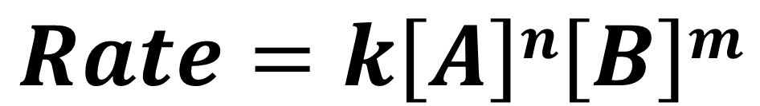
Rate Laws
For the reaction aA + bB → products the rate law would have the form given below.
  Orders of the reactants - n and m
  The rate constant - k
$$Rate=k\left[A\right]n\left[B\right]m$$

Slide 5
Rate Laws
The exponent on each reactant in the rate law is called the order with respect to that reactant.
Order of the reaction - the sum of the exponents on the reactants

Slide 6
Single Step Reactions
The orders do not match the coefficients in the balanced equation UNLESS the reaction happens in one single step.
Not as common as it taking multiple steps.

Slide 7
Single Step Reactions
The following reaction happens in one single step.
2 NO(g) + O₂(g) → 2 NO₂(g)
Rate = k[NO]²[O₂].
The reaction is
      second order with respect to [NO],
      first order with respect to [O₂],
      and third order overall.

Slide 8
Method of Initial Rates
Since we rarely know if a reaction happens in one or more steps, we have to use pattern recognition to figure out what the exponents must be.
  Systematically change the starting [ ]s of the various reactants while holding the [ ] of other reactants the same
  See how the rate changes as you change the [ ]s
      What is the relationship between the rate and the [ ]s ?
      That tells you the exponents!

Slide 9
Writing a (differential) Rate Law
Problem - Write the rate law, determine the value of the rate constant, k, and the overall order for the following reaction:
Method of Initial Rates
2 NO(g) + Cl₂(g) → 2 NOCl(g)
Experiment | [NO] (mol/L) | [Cl₂] (mol/L) | Rate Mol/L·s
1 | 0.250 | 0.250 | 1.43 x 10⁻⁶
2 | 0.500 | 0.250 | 5.72 x 10⁻⁶
3 | 0.250 | 0.500 | 2.86 x 10⁻⁶
4 | 0.500 | 0.500 | 11.4 x 10⁻⁶

Slide 10
Writing a (differential) Rate Law
Part 1 - Determine the values for the exponents in the rate law:
2 NO(g) + Cl₂(g) → 2 NOCl(g)
Rate = k[NO]^{x}[Cl₂]^{y}
Experiment | [NO] (mol/L) | [Cl₂] (mol/L) | Rate Mol/L·s
1 | 0.250 | 0.250 | 1.43 x 10⁻⁶
2 | 0.500 | 0.250 | 5.72 x 10⁻⁶
3 | 0.250 | 0.500 | 2.86 x 10⁻⁶
4 | 0.500 | 0.500 | 11.4 x 10⁻⁶
In experiment 1 and 2, [Cl₂] is constant while [NO] doubles.
Rate quadruples, so the rxn is 2nd order with respect to [NO]
Rate = k[NO]²[Cl₂]^{y}

Slide 11
Writing a (differential) Rate Law
Part 1 - Determine the values for the exponents in the rate law:
2 NO(g) + Cl₂(g) → 2 NOCl(g)
Rate = k[NO]²[Cl₂]^{y}
Experiment | [NO] (mol/L) | [Cl₂] (mol/L) | Rate Mol/L·s
1 | 0.250 | 0.250 | 1.43 x 10⁻⁶
2 | 0.500 | 0.250 | 5.72 x 10⁻⁶
3 | 0.250 | 0.500 | 2.86 x 10⁻⁶
4 | 0.500 | 0.500 | 11.4 x 10⁻⁶
In experiment 2 and 4, [NO] is constant while [Cl₂] doubles.
Rate doubles, so the reaction is first order with respect to [Cl₂]
Rate = k[NO]²[Cl₂]¹

Slide 12
Writing a (differential) Rate Law
Part 2 - Determine the value of the rate constant, k, including units, by using any of the experimental trials – doesn’t matter which one!
2 NO(g) + Cl₂(g) → 2 NOCl(g)
Rate = k[NO]²[Cl₂]¹
Experiment | [NO] (mol/L) | [Cl₂] (mol/L) | Rate Mol/L·s
1 | 0.250 | 0.250 | 1.43 x 10⁻⁶

Slide 13

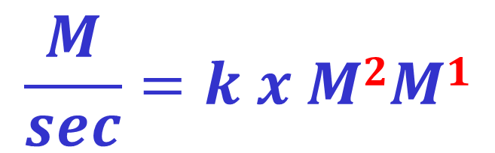

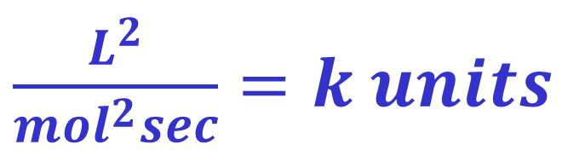
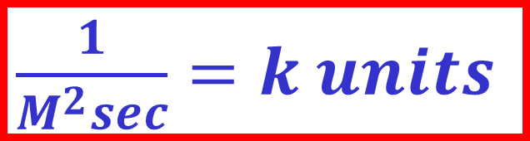
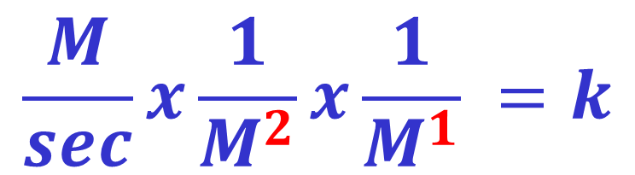
How I like to find the units because I’m lazy ☺
We know the unit for rate is always M/sec, and we know the rate law, and that the units for [ ] is M
Rate = k[NO]²[Cl₂]¹
$\frac{1}{M^{2}sec}=k units$
$$\frac{M}{sec}=k x M2M1$$
$\frac{L^{2}}{{mol}^{2}sec}=k units$
$$\frac{M}{sec}x\frac{1}{M^{2}}x\frac{1}{M^{1}} =k$$
$M^{−2}\sec^{−1}=k units$
$L^{2}{mol}^{−2}\sec^{−1}=k units$

Slide 14
Writing a (differential) Rate Law
Part 3 - Determine the overall order
The sum of the exponents, or orders, of the reactants.
R = k[NO]²[Cl₂]
2
+
1
= 3
∴ The reaction is 3rd order

Slide 15
The Effect of Orders
Rate = k[A]^{n}
If you Double [A]
Order | Effect on Rate
0 | No change
1 | x 2
2 | x 4
3 | x 9
1.5 | x ~2.83
-1 | 0.5
Not common

Slide 16
Integrated Rate Law
For the reaction A → products, the rate law depends on the concentration of A.
Applying calculus to integrate the rate law gives another equation showing the relationship between the concentration of A and the time of the reaction; this is called the integrated rate law.

Slide 17
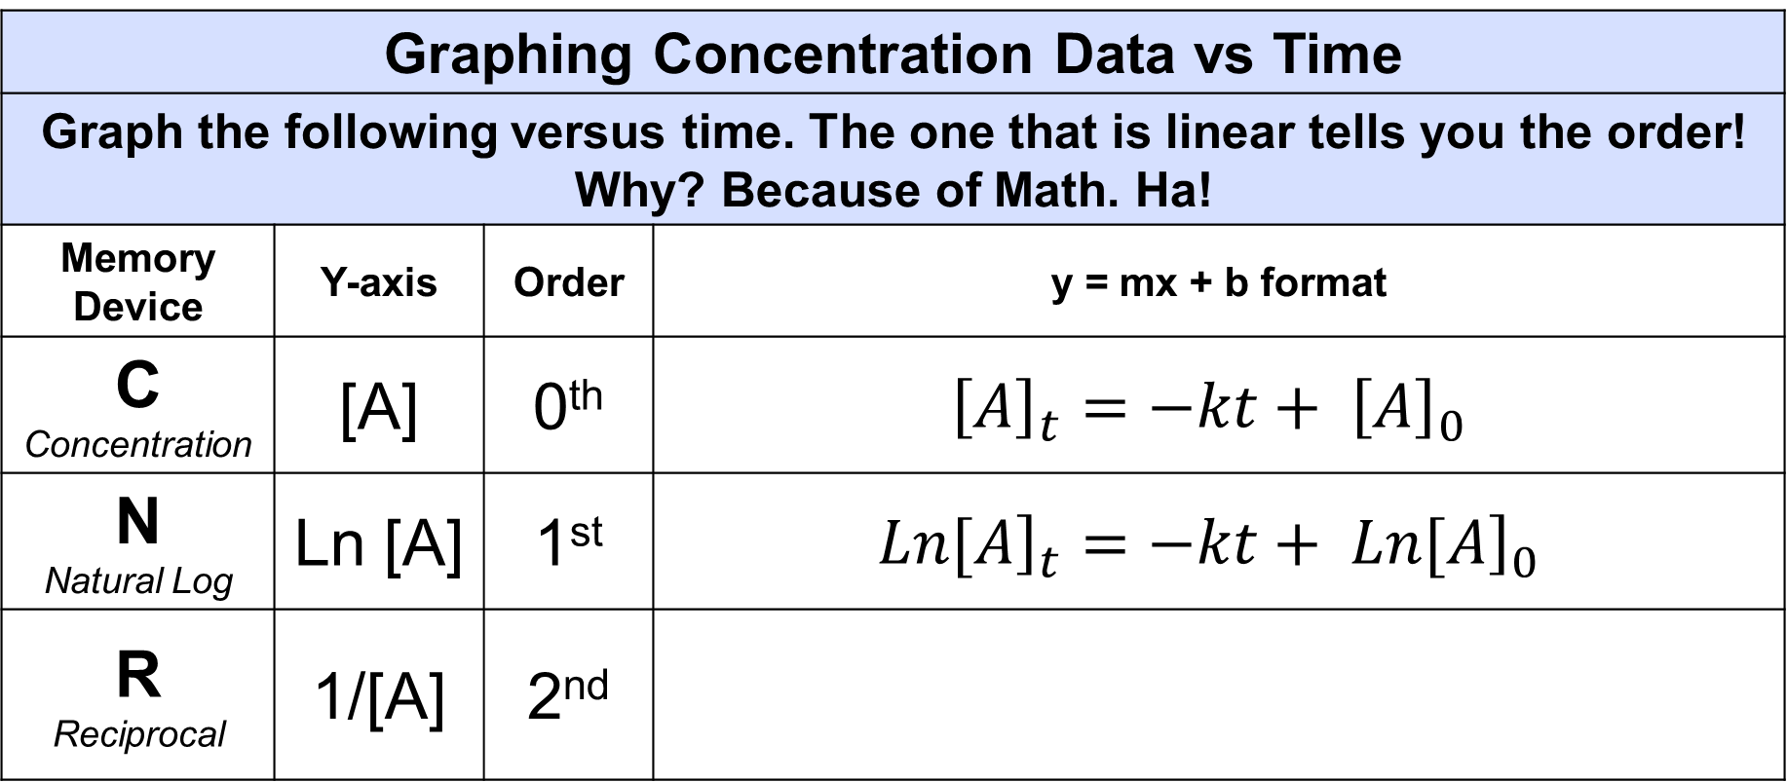
Integrated Rate Law
Graphing Concentration Data vs Time
Graph the following versus time. The one that is linear tells you the order! Why? Because of Math. Ha!
Memory Device | Y-axis | Order | y = mx + b format
C Concentration | [A] | 0th | $${\left[A\right]}_{t}=−kt+ {\left[A\right]}_{0}$$
N Natural Log | Ln [A] | 1st | $${\left.Ln[A\right]}_{t}=−kt+ {\left.Ln[A\right]}_{0}$$
R Reciprocal | 1/[A] | 2nd

Slide 18

Half Life with Integrated Rate Laws
If , then plug into
$${\left[A\right]}_{t}=−kt+ {\left[A\right]}_{0}$$
You get:
For 1st order:
$${\left.Ln[A\right]}_{t}=−kt+ {\left.Ln[A\right]}_{0}$$
You get:
For 2nd order:
You get:

Slide 19
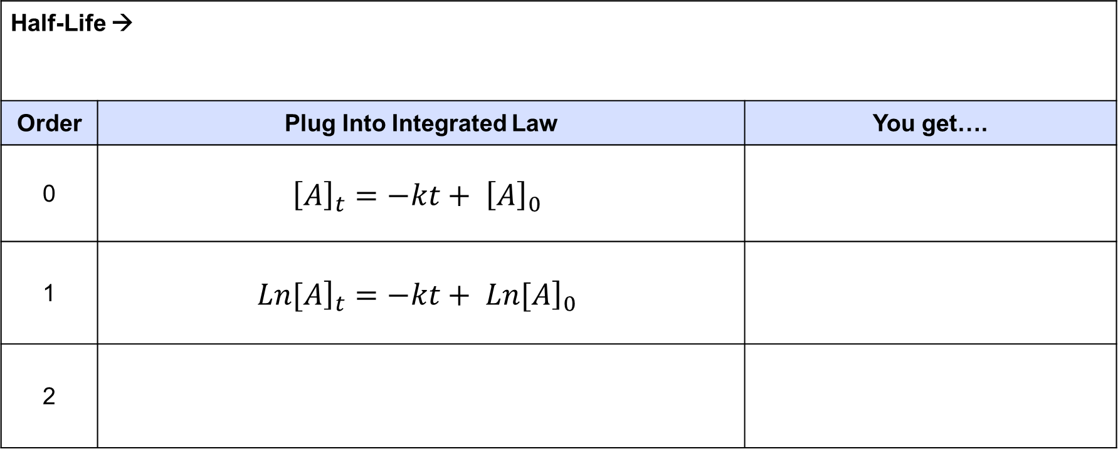
Half Life with Integrated Rate Laws
Half-Life →
Order | Plug Into Integrated Law | You get….
0 | $${\left[A\right]}_{t}=−kt+ {\left[A\right]}_{0}$$
1 | $${\left.Ln[A\right]}_{t}=−kt+ {\left.Ln[A\right]}_{0}$$
2

Slide 20
Relationship Between [ ] and ½ Life
0th Order -Lower the initial [ ] of reactants, the shorter the half-life.
  t_{1/2} = [A]_{init}/2k
1st Order - Half-life is independent of the concentration.
– Closest to true half-life
  t_{1/2} = ln(2)/k
2nd Order - Half-life is inversely proportional to the initial [ ] increasing the initial concentration shortens the half-life.
  t_{1/2} = 1/(k[A]_{init})

Slide 21
Graphical Determination of Rate Law
X-axis = Time
Order | Memory Device |  | Y-Axis
0 | C | Concentration | [ A ]
1 | N | Natural Logarithm | ln [ A ]
2 | R | Reciprocal | 1 [ A ]
Whichever plot gives a straight line determines the order with respect to [A].
  If linear is [A] versus time, Rate = k[A]⁰.
  If linear is ln[A] versus time, Rate = k[A]¹.
  If linear is 1/[A] versus time, Rate = k[A]².

Slide 22
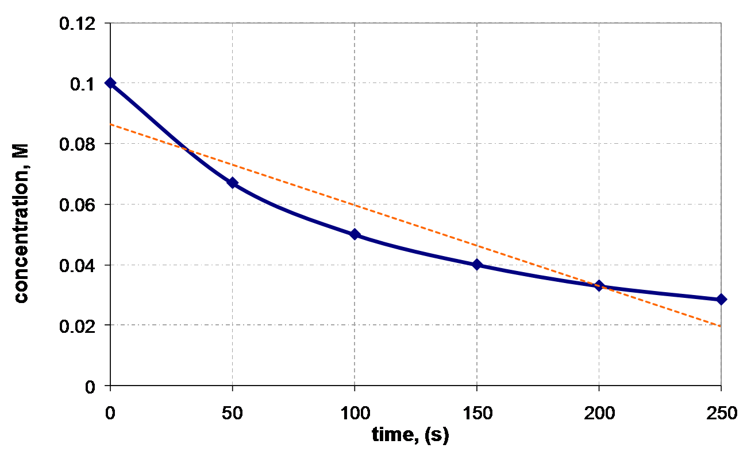
[ A ] vs. Time

Slide 23
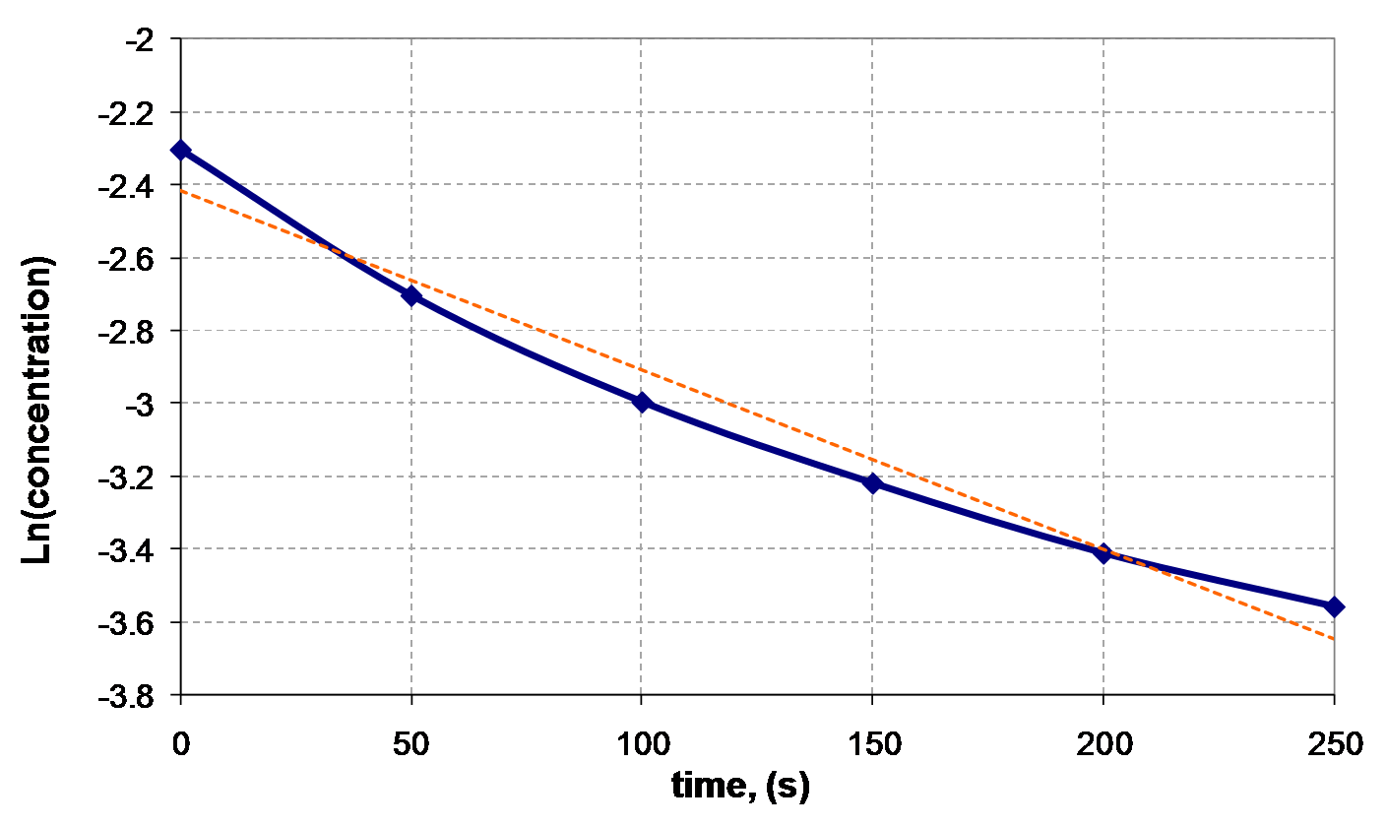
Ln [A] vs. Time

Slide 24
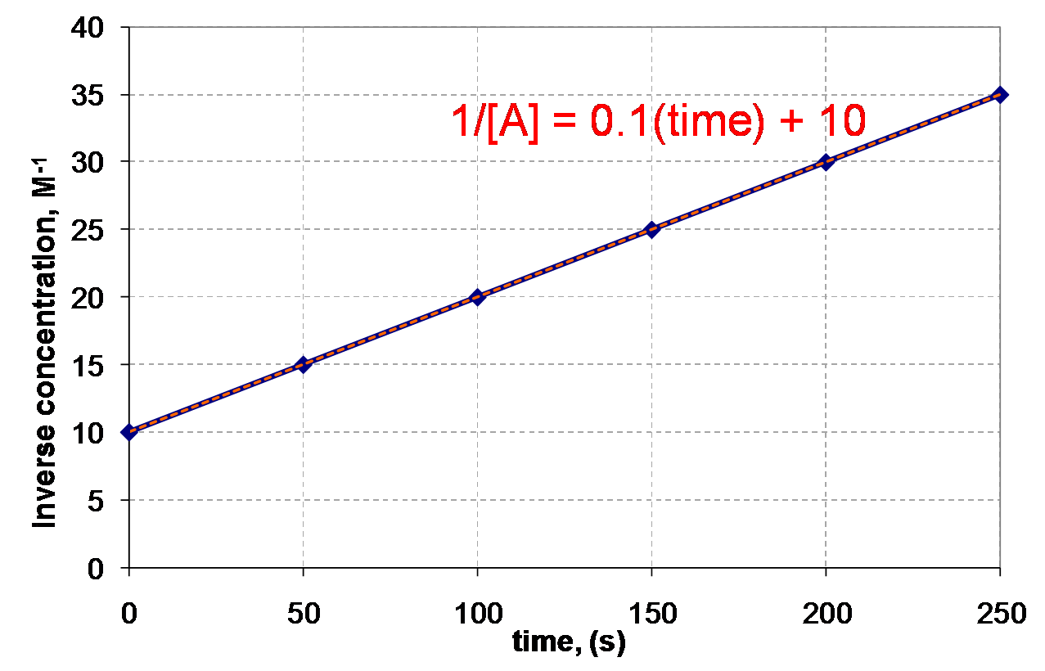
1 / [A] vs. Time
R² = 0.999
R² tells you how good your of a fit your line is – perfect is
R2 = 1. The closer to 1 the better the fit!

Slide 25
Solving an Integrated Rate Law
Time (s) | [H₂O₂] (mol/L)
0 | 1.00
120 | 0.91
300 | 0.78
600 | 0.59
1200 | 0.37
1800 | 0.22
2400 | 0.13
3000 | 0.082
3600 | 0.050
Problem: Find the integrated rate law and the value for the rate constant, k
Excel or a graphing calculator really help! Here is an Excel sheet I made to make the graphs. https://tinyurl.com/excel-kinetics
You can download Rate Law programs for the various brands/models of graphing calculators too.

Slide 26
Time vs. [H₂O₂]
Time (s) | [H₂O₂]
0 | 1.00
120 | 0.91
300 | 0.78
600 | 0.59
1200 | 0.37
1800 | 0.22
2400 | 0.13
3000 | 0.082
3600 | 0.050
Regression results:
y = ax + b
a = -2.64 x 10⁻⁴
b = 0.841
r² = 0.8891

Slide 27
Time vs. ln[H₂O₂]
Time (s) | ln[H₂O₂]
0 | 0
120 | -0.0943
300 | -0.2485
600 | -0.5276
1200 | -0.9943
1800 | -1.514
2400 | -2.04
3000 | -2.501
3600 | -2.996
Regression results:
y = ax + b
a = -8.35 x 10⁻⁴
b = -.005
r² = 0.99978

Slide 28
Time vs. 1/[H₂O₂]
Time (s) | 1/[H₂O₂]
0 | 1.00
120 | 1.0989
300 | 1.2821
600 | 1.6949
1200 | 2.7027
1800 | 4.5455
2400 | 7.6923
3000 | 12.195
3600 | 20.000
Regression results:
y = ax + b
a = 0.00460
b = -0.847
r² = 0.8723

Slide 29
And the winner is… Time vs. ln[H₂O₂]
1. As a result, the reaction is 1st order
2. The (differential) rate law is:
3. The integrated rate law is:
4. But…what is the rate constant, k ?

Slide 30
Finding the Rate Constant, k
Method #1: Calculate the slope from the Time vs. ln[H₂O₂] table.
Time (s) | ln[H₂O₂]
0 | 0
120 | -0.0943
300 | -0.2485
600 | -0.5276
1200 | -0.9943
1800 | -1.514
2400 | -2.04
3000 | -2.501
3600 | -2.996
Now remember:
∴ k = -slope
k = 8.32 x 10⁻⁴ s⁻¹

Slide 31
Finding the Rate Constant, k
Method #2: Obtain k from the linear regresssion analysis.
Regression results:
Now remember:
y = ax + b
a = -8.35 x 10⁻⁴
b = -.005
r² = 0.99978
∴ k = -slope
k = 8.35 x 10⁻⁴s⁻¹

Slide 32
1st Order – Integrated Rate Law
ln[A]_{initial}
Slope = −k
ln[A]
Time

Slide 33
2nd Order – Integrated Rate Law
1/[A]
Slope = k
1/[A]_{initial}
Time

Slide 34
Integrated Rate Laws w/ more than 1 reactant
Examine rate w/ one reactant very low [ ] and the others much higher
Rate = k[A]^{n}[B]^{m}[C]^{p}
  If [B]> >[A] and [C] > >[A] then [B] and [C] do not change as much relative to [A] so…they don’t really matter!
  Rate = k'[A]^{n}
Pseudo-first-order rate law (or zero-order , or second-order)
  Simplification yields a rate law of a particular order
  The Prime means pseudo

