Slide 1
KINETICS
Mechanisms

Slide 2
Rate Laws
Reaction Mechanism - The series of elementary steps by which a chemical reaction occurs.

Slide 3
Rate Laws
To validate (not prove) a mechanism, two conditions must be met:
1. The elementary steps must sum to the overall reaction.
The rate law predicted by the mechanism must be consistent with the experimentally observed rate law.
Elementary Steps = individual, single steps

Slide 4
Rate Laws
Rate Determining Step - the slowest step in the reaction mechanism It therefore determines the rate of the reaction.
The experimental rate law must agree with the rate-determining step!

Slide 5
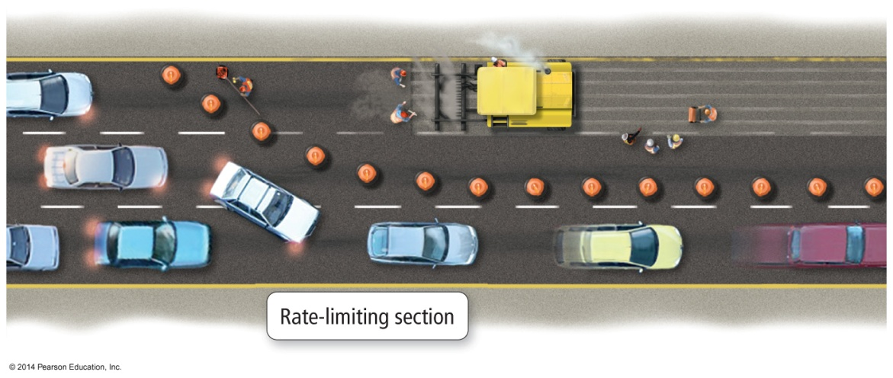
Rate Laws
In most mechanisms, one step occurs slower than the other steps.
The result is that product production cannot occur any faster than the slowest step; the step determines the rate of the overall reaction.
We call the slowest step in the mechanism the rate determining step.
The slowest step has the largest activation energy.
The rate law of the rate determining step determines the rate law of the overall reaction.

Slide 6
Identifying the Rate-Determining Step
2H₂(g) + 2NO(g) → N₂(g) + 2H₂O(g)
The experimental rate law is:
R = k[NO]²[H₂]
Which step in the rxn mechanism is the rate-determining step?
Step #1 H₂(g) + 2NO(g) → N₂O(g) + H₂O(g)
Step #2 N₂O(g) + H₂(g) → N₂(g) + H₂O(g)
Step #1 agrees with the experimental rate law

Slide 7
Identifying Intermediates
2H₂(g) + 2NO(g) → N₂(g) + 2H₂O(g)
Which species in the rxn mechanism are intermediates – substances that are made during one step of the mechanism and then get used up – they do not show up in the final, balanced equation because they were not an original reactant, or a final product.
Step #1 H₂(g) + 2NO(g) → N₂O(g) + H₂O(g)
Step #2 N₂O(g) + H₂(g) → N₂(g) + H₂O(g)
2H₂(g) + 2NO(g) → N₂(g) + 2H₂O(g)
∴ N₂O(g) is an intermediate

Slide 8
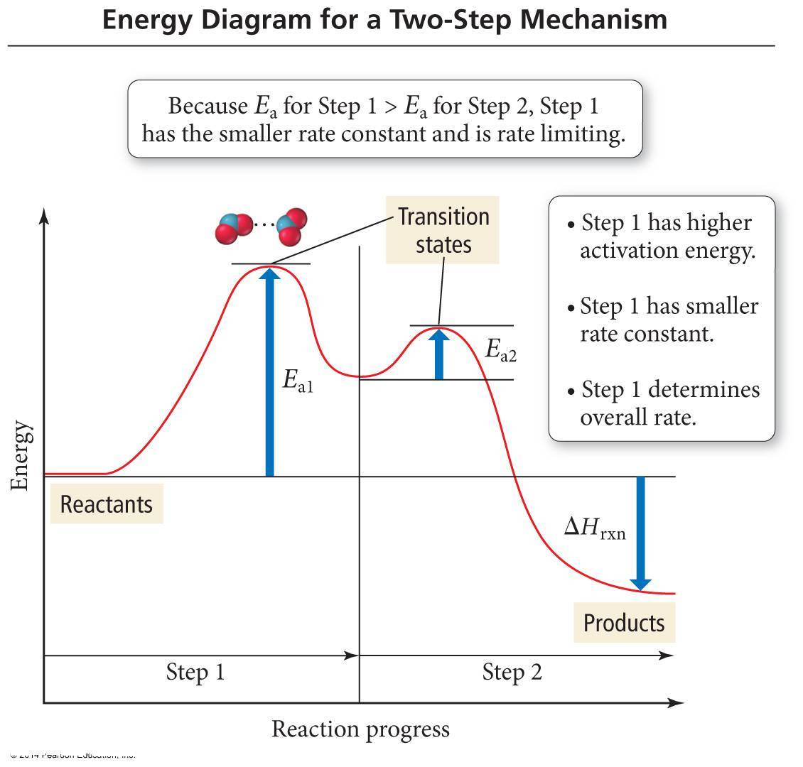
Another Reaction Mechanism
NO_{2(g)} + CO_{(g)} → NO_{(g)} + CO_{2(g)} Rate_{obs} = k[NO₂]2
1. NO_{2(g)} + NO_{2(g)} → NO_{3(g)} + NO_{(g)} Rate = k₁[NO₂]2 Slow
2. NO_{3(g)} + CO_{(g)} → NO_{2(g)} + CO_{2(g)} Rate = k₂[NO₃][CO] Fast
The first step is slower than the second step because its activation energy is larger.
The first step in this mechanism is the rate determining step.
The rate law of the first step is the same as the rate law of the overall reaction.

Slide 9
Mechanism with a Fast Final Step
When a mechanism contains a fast initial step, the rate limiting step may contain intermediates.
When a previous step is rapid and reaches equilibrium, the forward and reverse reaction rates are equal, so the concentrations of reactants and products of the step are related and the product is an intermediate.
Substituting into the rate law of the RDS will produce a rate law in terms of just reactants.

Slide 10
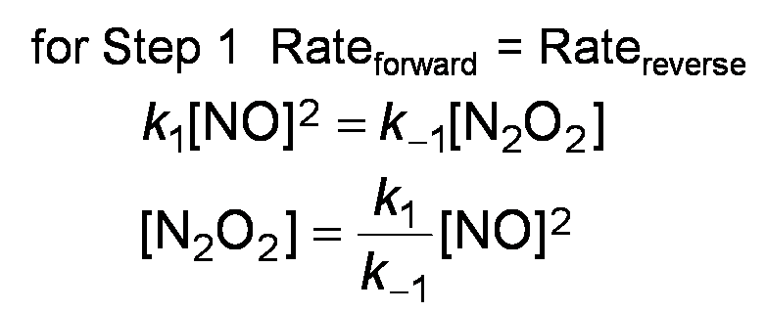

A (not so fun) Game of Substitution! Note: for each elementary step, coeff. = orders
k₁
2 NO_{(g)} ⇔ N₂O_{2(g)} Fast
H_{2(g)} + N₂O_{2(g)} → H₂O_{(g)} + N₂O_{(g)} Slow Rate = k₂[H₂][N₂O₂]
H_{2(g)} + N₂O_{(g)} → H₂O_{(g)} + N_{2(g)} Fast
k₋₁
2 H_{2(g)} + 2 NO_{(g)} → 2 H₂O_{(g)} + N_{2(g)} Rate_{obs} = k [H₂][NO]2
$$Rate=k_{2}\left[H_{2}\right]\left[N_{2}O_{2}\right]$$
$$Rate= k_{2}\left[H_{2}\right]\frac{k_{1}}{k_{−1}}{[NO]}^{2}$$
$$Rate= \frac{k_{2}k_{1}}{k_{−1}}\left[H_{2}\right]{\left[NO\right]}^{2}$$
Now plug this in anywhere you see [N₂O₂] in the slow step rate law!

