Slide 1
N10 - KINETICS
Mechanisms
Link to YouTube Presentation: https://youtu.be/elfsdYUnk8E

Slide 2
N10 - KINETICS
Mechanisms
Target: I can use rate laws to determine the slow step in a reaction, and can write rate laws based on reaction mechanism information.

Slide 3
Rate Laws
Reaction Mechanism
The series of elementary steps by which a chemical reaction occurs.
Elementary Steps = individual, single steps

Slide 4
Rate Laws
To validate (not prove) a mechanism, two conditions must be met:
1. The elementary steps must sum to the overall balanced equation (sometimes called the “stoichiometric equation.”)
The rate law predicted by the mechanism must be consistent with the experimentally observed rate law.

Slide 5
Rate Laws
Rate Determining Step
The slowest step in the reaction mechanism.
It therefore determines the rate of the reaction.
The experimental rate law must agree with the rate-determining step!

Slide 6
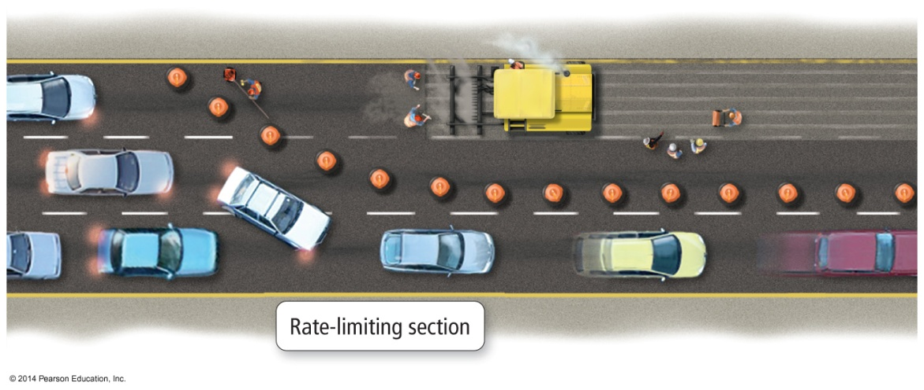
Rate Laws
In most mechanisms, one step occurs slower than the other steps.
The result is that product production cannot occur any faster than the slowest step; the step determines the rate of the overall reaction.
We call the slowest step in the mechanism the rate determining step.
The slowest step has the largest activation energy.
The rate law of the rate determining step determines the rate law of the overall reaction.

Slide 7
Can’t go faster than the slowest step!
https://youtu.be/NkQ58I53mjk

Slide 8
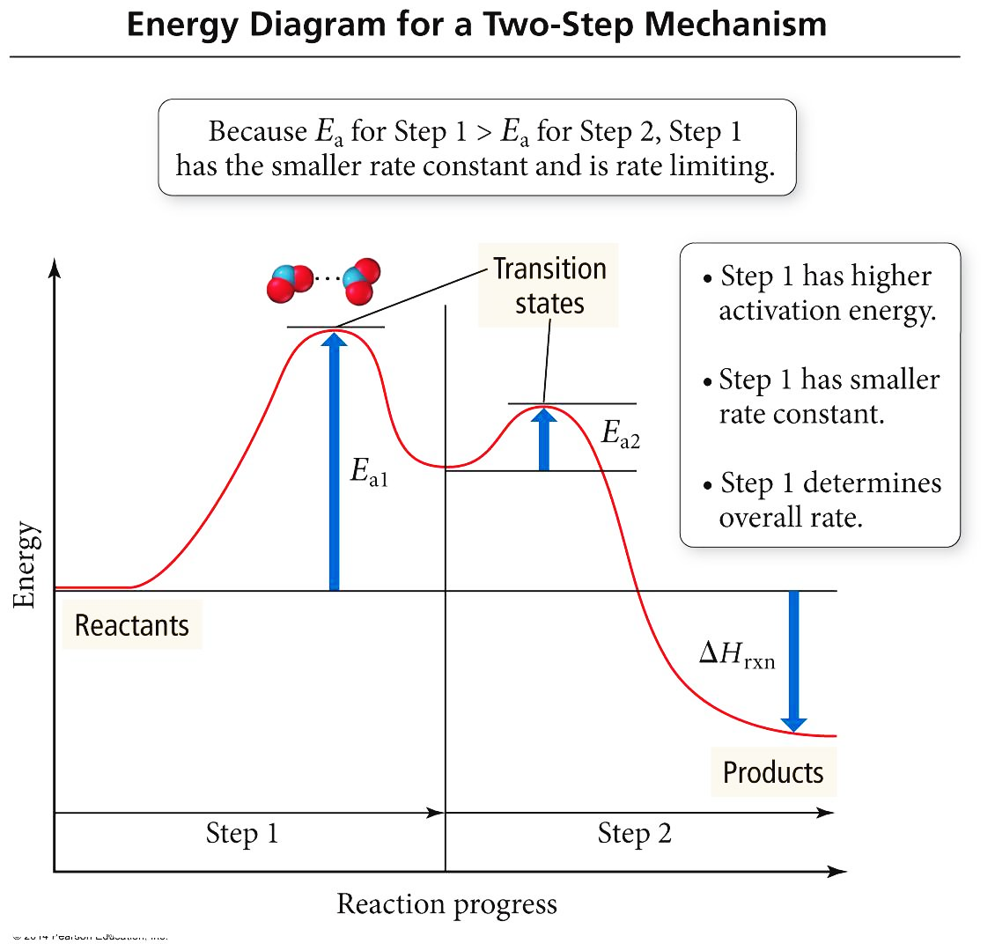
Another Reaction Mechanism
1
NO_{2(g)} + CO_{(g)} → NO_{(g)} + CO_{2(g)} Rate_{obs} = k[NO₂]2
1. NO_{2(g)} + NO_{2(g)} → NO_{3(g)} + NO_{(g)} Rate = k₁[NO₂]2 Slow
2. NO_{3(g)} + CO_{(g)} → NO_{2(g)} + CO_{2(g)} Rate = k₂[NO₃][CO] Fast
The first step is slower than the second step because its activation energy is larger.
The first step in this mechanism is the rate determining step.
The rate law of the first step is the same as the rate law of the overall reaction.

Slide 9
Identifying the Rate-Determining Step
2
2H₂(g) + 2NO(g) → N₂(g) + 2H₂O(g)
The experimental rate law is:
R = k[NO]² [H₂]
Which step in the rxn mechanism is the rate-determining step?
Step #1 H₂(g) + 2NO(g) → N₂O(g) + H₂O(g)
Step #2 N₂O(g) + H₂(g) → N₂(g) + H₂O(g)
Step #1 agrees with the experimental rate law

Slide 10
Identifying Intermediates
2H₂(g) + 2NO(g) → N₂(g) + 2H₂O(g)
Intermediates – substances that are made during one step of the mechanism and then get used up
– they do not show up in the final, balanced equation because they were not an original reactant, or a final product.
Step #1 H₂(g) + 2NO(g) → N₂O(g) + H₂O(g)
Step #2 N₂O(g) + H₂(g) → N₂(g) + H₂O(g)
2H₂(g) + 2NO(g) → N₂(g) + 2H₂O(g)
∴ N₂O(g) is an intermediate

Slide 11
Mechanism with a Fast Initial Step
We don’t like reaction rates to have intermediates in them. So we will rearrange/substitute to write it without them.
When a mechanism contains a fast initial step, the rate limiting step may contain intermediates.
When a previous step is rapid and reaches equilibrium, the forward and reverse reaction rates are equal, so the concentrations of reactants and products of the step are related and the product is an intermediate.
Substituting into the rate law of the RDS will produce a rate law in terms of just reactants.

Slide 12
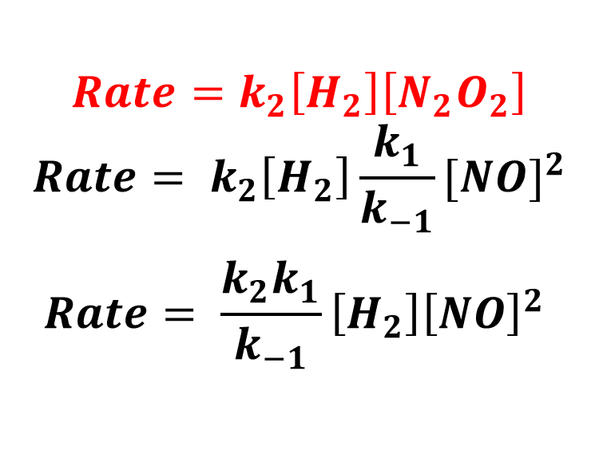
A (not so fun) Game of Substitution! Note: for each elementary step, coeff. = orders
3
k₁
2 NO_{(g)} ⇔ N₂O_{2(g)} Fast
H_{2(g)} + N₂O_{2(g)} → H₂O_{(g)} + N₂O_{(g)} Slow Rate = k₂[H₂][N₂O₂]
H_{2(g)} + N₂O_{(g)} → H₂O_{(g)} + N_{2(g)} Fast
k₋₁
2 H_{2(g)} + 2 NO_{(g)} → 2 H₂O_{(g)} + N_{2(g)} Rate_{obs} = k [H₂][NO]2
$$Rate=k_{2}\left[H_{2}\right]\left[N_{2}O_{2}\right]$$
$$Rate= k_{2}\left[H_{2}\right]\frac{k_{1}}{k_{−1}}{[NO]}^{2}$$
$$Rate= \frac{k_{2}k_{1}}{k_{−1}}\left[H_{2}\right]{\left[NO\right]}^{2}$$
$$For Step 1, {Rate}_{forward}={Rate}_{reverse}$$
$$k_{1}{[NO]}^{2}=k_{−1}\left[N_{2}O_{2}\right]$$
$$\left[N_{2}O_{2}\right]=\frac{k_{1}}{k_{−1}}{[NO]}^{2}$$
Now plug this in anywhere you see [N₂O₂] in the slow step rate law!
k’

Slide 13
YouTube Link to Presentation
https://youtu.be/elfsdYUnk8E

