Slide 1
N11 - KINETICS
Collision Theory and More
Link to YouTube Presentation: https://youtu.be/OgoI25FK9_M

Slide 2
N11 - KINETICS
Collision Theory and More
Target: I can use Collision Theory to describe how factors like temperature, concentration, and catalysts affect the speed of a reaction.

Slide 3
Rate Laws
Reaction Mechanism
The series of elementary steps by which a chemical reaction occurs.

Slide 4
Collision Model
Key Idea: Molecules must collide to react.
However, only a small fraction of collisions produces a reaction. Why?

Slide 5
Collision Model
Collisions must have sufficient energy to produce the reaction (must equal or exceed the activation energy).
Colliding particles must be correctly oriented to one another in order to produce a reaction.

Slide 6
Molecularity
The # of species that must collide to produce the rxn indicated by that step
Unimolecular step - a reaction involving one molecule
Bimolecular step - reaction involving the collisions of two species
Termolecular step - reaction involving the collisions of three species
Elementary Step | Molecularity | Rate Law
A → products | Unimolecular | Rate = k[A]
A + A → products (2A → products) | Bimolecular | Rate = k[A]²
A + B → products |  | Rate = k[A][B]
A + A + B → products (2A + B → products) | Termolecular | Rate = k[A]²[B]
A + B + C → products |  | Rate = k[A][B][C]

Slide 7
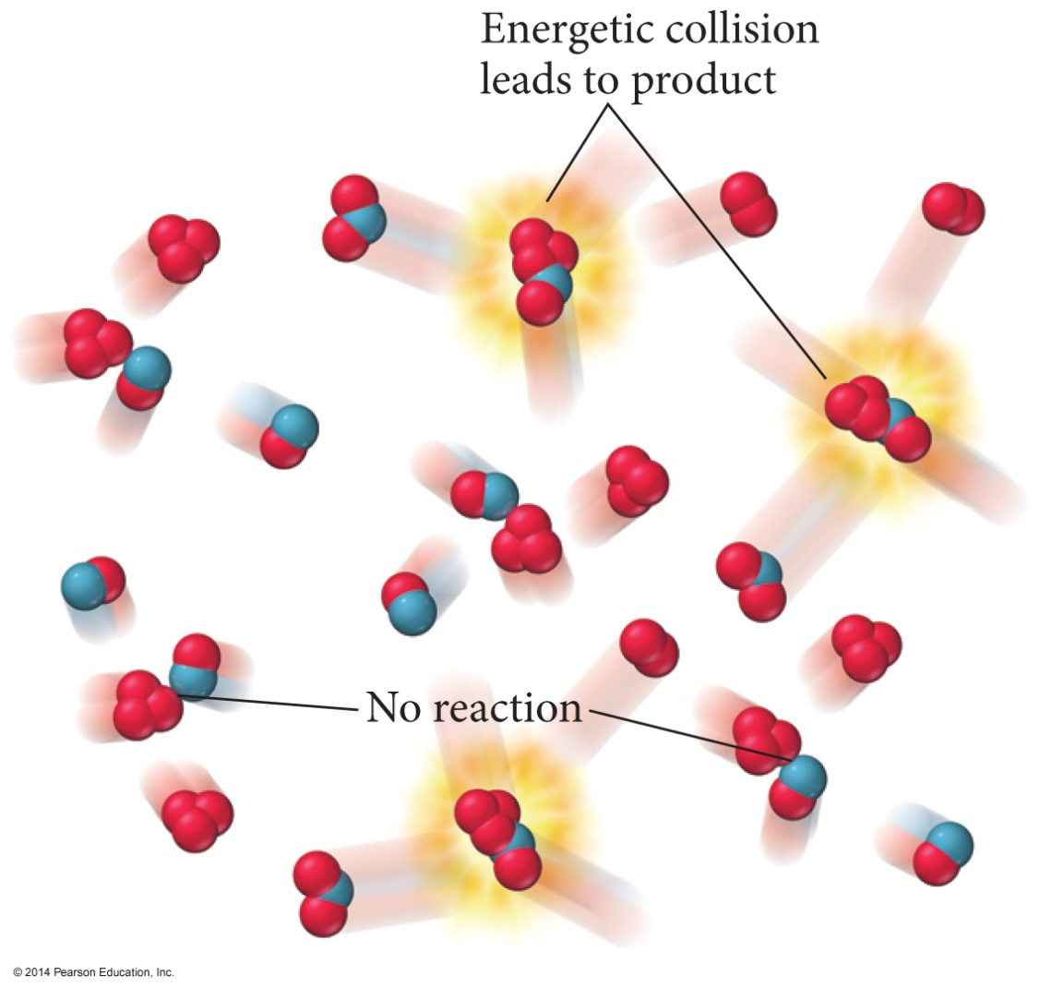
Effective Collisions- Kinetic Energy Factor
For a collision to lead to overcoming the energy barrier, the reacting molecules must have sufficient kinetic energy so that when they collide the activated complex can form.

Slide 8
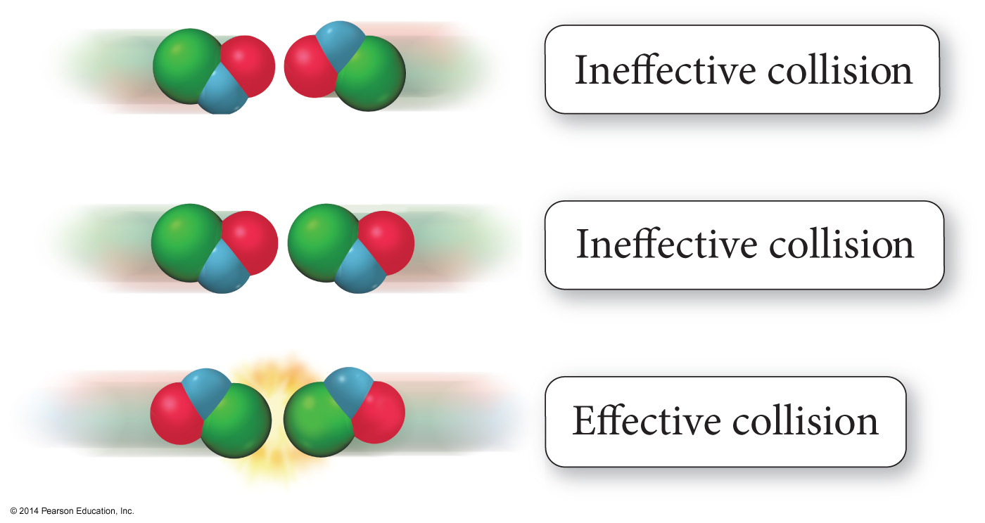
Effective Collisions - Orientation Factor

Slide 9
Molecular Interpretation of Factors Affecting the Rate – Reactant Nature
Reactions generally occur faster in solution than in pure substances.
Mixing gives more particle contact.
Particles are separated, allowing more effective collisions per second.
Forming some solutions breaks bonds that need to be broken.

Slide 10
Molecular Interpretation of Factors Affecting the Rate – Reactant Nature
Some materials undergo similar reactions at different rates either because they have a
1) Higher initial potential energy and are therefore closer in energy to the activated complex, or
2) Because their reaction has a lower activation energy.
CH₄ + Cl₂ → CH₃Cl + HCl is about 12 times faster than
CD₄ + Cl₂ → CD₃Cl + DCl because the C─H bond is weaker and less stable than the C─D bond.
CH₄ + X₂ → CH₃X + HX occurs about 100x faster with F₂ than Cl₂ because the A_{E} for F₂ is 5 kJ/mol, but for Cl₂ is 17 kJ/mol.

Slide 11
Molecular Interpretation of Factors Affecting the Rate – Concentration
Reaction rate generally increases as the concentration or partial pressure of reactant molecules increases.
Except for zero order reactions
More molecules leads to more molecules with sufficient kinetic energy for effective collision.
Distribution the same, just bigger curve

Slide 12
Molecular Interpretation of Factors Affecting the Rate – Temperature
Increasing the temperature raises the average kinetic energy of the reactant molecules.
There is a minimum amount of kinetic energy needed for the collision to be converted into enough potential energy to form the activated complex.
Increasing the temperature increases the number of molecules with sufficient kinetic energy to overcome the activation energy.

Slide 13
Effect of Temperature on Rate
Changing the temperature changes the rate constant of the rate law.
Svante Arrhenius investigated this relationship and showed the following:
$$k=Ae^{\left(\frac{−Ea}{RT}\right)}$$
T = temperature in kelvins.
R = gas constant in energy units, 8.314 J/(mol · K).
A = called the frequency factor, the rate the reactant energy approaches the Ea
E_{a} = activation energy, the extra energy needed to start the molecules reacting.

Slide 14
The Arrhenius Equation Rearranged
Simplifies solving for E_{a}
-E_{a} / R is the slope when graphing ln(k) vs. (1/T)
ln(A) is the y-intercept
Graphing ln(k) vs (1/T) and taking line of best fit can quickly yield a slope

Slide 15
Arrhenius Equation – Two Point Format
If you only have two (T, k) data points, the following form of the Arrhenius equation can be used:
Or...
$$ln\left(\frac{k_{2}}{k_{1}}\right)=\frac{E_{a}}{R}\left(\frac{1}{T_{1}}−\frac{1}{T_{2}}\right)$$
$$ln\left(\frac{k_{2}}{k_{1}}\right)=\frac{−E_{a}}{R}\left(\frac{1}{T_{2}}−\frac{1}{T_{1}}\right)$$

Slide 16
Arrhenius Equation – Exponential Factor
$$k=Ae^{\left(\frac{−Ea}{RT}\right)}$$
The exponential factor in the Arrhenius equation is a number between 0 and 1.
Represents the fraction of reactant molecules with sufficient energy so they can make it over the energy barrier.
The higher the energy barrier (larger E_{A}), the fewer molecules that have sufficient energy to overcome it.
That extra energy comes from converting the kinetic energy of motion to potential energy in the molecule when the molecules collide.
Increasing the temp increases the average kinetic energy of the molecules.
Therefore, increasing the temp will increase the number of molecules with sufficient energy to overcome the energy barrier.
Therefore, increasing the temperature will increase the reaction rate.

Slide 17
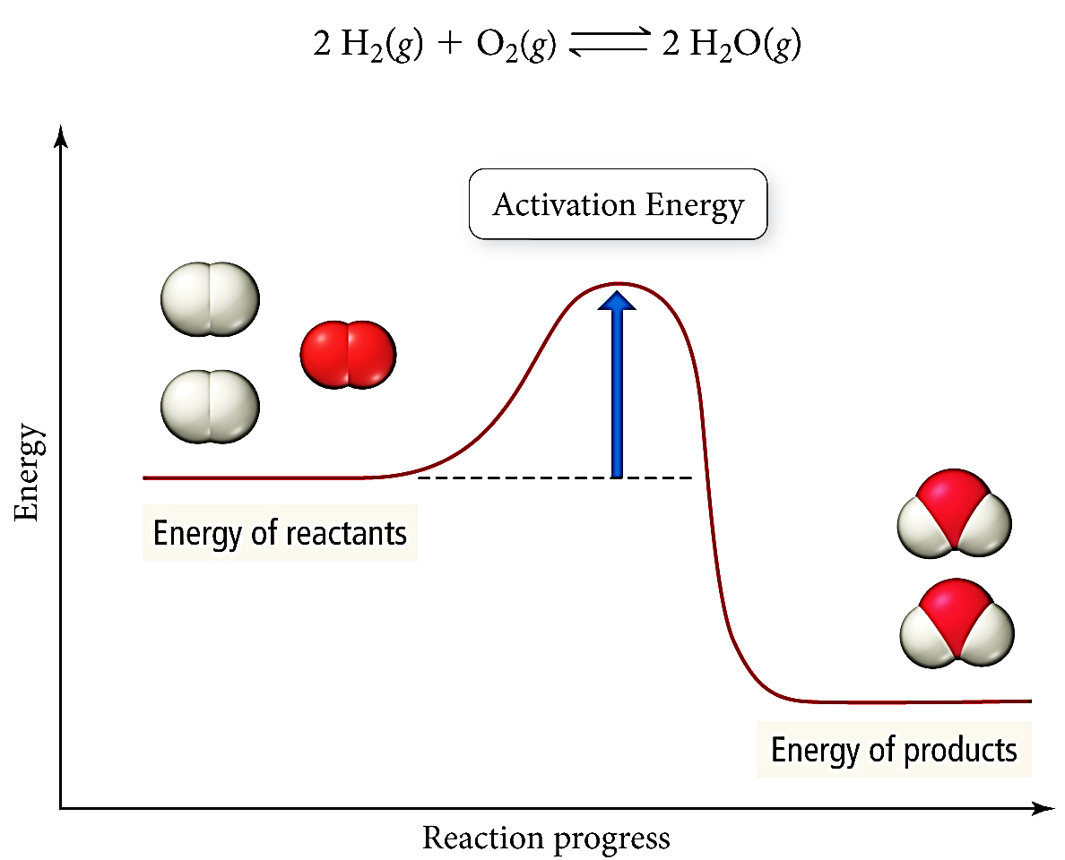
Activation Energy

Slide 18
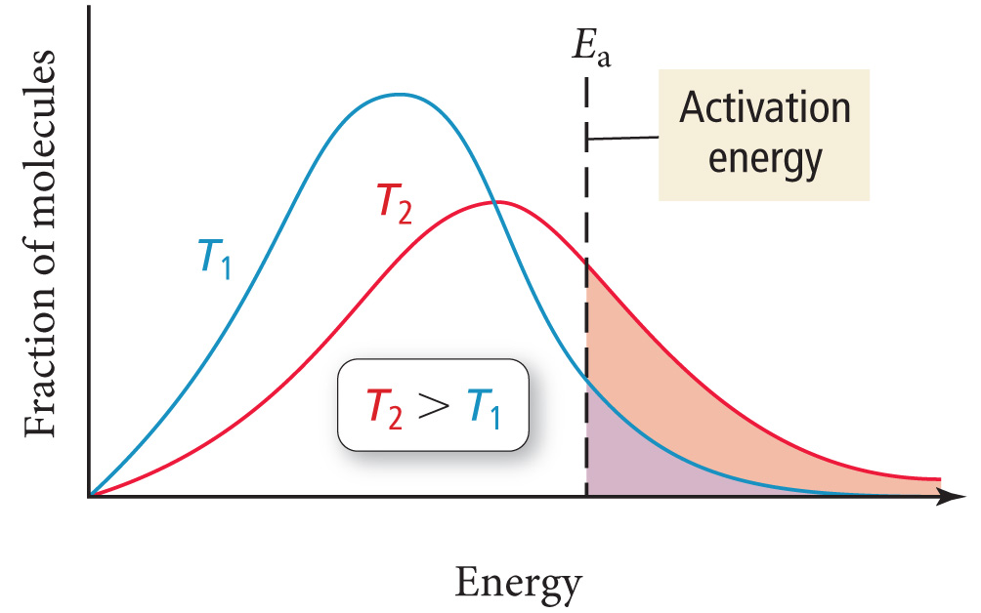
Thermal Energy Distribution
As temperature increases, the fraction of molecules with enough energy to surmount the activation energy barrier also increases.

Slide 19
Catalysts
Catalyst - A substance that speeds up a reaction without being consumed during the reaction.
Enzyme - A large molecule (usually a protein) that catalyzes biological reactions.
Homogeneous catalyst - Present in the same phase as the reacting molecules.
Heterogeneous catalyst - Present in a different phase than the reacting molecules.

Slide 20
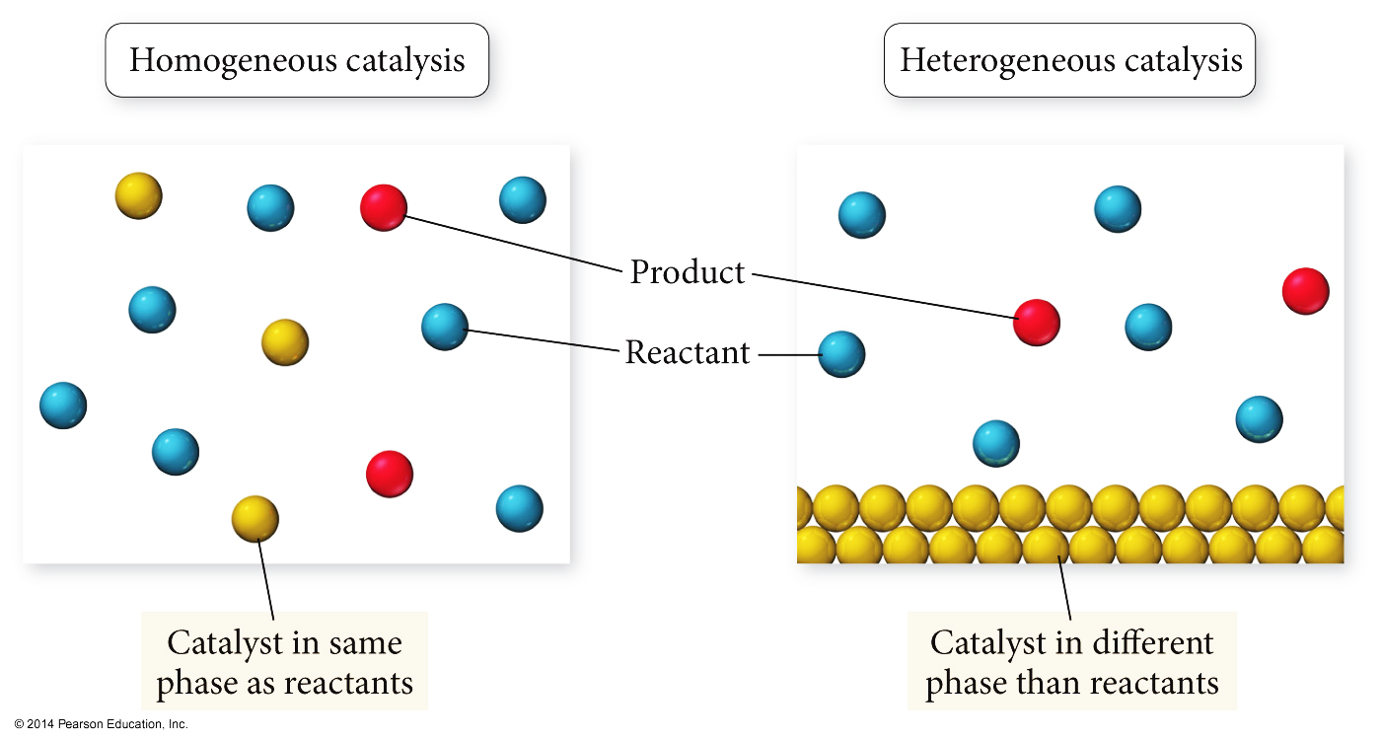
Types of Catalysts

Slide 21
Catalysts
Catalysts work by providing an alternative mechanism for the reaction with a lower activation energy.
Catalysts are consumed in an early mechanism step, and then re-made in a later step.
Mechanism without catalyst:
O_{3(g)} + O_{(g)} → 2 O_{2(g)} Very Slow
Mechanism with catalyst:
Cl_{(g)} + O_{3(g)} ⇔ O_{2(g)} + ClO_{(g)} Fast
ClO_{(g)} + O_{(g)} → O_{2(g)} + Cl_{(g)} Slow

Slide 22
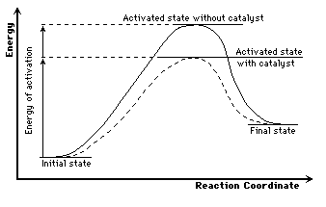
Lowering of E_{A} by a Catalyst

Slide 23
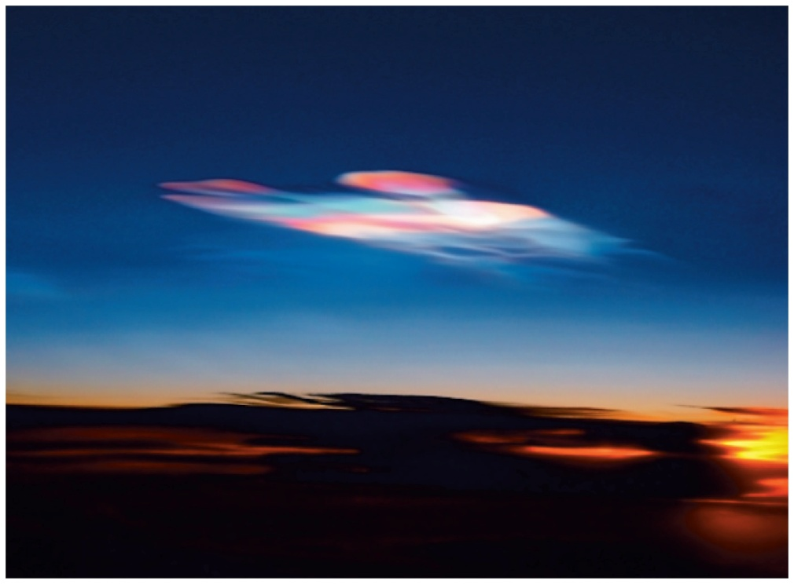
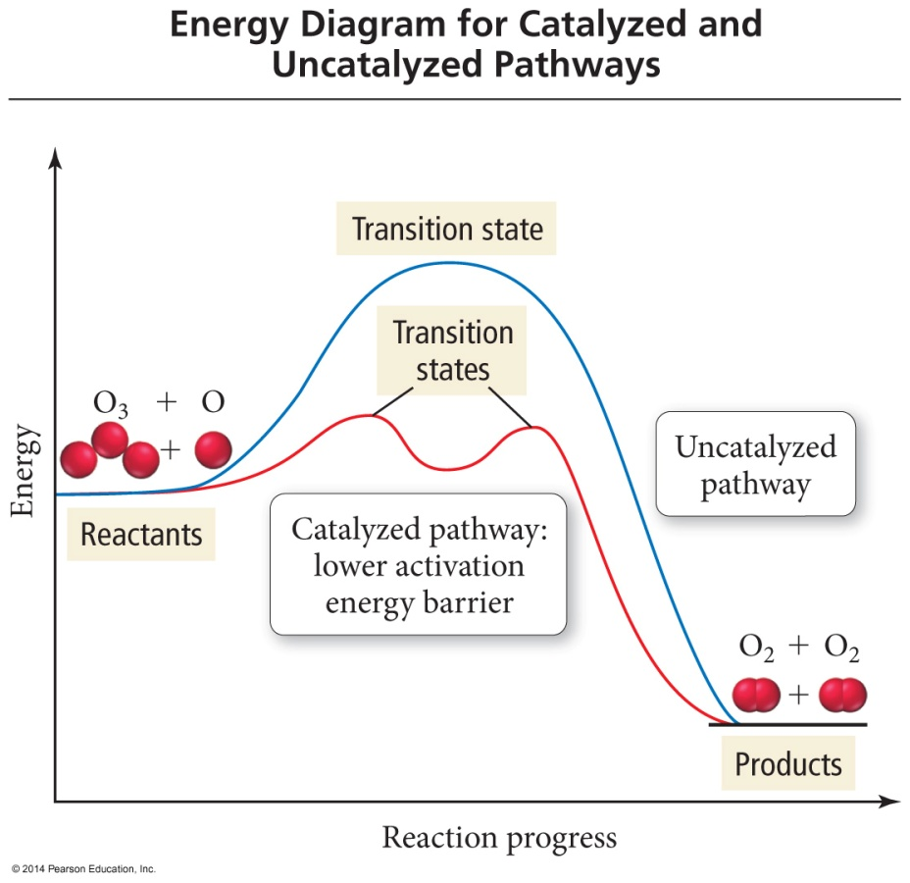
Energy Profile of a Catalyzed Reaction
Polar stratospheric clouds contain ice crystals that catalyze reactions that release Chlorine from atmospheric chemicals.

Slide 24
Catalysts Increase the # of Effective Collisions

Slide 25
Molecular Interpretation of Factors Affecting the Rate – Catalysts
Give reactant molecules a different path to follow w/ lower E_{A}.
Homogeneous catalysts react with one of the reactant molecules to form a more stable activated complex with a lower activation energy.
Heterogeneous catalysts hold one reactant molecule in proper orientation for reaction to occur when the collision takes place.
Sometimes they also help to start breaking bonds.

Slide 26
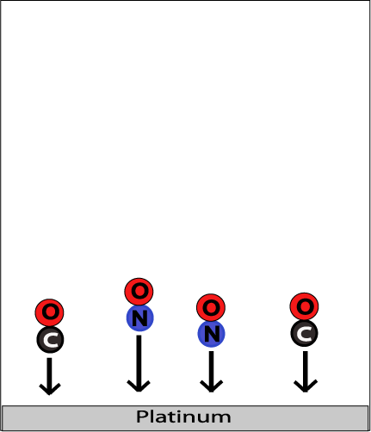
Heterogeneous Catalysts
Carbon monoxide and nitrogen monoxide adsorbed on a platinum surface
Step #1:
Adsorption and activation of the reactants.

Slide 27
Heterogeneous Catalysts
Carbon monoxide and nitrogen monoxide arranged prior to reacting
Step #2:
Migration of the adsorbed reactants on the surface.

Slide 28
Heterogeneous Catalysts
Carbon dioxide and nitrogen form from previous molecules
Step #3:
Reaction of the adsorbed substances.

Slide 29
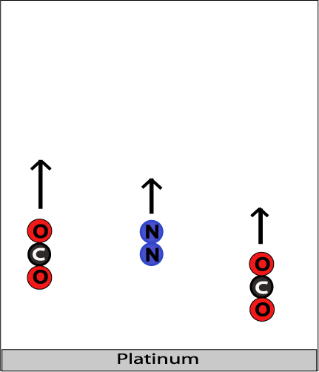
Heterogeneous Catalysts
Carbon dioxide and nitrogen gases escape (desorb) from the platinum surface
Step #4:
Escape, or desorption, of the products.

Slide 30
YouTube Link to Presentation
https://youtu.be/OgoI25FK9_M

