Slide 1
N8 - KINETICS
Quick Review
Link to YouTube Presentation: https://youtu.be/c3JlH98mA0U

Slide 2
N8 - KINETICS
Quick Review
Target: I can refresh my memory from Honors Chem about how we measure reaction rates.

Slide 3
Kinetics
Study of
reaction rates
reaction mechanisms

Slide 4
Reaction Rate
Reaction Rate - The speed of a chemical reaction
How fast products are made or How fast reactants are used.
The ability to control the speed of a chemical reaction is important! Speeding them up is sometimes good, slowing them down is sometimes good.

Slide 5
Defining Rate
Rate How much a quantity changes in a given period of time.
Example: Speed of a car — distance the car travels (miles) in a given period of time (1 hour).
So, the rate of your car has units of mi/hr.

Slide 6
Defining Reaction
Rate for a chemical reaction – change in concentration in a given amount of time.
Could be how fast products are made = +
Could be how fast reactants are used up = -
For reactants, a negative sign is placed in front of the definition.

Slide 7
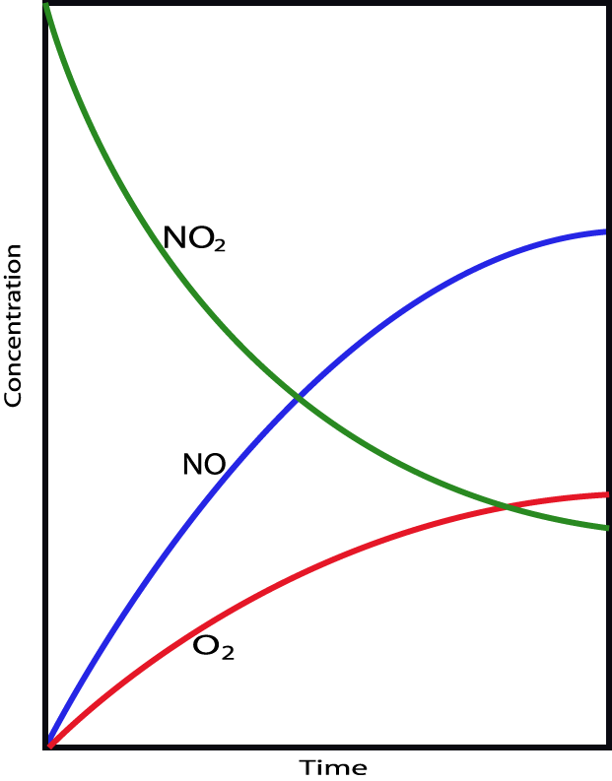
2NO₂(g) → 2NO(g) + O₂(g)
Reaction Rates:
1. Can measure
disappearance of
reactants
2. Can measure
appearance of
products
3. Are proportional
stoichiometrically

Slide 8
2NO₂(g) → 2NO(g) + O₂(g)
Reaction Rates:
4. Are equal to the
slope tangent to
that point
Δ[NO₂]
5. Change as the
reaction proceeds,
if the rate is
dependent upon
concentration
Δt

Slide 9
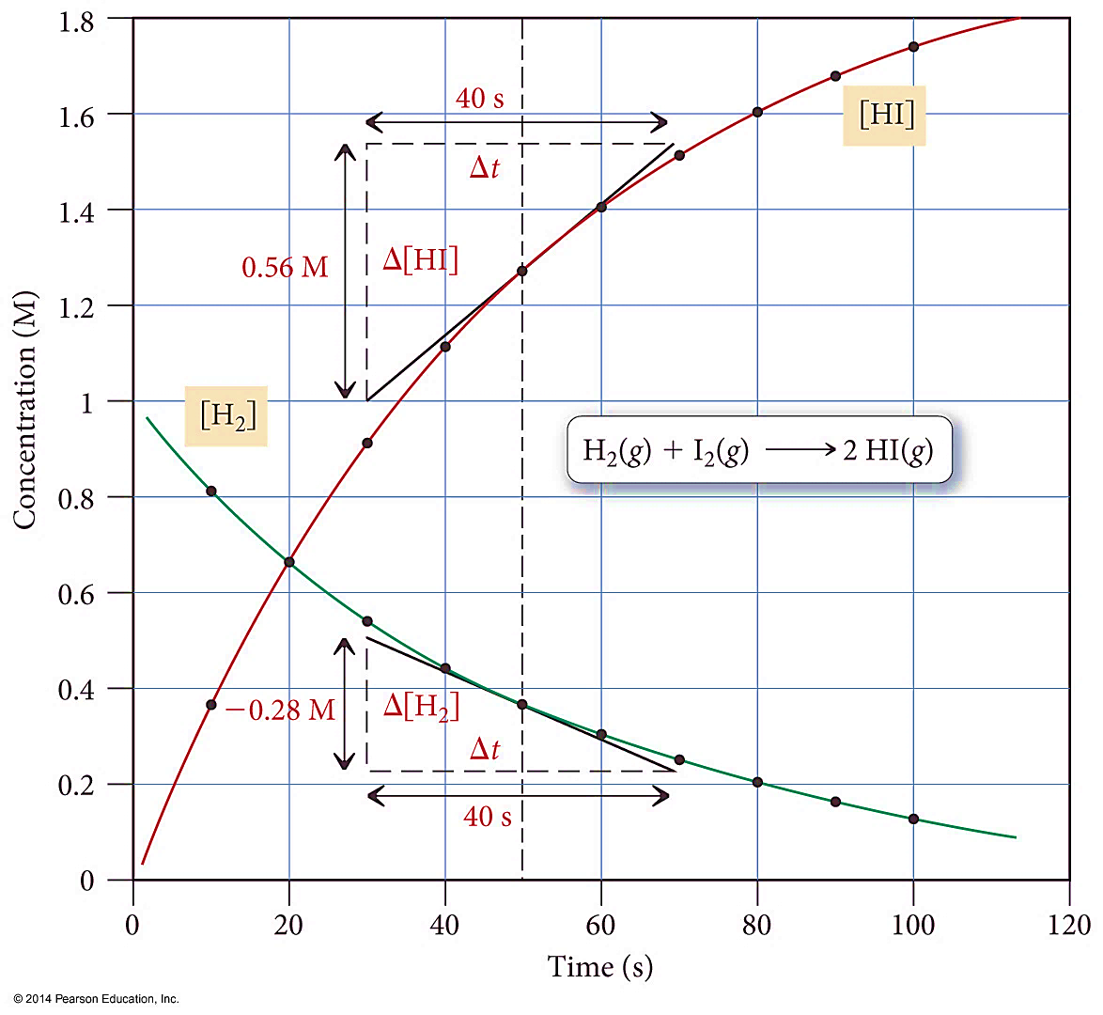
Reactant and Product [ ]s as a Function of Time

Slide 10
Reaction Rate and Stoichiometry
In most reactions, the coefficients of the balanced equation are not all the same.
H_{2 (g)} + I_{2 (g)} → 2 HI_{(g)}

Slide 11
Reaction Rate and Stoichiometry
H_{2 (g)} + I_{2 (g)} → 2 HI_{(g)}
For these reactions, the change in the number of molecules of one substance is a multiple of the change in the number of molecules of another.
For every 1 mole of H₂ used, 1 mole of I₂ will also be used and 2 moles of HI made.
Therefore, the rate of change will be different!

Slide 12
Reaction Rate and Stoichiometry
To be consistent, the change in the concentration of each substance is multiplied by $\frac{1}{coefficient}$

Slide 13
Average Rate vs. Instantaneous Rate
Average Rate
The change in concentrations over any particular time period.
Linear approximation of a curve
The larger the time interval, the more the average rate deviates from the instantaneous rate.

Slide 14
Average Rate vs. Instantaneous Rate
Instantaneous Rate
The change in concentration at a specific, particular time.
Slope at one point of a curve
Found by taking the slope of a line tangent to the curve at that particular point.
First derivative of the function (for all of you calculus fans)
(no we won’t be doing calculus)

Slide 15
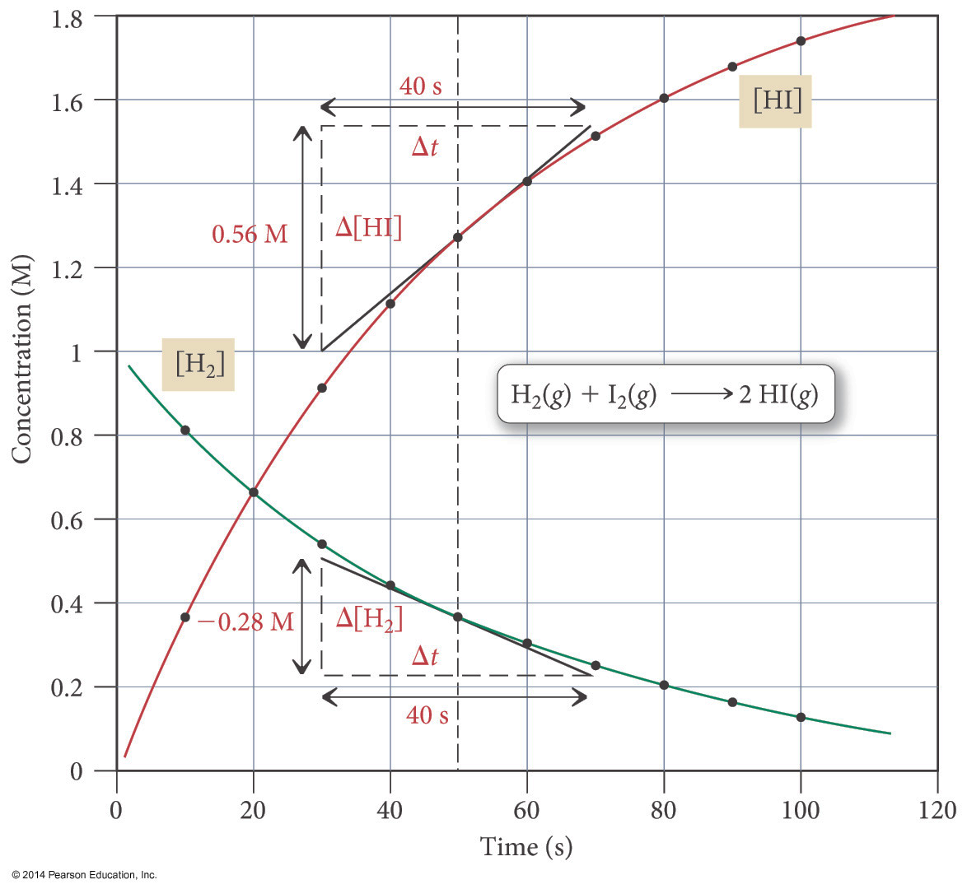
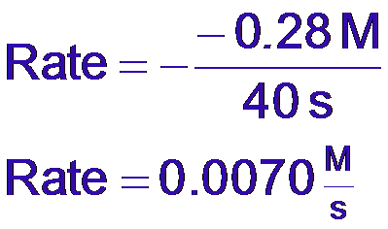
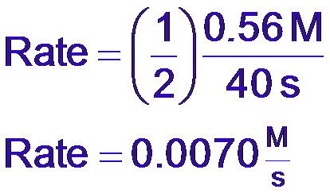
H_{2 (g)} + I_{2 (g)} → 2 HI _{(g)}
Using [H₂], the instantaneous rate at 50 s is as follows:
Using [HI], the instantaneous rate at 50 s is as follows:

Slide 16
Factors Affecting Reaction Rates
Nature of the Reactants
What kind of reactant molecules and what physical condition they are in.
Small molecules tend to react faster than large molecules.
Gases tend to react faster than liquids, which react faster than solids.

Slide 17
Factors Affecting Reaction Rates
Nature of the Reactants
Powdered solids are more reactive than “blocks.”
More surface area for contact with other reactants
Certain types of chemicals are more reactive than others.
For example, K is more reactive than Na
Ions react faster than molecules.
No bonds need to be broken.

Slide 18
Factors Affecting Reaction Rates
Temperature - Increasing temp increases the reaction rate.
Chemist’s rule - for each 10 °C rise in temperature, the speed of the reaction doubles.
Just an approximation, doesn’t always work.
There is a mathematical relationship between the absolute temperature and the speed of a reaction discovered by Svante Arrhenius, which will be examined later.

Slide 19
Factors Affecting Reaction Rates
Catalysts Substances that affect the speed of a reaction without being consumed. They are still there after the reaction is over.
Positive Catalysts – Most common kind, used to speed up a reaction
Negative Catalysts - Used to slow a reaction, also called inhibitors.
Homogeneous - present in same phase
Heterogeneous - present in different phase

Slide 20
Factors Affecting Reaction Rates
Catalysts Provide an alternative pathway that has a lower activation energy.

Slide 21
Factors Affecting Reaction Rates
Reactant Concentration
Generally, the larger the concentration of reactant molecules, the faster the reaction.
This increases the frequency of reactant molecules colliding with each other.
Concentration of gases depends on the partial pressure of the gases.
Higher pressure = higher concentration
Concentrations of solutions depend on the solute-to-solution ratio (molarity).
Remember Collision Theory???

Slide 22
YouTube Link to Presentation
https://youtu.be/c3JlH98mA0U

