Slide 1
N9 - KINETICS
Rate Laws
Link to YouTube Presentation: https://youtu.be/0ghPS-QFc9c

Slide 2
N9 - KINETICS
Rate Laws
Target: I can write differential rate laws and integrated rate laws, and I can use graphical methods to identify reaction orders.

Slide 3
Rate Laws
Differential rate laws
Express (reveal) the relationship between
concentration of reactants and rate of the reaction.
    Usually just called the rate law.
Integrated rate laws
Express (reveal) the relationship between
concentration of reactants and time

Slide 4
This section is review!
Only write stuff down if you need to! Or go back and add some notes to your notebook after class! We are going to zip through it since it is review!

Slide 5
Rate Laws
The rate law of a reaction is the mathematical relationship between the rate of the reaction and the concentrations of the reactants and homogeneous catalysts as well.
The rate law must be determined experimentally!
The rate of a reaction is directly proportional to the concentration of each reactant raised to a power.

Slide 6
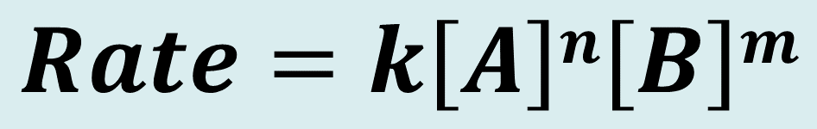
Rate Laws
For the reaction aA + bB → products the rate law would have the form given below.
  Orders of the reactants - n and m
  The rate constant - k
$$Rate=k\left[A\right]n\left[B\right]m$$

Slide 7
Rate Laws
The exponent on each reactant in the rate law is called the order with respect to that reactant.
Order of the reaction
The sum of the exponents on the reactants

Slide 8
Single Step Reactions
The orders do not match the coefficients in the balanced equation UNLESS the reaction happens in one single step.
Not as common as it taking multiple steps.

Slide 9
Single Step Reactions
The following reaction happens in one single step.
2 NO(g) + O₂(g) → 2 NO₂(g)
Rate = k[NO]²[O₂].
The reaction is
      second order with respect to [NO],
      first order with respect to [O₂],
      and third order overall.

Slide 10
Method of Initial Rates
Since we rarely know if a reaction happens in one or more steps, we have to use pattern recognition to figure out what the exponents must be.
  Systematically change the starting [ ]s of the various reactants while holding the [ ] of other reactants the same
  See how the rate changes as you change the [ ]s
      What is the relationship between the rate and the [ ]s ?
      That tells you the exponents!

Slide 11
Writing a (differential) Rate Law
Problem - Write the rate law, determine the value of the rate constant, k, and the overall order for the following reaction:
Use the Method of Initial Rates
2 NO(g) + Cl₂(g) → 2 NOCl(g)
Experiment | [NO] (mol/L) | [Cl₂] (mol/L) | Rate Mol/L·s
1 | 0.250 | 0.250 | 1.43 x 10⁻⁶
2 | 0.500 | 0.250 | 5.72 x 10⁻⁶
3 | 0.250 | 0.500 | 2.86 x 10⁻⁶
4 | 0.500 | 0.500 | 11.4 x 10⁻⁶

Slide 12
Writing a (differential) Rate Law
Part 1 - Determine the values for the exponents in the rate law:
2 NO(g) + Cl₂(g) → 2 NOCl(g)
Rate = k[NO]^{x}[Cl₂]^{y}
Experiment | [NO] (mol/L) | [Cl₂] (mol/L) | Rate Mol/L·s
1 | 0.250 | 0.250 | 1.43 x 10⁻⁶
2 | 0.500 | 0.250 | 5.72 x 10⁻⁶
3 | 0.250 | 0.500 | 2.86 x 10⁻⁶
4 | 0.500 | 0.500 | 11.4 x 10⁻⁶
4 = 2^{x}
In experiment 1 and 2, [Cl₂] is constant while [NO] doubles.
Rate quadruples, so the rxn is 2nd order with respect to [NO]
Rate = k[NO]²[Cl₂]^{y}

Slide 13
Writing a (differential) Rate Law
Part 1 - Determine the values for the exponents in the rate law:
2 NO(g) + Cl₂(g) → 2 NOCl(g)
Rate = k[NO]²[Cl₂]^{y}
Experiment | [NO] (mol/L) | [Cl₂] (mol/L) | Rate Mol/L·s
1 | 0.250 | 0.250 | 1.43 x 10⁻⁶
2 | 0.500 | 0.250 | 5.72 x 10⁻⁶
3 | 0.250 | 0.500 | 2.86 x 10⁻⁶
4 | 0.500 | 0.500 | 11.4 x 10⁻⁶
2 = 2^{y}
Watch honors YouTube if you need a review on this!
In experiment 2 and 4, [NO] is constant while [Cl₂] doubles.
Rate doubles, so the reaction is first order with respect to [Cl₂]
Rate = k[NO]²[Cl₂]¹

Slide 14
Writing a (differential) Rate Law
Part 2 - Determine the value of the rate constant, k, including units, by using any of the experimental trials – doesn’t matter which one!
2 NO(g) + Cl₂(g) → 2 NOCl(g)
Rate = k[NO]²[Cl₂]¹
Experiment | [NO] (mol/L) | [Cl₂] (mol/L) | Rate Mol/L·s
1 | 0.250 | 0.250 | 1.43 x 10⁻⁶

Slide 15

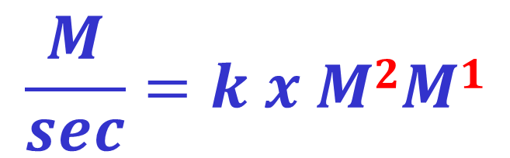

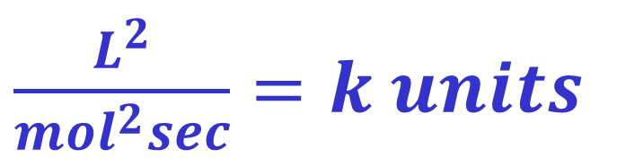
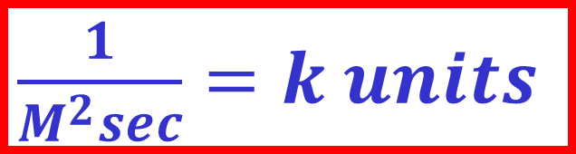
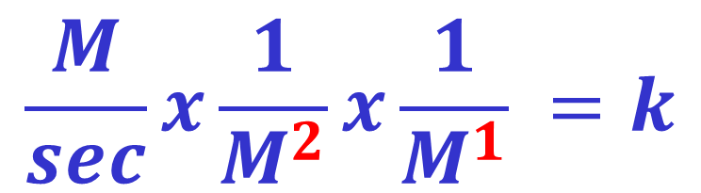
How I like to find the units because I’m lazy ☺
We know the unit for rate is always M/sec, and we know the rate law, and that the units for [ ] is M
Rate = k[NO]²[Cl₂]¹
$\frac{1}{M^{2}sec}=k units$
$$\frac{M}{sec}=k x M2M1$$
$\frac{L^{2}}{{mol}^{2}sec}=k units$
$$\frac{M}{sec}x\frac{1}{M^{2}}x\frac{1}{M^{1}} =k$$
$M^{−2}\sec^{−1}=k units$
$L^{2}{mol}^{−2}\sec^{−1}=k units$

Slide 16
Writing a (differential) Rate Law
Part 3 - Determine the overall order
The sum of the exponents, or orders, of the reactants.
R = k[NO]²[Cl₂]
2
+
1
= 3
∴ The reaction is 3rd order

Slide 17
The Effect of Orders on Rate
Rate = k[A]^{n}
If you Double [A]
Order | Effect on Rate
0 | No change
1 | x 2
2 | x 4
3 | x 8
1.5 | x ~2.83
-1 | 0.5
Not common

Slide 18
This section is new!
For sure take notes on this part, and add more details at home like normal!

Slide 19
Integrated Rate Law
For the reaction A → products, the rate law depends on the concentration of A.
Applying calculus to integrate the rate law gives another equation showing the relationship between the concentration of A and the time of the reaction; this is called the integrated rate law.

Slide 20

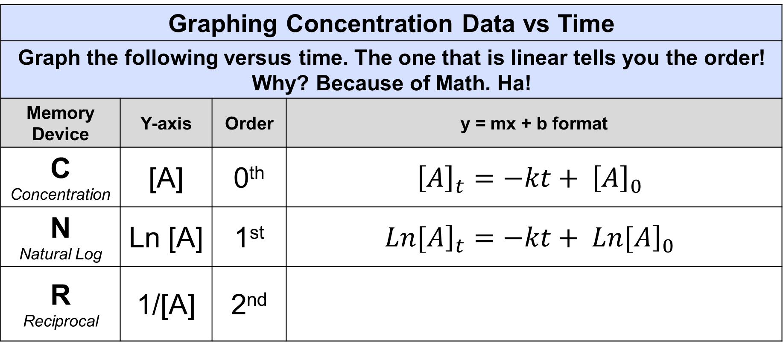
Integrated Rate Law
Graphing Concentration Data vs Time
Graph the following versus time. The one that is linear tells you the order! Why? Because of Math. Ha!
Memory Device | Y-axis | Order | y = mx + b format
C Concentration | [A] | 0th | $${\left[A\right]}_{t}=−kt+ {\left[A\right]}_{0}$$
N Natural Log | Ln [A] | 1st | $${\left.Ln[A\right]}_{t}=−kt+ {\left.Ln[A\right]}_{0}$$
R Reciprocal | 1/[A] | 2nd

Slide 21

Half Life with Integrated Rate Laws
$${\left[A\right]}_{t}=−kt+ {\left[A\right]}_{0}$$
Remember…
half life is the time it takes for ½ the starting amount to decay.
For 0th Order plug into:
You get:
For 1st order plug into:
$${\left.Ln[A\right]}_{t}=−kt+ {\left.Ln[A\right]}_{0}$$
You get:
So....if....
For 2nd order plug into:
You get:

Slide 22
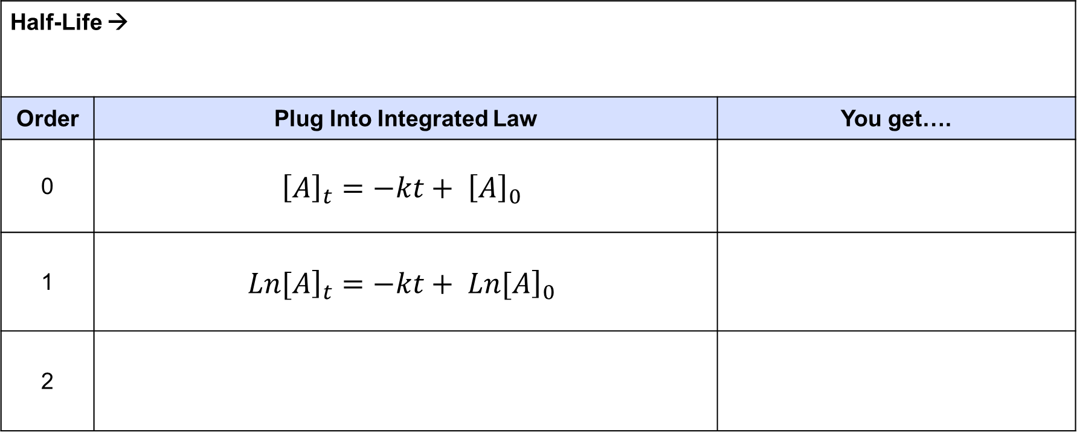
Half Life with Integrated Rate Laws
Half-Life →
Order | Plug Into Integrated Law | You get….
0 | $${\left[A\right]}_{t}=−kt+ {\left[A\right]}_{0}$$
1 | $${\left.Ln[A\right]}_{t}=−kt+ {\left.Ln[A\right]}_{0}$$
2

Slide 23
Relationship Between [ ] and ½ Life
0th Order – Half-life is directly proportional to the [ ] of reactants
Lower [ ] of reactants = shorter half-life (faster rate)
  t_{1/2} = [A]_{init}/2k
1st Order - Half-life is independent of the concentration.
Always the same half-life no matter what [ ] of reactants
– Closest to true half-life
  t_{1/2} = ln(2)/k
2nd Order - Half-life is inversely proportional to the [ ] of reactants
Lower [ ] of reactants = longer half-life (slower rate).
  t_{1/2} = 1/(k[A]_{init})

Slide 24
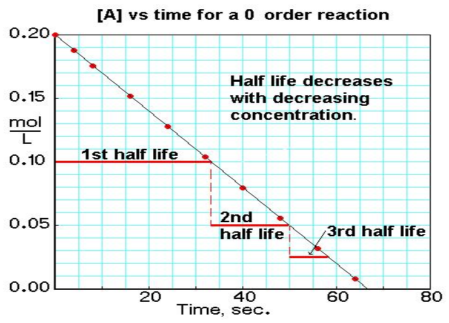
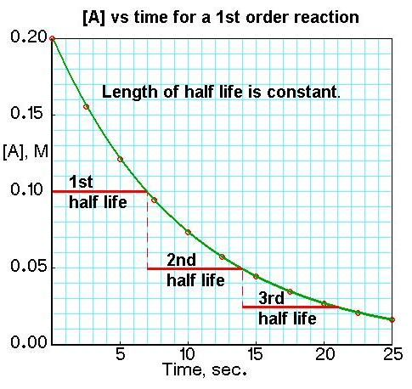
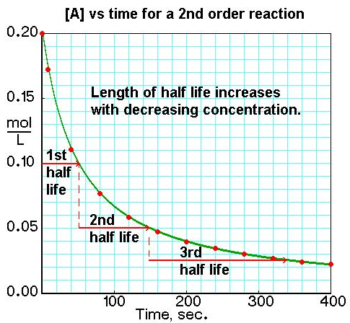
How Does Half Life Change Over Time?
0th Order – DECREASES as time goes on (faster rate)
1st Order – CONSTANT as time goes on (radioactive decay!)
2nd Order – INCREASES as time goes on (slower rate)

Slide 25
Graphical Determination of Rate Law
X-axis = Time
Order | Memory Device |  | Y-Axis
0 | C | Concentration | [ A ]
1 | N | Natural Logarithm | ln [ A ]
2 | R | Reciprocal | 1 / [ A ]
Whichever plot gives a straight line determines the order with respect to [A].
  If linear is [A] versus time, Rate = k[A]⁰.
  If linear is ln[A] versus time, Rate = k[A]¹.
  If linear is 1/[A] versus time, Rate = k[A]².

Slide 26
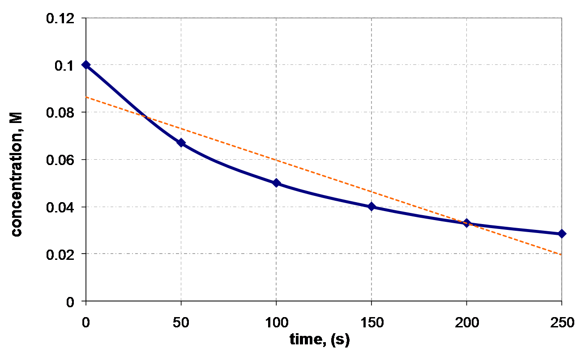
[ A ] vs. Time

Slide 27
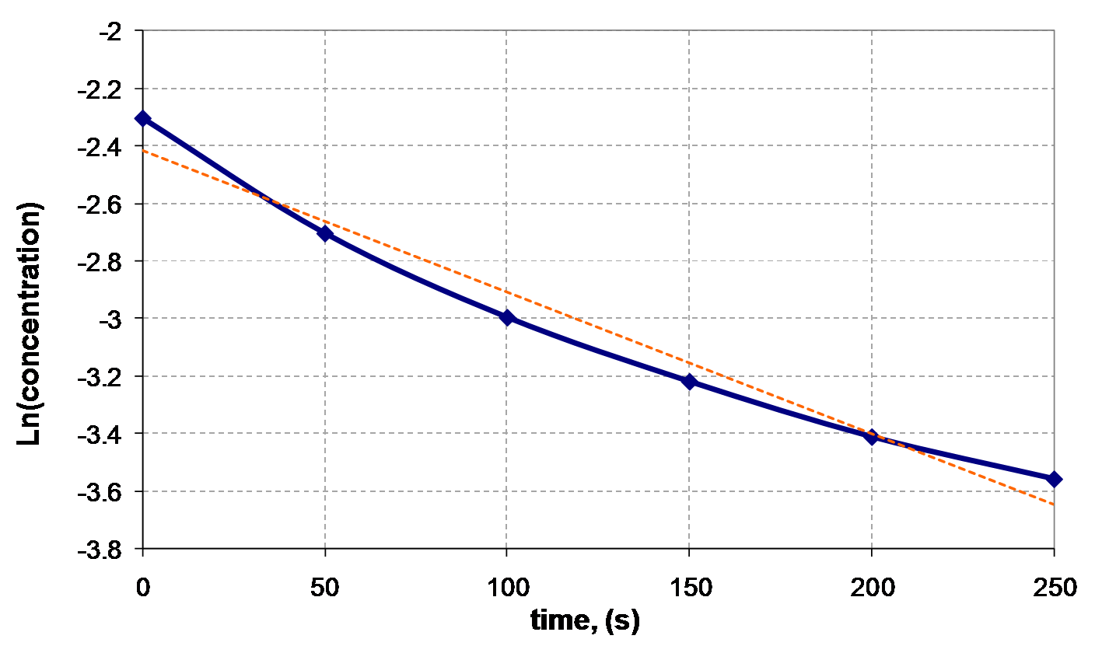
Ln [A] vs. Time

Slide 28
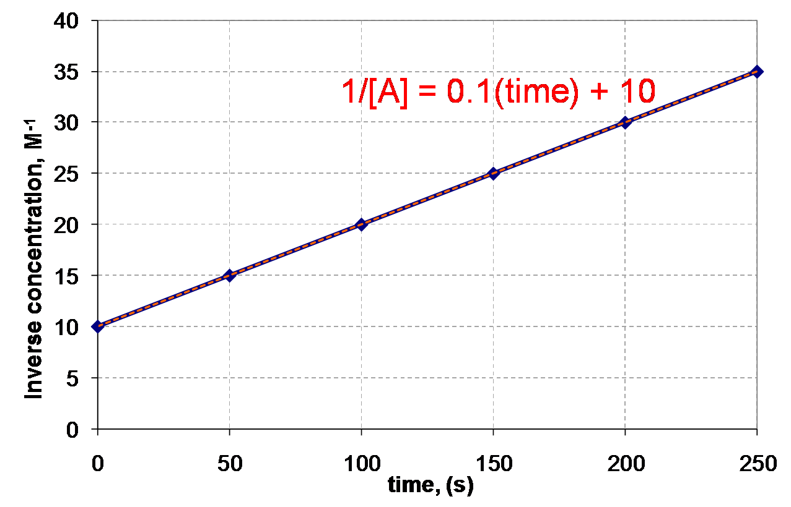
1 / [A] vs. Time
R² = 0.999
R² tells you how good your of a fit your line is – perfect is R² = 1. The closer to 1 the better the fit!

Slide 29
How to Get an R² value?
Time (s) | [H₂O₂] (mol/L)
0 | 1.00
120 | 0.91
300 | 0.78
600 | 0.59
1200 | 0.37
1800 | 0.22
2400 | 0.13
3000 | 0.082
3600 | 0.050
Excel or a graphing calculator!
Plug in the data!
Here is an Excel sheet I made to make the graphs. https://tinyurl.com/excel-kinetics
You can download Rate Law programs for the various brands/models of graphing calculators too.

Slide 30
Solving an Integrated Rate Law
Time (s) | [H₂O₂] (mol/L)
0 | 1.00
120 | 0.91
300 | 0.78
600 | 0.59
1200 | 0.37
1800 | 0.22
2400 | 0.13
3000 | 0.082
3600 | 0.050
Practice Problem:
Find the differential rate law, the integrated rate law and the value for the rate constant, k

Slide 31
Time vs. [H₂O₂]
Time (s) | [H₂O₂]
0 | 1.00
120 | 0.91
300 | 0.78
600 | 0.59
1200 | 0.37
1800 | 0.22
2400 | 0.13
3000 | 0.082
3600 | 0.050
Regression results:
y = ax + b
a = -2.64 x 10⁻⁴
b = 0.841
r² = 0.8891

Slide 32
Time vs. ln[H₂O₂]
Time (s) | ln[H₂O₂]
0 | 0
120 | -0.0943
300 | -0.2485
600 | -0.5276
1200 | -0.9943
1800 | -1.514
2400 | -2.04
3000 | -2.501
3600 | -2.996
Regression results:
y = ax + b
a = -8.35 x 10⁻⁴
b = -.005
r² = 0.99978

Slide 33
Time vs. 1/[H₂O₂]
Time (s) | 1/[H₂O₂]
0 | 1.00
120 | 1.0989
300 | 1.2821
600 | 1.6949
1200 | 2.7027
1800 | 4.5455
2400 | 7.6923
3000 | 12.195
3600 | 20.000
Regression results:
y = ax + b
a = 0.00460
b = -0.847
r² = 0.8723

Slide 34
And the winner is… Time vs. ln[H₂O₂]
1. As a result, the most linear line (best R² value)
for the reaction is Ln[A] therefore... 1st order!
2. The (differential) rate law is:
3. The integrated rate law is:
4. But…what is the rate constant, k ?

Slide 35
Finding the Rate Constant, k
Method #1: Calculate the slope from the Time vs. ln[H₂O₂] table.
Time (s) | ln[H₂O₂]
0 | 0
120 | -0.0943
300 | -0.2485
600 | -0.5276
1200 | -0.9943
1800 | -1.514
2400 | -2.04
3000 | -2.501
3600 | -2.996
Now remember:
∴ k = -slope
k = 8.32 x 10⁻⁴ s⁻¹

Slide 36
Finding the Rate Constant, k
Method #2: Obtain k from the linear regression analysis.
Regression results:
Now remember:
y = ax + b
a = -8.35 x 10⁻⁴
b = -.005
r² = 0.99978
∴ k = -slope
k = 8.35 x 10⁻⁴s⁻¹

Slide 37
1st Order – Integrated Rate Law
ln[A]_{initial}
Slope = −k
ln[A]
Time

Slide 38
2nd Order – Integrated Rate Law
1/[A]
Slope = k
1/[A]_{initial}
Time

Slide 39
Integrated Rate Laws w/ more than 1 reactant
Too hard! We need a way to simplify it!
Examine rate w/ one reactant very low [ ] and the others much higher
Rate = k[A]^{n}[B]^{m}[C]^{p}
  [A] much lower than [B] and [C] ( [B]> >[A] and [C] > >[A] )
  Then [B] and [C] do not change as much relative to [A] so…
  they don’t really matter!
  Rate = k'[A]^{n}
(analogy – Billionaire giving away $500, won’t feel it much.
Mrs. Farmer giving away $500 will feel it a lot more

Slide 40
Integrated Rate Laws w/ more than 1 reactant
Simplifies the Rate Law into something we can more easily measure and figure out
Rate = k[A]^{n}[B]^{m}[C]^{p} → Rate = k'[A]^{n}
We call this process
Pseudo-(1st/2nd/3rd etc..) order rate law
  Simplification yields a rate law of a particular order
  The Prime means pseudo

Slide 41
YouTube Link to Presentation
https://youtu.be/0ghPS-QFc9c

