Slide 1
Equilibrium
Quick Review

Slide 2
Chemical Equilibrium
Reversible Reactions - A chemical reaction in which the products can react to re-form the reactants
Chemical Equilibrium - When the rate of the forward reaction equals the rate of the reverse reaction and the concentration of products and reactants remains unchanged
2HgO_{(s)}  2Hg_{(l)} + O_{2(g)}
(  ) indicates equilibrium in a chemical equation

Slide 3
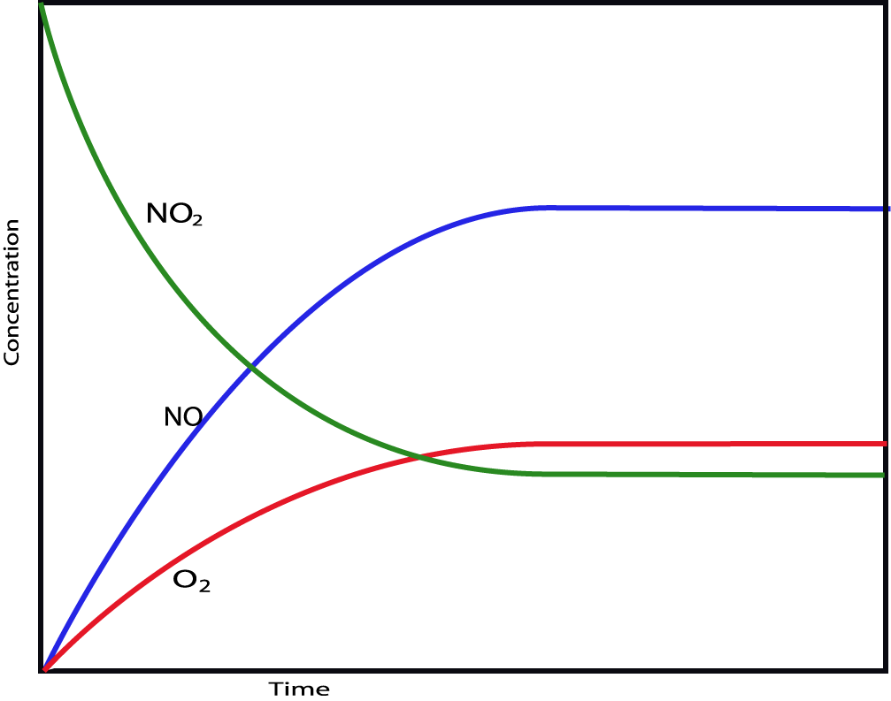
2NO₂(g)  2NO(g) + O₂(g)
Remember this from
Kinetics?
Why was it so important to measure reaction rate at the start of the reaction
(method of initial rates?)

Slide 4
2NO₂(g)  2NO(g) + O₂(g)

Slide 5
H₂(g) + I₂(g) ⇔ 2 HI(g)
As the concentration of product increases and the concentrations of reactants decrease, the rate of the forward reaction slows down, and the rate of the reverse reaction speeds up.

Slide 6
H₂(g) + I₂(g) ⇔ 2 HI(g)
At dynamic equilibrium, the rate of the forward reaction is equal to the rate of the reverse reaction.
The concentrations of reactants and products no longer change.

Slide 7
Equilibrium ≠ Equal Concentrations!
The rates of the forward and reverse rxns are equal at equilibrium.
But that does NOT mean the concentrations of reactants and products are equal.
Product Favored - Some reactions reach equilibrium only after almost all the reactant molecules are consumed; we say the position of equilibrium favors the products.
Reactant Favored - Other reactions reach equilibrium when only a small percentage of the reactant molecules are consumed; we say the position of equilibrium favors the reactants.

Slide 8
An Analogy: Population Changes
When Country A citizens feel overcrowded, some will emigrate to Country B .

Slide 9
An Analogy: Population Changes
However, after a time, emigration will occur in both directions at the same rate, leading to populations in Country A and Country B that are constant, but not necessarily equal.

