Slide 1
Equilibrium
K – Equilibrium Constant (Capitalized!)

Slide 2
Equilibrium Constant
Even though the concentrations of reactants and products are not equal at equilibrium, there is a relationship between them.
Law of Mass Action or also Equilibrium Expression – The relationship between the chemical equation and the concentrations of reactants and products is called the

Slide 3
Equilibrium Constant
For the general equation aA + bB → cC + dD,
The law of mass action gives the relationship below.
The lowercase letters represent the coefficients of the balanced chemical equation.
Always products over reactants
K is called the equilibrium constant.
Unitless

Slide 4
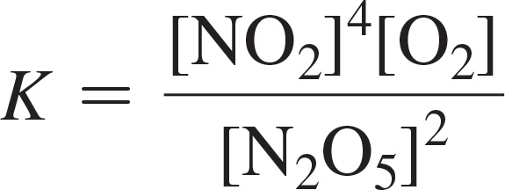
Writing Equilibrium Constant Expressions
2 N₂O_{5(g)} ⇔ 4 NO_{2(g)} + O_{2(g)}
The equilibrium constant expression is:

Slide 5
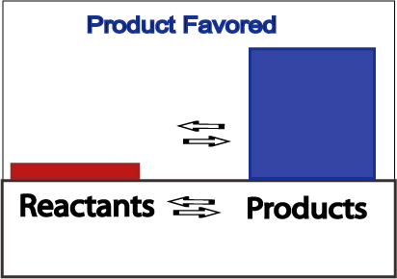
Product Favored Equilibrium
Large values for K signify the reaction is product favored
When equilibrium is achieved, most reactant has been converted to product

Slide 6
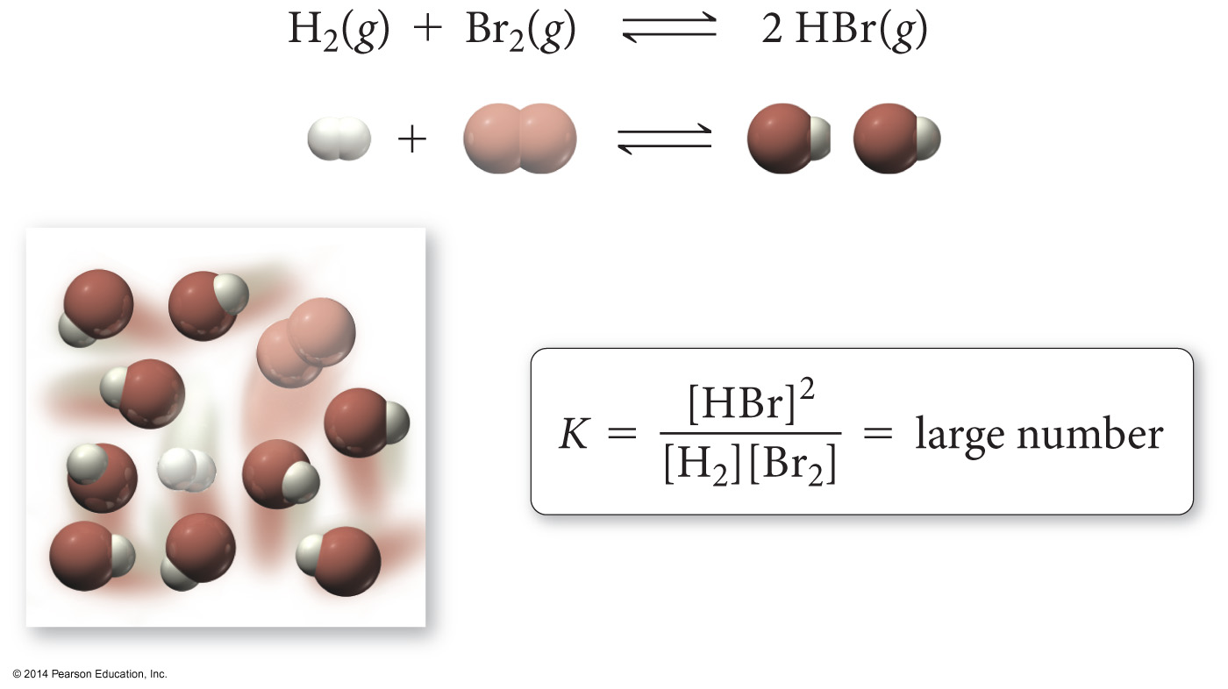
A Large Equilibrium Constant

Slide 7
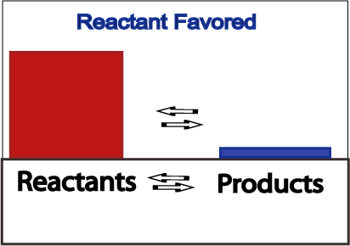
Reactant Favored Equilibrium
Small values for K signify the reaction is reactant favored
When equilibrium is achieved, very little reactant has been converted to product

Slide 8
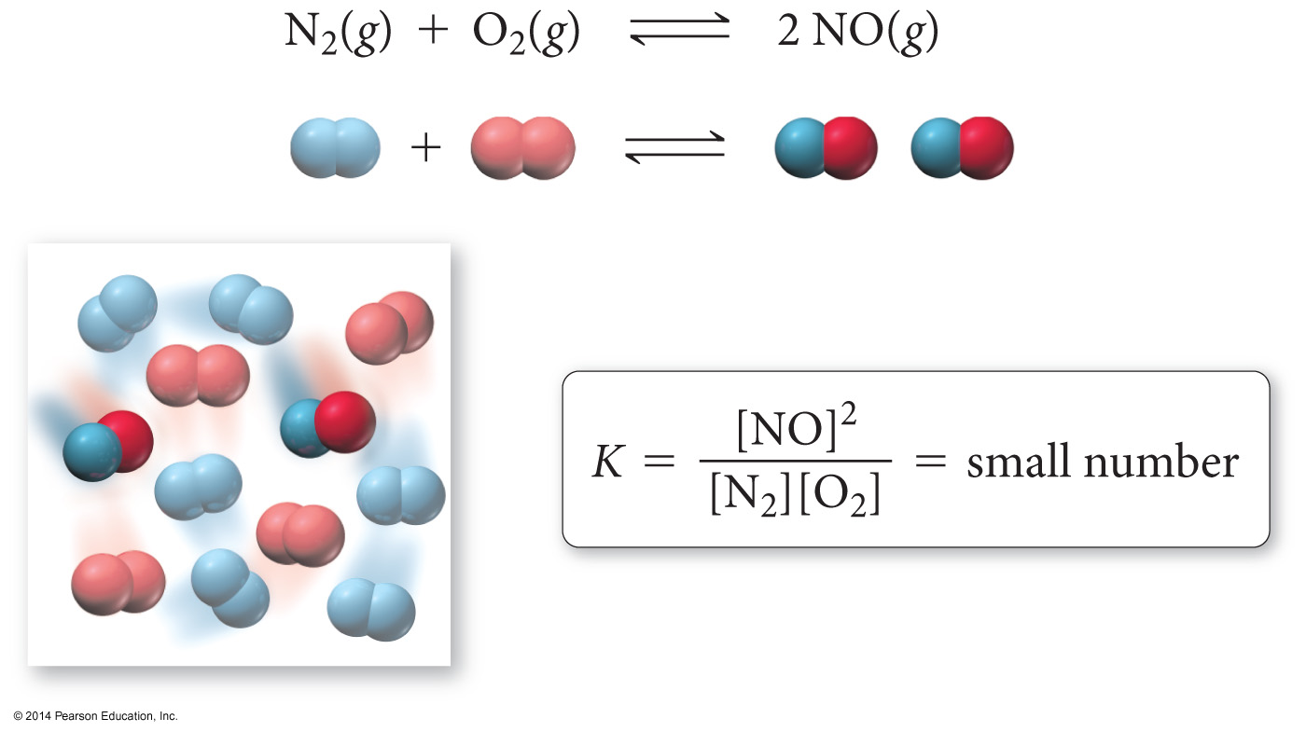
A Small Equilibrium Constant

Slide 9
Relationships between K and Chemical Equations
When the reaction is written backward, the equilibrium constant is inverted.
aA + bB → cC + dD
the equilibrium constant expression is:
cC + dD → aA + bB
the equilibrium constant expression is:

Slide 10
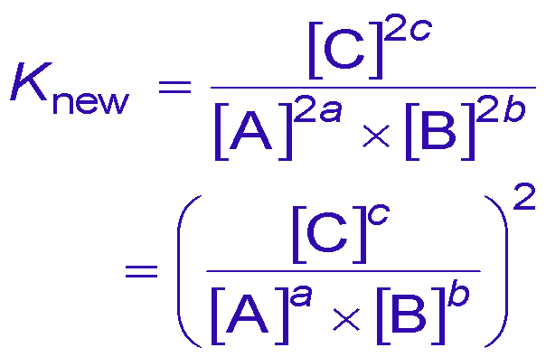
Relationships between K and Chemical Equations
When the coefficients of an equation are multiplied by a factor, the equilibrium constant is raised to that factor.
aA + bB ⇔ cC
the equilibrium constant expression is:
2aA + 2bB ⇔ 2cC
the equilibrium constant expression is:

Slide 11
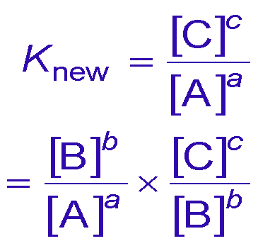
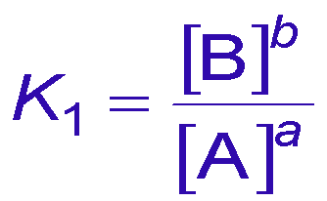
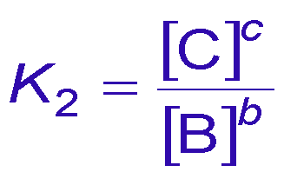
Relationships between K and Chemical Equations
When you add equations to get a new equation, the equilibrium constant of the new equation is the product of the equilibrium constants of the old equations.
aA ⇔ bB
bB ⇔ cC
the equilibrium constant expressions are:
aA ⇔ cC
the equilibrium constant is:

Slide 12
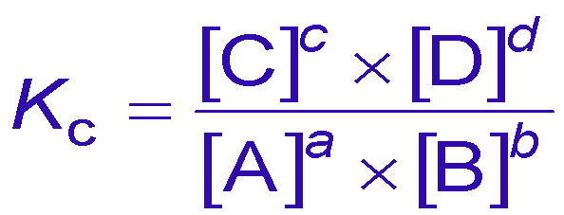
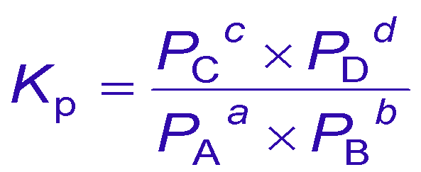
Equilibrium Constants for Rxns Involving Gases
The [ ]s of a gas in a mixture is proportional to its partial pressure.
Therefore, K can be expressed as the ratio of the partial pressures of the gases.
aA(g) + bB(g) ⇔ cC(g) + dD(g) the equilibrium constant expressions are:
or

Slide 13
Kc and Kp
K_{p}, the partial pressures are always in atm.
K_{p} and K_{c} are not necessarily the same because of the difference in units.
K_{p} = K_{c} when Δn = 0
Δn is the difference between the number of moles of reactants and moles of products.

Slide 14
Deriving the Relationship Between Kc and Kp

Slide 15
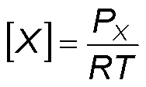
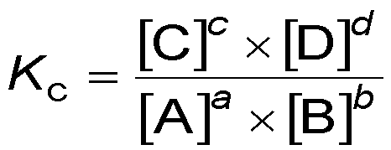
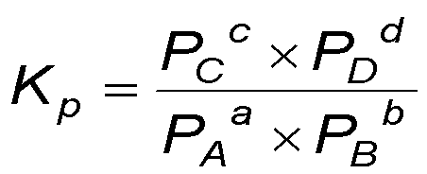
Deriving the Relationship Between Kc and Kp
aA(g) + bB(g) ⇔ cC(g) + dD(g)
substituting

Slide 16
Heterogeneous Equilibria
[ ]s of pure solids and pure liquids do not change during the course of a reaction.
Because their [ ]s don’t change, solids and liquids are not included in the equilibrium constant expression.
the equilibrium constant expression is as follows:

Slide 17
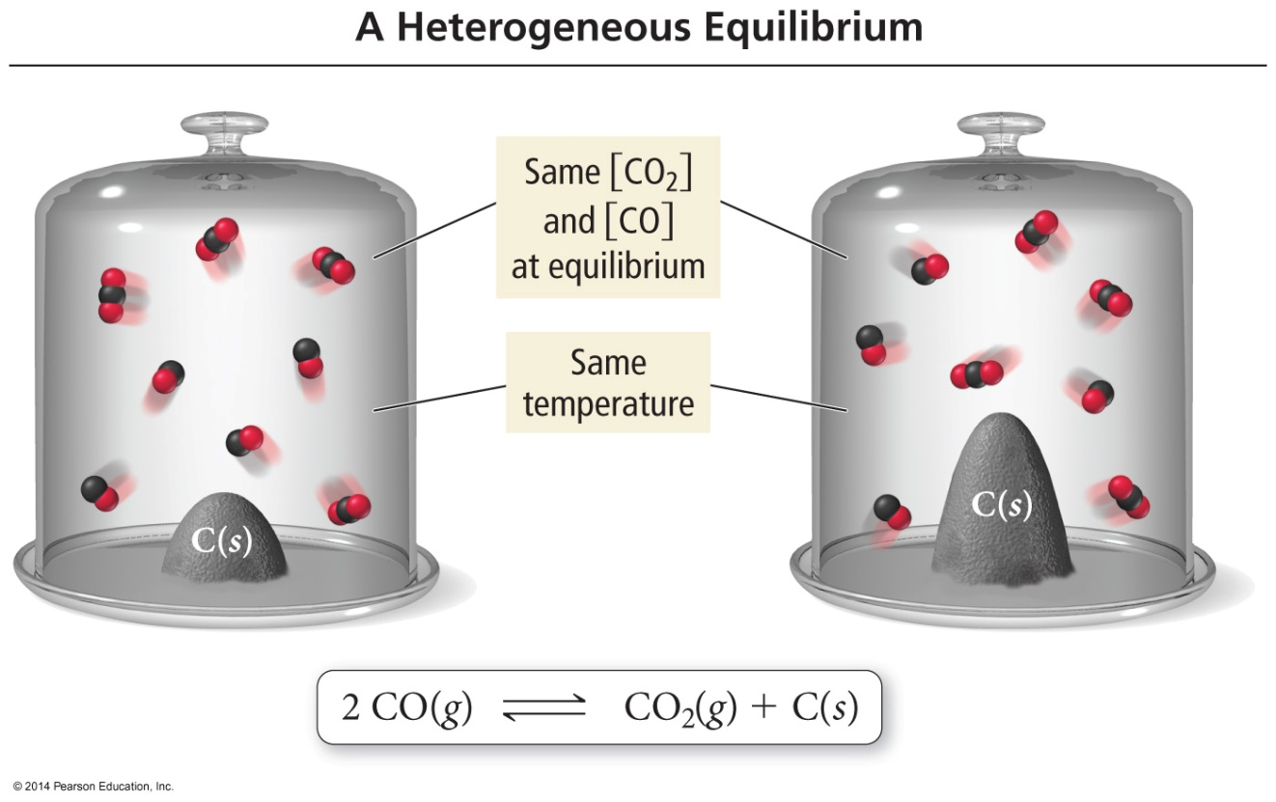
Heterogeneous Equilibria
The amount of C is different, but the amounts of CO and CO₂ remain the same. Therefore, the amount of C has no effect on the position of equilibrium.

